Slide 1




Digital Modeling of the Mechanical Processes of Hydraulic Fracturing in Poro-Elastic-Plastic Artificial Materials
Speaker: Grebenshchikova E.
Co-authors: Nachev V. and Turuntaev S.

Slide 2
Plan
Introduction
Laboratory experiment
Model
3.1. General equations
3.2. Geometry
4. Results

Slide 3
Overview
Validation of the numerical model on the example of one finite element of rock or cement, then modeling of the triaxial loading of the whole structure [Hoeink, 2016; Zubelewicz, 2013]
Investigation of parameters affecting hydraulic fracturing processes in porous media using numerical modeling [Sun, 2020];
Calculation of fracture geometry of hydraulic fracturing for the case of homogeneous and heterogeneous rock [Wangen, 2013];
Investigation of the propagation of a network of complex cracks in an medium with natural cracks [Azarov, 2021; Gu, 2012; Li, 2016;]

Slide 4
Research Goals
Preparation of a numerical model based on the laboratory geometry of the sample
Numerical simulation of fracture propagation
Validation of the numerical model for experimental mechanical properties and shapes of fractures
Investigation of the dependence of fracture initiation and propagation on various boundary conditions

Slide 5
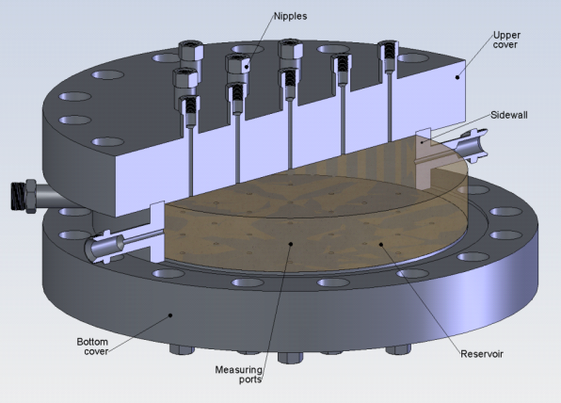
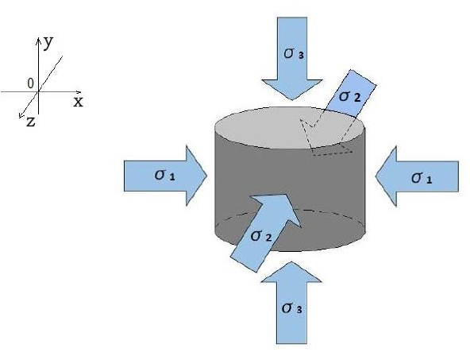
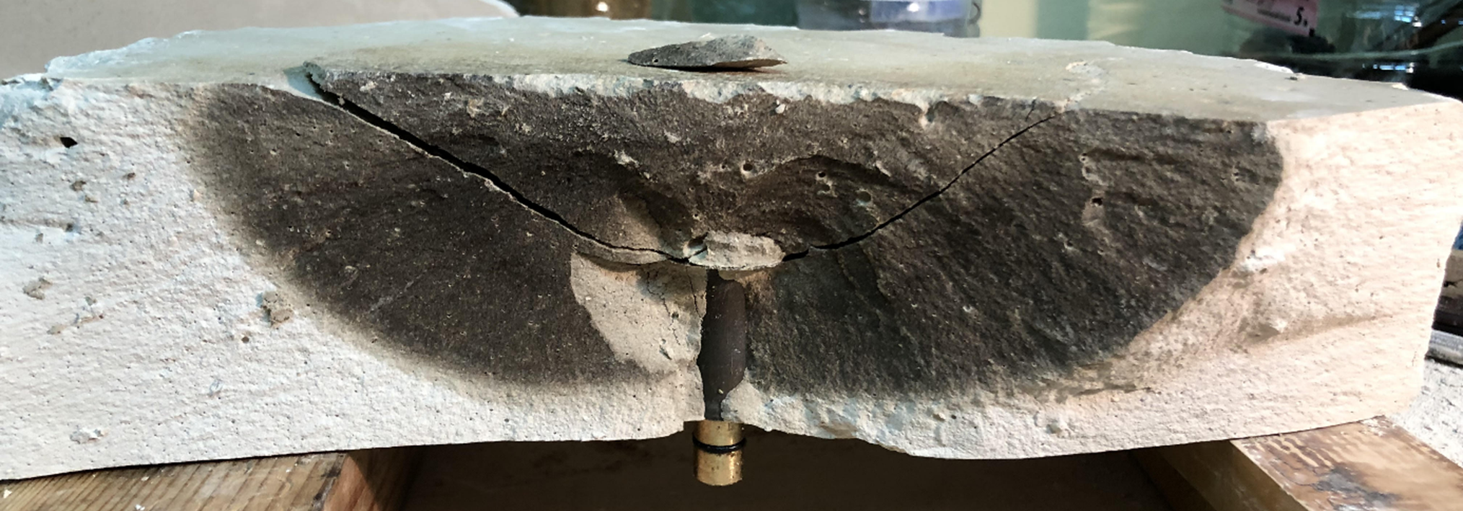
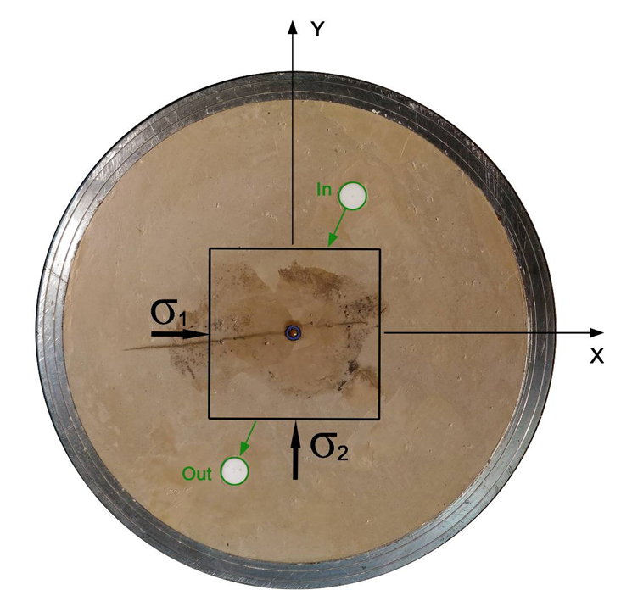
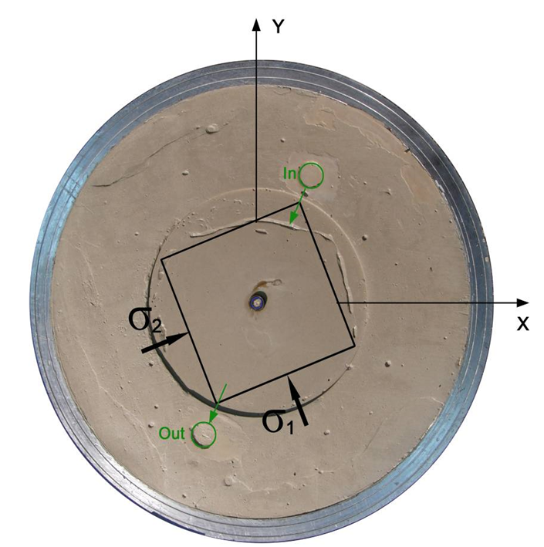
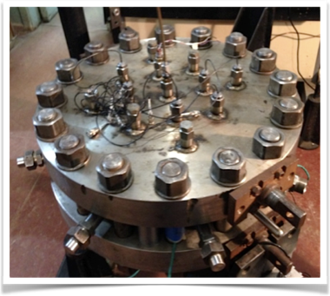
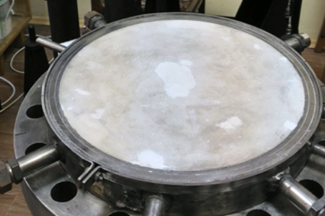
Laboratory Experiment
Horizontal fractures
Vertical fractures

Slide 6

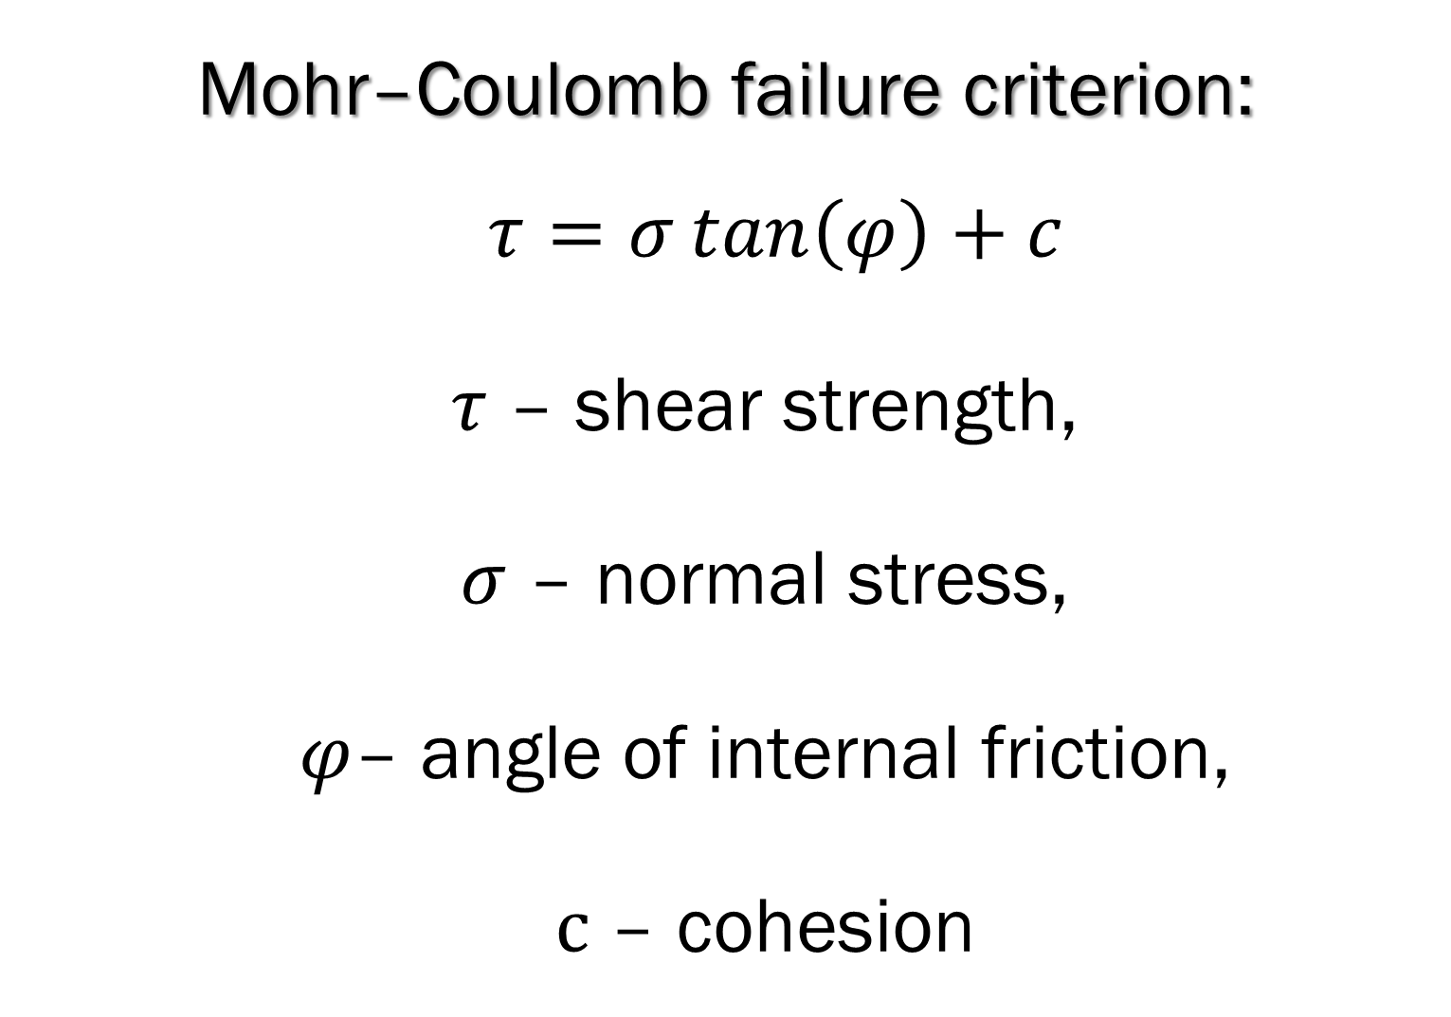


General Equations
Mohr–Coulomb failure criterion:
$τ=σ\tan\left(φ\right)+c$
$τ$ – shear strength,
$σ$ – normal stress,
$φ$– angle of internal friction,
$с$ – cohesion
Continuity equations of:
Mass
$$\frac{∂ρ}{∂t}+∇∙\left(ρθ\right)=0$$
Momentum
$$\frac{∂\left(ρθ\right)}{∂t}+∇∙\left(ρθ⊗θ−T\right)=ρg$$
Energy
$$ρ\frac{du}{dt}=T:\left(∇⊗θ\right)−∇∙q+ ρQ$$
6

Slide 7
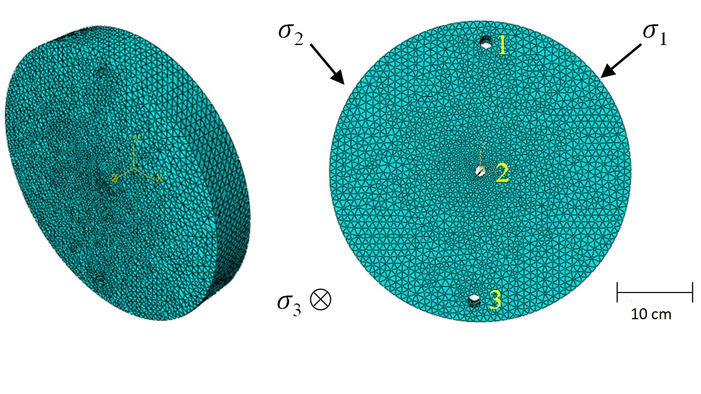
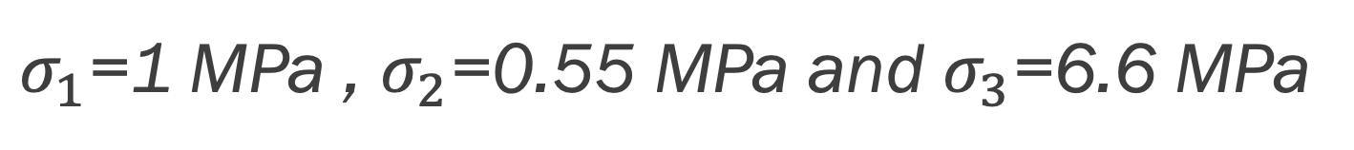
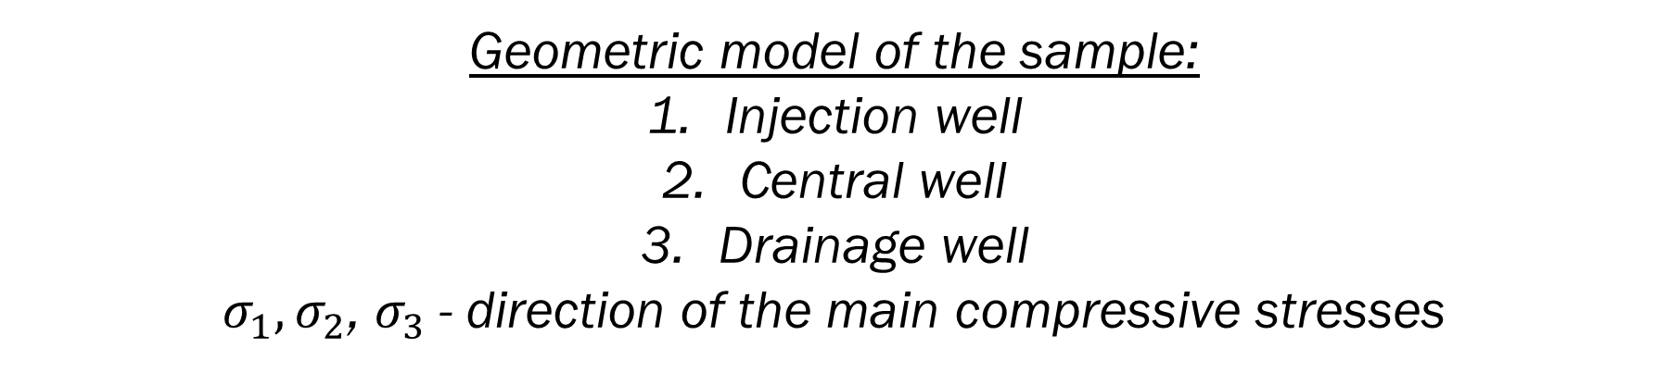
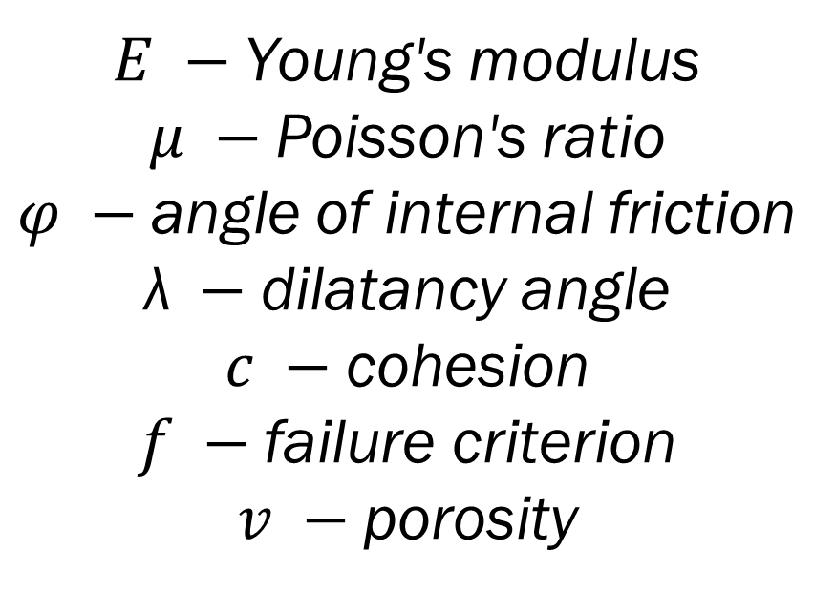
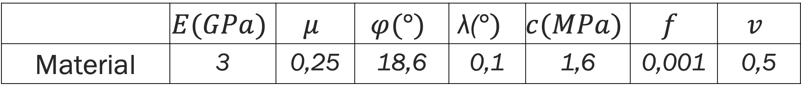
Geometric Model of the Sample and Mechanical Parameters
Mechanical parameters
$σ_{1}$=1 MPa , $σ_{2}$=0.55 MPa and $σ_{3}$=6.6 MPa
 | $$E(GPa)$$ | $$μ$$ | $$φ(°)$$ | $$\text{λ}\text{(}°)$$ | $$c(MPa)$$ | $$f$$ | $$v$$
Material | 3 | 0,25 | 18,6 | 0,1 | 1,6 | 0,001 | 0,5
$E −$Young's modulus
$μ −$Poisson's ratio
$φ −$angle of internal friction
$\text{λ} −$dilatancy angle
$c −$cohesion
$f −$failure criterion
$v −$porosity
Geometric model of the sample:
Injection well
Central well
Drainage well
$σ_{1},σ_{2}$, $σ_{3}$- direction of the main compressive stresses

Slide 8
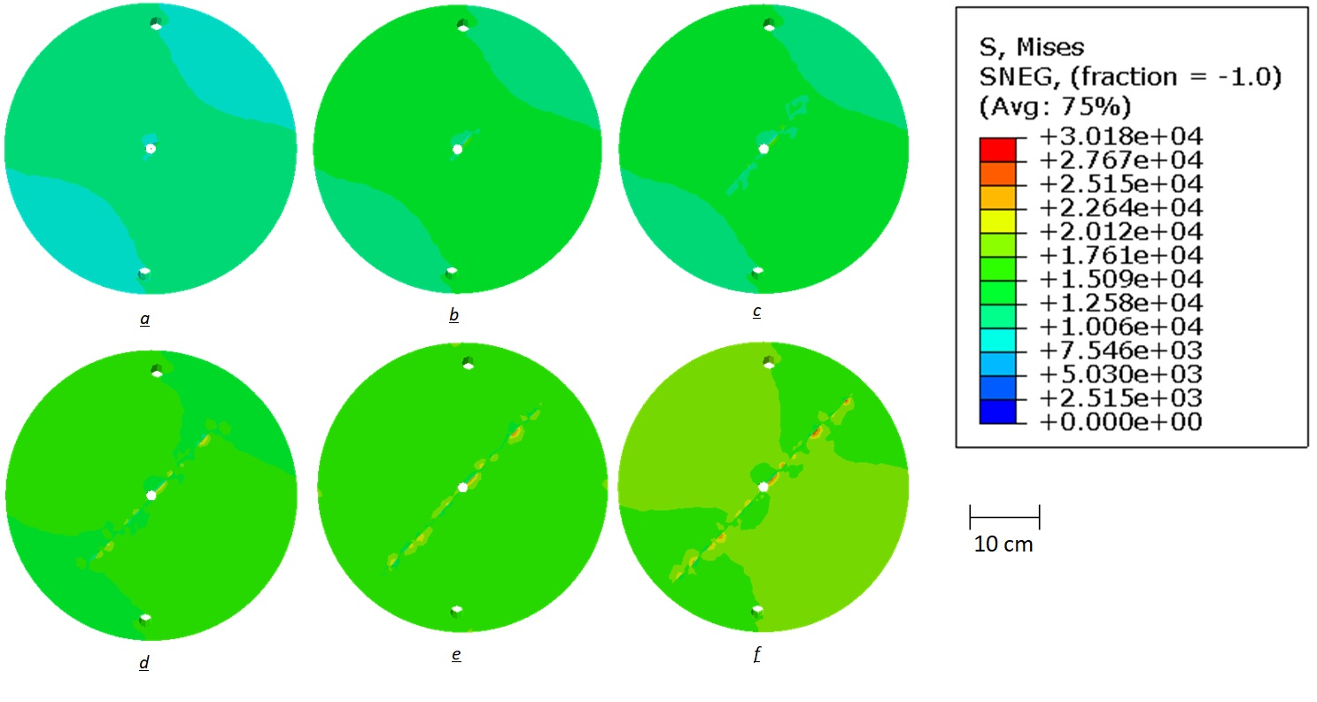
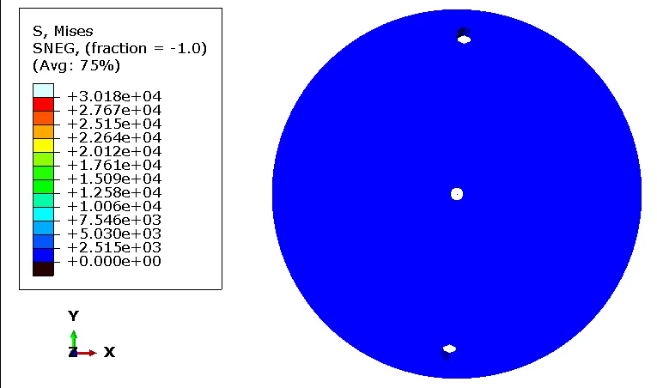
Results
Results of modeling stress fields during fracture growth, where S, Mises is the second invariant of the stress tensor.
a) 1.7300 µs; b) 2.1701 µs; c) 2.1703 µs; d) 2.1611 µs; e) 2.8361 µs; f) 3.0261 µs.

Slide 9
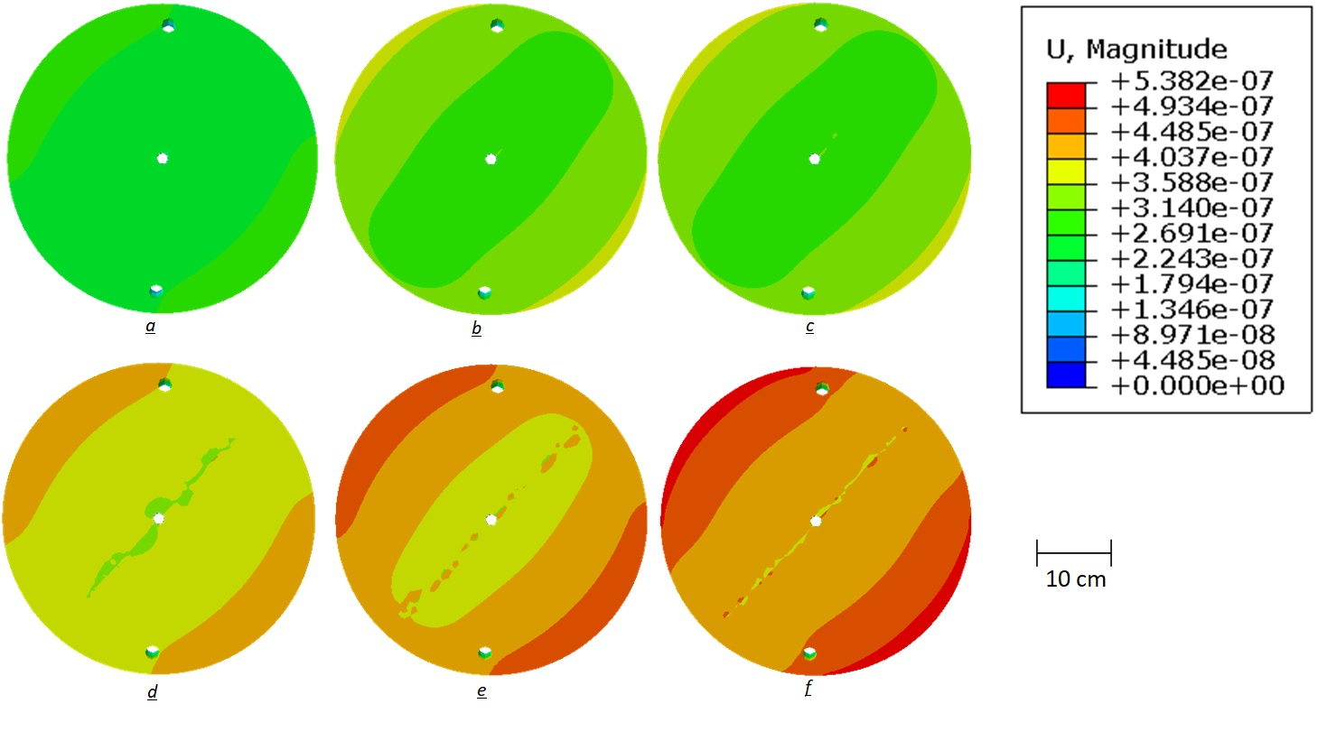
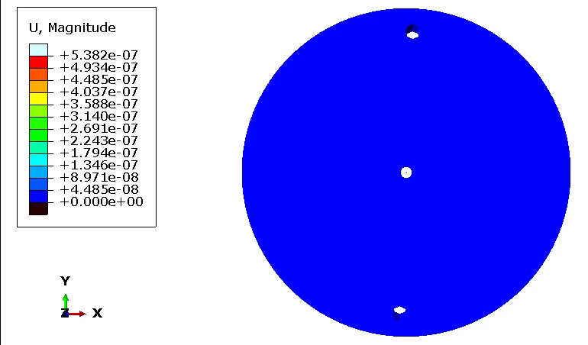
Results
Results of modeling deformation fields during fracture growth, where U, Magnitude is the magnitude of deformation.
a) 1.7300 µs; b) 2.1701 µs; c) 2.1703 µs; d) 2.1611 µs; e) 2.8361 µs; f) 3.0261 µs.

Slide 10
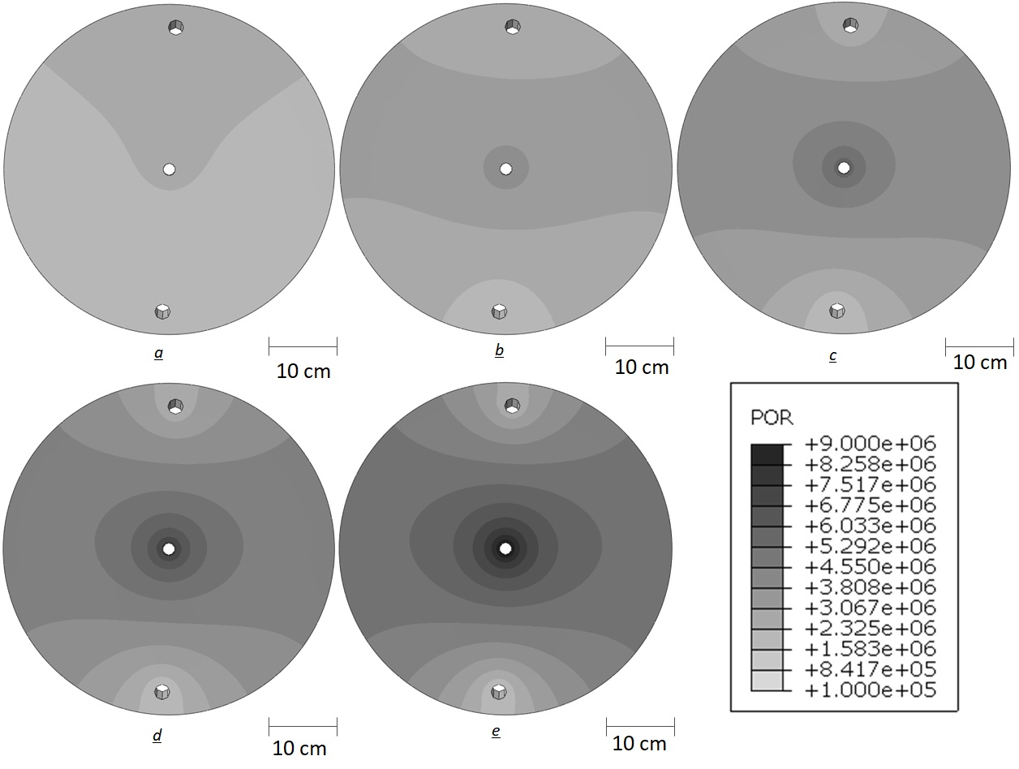
Results
Results of 3D-modeling pore pressure during the process of increasing the fluid injection pressure into central well.
a) 1 MPa, b) 3 MPa, c) 5 MPa, d) 7 MPa, e) 9 MPa, where POR is the pore pressure.

Slide 11
Results
Pore Pressure
Pore pressure, maximum and minimum compressive stresses along the axis of maximum compressive stress along the fracture trajectory before its formation, where S, Mises is the second invariant of the stress tensor.

Slide 12
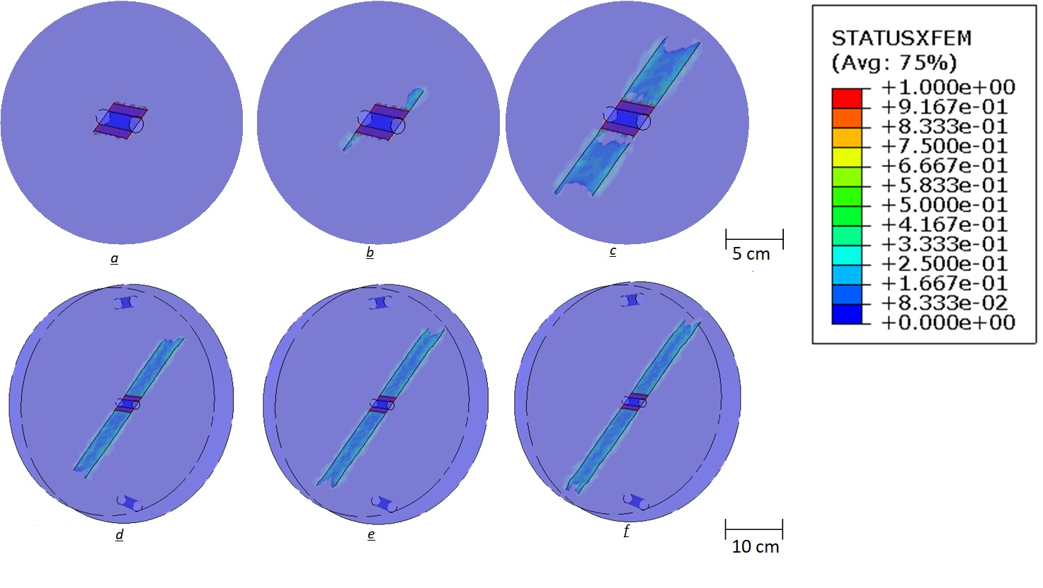
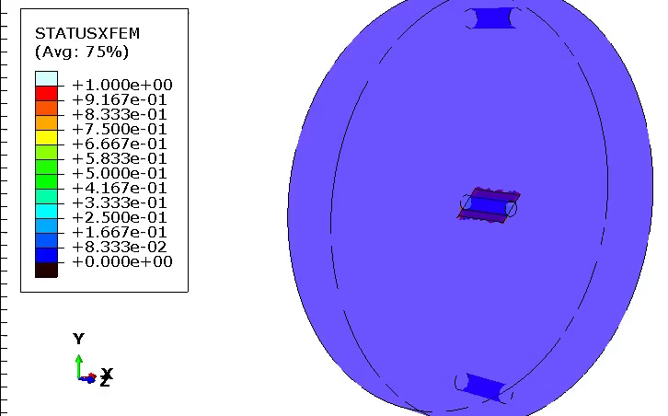
Results
Modeling results of fracture propagation, where STATUSXFEM is a parameter that characterizes the degree of coupling of elements in the model, if STATUSXFEM = 0, then the node is not damaged, if STATUSXFEM = 1.0, the node is completely destroyed.
a) 1.7300 µs – 1..2 mm; b) 2.1701 µs – 20 mm; c) 2.1703 µs – 80 mm;
d) 2.1611 µs – 140 mm; e) 2.8361 µs – 180 mm; f) 3.0261 µs – 200 mm.

Slide 13
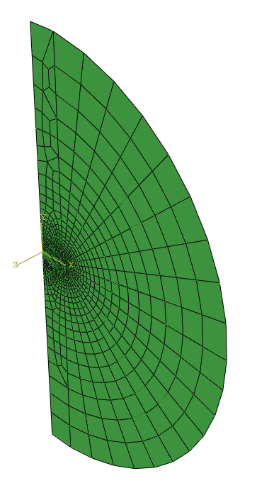
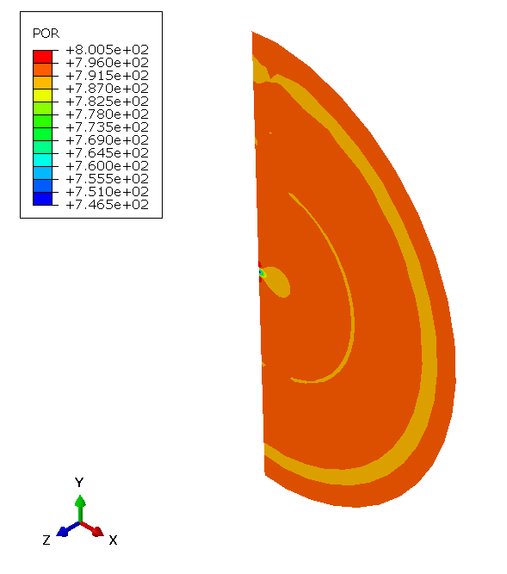
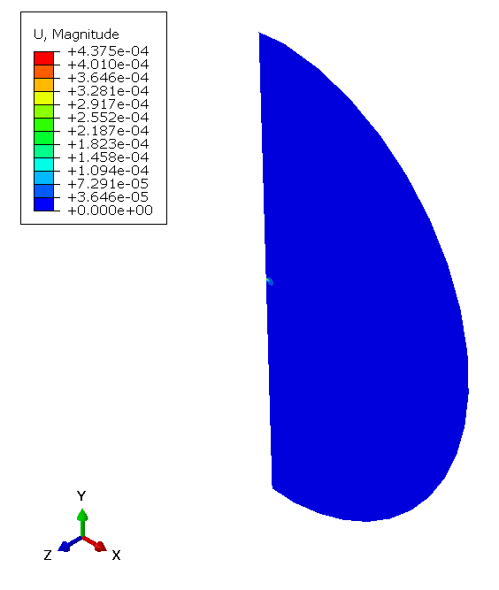
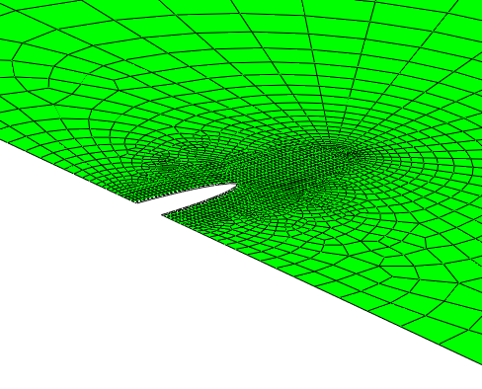
Current Work
E = 1,294 GPa
𝜈 = 0,25
q = 10⁻³ m³/s
Fracture geometry after the fluid injection stage.
Mesh
Results of 2D modeling of pore pressure changes after the injection stage, where POR is pore pressure.
Results of 2D modeling of changes in the deformation field after injection, where U, Magnitude is the magnitude of deformation.

Slide 14
Conclusions
A numerical model describing the geometry and mechanical parameters of the laboratory installation was prepared;
The dynamics of pore pressure in the sample were shown in the process of increasing the pressure of the hydraulic fracturing injection fluid in the central well up to 9 MPa;
The dynamics of stress and strain fields with a pressure of 9 MPa in the central well were shown;
It was found that the fracture begins to spread towards the maximum compressive stresses, which is consistent with the results of laboratory experiments conducted earlier;
Modeling the stress-strain state along the fracture trajectory shows asymmetric distributions of stresses, pressures, and porosity relative to the central well. Different pressure values caused it in the injection and drainage wells used in a laboratory experiment to create pore pressure. Also, it leads to the formation of different fracture lengths towards the production and injection wells, which we see during laboratory experiments.

Slide 15

Thanks!
OSPP QR code
Co-authors: Nachev V. and Turuntaev S.
Speaker: Grebenshchikova E.
Grebenshchikova.em@phystech.edu

