Slide 1
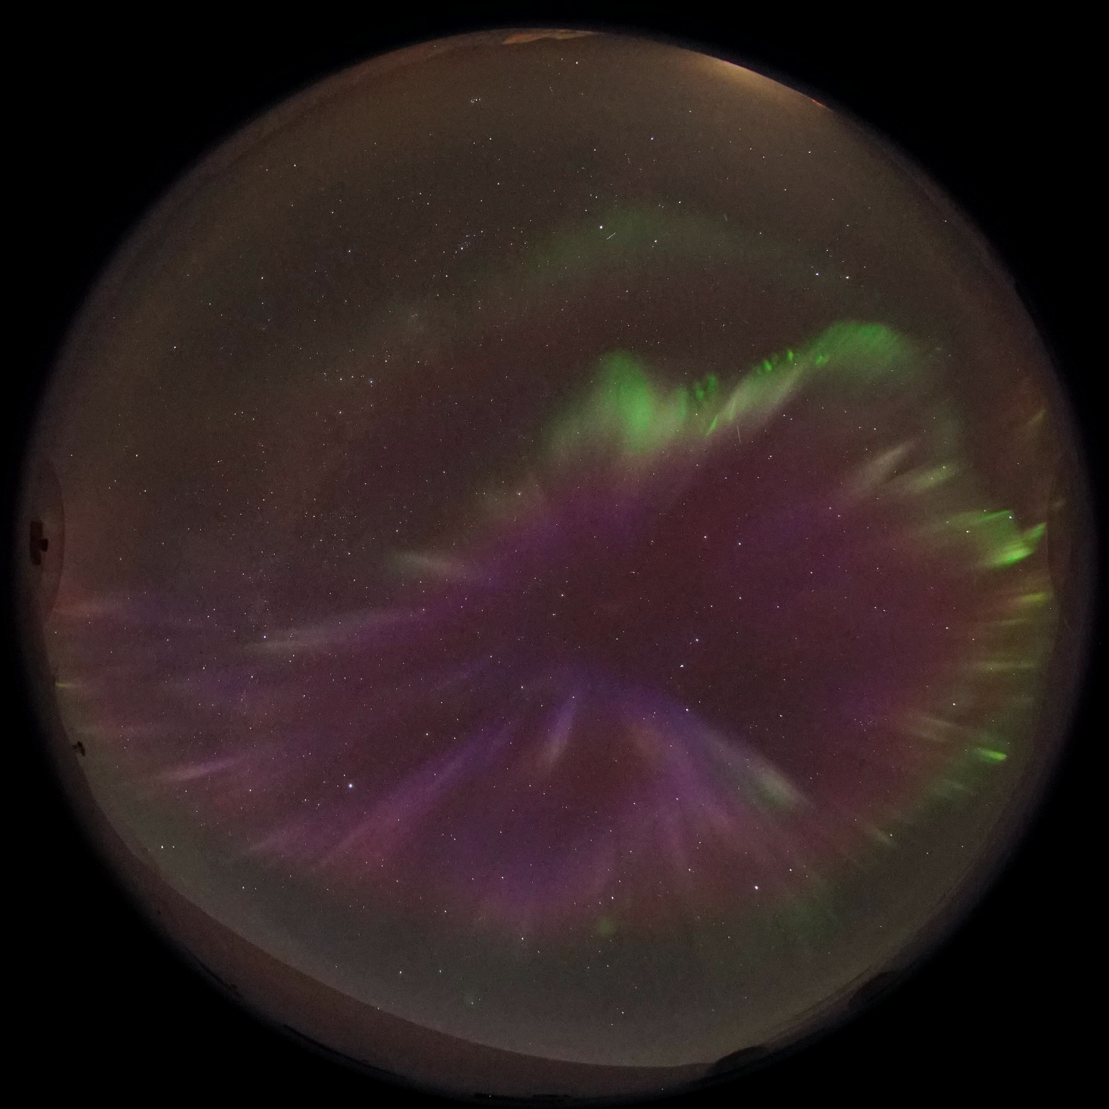



Characteristics of Fragmented Aurora-like Emissions (FAEs) observed on Svalbard
Uppsala Universitet
Joshua Dreyer^{1,2,(3)}, Noora Partamies³, Daniel Whiter⁴, Pål G. Ellingsen⁵, Lisa Baddeley³, and Stephan C. Buchert¹
(1) IRF-U (2) Uppsala Univ. (3) UNIS (4) Univ. of Southampton (5) UiT

Slide 2
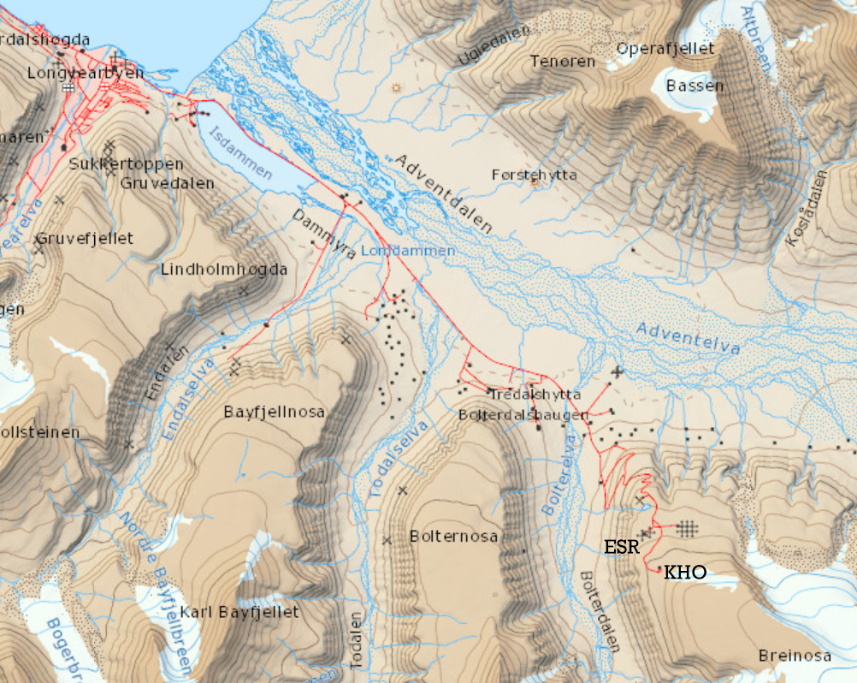
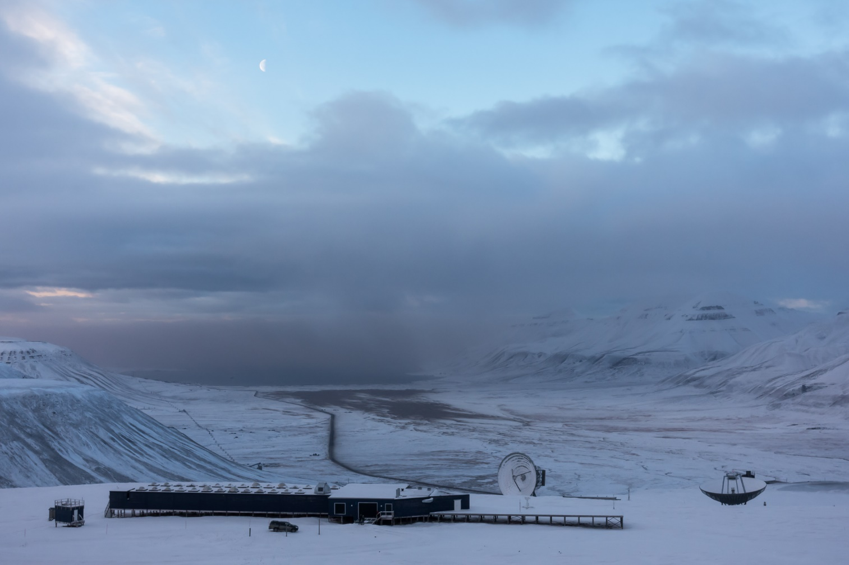
Where is the data from? --- KHO and EISCAT
near Longyearbyen, Svalbard, Norway
Notes:
∼78.15° N, 16.04° E at an altitude of ∼520 m

Slide 3
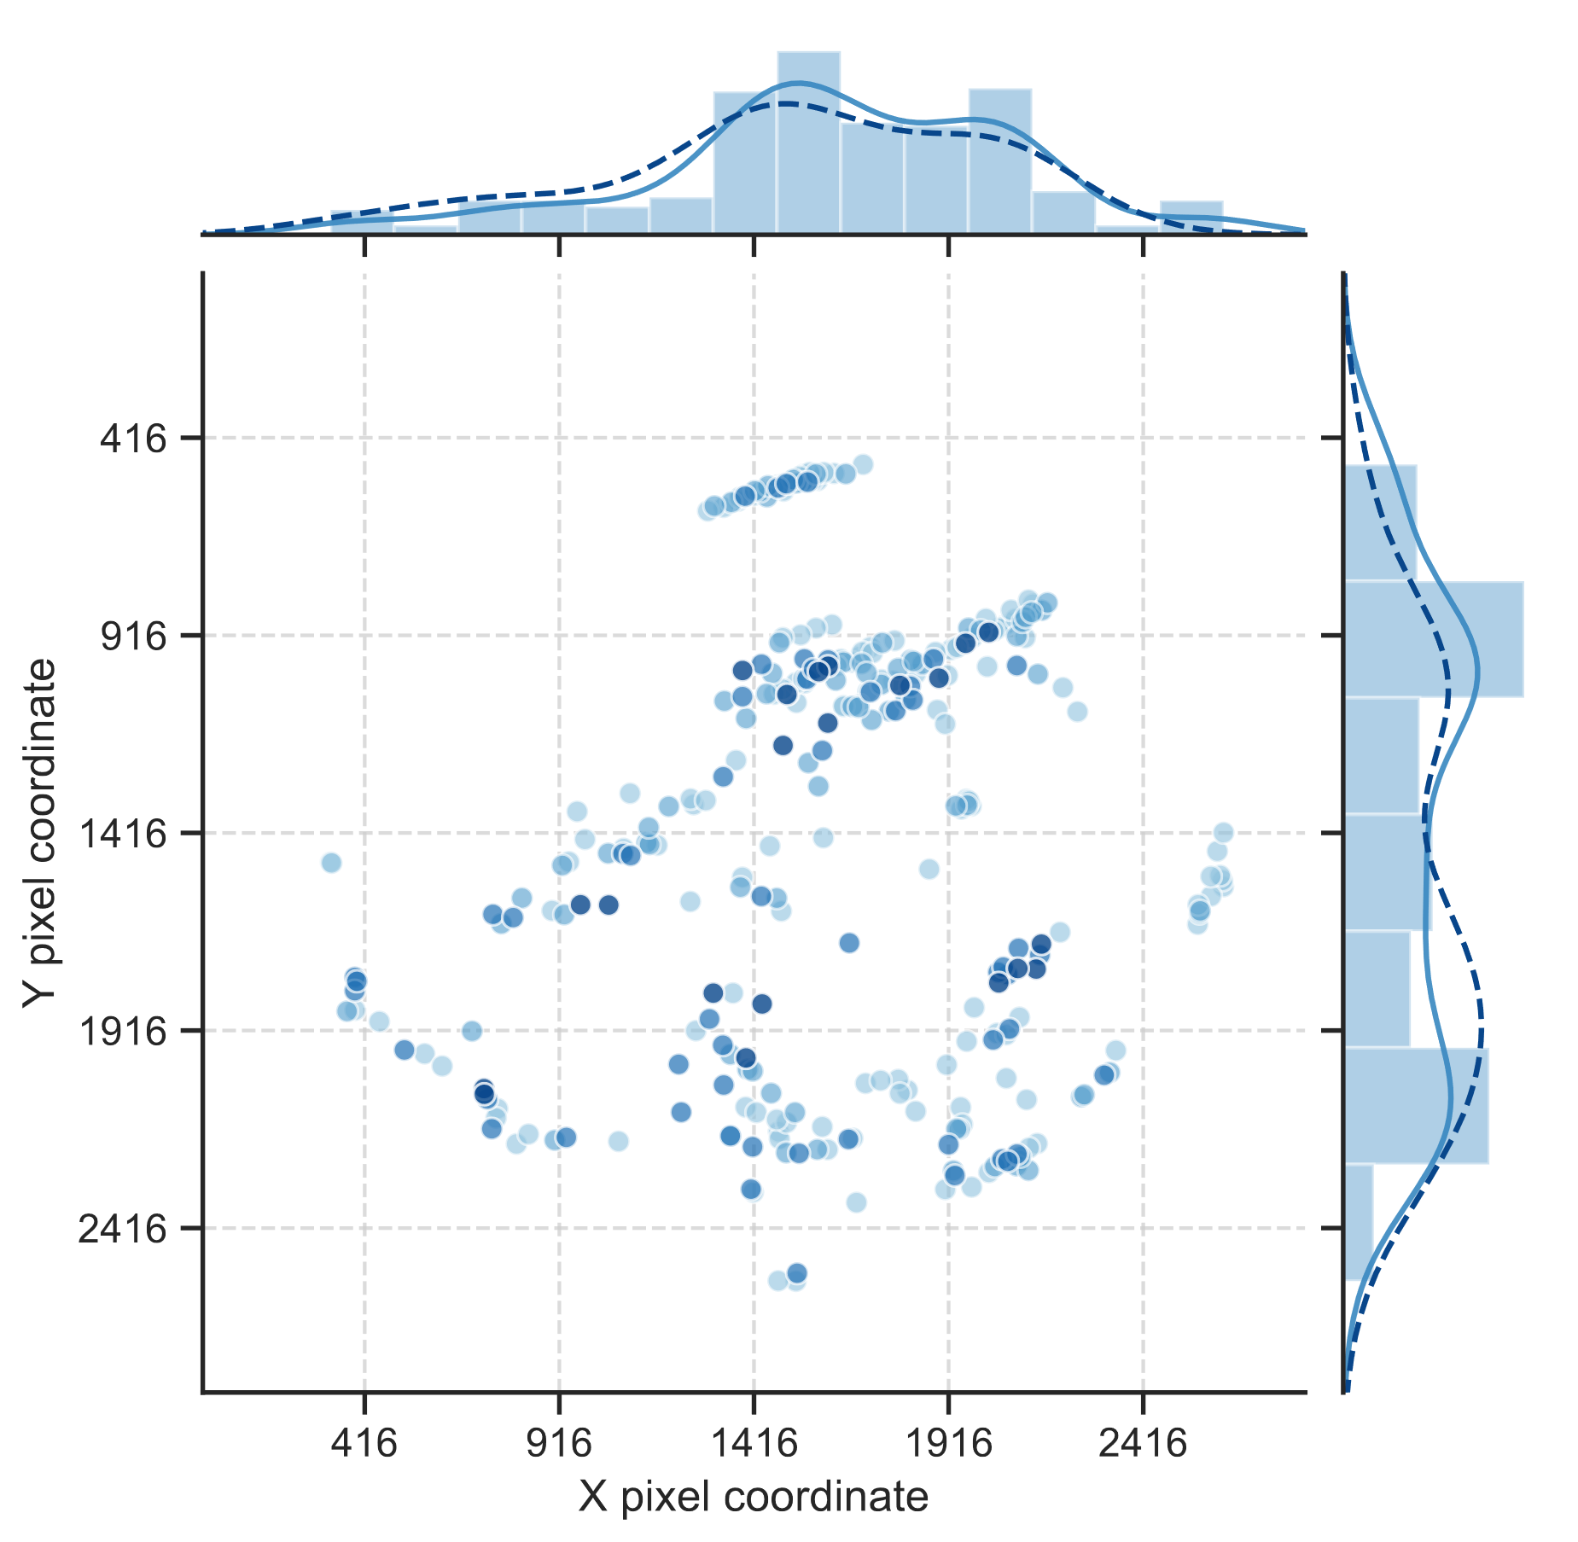
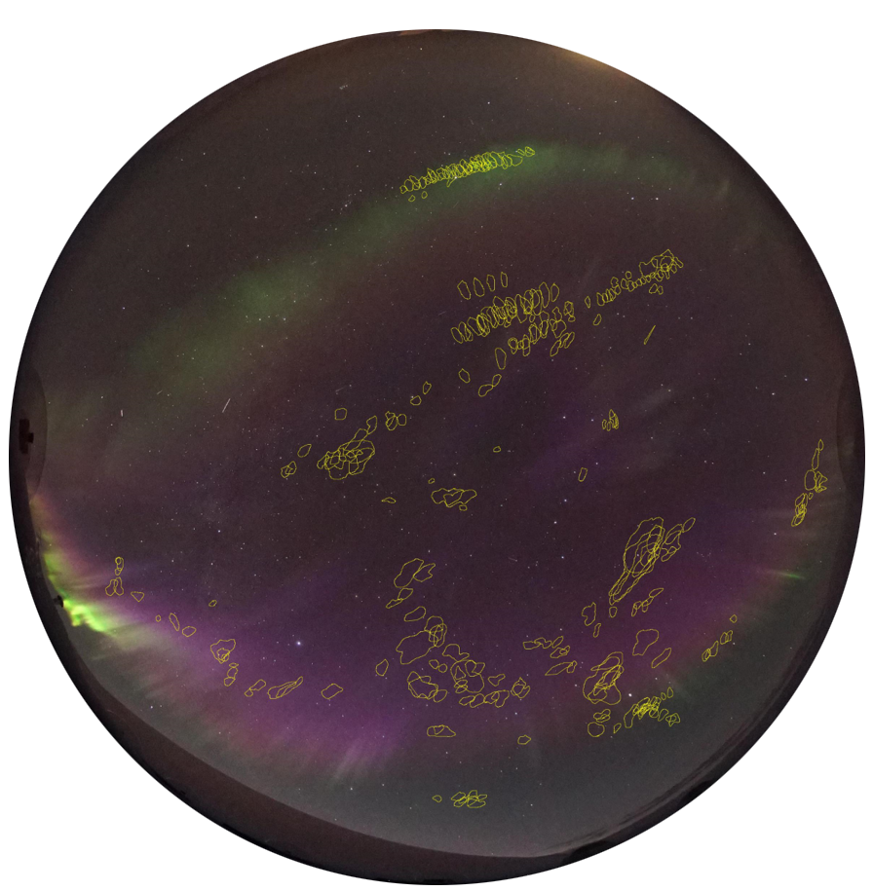
FAE dataset
+ check the presentation notes for more in-depth information!
103 analysed ASC images
305 identified FAE candidates in 4 confidence groups
Notes:
Data from All-sky cameras (ASCs), Meridian-scanning photometer (MSP), Auroral Structure and Kinetics instrument (ASK), Eiscat Svalbard Radar (ESR) + ACE and DSCOVR satellites.
The first two short events (meaning a time period of FAE occurrence) were observed in late 2015, with Svalbard having entered the evening cell of the convection.
By far the longest, the third event was observed on 18 Dec. 2017 and consists of 79 images taken between 07:36:35 UTC and 08:26:48 UT., towards the end of Svalbard being in the evening cell, close to flow reversal.
FAE candidates were identified on 74 of the 103 analysed images.
Distribution north/south of zenith is evenly split across the events
East-west asymmetry: 73% of FAEs are west of zenith

Slide 4

“Event 3” (2017)
Credit: Kjell Henriksen Observatory (KHO)
Notes:
ACE and DSCOVR data from period preceding this shows solar wind speeds of ~630 km s-1 (above threshold for high-speed streams)
Negative Bz and positive By

Slide 5
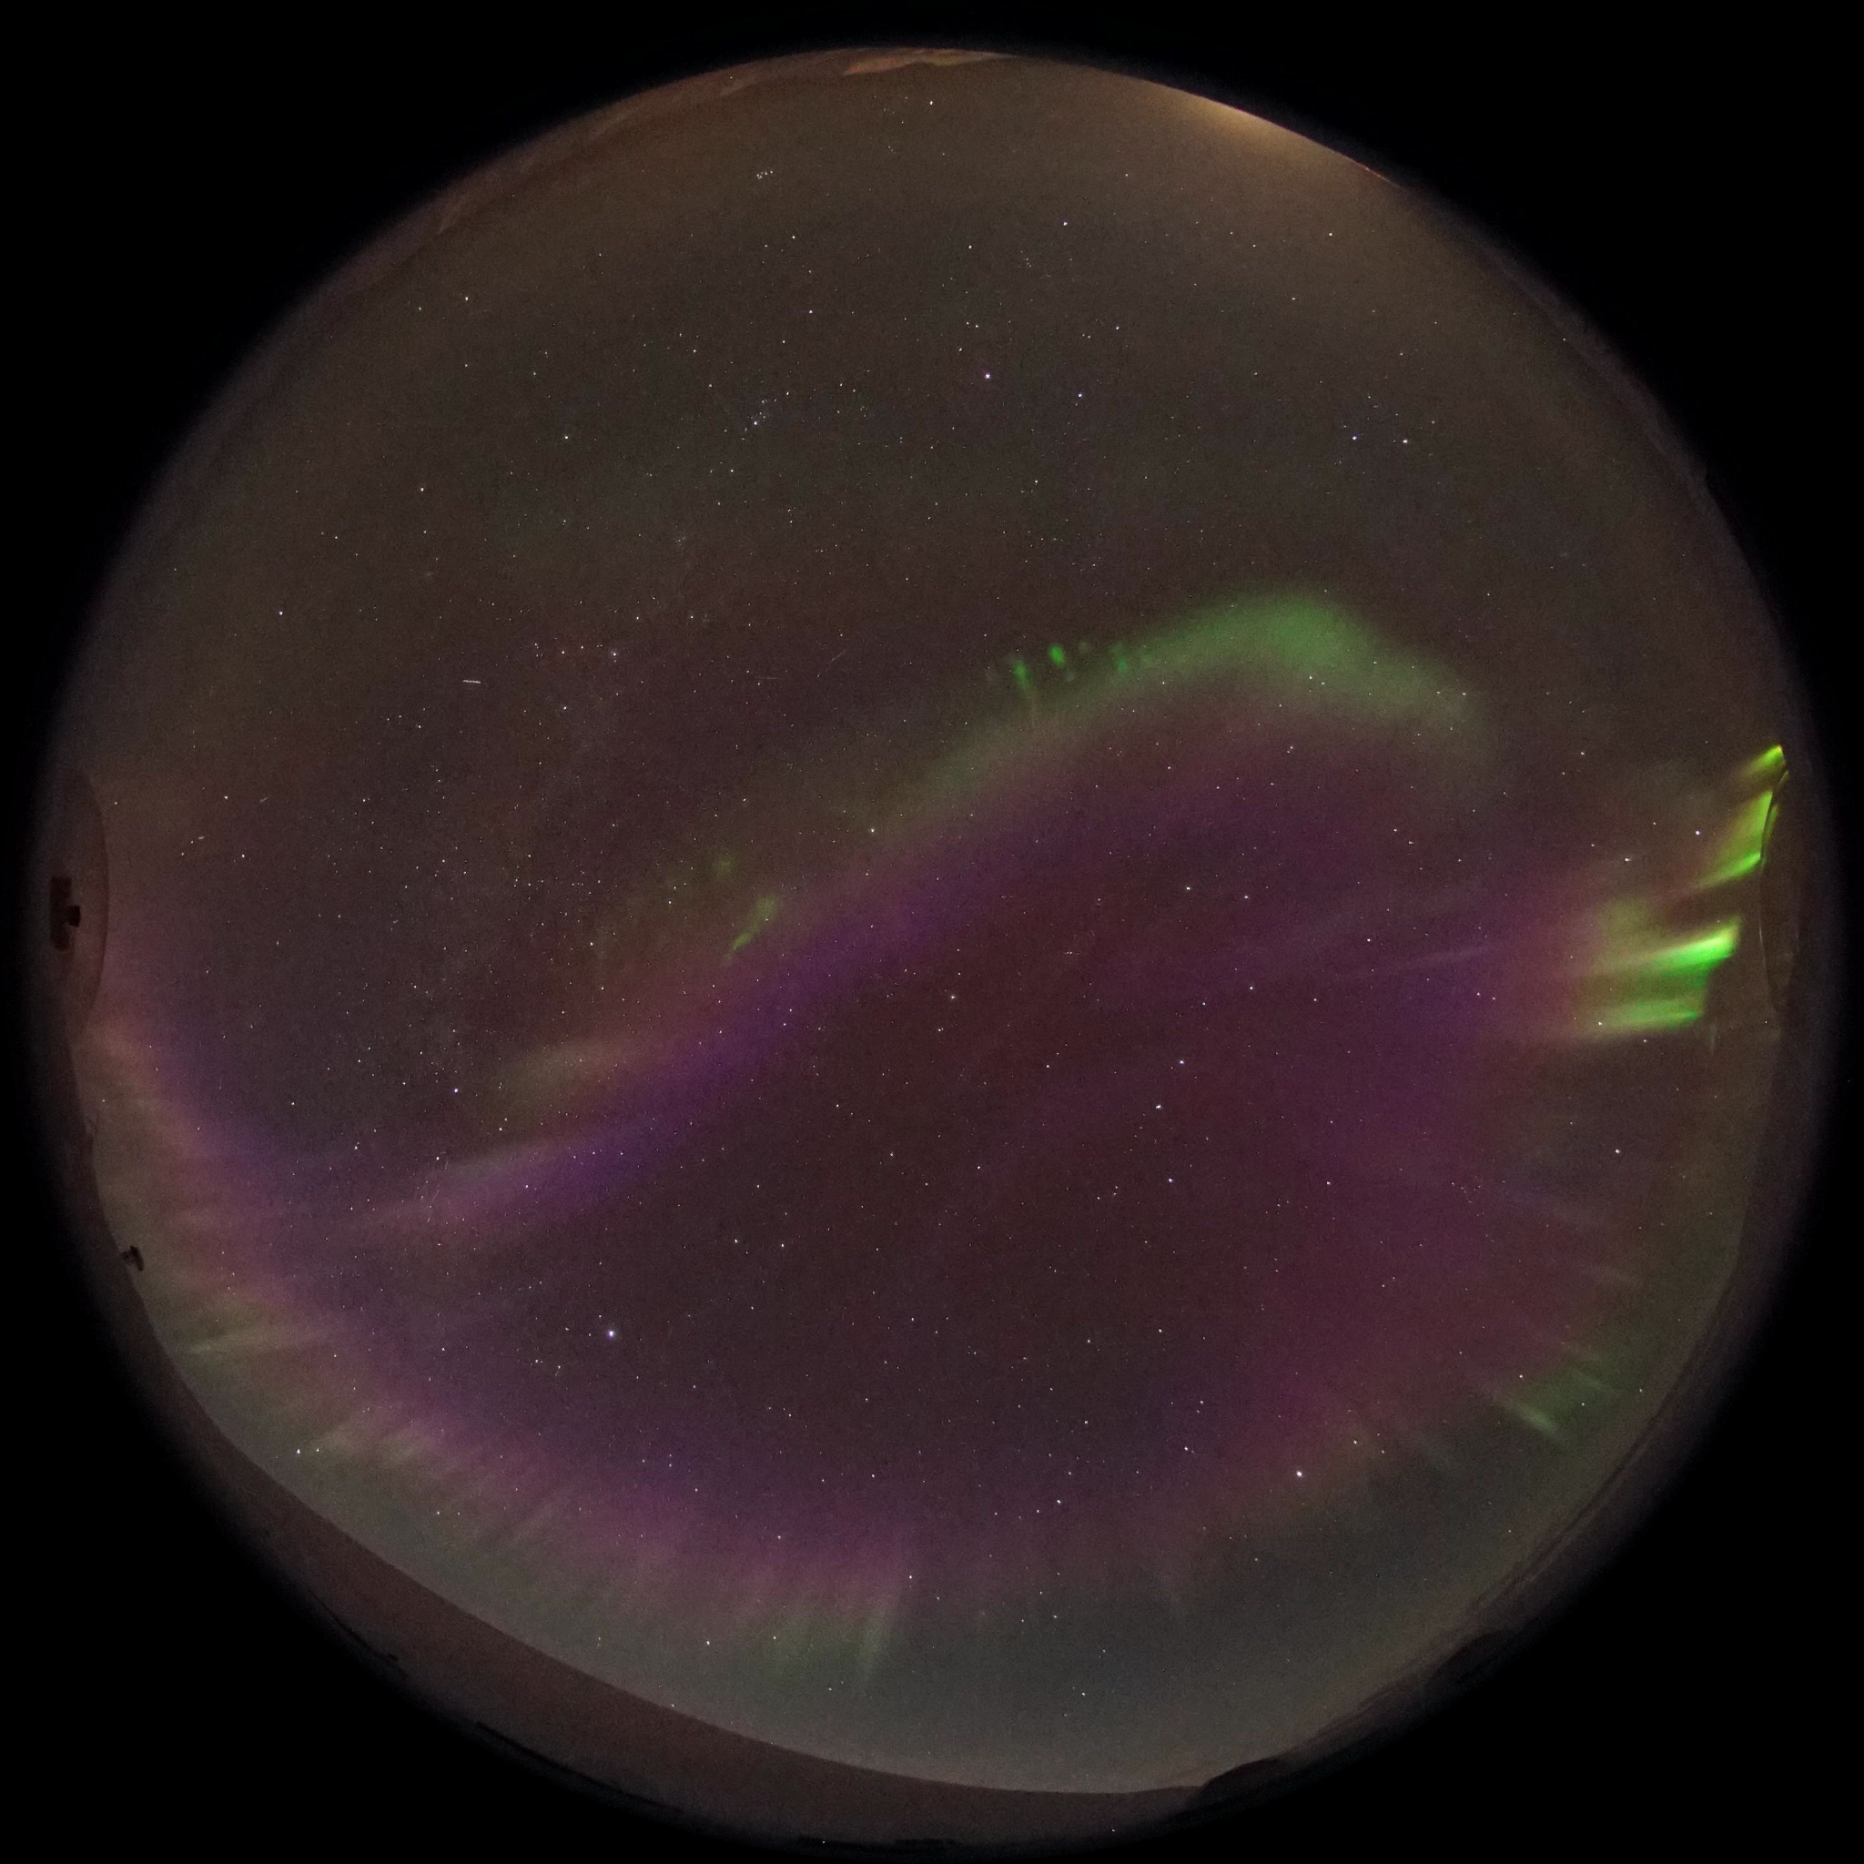
“Event 3” (2017)
Credit: KHO

Slide 6
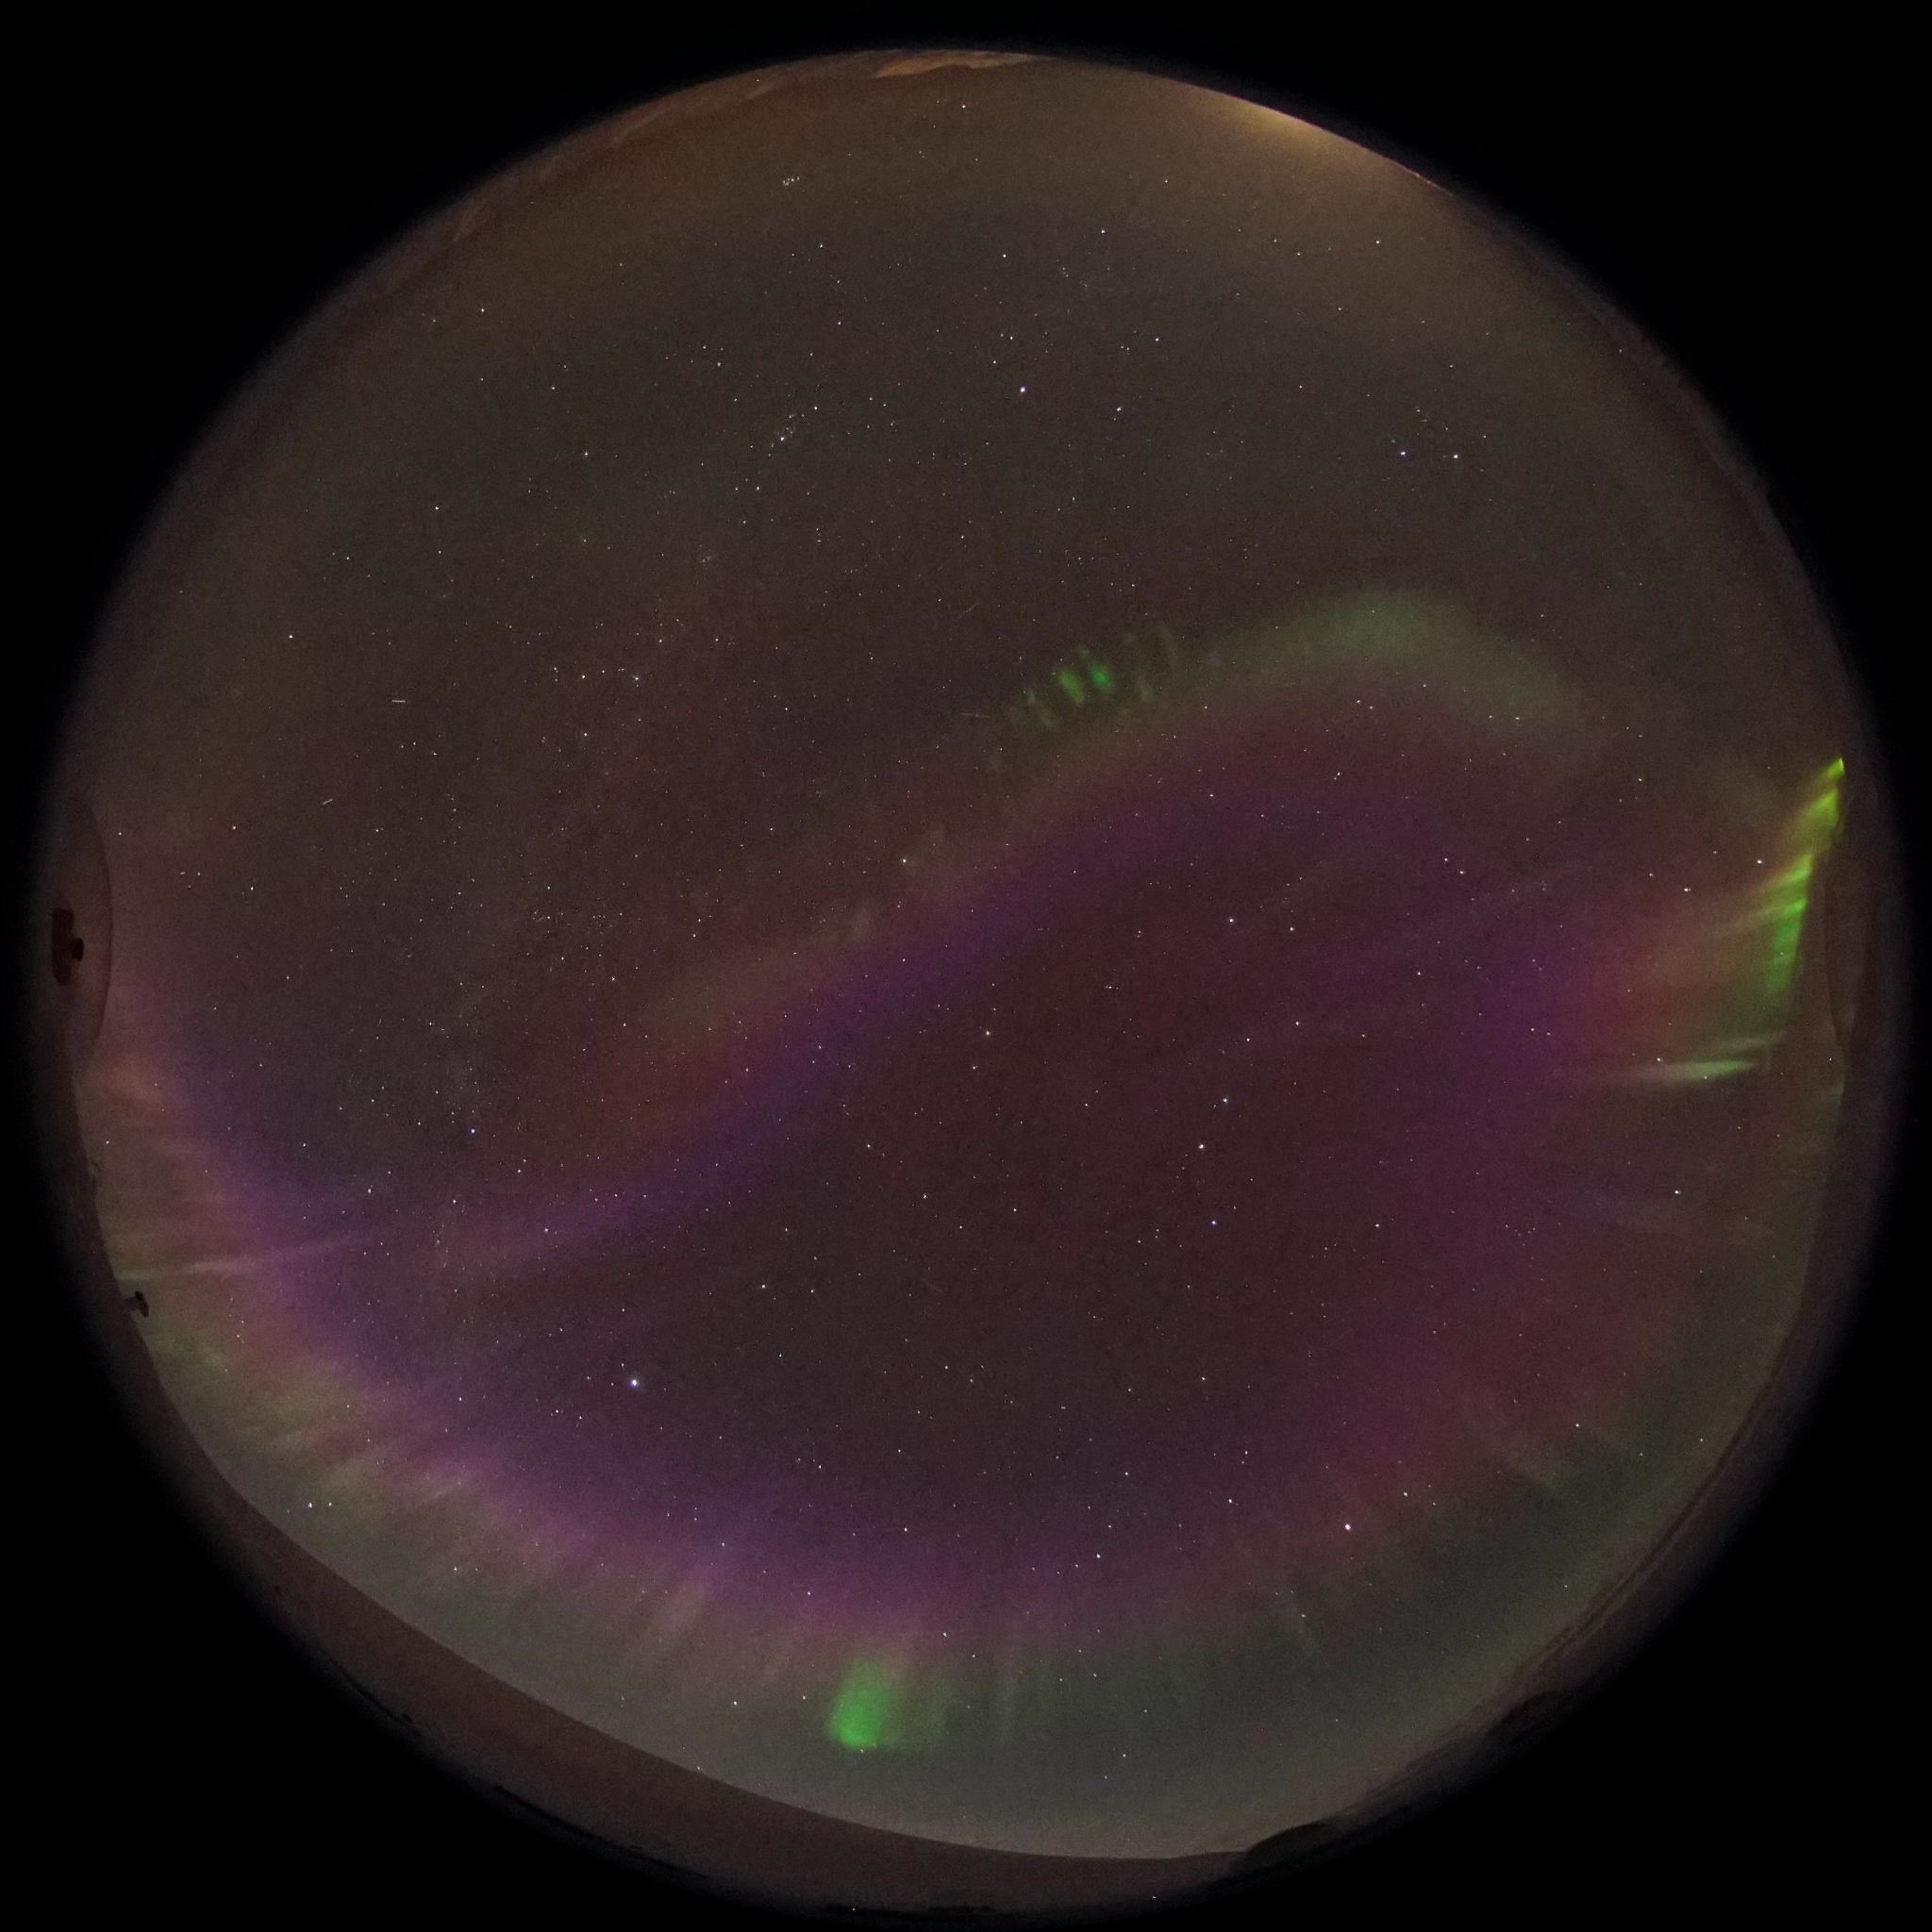
“Event 3” (2017)
Credit: KHO

Slide 7


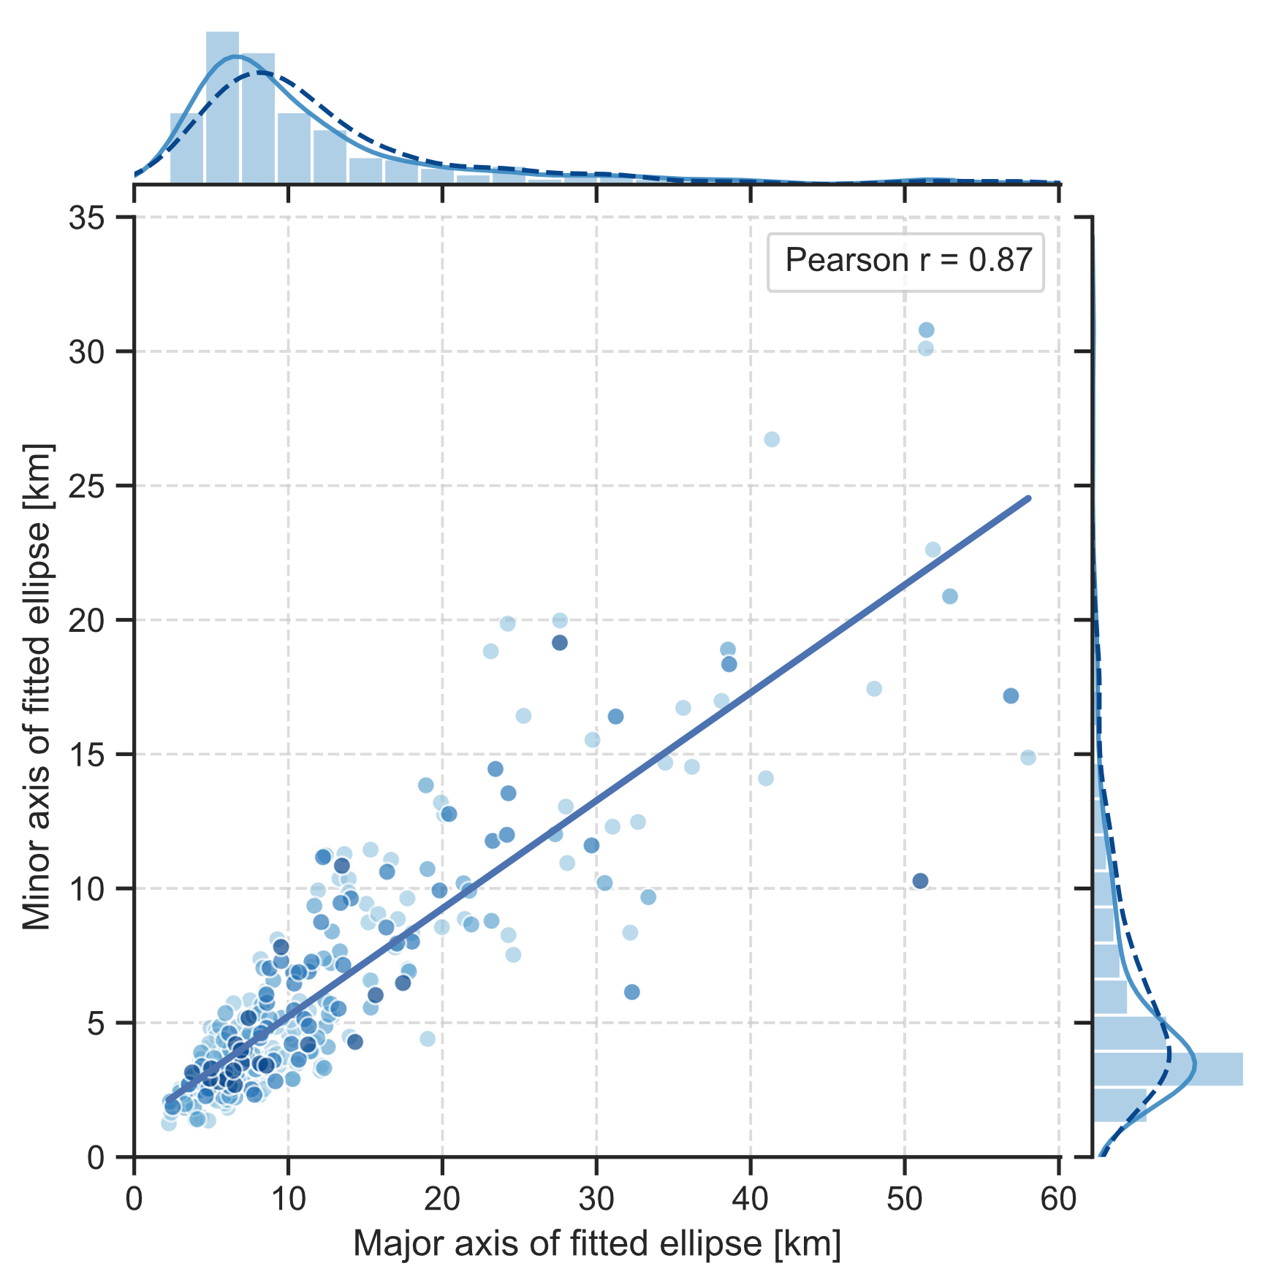
FAE sizes
Horizontal sizes are mostly below 20 km
Shape is generally close to elongated 2:1 ratio ellipse
Notes:
Assuming a FAE altitude of 110 km

Slide 8
FAE characteristics
Short lifetimes: ~ less than a minute; a few seconds for most
Small: Horizontal sizes are mostly below 20 km, elliptical (~2:1) shape
Distinct offset from the main auroral features
More or less defined outline and intensity enhancement in the visible spectrum
Two categories: (1) Individual FAEs, and (2) groups with regular spacing
FAE intensity enhancements have very limited field-aligned extent
Clear signatures only in some of the “typical” auroral wavelengths

Slide 9
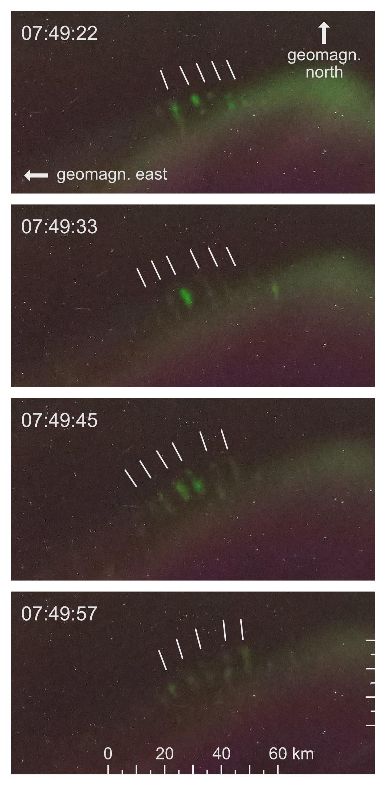
Category 2 FAEs
Wave-like structures
Seemingly regular spacing
Small offset to auroral arc

Slide 10
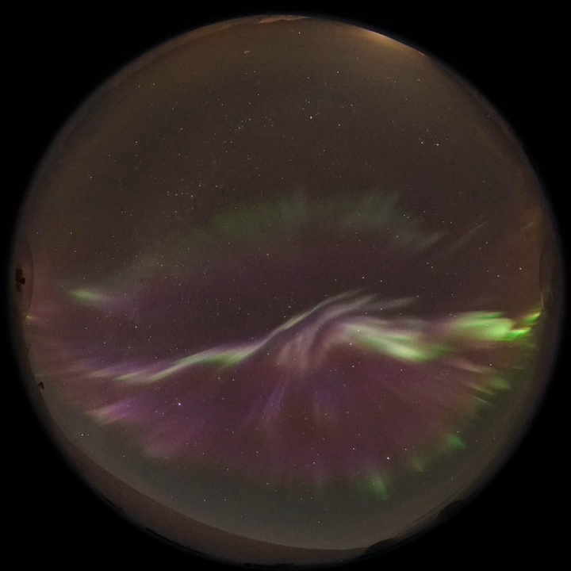
I’m a video, click me!
“Event 3” (2017)
Credit: KHO
Notes:
ACE and DSCOVR data from period preceding this shows solar wind speeds of ~630 km s-1 (above threshold for high-speed streams)
Negative Bz and positive By

Slide 11
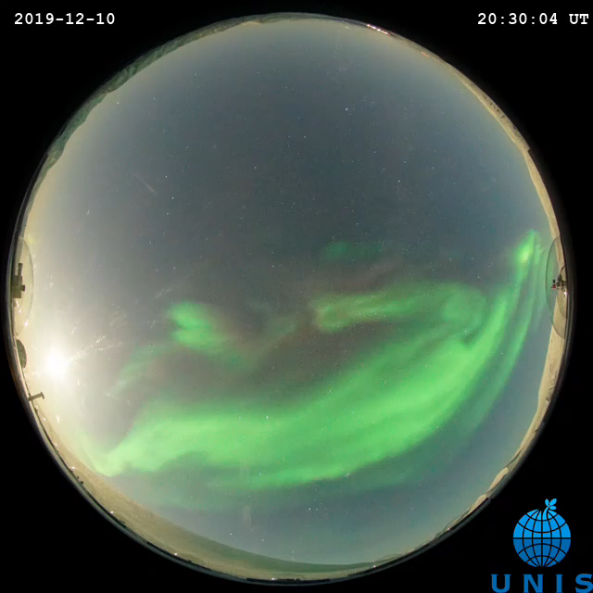
I’m a video, click me!
2019 event
Credit: KHO, N. Partamies
Notes:
This event from 2019 (around 2100 UT, so midnight MLT) is not included in the study but shows a lot of nice FAEs.
These were also captured by a Japanese film crew (https://www3.nhk.or.jp/nhkworld/en/ondemand/video/2015234/).
There is no real reason at this stage to believe that they would be exclusive to Svalbard (or rather the polar cap).

Slide 12
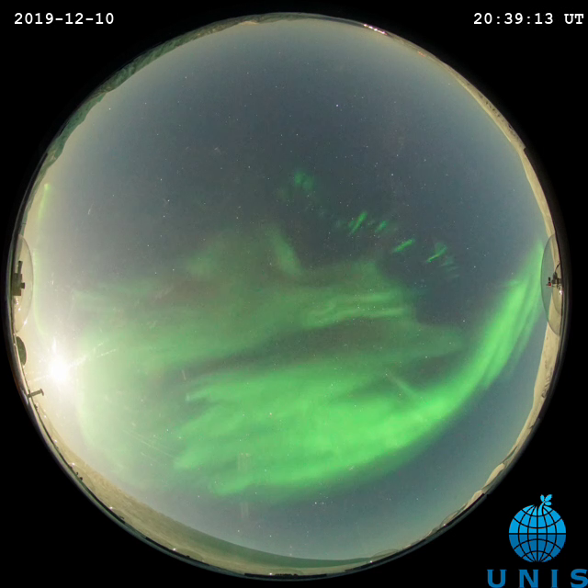
2019 event
Credit: KHO
Credit: KHO, N. Partamies
Notes:
This event from 2019 (around 2100 UT, so midnight MLT) is not included in the study but shows a lot of nice FAEs.
These were also captured by a Japanese film crew (https://www3.nhk.or.jp/nhkworld/en/ondemand/video/2015234/).
There is no real reason at this stage to believe that they would be exclusive to Svalbard (or rather the polar cap).

Slide 13
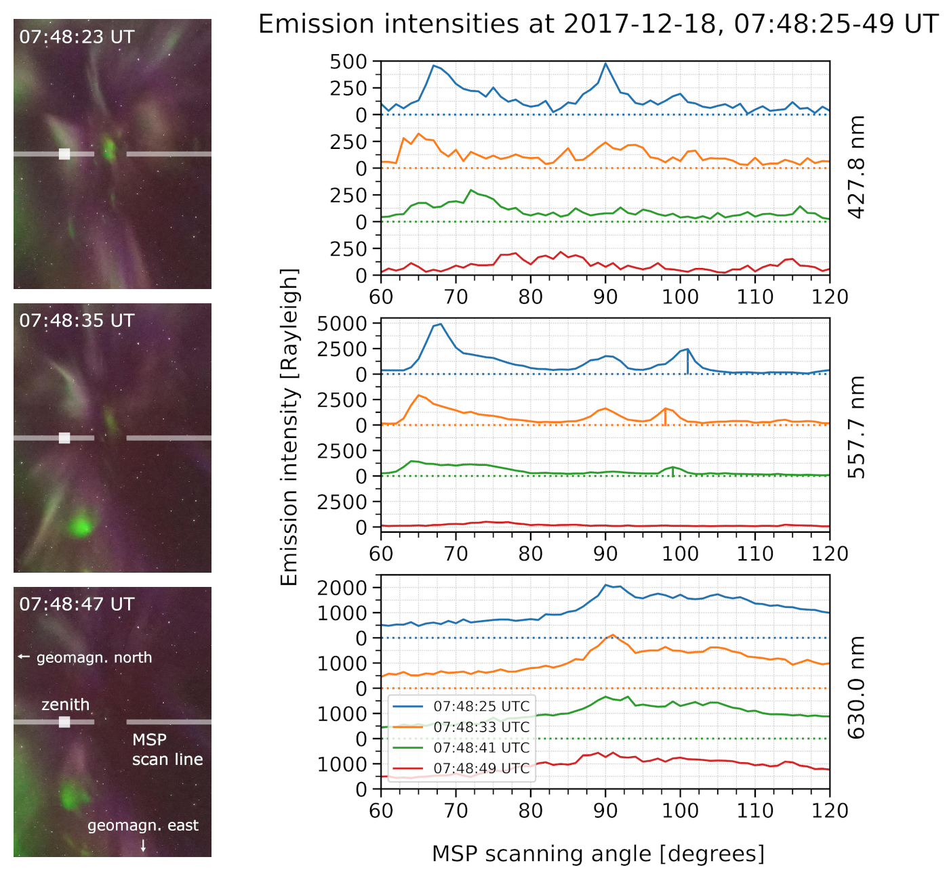
Notes:
FAEs are visible at 557.7 nm in MSP data, as well as 673.0 nm (N2 1P, first positive band system) in ASK
No clear signatures at 427.8 nm and 630.0 nm in MSP or the atomic oxygen emission line at 777.4 nm in ASK

Slide 14
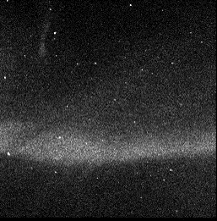
Auroral Structure and Kinetics Dec 2013
event
Credit: D. Whiter see Whiter et al. (2021)
“Fine Scale Dynamics of Fragmented Aurora-Like Emission“
Notes:
ASK1 measuring N2 1P (first positive band system) emissions at 673.0 nm (no 777.4 nm atomic oxygen emissions visible)
FAEs are the first feature observed in ASK data with a clear 673.0 nm signature, but no 777.4 nm emissions (with few exceptions)
The OI 777.4 nm emission is a result of two excitation processes; direct excitation of O (from predominantly low energy precipitation) and dissociative excitation of O2 (from predominantly high energy precipitation)
ASK estimates the energy and flux of precipitation by measuring the ratio of brightnesses of the OI and N2 1P emissions
The lack of OI 777.4 nm emissions suggests a local generation and excludes particle precipitation as a source (even for high energy particle precipitation OI has a brightness of ~10% of N2 1P)
Taken together, the observed emissions point to a typical upper limit for energy of the generation mechanism of ~10.76 eV
Overall, suprathermal electrons are required to explain all observed emissions
FAEs also show internal structures, with wavelengths of ~425—850 m at 100 km altitude
This leads to interpretation of the motion of FAEs and their internal structure as group and phase velocities of a wave, respectively
FAE drift speeds of 580—700 ms⁻¹, with internal dynamics moving at 2200-2500 ms⁻¹

Slide 15
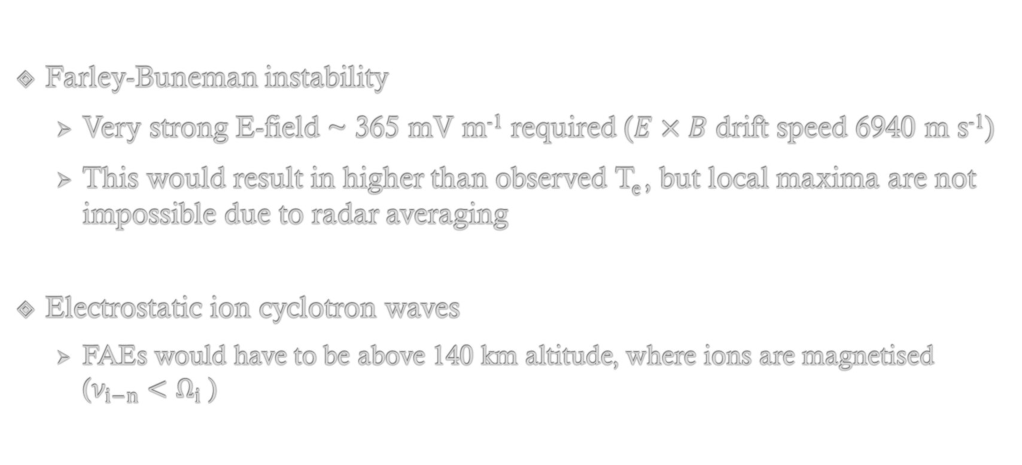
Potential generation mechanisms (see also Whiter et al., 2021)
Farley-Buneman instability
Very strong E-field ~ 365 mV m⁻¹ required ($E×B$ drift speed 6940 m s⁻¹)
This would result in higher than observed T_{e} , but local maxima are not impossible due to radar averaging
Electrostatic ion cyclotron waves
FAEs would have to be above 140 km altitude, where ions are magnetised ($ν_{i−n}<Ω_{i}$)
Notes:
See Whiter et al. (2021), https://doi.org/10.5194/angeo-39-975-2021
EIC: above 140 km: ion-neutral collision frequency $ν_{i}<{ Ω}_{i}$ (ion cyclotron frequency), cyclotron motions of ions
The measured speeds would have to be scaled up accordingly (*1.4) to fit the EIC dispersion relation, same for ion acoustic speed c_{s}.
This could be due to higher ion and electron temperatures (~3000 K) or a change from NO+ to O+ ions.
These are based on assumption of group and phase speed interpretation and simplified linear theory concepts, which might have limited applicability.
All observed FAE events so far occurred in the evening sector of the polar cap, close to flow reversal.

Slide 16
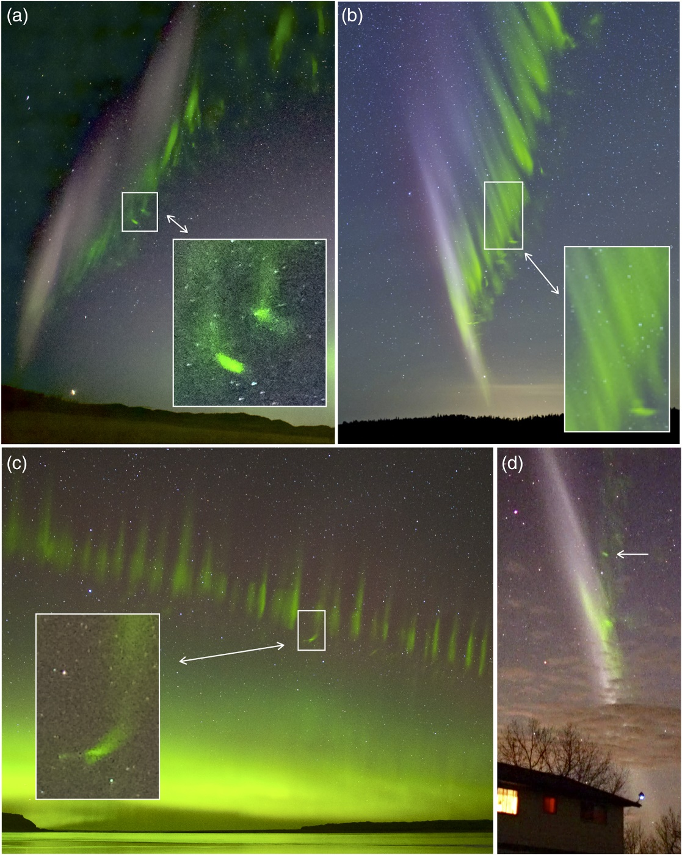
Semeter et al. (2020) The Mysterious Green Streaks Below STEVE
similar appearance and characteristics
could be related phenomena
same generation mechanism? (extreme electric fields during STEVE occurrences)
Fig. 1 in Semeter et al. (2020), https://doi.org/10.1029/2020AV000183

Slide 17
Summary
FAEs as new type of aurora-like phenomenon:
Horizontal sizes mostly < 20 km
Lifetimes generally < 1 min
Do not show the field-aligned extent of typical aurora
Emissions visible at 557.7 nm (O) and 673.0 nm (N2 1P)
Group speeds of ~ 600–700 m s⁻¹ and internal phase speeds of 2200-2500 m s⁻¹
The proposed generation mechanism is localized in the ionosphere, rather than particle precipitation from the magnetosphere (Farley-Buneman instabilities or EICs; see Whiter et al., 2021)
They show similarities to the green streaks described by Semeter et al. (2020)

Slide 18
Papers:
Dreyer, J. / Partamies, N. / Whiter, D. / Ellingsen, P. G. / Baddeley, L. / Buchert, S. C. Characteristics of fragmented aurora-like emissions (FAEs) observed on Svalbard 2021 Annales Geophysicae , Vol. 39, No. 2, p. 277-288 https://doi.org/10.5194/angeo-39-277-2021
Whiter, D. K. / Dahlgren, H. / Lanchester, B. S. / Dreyer, J. / Partamies, N. / Ivchenko, N. / Di Fraia, M. Z. / Oliver, R. / Serpell-Stevens, A. / Shaw-Diaz, T. / Braunersreuther, T. Fine Scale Dynamics of Fragmented Aurora-Like Emission 2021 Annales Geophysicae Discussions , Vol. 2021, p. 1-20 https://doi.org/10.5194/angeo-39-975-2021

