Slide 1
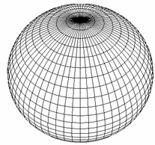
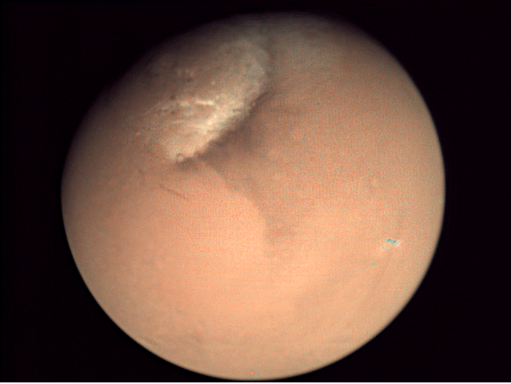
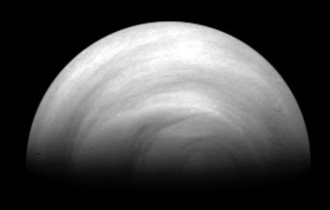




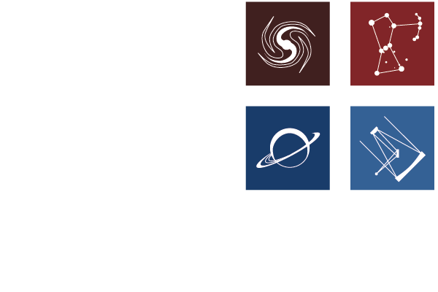
Studying the middle/upper atmosphere
of Venus and Mars combining
3D modeling and observations
Gabriella Gilli^{1,2} (e-mail: gilli@iaa.es )
S. Lebonnonis³, T. Navarro⁴, D. Quirino², A. Martinez³, F. Forget³, J. Liu³,
A. Spiga³, F. Gonzalez-Galindo¹, E. Millour³, F. Lefevre⁵, LMD and LATMOS Team
Instituto de Astrofísica de Andalucia (IAA), Granada, Spain
Instituto de Astrofísica e Ciências do Espaço (IA), Portugal
Laboratoire de Météorologie Dynamique (LMD), Paris, France
McGill Univ. Montreal, Canada
LATMOS, Paris,France
G.Gilli @ EGU 2022, Session PS9.1

Slide 2




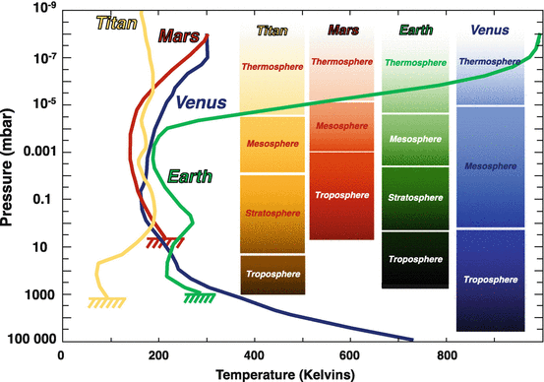

Comparative terrestrial
planets atmosphere
PLANET | Psup | Tsup (K) | Main Specie | H
Venus | 90 | 723 | CO2(~95%) | 15.9
Earth | 1 | 288 | N2(~80%) | 8.4
Mars | 0,006 | 210 | CO2(~96%) | 11.1
Credits: Montmessin & Määttänen
In Handbook of Exoplanets
G.Gilli @ EGU 2022, Session PS9.1

Slide 3
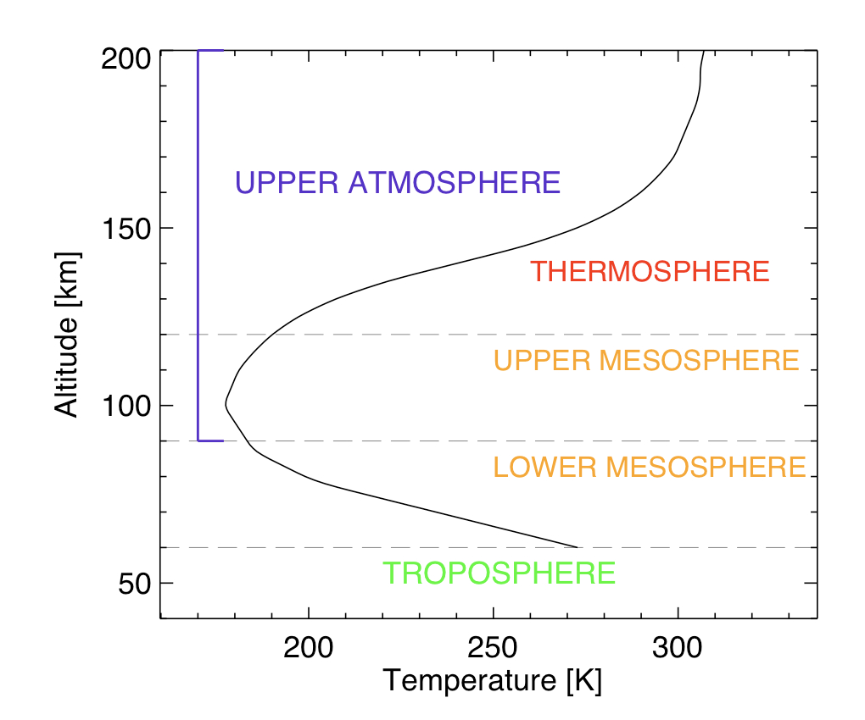
Main physical processes in the
Venus (Mars) atmosphere
Sketch of Venus vertical thermal structure
Heating by solar UV
Near IR CO₂ bands (heating at 4.3 um and cooling at 15 um)
Molecular diffusion
Thermal conduction
Radiative balance
Radiation
Convection
Adiabatic gradient dT/dz = -g /C_{p}
G.Gilli @ EGU 2022, Session PS9.1

Slide 4
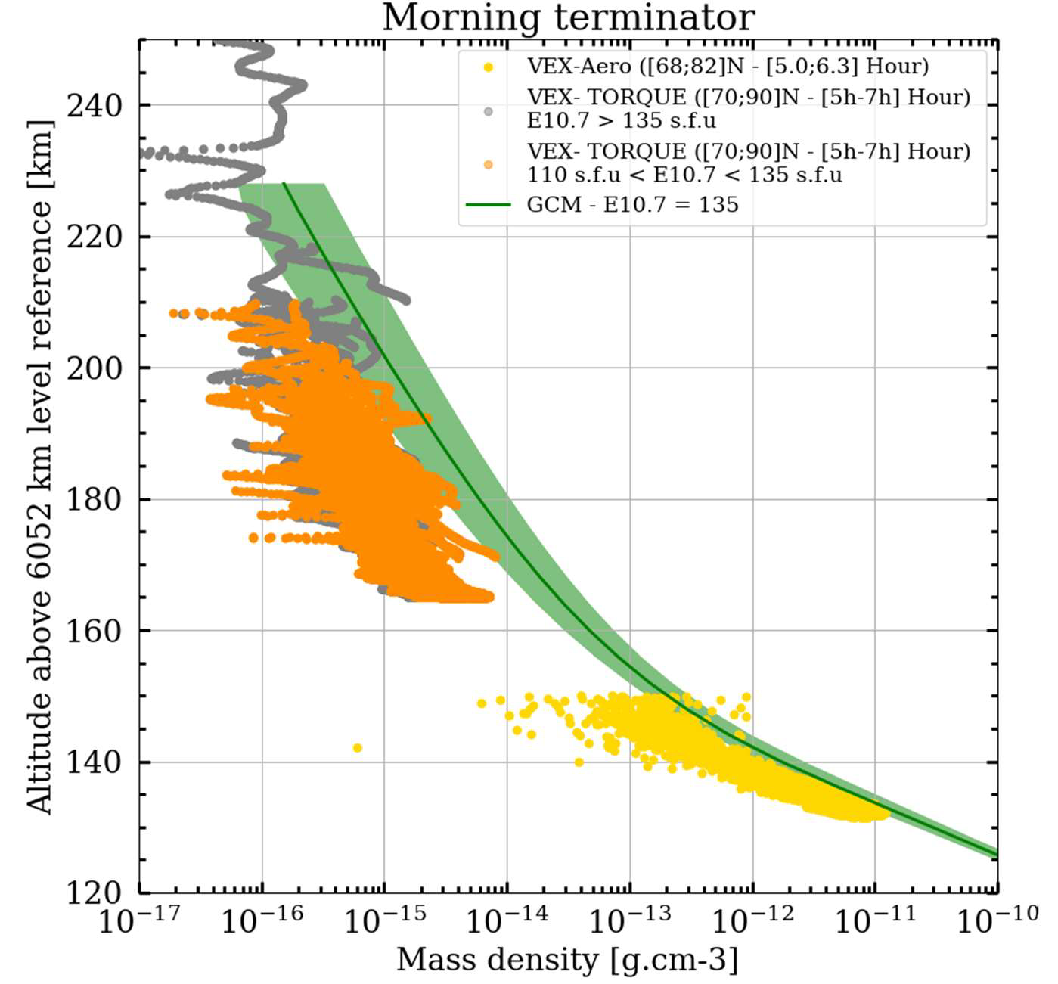
Recent improvements:
Ground-to-exosphere 3D model + photochemistry (up to ~ 250 km altitude)
High-horizontal resolution
Update of the parametrization of non-LTE CO₂ IR heating rates
Update of the non-orographic gravity wave parameterization
Tuning of the atomic oxygen production to improve thermosphere densities
Simulations:
IPSL Venus GMC
(LMD and LATMOS collaboration)
See talk EGU22-5271, PS4.1
Martinez et al. “ Venusian Thermosphere variability by IPSL Venus GCM”
Mass density:
VGCM vs VEX aerobraking
Lebonnois et al. (2010), Gilli et al. (2017);
Garate-Lopez & Lebonnois (2018)
Gilli et al. (2021), Navarro et al. (2021)
See also talk EGU22-5218, Lebonnois et al “Wave activity in and below Venusian clouds with the IPSL Venus GCM”
Martinez et al. 2022
(under revision)
G.Gilli @ EGU 2022, Session PS9.1

Slide 5
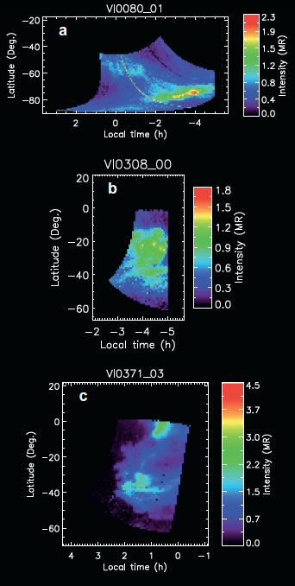
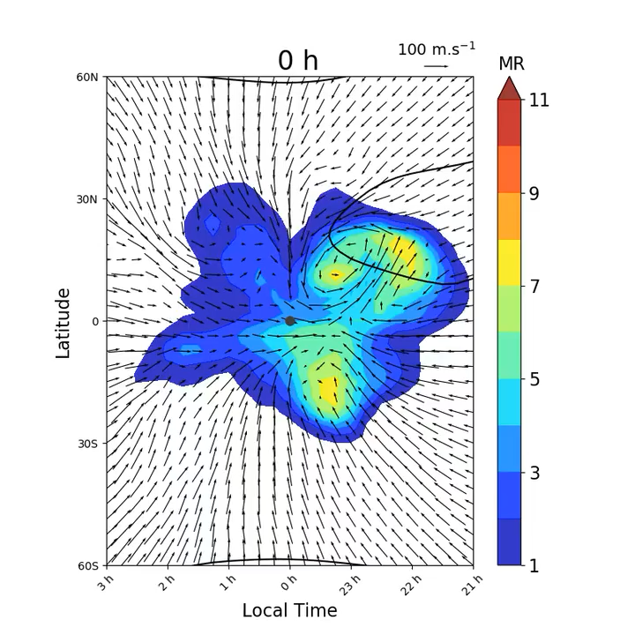
O₂ airglow variability simulated for the first time with a GCM
SS
MT
AS
ET
SS
~5 days Kelvin wave propagate westward
Kelvin waves enhance poleward injection of material at high latitudes, after downward transport of CO and O
Only horizontal motion cannot explains the fast changing nightglows (e.g. vertical transport (20%) and chemical reactions (50%) also contribute at emission peak)
1.27 um airglow with wind arrows at 95 km
Individual O₂ airglow observed by VIRTIS/VEX (Soret et al. 2014)
Navarro et al. 2021
G.Gilli @ EGU 2022, Session PS9.1
Notes:
The black contours indicate the cloud top zonal retrograde wind at 100 m s−1 to show how the wind field is perturbed by the Kelvin wave underneath. Red colours correspond to brighter fluorescence.

Slide 6
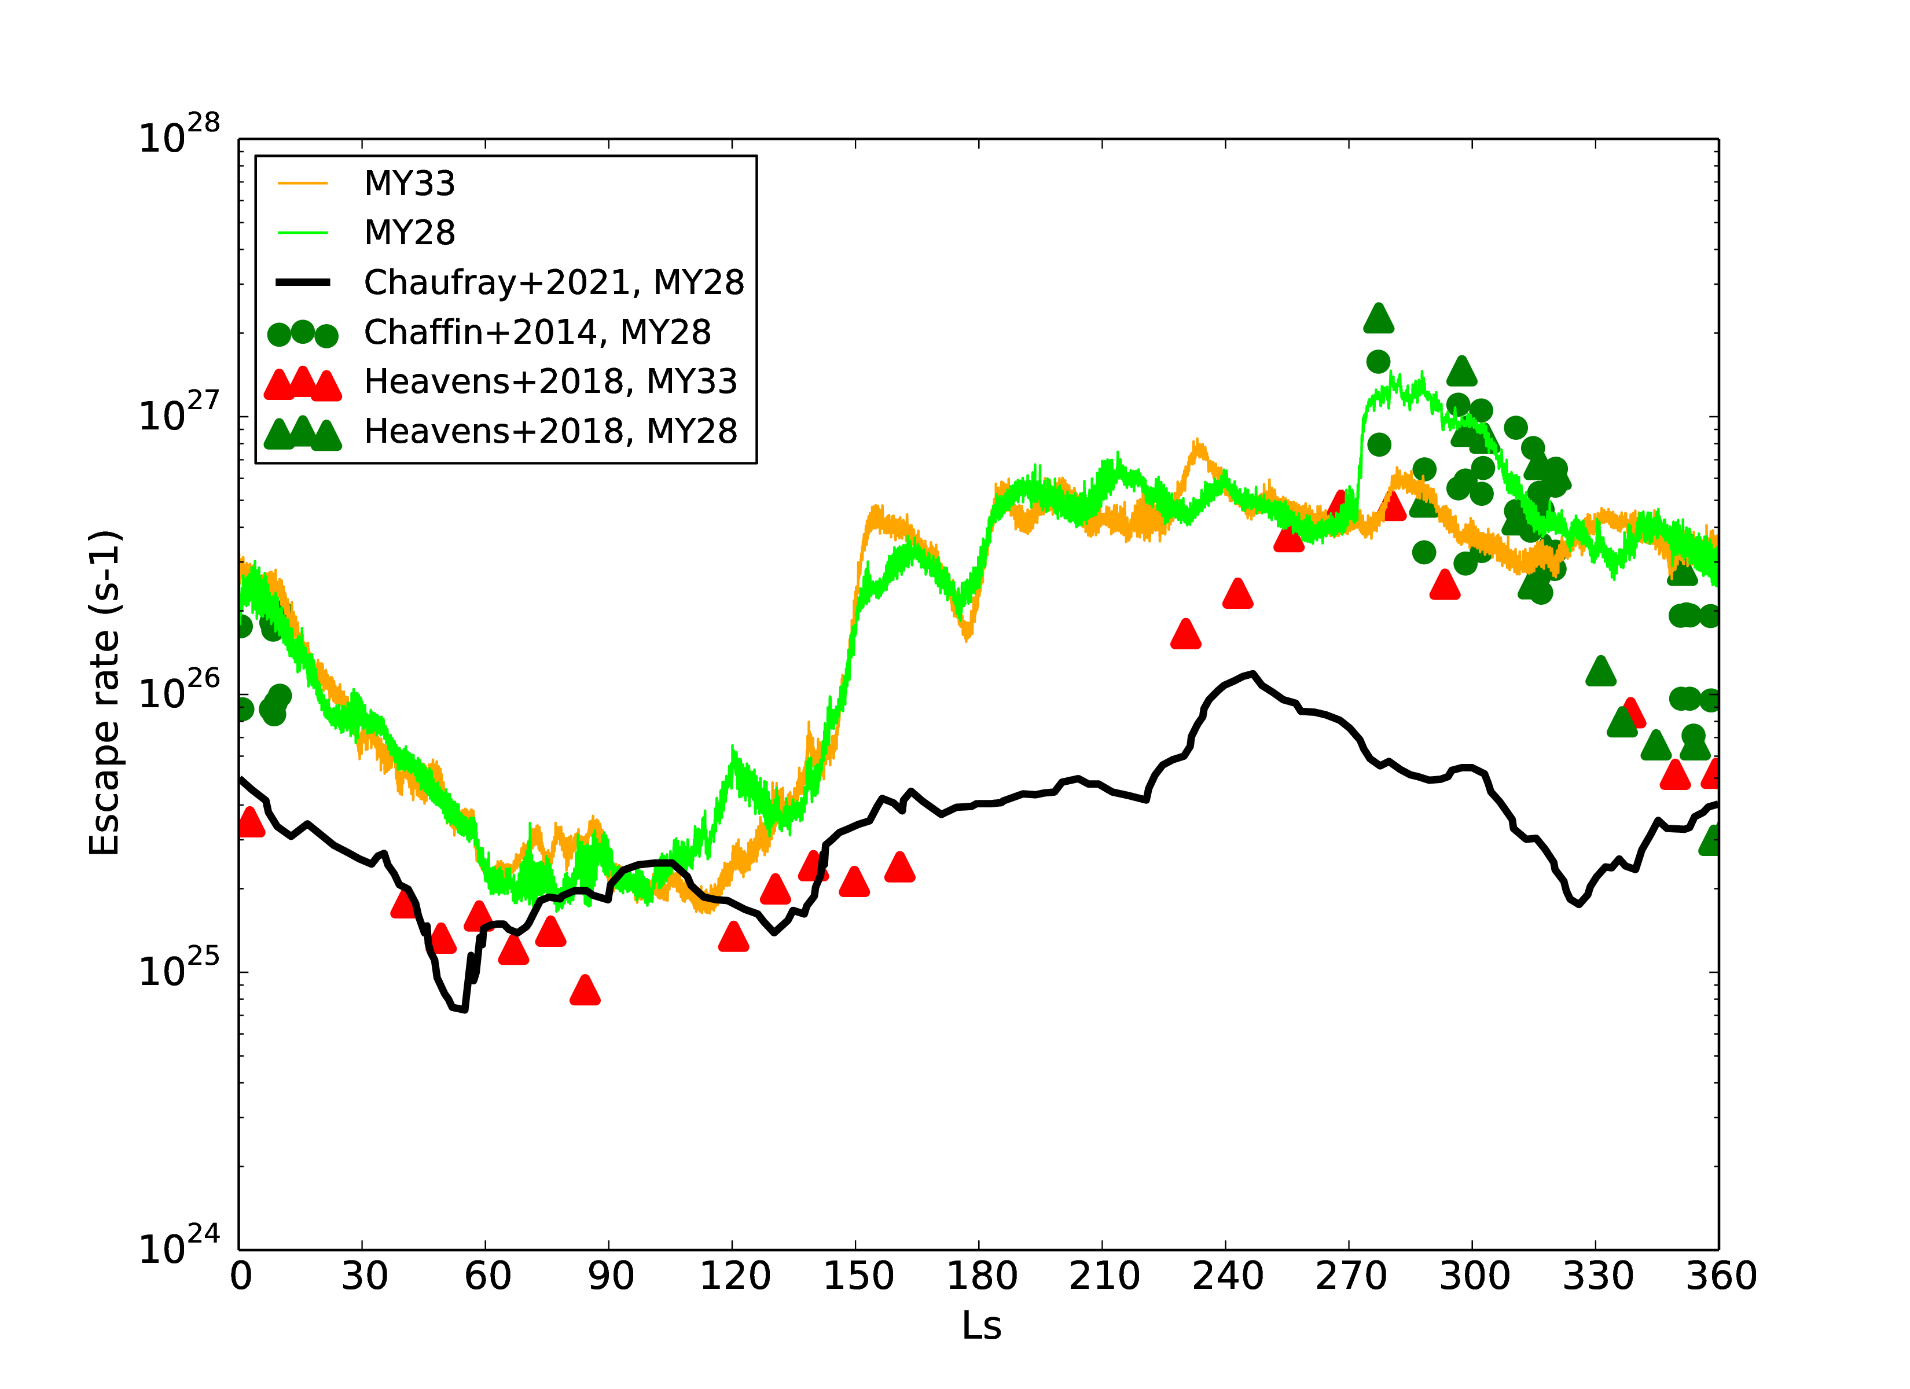
Recent improvements
(relevant for the upper atmosphere)
Update of the non-orographic GW parameterization described in Gilli et al. 2020
Coupling lower-upper atmosphere: inclusion of microphysics of water ice clouds
Incorporation of chemistry of H₂O+ and derived ions
Improved model deuterium fractionation (Vals et al. submitted)
Simulations:
LMDZ Mars GCM
Ground-to-exosphere 3D model
(~0-250 km)
Interannual variability of H escape
Water derived ions increase the escape rate by 20-40%
Water supersaturation main contribution in the second half of the year (up to 1 order of magnitude)
Some references:
Forget et al. (1999);
Madeleine et al. (2012);Navarro et al. (2014)
Gonzalez-Galindo et al. 2015,2021
Gilli et al. (2020)
Chaufray et al. (2021)
Credits: F. Gonzalez-Galindo
G.Gilli @ EGU 2022, Session PS9.1

Slide 7
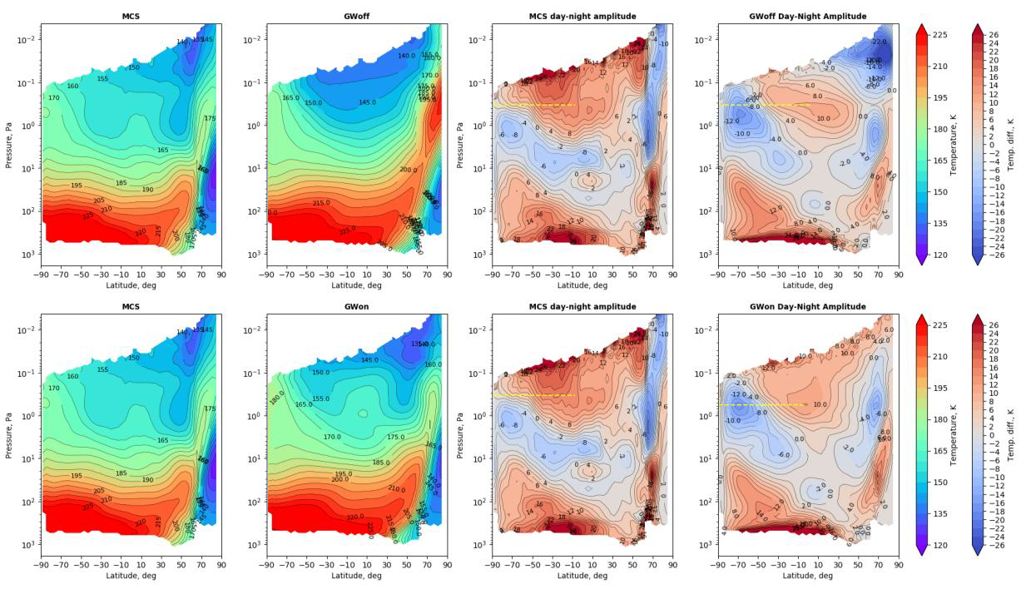
Thermal tides characterization
Mars Climate Sounder LMDZ MGCM
MY29 L_{s}= 240-270
SS
MT
AS
ET
SS
Non-orographic GW scheme OFF
- Amplitude and vertical phase of modelled thermal tides were systematically biased
Non-orographic GW scheme ON
primary effect of GW is to damp the thermal tides by reducing the diurnal oscillation of the meridional and zonal winds (as in Gilli et al. 2020)
the vertical phase is controlled by water/dust-cycle
the amplitude is controlled by non-orographic GW
Credits: J. Liu
G.Gilli @ EGU 2022, Session PS9.1

Slide 8
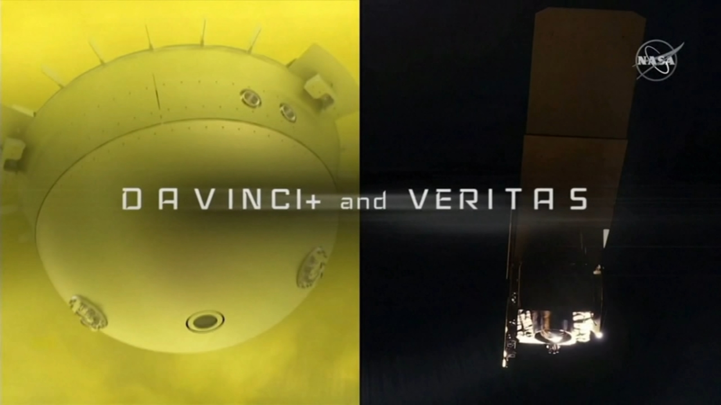


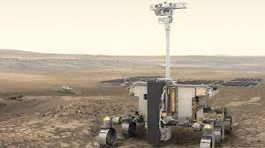

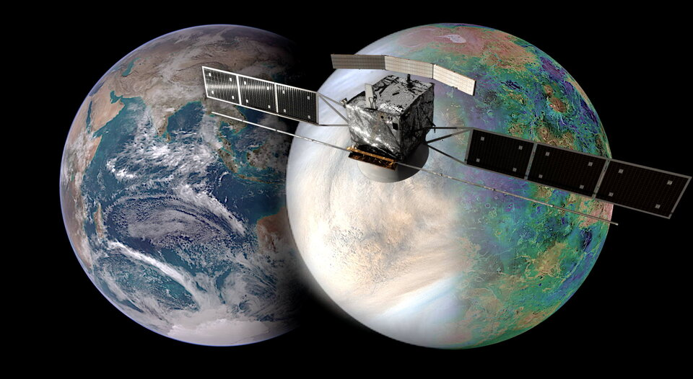

Take home message
GCMs are essential tools to interpret the upper atmosphere of Venus and Mars (usually poorly explored by observations)
The upper atmosphere is the main reservoir for atmospheric escape to space
Coupling deep-upper layers is crucial to reproduce the observed variability:
  (e.g. Convectively generated Gravity waves + Kelvin wave strongly impact the circulation, water/dust cycle on Mars, integration of microphysics module, etc)
  IPSL GCMs provide useful environmental predictions to analyse observations and/or prepare future missions:
  Mars climate Database
  Venus Climate database
G.Gilli @ EGU 2022, Session PS9.1

Slide 9
THANKS FOR YOUR ATTENTION
G.Gilli @ EGU 2022, Session PS9.1

Slide 10
EXTRA SLIDES
G.Gilli @ EGU 2022, Session PS9.1

Slide 11
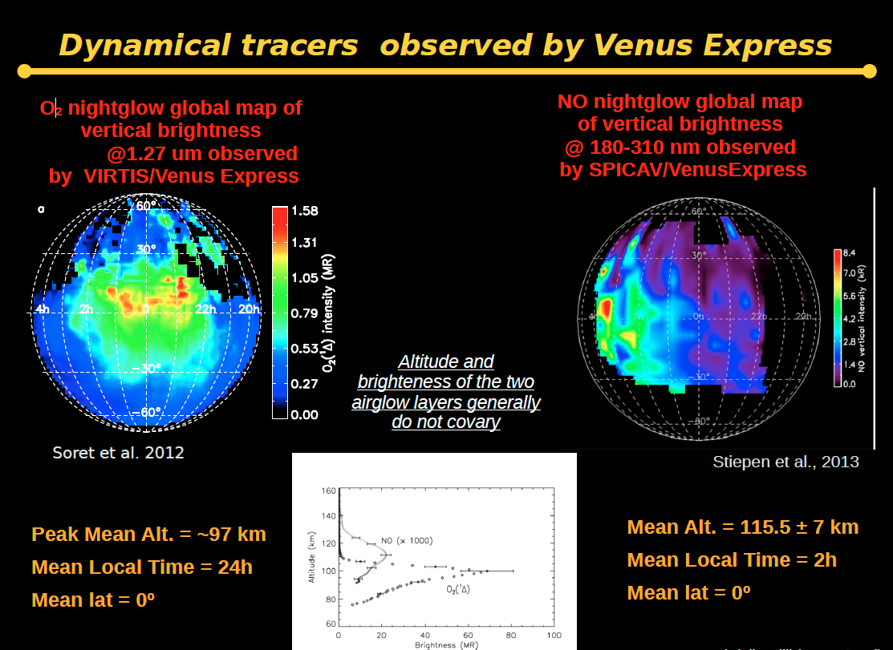

Slide 12
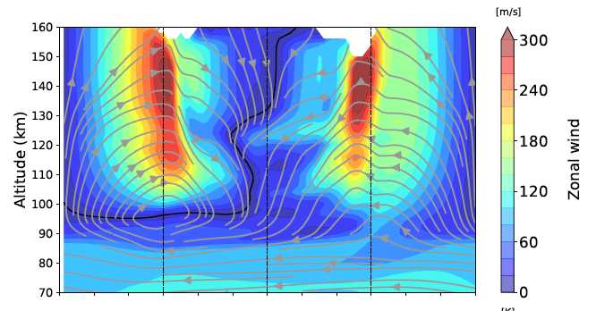
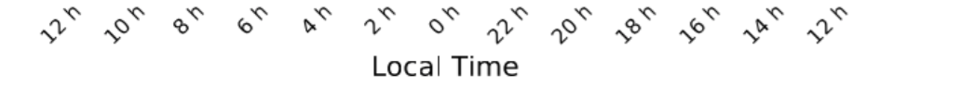
Zonal wind at the equator by the GCM
(averaged for 1 Venus day)
SS
MT
AS
ET
SS
Navarro et al. 2021
Black line: converging stagnation point (e.g. horizontal wind converges to zero) not located at the Anti-Solar point (as for a pure SS-AS flow) but shifted toward morning terminator (MT) (e.g Retrograde flow added around about 120 km)

Slide 13
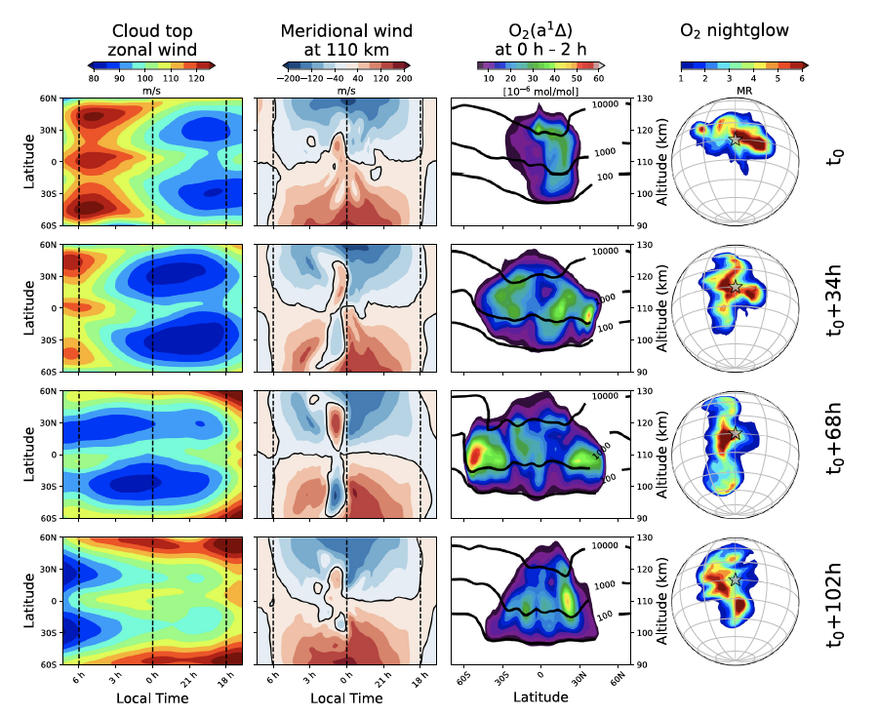
Navarro et al. 2021. Icarus
G.Gilli @ EGU 2022, Session PS9.1

Slide 14
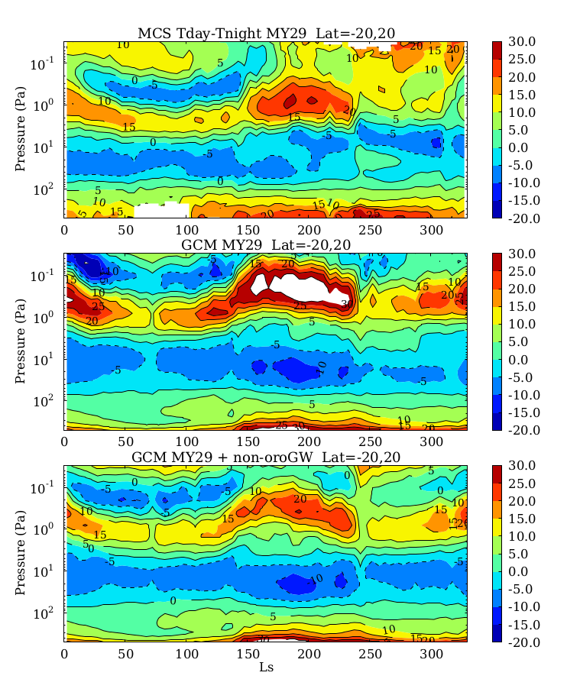
Seasonal variation of diurnal tide (tropical region)
Mars Climate Sounder (MCS) (observations)
no GW
Overall improvement in characterizing thermal tides above 10 Pa
with GW
Gilli et al. 2020, JGR
Notes:
This figures show the seasonal variation of diurnal tide in the tropical region, as function of pressure and solar longitude, for MY29.
considering that GW basic characteristics are highly unconstrained by observations, our strategy was to fine tune the key parameters by comparing GCM simulated temperature with data by Mars Climate Sounder, which are the best systematic temperature measurements in the middle atmosphere, so far.
Top panels is MCS data, and the middle and bottom panels are model simulations with and without the GW scheme . Above 10 Pa both the AMPLITUDE and the INTENSITY of the thermal tides were higher in model simulations without GW, and now they are better reproduced by the model when the GW scheme is on.
(This improvements in the thermal tides reflects a general improvement in the predicted thermal structure.)
However the impact on the temperature is relatively moderate 10-20 K compared with the impact on zonal winds.

Slide 15
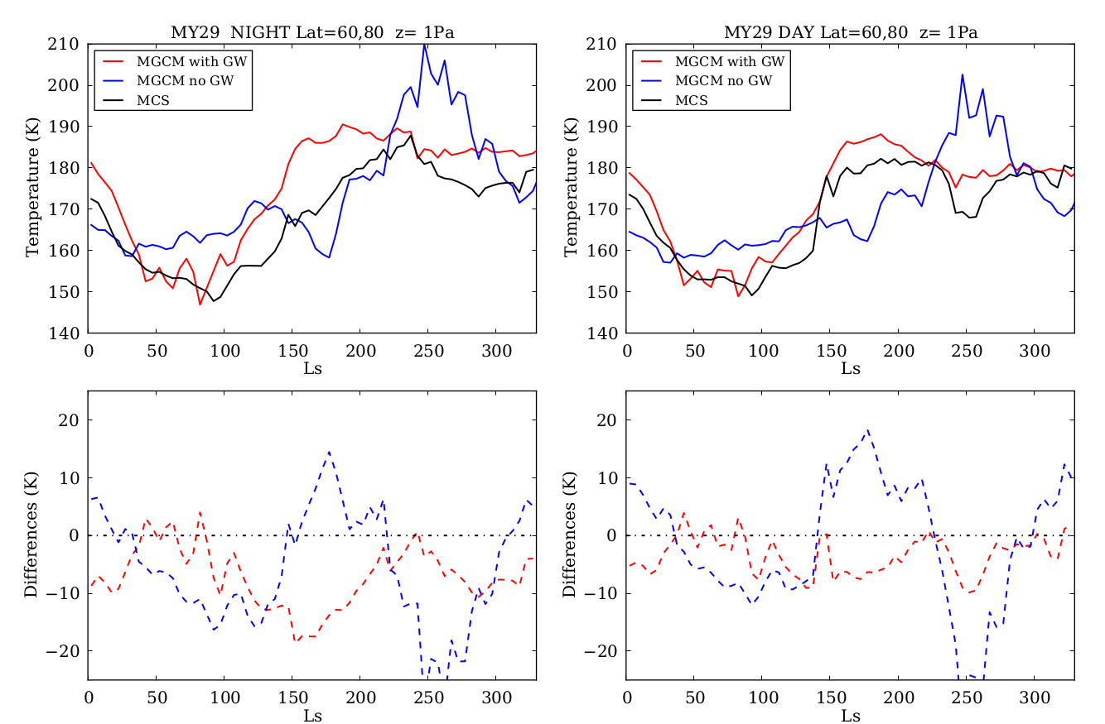
Seasonal variation of night/day T (@ Lat:60N-80N, z= 1Pa)
Night (LT=3:00)
Day (LT=15:00)
MCS-MGCM reduced up to 15 K with GW
(almost all seasons)
With GW
GW induced alteration of the meridional flow responsible for the simulated temperature variations
No GW
With GW
No GW
Gilli et al. 2020, JGR
G.Gilli @ EGU 2022, Session PS9.1

Slide 16
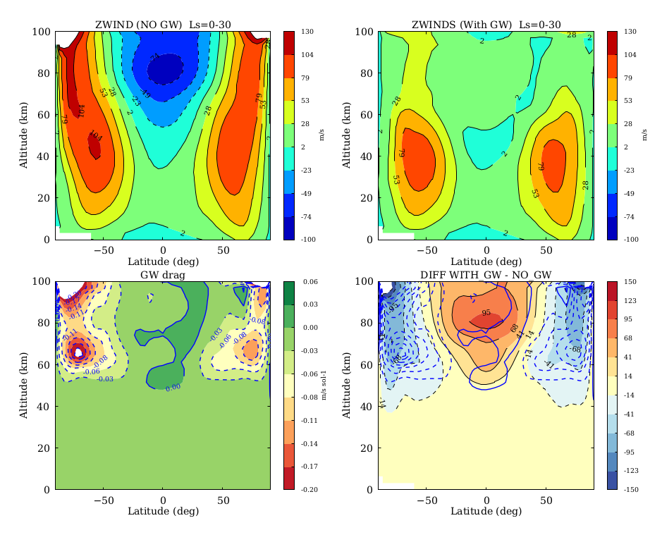
Impact of non-orographic GW drag on
simulated jet streams (example for NH Spring)
Mean U (no GW)
Mean U (with GW)
u>0 eastward (prograde)
For a given GW with phase speed c, the intrinsic speed |ῡ – c | is larger in presence of wind jets → stronger GW drag
Positive GW drag: aceleration
Negative GW drag: deceleration
Zonal Wind
Difference
GW drag
Gilli et al. 2020, JGR
Notes:
Top panels show the simulated mean zonal wind as function of altitude vs latitude are here, during NH spring, without and with the GW parameterization. Positive values are prograde winds.
The panels below show the GW drag and thw zonal wind differences. As you can see, the deposition of momentum occurs here above around 50 km and the effect is to decelerate the mid-high latitude wind jets in the NH spring.
For a given phase speed c, The drag is stronger in the presence of wind jets because the intrinsic speed is larger
Deceleration/Acceleration of wind jets above 50 km, up to 100 [m/s]
(current observations in those upper layers only indirect measurements derived from the thermal wind equation)

