Slide 1

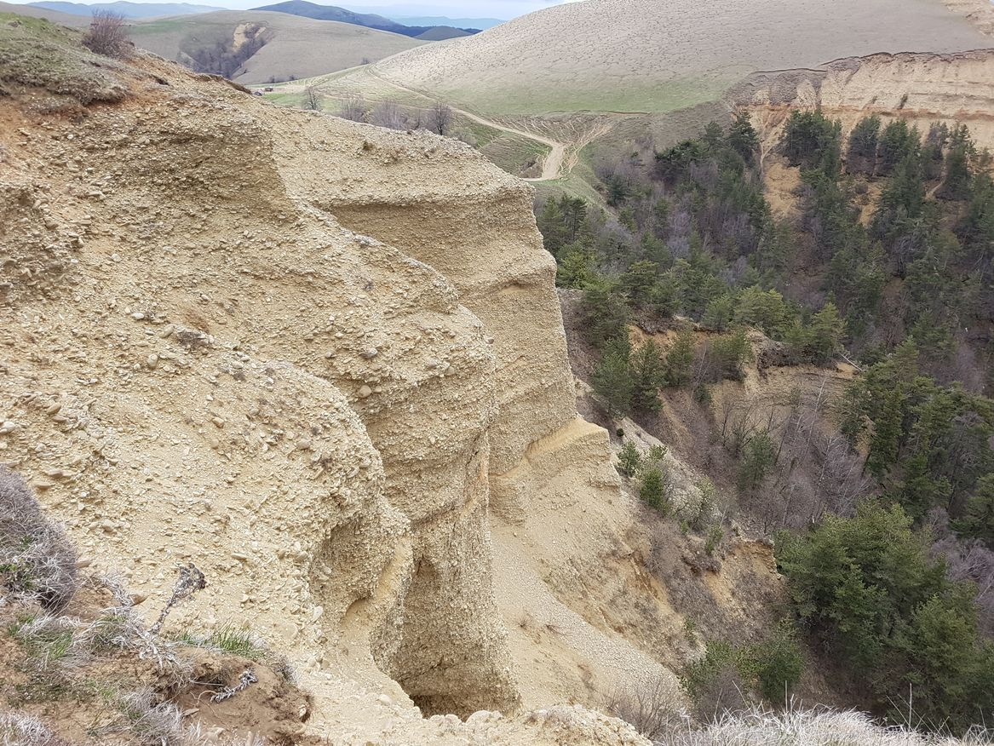


Reconstruction of Tectonically Driven Quaternary Fluvial Dynamics of the Western Kura Fold-Thrust Belt (Eastern Caucasus, Georgia)
EGU22-5691
Lasha Sukhishvili¹,
Giorgi Boichenko¹,
Giorgi Merebashvili¹,
Zurab Javakhishvili¹,
Adam M. Forte²,
Tea Godoladze¹
1. Institute of Earth Sciences and National Seismic Monitoring Network of Georgia, Ilia State University
^{2. Louisiana State University}
This work was supported by Shota Rustaveli National Science Foundation of Georgia (SRNSFG) FR-19-3211

Slide 2
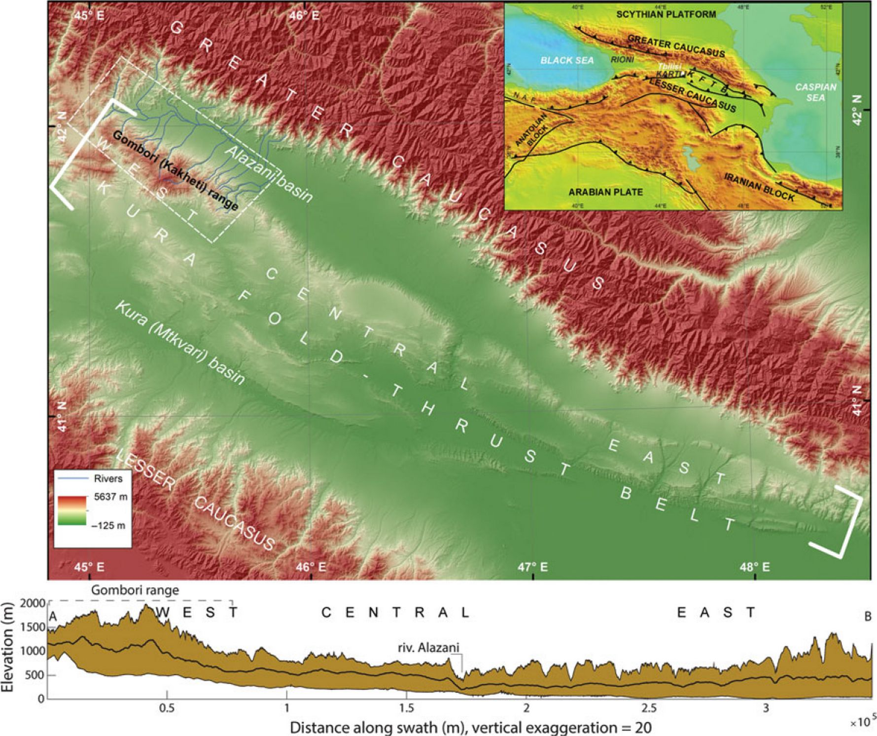
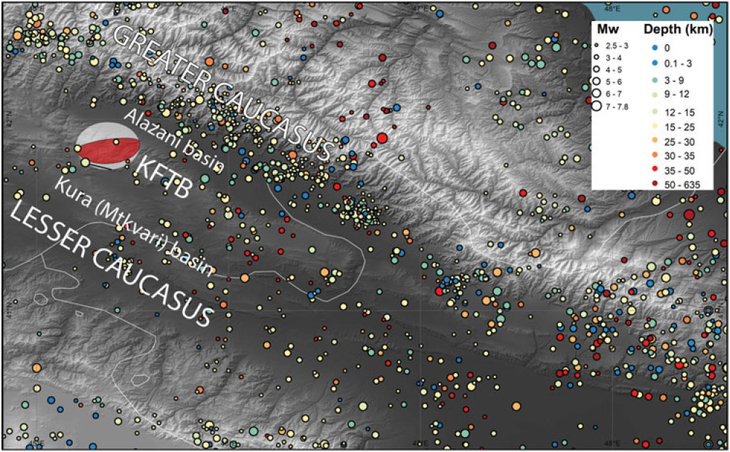
EGU22-5691
Sukhishvili et al. 2020
1
This work was supported by Shota Rustaveli National Science Foundation of Georgia (SRNSFG) FR-19-3211
Notes:
Since Plio-Pleistocene time, southward migration of shortening in the eastern part of the Greater Caucasus into the Kura foreland basin has progressively formed the Kura fold–thrust belt and Alazani piggyback basin, which separates the belt from the Greater Caucasus.
Here we investigate tectonically driven Quaternary fluvial dynamics of the Western Kura Fold-Thrust Belt, which is also known as Gombori Range.
Seismic data as well as analyses of

Slide 3
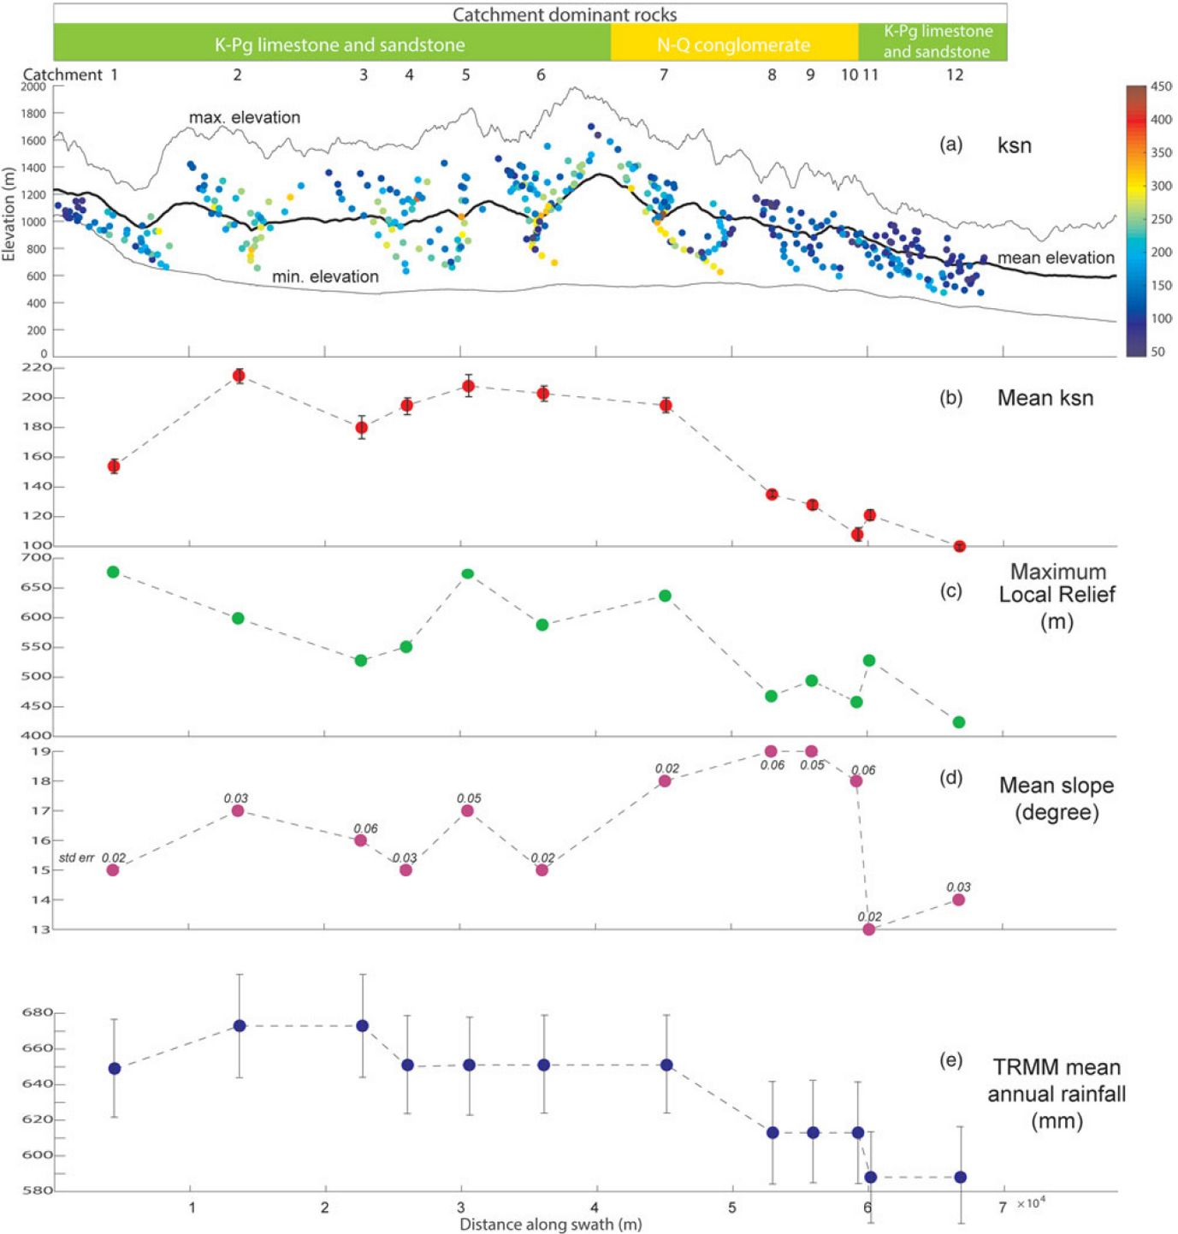
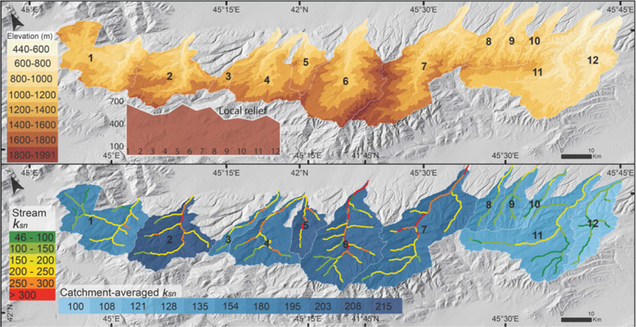
EGU22-5691
Sukhishvili et al. 2020
2
This work was supported by Shota Rustaveli National Science Foundation of Georgia (SRNSFG) FR-19-3211
Notes:
tectonic geomorphologic proxies indicate that the range is experiencing significant deformations during Quaternary, until recently. Our previous studies bracketed timing of initiation of deformation of Gombori range and it was estimated about 2.7Ma – 1.0Ma years.

Slide 4
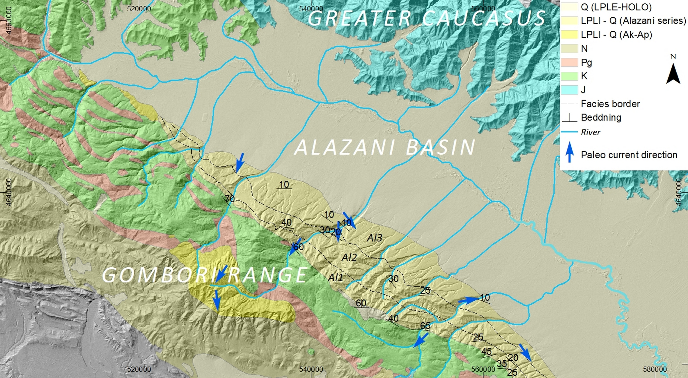
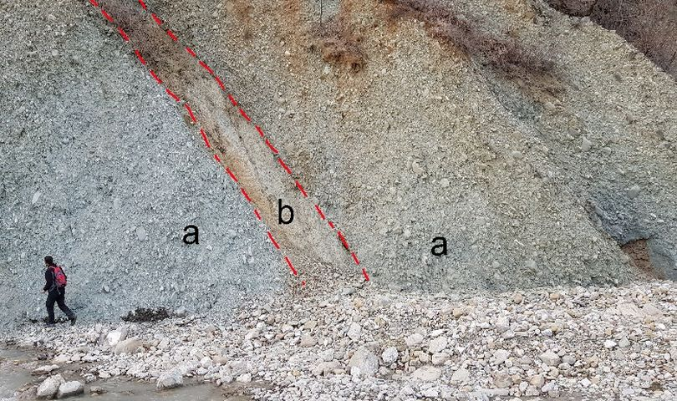
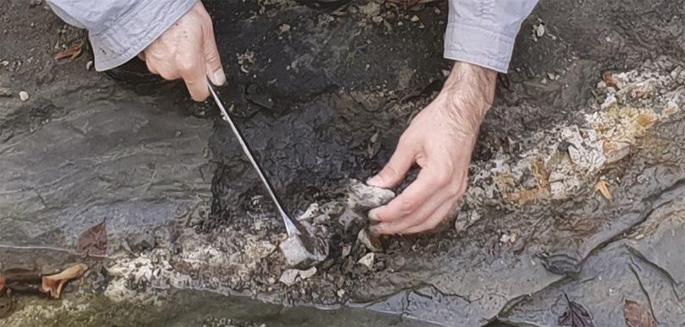
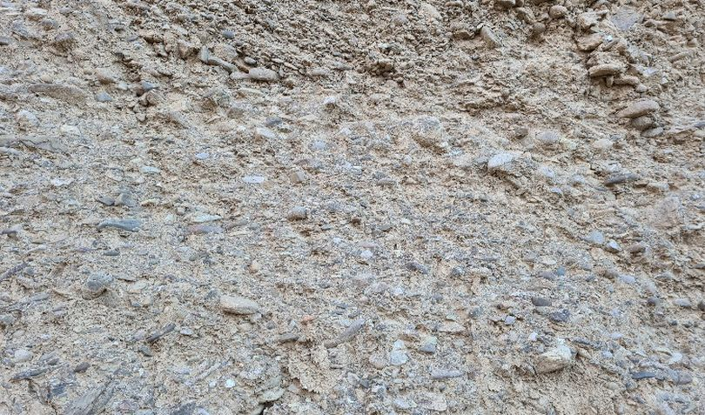
EGU22-5691
Alazani 1
Alazani 2
Alazani 3
3
This work was supported by Shota Rustaveli National Science Foundation of Georgia (SRNSFG) FR-19-3211
Notes:
The range itself is built by Cretaceous, Paleogene, Neogene and Quaternary sediments. The Northern slopes are dominantly covered by the sediments of Alazani suites, which is part of Akchagyl-Apsheronian stages. The suite has three facies. The oldest age is estimated as 2.7 Ma, while the youngest is younger than 1.0 Ma. The oldest (Alazani 1) and the youngest (Alazani 3) are represented by coarse grained alluvial conglomerates, and the middle Alazani 2 has fine grained, lacustrine-like sediments.

Slide 5
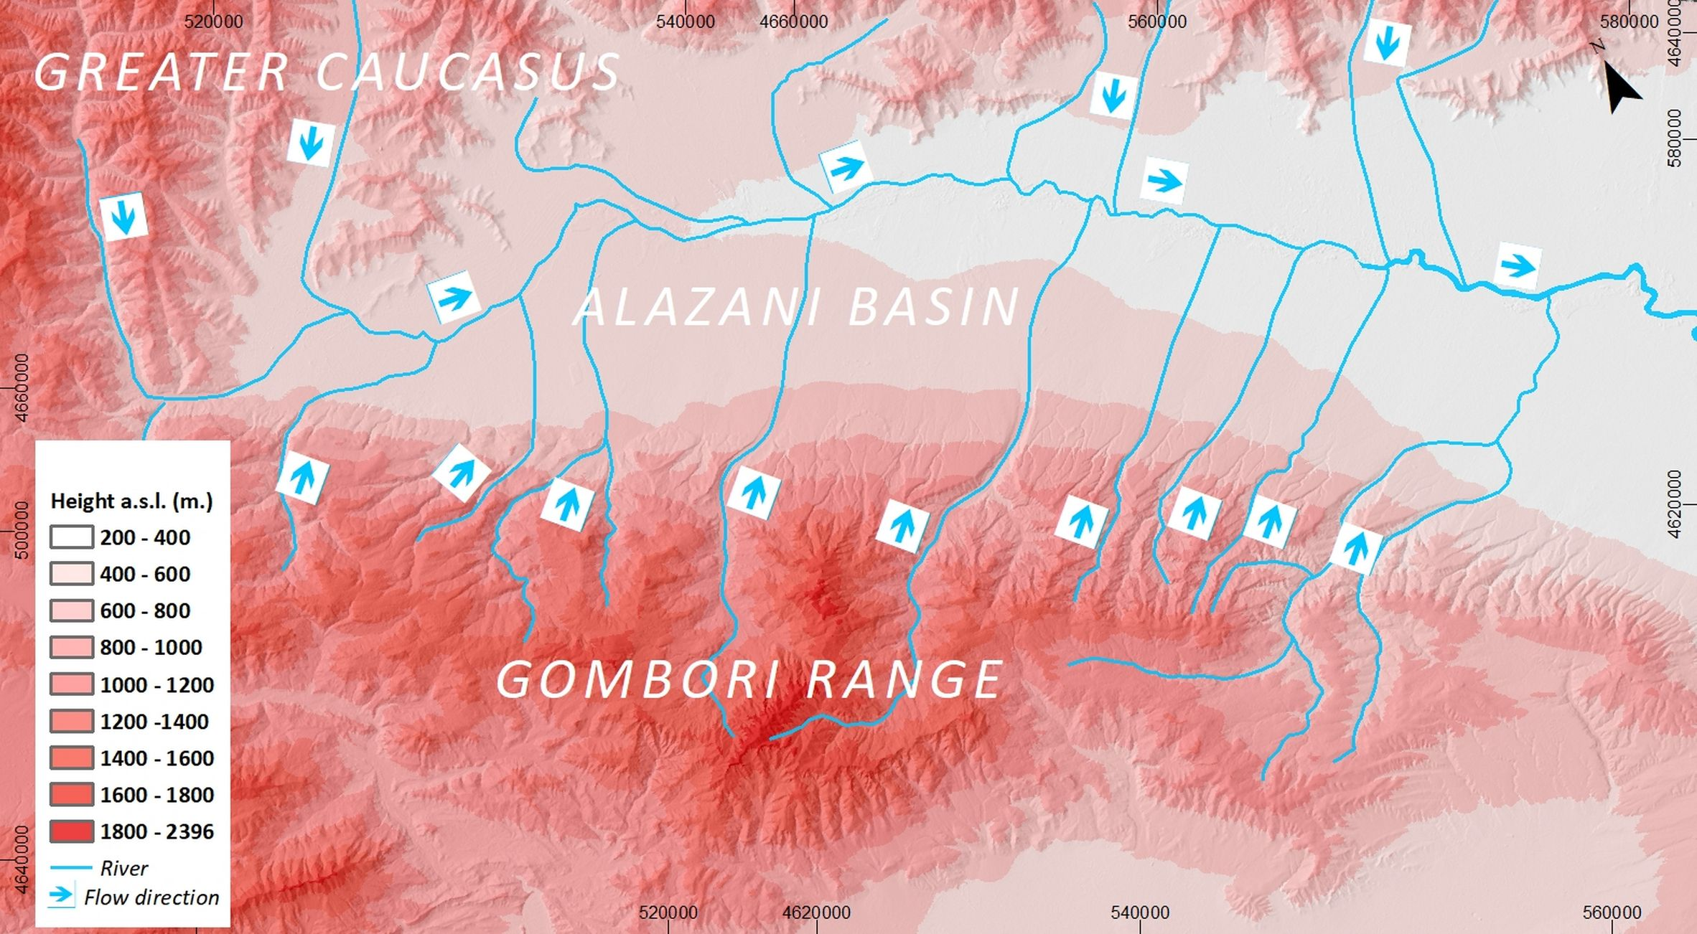
EGU22-5691
4
This work was supported by Shota Rustaveli National Science Foundation of Georgia (SRNSFG) FR-19-3211
Notes:
The geometry of the present day fluvial system is governed by Greater Caucasus (with rivers flowing to the South and South-West), Gombori range (rivers flowing towards the Greater Caucasus, which is North-East) and Alazani basin where rivers from both systems merge and contribute to Eastward flowing Alazani river.

Slide 6
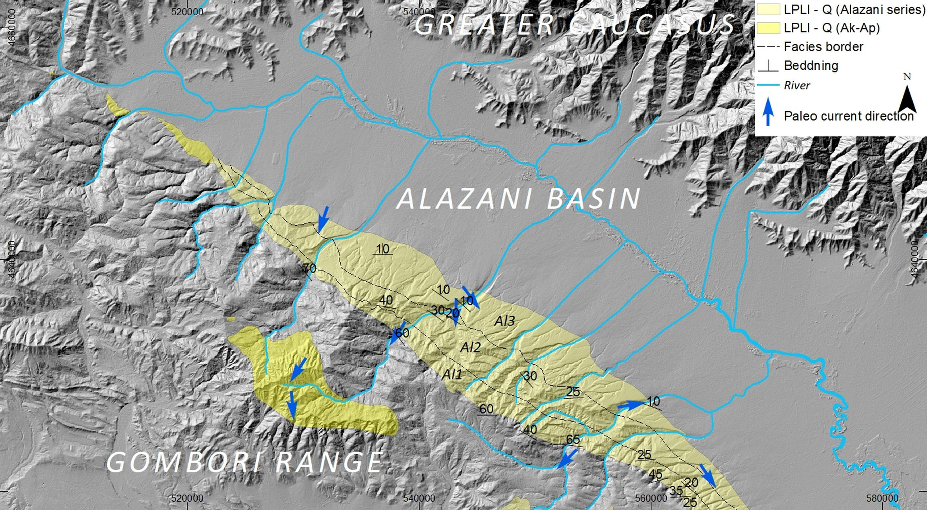
EGU22-5691
5
This work was supported by Shota Rustaveli National Science Foundation of Georgia (SRNSFG) FR-19-3211
Notes:
Paleo current analyses performed at the outcrops of Alazani series and other Akchagyl-Apsheronian sediments of Gombori range revealed opposite flowing direction of the streams forming these sediments.

Slide 7
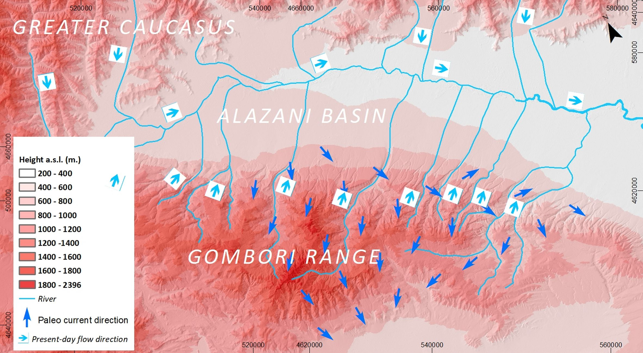
Interpolated flowing directions of the paleo streams
EGU22-5691
6
This work was supported by Shota Rustaveli National Science Foundation of Georgia (SRNSFG) FR-19-3211
Notes:
Instead of expected North East directions (as present day rivers course) we`ve got the results of dominantly Southward directions, which hints to the great scale fluvial dynamic and river system reorganization.

Slide 8
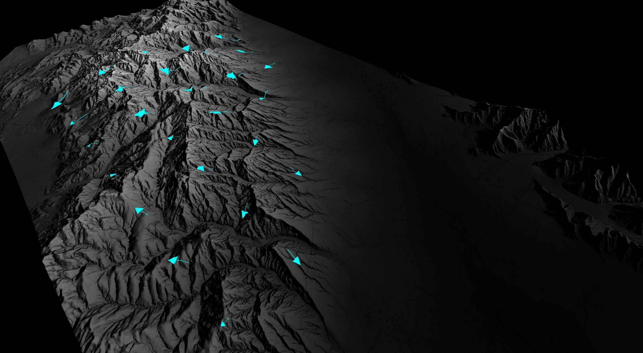
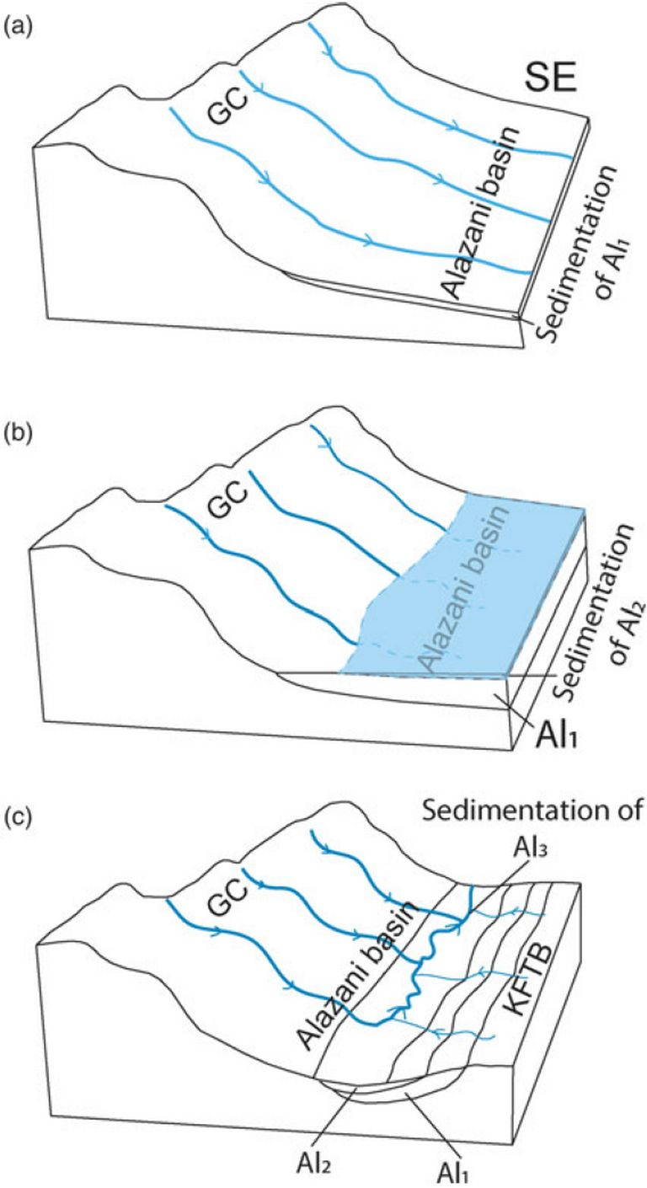
Present-day interpolated flowing direction
EGU22-5691
Interpretation
Sukhishvili et al. 2020
7
This work was supported by Shota Rustaveli National Science Foundation of Georgia (SRNSFG) FR-19-3211
Notes:
Our interpretation of the fluvial system evolution is following: During the deposition of Alazani 1, rivers draining from the Greater Caucasus were still able to flow directly south across what is now the KFTB. (b) Alazani 2 represents deposition in a lacustrine setting, which could relate to damming of rivers by growth of the KFTB, or could be related to broader, basin-wide changes in base level. (c) By the time of deposition of Alazani 3, the river network in the northwestern KFTB had developed into something similar to the modern situation, with rivers draining northward out of the Gombori range.

Slide 9
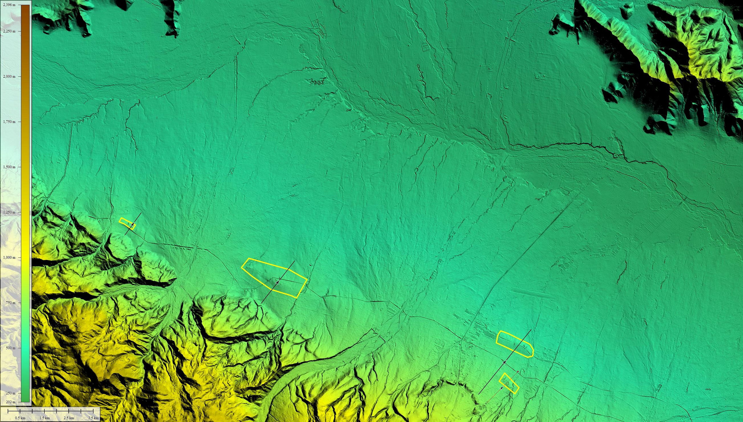
EGU22-5691
8
This work was supported by Shota Rustaveli National Science Foundation of Georgia (SRNSFG) FR-19-3211
Notes:
Beside seismic activity, we tried to get additional neotectonic footprints of region`s tectonic deformation and as a result of field survey and DEM analyses these interesting, almost linear aligned features were identified. These 5-10 meter height ridges are preserved at the areas protected from the alluvial fans` wiping influences and, even though we do not have a straight evidence, but it seems Quaternary or recent sediments are deformed as well.

Slide 10
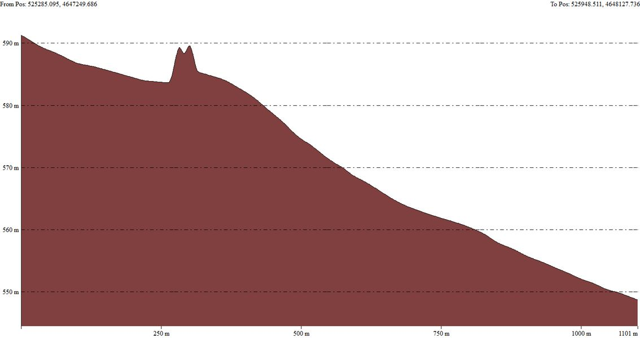
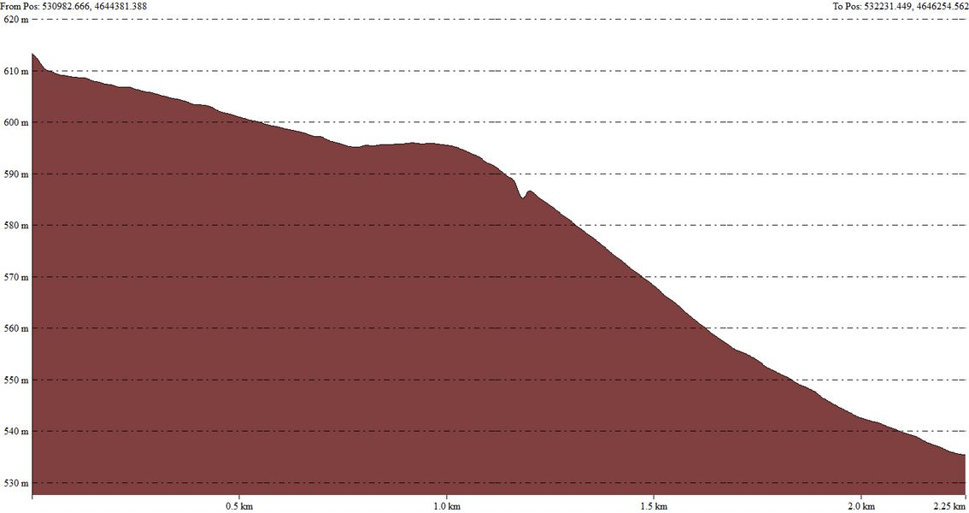
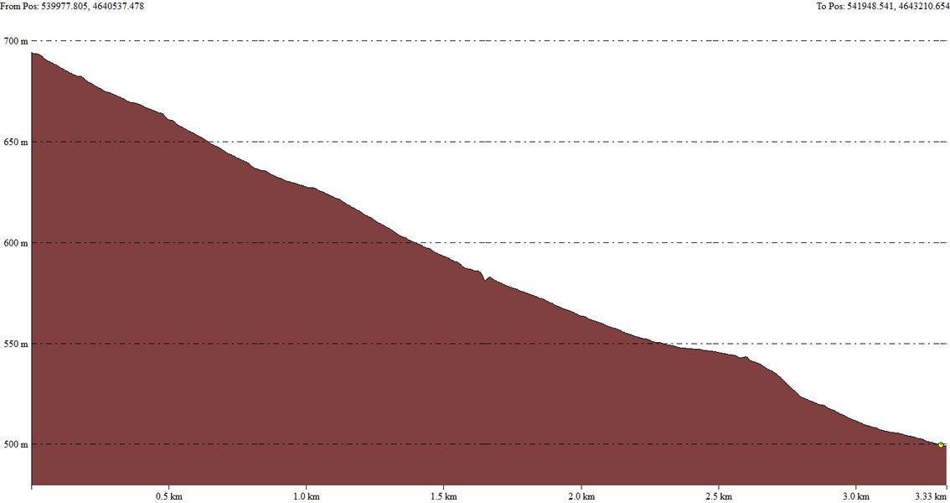
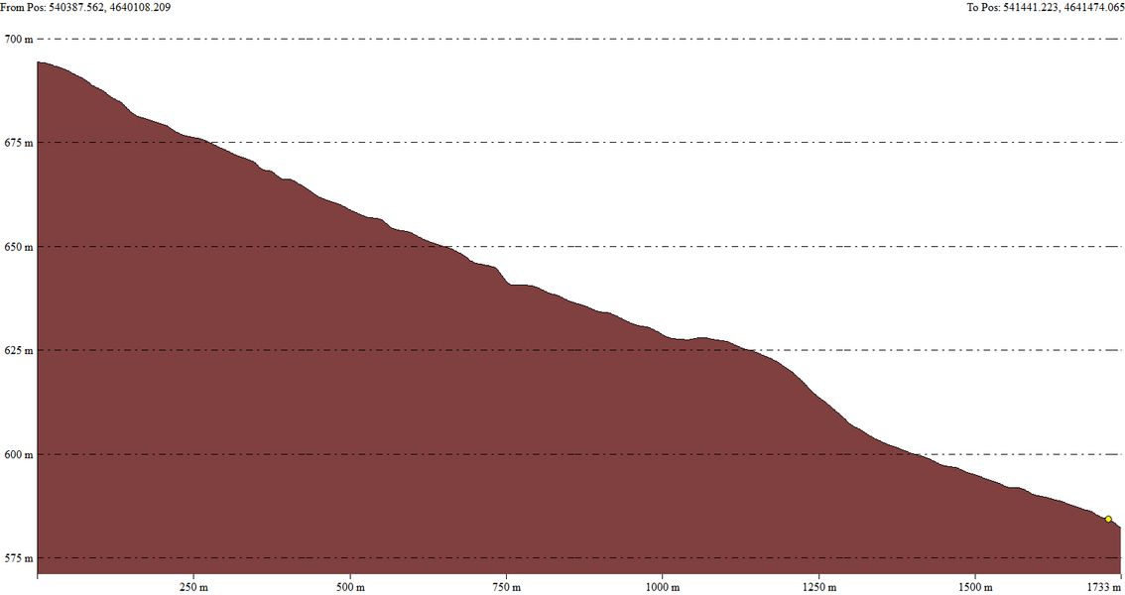
EGU22-5691
9
This work was supported by Shota Rustaveli National Science Foundation of Georgia (SRNSFG) FR-19-3211
Notes:
You can see these little bumps at topographical cross sections

Slide 11
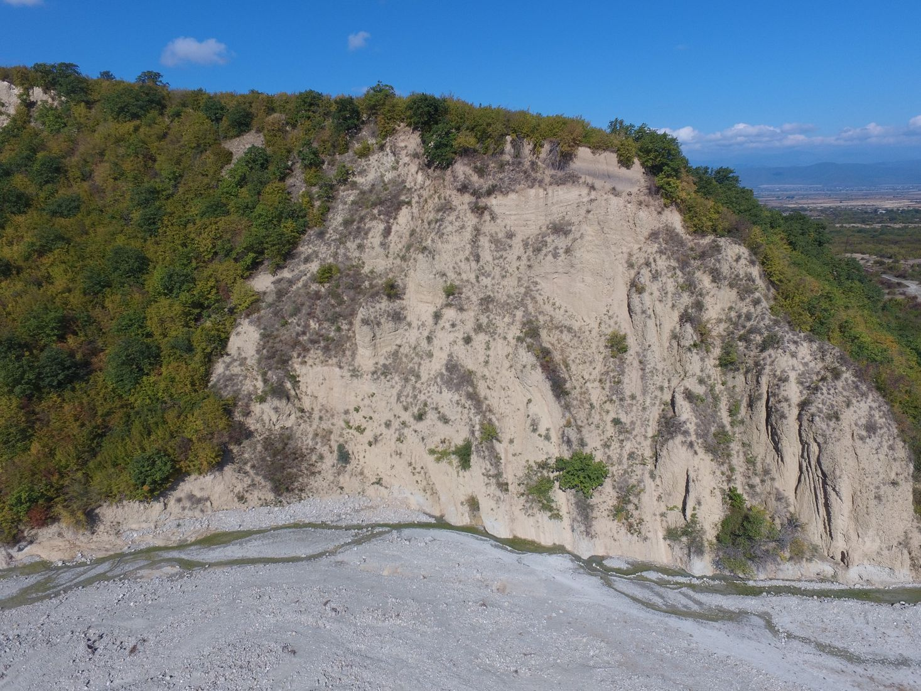
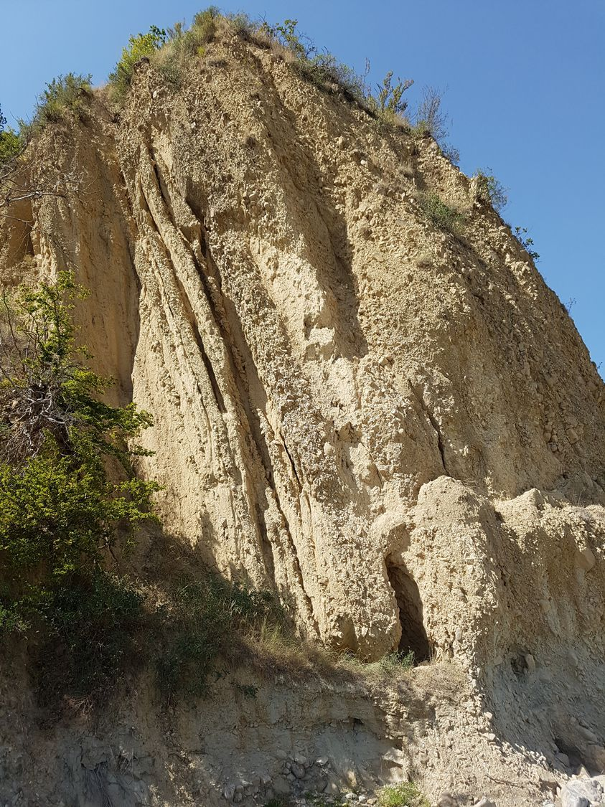
EGU22-5691
13
This work was supported by Shota Rustaveli National Science Foundation of Georgia (SRNSFG) FR-19-3211
Notes:
Additionally, we`ve found this 60 meter-height fold, deforming Alazani 3 facies and probably most recent sediments, that in combination with those ridges hints us to interpret as an active fault propagation fold.

Slide 12
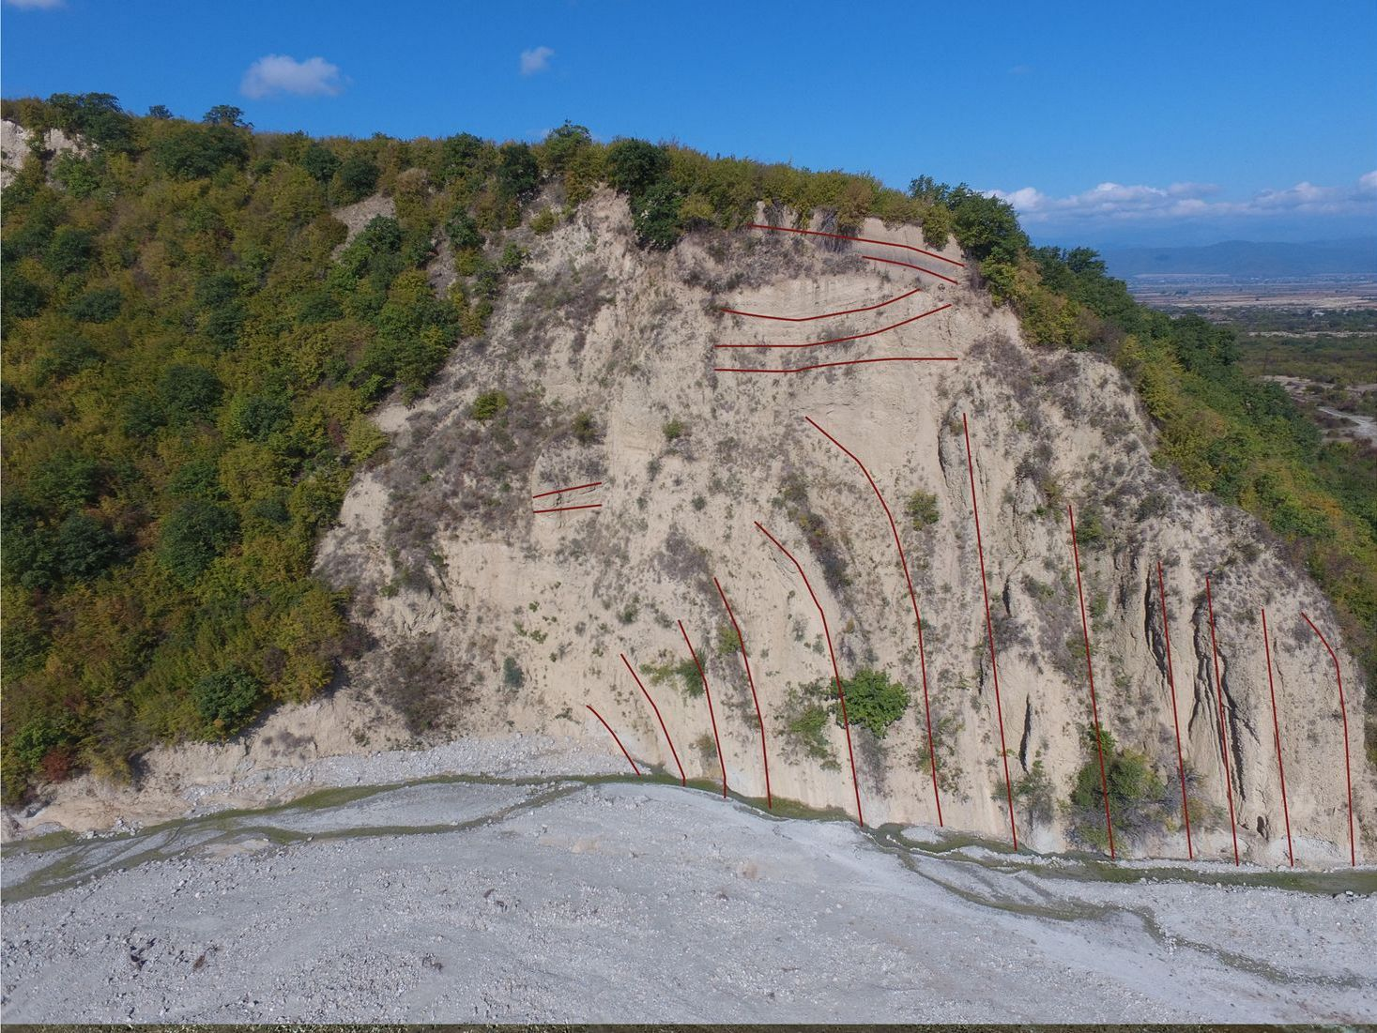
EGU22-5691
14
This work was supported by Shota Rustaveli National Science Foundation of Georgia (SRNSFG) FR-19-3211

Slide 13

EGU22-5691
15
This work was supported by Shota Rustaveli National Science Foundation of Georgia (SRNSFG) FR-19-3211

Slide 14
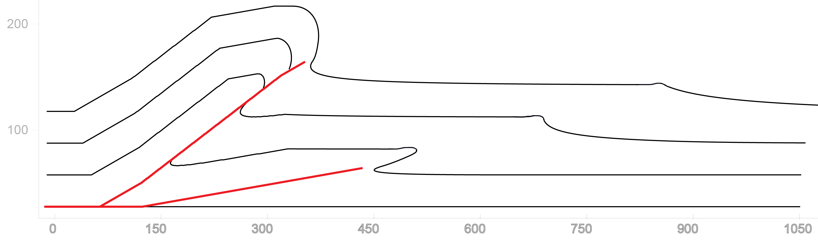

EGU22-5691
16
This work was supported by Shota Rustaveli National Science Foundation of Georgia (SRNSFG) FR-19-3211

Slide 15
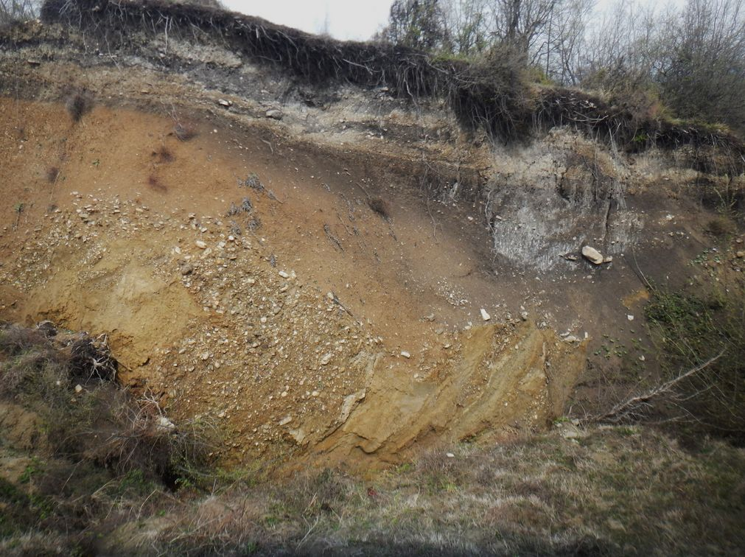
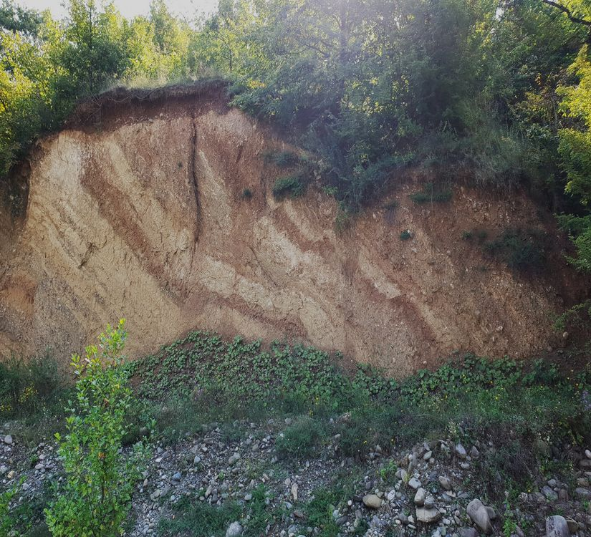
EGU22-5691
Landslides? Fault zones? Both?
17
This work was supported by Shota Rustaveli National Science Foundation of Georgia (SRNSFG) FR-19-3211
Notes:
There are other interesting features in the same region, along the same line, but they are the matters of upcoming researches, including dating of these deformations and geophysical screening

Slide 16
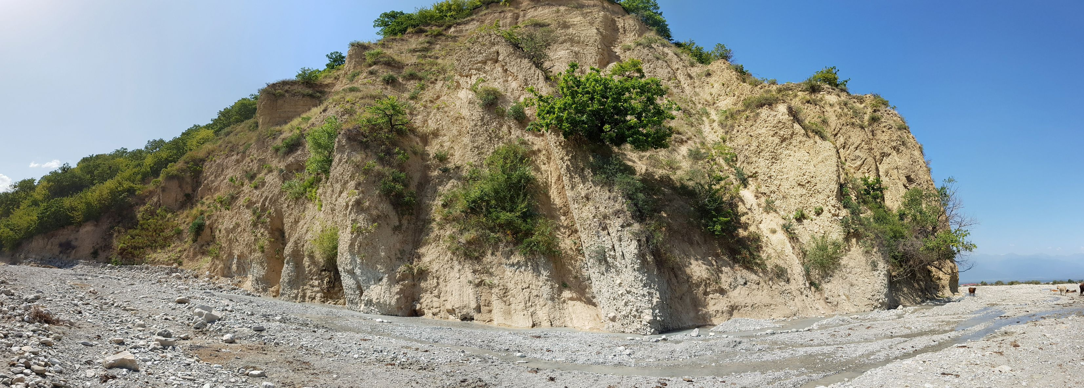
EGU22-5691
Thank You
17
This work was supported by Shota Rustaveli National Science Foundation of Georgia (SRNSFG) FR-19-3211

