Slide 1




Quantum navigation with multi-axis atomic interferometry and hybrid sensing
Yueyang Zou
Institut für Quantenoptik, Leibniz Universität Hannover
*zou@iqo.uni-hannover.de
Institute of Quantum Optics

Slide 2
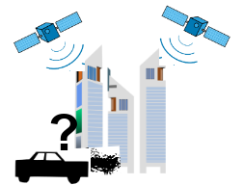
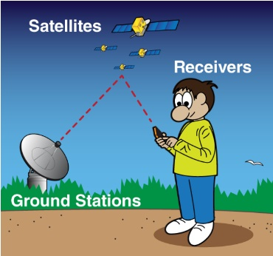

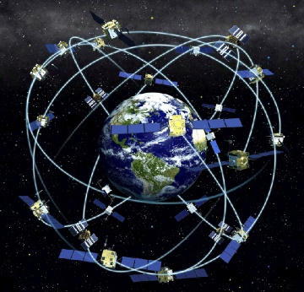
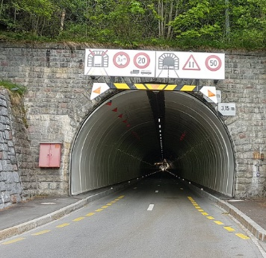
Autonomous Inertial Navigation
Inertial navigation:
Inertial measurements backbone for highly accurate trajectory determination
GNSS corrections inertial measurement units
But! No GNSS available in some areas
If there is no GNSS – You rely on inertial navigation!

Slide 3
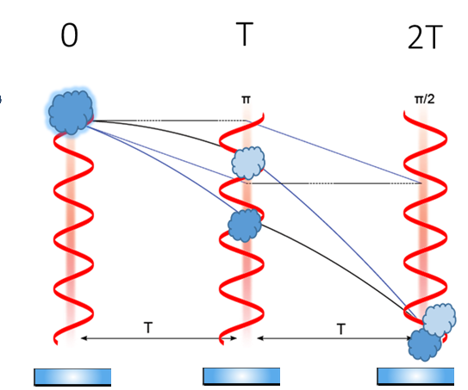




Inertial Sensing with Cold Atoms
Mach-Zehnder Atom Interferometer
Signal:
$$P_{1}\left(Δφ\right)=\frac{N_{1}}{{(N}_{1}+N_{0})}=\frac{1}{2}+A∙cos\left(Δφ\right)+P_{0}$$
Gravitation:
$$∆φ_{g}={\vec{k}}_{eff}\vec{g}T^{2}$$
Contrast:
$$C=\frac{A}{P_{0}}$$
Earth rotation :
$$∆φ_{Ω_{E}}=2{\vec{Ω}}_{E} ({\vec{k}}_{eff}×{\vec{v}}_{at})T^{2}$$

Slide 4

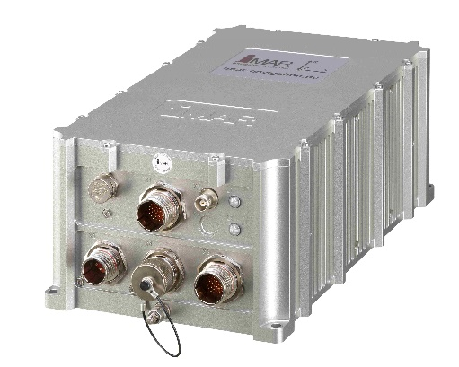
Quantum Hybrid Navigation Systems
Classical IMUs
Atom Interferometer
Hybridization
+
+
F(a, Ω)
Data
magic
S
Position determination,
Kalman filters,
Bias Estimator
[iMAR Navigation]
@ 0,1 - 10 Hz
@ 200-400 Hz
Combination of different systems:
Classic inertial sensors show device-dependent drifts and bias
Atomic interferometers have small repetition rates and low dynamic bandwidths
Hybrid approach: Both sensors are combined to determine trajectories

Slide 5
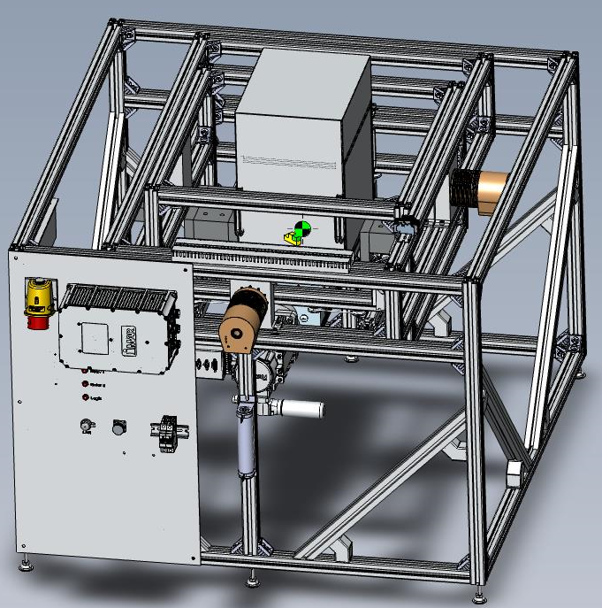

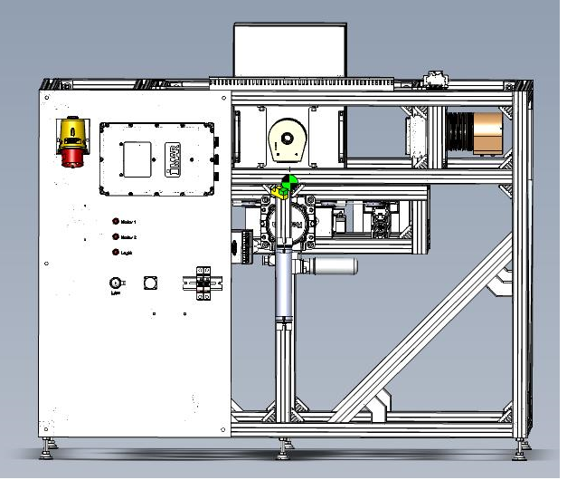
Hybrid Navigation Solution
1277mm
900mm
iMAR stabilized platform
1190mm
Simulated dynamic environments in lab
Sensor fusion with classical IMU
Perform translation movement along x-axis
Perform tilt movements around x-y axis

Slide 6
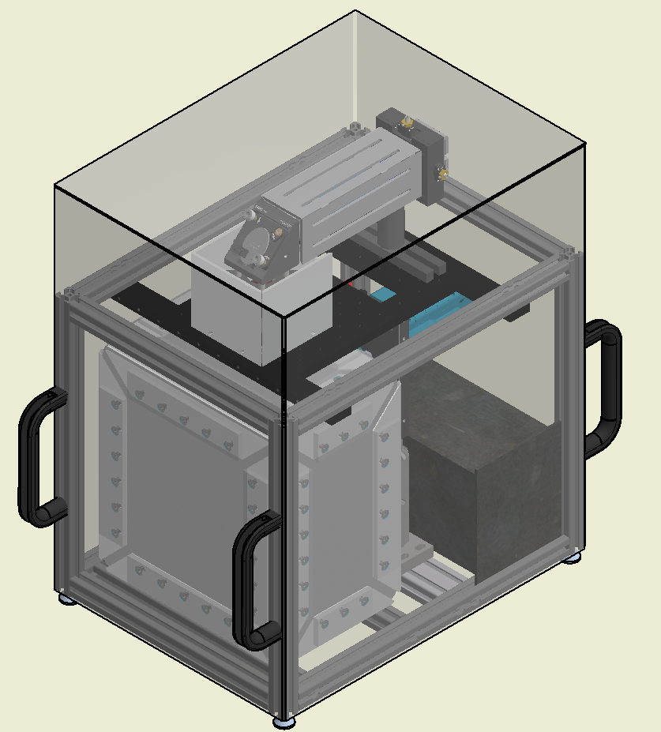
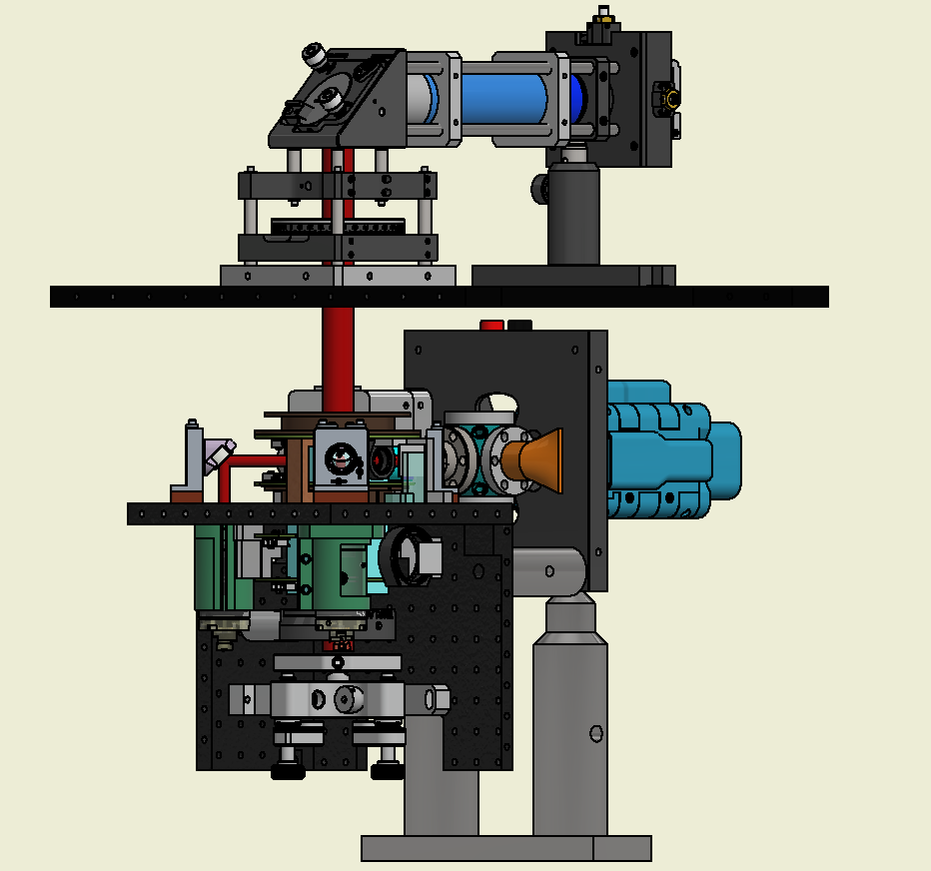
The Sensor Head
Weight:28kg
Unit: mm
382,00
286,00
Raman telescope
LCVR
400,00
3D MOT
2D MOT
Coldquanta
Vacuum system
g
Detection
Piezo electric mirror

Slide 7
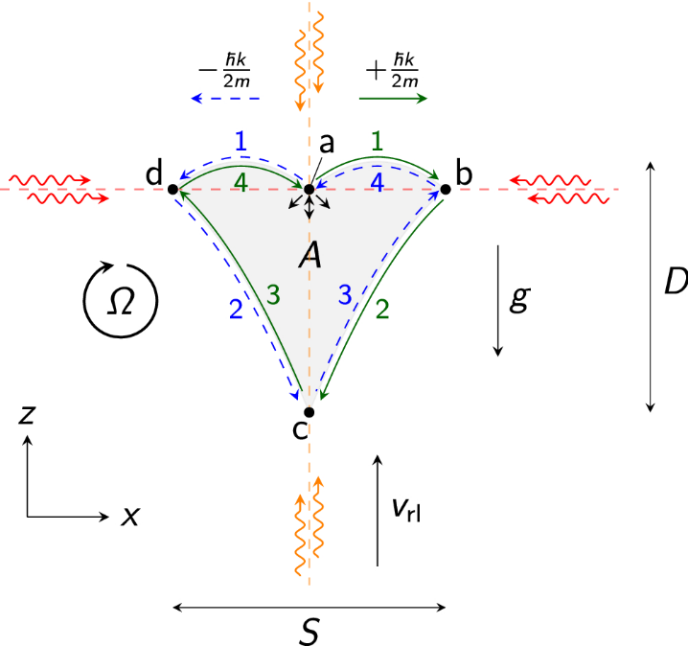
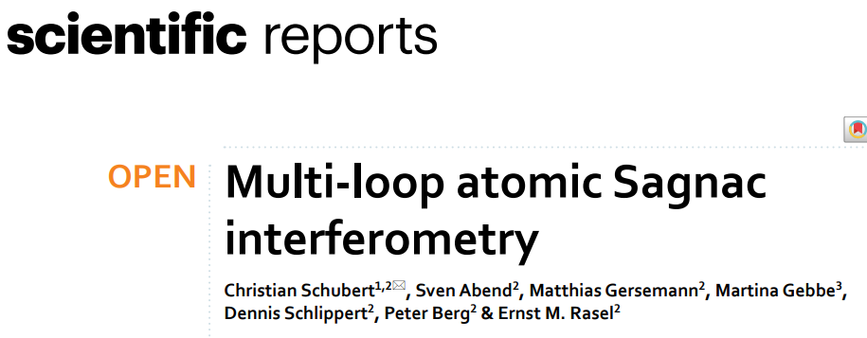
Large area gyroscope with BEC interferometry
New multi-loop geometry:
Beam splitter is based on the twin lattice
Fountain geometry as in the atomic chip gravimeter
Notes:
Atomic chip
Multi-loop atomic Sagnac interferometry Schubert et al. 2021 Sci. Rep. 11 16121
The twin lattice is formed by retroreflecting light featuring two frequencies with linear orthogonal polarization.

Slide 8

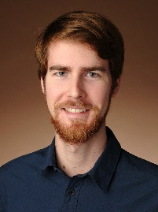
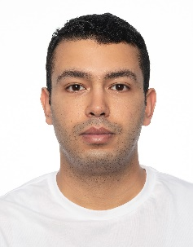
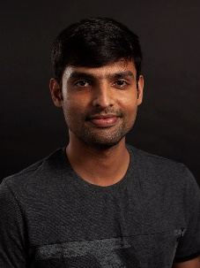



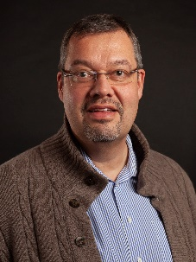








Thank you and acknowledgments
Yueyang
Zou
Philipp
Barbey
Mouine
Abidi
Ashwin
Rajagopalan
Sven
Abend
Christian
Schubert
Dennis
Schlippert
Ernst M.
Rasel
Thank for your attention!
This work is supported by the Federal Ministry of Economics and Climate Protection (BMWK)
due to an enactment of the German Bundestag under Grand No. DLR 50RK1957 (QGyro).

Slide 9
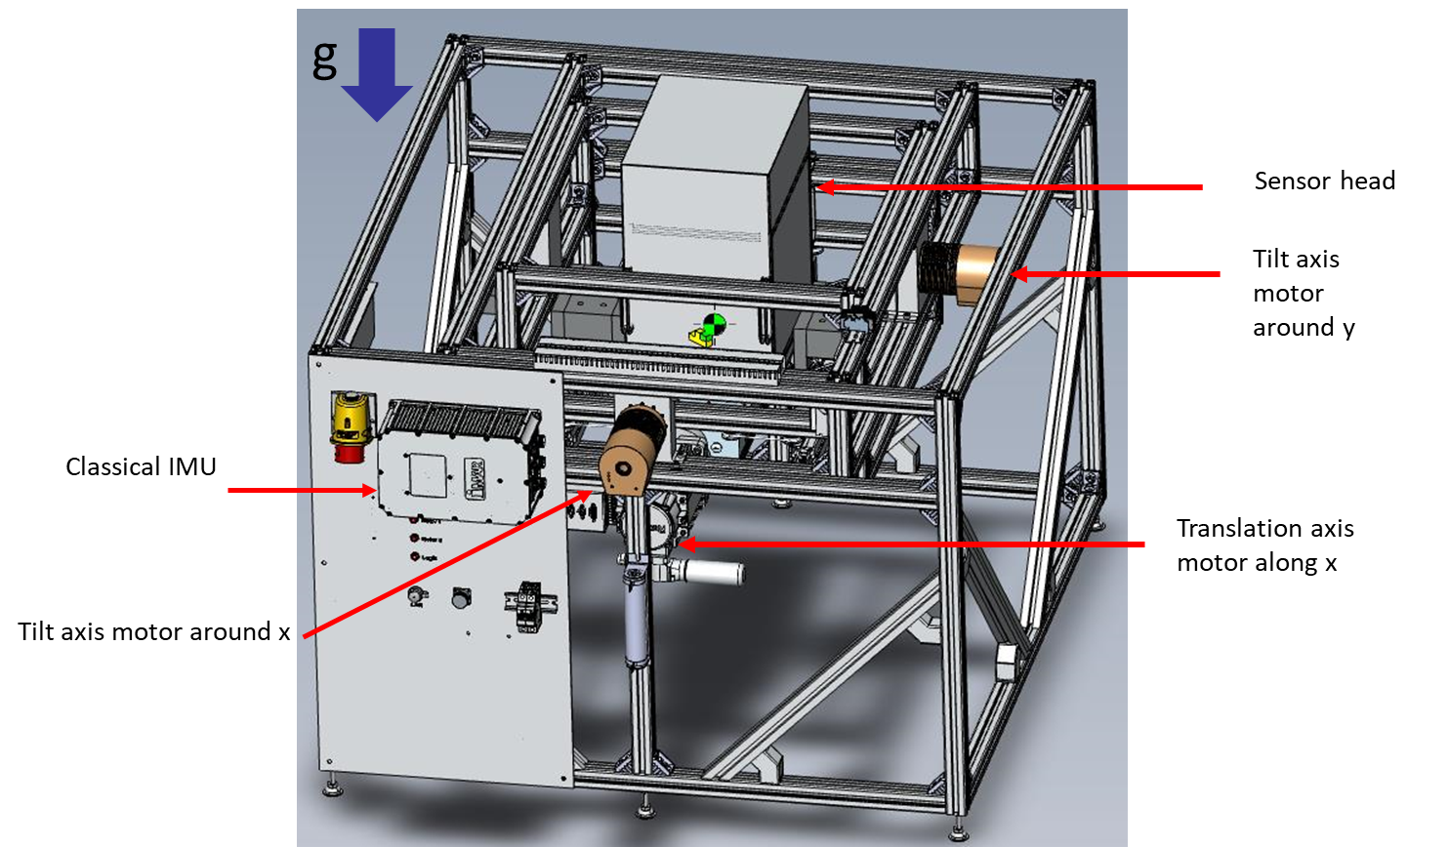

Slide 10
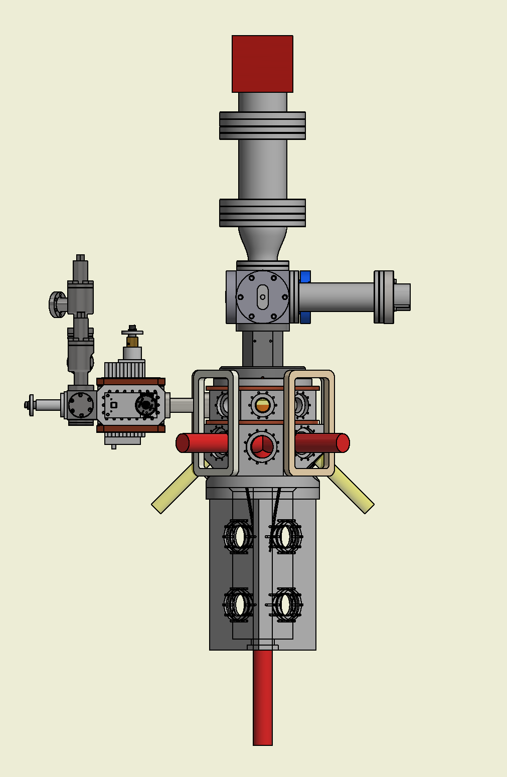
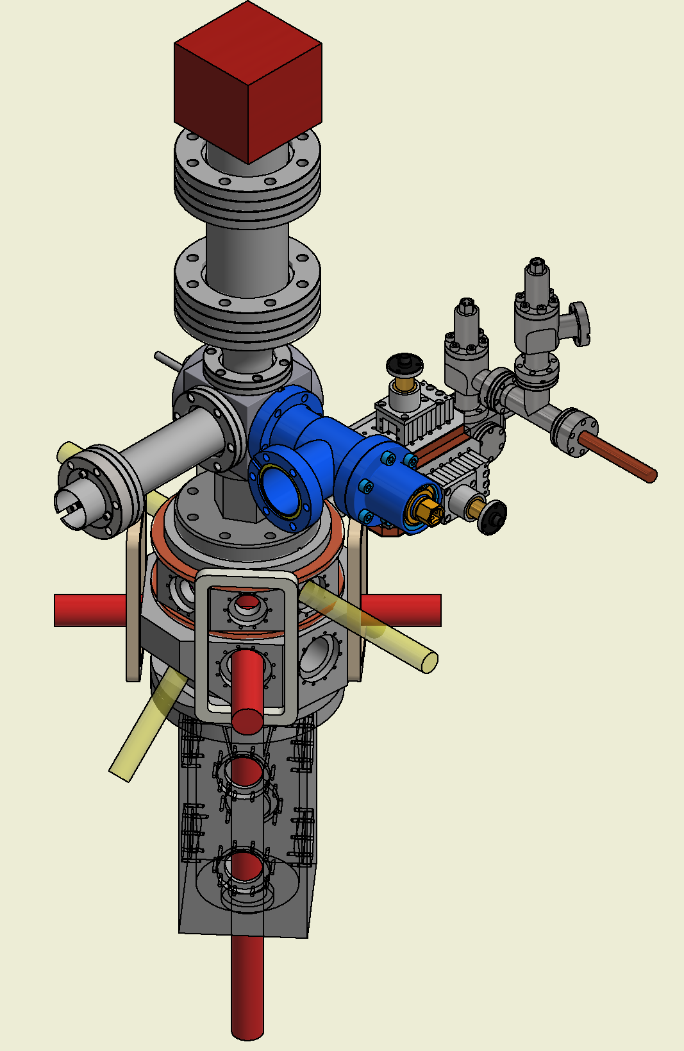
Multi-loop atomic interferometer demonstrator design
80cm

