Slide 1






Pangeo for everyone with Galaxy
Anne Fouilloux , Yvan Le Bras, and Adele Zaini
How to make Pangeo available to everyone?
Example with a Biodiversity use case
Enabling Open Science with Research Objects
eScience course 2021: showcase with Adele Zaini, Master student at the University of Oslo
What’s next?

Slide 2

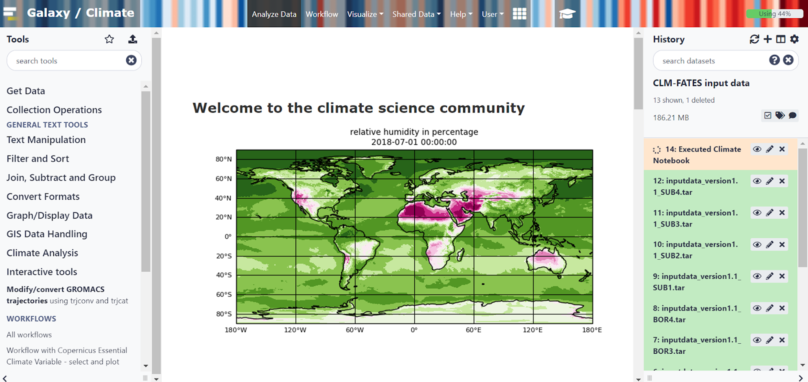
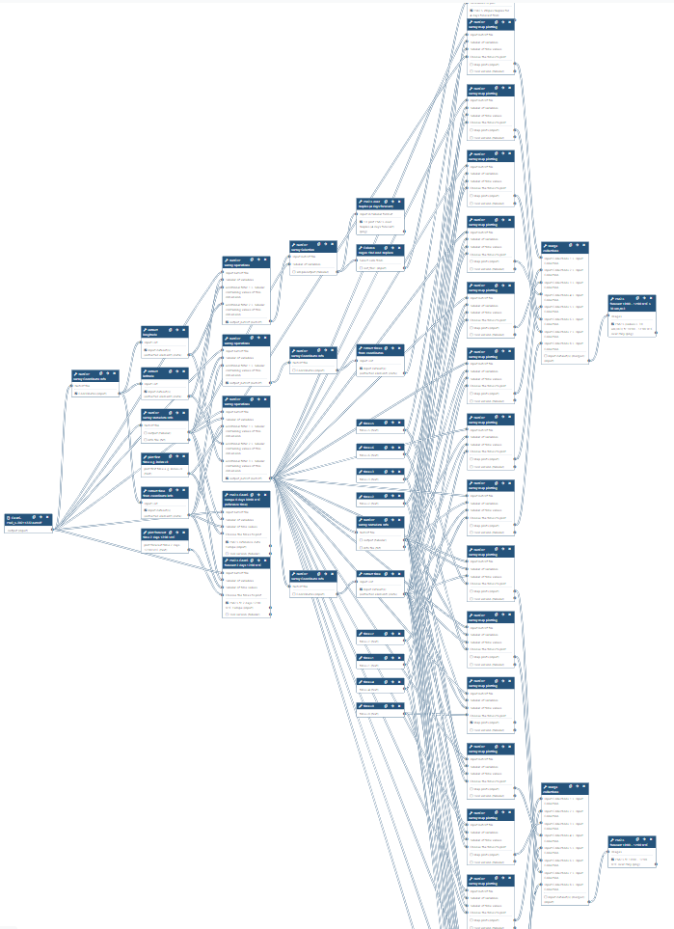
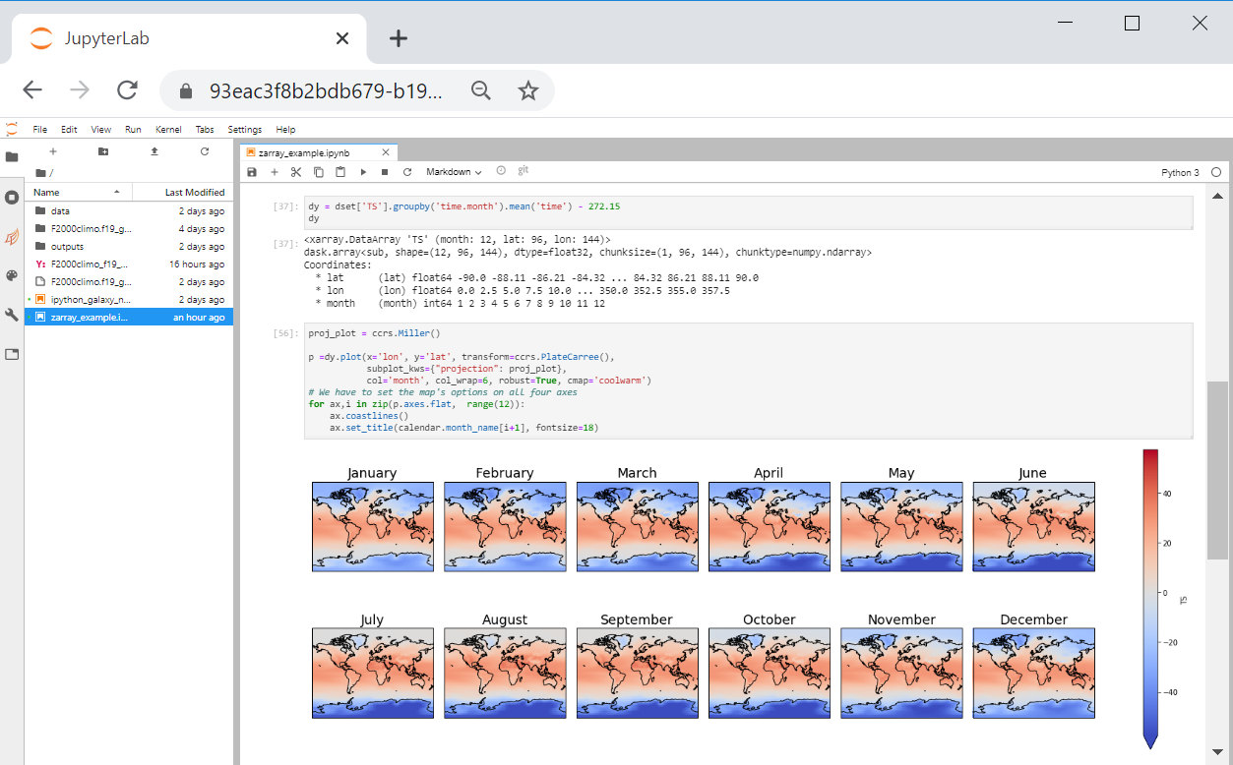



Pangeo teams up with Galaxy Europe
Galaxy open-source platform for FAIR data analysis offers:
Pangeo notebook deployment (local dask) available to everyone (free registration);
Pangeo Galaxy Tools for fully automated workflows;
GUI for users with no programming skills;
Self-Paced Learning material and organisation of online training events with the Galaxy Training Network;
Training Infrastructure as a Service is a free and ready to use with private queues where only training’s jobs run.

Slide 3
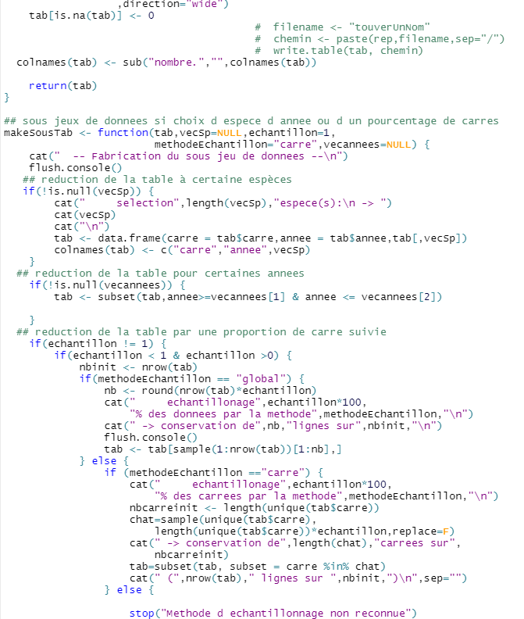
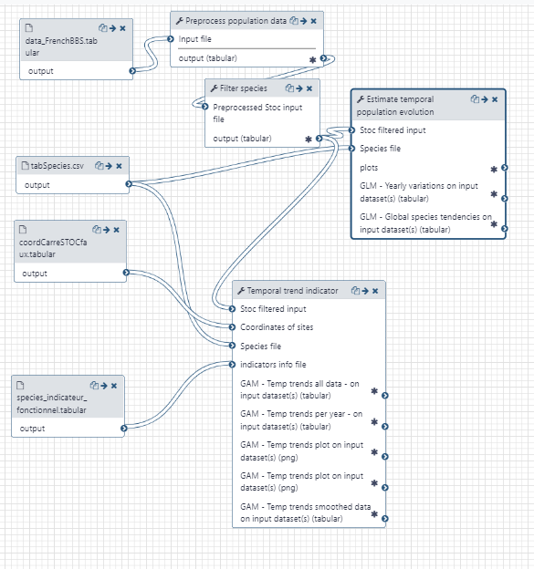
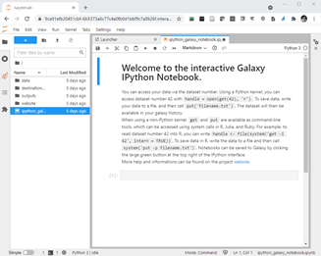








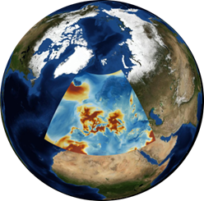
From Jupyter Notebooks to Galaxy Tools
One Jupyter Notebook is turned into one script
Several atomic scripts from which generic and fully annotated Galaxy Tools are created
Create a Jupyter Python/R/Julia Notebook

Galaxy Europe





Slide adapted from Coline Royaux, Natural History Museum, France.

Slide 4
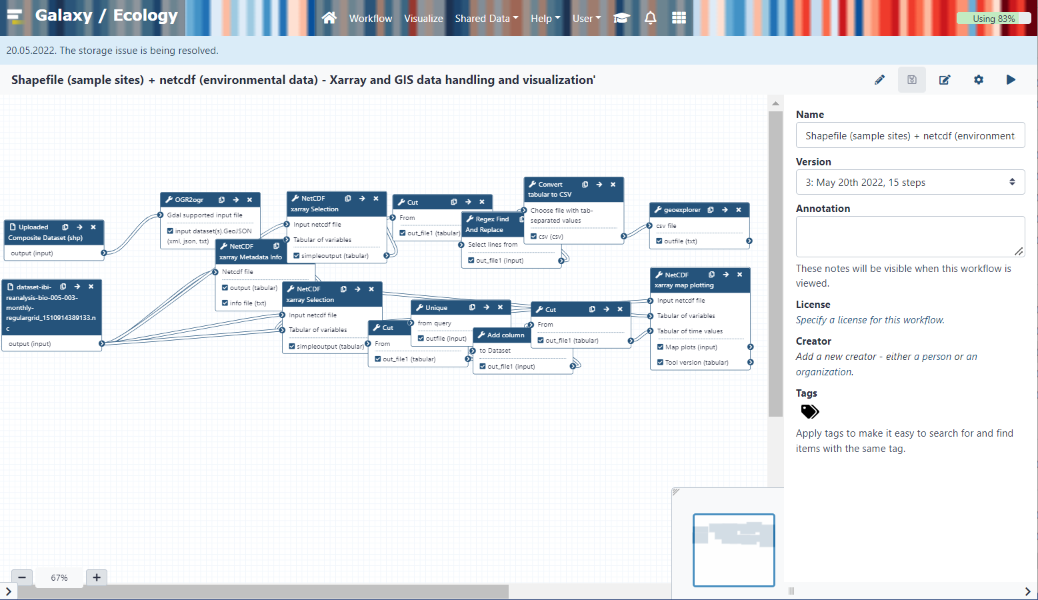
Biodiversity use case
A “Classical” data processing:
Sampling sites information in GIS data file (often shapefile)
Environmental information in netCDF file
Create a file with environmental information on sampling sites!
Visualize maps of environmental parameters on sampling sites
Until now: R + QGIS + a lot of manual manipulation
Now: a Galaxy workflow mixes scripts, GDAL & Xarray tools making it easily accessible and (re)-runnable.

Slide 5

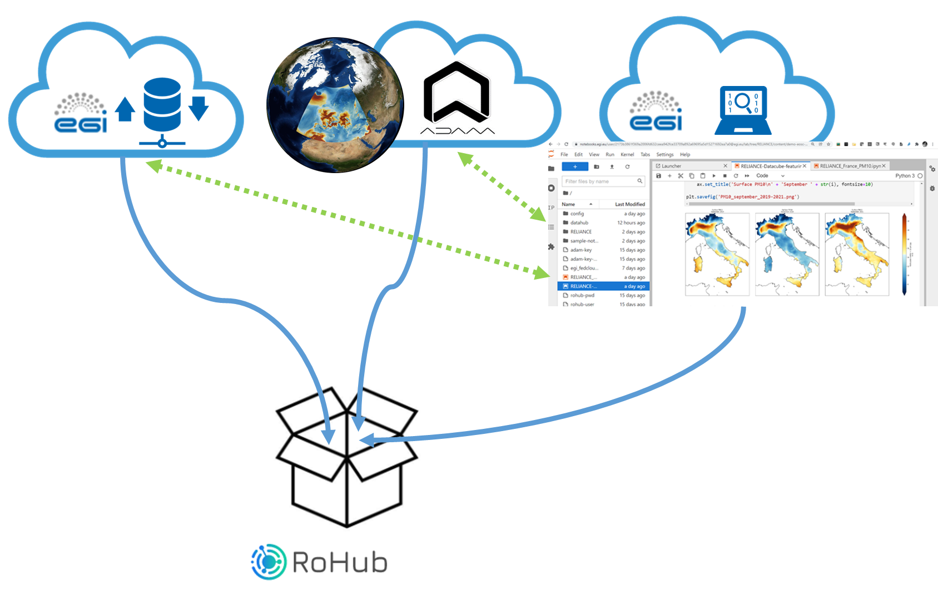



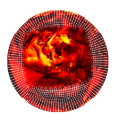
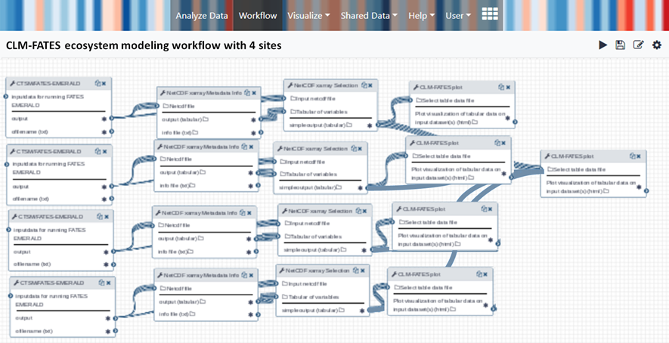

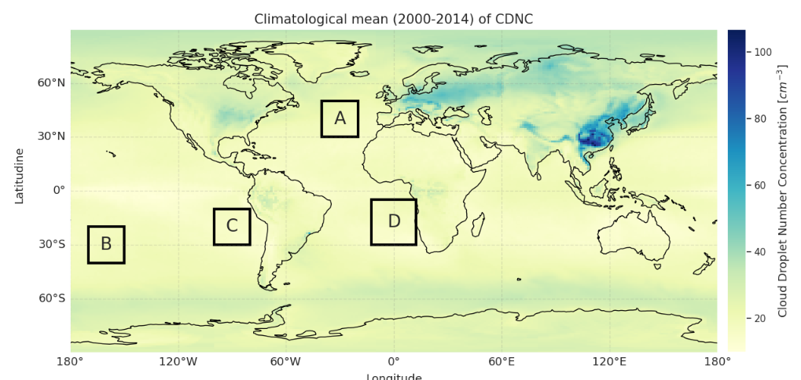





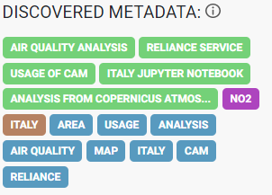




RoHub for FAIR and Open Science
Create and manage Research Objects to work open, from initial ideas to publication and beyond.
https://reliance.rohub.org/

Slide 6

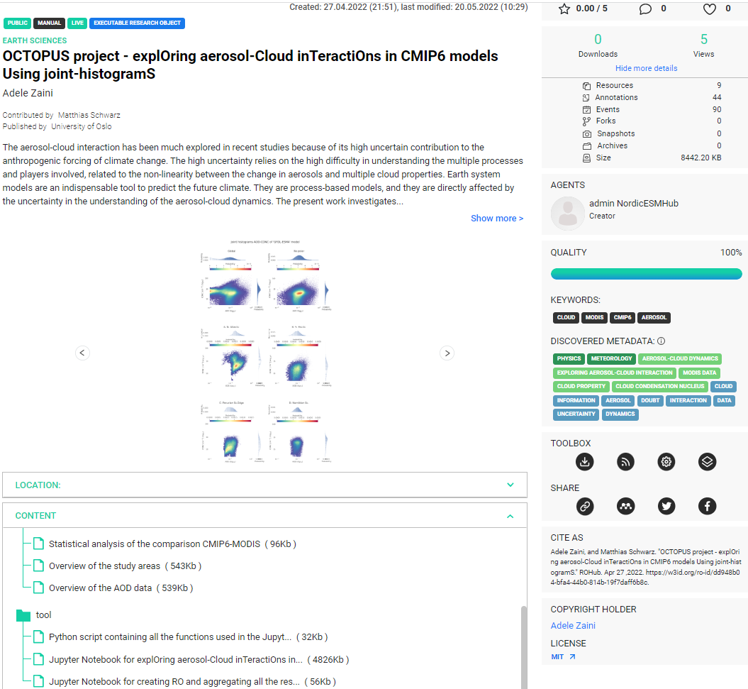


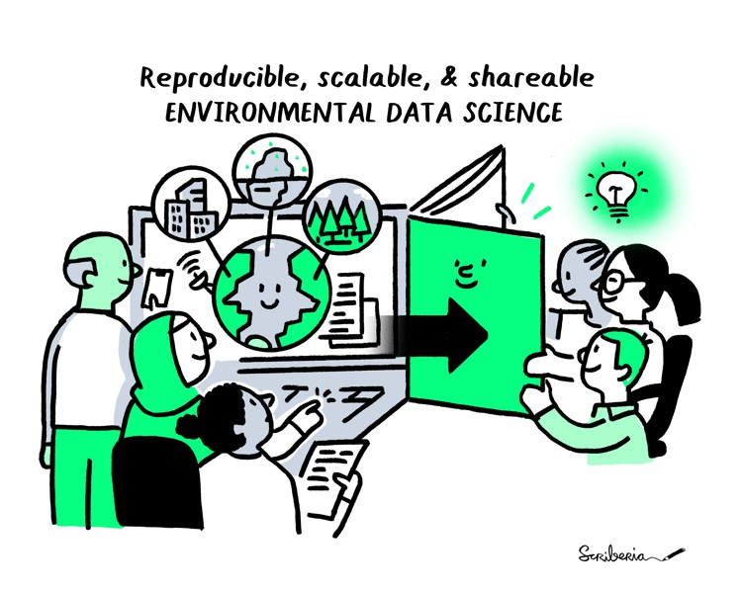
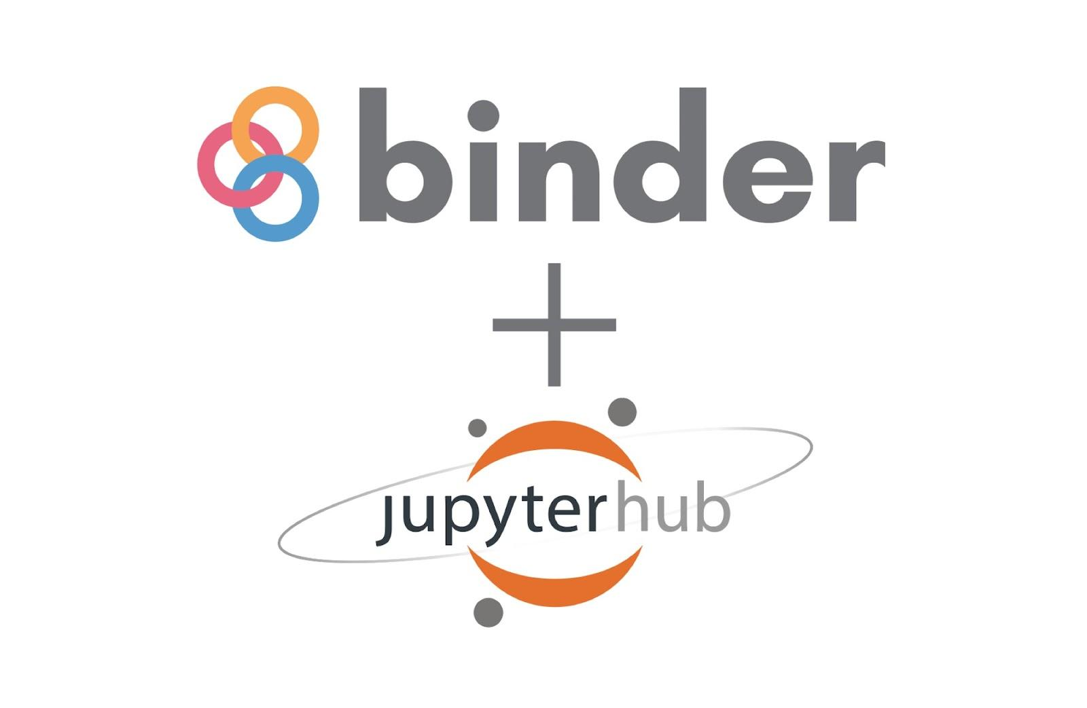

Showcase with Adele Zaini
Example of Research Object in RoHub
Collaboration with Environmental Data Science Book
Next step is to automate the creation of github repository, computational (conda) environment and Jupyter book.
Open-source tools
Reproducible
https://reliance.rohub.org/

Slide 7
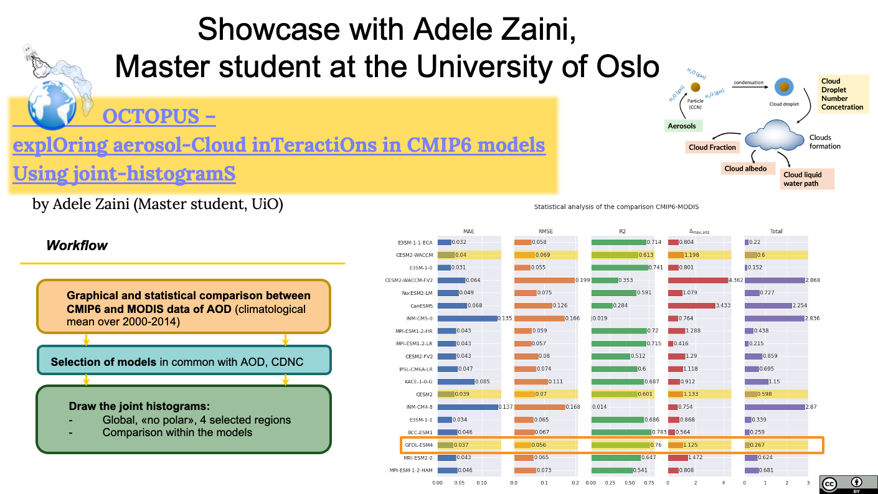

OCTOPUS –
explOring aerosol-Cloud inTeractiOns in CMIP6 models Using joint-histogramS

Slide 8
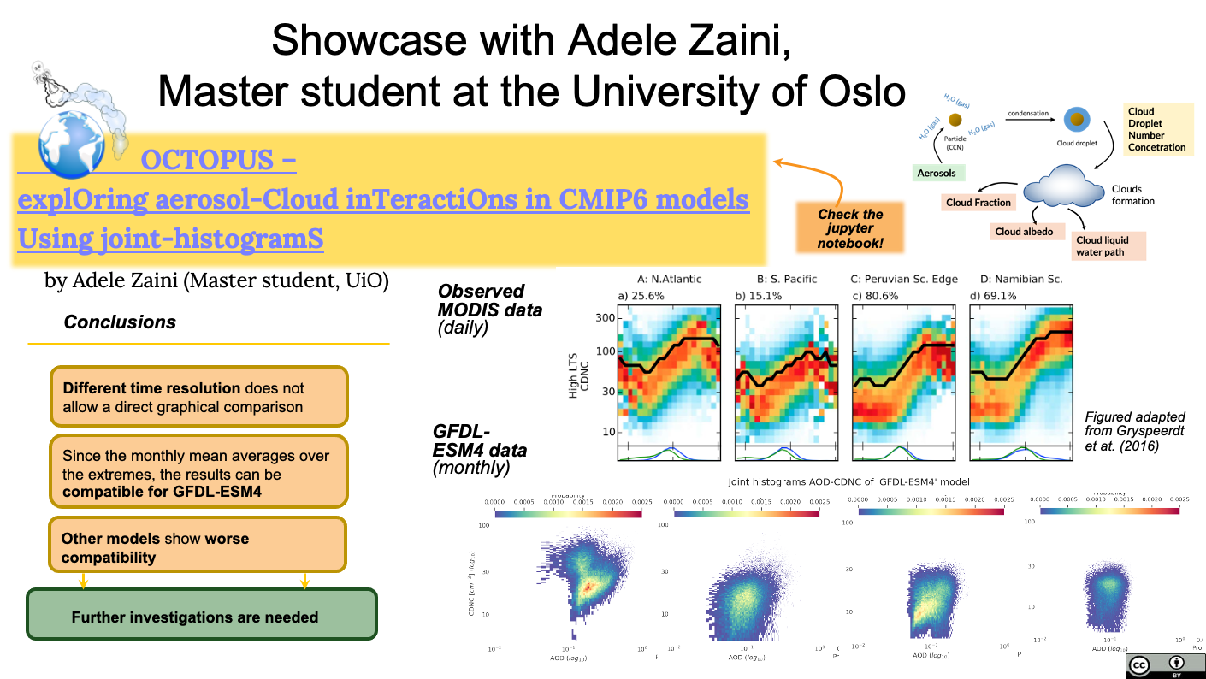
OCTOPUS –
explOring aerosol-Cloud inTeractiOns in CMIP6 models Using joint-histogramS

Slide 9

What questions do you have?
@AnneFouilloux

