Slide 1




Validation of the Arctic water and energy cycles in CMIP6 with consistent observation-based estimates
Susanna Winkelbauer^{1,*}, Michael Mayer^{1,2}, Leopold Haimberger¹
¹University of Vienna (Austria), Department of Meteorology and Geophysics
²European Centre for Medium-Range Weather Forecasts (ECMWF)
*susanna.winkelbauer@univie.ac.at

Slide 2


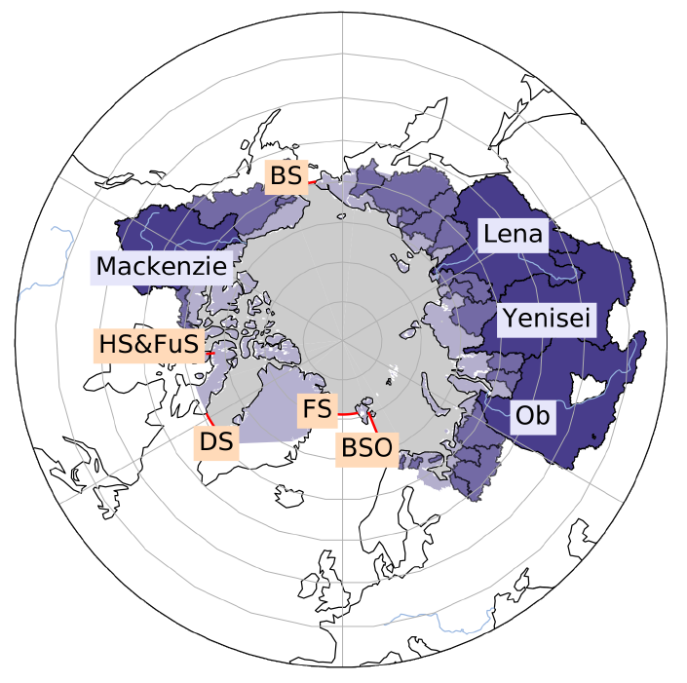
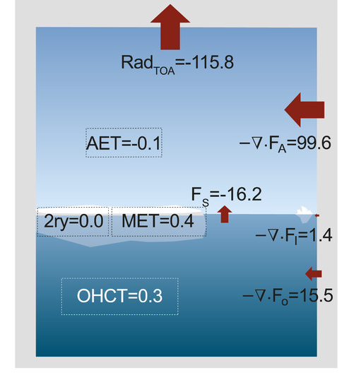
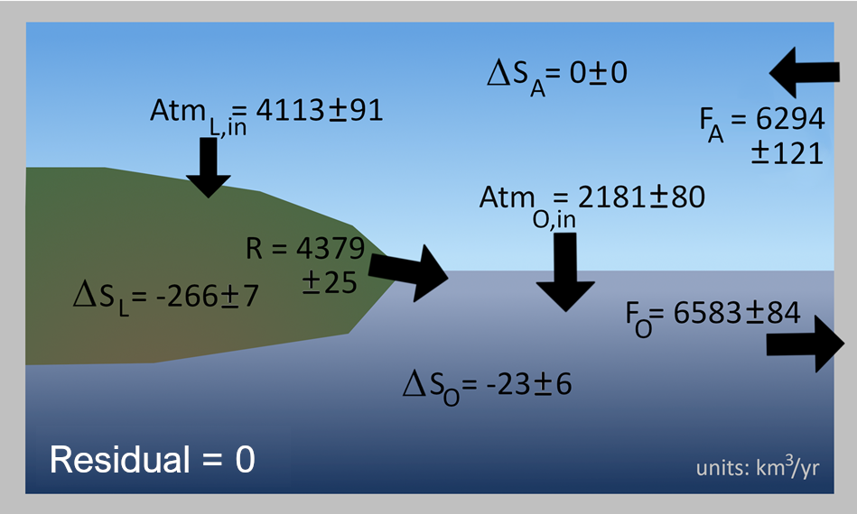
Observation based estimates
Observationally constraint estimates of Arctic water cycle:
Winkelbauer et al. (2022), Diagnostic evaluation of river discharge into the Arctic Ocean and its impact on oceanic volume transports, https://doi.org/10.5194/hess-26-279-2022
Observationally constraint estimates of Arctic energy cycle:
Mayer, M. et al. (2019), An Improved Estimate of the Coupled Arctic Energy Budget, https://doi.org/10.1175/JCLI-D-19-0233.1
Energy cycle [W/m2]
Water cycle

Slide 3

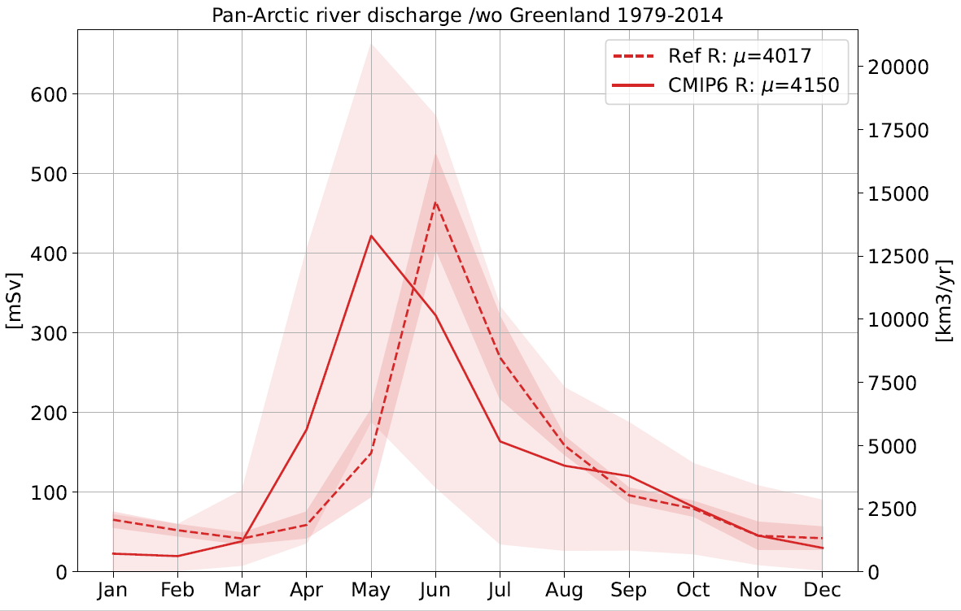
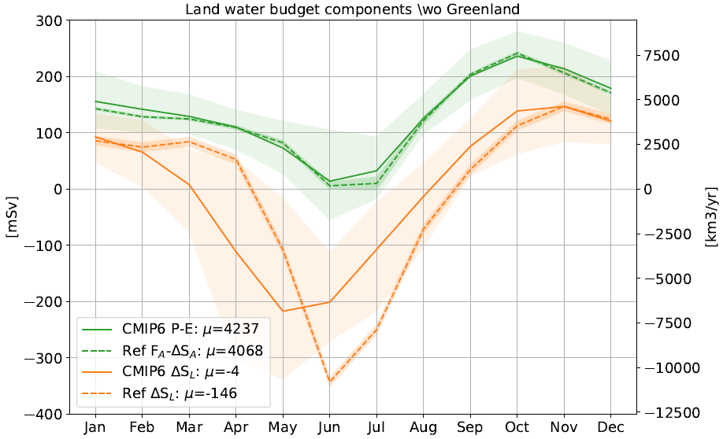
Water cycle CMIP6 (1979-2014)
Runoff: Models disagree in discharge peak timing (64% in May, 36% in June)
Good reproduction of multiannual means and trends
Atmosphere: Good agreement in seasonal cycle and annual mean
Land storage change: 1 month offset between CMIP6 and obs. based reference

Slide 4
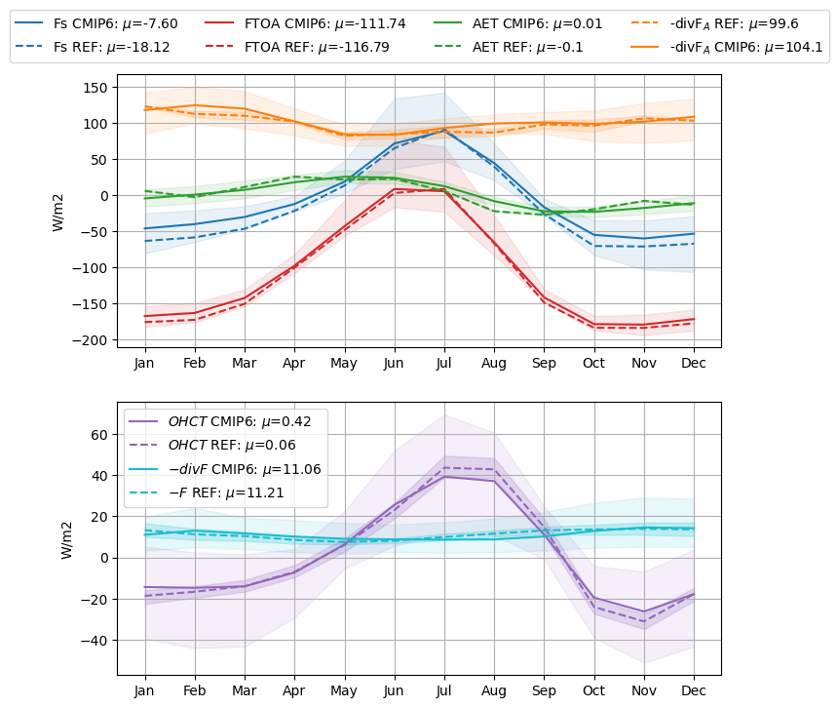
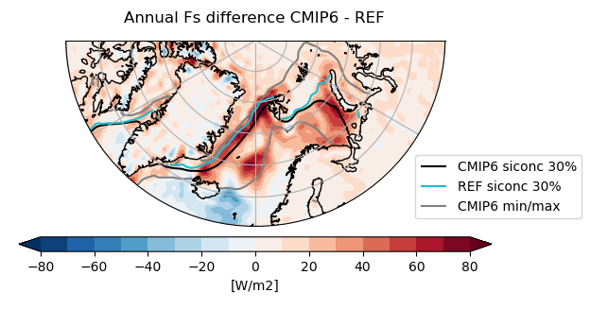
Energy cycle CMIP6
Largest error in net vertical energy flux Fs (especially in the cold season)
Large spread in OHC tendencies
Overall good representation of seasonal cycles

