Slide 1




Deep learning for surrogate modeling of two-dimensional mantle convection
Siddhant Agarwal
PhD Supervisors
Nicola Tosi
Doris Breuer
Pan Kessel
Grégoire Montavon
Klaus-Robert Müller

Slide 2
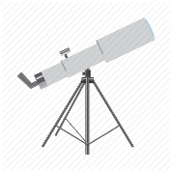
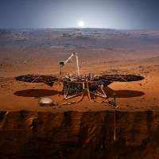

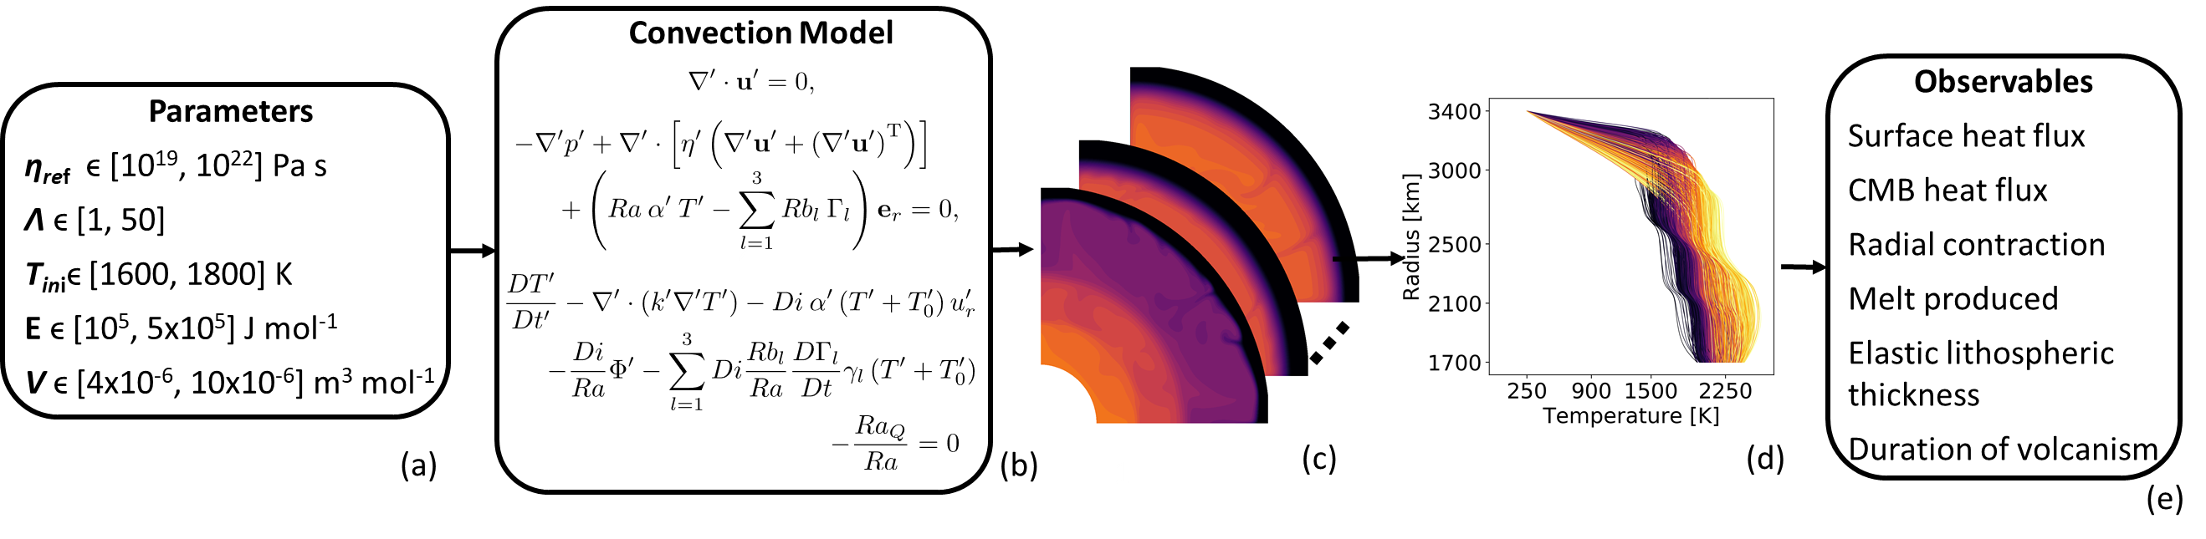


Introduction
?

Slide 3
Introduction
?
https://elib.dlr.de/146282/1/PhysRevFluids.6.113801.pdf

Slide 4
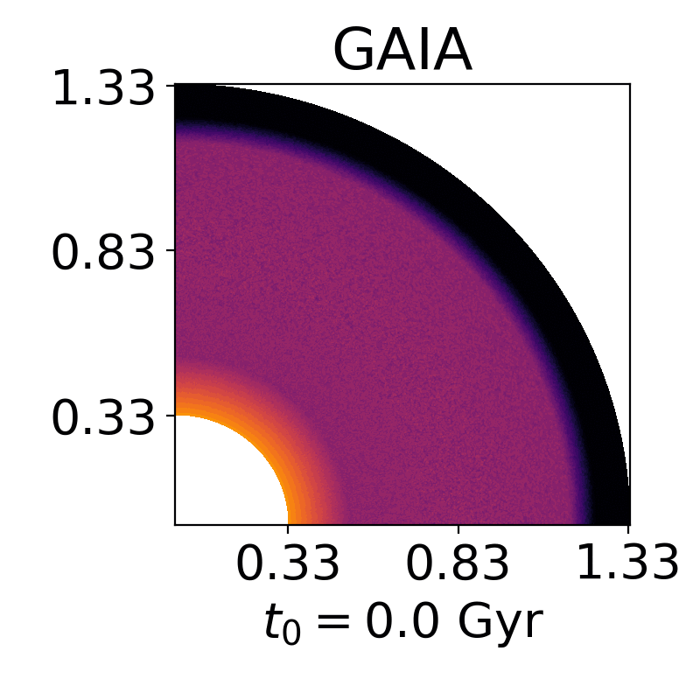
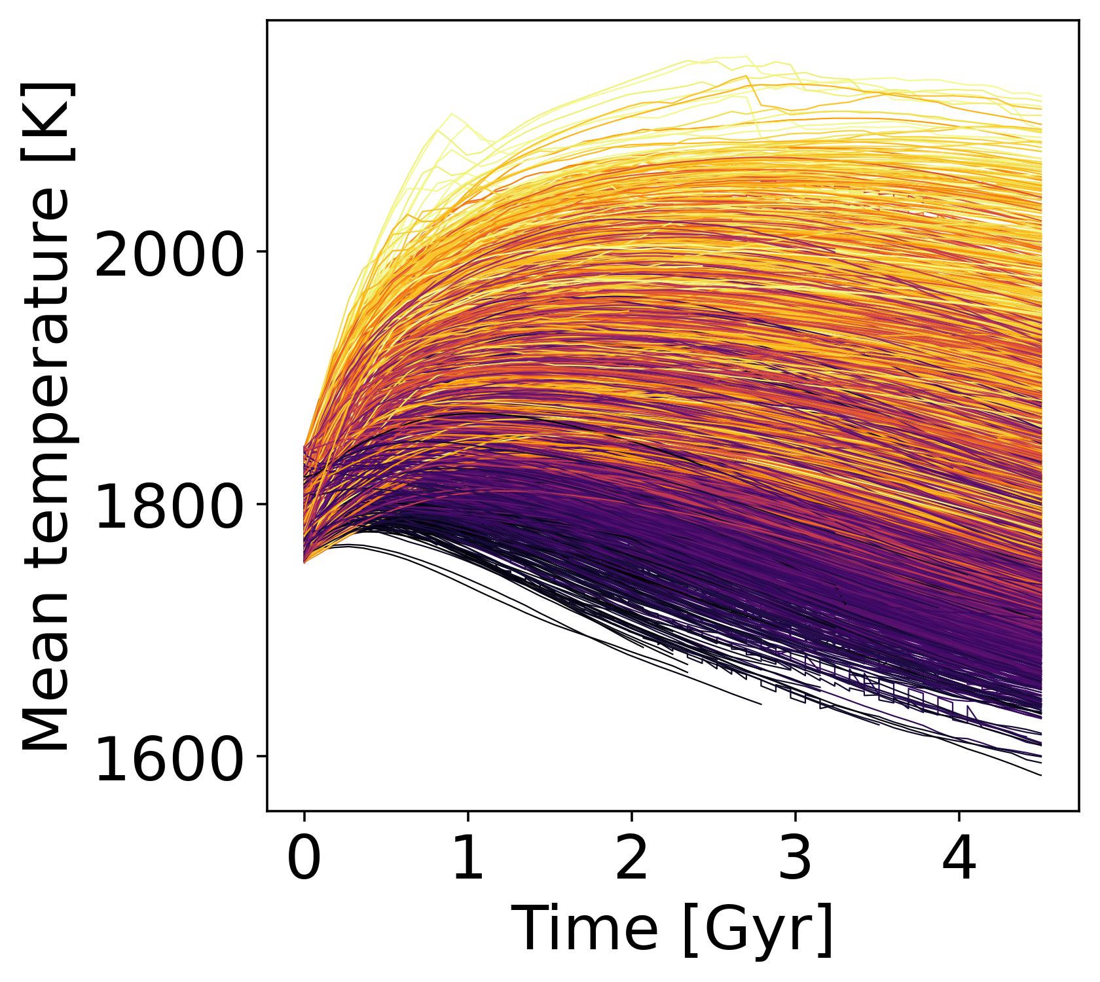

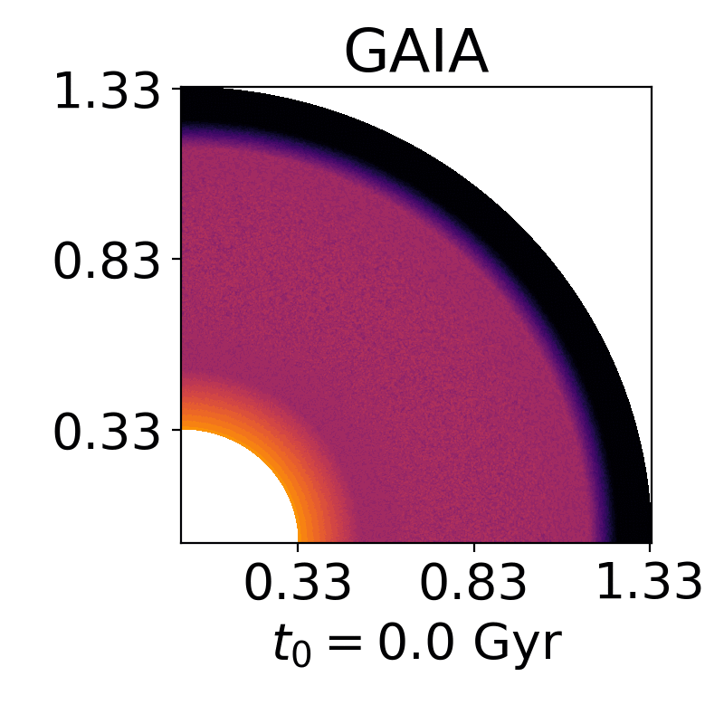
Dataset
10,500 thermal evolution simulations over 4.5 Gyr
2D Mars-like planet
Data-split:
98% of simulations used for training
1% used for architecture selection
1% used for presenting results
Notes:
Including a number of complexities and pressure- and temperature-dependent processes

Slide 5
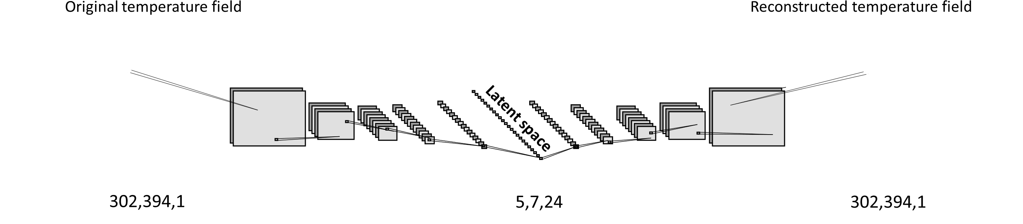
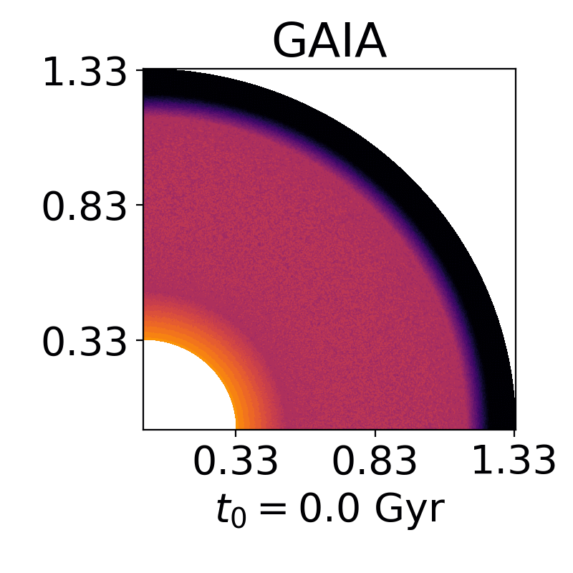
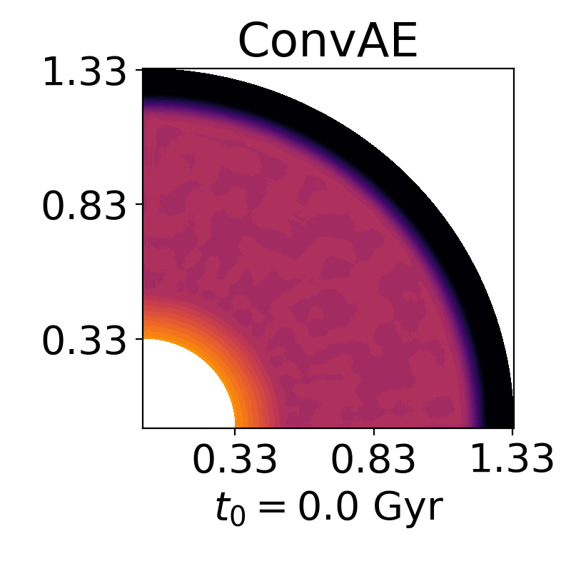
Compression
Reduce dimensionality using convolutional autoencoders

Slide 6

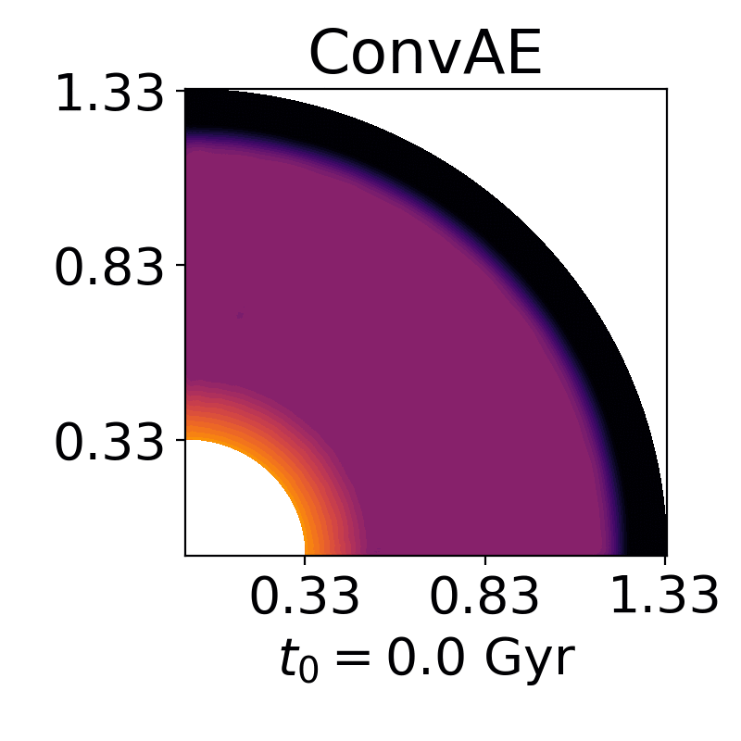
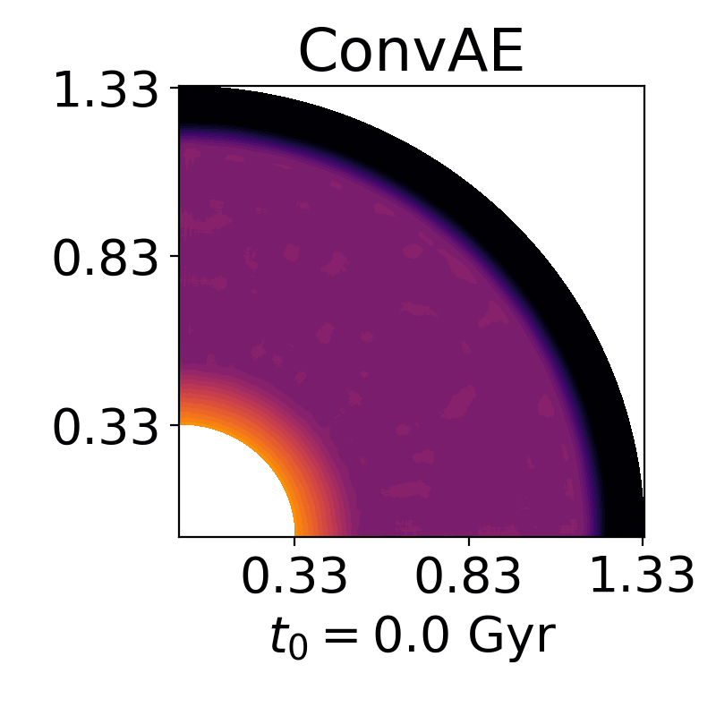


Compression
1 TB → 7 GB

Slide 7

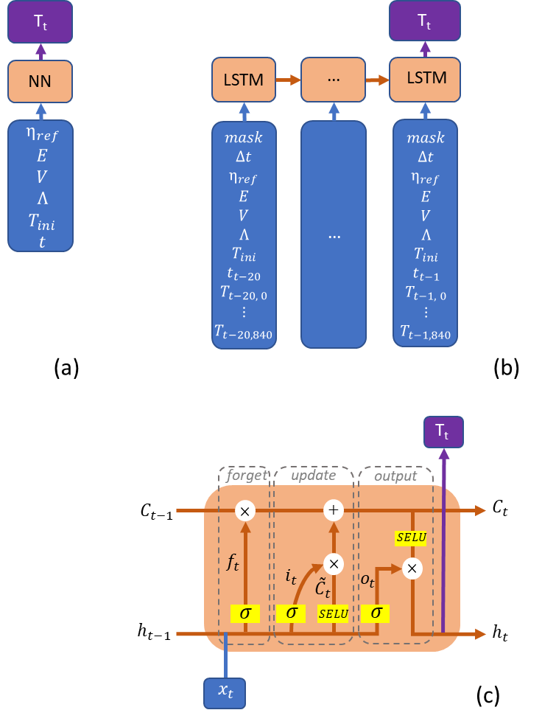
Prediction
Original simulation
Prediction of simple neural network

Slide 8

Prediction
Original simulation
Prediction of simple neural network
Prediction of Long-Short Term Memory network

Slide 9
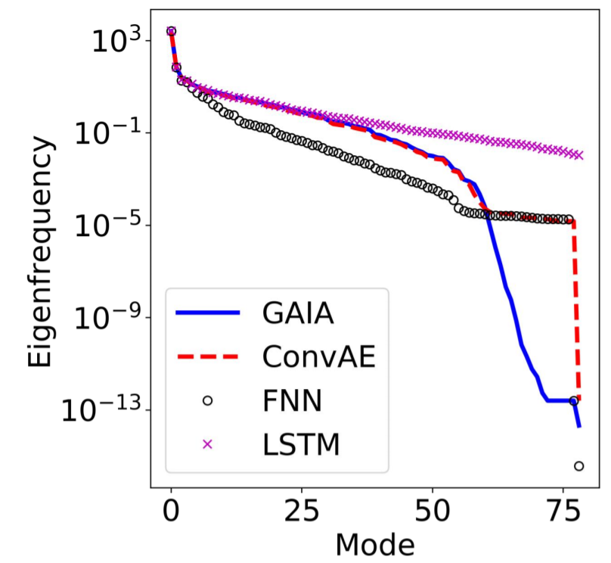


Prediction

Slide 10
Conclusion
Reliable spatio-temporal modelling based only on parameters.
Limitations:
Could be more accurate
Data-intensive (2 million CPU hours)
Modelling is limited to the parameters and physical setup
Thanks to (Norddeutscher Verbund für Hoch- und Höchstleistungsrechnen – HLRN) for the HPC resources.

Slide 11
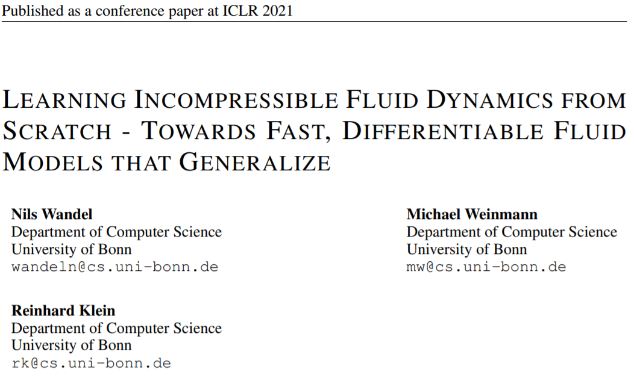
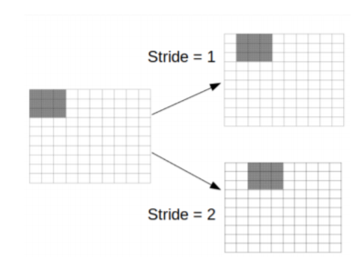
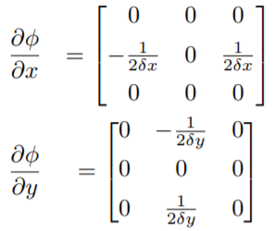
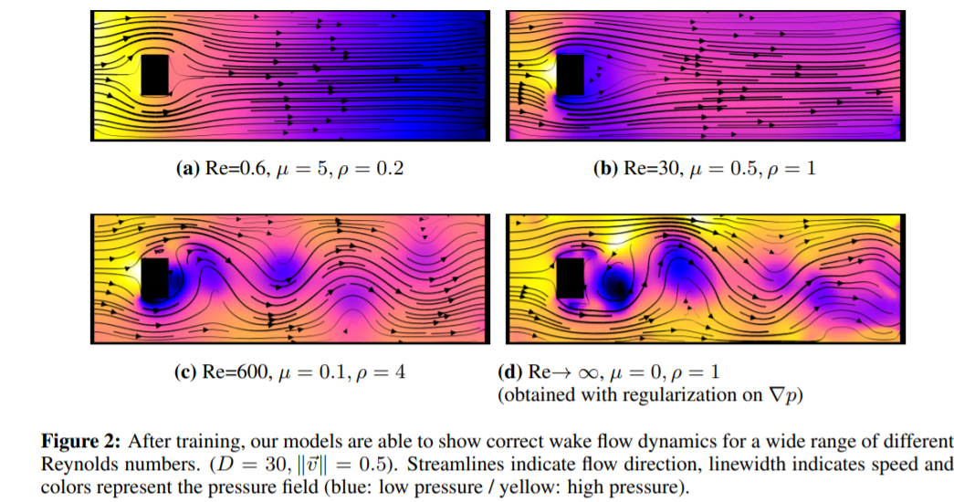
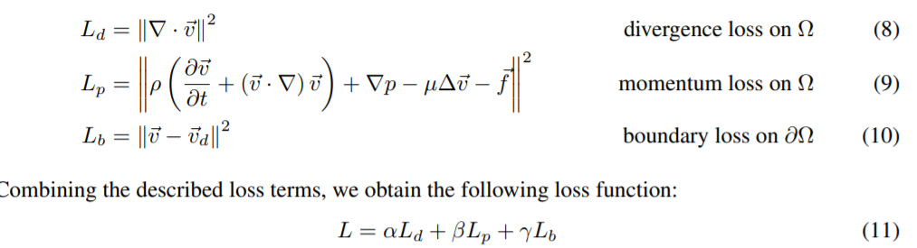
Bonus (physics-based machine learning)

Slide 12
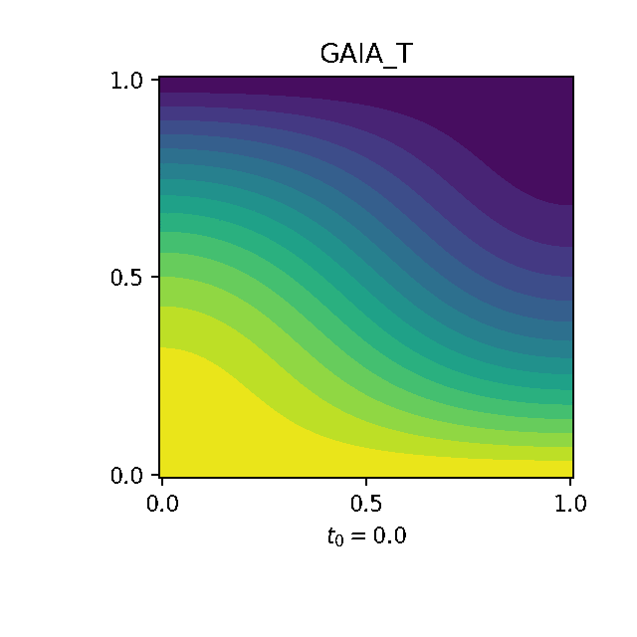
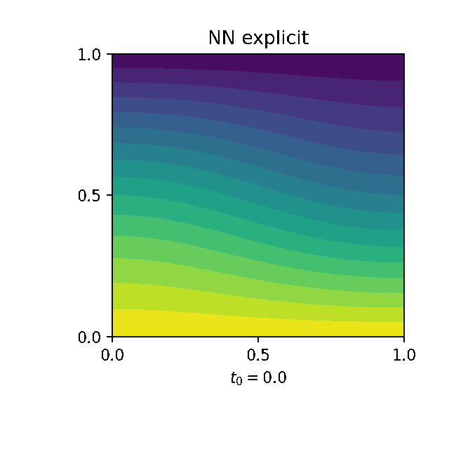
Bonus (towards…physics-based machine learning)

