Slide 1
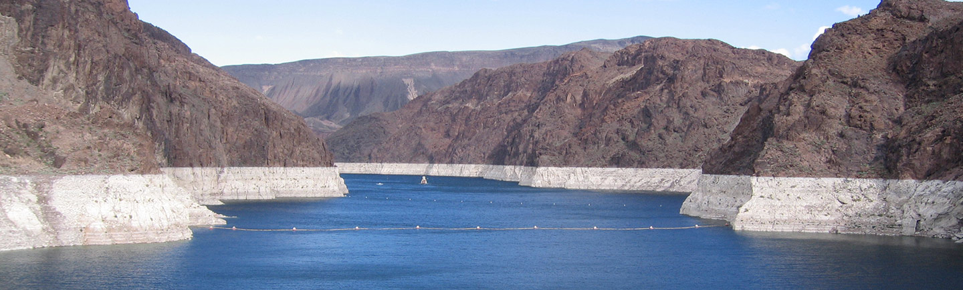
Assessing Future Climate and Land Use Impacts to the Colorado River using a Bottom-up Modelling Approach Informed by Water Managers.
EGU General Assembly
Session HS2.4.2 – Abstract 5757
May 23, 2022
Kristen M Whitney
Graduate Research Assistant
Arizona State University

Slide 2





Kristen M. Whitney
¹
Graduate Research Assistant
Co-authors: Enrique R. Vivoni^{1,2}, Zhaocheng Wang², and Giuseppe Mascaro²
¹School of Earth and Space Exploration, Arizona State University, Tempe, AZ;
²School of Sustainable Engineering and the Built Environment, Arizona State University, Tempe, AZ

Slide 3
Presentation Outline
1.
Background and objectives.
2.
Model framework.
3.
Climate + land cover scenario development.
4.
Main results.
5.
Major conclusions and next steps.

Slide 4
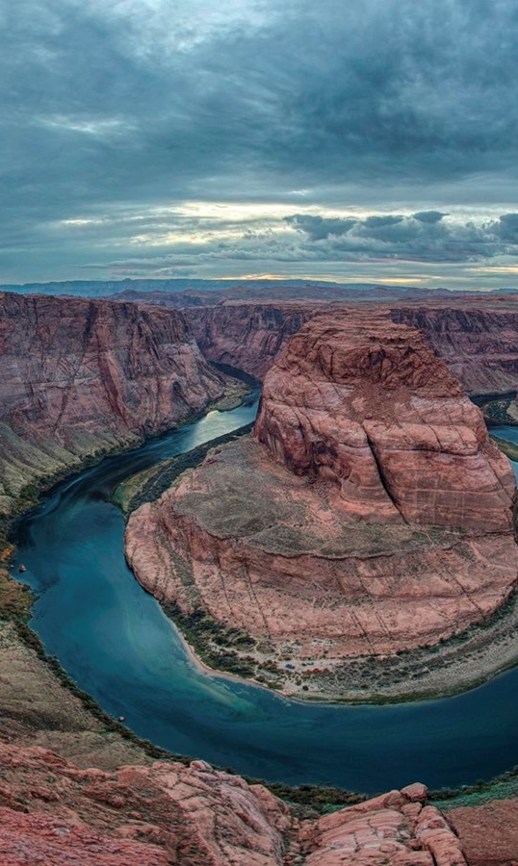
Background and Objectives

Slide 5
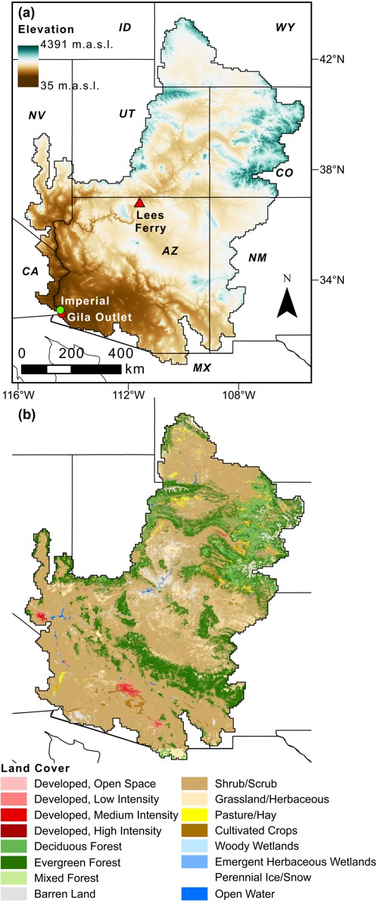
The Colorado River Basin
z
Elevation
“The lifeblood of the Southwest.”
Supplies freshwater to 40M people irrigation to 5.5M acres, and 4,200MW of power generation.¹
Arid and semi-arid climate 354 mm/yr of precipitation, often plagued by drought.^{2,3}
The extent that warming could intensify droughts is unclear given climate uncertainties (high precipitation variability).⁴⁻¹⁰
z
4391 masl
z
35 masl
z
XX
XX
z
Elevation across the Colorado River Basin with major basin outlets.

Slide 6
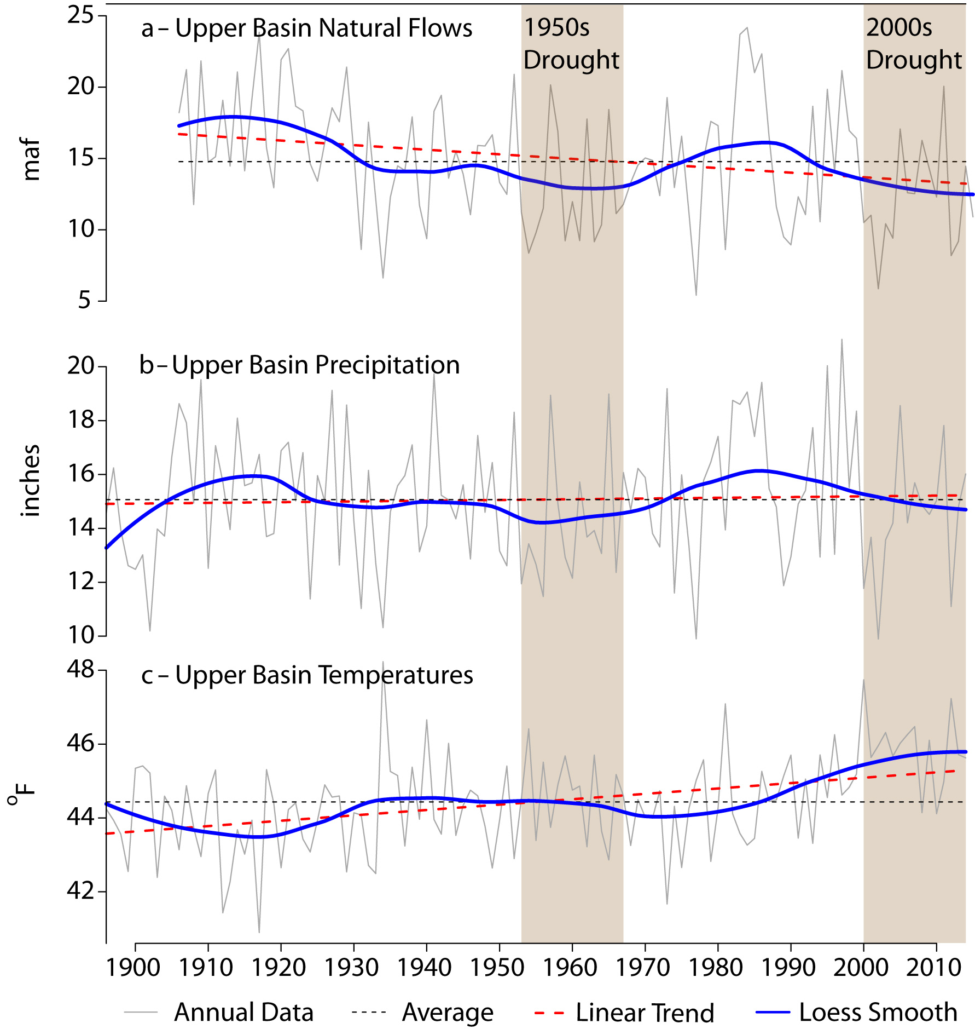
Climate change assessments
Studies have focused on the Upper Basin where 90% of streamflow originates as snowmelt.
The Millennium Drought (since year 2000) cannot be explained by precipitation changes alone.⁴
Anomalously high precipitation and runoff in the northwest did not offset drought elsewhere.¹²
It is unclear if precipitation variability could offset warming impacts to future surface water supplies.⁸⁻¹⁰
Climate change impacts across the entire basin are less understood, but key for water management.
Observed Upper Basin trends from Udall and Overpeck (2017).

Slide 7

Land Cover Change Impacts
Most of the basin is covered by shrubs (60%) and forests (24%)¹³
Climate change is projected to intensify forest disturbances including wildfire, drought, and pest-infestations.¹⁴⁻¹⁶
Forest cover changes can drastically increase or decrease streamflow rates.^{17,18} - Flow increase from reduced evapotranspiration & increased snowpack.¹⁹⁻²⁸ - Flow decline from increased evaporation & understory transpiration.²⁹⁻³⁹
Climate and forest disturbance impacts across the basin are understudied, but key for decision-makers.⁴⁰
Historic (2011) land cover across the basin.¹³

Slide 8
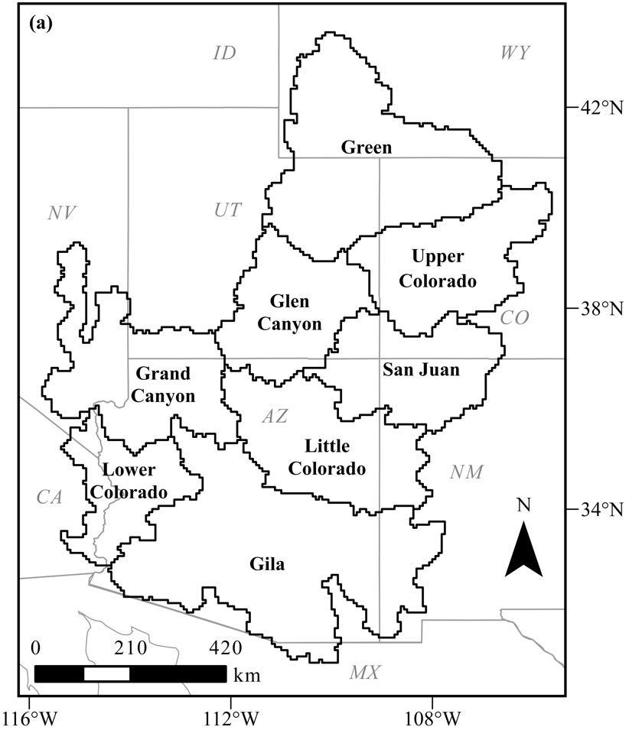
Main Objectives
Simulate and compare long-range streamflow projections across the basin, including subbasins key for management.
Assess an envelope of hydrologic possibility in climate futures using a top-down, climate model ensemble approach.
Simulate under scenarios of land cover change and disturbances using a bottom-up approach, co-developed with stakeholders.
Identify cases that offset the impacts of warming compare the roles of internal subbasins and seasons in these outcomes.
Study domain and subbasin delineations.

Slide 9
Model Framework

Slide 10
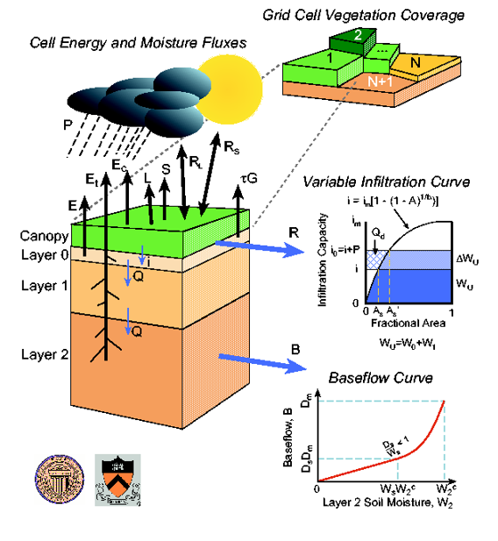
Main Model Component
The Variable Infiltration Capacity (VIC) Model
A macroscale land surface model^{41,42}
Solves the full water and energy balance on a regular grid, each grid divided into land cover tiles.
All tiles are modeled independently for snowpack and evapotranspiration dynamics.
Accounts for heterogeneity of infiltration capacities based on soil storage capacities and antecedent conditions.
Runoff and baseflow are routed to streamflow using a separate model called “R-VIC”.^{43,44}
Schematic of the Variable Infiltration Capacity (VIC) model.^{41,42}

Slide 11
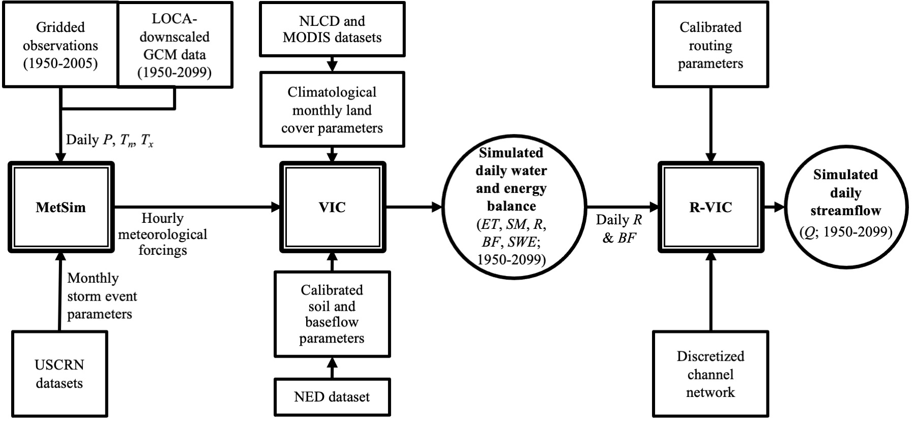
Model Framework
45
*
46,47
*
32,54
13,52
48,49
41,42
43,44
CRSS
Water manager efforts
*
31
*
*
50
51
53
Key improvements in this study
*
(See supplemental slides at end of presentation for more details)

Slide 12
Climate and Land Cover Scenario Development

Slide 13
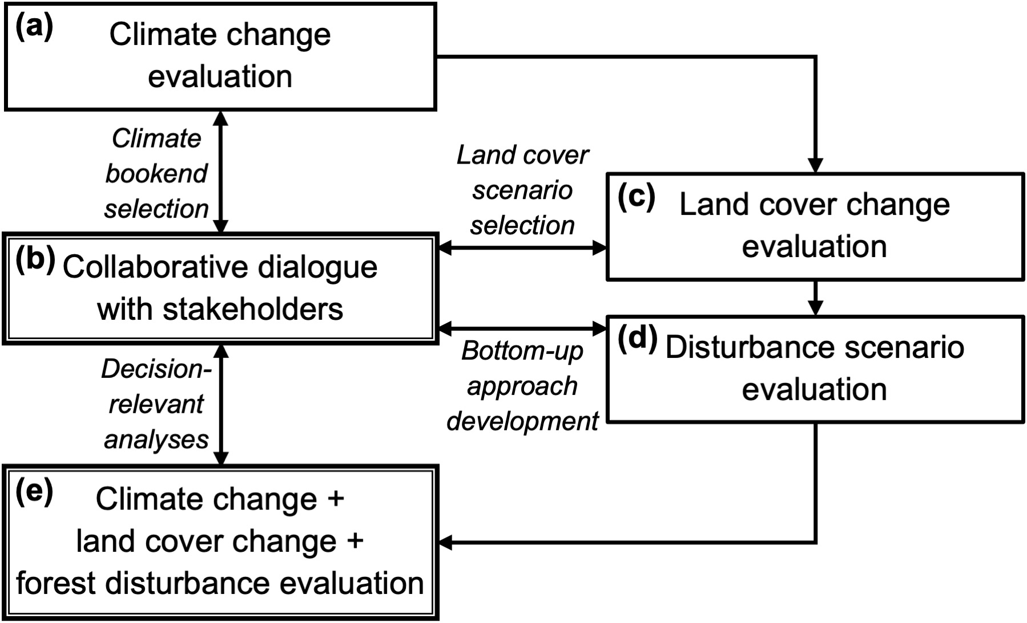
Scenario development process
Each stage was informed by feedback from (b) water managers and other basin stakeholders.
Stages included evaluations of:
(a) The climate model futures to select bookends,
(c) The VIC simulated outcomes under the climate bookends when parameters were updated with future modeled land cover products,
(d) The VIC simulated outcomes under the climate bookends with alternative forest disturbances,
(e) The decision-relevant analyses of VIC simulated outcomes using the final model framework.

Slide 14
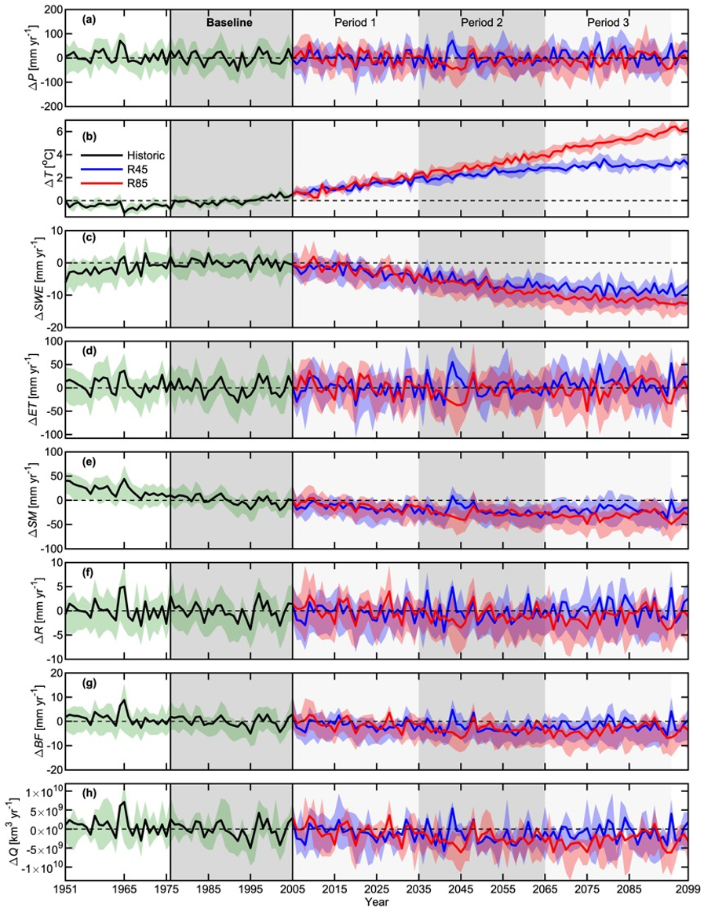
Climate Change Evaluation
Results under a larger ensemble of climate forcings were available for the stakeholder engagement process (shown here).
Stakeholders preferred selecting two bookend climate cases to drive the modeling framework.
We compared mean annual precipitation and air temperature changes and selected a Hot/Dry and Warm/Wet climate future.
(a) Precipitation
Baseline
Far-future
(b) Temperature
Historic
Low-emissions
High-emissions
(c) Streamflow
Basin-wide mean annual changes in precipitation and temperature, and streamflow, relative to baseline. Lines show the median across 8 climate models and envelopes show the spread.
Whitney et al., 2022a. (in review)

Slide 15
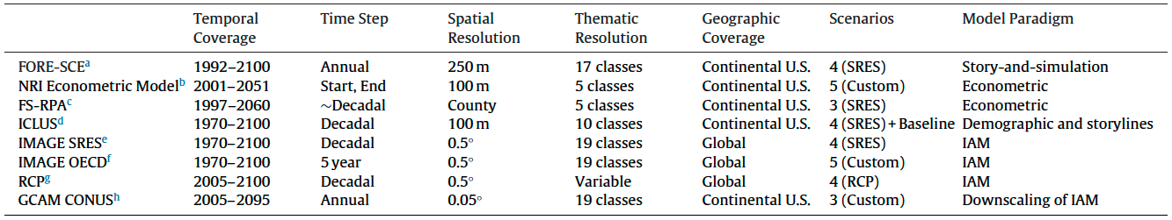
Land Cover Product Selection
Product comparison from Sohl et al. (2016).
FOREcasting Scenario (FORE-SCE)⁵⁶
Stakeholders agreed that the FORE-SCE products are the ideal candidate for our work.
Historic data based on NLCD products (similar to our earlier VIC framework).
Future data from regionally-downscale IPCC scenarios:
We selected the A2 (economic-growth) scenario, given identical VIC results under A2 and B2 (sustainable-development).
Includes yearly changes of forest, range, agriculture, and urban (other products only consider urban growth)
Captures a wider range of outcomes than other products.
Notes:
We looked into other lulc change products to expand our modeling efforts.
Water managers and stakeholders agreed that the FORE-SCE product is the ideal for our work, based on these comparisons

Slide 16
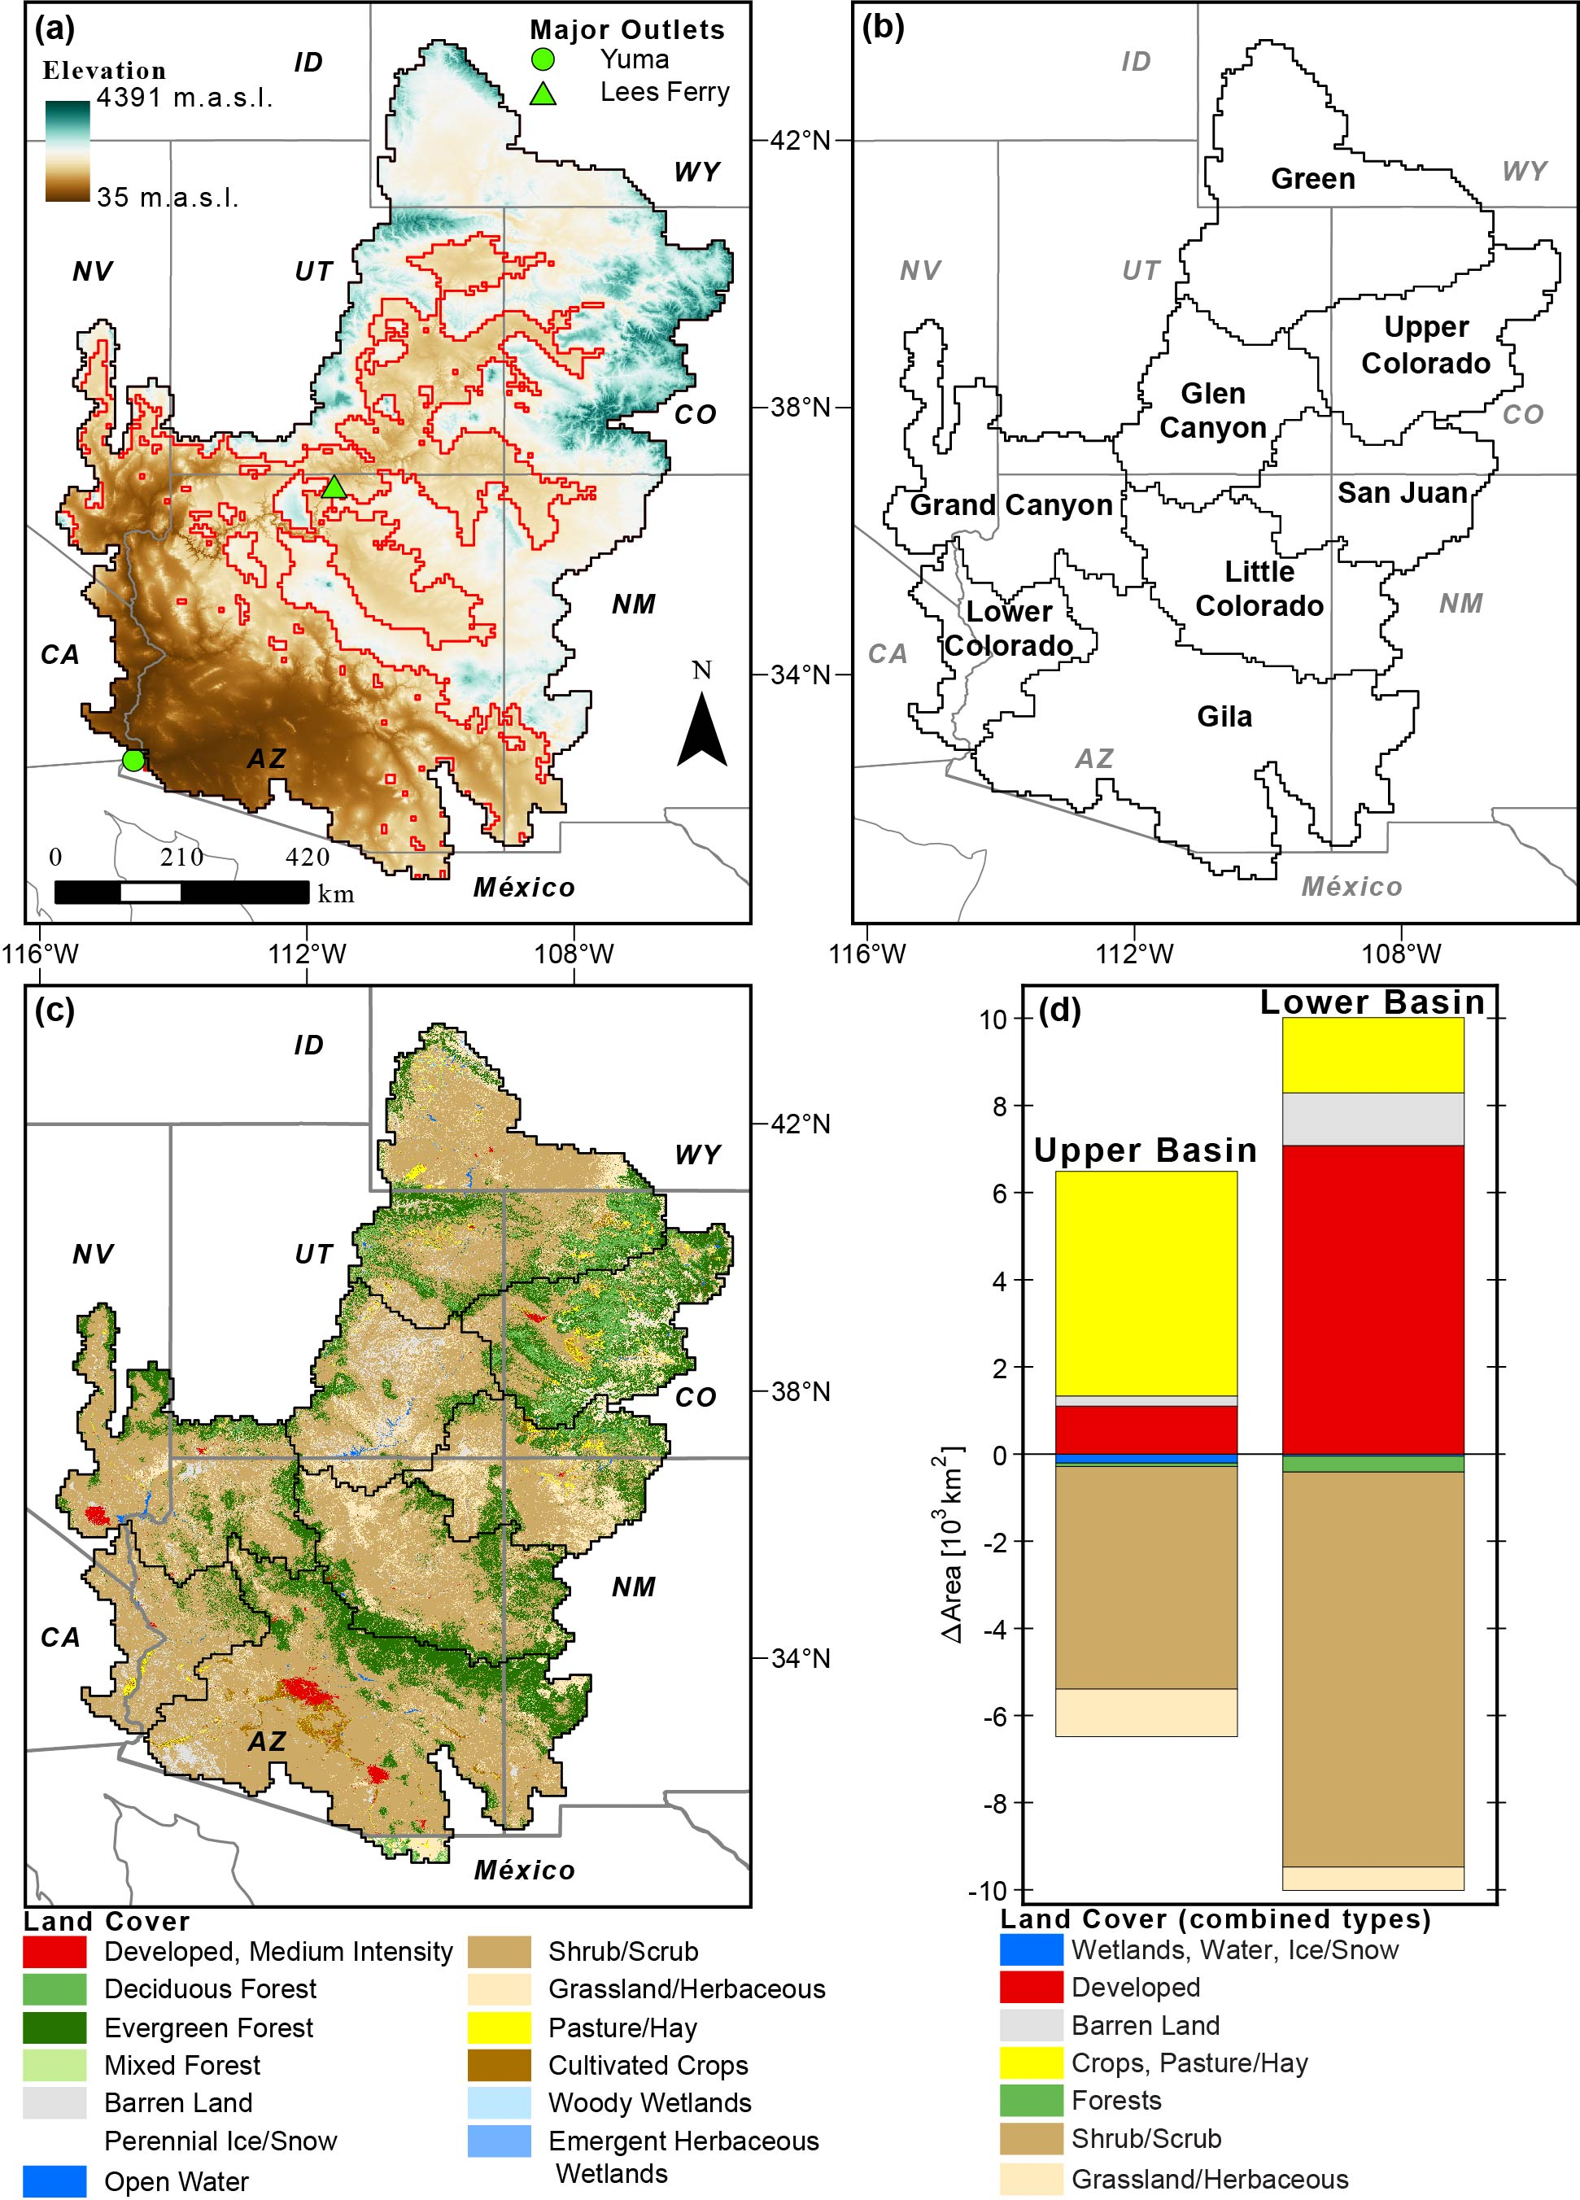
Land Cover Change Evaluation
We updated the model parameters to include land cover from FORE-SCE products (historic and future A2).
We then ran VIC simulations to test the sensitivity of results to these updates.
Future land trends included minimal changes in forest land cover types.
Forest changes were not enough to produce a large signal in simulated streamflow.​
Stakeholders were interested in exploring the impacts of additional forest disturbances applied to the FORE-SCE scenarios.
(a) Historic FORE-SCE land cover map.
(b) Total land area changes in future land cover relative to historic across the Upper Basin and Lower Basins.

Slide 17
Final Scenarios
(Climate bookends + bottom-up forest disturbances)
Sensitivity analyses revealed:
Minimal impact at mid-elevations.
Similar impact for forests converted to shrubs or grasses. → (Grasses are more likely).^{57,58}
Literature-based disturbance extents:
~30% of mid- to high- elevation forests burned historically.⁵⁹
Empirical estimates project ~90% of forests impacted by drought-related mortality by 2100.¹⁴
Disturbances were chosen based on VIC sensitivity tests and prior work.

Slide 18
Main Results

Slide 19
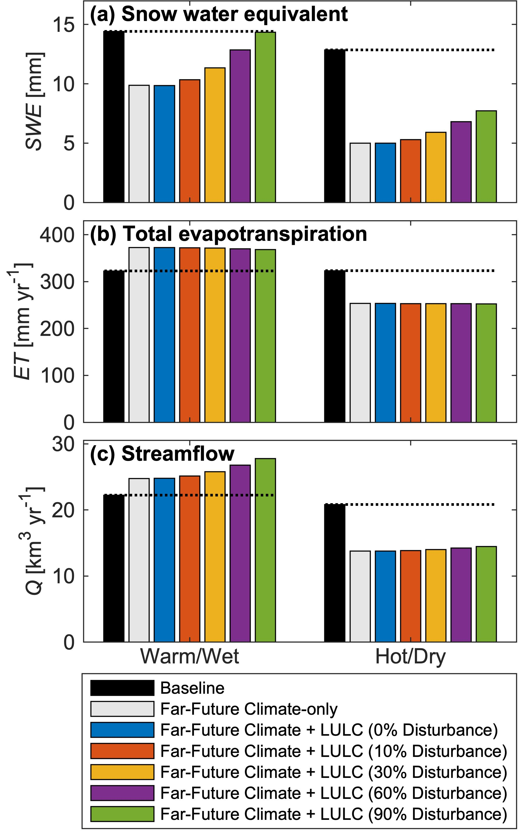
Basin-wide Annual Impacts
(snowpack)
Main forest disturbance impacts:
Snowpack and melt reductions were minimized with the decline in canopy.
Streamflow increase was amplified in the Warm/Wet future.
Streamflow decline was minimized in the Hot/Dry future.
Basin-wide mean annual values in the baseline and far-future for each forest disturbance case under Warm/Wet or Hot/Dry climates.

Slide 20
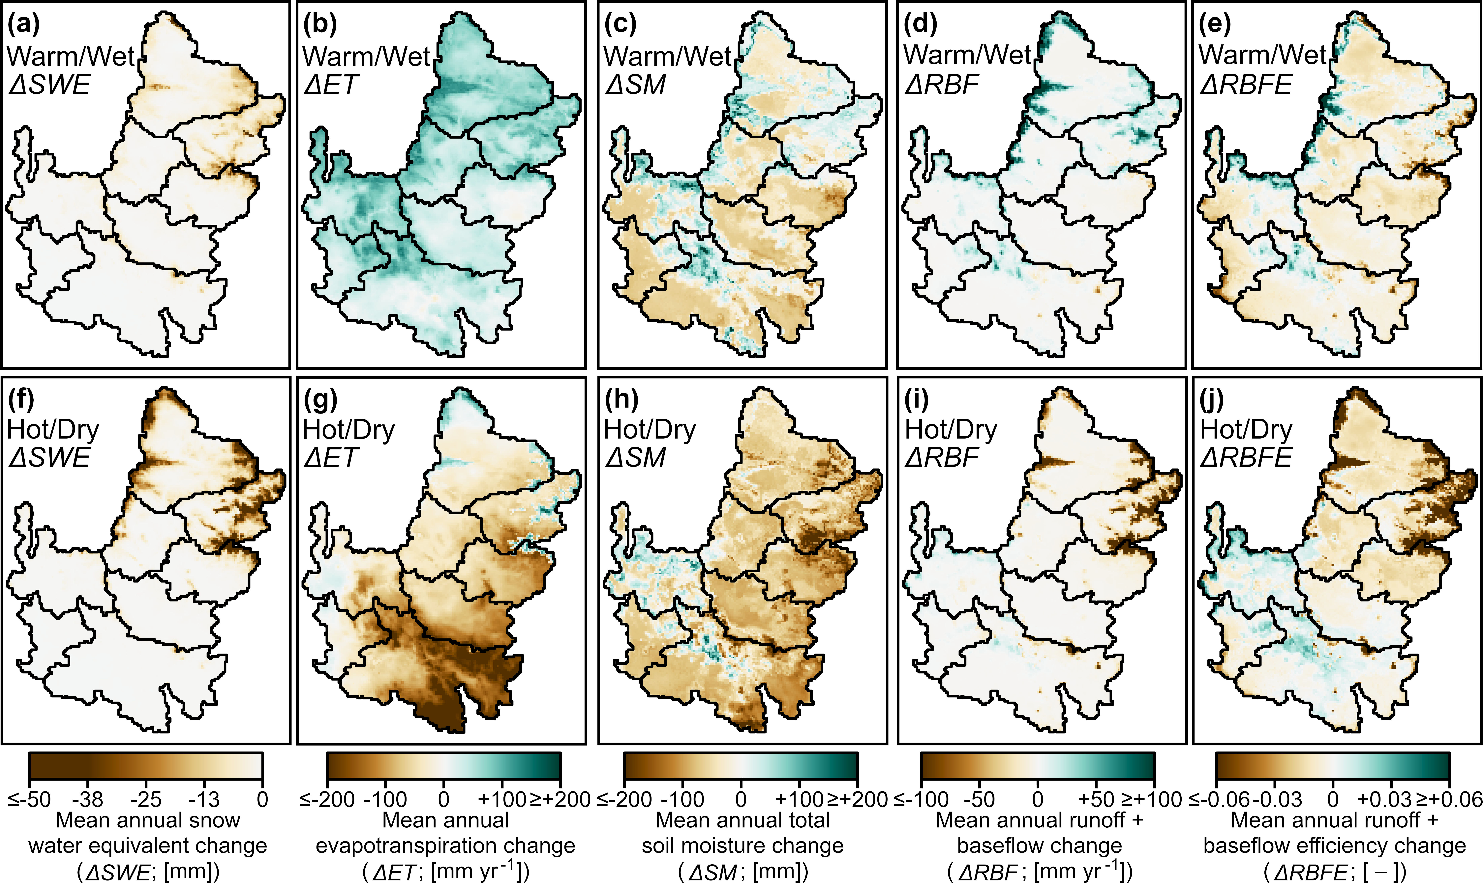
Climate Change Impacts
(No applied forest disturbances)
Streamflow supplies
Efficiency = (R+BF)/P
Streamflow supplies increased where soil moisture increased despite declines in snowpack.
Warm/Wet future amplified energy-limited conditions in key headwater regions with efficiency increases.
Hot/Dry future amplified water- limited conditions with efficiency declines.
Snowpack
Far-future mean annual changes under Warm/Wet or Hot/Dry climates (relative to baseline).

Slide 21
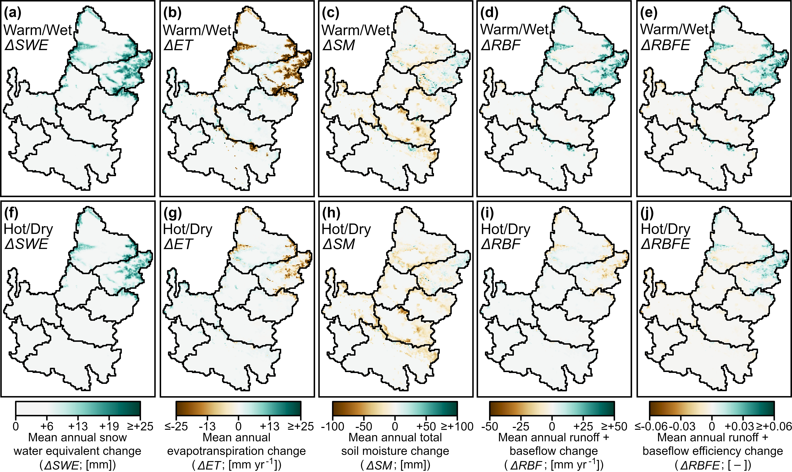
Forest Disturbance Impacts
(Disturbance = with disturbance – without disturbance)
Streamflow supplies
Efficiency = (R+BF)/P
Snowpack
Reduced evapotranspiration and increased snowpack led to increased efficiency.
Impacts were smaller in the more water- limited conditions of the Hot/Dry case.
Climate bookends led to opposite impacts to streamflow supplies in key headwater regions
Far-future mean annual changes with disturbance to 30% of high-elevation forests (relative to no disturbance).

Slide 22
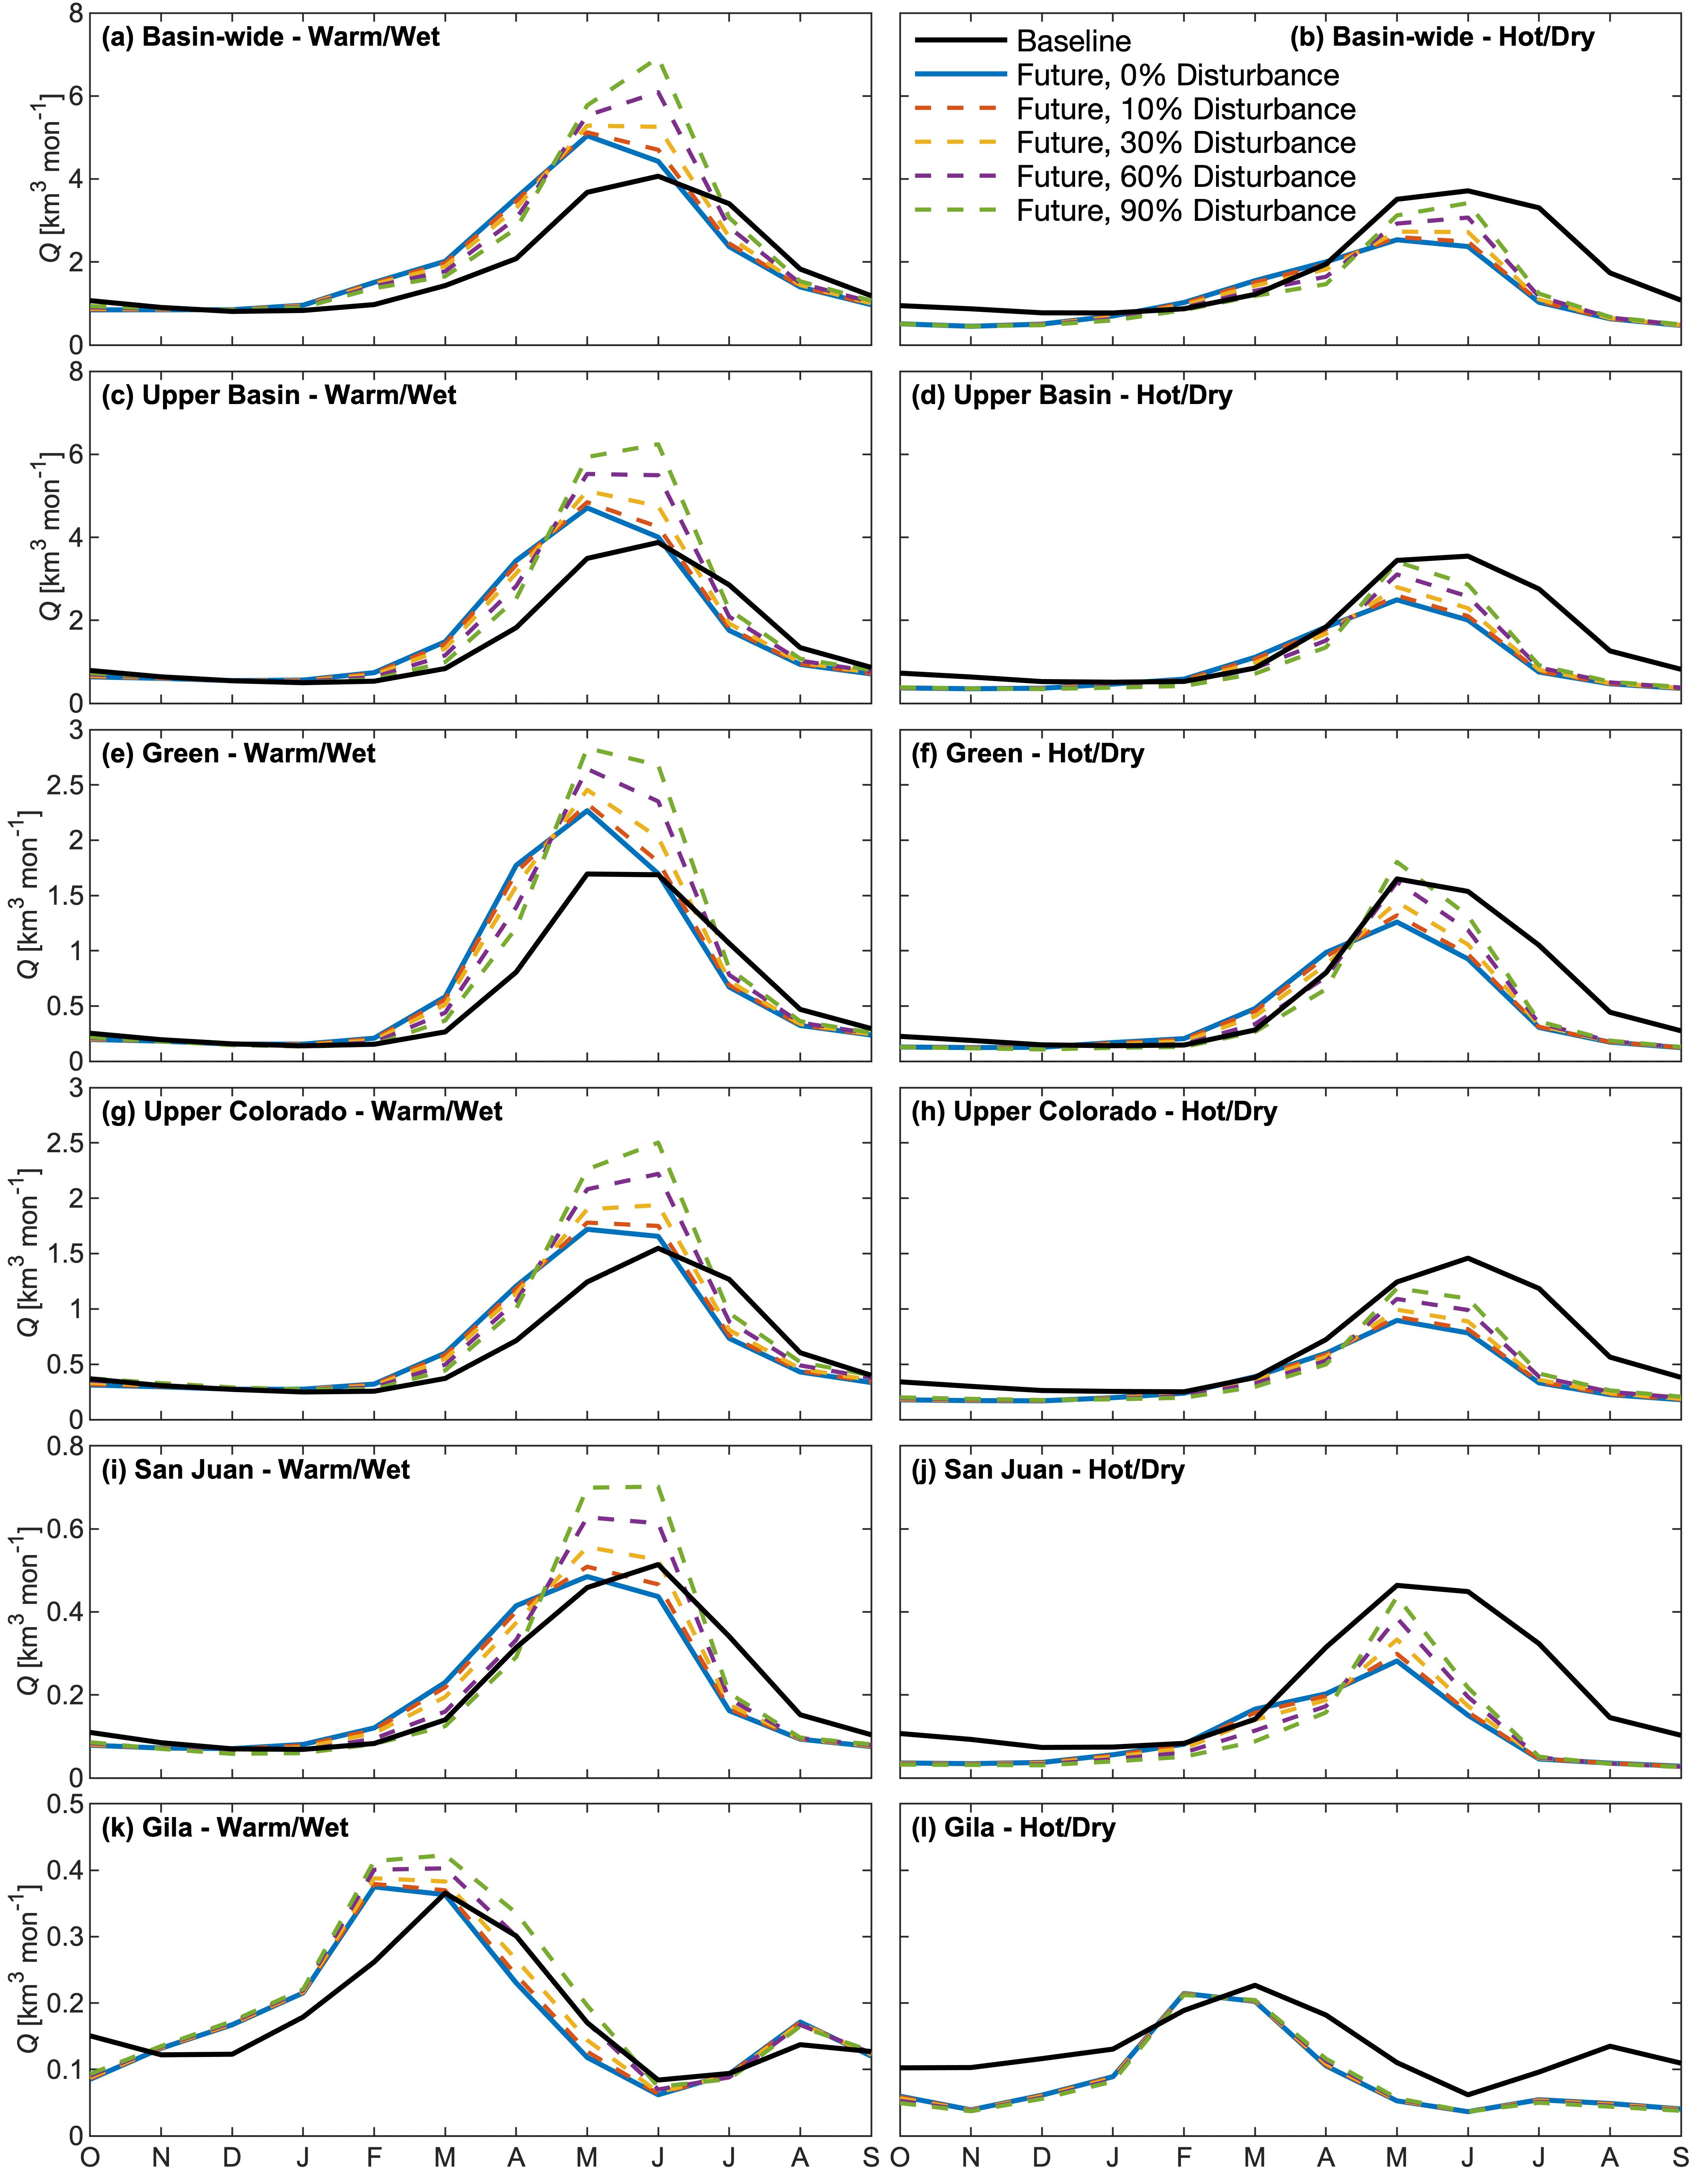
Impacts to Monthly Streamflow
Disturbances increased streamflow in late spring to early winter months. Due to higher ground snowpack and shift in peak snowmelt to later months.
Increased snowmelt reversed climate change effects to streamflow in key months of the Warm/Wet future. Effects were only neutralized in the Hot/Dry future.
Mean monthly basin-wide streamflow in the baseline and future for each forest disturbance case under the Warm/Wet (a) and Hot/Dry (b) climates.

Slide 23
Major Conclusions and Next Steps

Slide 24
Management Impacts
Whitney et al., 2022b. (in prep.)
We developed a stakeholder engagement process and conducted the first basin-wide assessment of forest disturbance impacts to Colorado River hydrology under future climate changes.
Forest disturbances neutralized the warming effects to streamflow. Due to higher ground snowpack and streamflow timing shifts, and smaller evapotranspiration losses.
Forest disturbances did not reverse the climate impacts of the Hot/Dry future. Due to more water-limited conditions. Results are supported by prior subbasin studies.²²⁻³³
Water managers are using our improved simulations to plan for the anticipated changes in streamflow supplies under different climate and land cover futures.
We are also developing a software tool to enable analyses of hydroclimate extremes and other result aspects by endmember stakeholders. (Whitney et al., 2022c, in prep.)

Slide 25
THANK YOU
Manuscripts are in the process of publication.
Kristen Whitney is seeking a postdoctoral position for 2023.
Contact email: kmwhitne@asu.edu
EGU General Assembly
Session HS2.4.2 – Abstract 5757
May 23, 2022

Slide 26
References
Bureau of Reclamation, 2012. Colorado River Basin water supply and demand study. Washington, DC. https://www.usbr.gov/lc/region/programs/crbstudy/finalreport/Executive%20Summary/CRBS_Executive_Summary_FINAL.pdf
Christensen et al., 2004. Climate Change, 62, 337–363. https://doi.org/10.1023/B:CLIM.0000013684.13621.1f
Christensen and Lettenmaier, 2007. Hydrology and Earth System Sciences, 11, 1417–1434. http://doi.org/10.5194/hess-11-1417-2007
MacDonald, 2010. Proceedings of the National Academy of Sciences, 107(50), 21256–21262. https://doi.org/10.1073/pnas.0909651107
McCabe et al., 2017. Bulletin of the American Meteorological Society, 21(10), 1–14. https://doi.org/10.1175/EI-D-17-0007.1
Hoerling et al., 2019. Journal of Climate, 32(23), 8181–8203. https://doi.org/10.1175/JCLI-D-19-0207.1
Milly and Dunne, 2020. Science, 367(6483), 1252–1255. https://doi.org/10.1126/science.aay9187
Lukas et al., 2014. Western water Assessment, University of Colorado Boulder. https://wwa.colorado.edu/climate/co2014report/Climate_Change_CO_Report_2014_FINAL.pdf
Pendergrass et al., 2017. Scientific Reports, 7(1), 17966. https://doi.org/10.1038/s41598-017-17966-y
Harding et al., 2012. Hydrology and Earth System Sciences, 16, 3989–4007. https://doi.org/10.5194/hess-16-3989-2012
Udal and Overpeck, 2017. Water Resources Research, 53, 2404–2418. https://doi.org/10.1002/2016WR019638
Xiao et al., 2018. Water Resources Research, 54, 6739–6756. https://doi.org/10.1029/2018WR023153
Bohn and Vivoni, 2019. Scientific Data, 6, 144. https://doi.org/10.1038/s41597-019-0150-2
McDowell et al., 2016. Nature Climate Change, 6, 295–300. https://doi.org/10.1038/nclimate2873
Allen et al., 2010. Forest Ecology and Management, 259(4), 660–684. https://doi.org/10.1016/j.foreco.2009.09.001
Van Mantgem et al., 2009. Science, 323, 521–524. https://doi.org/10.1126/science.1165000
Zhang et al., 2017. Journal of Hydrology, 546, 44–59. http://dx.doi.org/10.1016/j.jhydrol.2016.12.040
Goeking and Tarboton, 2020. Journal of Forestry, 118(2), 172–192. https://doi.org/10.1093/jofore/fvz069
Buma and Livneh, 2017. Environmental Research Letters, 12(7), 074028. http://dx.doi.org/10.1088/1748-9326/aa7091
Johnson and Kovner, 1956. Forest Science, 2, 82–91.
Li et al., 2018. Journal of Hydrology, 557, 448–459. http://dx.doi.org/10.1016/j.jhydrol.2017.12.056
Buma and Livneh, 2015. Society of American Foresters, 61(5), 895–903. http://dx.doi.org/10.5849/forsci.14-164
Moreno et al., 2016. Hydrology and Earth System Sciences, 20, 1241–1267. https://doi.org/10.5194/hess-20-1241-2016
Williams et al., 2022. Proceedings of the National Academy of Sciences, 119(10), e2114069119. https://doi.org/10.1073/pnas.2114069119
Hallema et al., 2018. Nature Communications, 9, 1307. https://doi.org/10.1038/s41467-018-03735-6
Robles et al., 2015. PLoS ONE, 9(10): e111092. https://doi.org/10.1371/journal.pone.0111092
Livneh et al., 2015. Journal of Hydrology, 523, 196–210. https://doi.org/10.1016/j.jhydrol.2015.01.039
Wine & Cadol, 2016. Environmental Research Letters, 11, 085006. https://doi.org/10.1088/1748-9326/11/8/085006.
Guardiola-Claramonte et al., 2011. Journal of Hydrology, 406, 225–233. http://dx.doi.org/10.1016/j.jhydrol.2011.06.017
Bennett et al., 2018a. Hydrology and Earth System Sciences, 22, 709–725. https://doi.org/10.5194/hess-22-709-2018
Biederman et al., 2022. Water Resources Research, 51(12), 9775–9789. https://doi.org/10.1002/2015WR017401
Yates et al., 2015. Climate Risk Management, 10, 35–50. https://doi.org/10.1016/j.crm.2015.06.001
Biederman et al., 2015. 51(12), 9775–9789. http://dx.doi.org/10.1002/2015WR017401
Biederman et al., 2014a. Water Resources Research, 50(7), 5395–5409. https://doi.org/10.1002/2013WR014994
Bart et al., 2016. PLoS ONE, 11(8), e0161805. https://doi.org/10.1371/journal.pone.0161805
Harpold et al., 2014. Ecohydrology, 7(2), 440–452. http://dx.doi.org/10.1002/eco.1363

Slide 27
References
Stevens, 2017. Ecological Applications, 27(6), 1888–1900. https://doi.org/10.1002/eap.1575
Biederman et al., 2014b. Water Resources Research, 7(1), 150–162. https://doi.org/doi:10.1002/eco.1342
Chen et al., 2015. Journal of Hydrometeorology, 16(2), 744–761. https://doi.org/10.1175/JHM-D-14-0059.1
Zou et al., 2010. Forest Ecology and Management, 259, 1268–1276. http://dx.doi.org/10.1016/j.foreco.2009.08.005
Liang et al., 1994. Journal of Geophysical Research, 99(D7), 14415. https://doi.org/10.1029/94JD00483
Hamman et al., 2018. Geoscientific Model Development, 11, 3481–3496. https://doi.org/10.5194/gmd-11-3481-2018
Lohmann et al., 1996. Tellus 48A, 708–721. https://doi.org/10.1034/j.1600-0870.1996.t01-3-00009.x
Lohmann et al., 1998. Hydrological Sciences Journal, 43, 131–141. https://doi.org/10.1080/02626669809492107
Livneh et al., 2013. Journal of Climate, 26, 9384–9392. https://doi.org/10.1175/JCLI-D-12-00508.1
Pierce et al., 2014. Journal of Hydrometeorology, 15, 2558–2585. https://doi.org/10.1175/JHM-D-14-0082.1
Gautam & Mascaro, 2018. International Journal of Climatology, 38, 3861–3877. https://doi.org/10.1002/joc.5540
Bohn et al., 2013. Agricultural and Forest Meteorology, 176, 38–49. https://doi.org/10.1016/j.agrformet.2013.03.003
Bennett et al., 2020. Journal of Open Source Software, 5(47), 2042. https://doi.org/10.21105/joss.02042
Bohn, Whitney, Mascaro, & Vivoni, 2019. Journal of Hydrometeorology, 20(2), 298–317. https://doi.org/10.1175/JHM-D-18-0203.1
Diamond et al., 2013. Bulletin of the American Meteorological Society, 94, 485–498. https://doi.org/10.1175/bams-d-12-00170.1
Bohn et al., 2019. Journal of Hydrometeorology, 20(2), 298–317. https://doi.org/10.1175/JHM-D-18-0203.1
USGS et al., 2016. USGS National Elevation Dataset (NED) 1 arcsecond downloadable data collection from The National Map 3D Elevation Program (3DEP) - National Geospatial Data Asset (NGDA) National Elevation Data Set (NED). https://www.usgs.gov/core-science-systems/ngp/tnm-delivery
Bennett et al., 2018b. Water Resources Research, 54, 132–149. https://https://doi.org/10.1002/2017WR020471
Sohl et al., 2016. Ecological Modelling, 337, 281–297. http://dx.doi.org/10.1016/j.ecolmodel.2016.07.016
Sleeter et al., 2012. Global Environmental Change, 22, 896–914. http://dx.doi.org/10.1016/j.gloenvcha.2012.03.008
Rother et al., 2015. Journal of Forest Research, 45(11), 1607–1616. https://doi.org/10.1139/cjfr-2015-0033
Haffey et al., 2018. Fire Ecology, 14(1), 143–160. https://doi.org/10.4996/fireecology.140114316
Litschert et al., 2012. Forest Ecology and Management, 269, 124–133. http://dx.doi.org/10.1016/j.foreco.2011.12.024
Whitney et al., 2022a. Water Resources Research. (in review)
Whitney et al., 2022b. Journal of American Water Resources Associations. (in prep)
Whitney et al., 2022c. Environmental Modelling & Software. (in prep)

Slide 28
Supplemental Slides
Notes:
Background literature and project overview

Slide 29
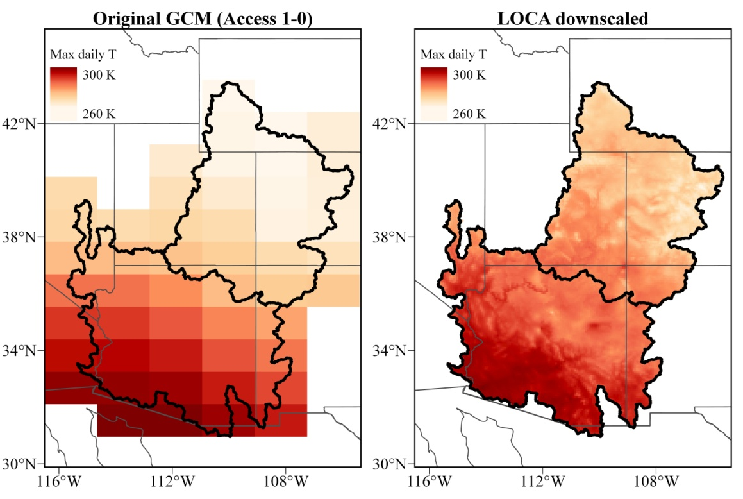
Selected Climate Forcings
Outputs from General Circulation Models (GCMs) of CMIP5 Statistically downscaled (6-km) using LOCA (Locally Constructed Analogs).⁴⁶
Daily precipitation and min/max air temperature For 1950-2005 (historical emissions) and 2006-2100 under low and high emission scenarios (rcp 4.5, 8.5).
Selected eight GCMs from the LOCA products that more reliably reproduce seasonal climatology in the basin.⁴⁷ Two were then selected from this ensemble for the climate bookends.
Title goes here
Title goes here
Comparison of original climate model output to LOCA-downscaled product.

Slide 30
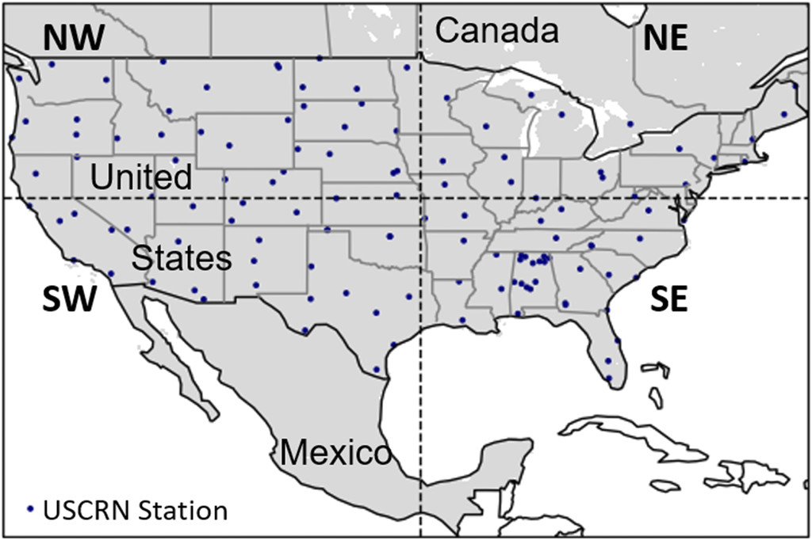
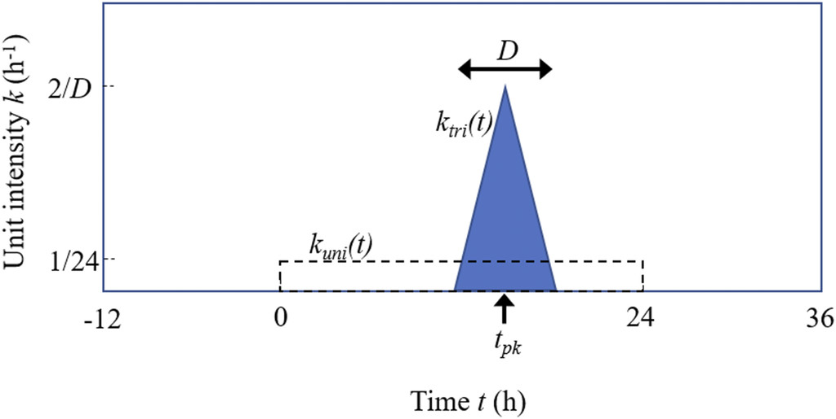
Model Enhancements
More realistic disaggregation of daily precipitation to hourly resolutions
Prior VIC studies distributed daily precipitation uniformly Causes streamflow biases of -11%.
We developed the use of a triangular hyetograph (PITRI) Event duration and time to peak intensity based on US Climate Reference Network (USCRN) observations.
New approach substantially improved streamflow results Annual and seasonal biases of less than 1% at all stations.
Title goes here
Bohn et al. (2018) study domain and station locations.
Title goes here
Two storm event disaggregation types.
Bohn, Whitney, Mascaro, & Vivoni. 2019. J. of Hydromet. doi: 10.1175/JHM-D-18-0203.1
Notes:
Skills github

Slide 31
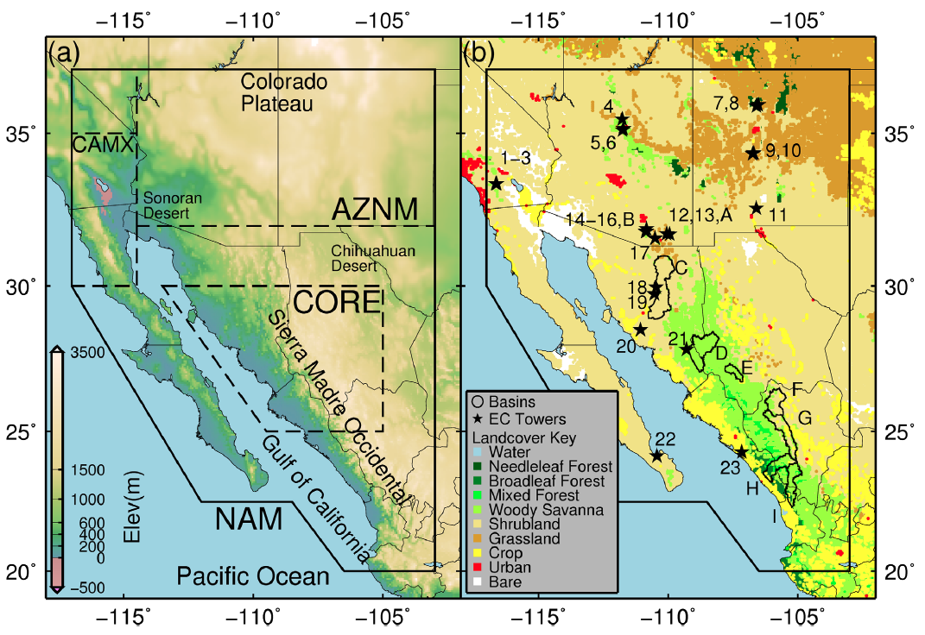
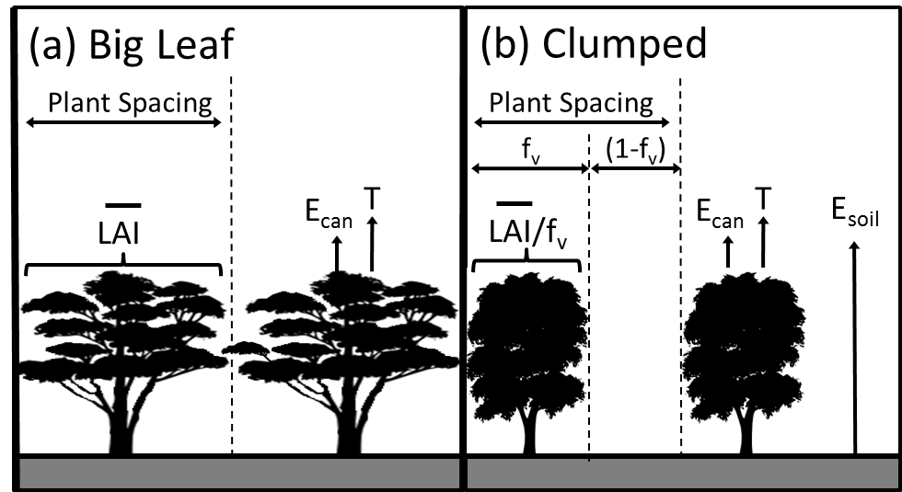
Model Enhancements
More realistic evapotranspiration (ET)
Prior VIC studies used a “big-leaf” formation No bare soil evaporation (E_{soil}) from inter-canopy spaces. Underestimates ET in southwest landscapes (biases up 10 49%).
We use of a “clumped” canopy approach to account for Transpiration (T) in vegetated fractions (f_{v}) and E_{soil} elsewhere (1- f_{V}).
Moderate Resolution Imaging Spectrometer (MODIS) products were used to estimate f_{v} and monthly leaf area index (LAI) values.
Comparisons to eddy covariance tower (ECT) data revealed significant improvement in estimations of ET (biases < 5%).
Title goes here
North American Monsoon (NAM) study region showing elevation (left), land cover and EC tower locations (right)
Title goes here
Bohn & Vivoni. 2016. Water Resour. Res. doi: 10.1002/2015WR017934
Two canopy schemes for evapotranspiration.
Notes:
Skills github

Slide 32
Model Enhancements
Parameters were updated using remote-sensing products (see next slide for more info)
Red box highlights selected products. Table from: Bohn & Vivoni. 2019. Nature Sci. Data. doi: 10.1038/s41596-019-0150-2

Slide 33
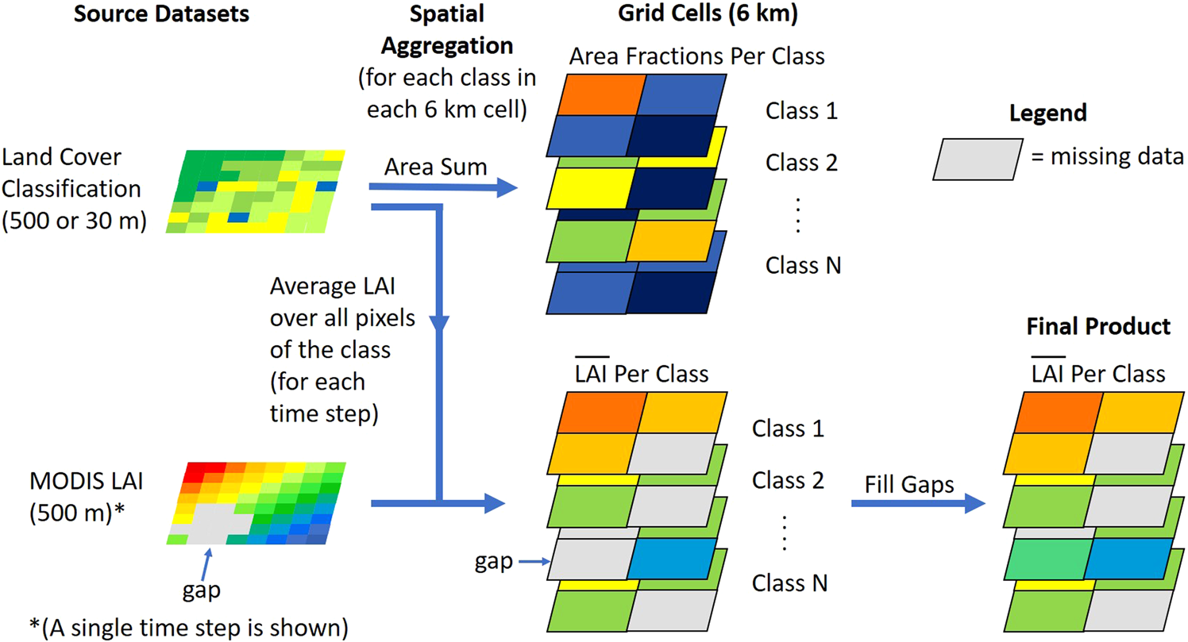
Model Enhancements
Updated land cover classifications to include 2011 maps from: - National Land Cover Datasets (NLCD) for US. - Instituto Nacional de Estadística y Geografía (INEGI) for Mexico.
Moderate Resolution Imaging Spectroradiometer (MODIS) Used to derive monthly-varying: - Leaf Area Index (LAI), - Normalized Difference Vegetation - (NDVI), and Albedo.
Example process flow for monthly Leaf Area Index (LAI) parameter estimation.
Bohn & Vivoni. 2019. Nature Sci. Data. doi: 10.1038/s41597-019-0150-2
Notes:
Skills github

