Slide 1







Tectonic activity at the Mangatolu triple junction and the Fonualei Rift and Spreading Center: breaking apart the intra-oceanic Niuafo’ou-Tonga microplate, Lau Basin, southwest Pacific Ocean
Anouk Beniest^{1,2}
a.beniest@vu.nl
Michael Schnabel³, Udo Barckhausen³, Anke Dannowski², Florian Schmid², Michael Riedel², Anna Jegen², Heidrun Kopp²
1. Vrije Universiteit Amsterdam, Amsterdam, Netherlands
2. GEOMAR Helmholtz Centre for Ocean Research Kiel, Kiel, Germany
3. BGR Federal Institute for Geosciences and Natural Resources, Hannover, Germany
EGU22, 27 May 2022

Slide 2
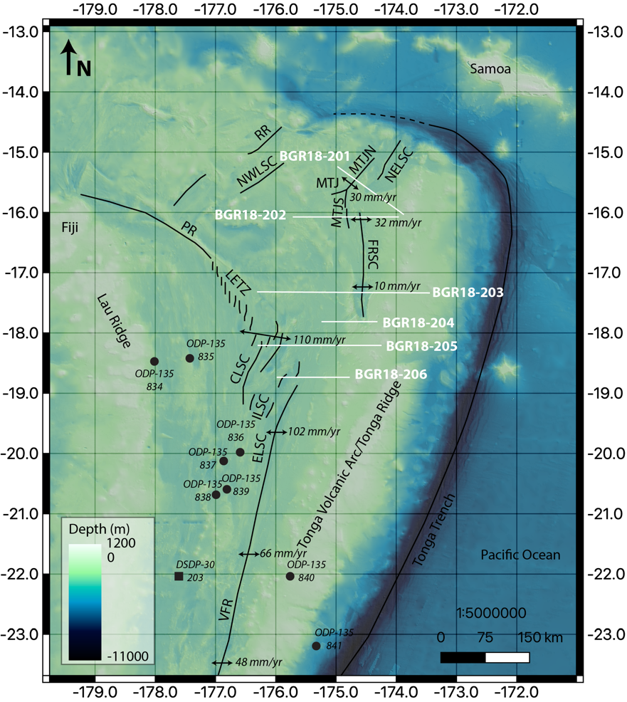
Click on the audio icon
for an explanation!
Where is
this???
Main observation:
Extension in the northern Lau Basin is accommodated along to major extensional zones:
the Fonualei Rift and Spreading Center
the Central Lau Spreading Center.
Niuafo’ou
Plate
Objective
How is extension accommodated in the northern Lau Basin?
?
Australian Plate
Tonga
Plate
Click on the orange profiles
For our Reflection Seismic data results.
Click on the ?
to learn all about the diffusive plate boundary.
Click here for the analogue model that can explain the tectonic history!
Beniest et al., in prep.

Slide 3
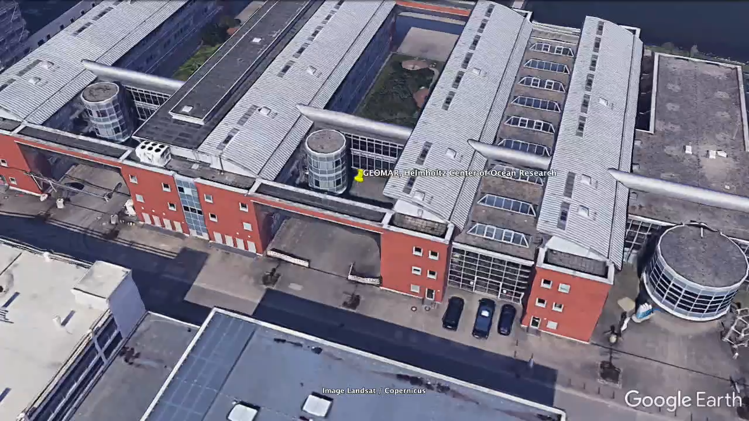
Home

Slide 4
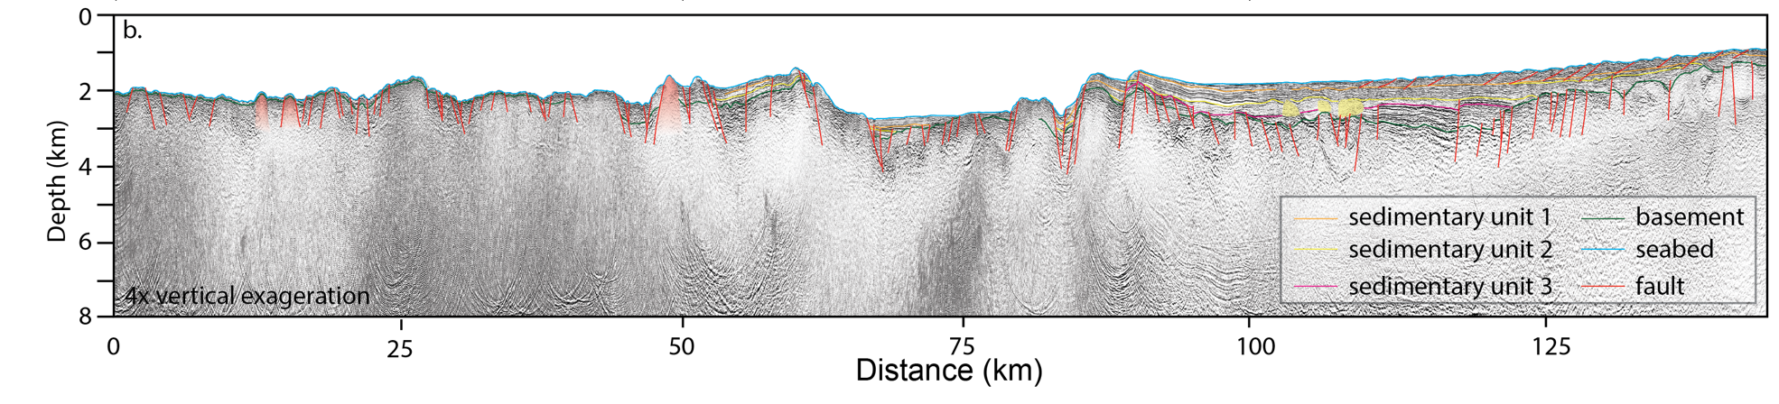

BGR18-201
Westward-dipping
faults
NW
Covered
Basement Fault
Mongatulo Triple Junction
SE
Covered
Basement Fault
Rift shoulders
Volcanoes
Bright spots
Surfacing
Basement Fault
Beniest et al., in prep.
Observations:
Two bathymetric highs are interpreted as the the rift-shoulders
One set of faults cross-cut the basement
In the East they do not reach the surface, covered by a thick sediment package
In the West they are covered in only a thin layer in sediments
A second set of faults cross-cut the basement but reach the surface.
A third set of westward-dipping faults are observed in the sediments
Some hill-shaped features with high acoustic impedance are interpreted as volcanoes
Some bright spots are observed in the thick sediment package
Go straight to:
Magnetic and echo sounding data
Tectonic evolution
Home

Slide 5
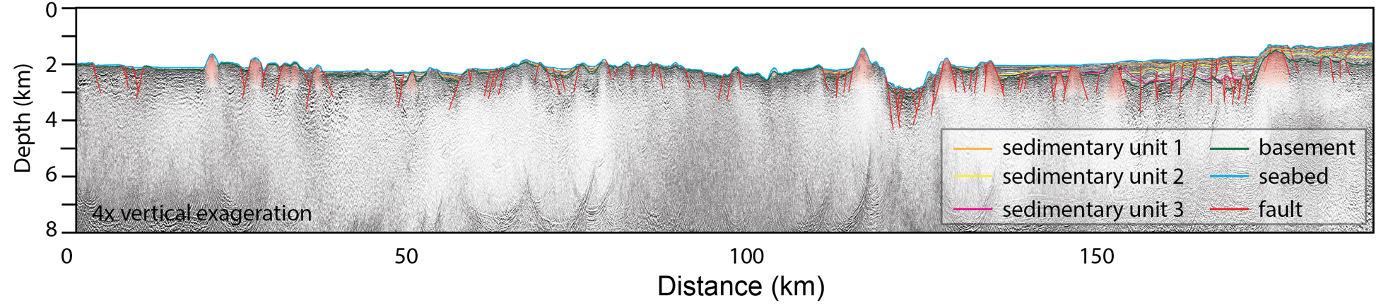
BGR18-202
Westward-dipping
faults
Mongatulo Triple Junction
W
Covered
Basement Fault
Covered
Basement Fault
E
Rift shoulders
Volcanoes
Surfacing
Basement Fault
Beniest et al., in prep.
Observations:
Two bathymetric highs are interpreted as the the rift-shoulders
One set of faults cross-cut the basement
In the East they do not reach the surface, covered by a thick sediment package
In the West they are covered in only a thin layer in sediments
A second set of faults cross-cut the basement but reach the surface.
A third set of westward-dipping faults are observed in the sediments
Some hill-shaped features with high acoustic impedance are interpreted as volcanoes
Go straight to:
Magnetic and echo sounding data
Tectonic evolution
Home

Slide 6
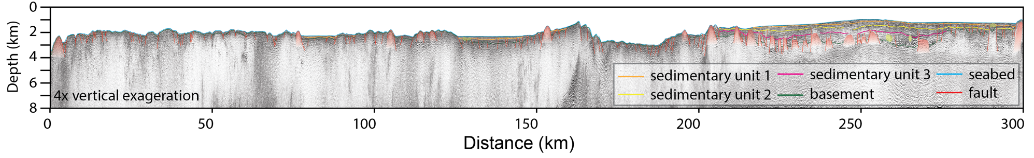
BGR18-203
Covered
Basement Fault
Fonualei Rift and Spreading Center
Westward-dipping
faults
W
Rift shoulders
Covered
Basement Fault
E
?
Volcanoes
Bright spots
Surfacing
Basement Fault
Beniest et al., in prep.
Modified after Schmid et al., 2020
Observations:
At least one bathymetric highs is interpreted as the the rift-shoulder
One set of faults cross-cut the basement
In the East they do not reach the surface, covered by a thick sediment package
In the West they are covered in only a thinner layer in sediment.
A second set of faults cross-cut the basement but reach the surface.
A third set of westward-dipping faults are observed in the sediments
Some hill-shaped features with high acoustic impedance are interpreted as volcanoes
Some bright spots are observed in sediment packages
Go straight to:
Magnetic and echo sounding data
Tectonic evolution
Home

Slide 7
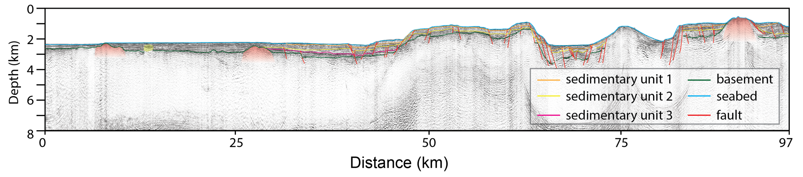
BGR18-204
Fonualei Rift and Spreading Center
W
Covered
Basement Fault
Covered
Basement Fault
Rift shoulders
E
Surfacing
Basement Fault
Bright spots
Volcanoes
Beniest et al., in prep.
Observations:
Two bathymetric highs are interpreted as the the rift-shoulders
One set of faults cross-cut the basement and are covered in sediments.
A second set of faults cross-cut the basement but reach the surface.
Some hill-shaped features with high acoustic impedance are interpreted as volcanoes
Go straight to:
Magnetic and echo sounding data
Tectonic evolution
Home

Slide 8
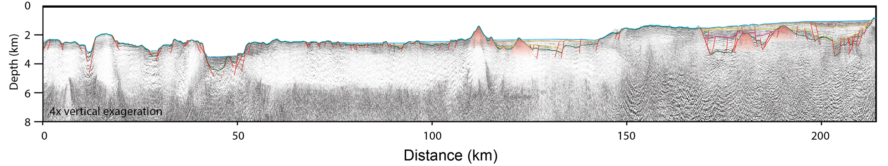
BGR18-205
Central Lau Spreading Center
Westward-dipping
faults
W
Covered
Basement Faults
Covered
Basement Faults
E
Surfacing
Basement Fault
Volcanoes
Beniest et al., in prep.
Observations:
One set of faults cross-cut the basement
In the East they do not reach the surface, covered by a thick sediment package
In the West they are covered in only a thinner layer in sediments
A second set of faults cross-cut the basement but reach the surface.
A third set of westward-dipping faults are observed in the sediments
Some hill-shaped features with high acoustic impedance are interpreted as volcanoes
Some bright spots are observed in the thick sediment package
Go straight to:
Magnetic and echo sounding data
Tectonic evolution
Home

Slide 9
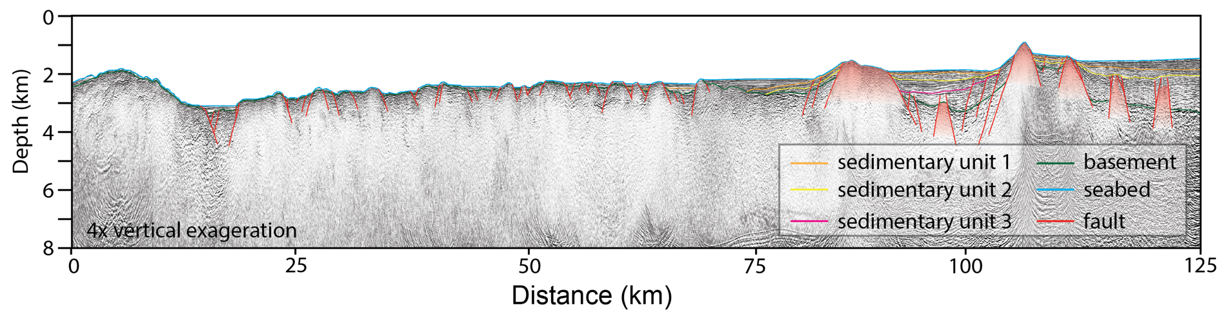
BGR18-206
Central Lau Spreading Center
W
Covered
Basement Fault
Covered
Basement Fault
E
Surfacing
Basement Fault
Volcanoes
Beniest et al., in prep.
Observations:
One set of faults cross-cut the basement
In the East they do not reach the surface, covered by a thick sediment package
In the West they are covered in only a thin layer in sediments
A second set of faults cross-cut the basement but reach the surface.
Some hill-shaped features with high acoustic impedance are interpreted as volcanoes
Go straight to:
Magnetic and echo sounding data
Tectonic evolution
Home

Slide 10
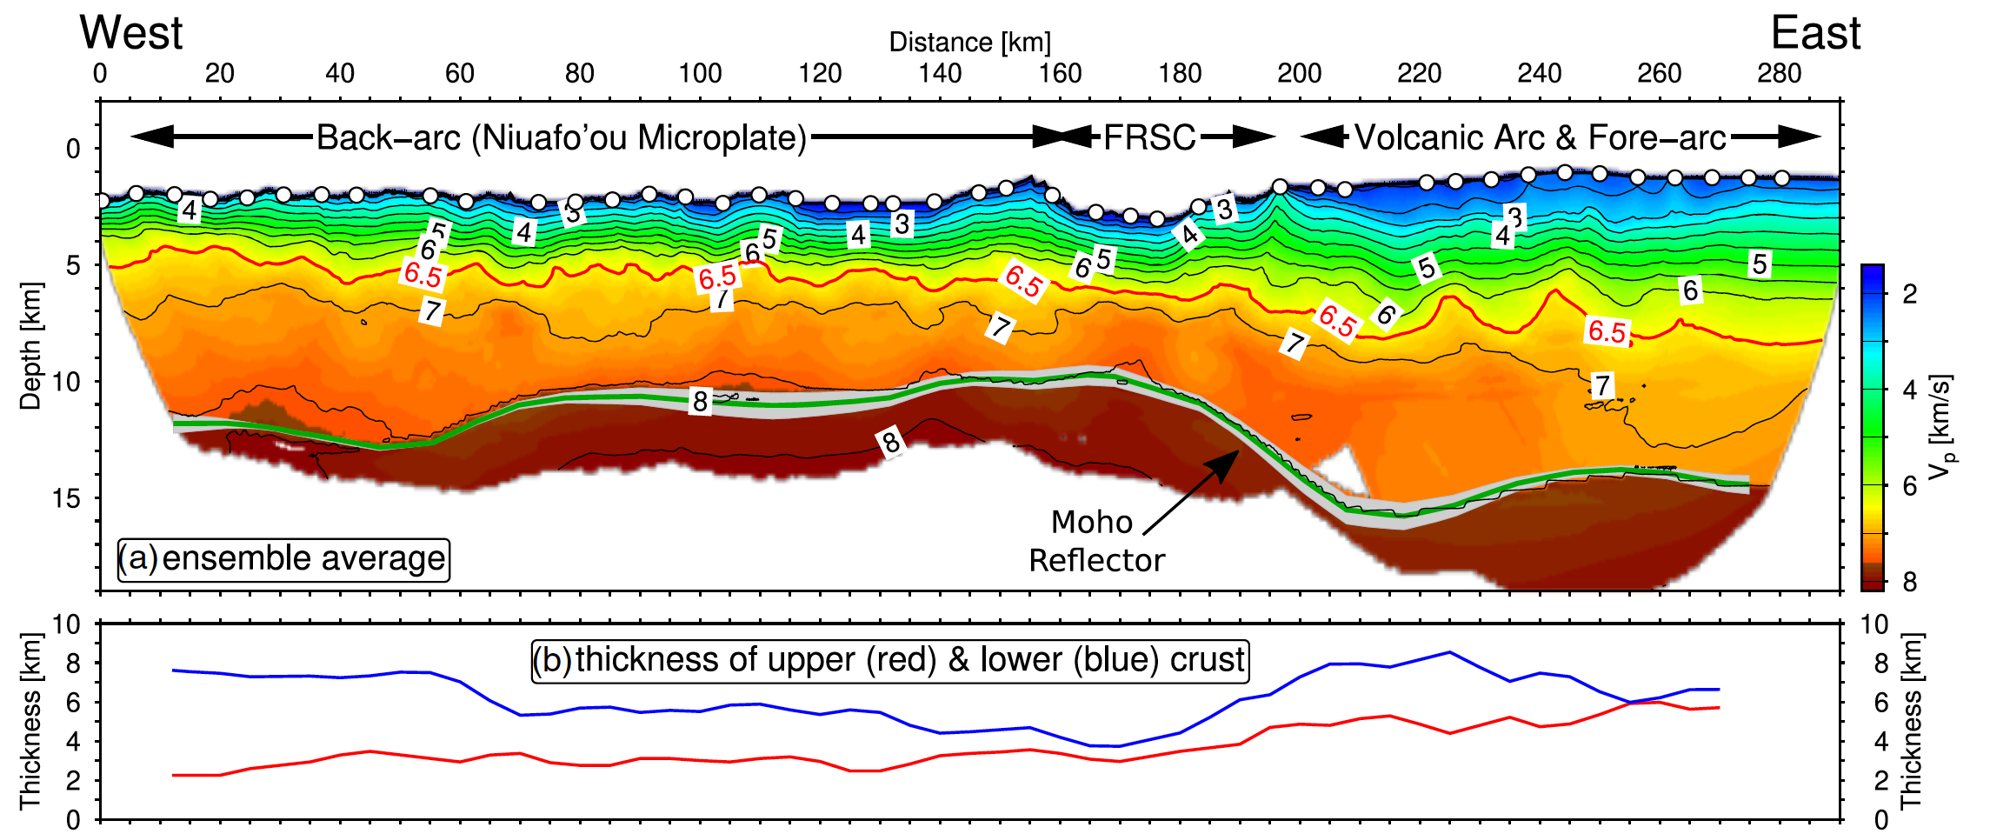
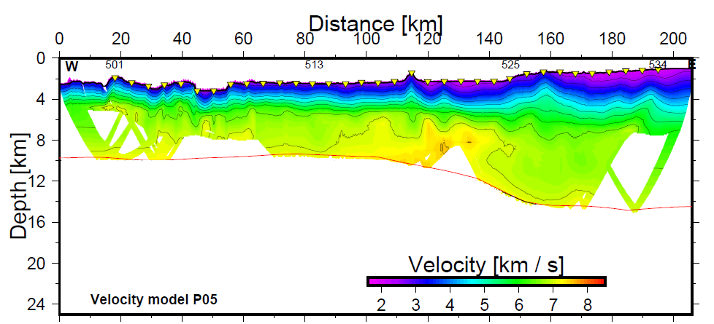
Refraction seismic data
a. BGR18-203
Schmid et al., 2020
Along profile P03:
• Back-arc crust is 11 km thick.
• Arc-crust is 13-14 km thick.
• Western part different crustal domain, perhaps arc-crust?
b. BGR18-205
Along profile P05:
• Back-arc crust is 10 km thick.
• Arc-crust is 13-14 km thick.
• Western part different crustal domain, perhaps arc-crust?
Beniest et al., in prep.
Go straight to:
Conclusions
Home
Seismic data
Tectonic evolution
Conclusions

Slide 11
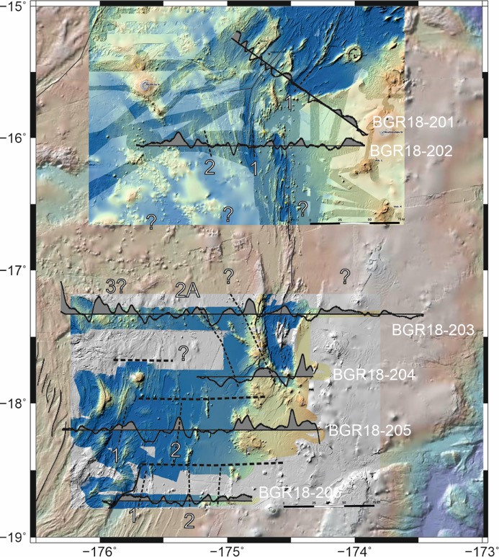
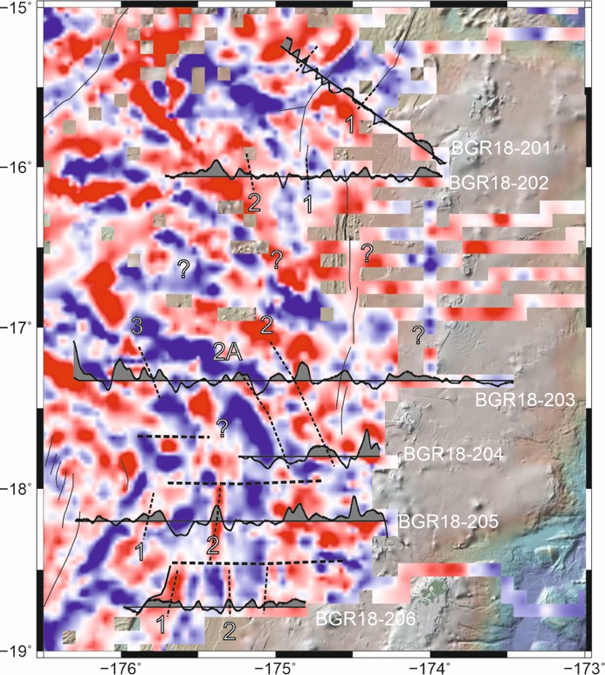
Magnetic data
a.
b.
The magnetic data are complex, with potential older (> 5 Ma) crust towards the west of the FRSC.
The magnetic data is used to estimate the timing of basin formation and sediment accumulation.
Beniest et al., in prep.
a. Map of the northern Lau Basin, overlain with the results for the forward magnetic model, the magnetic anomaly data profiles and the identified chrons. No data is available in between BGR18-202 and BGR18-203, which means no chrons have been identified in this region. Horizontal dashed lines are profiles from the forward model (b). Fine dashed lines correlate the chrons across profiles.
Go straight to:
Conclusions
Home
Seismic data
Tectonic evolution
Conclusions

Slide 12
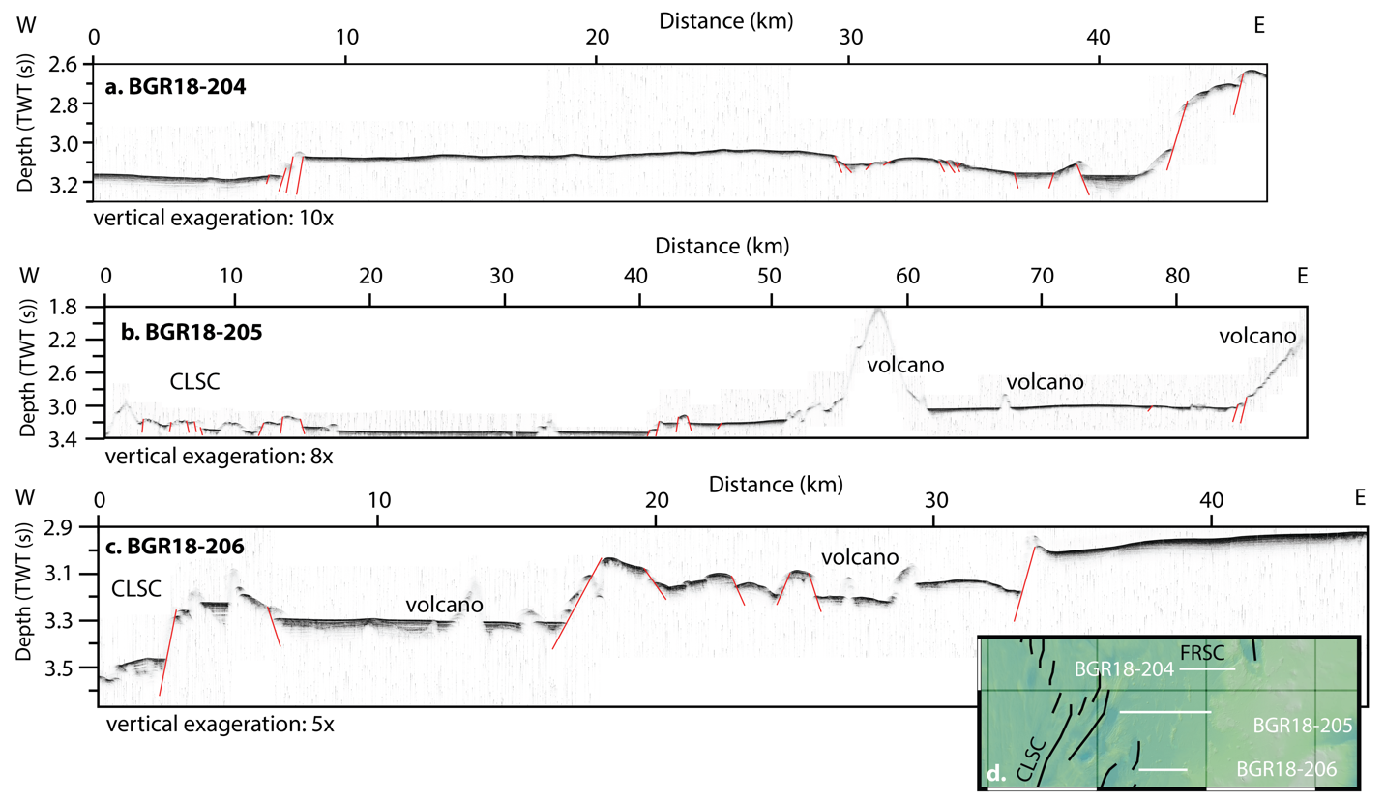
Echo sounding data
The echosound data show no recent active faulting in the basins that accumulated sediments in the diffuse deformation zone.
Beniest et al., in prep.
Go straight to:
Conclusions
Home
Seismic data
Tectonic evolution
Conclusions

Slide 13

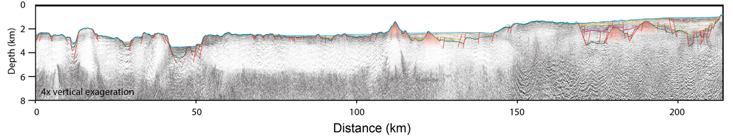

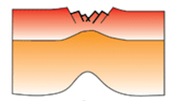
Tectonic evolution of the area
Central Lau Spreading Center
BGR18-205
W
Westward-dipping
faults
Covered
Basement Faults
Covered
Basement Faults
E
Surfacing
Basement Fault
Volcanoes
Beniest et al., in prep.
The inactive, covered basement faults are widespread and suggest an initial wide-rift extensional tectonic phase.
The active faults reaching the surface are observed in specific areas and suggest a second wide-rift extensional tectonic phase.
No clear plate boundary observed on reflection seismic data in this region.
?
Go straight to:
Seismic data
Magnetic and echo sounding data
Conclusions
Home

Slide 14
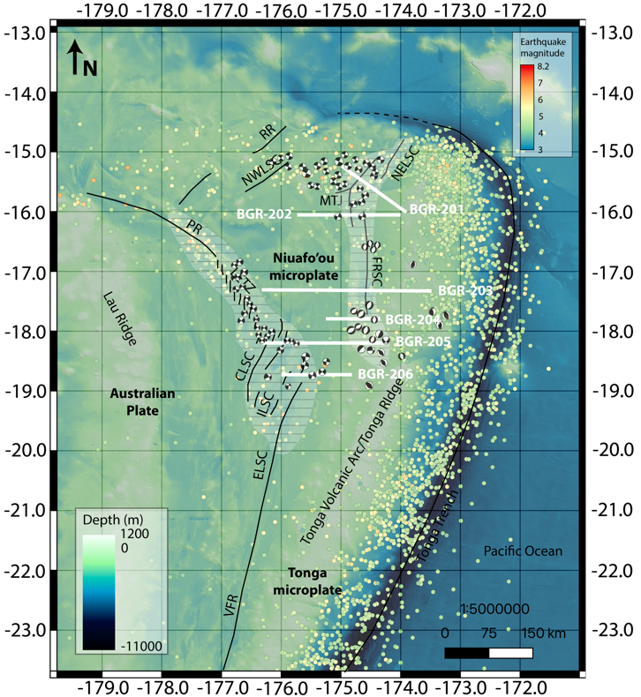
How is extension accommodated in the northern Lau Basin?
Two extensional phases, wide followed by narrow, concentrated now around CLSC and MTJ-FRSC extensional zones.
The MTJ-FRSC, should be regarded as single large extensional zone.
No plate boundary in between Niuafo’ou and Tonga microplates.
?
In conclusion!
Go back to:
Seismic data
Magnetic and echo sounding data
Tectonic evolution
Home

