Slide 1

Lithospheric
thermo-chemical heterogeneity
and density structure of
the Siberian craton
and
the West Siberian Basin
Alexey Shulgin - CEED University of Oslo, Geomap Norge, Norway
Irina Artemieva - GEOMAR, Kiel, Germany

Slide 2
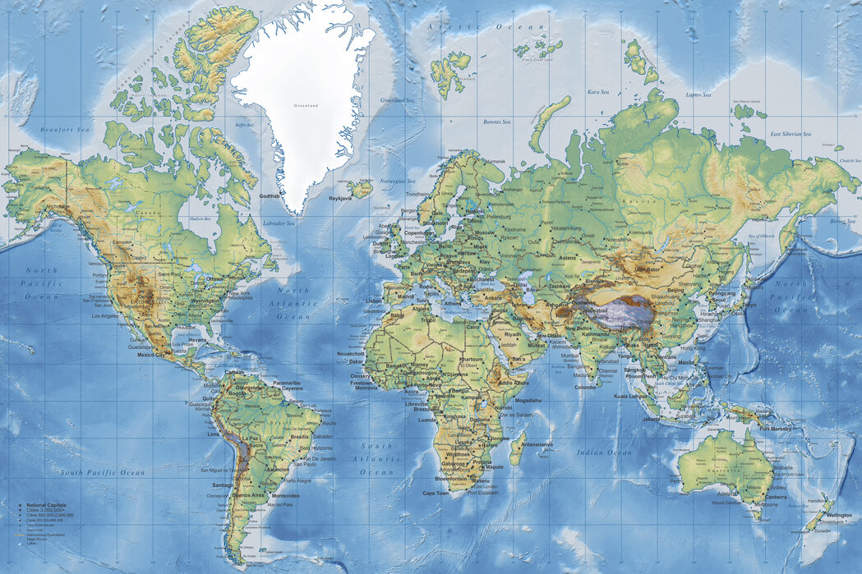
Geological and Tectonic overview
Crustal ages – from Archean to Mesozoic
Several pulses of magmatism and large-scale rifting
Large area covered by the Siberian traps, the extent is debated
Data on sedimentary cover - controversial
Lithosphere structure - controversial
SC
SC
WSB
WSB
Cherepanova et al., 2013

Slide 3
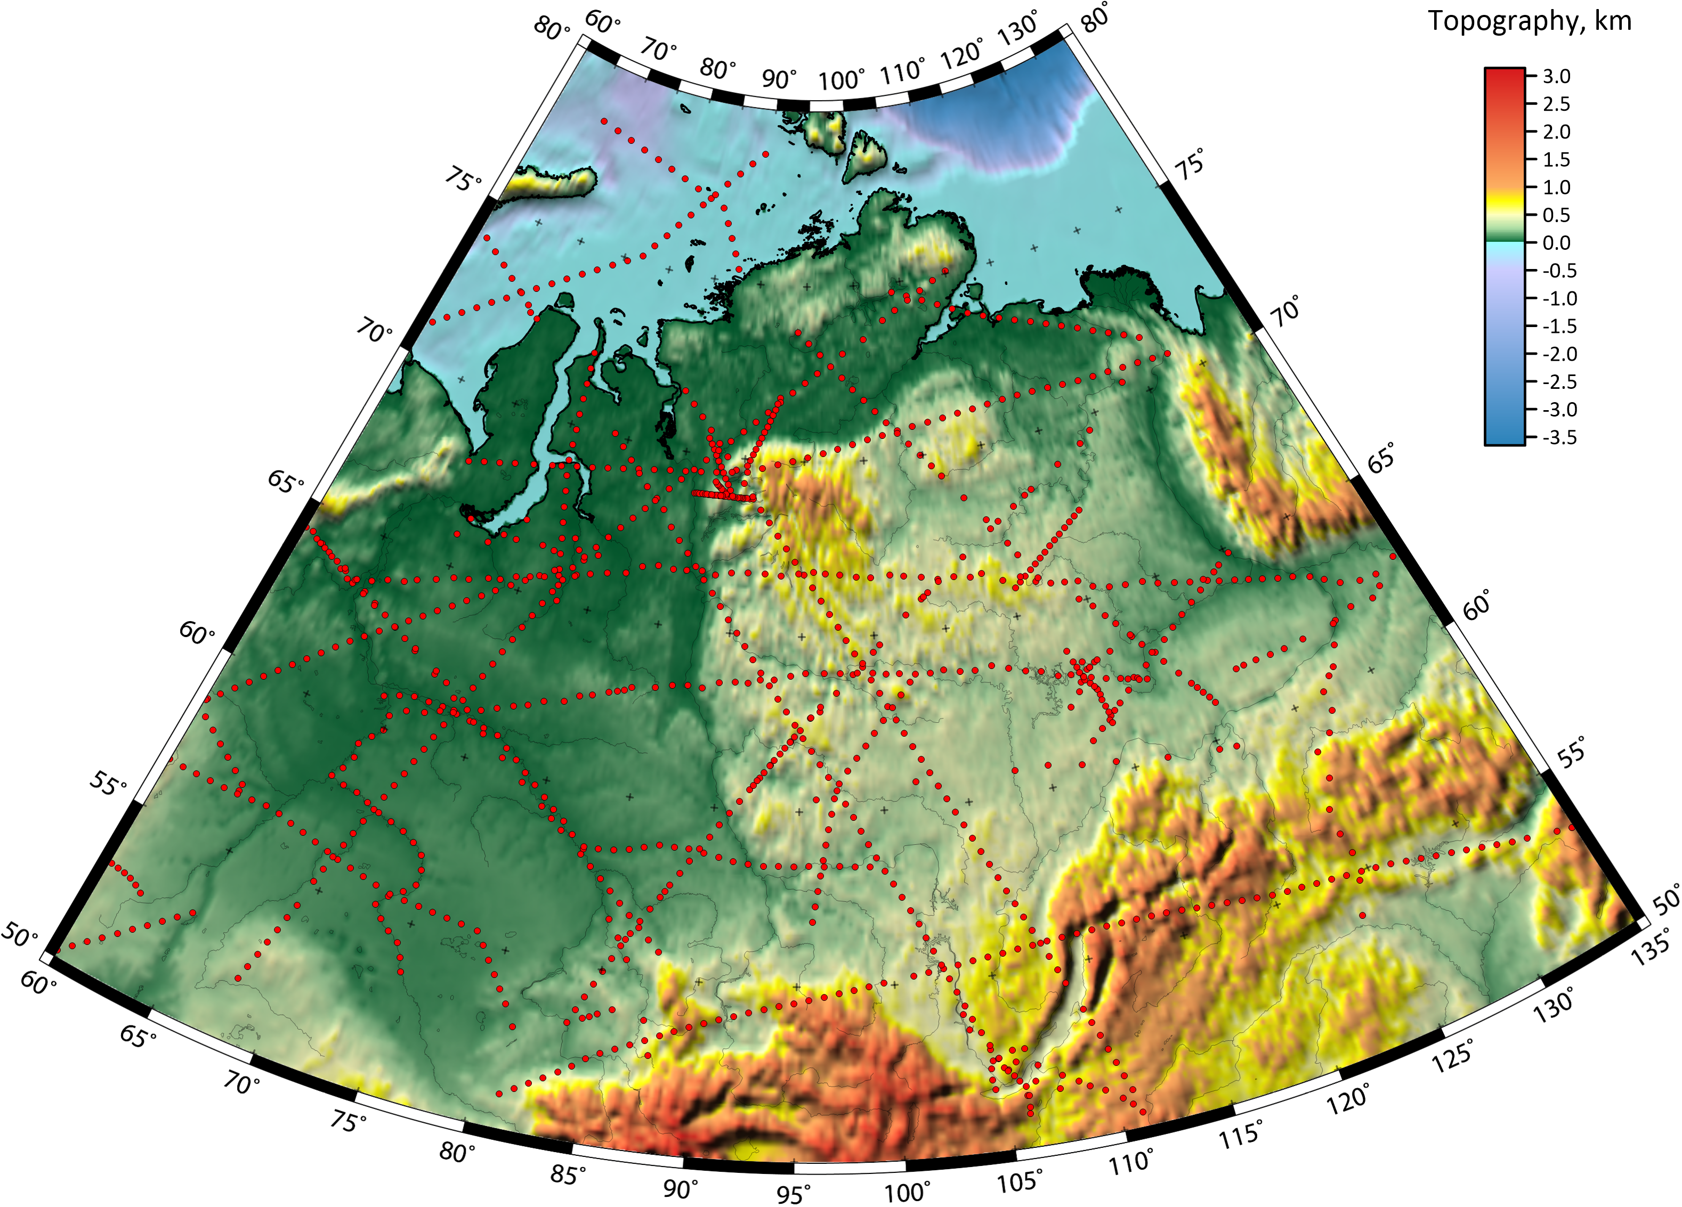
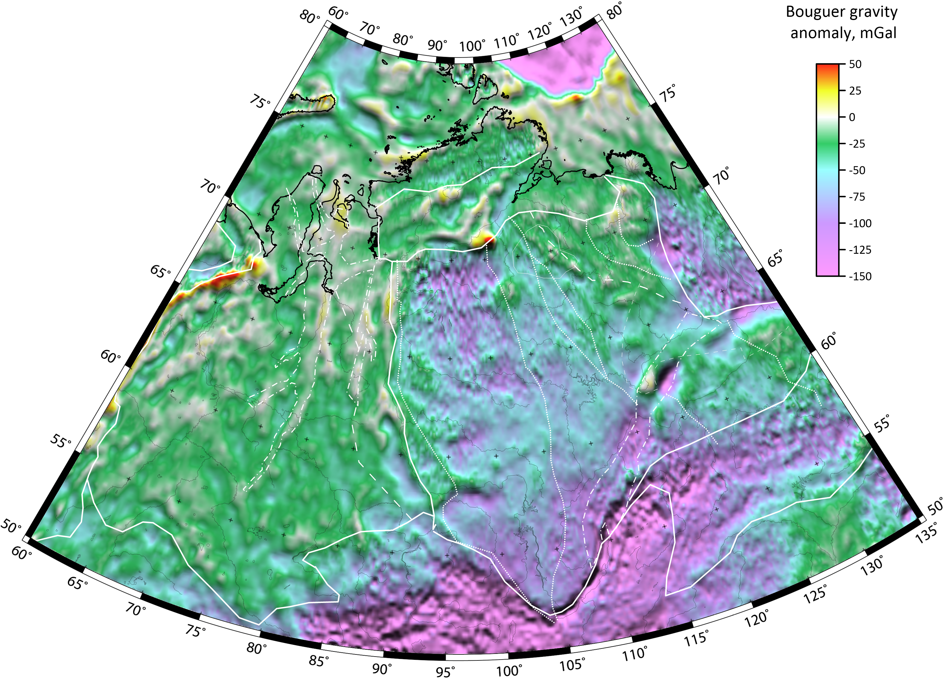
3D gravity modeling
Step 1: Remove crustal gravitational signature (using SibCrust database)
Step 2: Residual gravity anomalies, confined to the layer between Moho and LAB, are
converted to LM (lith. mantle) density structure
The model is computed on a 0.2°x 0.2° grid down to 400 km depth.
ETopo
Red lines - seismic profiles constraining the SibCrust
crustal database Cherepanova et al., 2013
Bouguer gravity anomaly
(XGM 2016), range -150 to +50 mGal

Slide 4
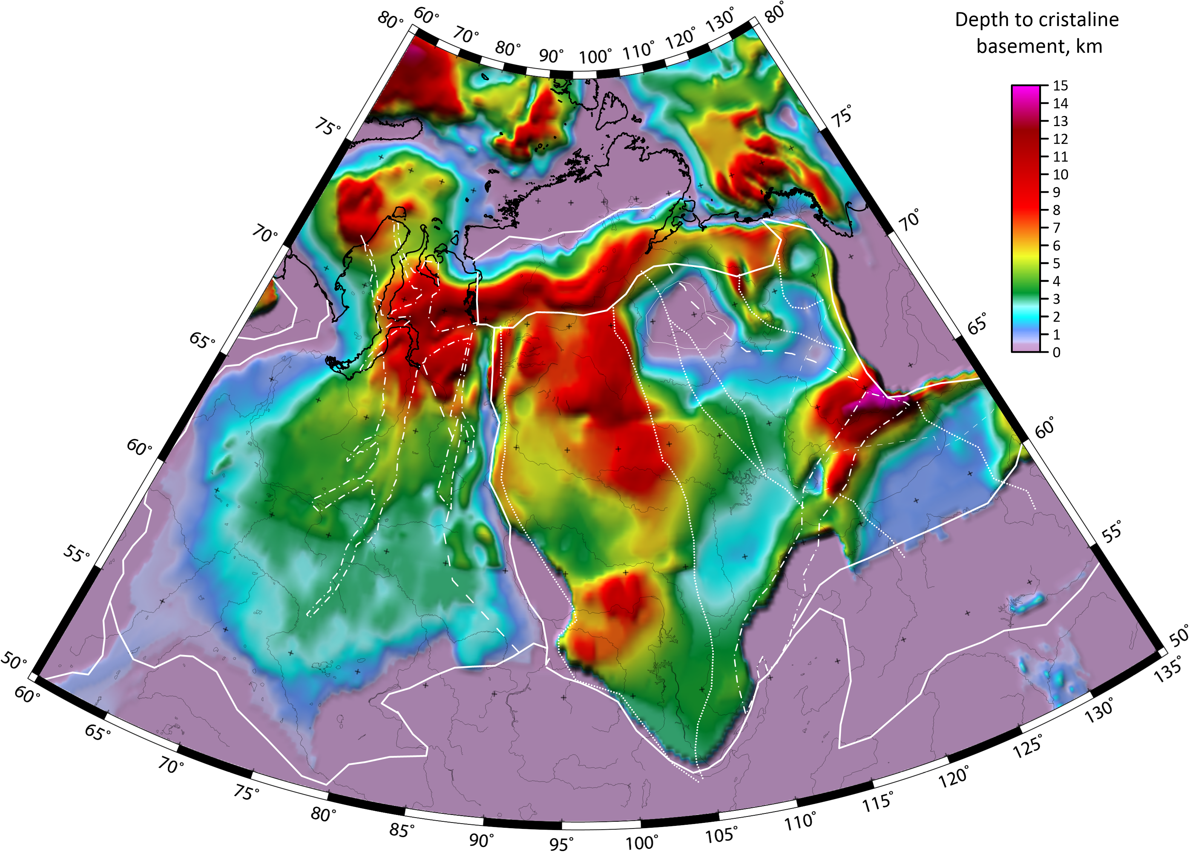
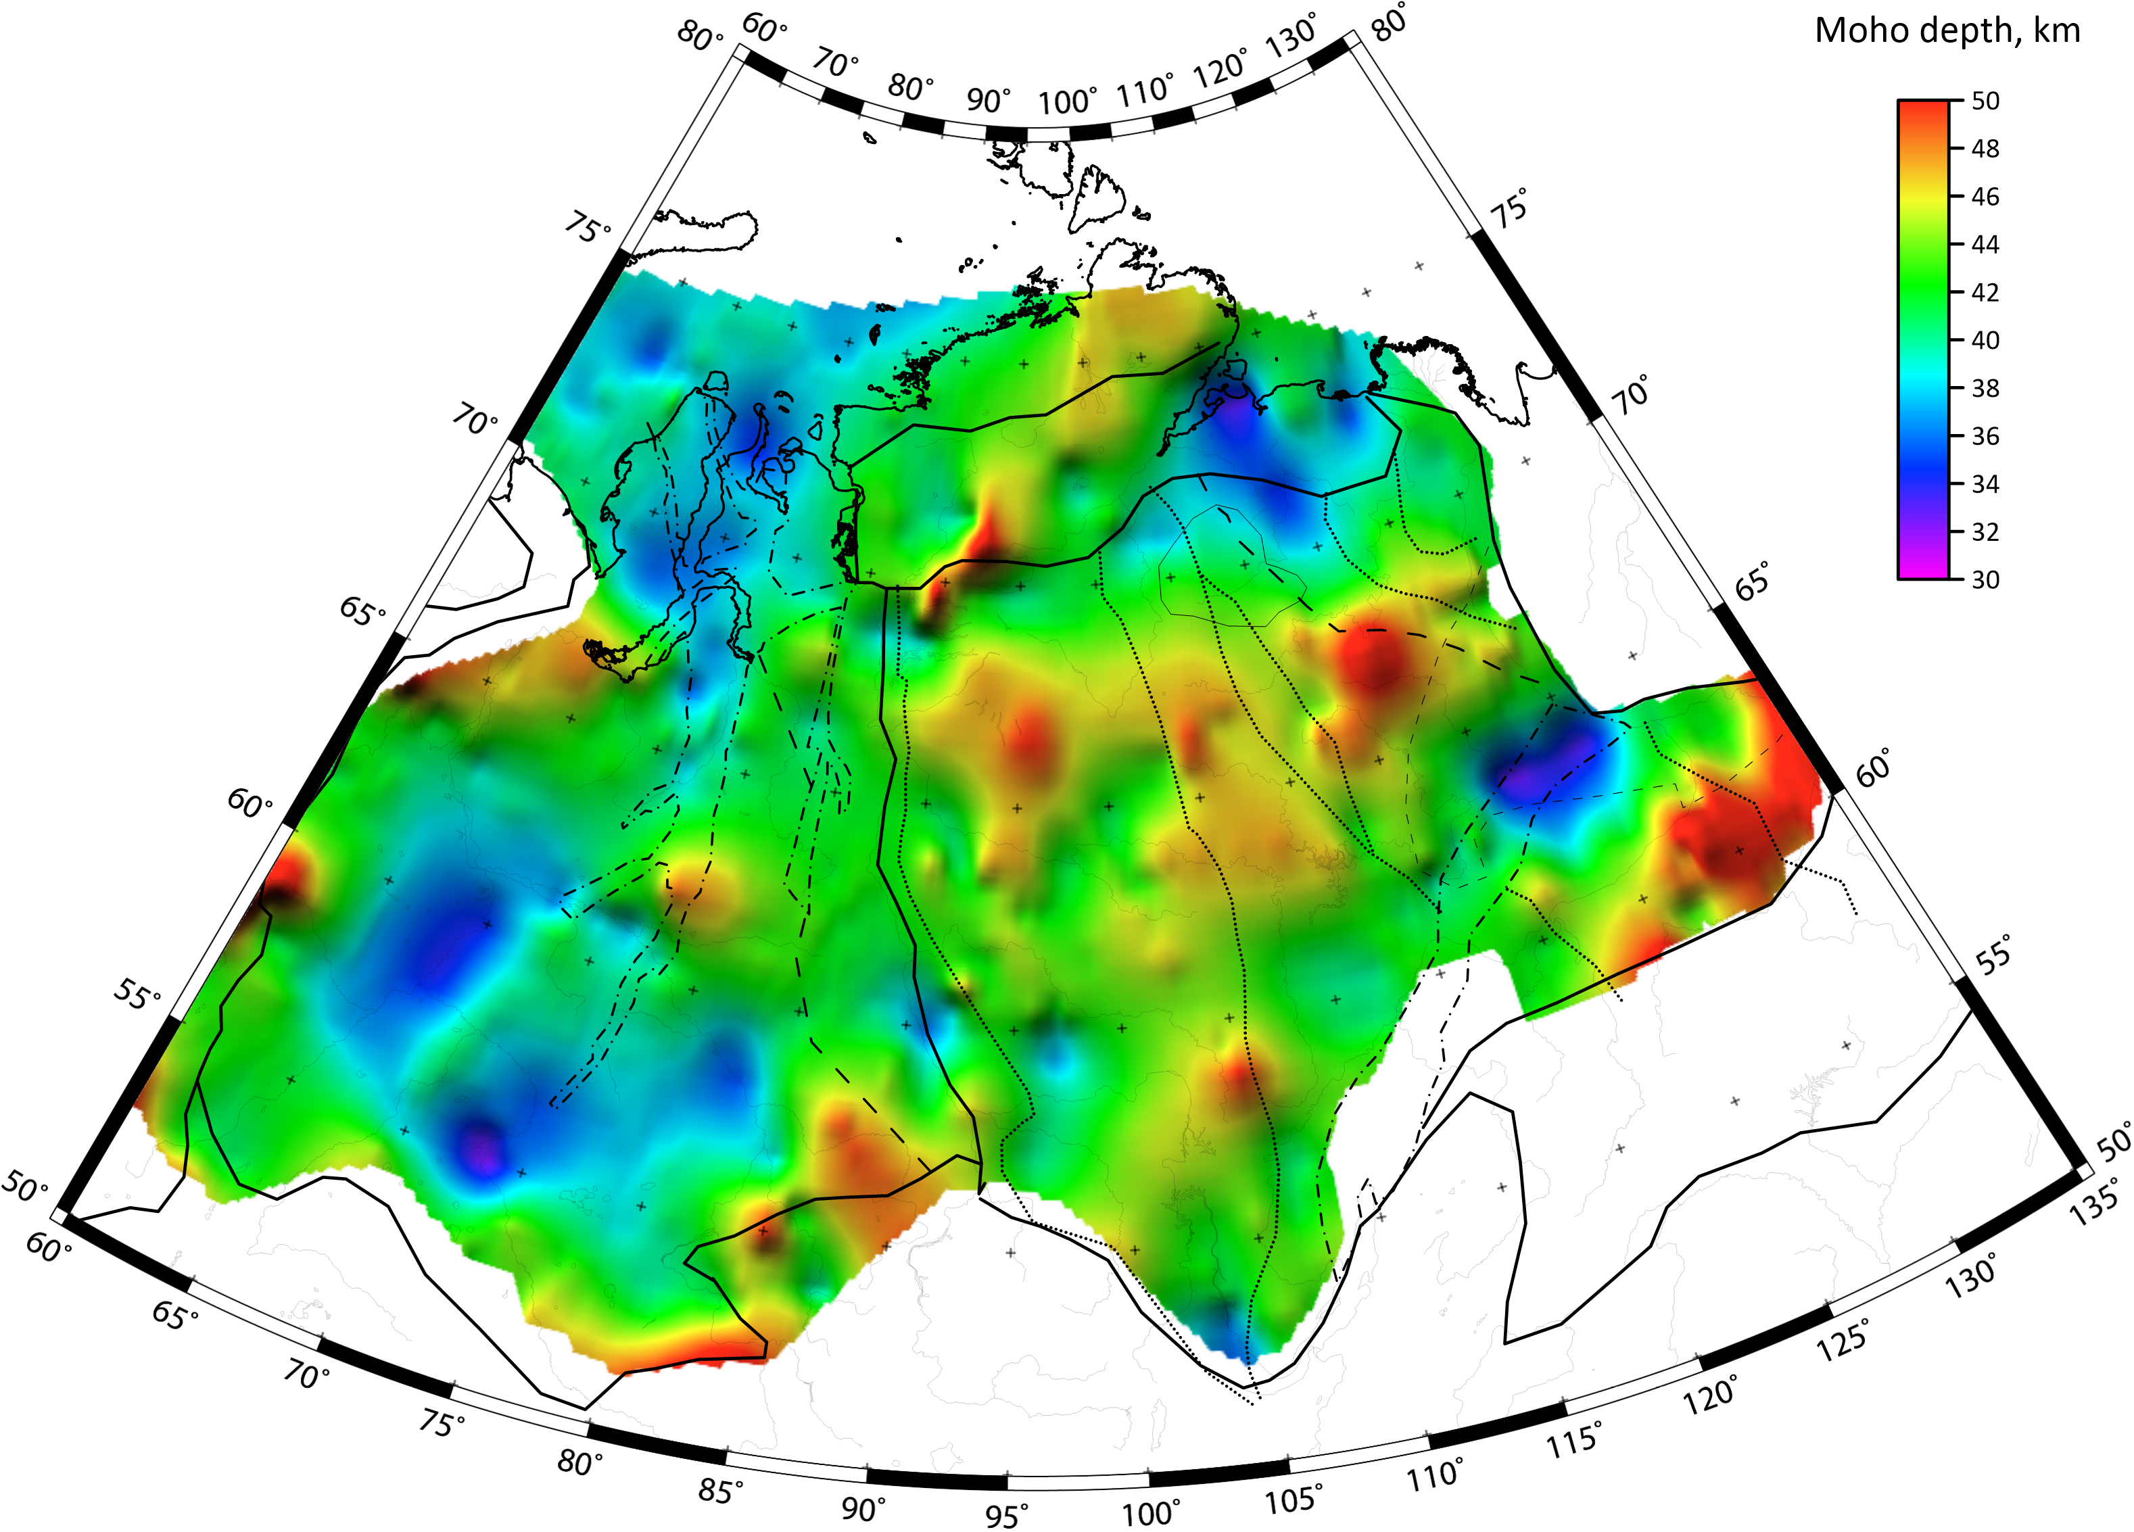
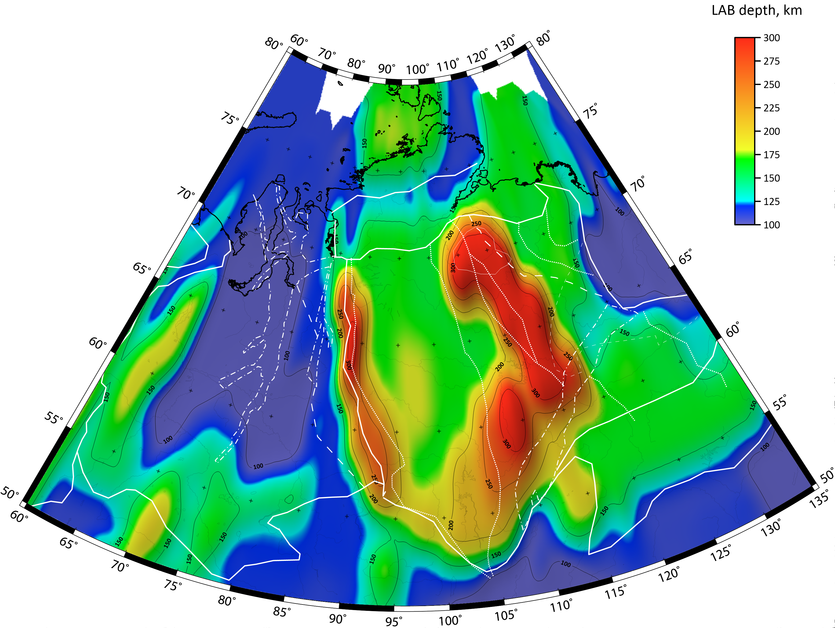
Model input parameters
Sediment thickness
New compilation of multiple databases and maps
Higher resolution than previous models
Controlled by borehole data
Crustal structure
from SibCrust seismic data
(Cherepanova et al., 2013)
Includes thicknesses and Vp of 5 layers:
  Sediments
  Upper crust
  Middle crust
  Lower crust
  Fast lowermost crust
We convert Vp to densities
Depth of LAB
(TC1 model, Artemieva, 2006)

Slide 5
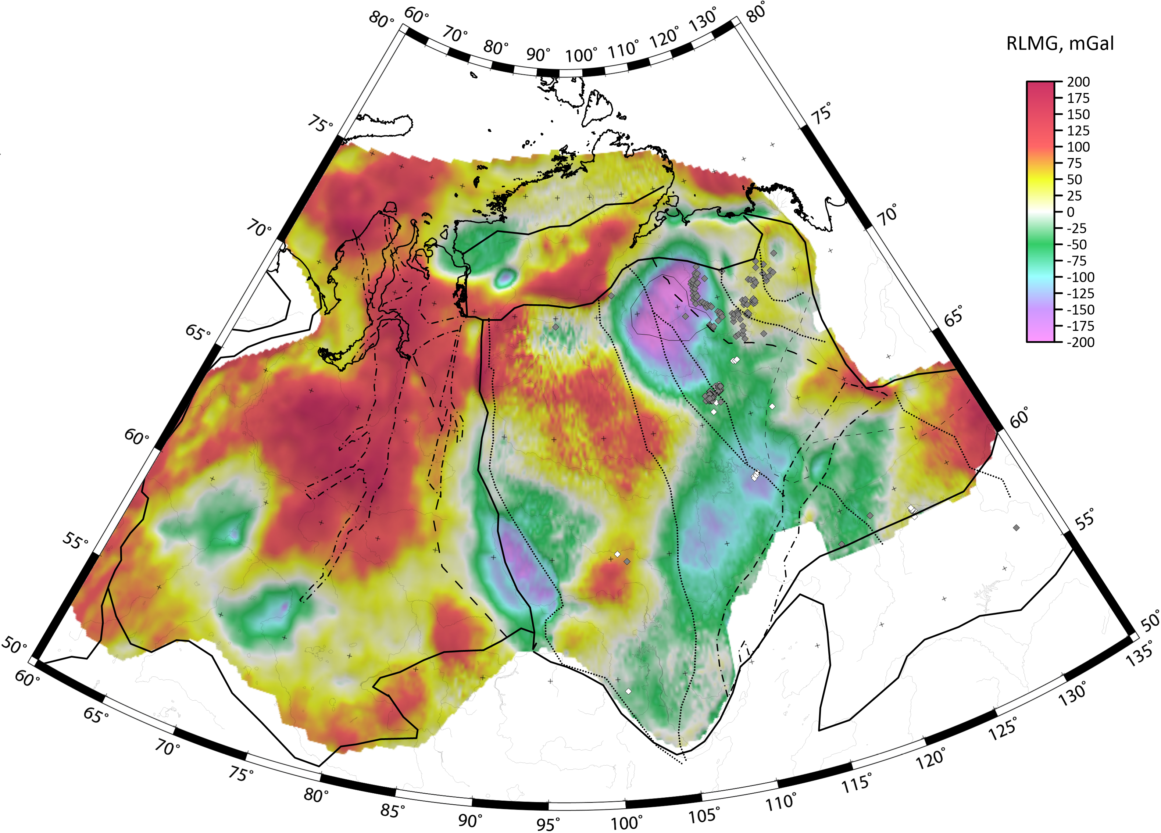
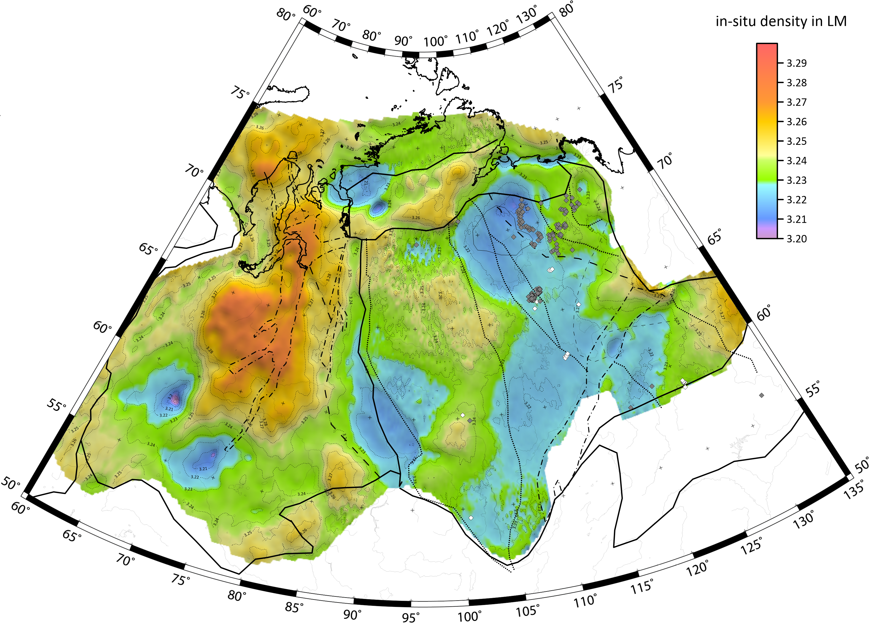
RESULTS: In situ (include T-heterogeneity)
Residual Lith. Mantle Gravity Anomalies
Show gravity effect of LM (Moho to LAB)
Range from -200 to +200 mGal
In-situ density in Lithospheric mantle
Vertically averaged from Moho to LAB
Range from 3.20 to 3.30 g/cm³
3.28
3.24
3.22
Diamonds - known kimberlite pipes:
White – diamondiferous; Grey - unknown
Very high LM density in the rifts of WSB
Intermediate density in SC covered by traps
Low density LM in kimberlite provinces

Slide 6
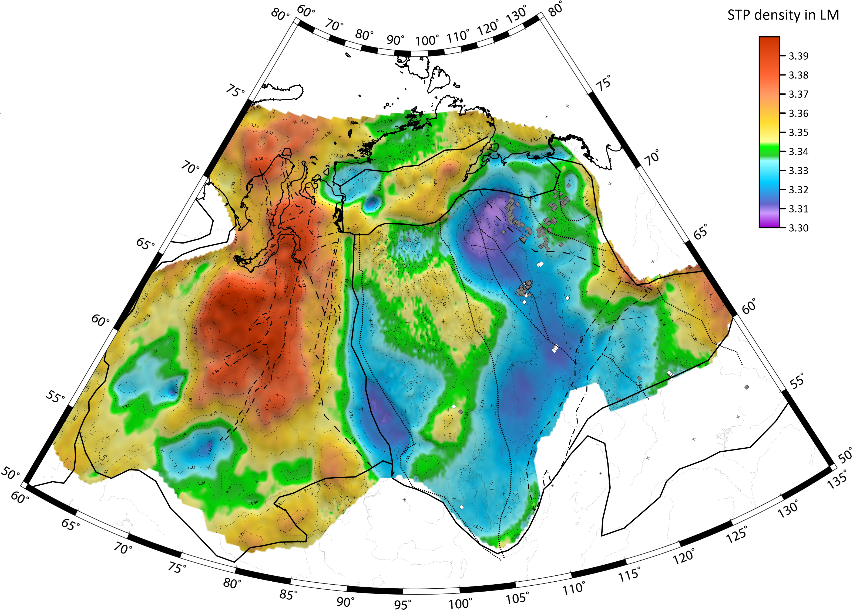
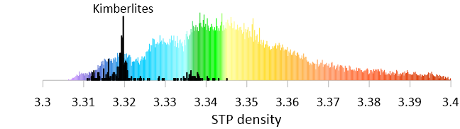
RESULTS: LM density at room P-T
STP densities in Lithospheric Mantle
WSB:
Very dense LM
High density anomalies correspond to major rifts
Possible presence of cratonic fragments
SC:
Strongly heterogeneous LM
Increased mantle density below the traps → LM reworked during the trap emplacement?
Typical cratonic low density LM in kimberlite provinces, cluster at 3.32 g/cm³
Anomalously low density LM in regions without kimberlite magmatism (pristine LM?)
3.30
3.40
3.34
3.32

