Slide 1


Electrical geophysical exploration of Lake Abhé’s hydrothermal chimney system, Djibouti
Loris Piolat
Phd Student
Engineer in geophysics and geology
GeoRessources Laboratory, France
loris.piolat@univ-lorraine.fr
linkedin.com/lrsplt

Slide 2


Problematics and Summary
European Project LEAP-RE, Subproject Geothermal Village :
aiming to develop geothermal energy in off grid regions of the East African Rift
Geophysical work :
developing electrical resistivity tomography (ERT) and IP methods to investigate circulation areas and structural controlling network of hydrothermal activity
Main survey parameters followed :
electrical resistivity (sediment vs basalt) and chargeability + normalized chargeability (clay alteration processes leading to higher cation exchange capacities)
Summary
I) Survey presentation
II) Resistivity and chargeability results
III) Interpretation and integration with geophysical and geological data, 3D modelling
Figure 1 : LEAP-RE Africa-EU Partnership and the participants of the geothermal village subproject

Slide 3
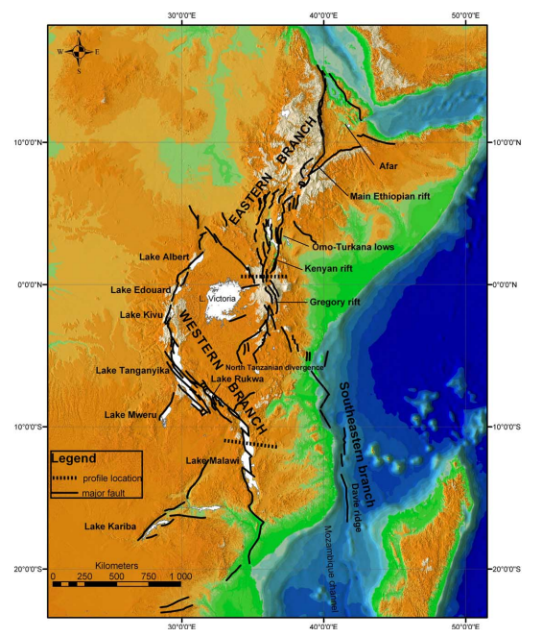
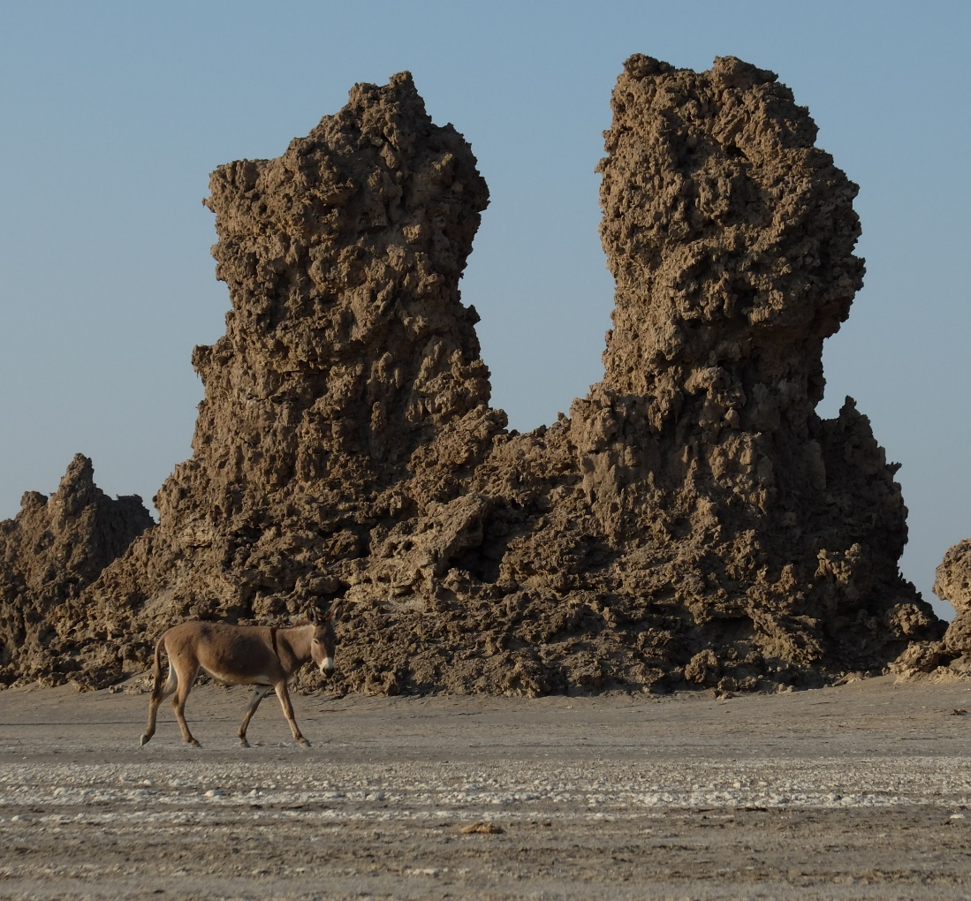
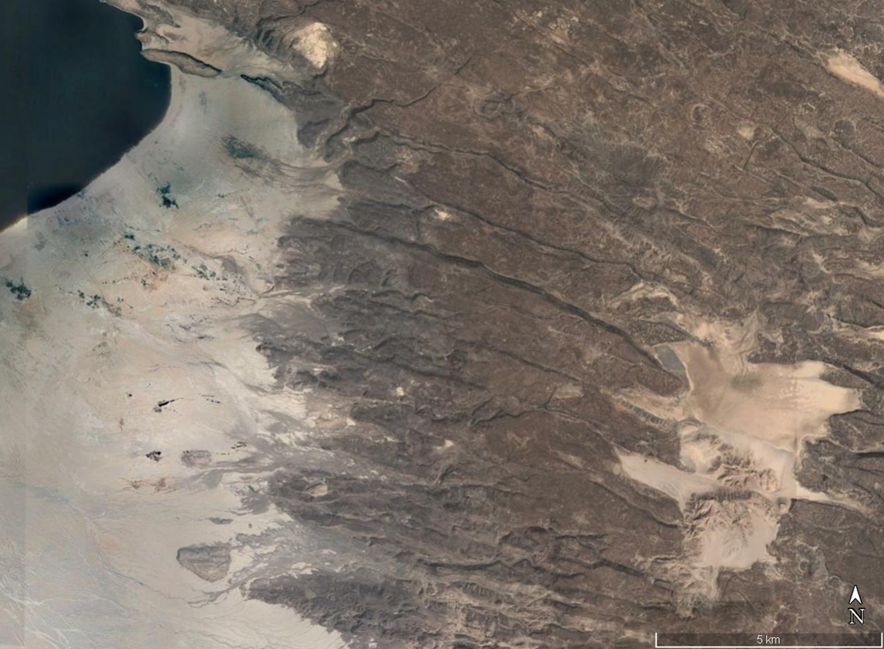
I) Survey presentation :
2
3
4
Basalt Grabens
Sedimentary Basin
5km
Figure 2, 3, and 4 : East African Rift, Lake Abhé’s basin border, and photography of the hydrothermal chimneys

Slide 4
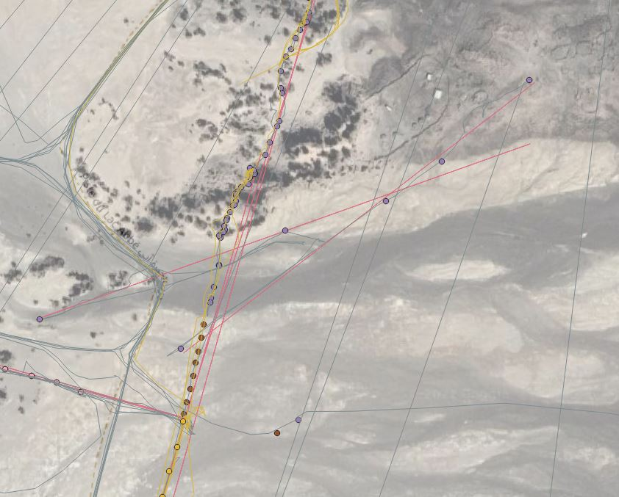
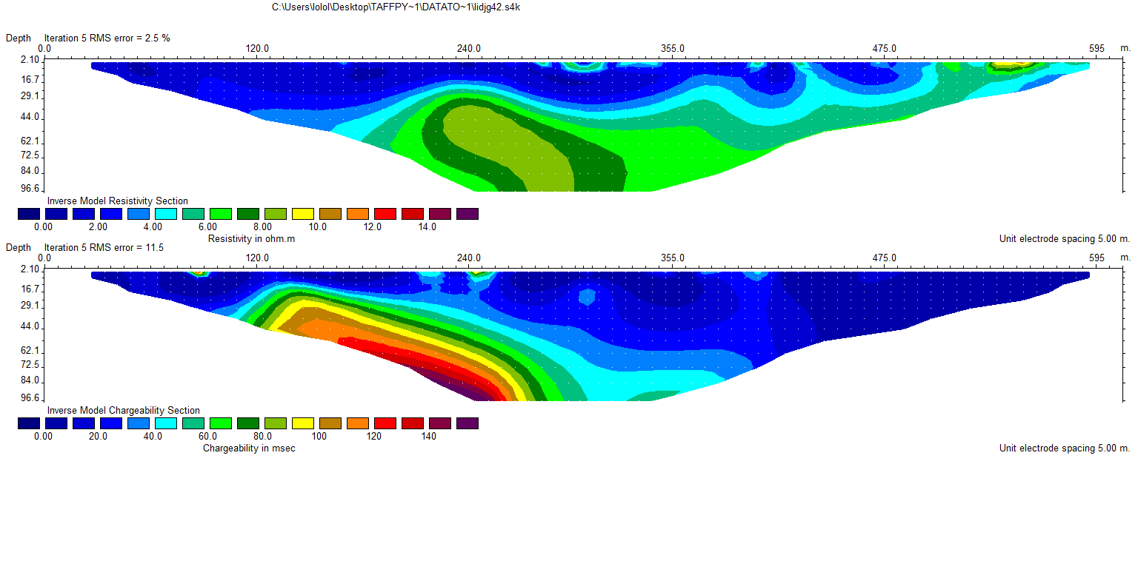
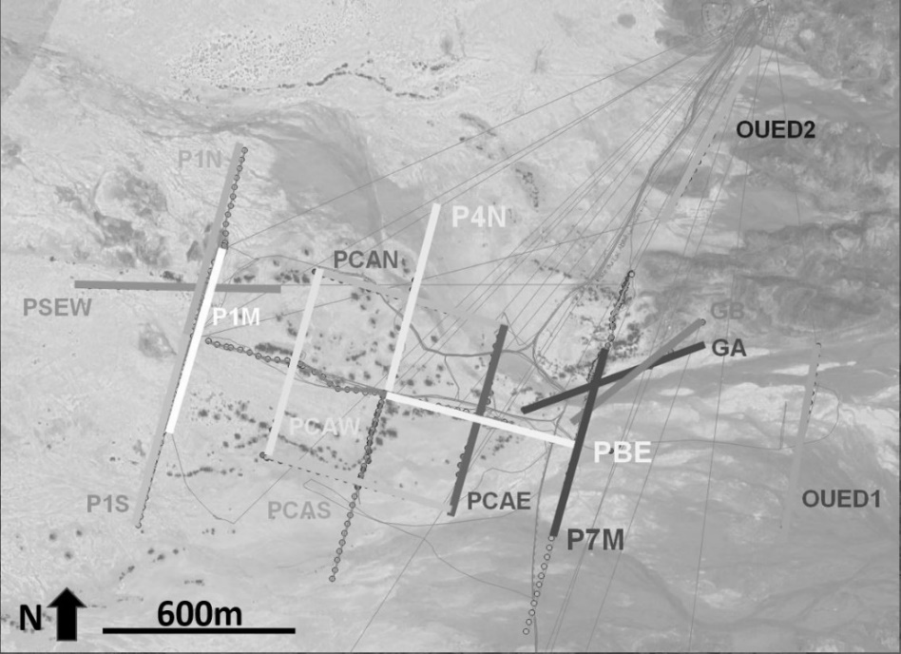

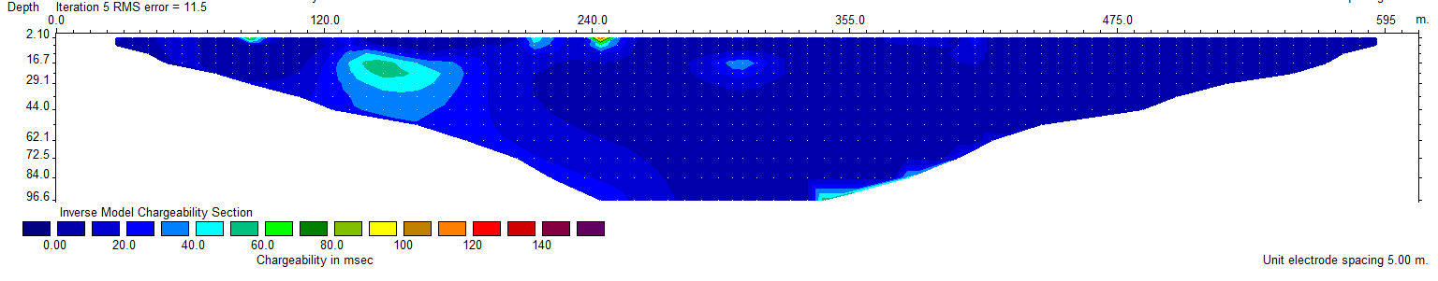
II) Resistivity and chargeability results : graben to basin typical signature
a
a
ρ resistivity ohm.m
b
b
M chargeability 10e-2
c
MN normalized chargeability 10e-2
Figure 5a, 5b, 5c : resistivity, chargeability and normalized chargeability for the GA profile
Figure 6a and 6b : localization of the GA profile

Slide 5
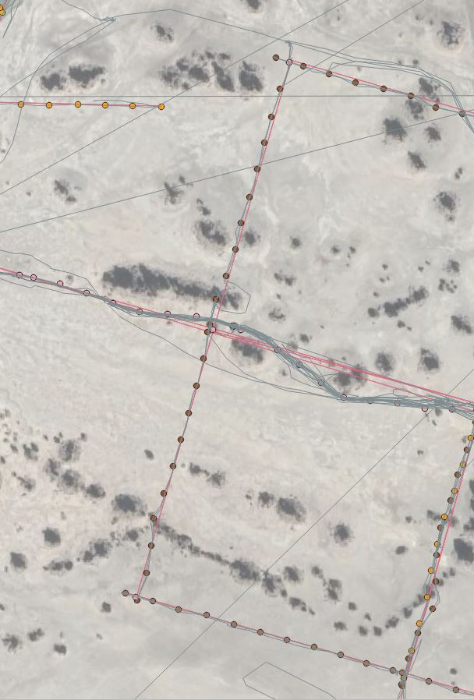
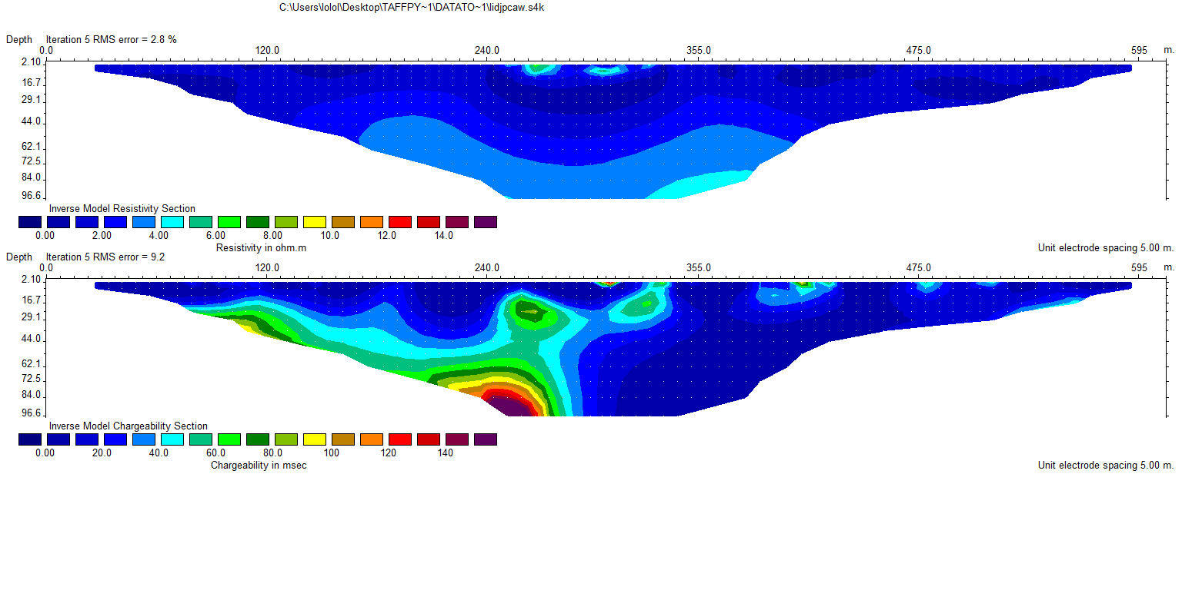

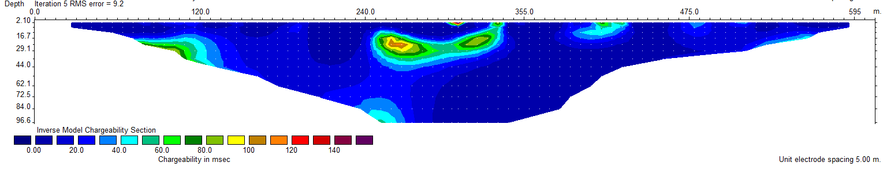
II) Resistivity and chargeability results : basin typical signature
a
a
ρ resistivity ohm.m
b
b
M chargeability 10e-2
a
MN normalized chargeability 10e-2
c
Figure 7a, 7b, 7c : resistivity, chargeability and normalized chargeability for the PCAW profile
Figure 8a and 8b : localization of the PCAW profile

Slide 6
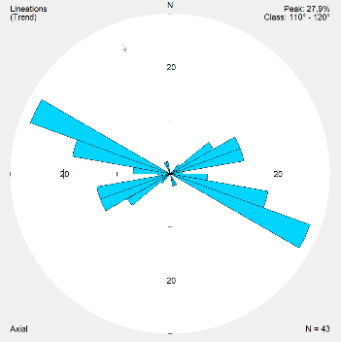
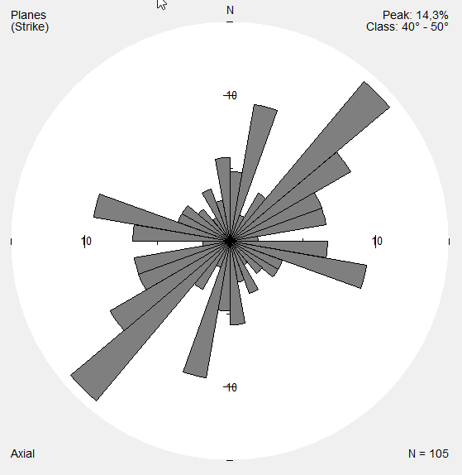
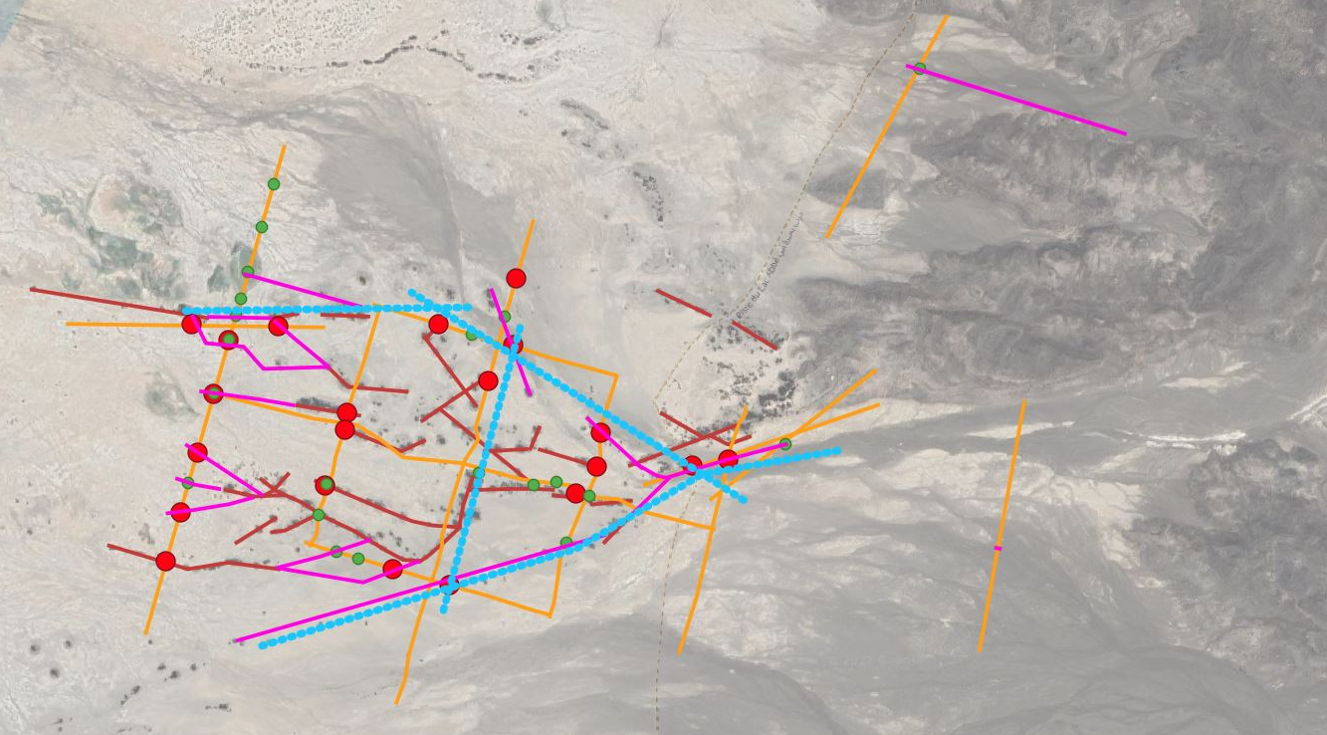
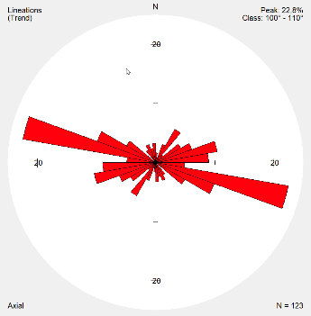
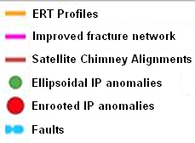
III) Interpretation of structural control and integration with geological and geophysical data
-Integration of all geophysical data sets + structural survey on the field
-Detection of fault structures and extrapolation of the fracture network with IP anomalies and chimney’s satellite alignement
Lineation in basalt
Chimney Structure
Secondary structure
N
600m
Figure 9 : structural control interpreted from new ERT and IP data sets

Slide 7
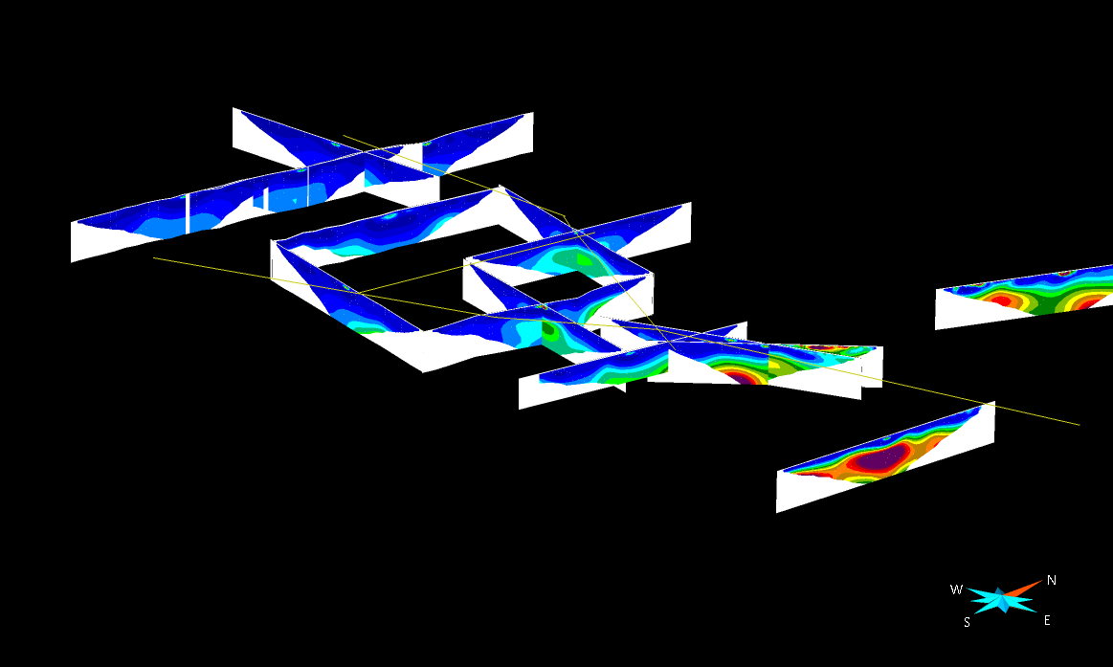
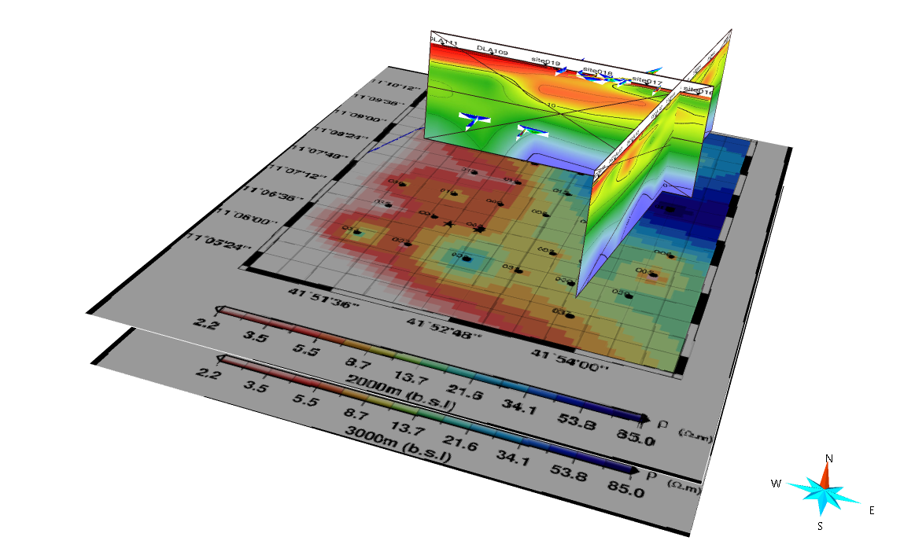
III) 3D modelling
a
Integration of all data sets (geological, geophysical, geochemical) and comparison of signatures
Modeling of geological units, fault plans, and fluid circulation
Aiming to suggest drilling first targets
b
Figure 10 : ERT and MT integrations in GOCAD

Slide 8
Conclusion
ERT and IP used to define basin sedimentary cover, basalt faulting, chimney structure, and fracture network
3D modeling for basalt surface and fault network : setting of drilling targets guidelines
Use of joint geophysical (ERT+MT), petrophysical analysis, and geochemical data to determine porosity, salinity and distribution of fluids

