Slide 1



Utilization of geomagnetic data and indices for GIC applications Larisa Trichtchenko Geomagnetic Laboratory/Canadian Space Weather Forecast Centre Natural Resources Canada
EGU 2022

Slide 2
Outline:
Understanding the phenomena: observations
Understanding the need: modelling
Geomagnetic data: fast sampling
Geomagnetic data: indices
Geomagnetic data: importance of good coverage
Conclusions
Notes:
One of the most detrimental impacts of space weather on critical infrastructure is the effect of geomagnetic storms on the operations of electrical power systems. Depending on the severity of the geomagnetic storms (often referred as Geomagnetic Disturbance, GMD), significant GIC can be produced, followed by multiple negative effects, from voltage fluctuations to power blackouts and damage to transformers. Remarkable progress has been made in the last decades towards understanding the complete chain of phenomena, from the solar sources, through the geophysical responses, to the power system problems, which has resulted in the development of mitigation procedures and standards (North American Electric Reliability Corporation (NERC) Implementation Plan, 2018).

Slide 3
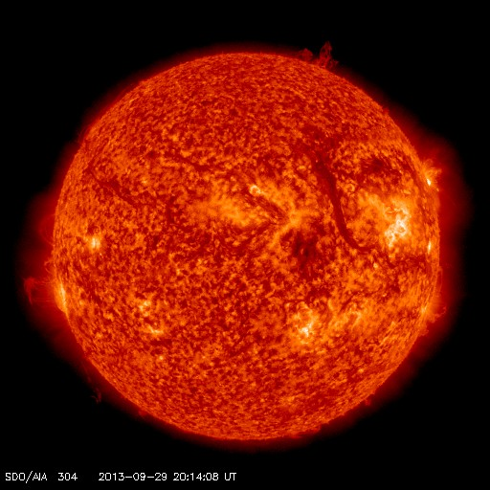
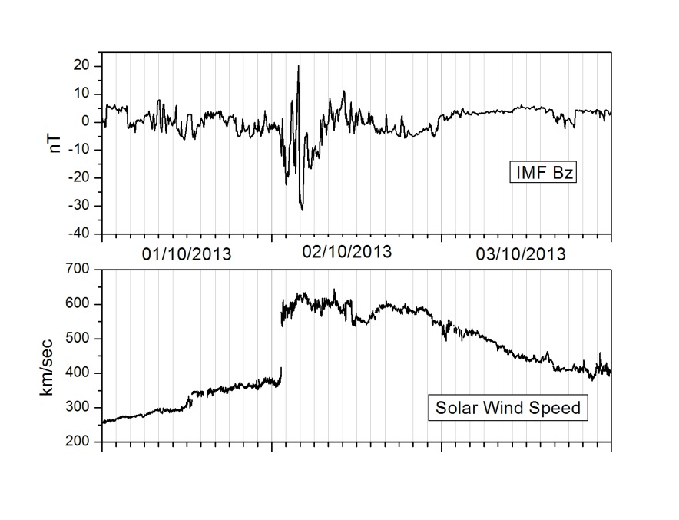

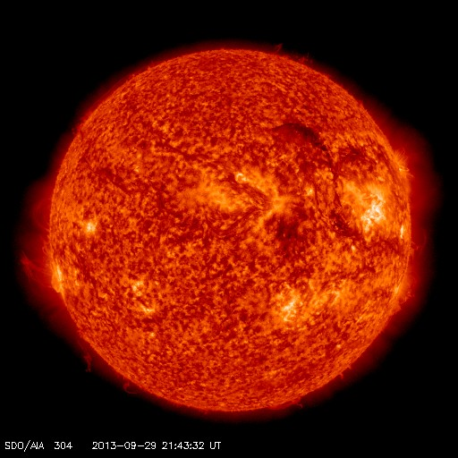
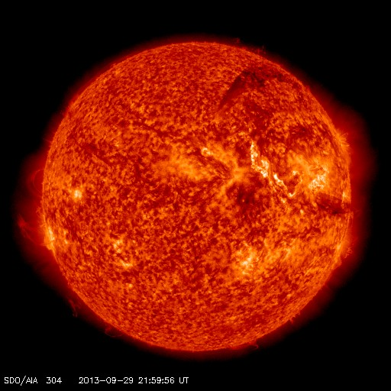
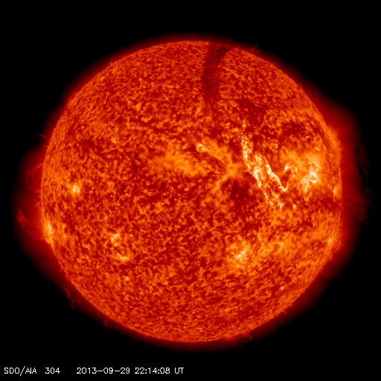
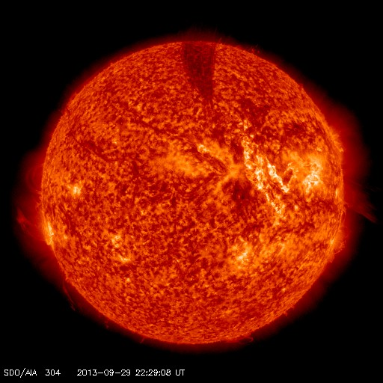
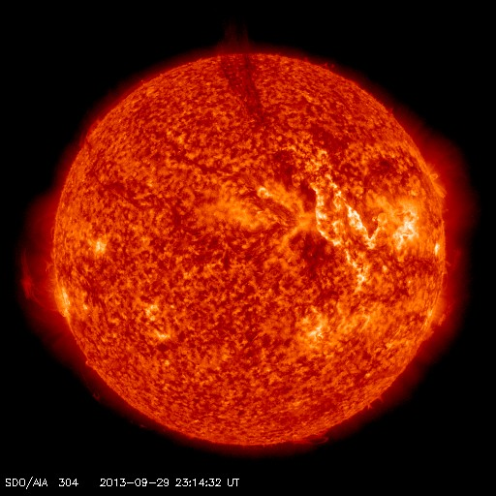

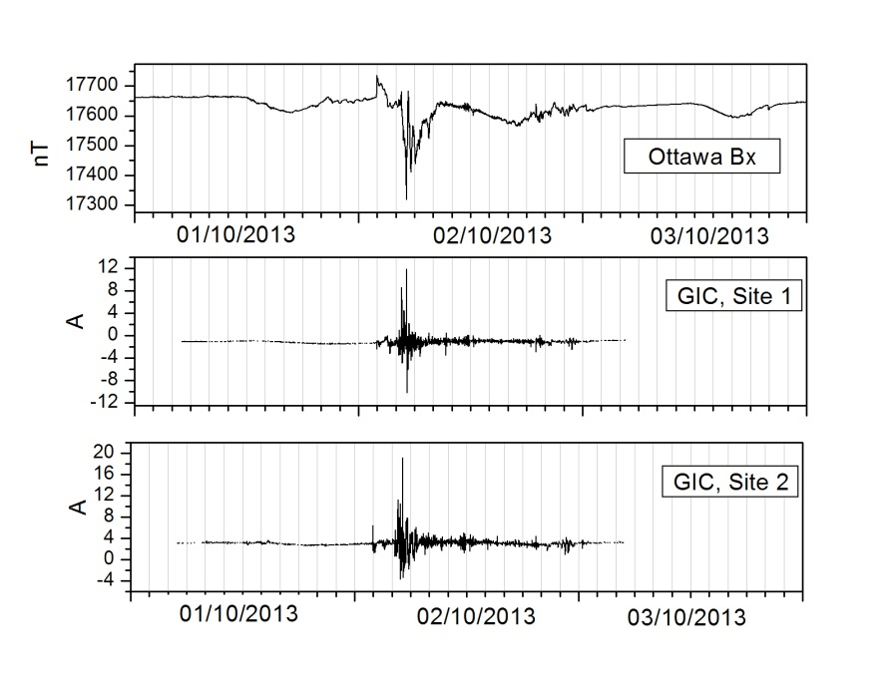
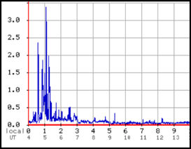
Understanding the phenomena: observations
Space Weather Event October 2013: Solar Source and interplanetary response
29 September 2013/2337 UT: CME produced by filament eruption; Approximate location at: N15W40.
02 October ACE Solar wind: ~01:20 UT: speed increased from ~ 400 km/s ~ 640 km/s after the shock. At ~0425 UT: IMF Bz decreases to ~ -30 nT
Solar Wind
Geomag
GIC
Harmonics
in power system
Notes:
The origin of disturbances in the Earth magnetic field: The Sun. Presented are SDO AIA 304 image of the Sun with “shadow “ caused by a filament eruption on Sept 29, 2013 (inside the white oval). Corresponding disturbances in solar wind are presented at ACE measurements of IMF and solar wind speed on October 01-03 2013. The impact is seen on October 2 as magnetic storm (Ottawa geomagnetic data), increase of GIC (North American Power grids) and harmonics in power system (North American Power grid). GIC Impacts: Harmonics due to half-cycle saturation; increased reactive power demand;
transformer heating; power blackout (Hydro Quebec, March 1989)

Slide 4


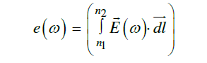



Understanding the phenomena: need for modelling
is frequency
is network impedance
is emf
GIC in network
emf
n₁ and n₂ are network nodes
is geoelectric field
is surface impedance
Geoelectric field
Geomagnetic field
1. Case studies; 2. Climatology/extremes (for design of network components)
3. NRT monitoring; 3. Forecast (for mitigation purposes)
Notes:
Due to the limiting availability of GIC and other relevant observations on power grids, modelling has been a primary source for GIC evaluations for many power companies. Modelling of the GMD effects on power systems has played a vital role in the development of mitigation standards.
The modelling approach includes: calculation of GIC based on power network model (usually as linear circuit with Ohmic resistances at geophysical frequencies), calculations of electromotive force based on geoelectric field. In turn, the geoelectric field needs to be modelled, as there are no continuous local to power grid recordings available. Thus, the geoelectric field is modelled based on MT relation in frequency domain, which includes: Earth’s surface impedance (in frequency domain, depends on frequency) and geomagnetic field (FFT to frequency domain). Thus, geomagnetic field observations are the clue to the GIC understanding.

Slide 5
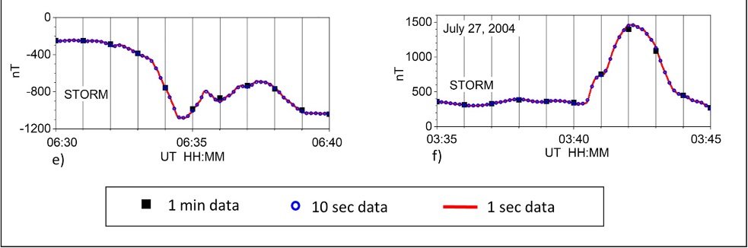
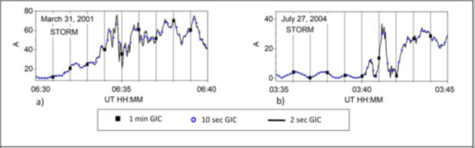
Geomagnetic data: which sampling rate to use?
Geomagnetic variations during storm main phase
GIC observations during storm main phase
March 31, 2001 July 27, 2004
March 31, 2001 July 27, 2004
Geomagnetic variations can be under-estimated due to under-sampling. It is important to know if this can impact GIC modelling
GIC variations have fine structure: under-sampling leads to significant underestimation
of GIC amplitude and introduce errors in timing of the largest GIC.
1 sec magnetic data are best suitable for GIC:
1. Case studies; 2. Climatology/extremes (for design of network components)
3. NRT monitoring; 4. Forecast (for mitigation purposes)
Reference: Trichtchenko L., Frequency considerations in GIC applications, 10.1029/2020SW002694
Notes:
To properly model GIC the sufficient sampling rate of geomagnetic data should be provided. As presented in examples, the 1 min geomagnetic data (OTT, Intermagnet) can under-estimate the variations by 200-300 nT in this period of time, shifting the time of maximum (green line)
While for GIC, as presented by examples of GIC observations for the same period of time, (originally 2 sec., then down-sampled by averaging to 10 sec and 1 min), the underestimation of GIC can be as large as 35 A for 1 min and 10 A for 10 sec.
Thus, sufficient (best available) geomagnetic sampling rate is most useful when the amplitude and timing of GIC are of primary importance. It should be noted, that fast sampling rate introduces artificial noise due to many types of interference, and de-spiking of data, especially near-real time, is difficult.

Slide 6
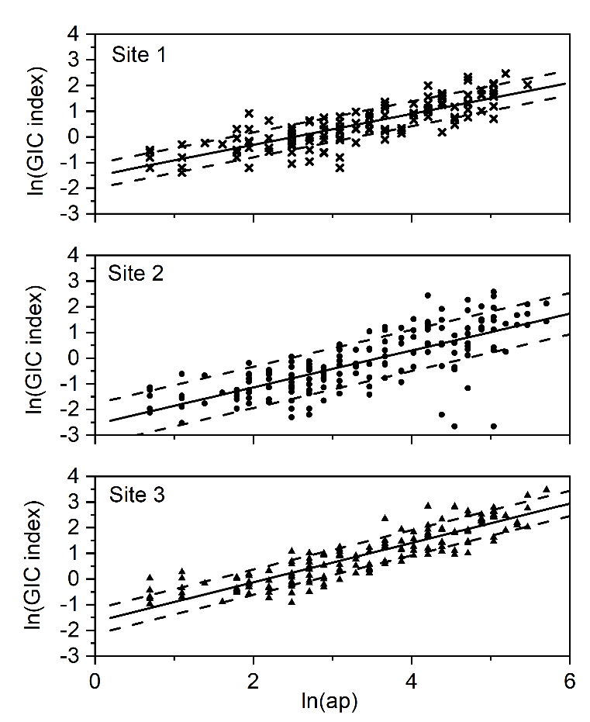
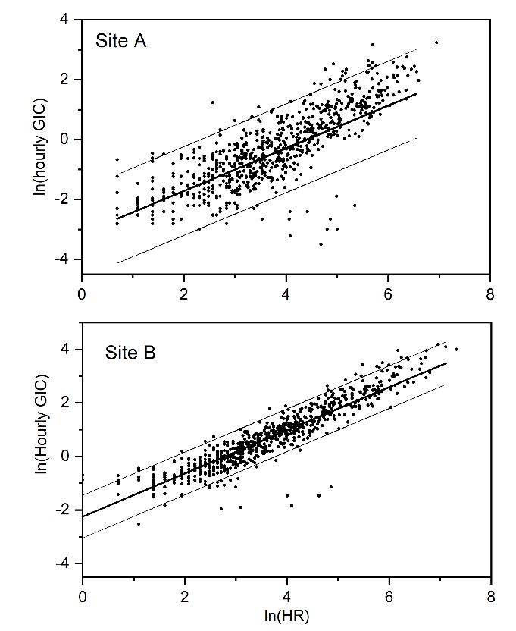
Geomagnetic data: which sampling rate to use?
Forecast
MAG Index
FCST
MODEL
GIC Index
FCST
GIC indices are obtained from observations at different recording sites of different networks and compared with magnetic indices (global ap and local, hourly range)
Ref: Trichtchenko, L., Boteler, D H., Modeling geomagnetically induced currents using geomagnetic indices and data, IEEE Trans. on Plasma Science vol. 32, no. 4, pt. 1, 2004 p. 1459-1467, https://doi.org/10.1109/TPS.2004.830993
magnetic indices are best suitable for GIC:
1. Case studies; 2. Climatology/extremes (for design of network components)
3. NRT monitoring; 4. Forecast (for mitigation purposes)
Notes:
Although it has been shown that higher sampling rate gives better GIC modelling results, to forecast geomagnetic variations at 1 sec or even 1 min cadence is not yet possible.
However, forecasts of the geomagnetic indices, such as Dst, Kp, Hourly range index, are provided by many space weather service centres. Would these forecasts be useful for GIC applications? As shown on the stack-plot, the logarithm of 3 hr maximum GIC (index) at 3 different observational sites can be linearly fitted by geomagnetic 3-hour index ap (which is similar to Kp, but have continuous numerical values)

Slide 7
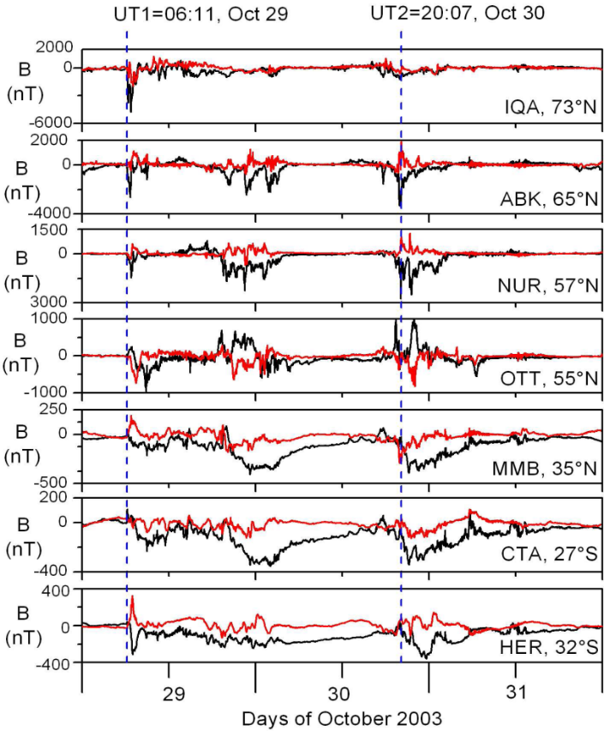
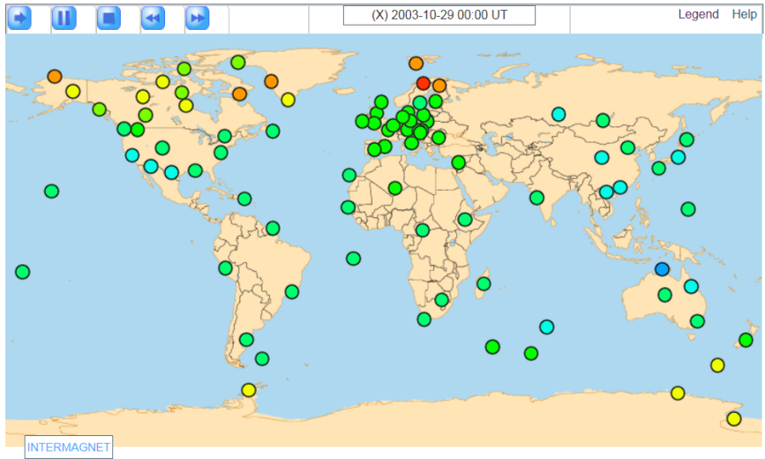
Geomagnetic data: spatial coverage - more dense is better
Example: October 29-31, 2003 event
1 min data 7 observatories, from 73N to 32S
Example: Global Geomagnetic activity map (hourly indices), 29 October 2003, 00:00 UT
https://www.intermagnet.org/activitymap/activitymap-eng.php
ATTENTION: SCALES ARE DIFFERENT
Notes:
The geomagnetic field variations differ significantly from location to location, as presented at the left stack plot. Thus, when the goal is to model GIC at specific location, the use of local geomagnetic observations is important. Although to monitor the overall global activity, less detailed coverage can be sussessfully utilised, as presented in the global map of geomagnetic activity extracted from Intermagnet website.

Slide 8
Geomagnetic data are of primary importance for GIC applications, as GIC are directly related to the geomagnetic disturbances. Thus, all listed below provides essential information for GIC applications:
Availability of historical indices and data
Availability of high quality 1 min data
Substantial progress in availability of 1 sec data
Availability of NRT data
Possibility to improve spatial coverage
Availability of the forecast of geomagnetic indices

