Slide 1

A Novel Plant Growth Chamber for Separate and Continuous Monitoring of Above-ground and Below-ground Gas Exchange
E.O Osuebi-Iyke^{1Aa}, O. O’Nagy^{1Ab}, F. Minette^{1Ab}, S. Schymanski^{1Aa}
¹ Luxembourg Institute of Science and Technology, Belvaux, Luxembourg ^{A}Environmental Research and Innovation
ª Environmental Sensing and Modelling Unit ^{b} Observatory for Climate, Environment & Biodiversity Unit
Contact: emmanuella.osuebiiyke@list.lu
Supported by the Luxembourg National Research Fund (FNR) ATTRACT programme (A16/SR/11254288)
Notes:
A plant growth chamber that allows separate and continuous monitoring of shoot and root gas fluxes.

Slide 2
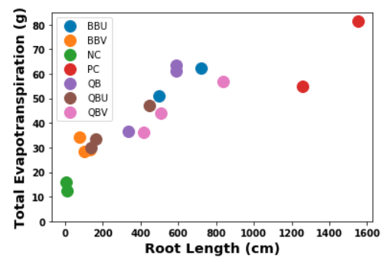
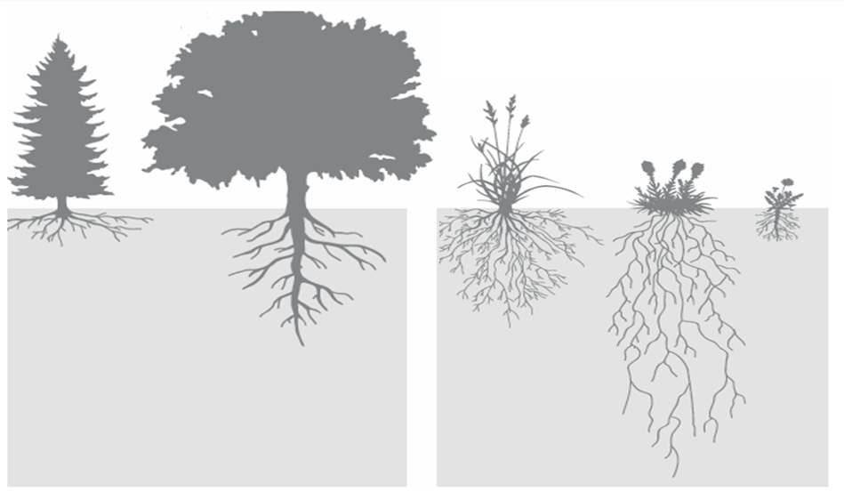
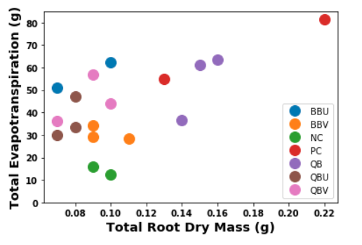
How Much Carbon Does a Plant Invest to Take up Water ?
Jones et al., 2009
Many field studies have shown a correlation between root length and evapotranspiration
Preliminary experiments emphasize the need to measure root respiration, not just biomass for capturing root costs
Need to measure root respiration/ exudates
Page__1__
Notes:
Many field studies have highlighted the relationship between ET and rooting depth / root length density.
My preliminary experiments to determine the best carbon free soil substrate for my studies (I will come to this later) confirmed this relationship between Evapotranspiration and Root Length but not with Root Biomass as displayed on the plots on the left of this slide. (The legend shows the sample names, and similarly coloured points are replicates of same sample.
This observed relationship is due to root exploration of soils with varying penetration resistance in order to take up water and nutrients, increasing energetic costs. This emphasizes the need to measure root respiration, not just biomass for capturing root costs.
This begs the question:
How do we capture these costs empirically?
We need to measure root respiration and/exudates.

Slide 3
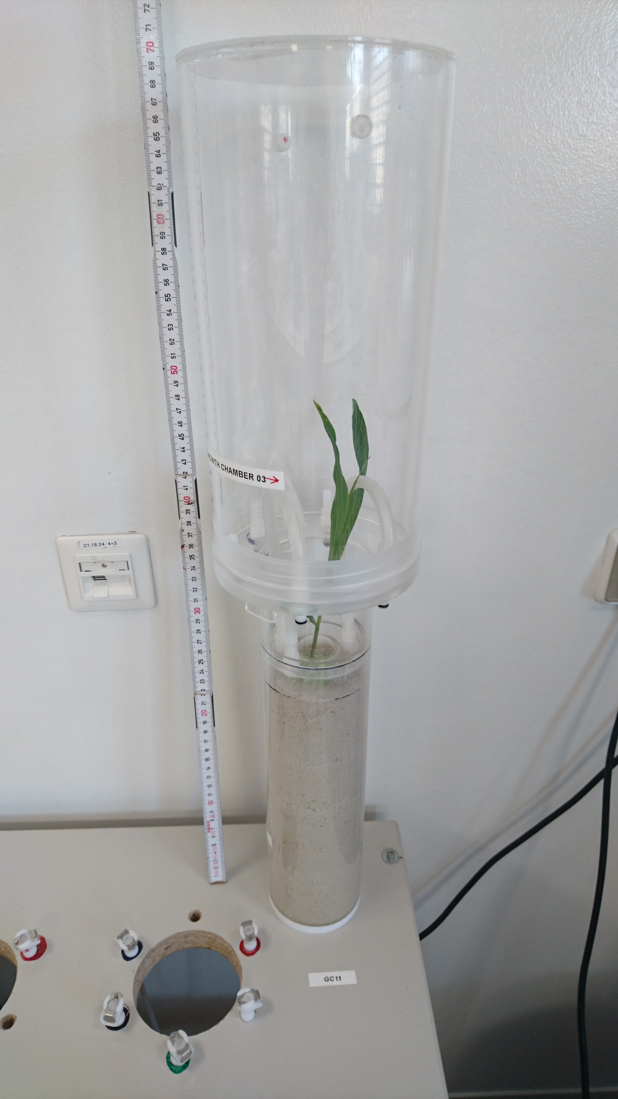
Objectives
Quantify carbon investment dynamics in the root system
Compare dynamic root investments to shoot assimilation
Experimental Requirements
Separate above-ground and below-ground compartments
Measure gas exchange of each compartment
Isolate root respiration
Page__2__
Notes:
Capturing the carbon costs of construction, maintenance and cost of resources acquisition by plant roots is important to access plant root carbon investments, benefits and tradeoffs, bringing me to the objective of my study.
1. To quantify carbon investment dynamics in the root system and
2. To compare these dynamic root investments to shoot assimilation.
To achieve these objectives, we need a plant growth chamber that allows separation beween the roots and the shoots.
We need to separately and simultaneously monitor gas fluxes in each compartment and we also need to nicely isolate root respiration from other soil processes including microbial respiration.

Slide 4
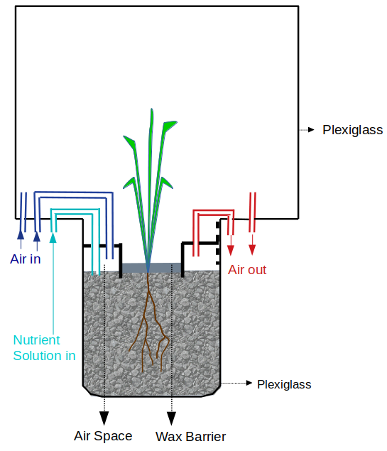
Custom Growth Chamber Set-up
Objectives
Use growth chamber to quantify carbon investment dynamics in the root system
Compare dynamic root investments to shoot assimilation
Experimental Solutions
Wax separation of above and below ground compartments
Fluxes measurement with IRGA (LI-6800)
Custom carbon-free soil: Quartz Bentonite mix
What about replicates and control?
Page__3__
Notes:
… Bringing us to my experimental solution.
Our growth chambers allow the separation of the above and below ground compartments using a wax layer as shown in the image on the right corner.
Fluxes are measured in both compartments simultaneously and continuously using two Licor portable photosynthesis devices.
Isolation of root respiration from other soil activities is achieved by using a carbon free soil consisting of Quartz and Bentonite.
You might ask? What about replicates and control?

Slide 5
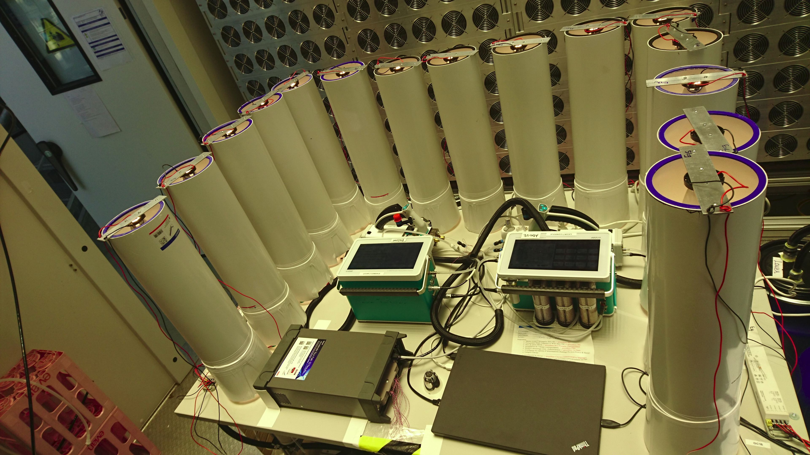
Custom Growth Chamber Set-up
Lighting Cylinder
LI-6800 Gas Exchange System
15 plants in parallel connected to two LI-6800 using multiplexed valve systems
Individual lighting
Page__4__
Notes:
Our complete system allows the measurement of 15 plants in parallel, each compartment with one Licor using multiplexing valve systems to switch from one growth chamber to the next.
Each growth chamber is provided with its own lighting provided by LEDs mounted on the lighting tubes.
Fluxes measurement start at the emergence of the coleoptile from the wax layer until the end of the experimental period.

Slide 6
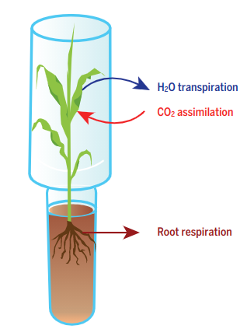
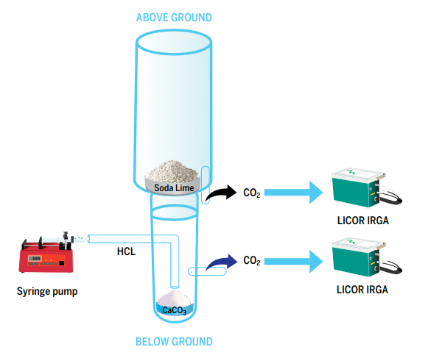
Test of Measurement Accuracy
Quantify chemical CO₂ uptake: Soda Lime and total carbon analysis
Quantify chemical CO₂ evolution: control HCl injection rate into CaCO₃
Integrate fluxes over hours to days
Page__5__
Notes:
Pre-experiments were carried out with chemicals to simulate shoot assimilation and root respiration to test the accuracy of our system to quantify these fluxes.
Soda lime was used to simulate shoot assimilation followed by a total carbon analysis of the used soda lime at the end of the experiment while controlled injection of HCl into calcium carbonate at different rates was used to simulate root respiration.
Fluxes were integrated at the end of the experimental period.

Slide 7
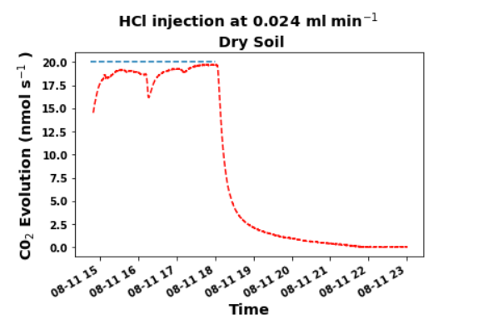
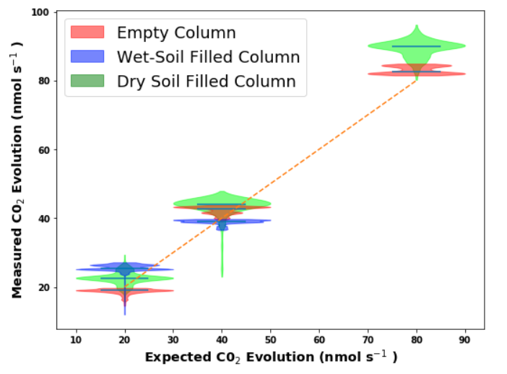
How Quickly and Accurately can the System Detect CO₂ Evolution Rates?
3.5 h
0.5 h
CO₂ release
3.5 h
Respiration
CO₂ evolution signals are visible immediately at the start and stop of the syringe pump
Signals did not differ much between columns with wet or dry soil/ without soil
Assimilation
Time integral of assimilation rate (4 days): 0.016 mols CO₂ while change in the C in soda lime after TC analysis was 0.015 mols
Page__6__
Notes:
This slide shows some of the results of the accuracy test. The top left figure shows that it takes about 30 minutes from the injection of HCL to reach the expected CO2 evolution rate and 3.5 hours after stopping injection to go back to zero.
The violin plots on the top right show that signals did not differ much between empty columns or columns with wet or dry soil. We can also see that measured CO2 evolution rates correspond with the expected values.
For the assimilation experiments, Time integral of assimilation rate after 4 days was 0.016 mols CO₂ as against 0.015 mols as determined by total carbon analysis of the used soda lime at the end of the experiment indicating a measurement accuracy within 1% margin of error.

Slide 8
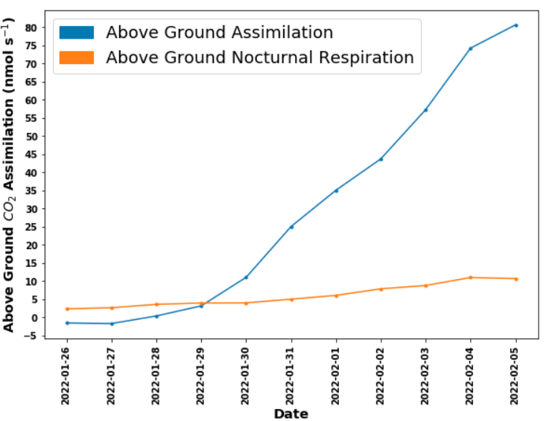
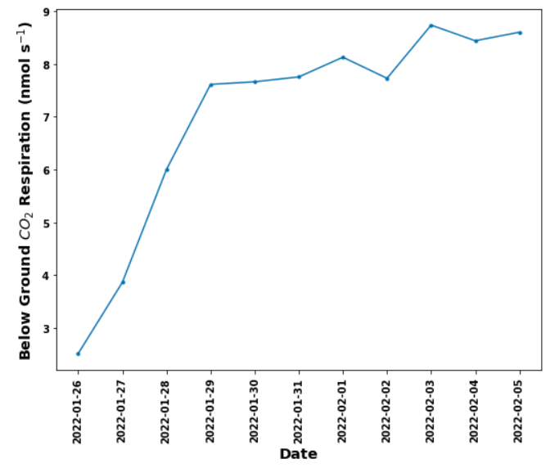
Utilitization of Custom Soil and Growth Chamber to Capture Shoot and Root Fluxes
Above-ground assimilation significantly exceeded respiration after 5 days
Below-ground respiration stabilized after 5 days
Page__7__
Notes:
Subsequent experiments carried out after the accuracy test; with Maize and Barley plants with 7 growth chambers over 11 days to verify the utility of our system to capture actual plant fluxes showed that in one of the growth chambers with maize, shoot assimilation (in blue- top left figure) starts off on the same trajectory with nocturnal shoot respiration (in orange), exceeds it after 5 days and is an order of magnitude higher at the end of the experimental period.
The top right figure shows that root respiration for the same plant takes off at the start and stabilizes after 5 days.

Slide 9
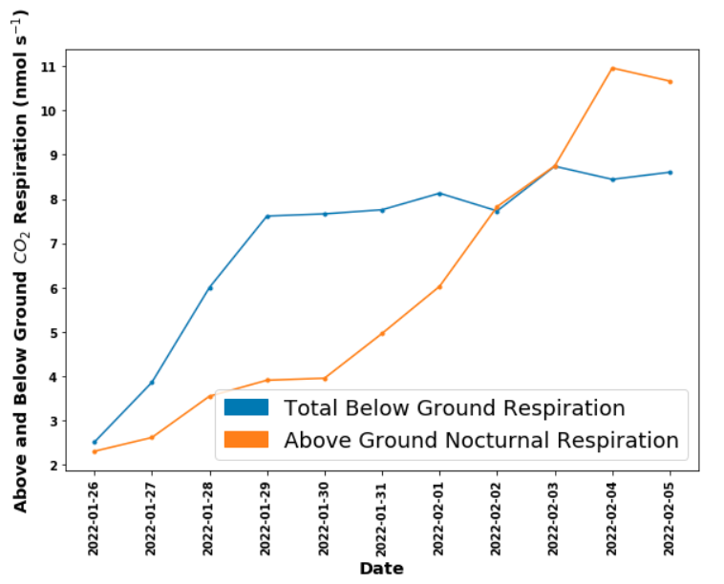
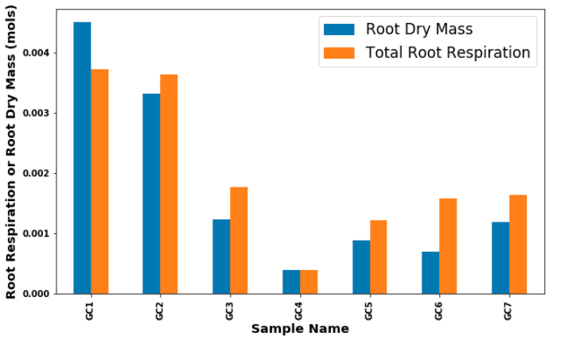
Utilitization of Custom Soil and Growth Chamber to Capture Shoot and Root Fluxes
Above-ground Nocturnal respiration is similar to root respiration
Carbon stored in the root system and cumulative root respiration is in the same order of magnitude
Page__8__
Notes:
Plotting shoot nocturnal respiration and root respiration as shown in the top left figure, we see clearly that both fluxes are similar.
On the rop right plot, we see that root dry mass and cumulative root respiration at the end of the experiment is correlated and on the same order of magnitude.

Slide 10
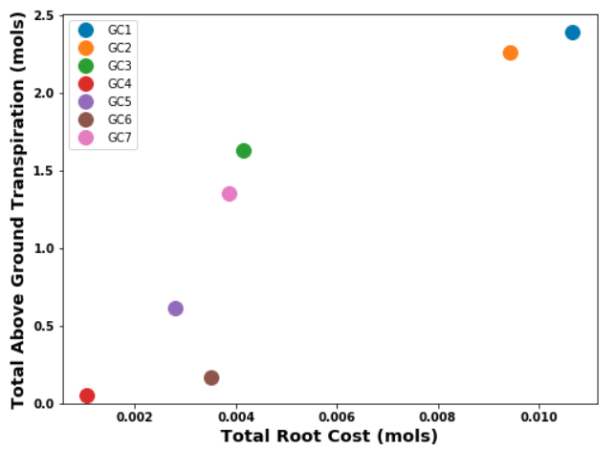
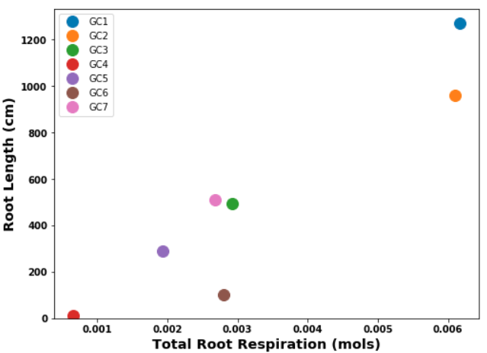
Utilitization of Custom Soil and Growth Chamber to Capture Shoot and Root Fluxes
Root respiration correlated with Root Length
Total Root cost correlated with Transpiration
Page__9__
Notes:
On this slide, I would like to use the little figure on the top left to remind us about my research motivation at the start of this presentation, where Evapotranspiration was correlated with root length but not root biomass.
On the lower left plot, we see that there is a correlation between total cost (ie sum of root respiration and root biomass) explaining the correlation implied by the bar plot in the previous slide.
We can also clearly see that as suspected in the beginning, root respiration correlates with root length as shown on the lower right plot.
While my pre-experiments suggested no relationship between evapotranspiration and Root biomass, this current experiment shows otherwise. I will be investigating this more in my next experiments.

Slide 11
Conclusions
Chemical tests confirmed that the growth chamber coupled with the LI-6800 enables reliable quantification of above-ground assimilation and below-ground respiration over days
Carbon-free soil enables root respiration measurements
Preliminary experiments with maize plants suggest that root respiration correlates with root length, not biomass, and dominates root carbon costs
Page__10__
Notes:
In conclusion...

