Slide 1
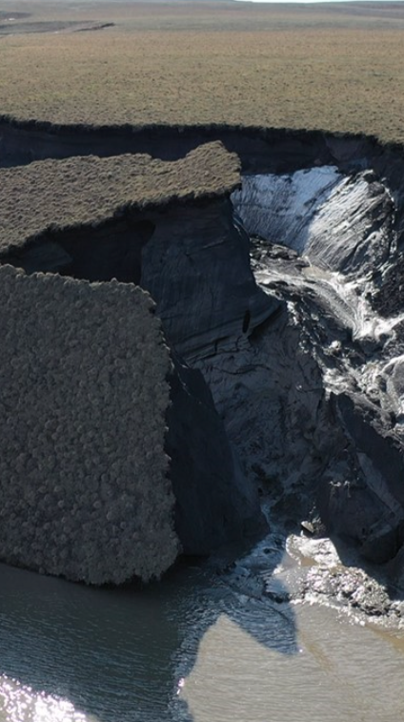


A multidecadal model estimate of pan-Arctic coastal erosion rates and associated nutrient fluxes
S. Rynders and Y. Aksenov, National Oceanography Centre, UK
Marine Systems Modelling
This project has received funding from the European Union’s Horizon 2020 research and innovation programme under grant agreement No 820989 . The work reflects only the author’s/authors’ view; the European Commission and their executive agency are not responsible for any use that may be made of the information the work contains.

Slide 2
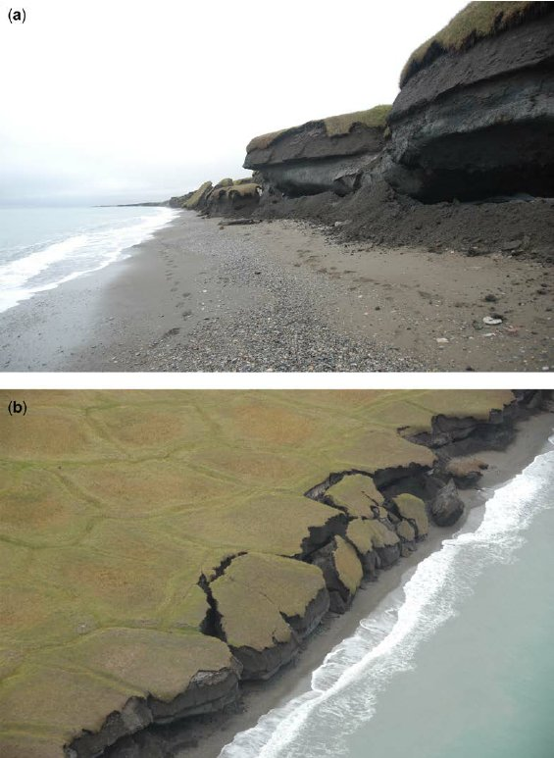
Introduction
Arctic coastal erosion is an increasing problem
Threat to infrastructure, also affects the marine environment
Arctic coast is mainly soft sediment permafrost
Sea ice protection is decreasing, leading to increased erosion from waves and melting
Yukon
Notes:
Good morning, I am Stefanie Rynders from the National Oceanography Centre in the UK.
Today I am presenting some model-based work on coastal erosion I have been doing with my colleague Yevgeny.
Coastal erosion is an increasing problem in the Arctic affecting both the land and the marine environment.
Erosion of permafrost coasts can be caused by melting from the top as well as from the sea by undercutting from waves, which can be seen in the photograph.
We will focus on the latter process. Erosion from the seaward side is getting worse because the protective sea ice cover is decreasing.
The Arctic coastline is mostly soft sediment, once the ice inside the permafrost melts the material disintegrates and the nutrients and other elements end up in the sea.

Slide 3

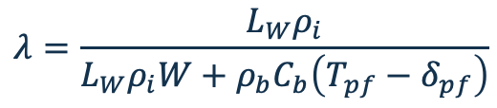
Method
Erosion
Barnhart 2014: compared erosion models for Beaufort Sea coast, White model best out of 3
White model calculates iceberg erosion due to wave action
Following Wight model with added permafrost probability and adjustment for rocky/non rocky coast
L_{w} latent heat, rho density, W ice content, delta melting temperature, chi dimensionless number, R surface roughness, H significant wave height, P permafrost probability, tau wave period, C heat capacity, L lithification
Depends on geological (permafrost temperature, probability (PEX); ice content (ACD)) and marine parameters (SST, SWH, wave period)
$e_{submarine}=LPλχ\frac{R^{0.2}H^{0.8}}{τ}\left(T_{w}−δ_{W}\right)$
$$λ=\frac{L_{W}ρ_{i}}{L_{W}ρ_{i}W+ρ_{b}C_{b}\left(T_{pf}−δ_{pf}\right)}$$
Notes:
To calculate the erosion rates, we are using the White model for dirty iceberg erosion, which is quite simple. The formula calculates how much heat is required to melt the permafrost, based on its composition and temperature. The required heat is supplied by ocean waves, so the erosion is mostly a melting process rather than a mechanical abrasion. There are more complicated models with include different erosion processes and more geological details, but they can not easily be used for the whole arctic, because the input information is lacking.
We added some extra parameters that were not in the original formula, namely permafrost probability, which tell use whether the permafrost is continuous and the lithification state, which tells whether the coast is rocky. Discontinuous or rocky permafrost is not so sensitive to the wave erosion.
The input information comes from 3 sources: the unchangeable geological information comes from the Arctic Coastal Dynamics database, the permafrost temperature and probability comes from the PEX model and finally the marine information, namely sea surface temperature and wave information comes from our own wave-forced NEMO ocean model simulations, which account for wave-ice interaction, so we account for sea ice sheltering.
Lithification: rocky coast: erosion rate / 10
ACD: Arctic Coastal Dynamics database; about 1300 segments in the coastline
PEX: permafrost model, https://apgc.awi.de/dataset/pex
NEMO: ORCA1 grid, wave forcing from WAM

Slide 4
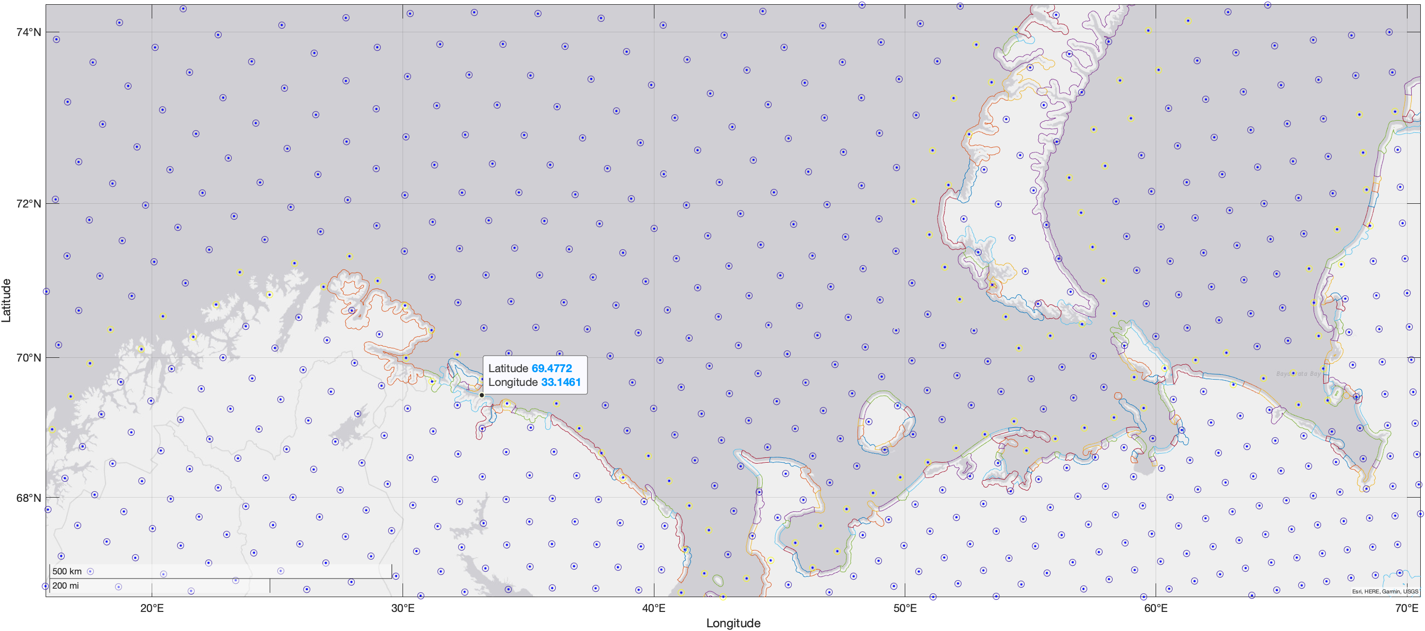
Observation dataset
Shapes are from the Arctic Coastal Dynamics database, blue points are NEMO grid, yellow ones are coastal points; coastal points are assigned values of the nearest shape.
Notes:
About 1300 segments in the coastline
ORCA1 NEMO grid
Remapped onto the NEMO grid using the nearest point

Slide 5
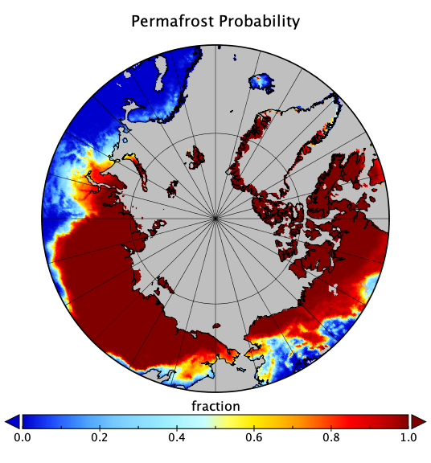
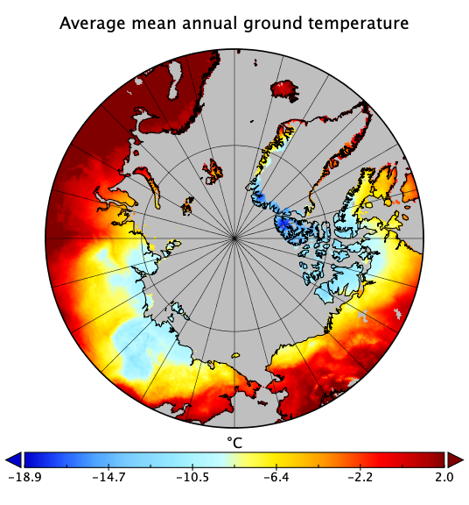
Permafrost model
Permafrost probability and temperature from model PEX
Use the nearest point value
Notes:
https://apgc.awi.de/dataset/pex
Permafrost probability: whether the permafrost is continuous

Slide 6
Erosion rate results
Erosion
Wave forced ORCA1 NEMO3.6 simulation
Spatial pattern is okay
Calculated erosion rates are too high compared to observations, could be caused by using different time periods. High values at river mouths need to be examined further.
Notes:
The figure on the left shows an example of calculated pan-Arctic erosion rates, this particular time slice is for September 2014. As you can see there is spatial variability in the rates; the pattern broadly matches the observed values from the ACD database, only the values at river mouths are a bit high. The database also contains all the variables need to calculate the carbon fluxes caused by erosion, namely the ice percentage and weight percentage of carbon in the sediment. Using observed sediment nutrient ratios, one can convert further and also calculate nitrogen and phosphor fluxes. The figure on the right shows the example for carbon. Such fluxes can be used in a biogeochemistry model to complement the nutrient fluxes from rivers, Terhaar 2021 shows the potential to solve biases in shelf productivity in this way.
https://doi.pangaea.de/10.1594/PANGAEA.919573?format=html#download
ORCA1 NEMO3.6 from my PhD thesis

Slide 7
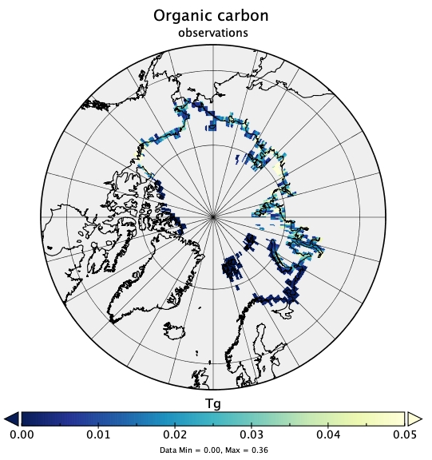
From erosion rate to BGC fluxes
ACDD has the required variables to calculated organic carbon flux from erosion rate
Bias in erosion rate causes bias in carbon flux. Using known ratios, DIN and P fluxes can also be calculated and used in a BGC model. Potentially solving biases in shelf productivity
$$OCarb=erosion_{r}∗height∗width_{grid}∗\left(1−W\right)∗dens ∗weight\%$$
Notes:
Biases in shelf productivity: Terhaar paper

Slide 8
Trend over time
Tg
Month
Hosekova 34 year wave-forced ORCA1 simulation 1979-2012
Huge seasonal cycle and interannual variability
Notes:
Wave period output missing in the run.
Wave period is parameterized based on ice concentration, tau(aice>=0.15)=15 tau(aice<0.15=5)

Slide 9
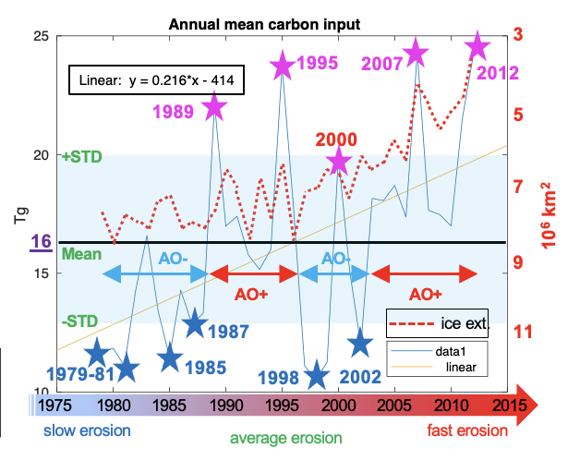
Seasonal cycle increasing in amplitude
Erosion season is starting earlier and ending later over time
Increase from 12 Tg to 19 Tg per year, Terhaar et al. has 15.4 Tg per year based on observations
Notes:
We have extended the erosion calculation for a multidecadal wave-forced ocean simulation from 1979 to 2012, the geological variables were kept constant. The resulting timeseries, here shown in terms of carbon input is quite interesting, with a lot of variability. The figure on the left shows the seasonal cycle and the figure on the right the yearly averages. The seasonal cycle is very large, with no erosion in winter. The erosion season is starting earlier and ending later over time and the peaks in summer are getting larger. The yearly averaged values also show an increasing trend over time. There is however also a lot of interannual and multi-year variability. There is possibly a relation to the Arctic Oscillation with lower erosion in negative AO phases. In the more recent years it is probably the decreasing ice extent that pushed the erosion up. We may need to look into this further.
Finally, the yearly carbon fluxes we calculated, between 12-19Tg are consistent with observations of 15Tg.

Slide 10
Further work/possibilities
Higher resolution: ORCA025 output
Use wave coupled model output
Can calculate future erosion rates from projections, need an offline wave model
Once wave models are more widely used, say in ESMs, it is possible to calculate erosion fluxes on-line

Slide 11
- Photo 1: https://www.sofarocean.com/posts/successful-deployments-for-the-2021-beluga-habitat-program
- photo 2: Lantuit, D. St-Hilaire-Gravel, F. Günther and S. Wetterich P. P. Overduin, M. C. Strzelecki, M. N. Grigoriev, N. Couture, H. C, Geological Society, London, Special Publications, doi 10.1144/SP388.13
- Barnhart K. R., Anderson R. S., Overeem I. , Wobus C., Clow G. D., and Urban F. E. (2014), Modeling erosion of ice-rich permafrost bluffs along the Alaskan Beaufort Sea coast, J. Geophys. Res. Earth Surf., 119, 1155–1179, doi:10.1002/2013JF002845.
- PEX: Obu J., Westermann S., Kääb A., Bartsch A. (2018): Ground Temperature Map, 2000-2016, Northern Hemisphere Permafrost. Alfred Wegener Institute, Helmholtz Centre for Polar and Marine Research, Bremerhaven, PANGAEA, https://doi.org/10.1594/PANGAEA.888600
- ACD: Lantuit, H., Overduin, P.P., Couture, N. et al. The Arctic Coastal Dynamics Database: A New Classification Scheme and Statistics on Arctic Permafrost Coastlines. Estuaries and Coasts 35, 383–400 (2012). https://doi.org/10.1007/s12237-010-9362-6
- Terhaar J., Lauerwald R., Regnier P., Gruber N., Bopp L. (2021). Around one third of current Arctic Ocean primary production sustained by rivers and coastal erosion. Nature Communications, 12(1), -. https://doi.org/10.1038/s41467-020-20470-z
- Aksenov, Y., Rynders, S., Feltham, D.L., Hosekova, L., Marsh, R., Skliris, N., Bertino, L., Williams, T.D., Popova, E., Yool, A. and Nurser, A.J., 2022. Safer operations in changing ice-covered seas: Approaches and perspectives. In IUTAM Symposium on Physics and Mechanics of Sea Ice (pp. 241-260). Springer, Cham. DOI: 10.1007/978-3-030-80439-8_12
References

