Slide 1
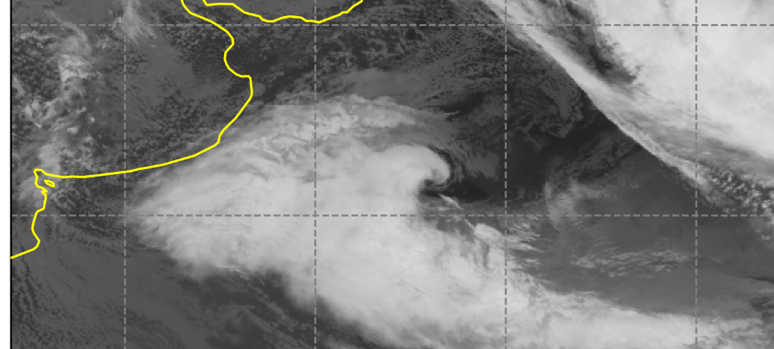
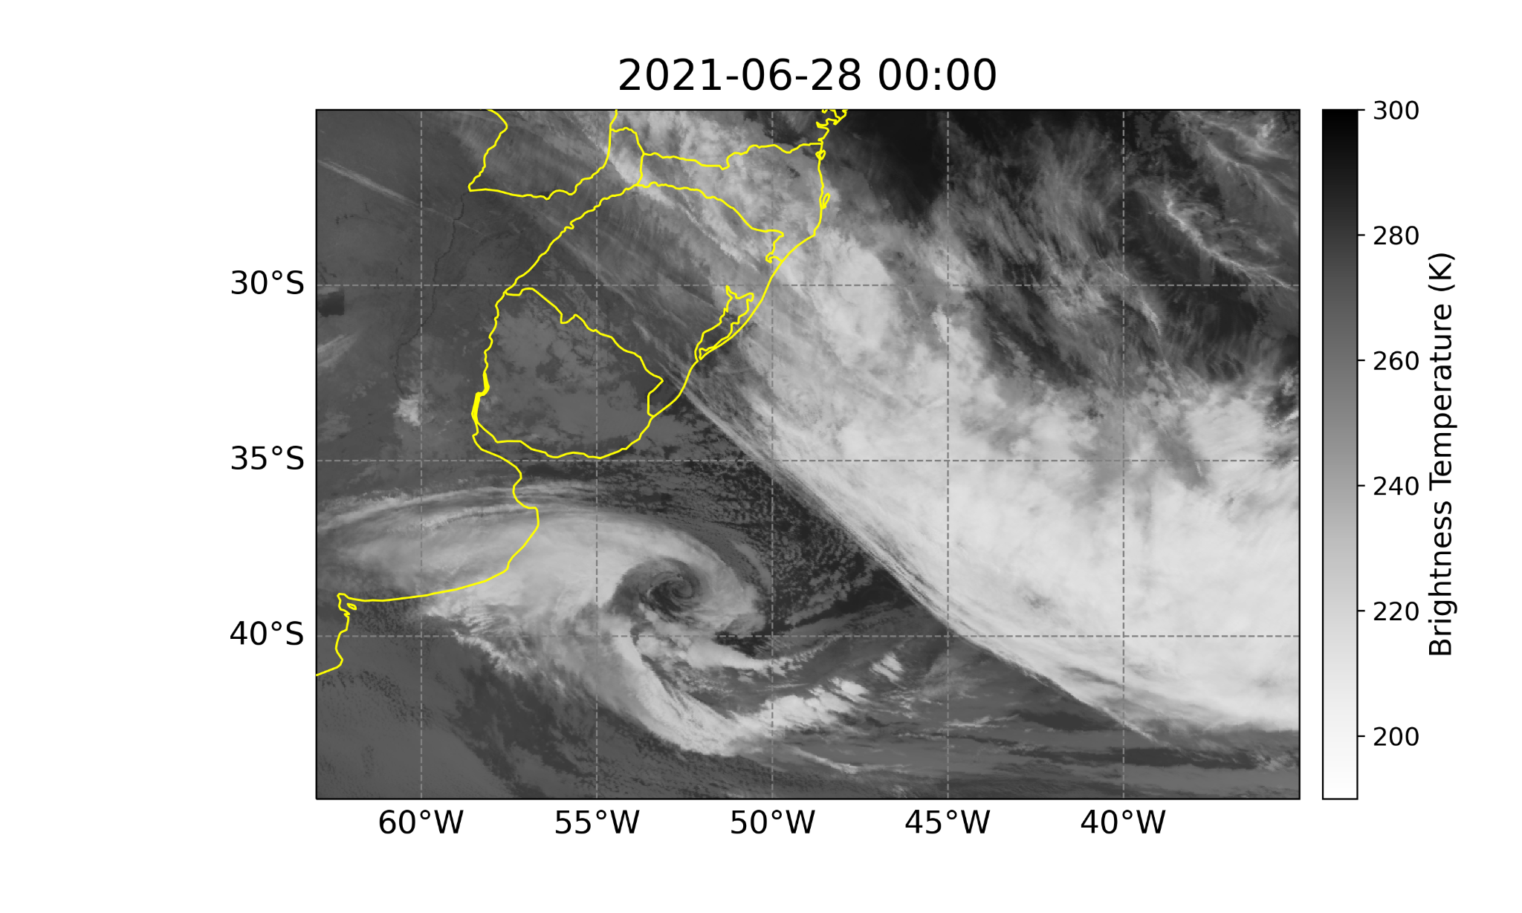
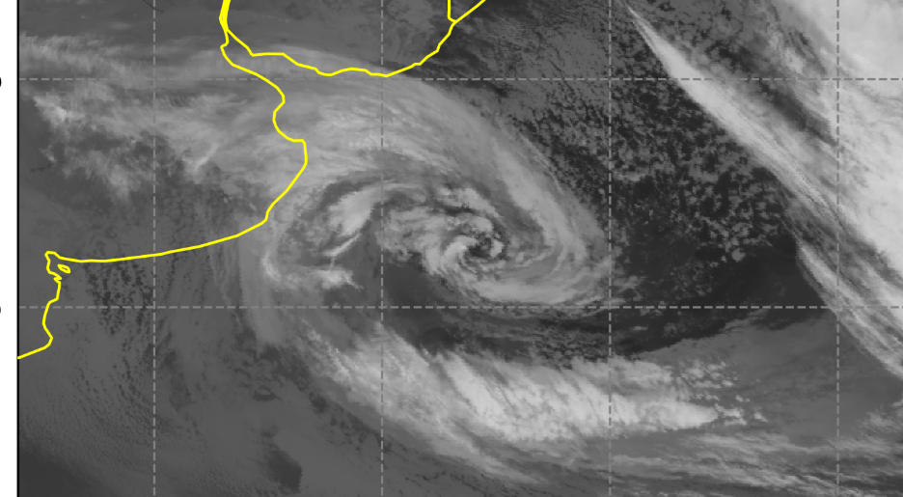
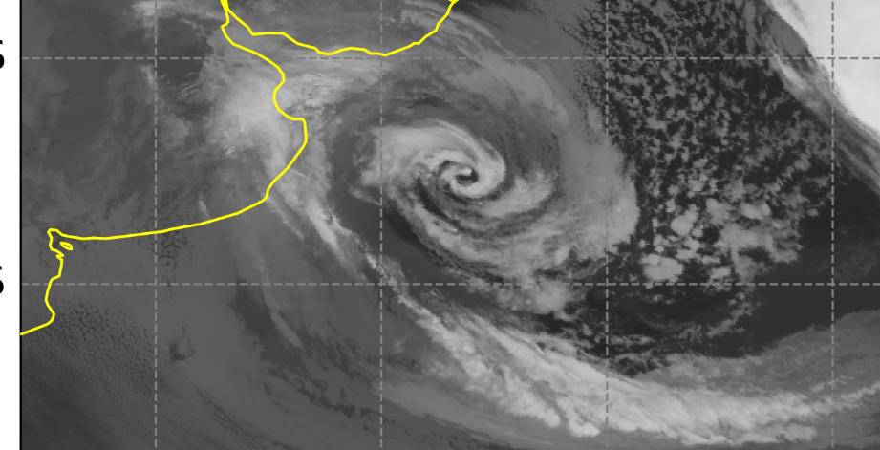
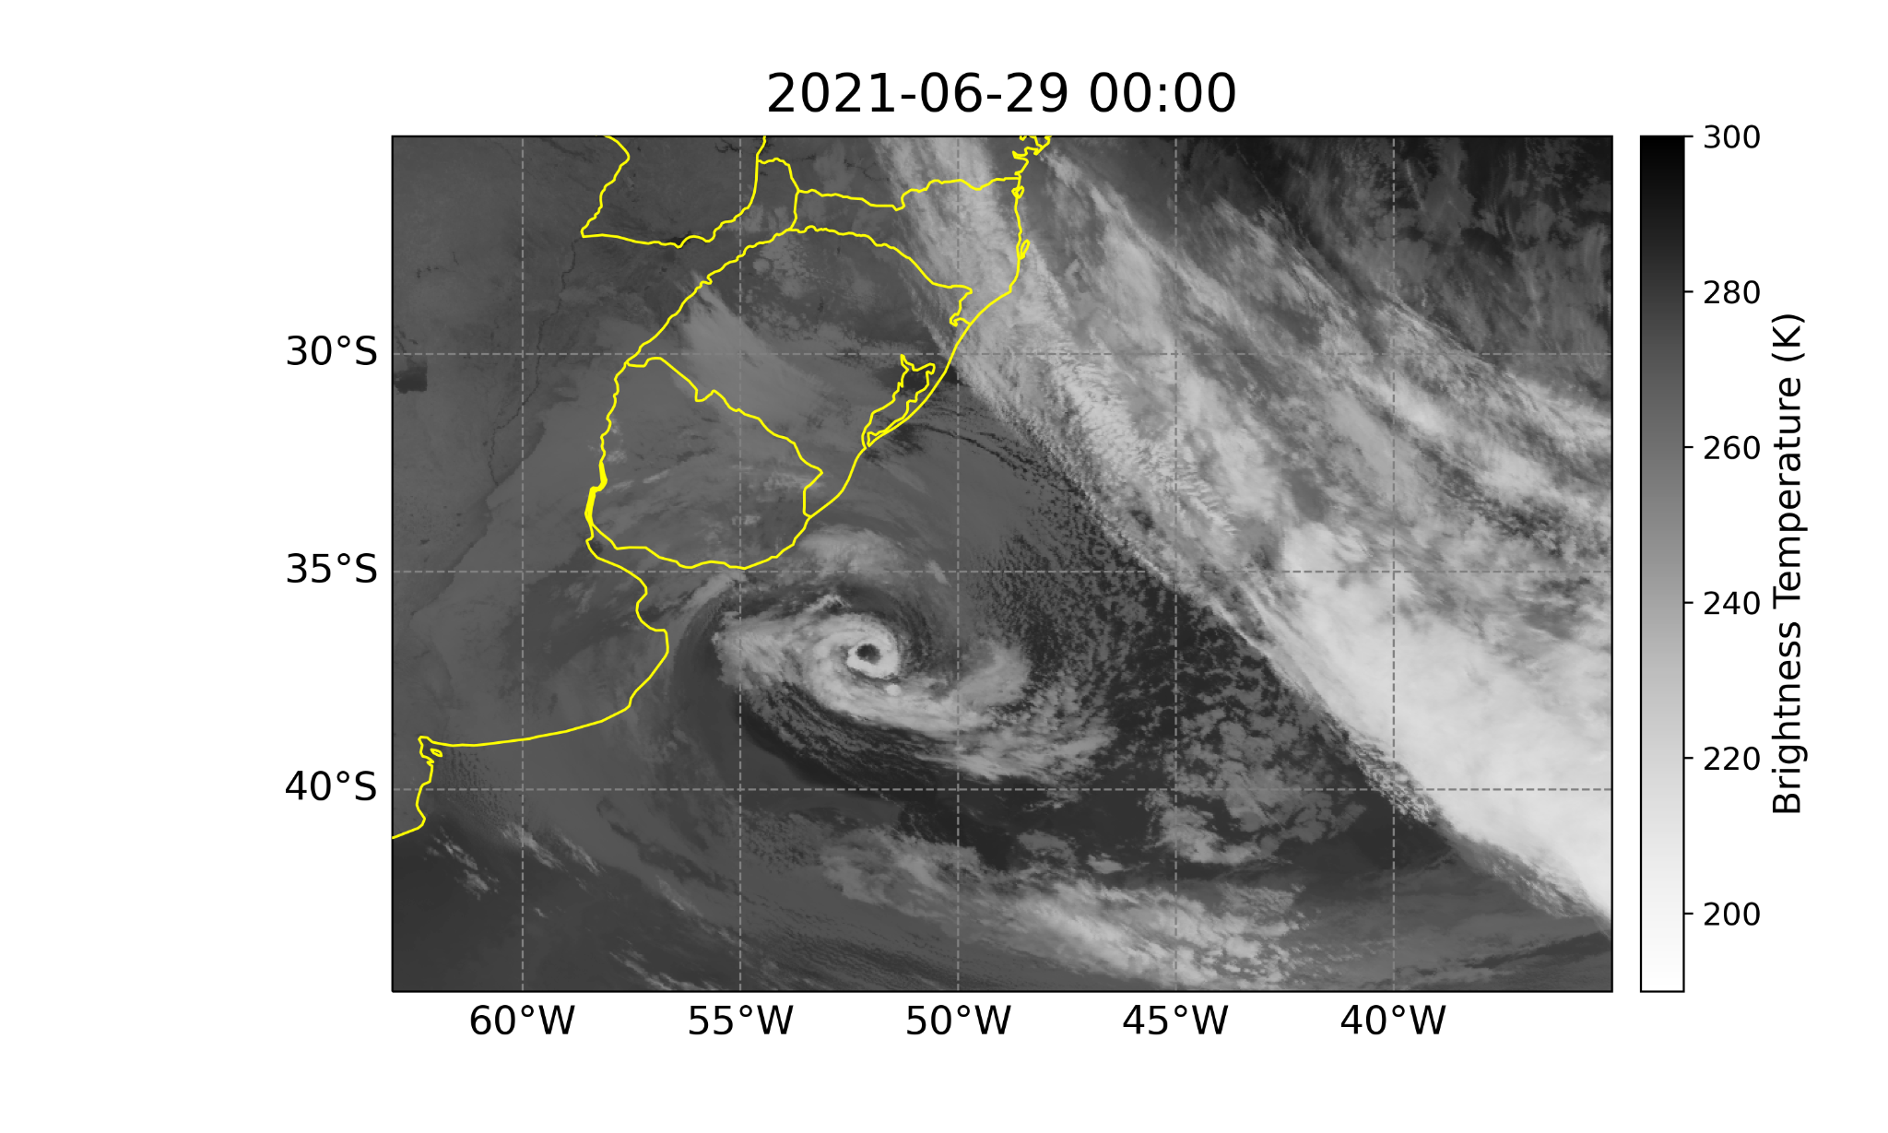
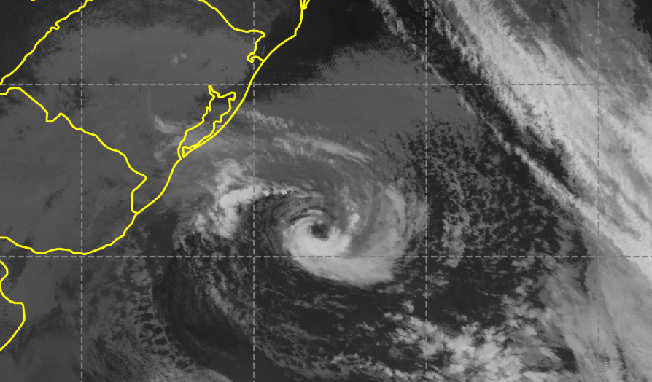





The role of surface heat fluxes on development of warm seclusion favouring subtropical cyclone Raoni transition over the Southwestern Atlantic Ocean
Michelle S. Reboita,
Rosmeri P. da Rocha, Natália M. Crespo, Luiz F. Gozzo, Maria Custódio, Vinícius Lucyrio and Eduardo M. de Jesus

Slide 2
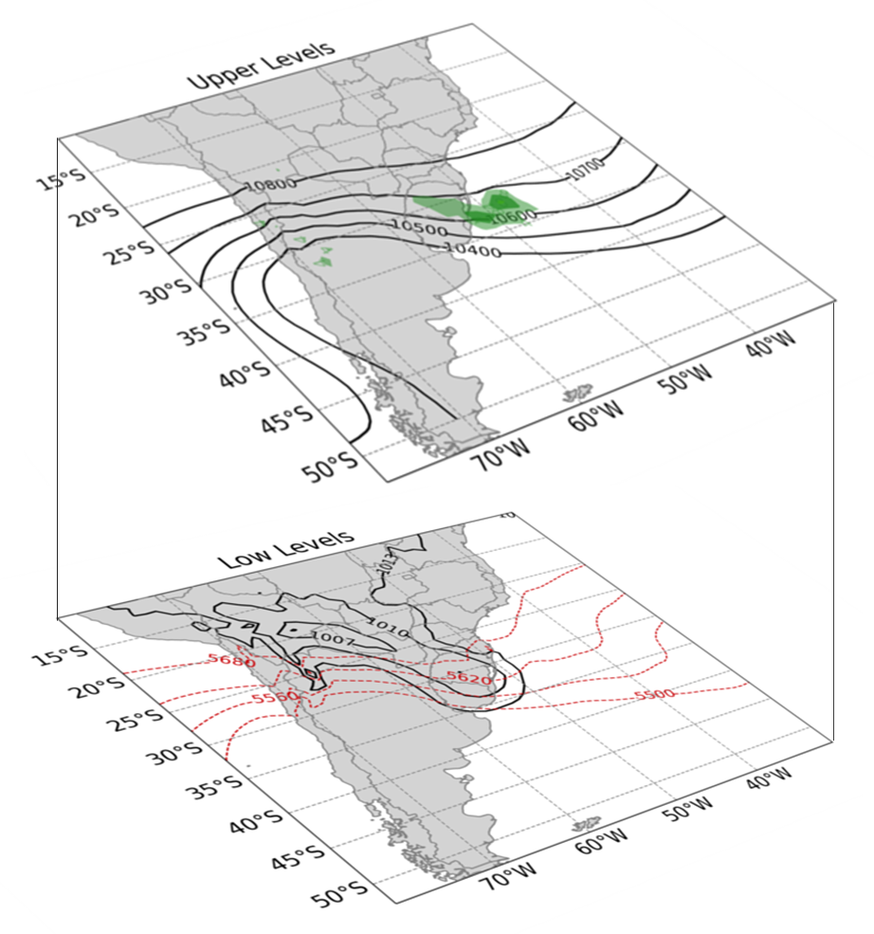

Introduction
In June 2021, an unusual synoptic development occurred over the South Atlantic Ocean (SAO):
a)
Cyclogenesis
1800 UTC 26 June 2021
L

Slide 3
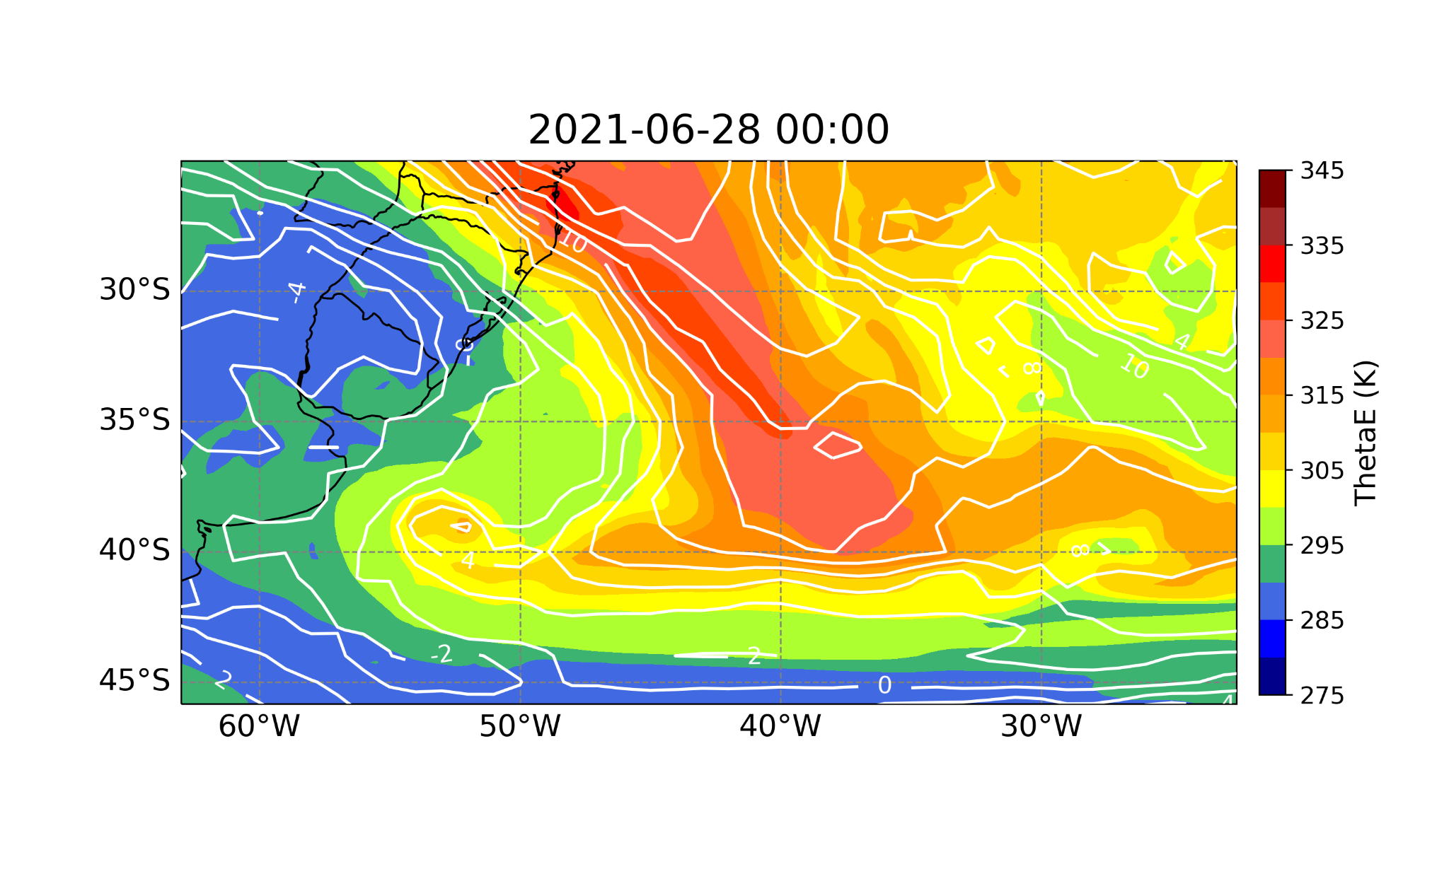
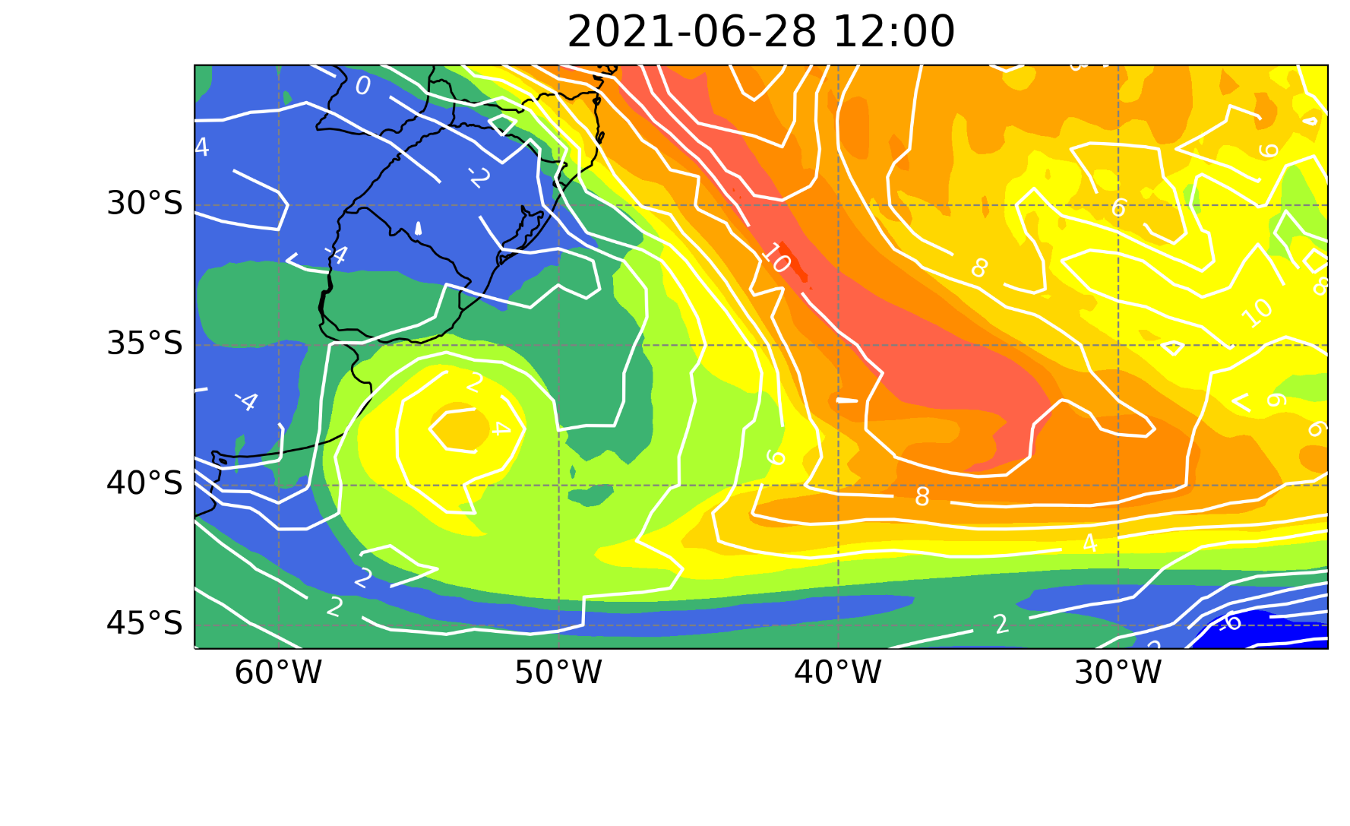
Introduction
Shapiro and Keyser (1990) model
b)
T-bone pattern
The low evolved to a cyclone following the Shapiro-Keyser (1990) model
Warm seclusion
Warm seclusion
c)
Warm seclusion favored a subtropical transition
Raoni

Slide 4
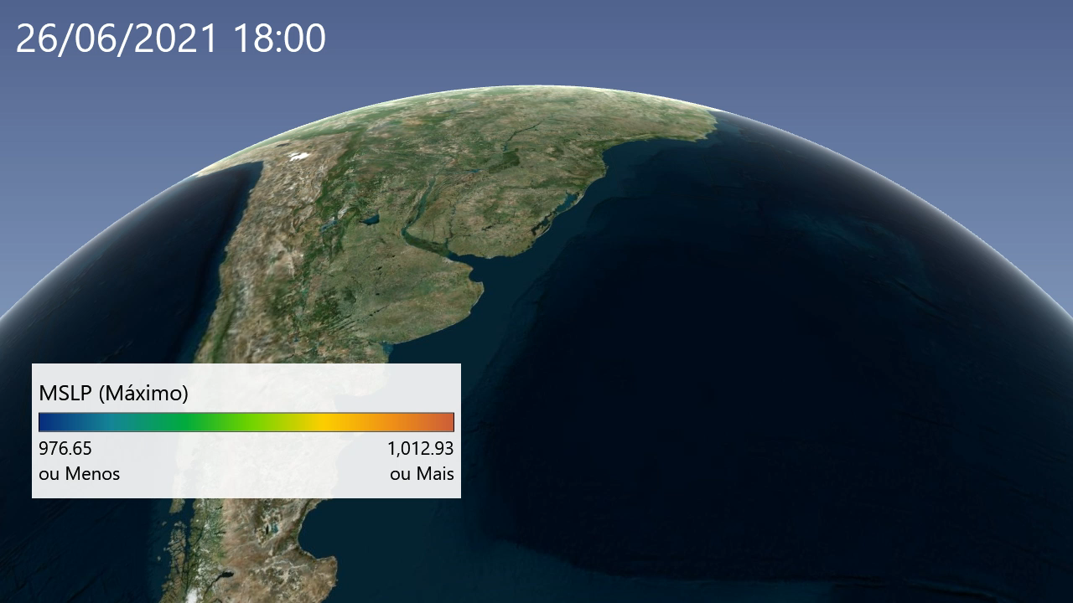
Introduction
Why was it an unusual synoptic development?
genesis as a common extratropical cyclone
evolved to a S-K model
underwent to subtropical cyclone
this evolution occurred in winter, which is a season not favourable for subtropical cyclones
moved to northeast

Slide 5
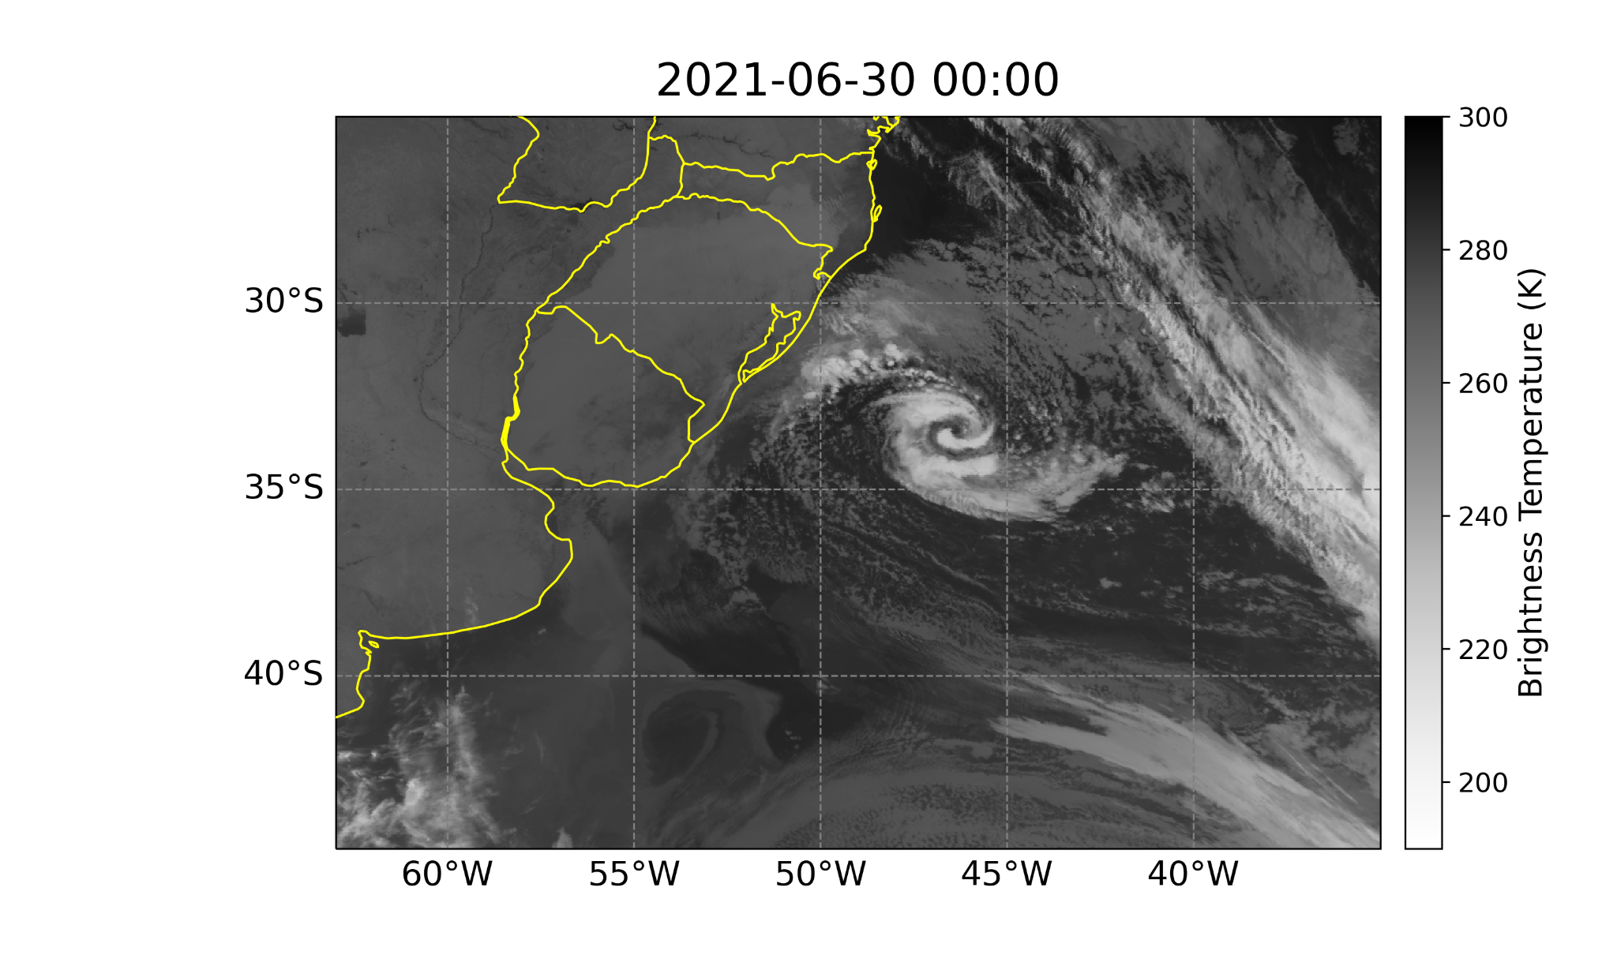
Scientific Question
Which processes have contributed to the warm seclusion and the subtropical transition?

Slide 6
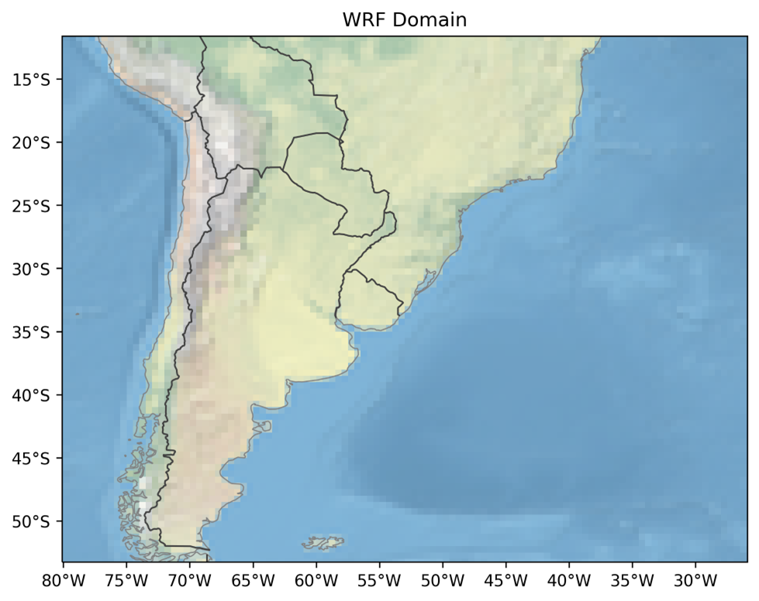
Methodology
Cyclone analysed in ERA5 reanalysis and
simulated with WRF model
CTRL experiment → all physical parameterizations
NOFLUX → turned off sensible and latent heat fluxes
Model driven by ERA5 atmospheric variables and SST
Simulations started 18 hours before the cyclogenesis
Notes:
Kain-Fritsch convective scheme, Thompson microphysics, CLM4 land-surface interactions, Mellor-Yamada Nakanishi and Niino - MYNN - surface-layer, MYNN level 2.5 boundary layer

Slide 7
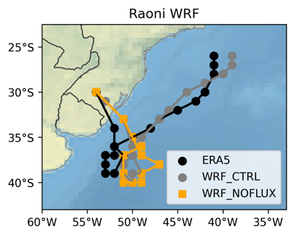
Results
Track
18Z 26/06 Genesis
CTRL experiment displaces slightly the track eastward, but the cyclone lifetime and intensity are similar to that from ERA5.
NOFLUX simulates a weaker system with shorter lifecycle, and without northeast movement.
06Z 28/06 Sub Trans
18Z 27/06
warm seclusion is
configurated

Slide 8
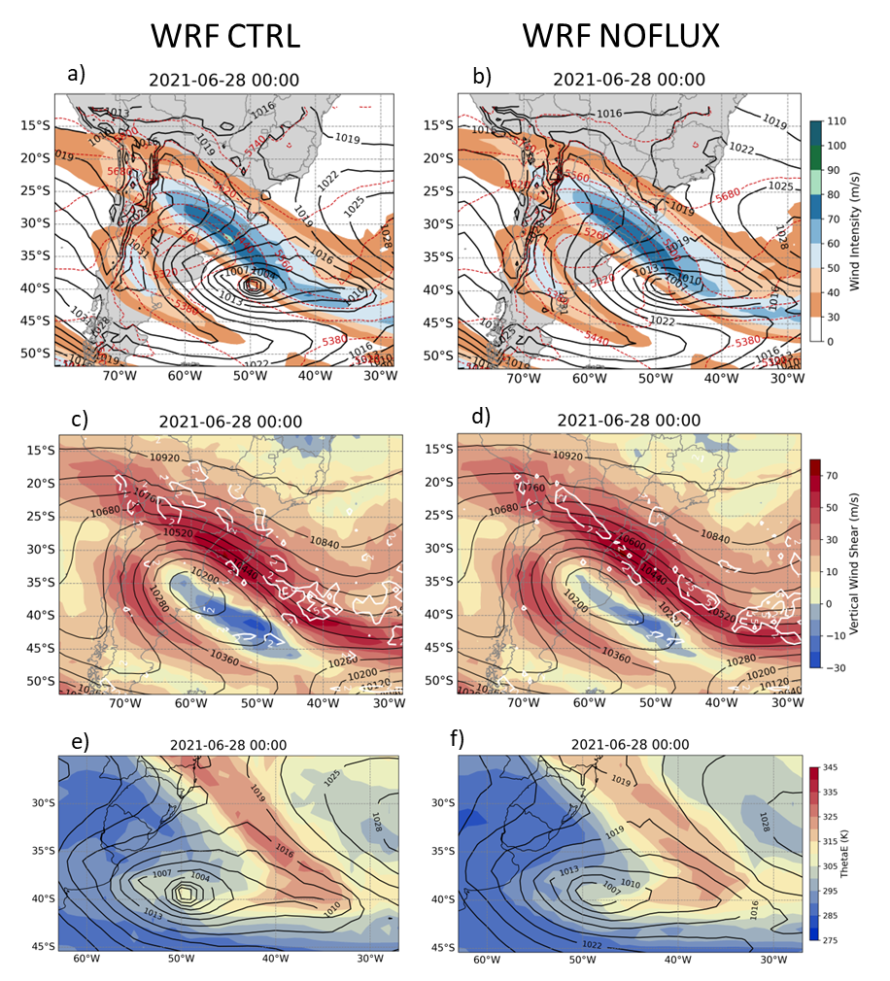
250 hPa Jets (m/s, shaded)
MSLP (black lines)
Results
In both experiments, the mid-upper levels dynamic is similar, except by
the stronger cutoff low in NOFLUX (see geopotential height).
HGT at 250 hPa (mgp, black lines)
850-250 hPa Vertical wind shear (m/s, shaded)
Near surface, the experiments show differences, such as no warm seclusion in NOFLUX.
NOFLUX → smaller diabatic heating, which does not weaken the mid-upper level cold-core.
Equivalent Pot. Temp. at 850 hPa (K, shaded)
MSLP (hPa, black lines)

Slide 9
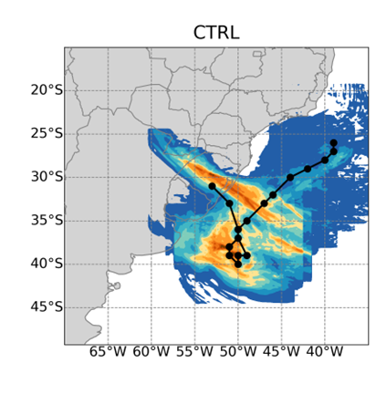
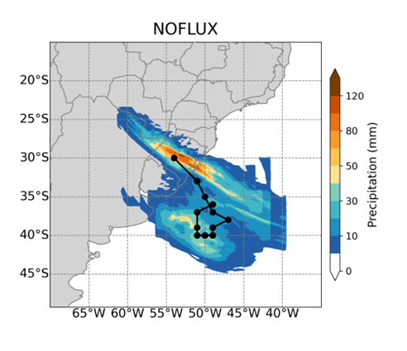
Results
Accumulated Precipitation
Why is there no warm seclusion in NOFLUX?
Without sensible and latent heat transfer to atmosphere, the diabatic warming decreases.
Accumulated precipitation → proxy of the latent heating in the atmosphere → stronger in CTRL than in NOFLUX.
The most important difference between the experiments occurs when the cyclone was performing a backward movement, at the time of the subtropical transition.
Answer: No transfer of surface fluxes to atmosphere

Slide 10
Results
Which is the role of the cutoff low in both experiments?
Cutoff low provides a weakened zonal flow, which can be seen by weak vertical wind shear.
Low vertical wind shear environment helps to build the cyclone's warm core since the convective activity is taking place concentrating the latent heat released and, consequently, a more efficient heating of the atmospheric column.
BUT in NOFLUX there is no sensible and latent heat fluxes to atmosphere, then only the cutoff low is not enough to develop a warm seclusion.

Slide 11
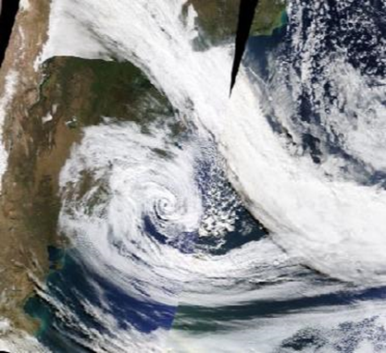
Conclusions
Which processes have contributed to the warm seclusion and the subtropical transition?
Sea-air turbulent heat fluxes provided energy to the atmosphere.
Mid-upper level cutoff low was important to weaken the vertical wind shear.
This environment allowed the organisation of convection, which was fueled by the sea-air fluxes.
Consequently, the warm seclusion strengthened and led to the subtropical transition.
Thanks for your attention!
reboita@unifei.edu.br

