Slide 1
Bridging the gap between GRACE and
GRACE-Follow On by the combination of hlSST and SLR
M. Weigelt¹, A. Jäggi², U. Meyer², D. Arnold², T. Mayer-Gürr³, B. Dutt Vishwakarma⁴, B. Devaraju⁵, H. Steffen⁶, K. Sośnica⁷, S. Ebadi¹
1) Institute of Geodesy, Leibniz Universität Hannover
2) Astronomical Insitute, University Bern
3) Institute of Geodesy, Graz University of Technology
4) Interdisciplinary Centre for Water Research, Indian Institute of Science
5) Department of Civil Engineering, IIT Kanpur
6) Lantmäteriet, Sweden
7) Institute of Geodesy and Geoinformatics, Wroclaw University of Environmental and Life Sciences

Slide 2
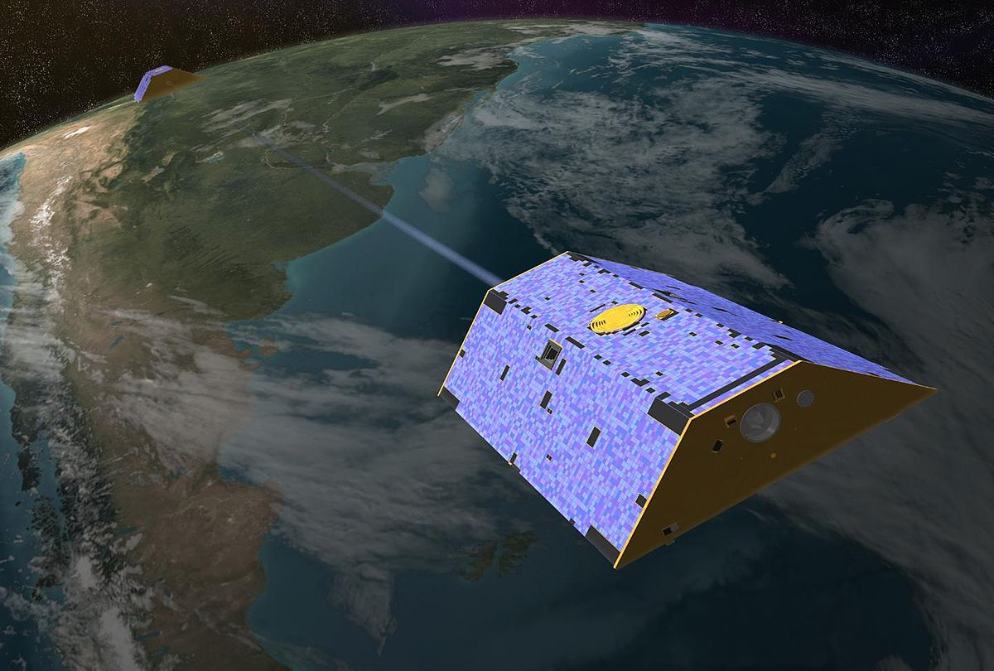
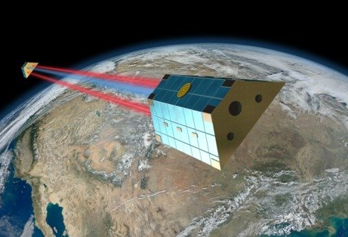
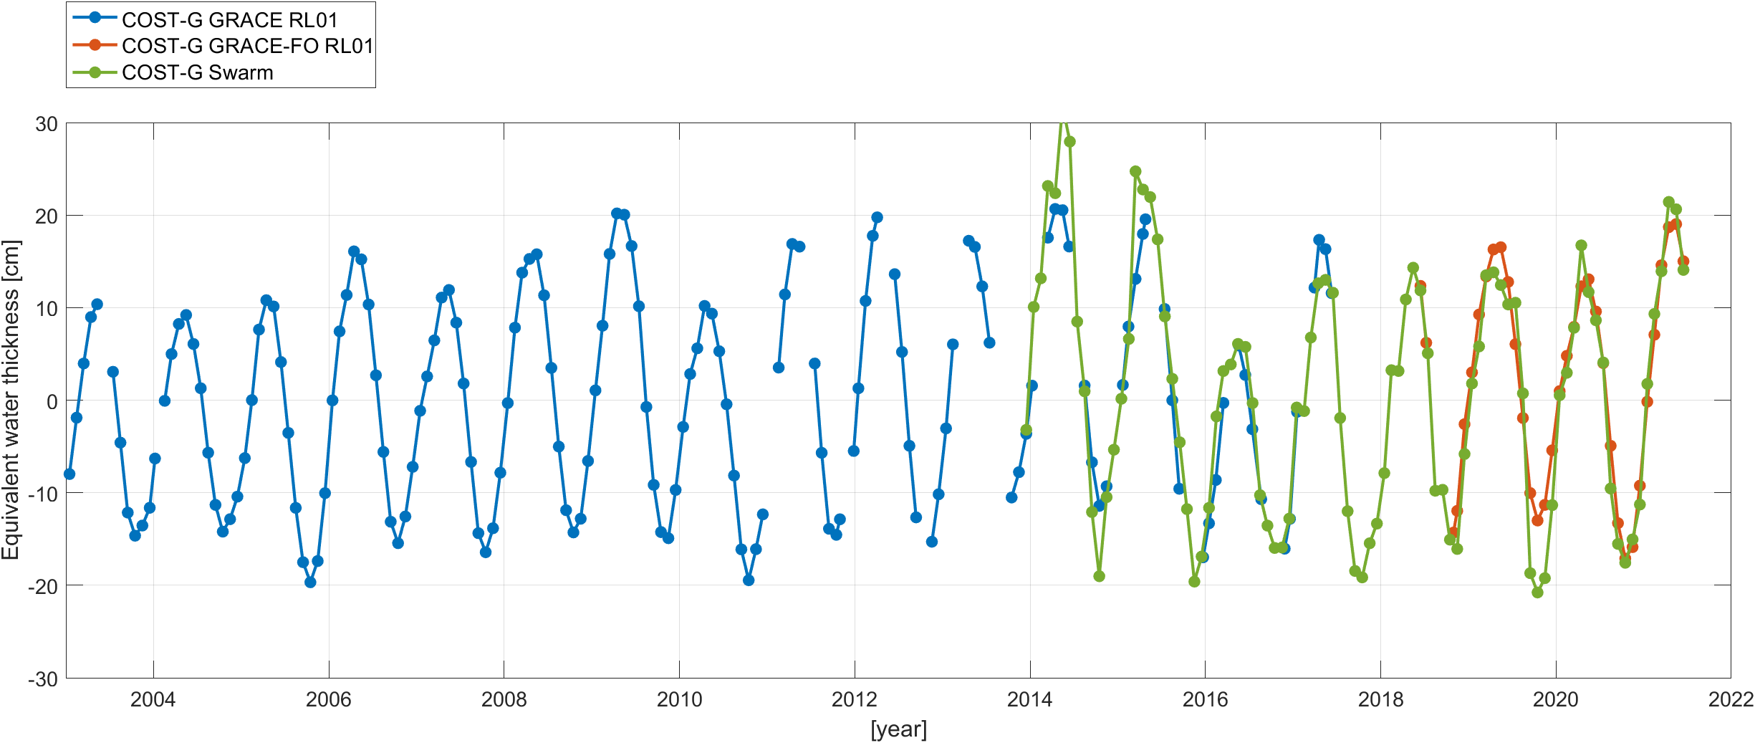
Motivation
Bridging the gap between GRACE and GRACE-FO
Bridging the gaps of GRACE
Cross-validating GRACE and GRACE Follow-On
Combination of gravity fields from various sources for improved recovery
Amazon basin
Gaussian filter 700 km

Slide 3
Key elements of the data processing
Normal equations for hlSST and SLR part
Combination of hlSST and SLR
Temporal filtering

Slide 4
Acceleration approach and background models
Acceleration approach and combination on the normal equation level using variance component estimation
Kinematic orbits from
  Astronomical Institute, University Bern
  Institute for Geodesy, Graz
  Institute for Geodesy, Hannover
  European Space Agency
  totalling
  79 kinematic orbit products from 30 satellites.
Accelerometer data used for CHAMP, GRACE, GRACE-FO and GOCE
Background models
  JPL Ephemeris DE440
  Solid Earth tides (IERS Conventions)
  Solid Earth pole tides (IERS Conventions)
  Ocean tides (FES2014b)
  Ocean pole tides (IERS Conventions)
  Relativistic corrections (IERS conventions)
  Atmospheric tides (AOD1B-product Rel. 06)
  Atmospheric and ocean dealiasing (AOD1B-product Rel.06)

Slide 5
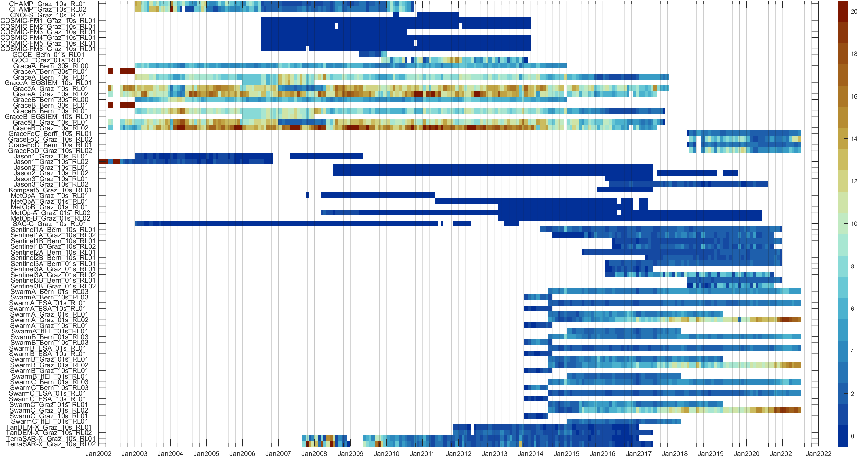
Relative contribution of hlSST-satellite products

Slide 6
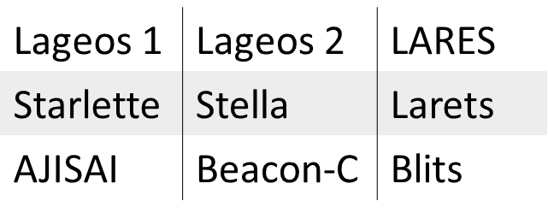
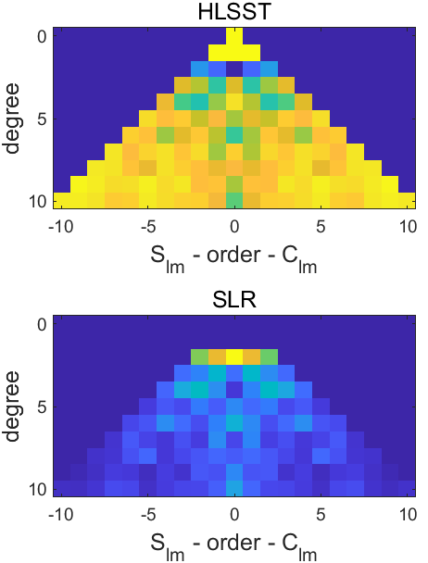
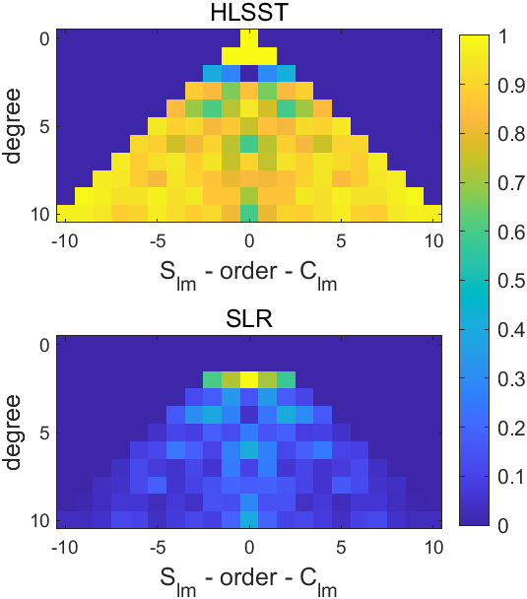
Combination with satellite laser ranging
January 2007
October 2007
    9 satellites
  Combined estimation:
    gravity parameters degree 2-10
    station coordinates
    Earth rotation parameter
    geocenter
    range biases
  Combination using empirical weighting factors based on the ocean RMS
1.00
1.00
1.24
0.65
More details in EGU22-6526 by Ebadi et al.

Slide 7
Temporal filtering
Trend +
Annual cycle
Semi-annual cycle
Monthly SH coefficients
Least squares adjustment
Kalman filter
residual
filtered
residual signal
modelled signal
Filtered SH coefficients
Kalman filter:
following the Kurtenbach (2012) approach
introducing only the stochastic information of the ESA ESM model using H+I+AOerr (Dobslaw et al. 2015)

Slide 8
Temporal signal evaluation

Slide 9
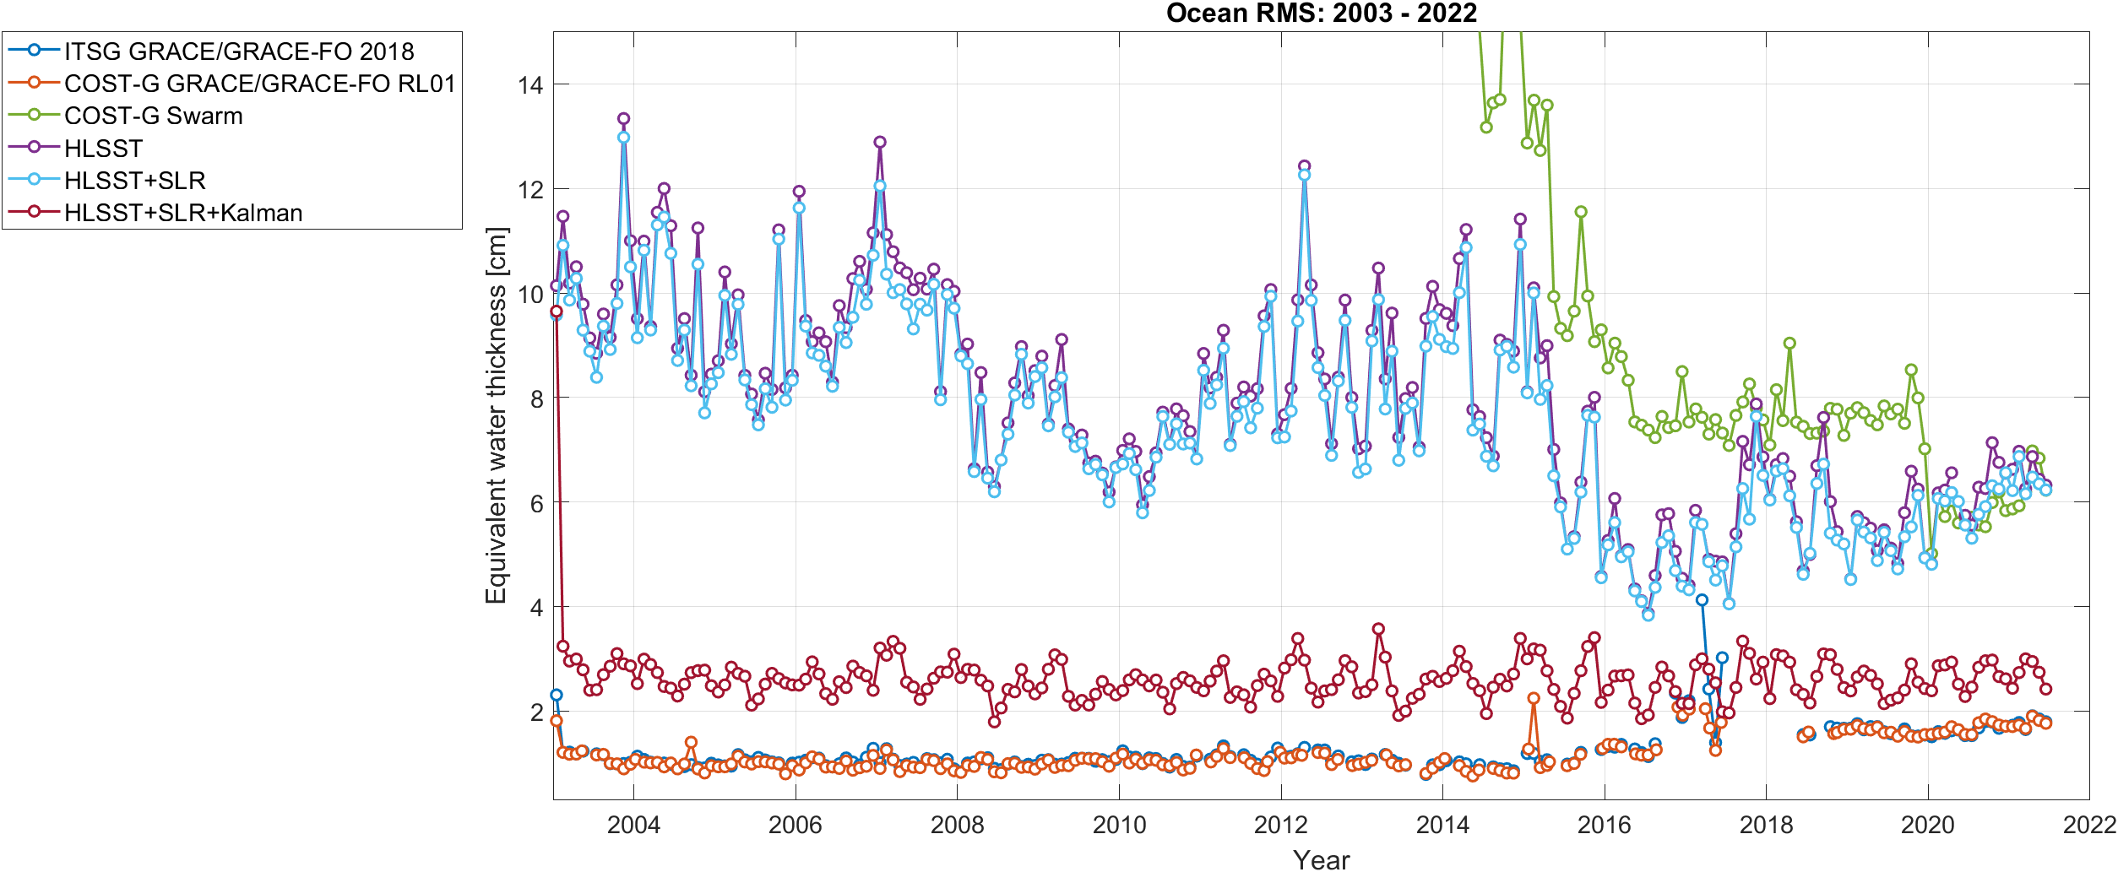
Spatial RMS over ocean areas
Gaussian filter 700 km

Slide 10
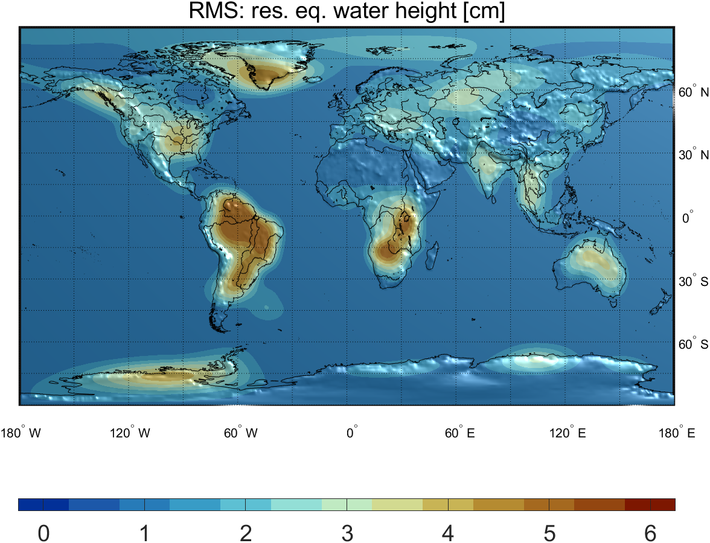
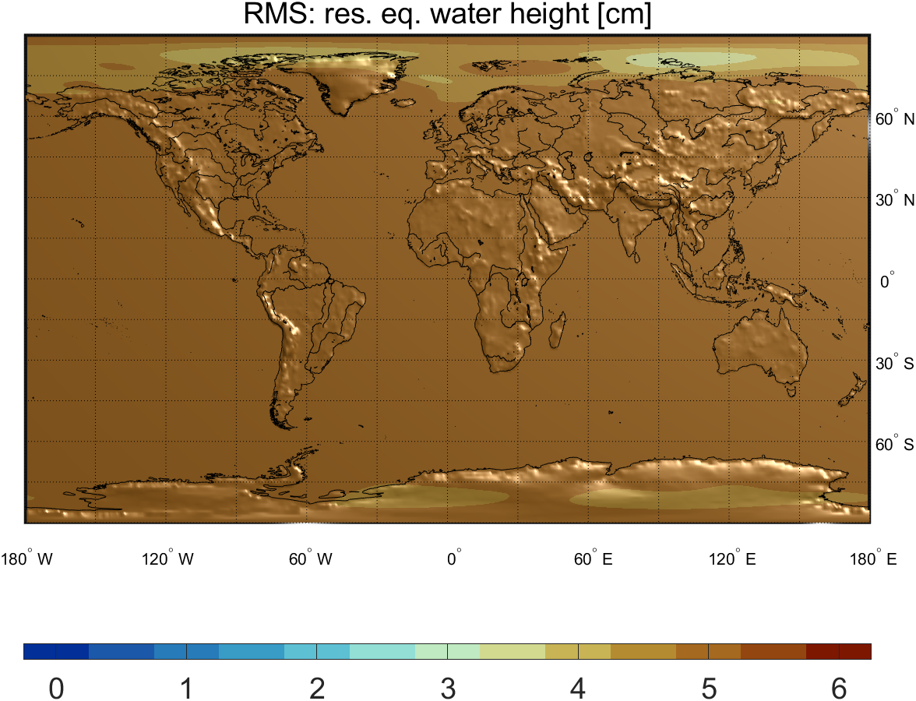
Residual RMS
Gaussian filter 700 km
COST-G GRACE/GRACE-FO RL01
hlSST+SLR

Slide 11
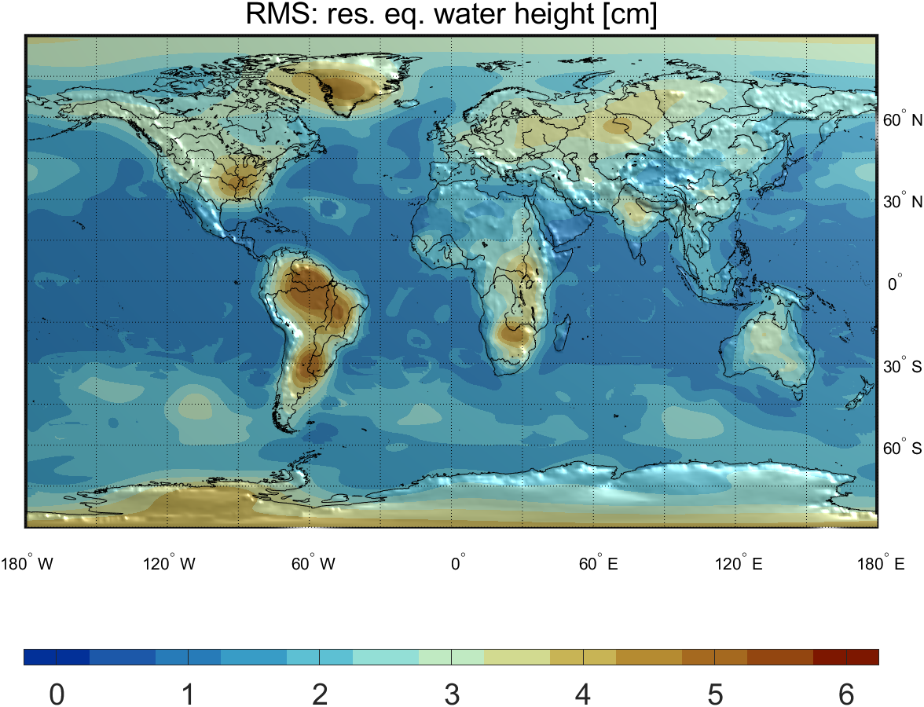
Residual RMS after Kalman filtering
Gaussian filter 700 km
COST-G GRACE/GRACE-FO RL01
hlSST+SLR+Kalman

Slide 12
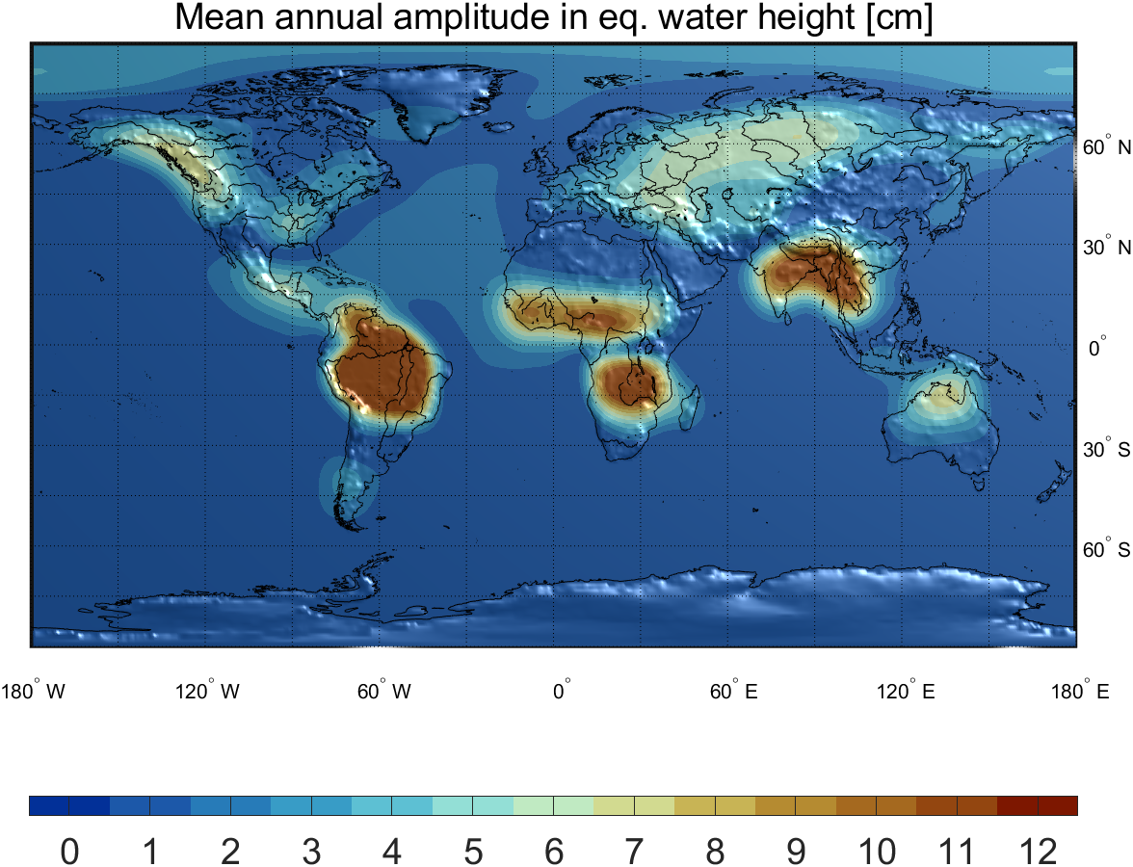
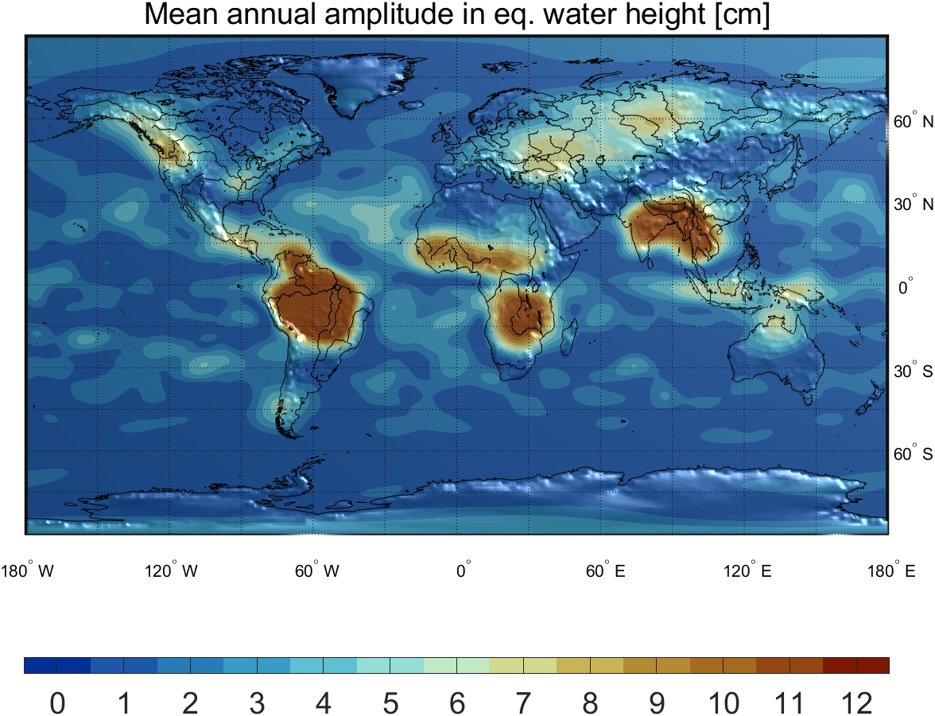
Annual signal amplitude after Kalman filtering
Gaussian filter 700 km
COST-G GRACE/GRACE-FO RL01
hlSST+SLR+Kalman

Slide 13
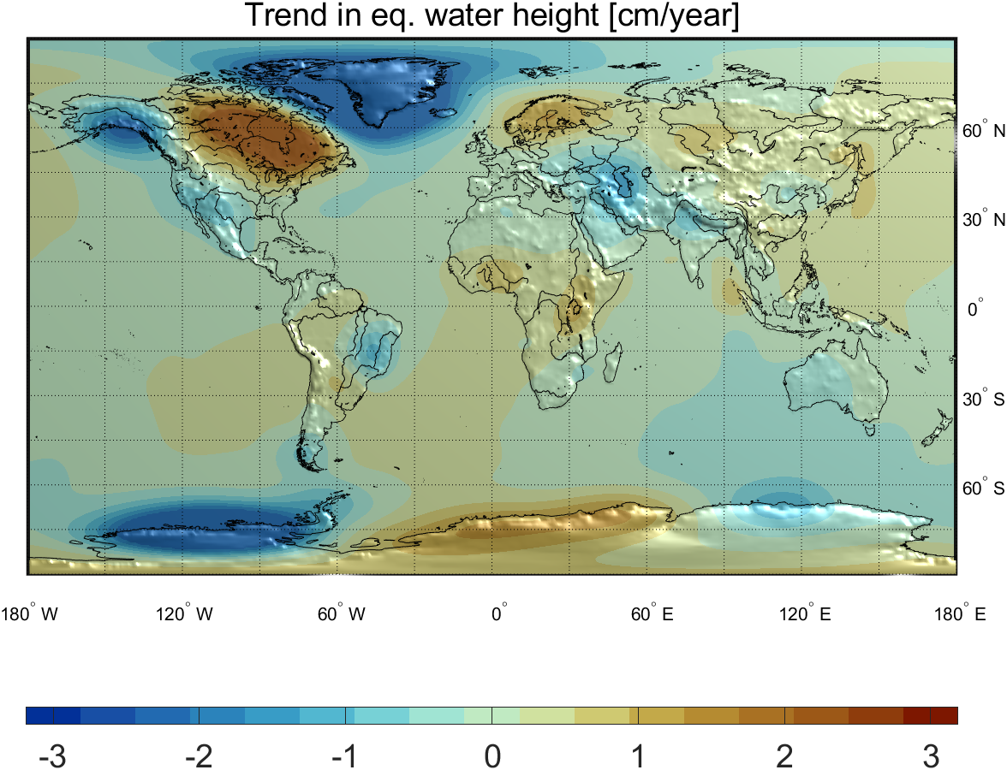
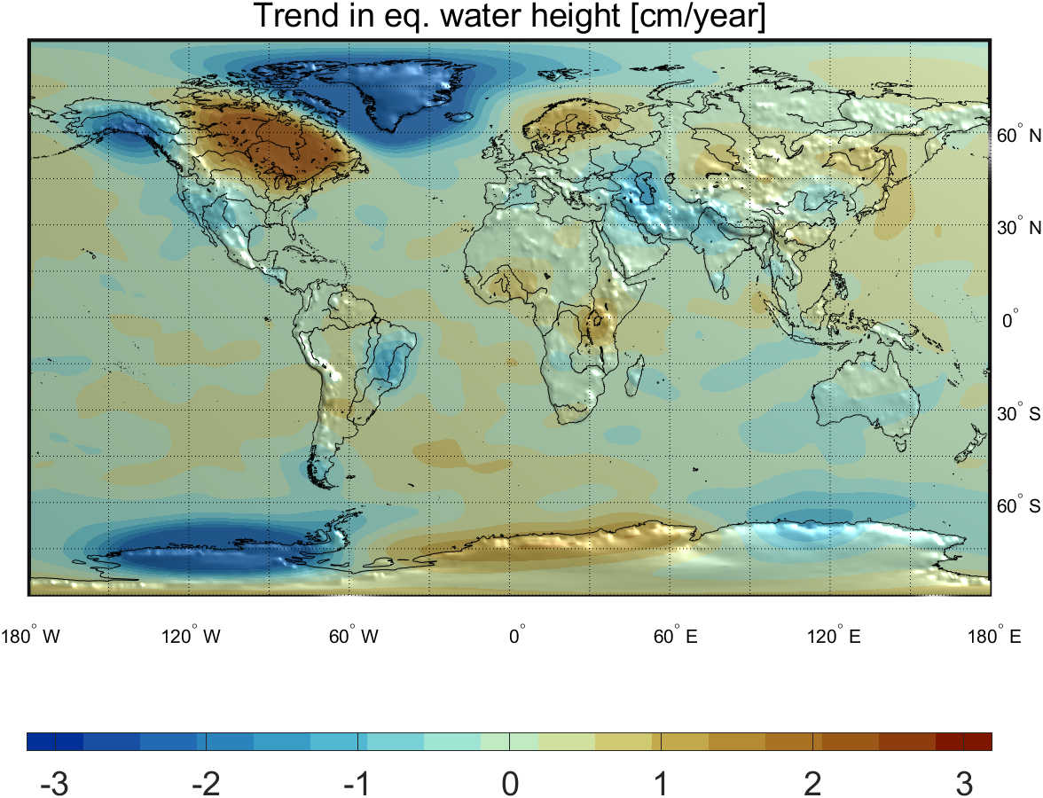
Trend after Kalman filtering
Gaussian filter 700 km
COST-G GRACE/GRACE-FO RL01
hlSST+SLR+Kalman

Slide 14
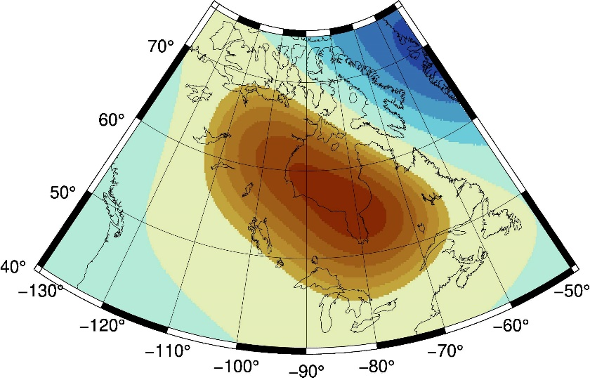
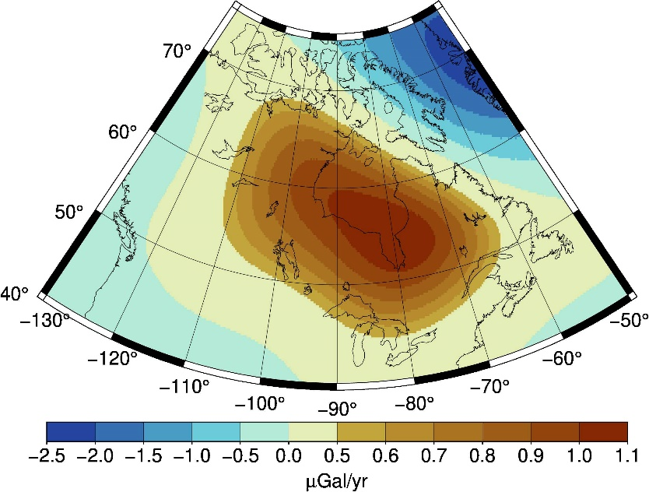
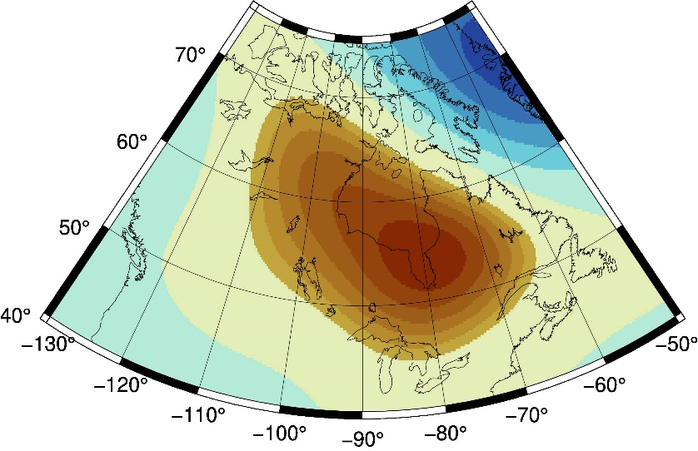
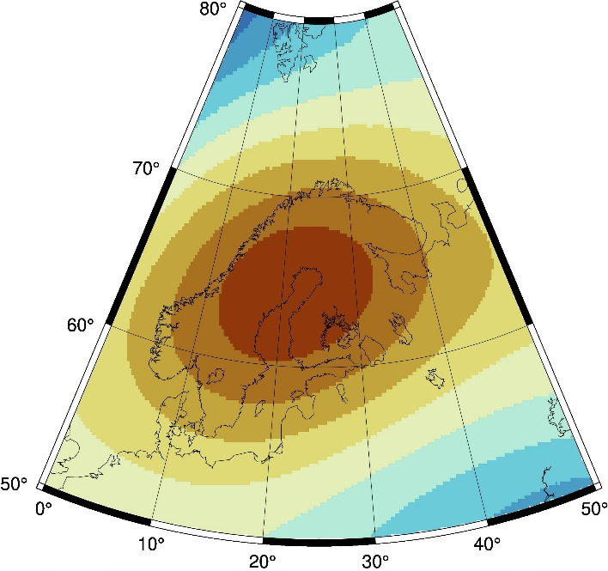
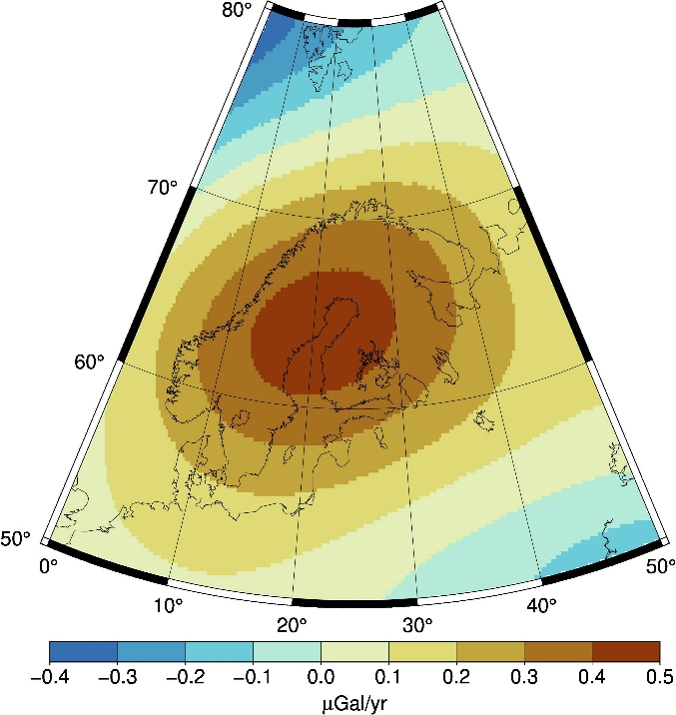
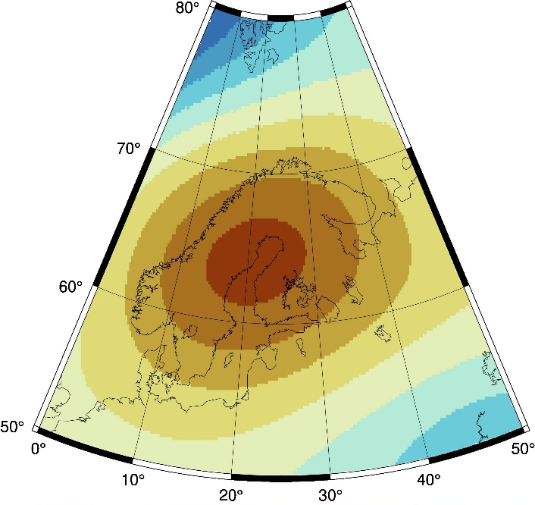
Glacial Isostatic Adjustment
Gaussian filter 750 km
CSR GRACE RL06
hlSST+SLR
hlSST+SLR+Kalman
Max:
55N 279E
1.08
Max:
55N 280E
1.09
Max:
54N 281E
1.08
Max:
64N 21E
0.47
Max:
64N 21E
0.45
Max:
64N 21E
0.44

Slide 15
Conclusion

Slide 16
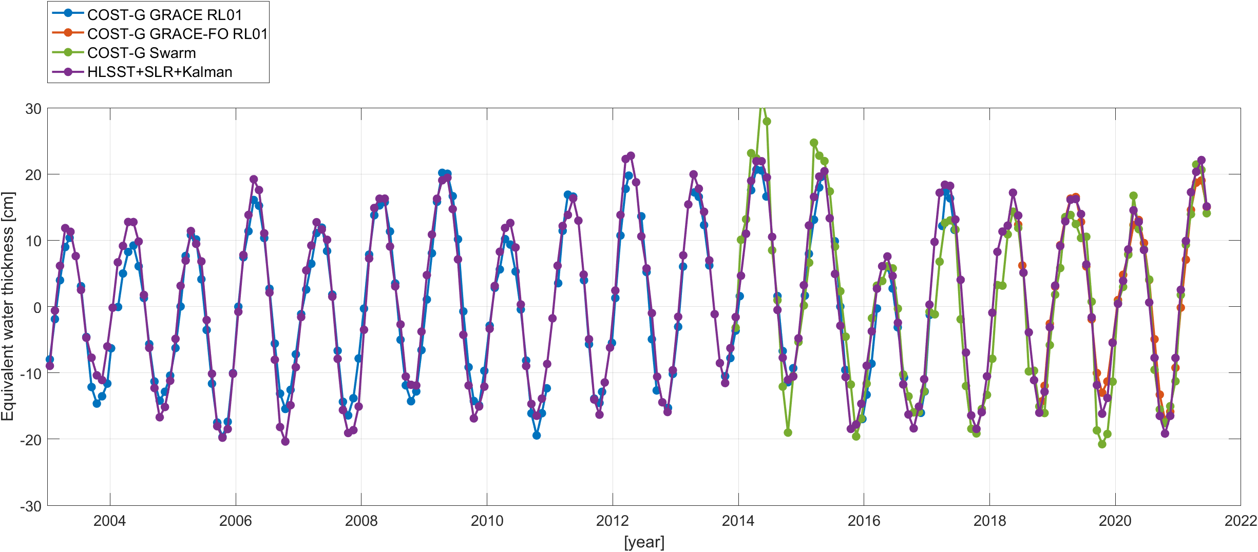
Conclusions
Mutual benefit by combining HLSST and SLR:
  SLR improves (dominates) the degree-2 coefficients
  HLSST provides the higher spatial resolution
Closing the gaps by real observations (at reduced spatial resolution)
Amazon basin
Gaussian filter 700 km
Data available at
Combined hlSST+SLR solution:
https://seafile.cloud.uni-hannover.de/f/e55646a0dd484dfca428/?dl=1
Kalman-filtered solution:
https://seafile.cloud.uni-hannover.de/f/adb09152e6c9418e805f/?dl=1

