Slide 1

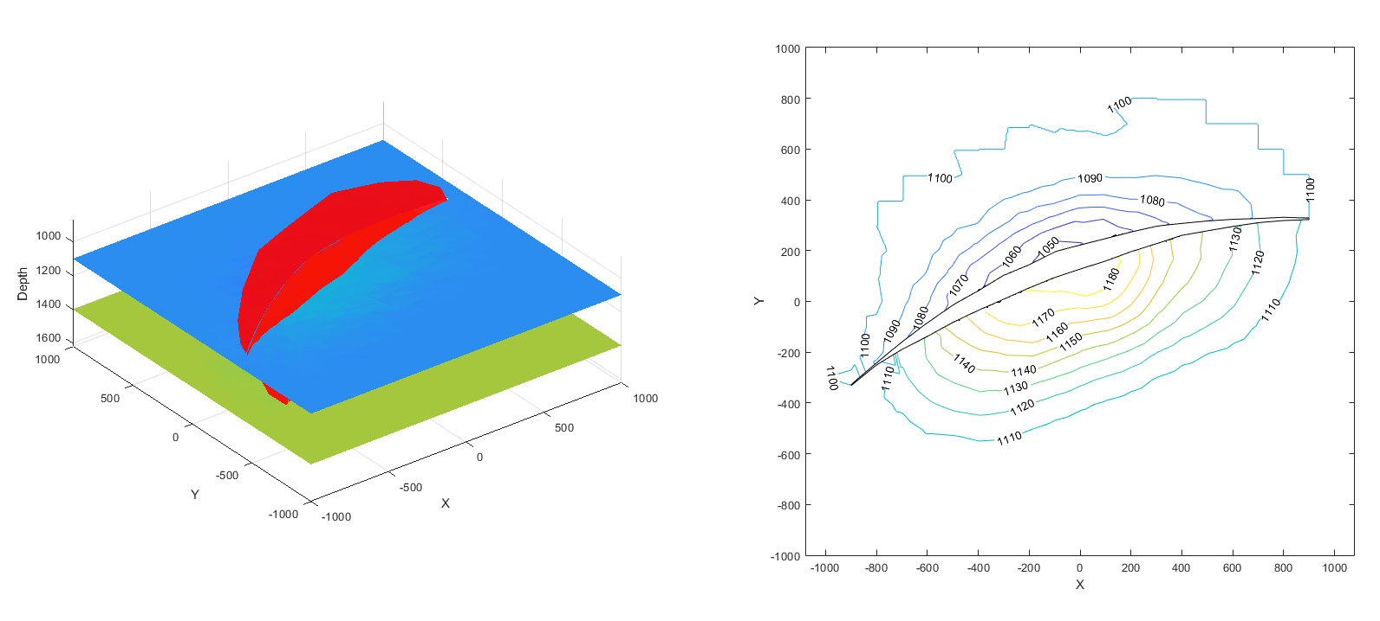
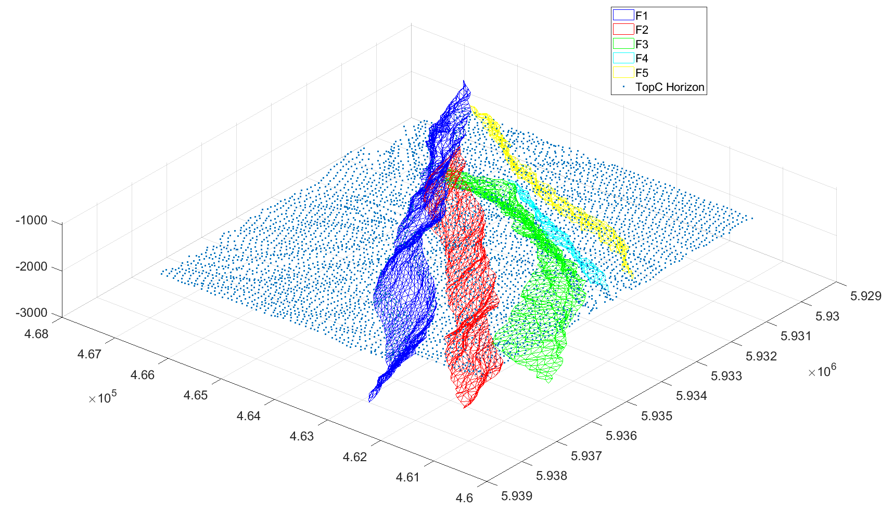
Structural Geologic Modelling and Restoration Using the Ensemble
Kalman Filter
David Oakley^{1,} Nestor Cardozo¹, Per Røe², and Ariel Almendral Vazquez²
¹University of Stavanger, Dept. of Energy Resources, Stavanger, Norway
²Norwegian Computing Center, Oslo, Norway

Slide 2
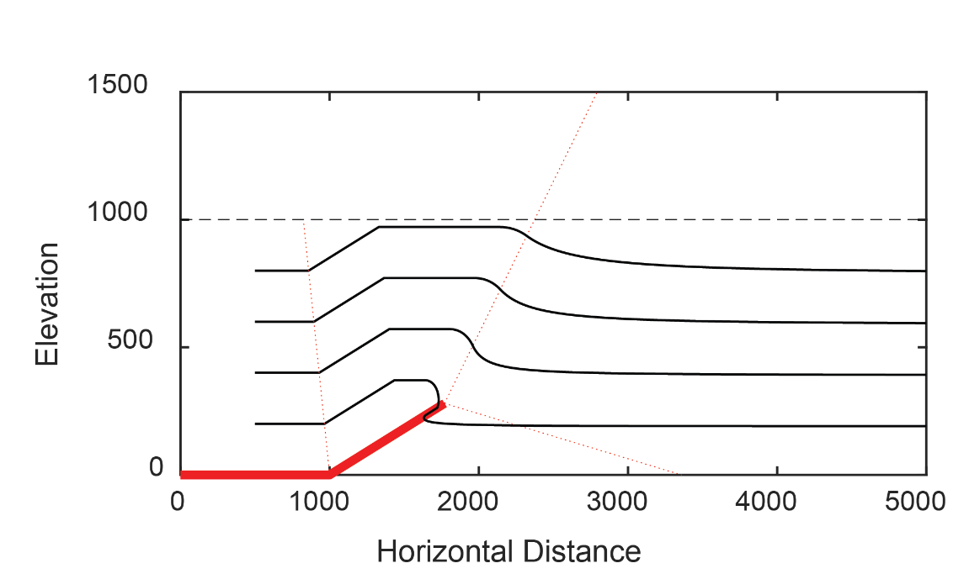
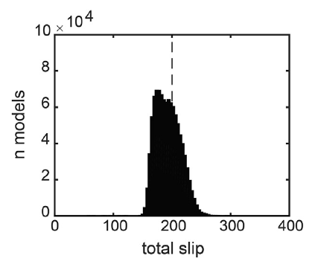
Fault Kinematics and Data Inversion
Histogram from MCMC inversion:
Trishear Fault Propagation Fold
Oakley and Fisher (2015)
Fault Kinematics
  Methods such as trishear and fault-bend folding.
  Can be used to make balanced cross sections.
Data inversion
  Can fit for kinematic model parameters
  Previous work has been limited to fairly simple models
Notes:
Balanced Cross Sections: Geological cross sections that can be restored to original horizontality, while honoring rules such as constant line length or constant area.
Fault Kinematic Models: Relate fault slip and fold shape through simple geometrical rules and equations.

Slide 3
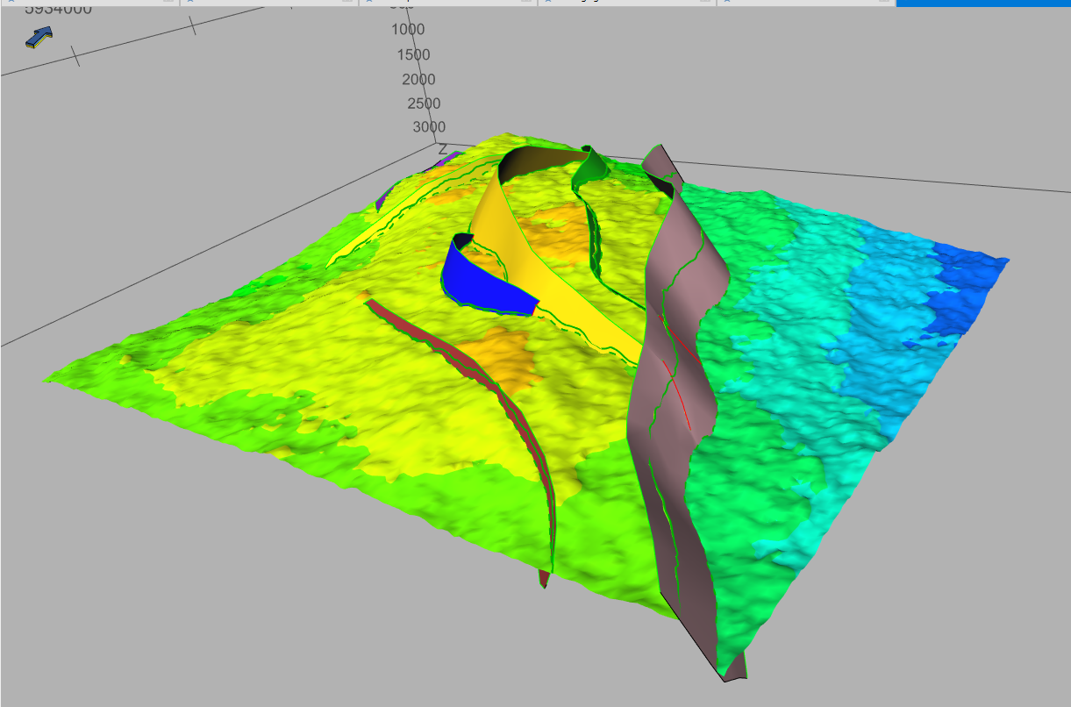
Ensemble Kalman Inversion
How can we go from data inversion on simple, single-fault cross sections, to complex, multi-fault or three-dimensional models?
The Ensemble Kalman filter and related ensemble-based methods are well suited to this kind of large, many-parameter problem.
?
Emerald Field 3D model
(from RMS software)
Trishear Fault Propagation Fold
Notes:
Mention that EnKF uses an ensemble of models.
Mention that EnKF is used in other fields, but not previously in structural geology.

Slide 4
Synthetic Model
Test the method with a case in which the truth is known.
3D kinematic model (Georgsen et al., 2012) for deformation.
Model parameters define horizon geometry, fault geometry, fault slip
Data: Interpreted horizon geometry, interpreted fault geometry, misfit of restored state from horizontal.
Structure contours on upper horizon
(in depth, meters)
Notes:
Maybe somewhere in here give total number of parameters and data points.

Slide 5
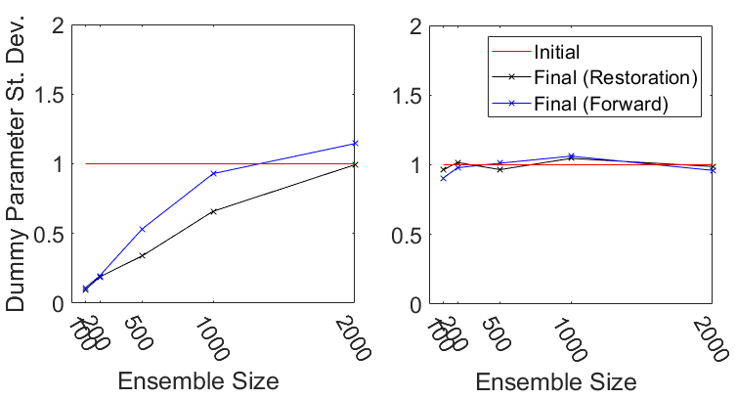
Problem: Ensemble Collapse
Dummy Parameter
Mitigation with Covariance Inflation and Localization
No effect on model.
Initial values: 0 ± 1.
With Localization and Inflation
Original

Slide 6
Synthetic Model Results
Fault Displacement
Truth
Ensemble Mean
Ensemble St. Dev.
Mean of the final ensemble is generally close to and within uncertainty of the truth.
Uncertainty is higher in some parameters than others.
Notes:
Mention that fault displacement is parameterized on a grid.

Slide 7
Additional Work
Sparse Data
Emerald Field
Notes:
Maybe add a histogram for the scattered data
Maybe something else for the Emerald Field.
For scattered data, point out that it helps as a method to interpolate between the data.

Slide 8
Conclusions and Future Directions
Conclusions
  Ensemble Kalman Inversion can be used to make kinematically balanced 3D structural models.
  Ensemble collapse poses challenges to estimating uncertainty, but this can be mitigated.
Future Directions
  “Closed loop” integration with other modelling workflows
  Geomechanical Models
Data
Model
Boundary element geomechanical model fit to data with ensemble Kalman inversion.
Notes:
Add some figures to this.

Slide 9
Acknowledgements
This research is funded by the Norwegian Ministry of Education and Research (Kunskapsdepartamentet).
Thank you to Emerson for use of the RMS software .
Thank you to NR for use of the Havana software.

