Slide 1
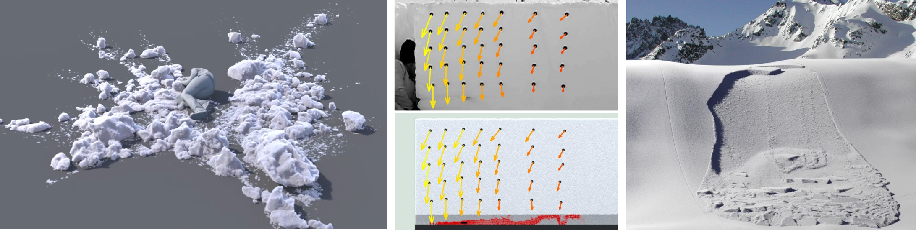
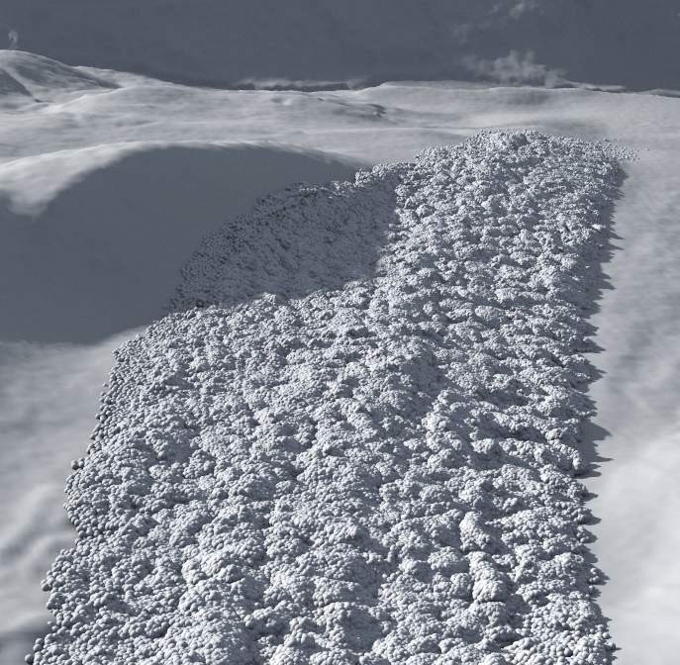
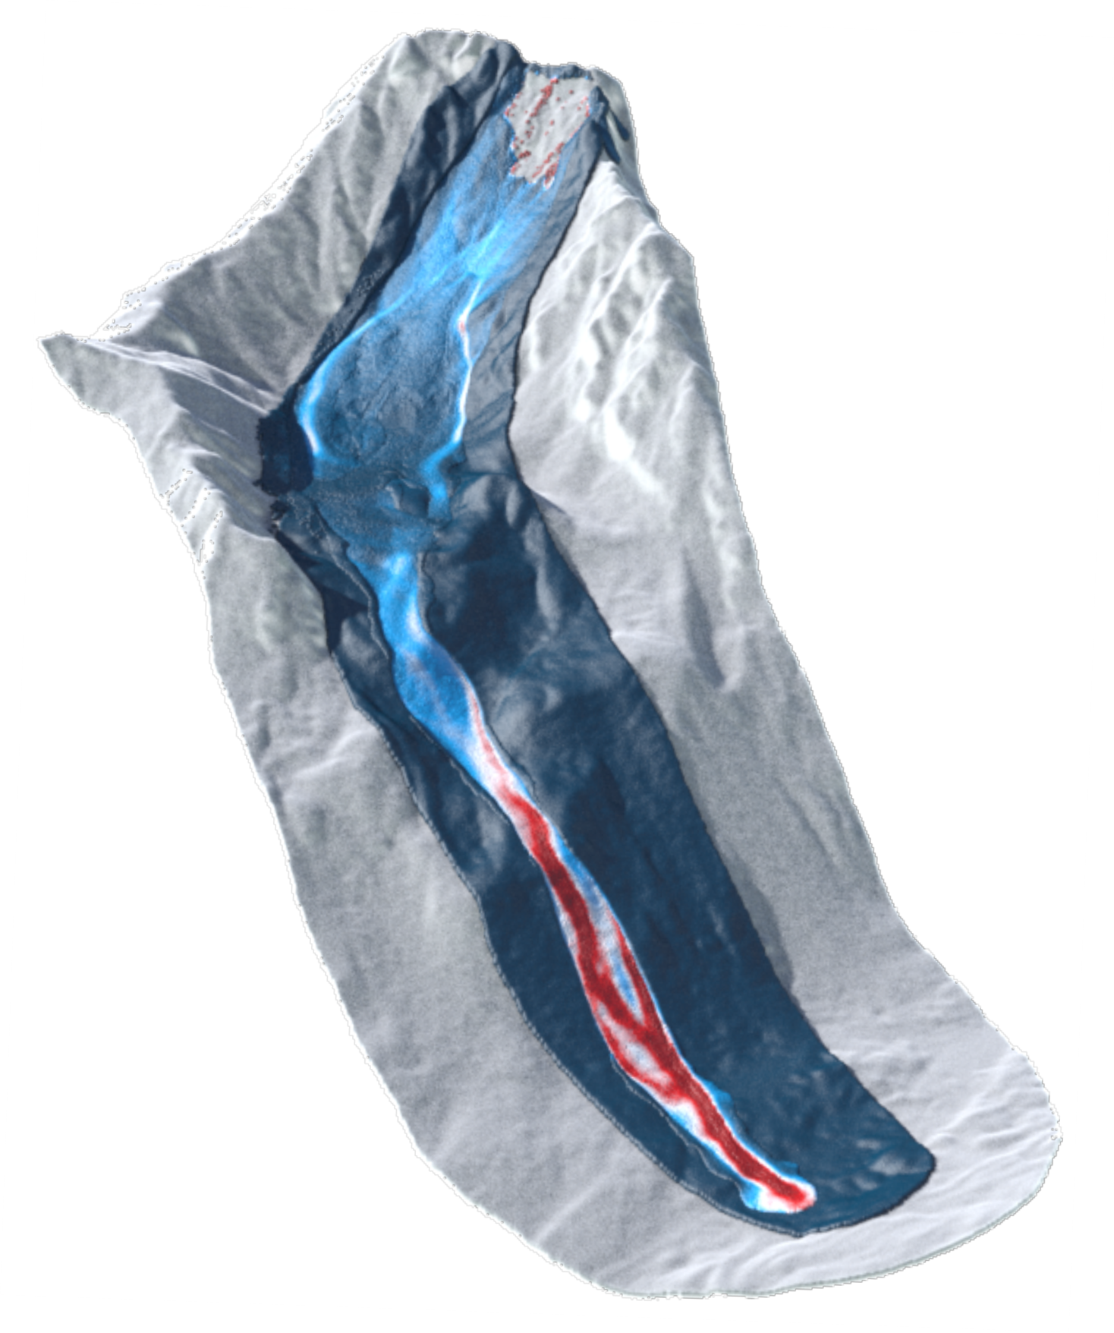
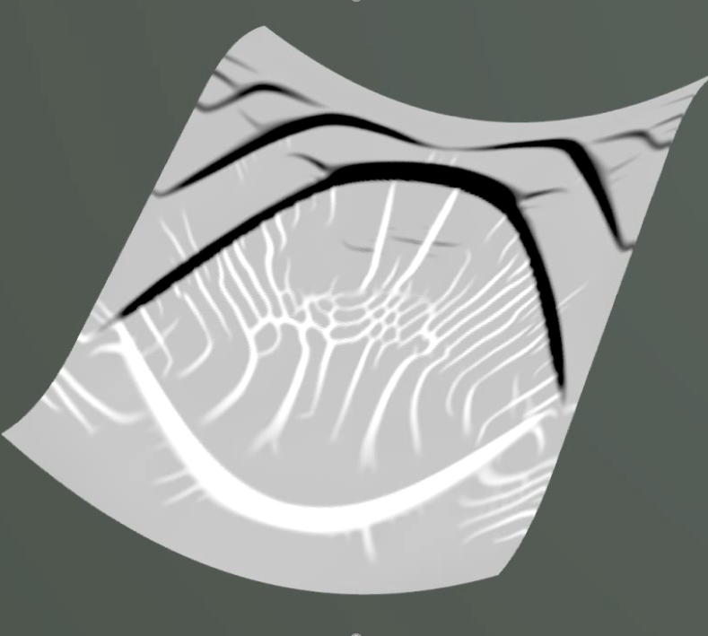



A depth averaged Material Point Method for the simulation of snow slab avalanche Release
Louis Guillet¹, Bertil Trottet¹, Lars Blatny¹, Denis Steffen¹, Johan Gaume^{1,2}
¹Snow and Avalanche Simulation Laboratory (SLAB), Swiss Federal Institute of Technology (EPFL), Lausanne, Switzerland
²WSL Institute for Snow and Avalanche Research SLF, CH-7260 Davos, Switzerland
EGU 2022
Notes:
Alternative title: New insights into the initiation and propagation of snow avalanches.

Slide 2
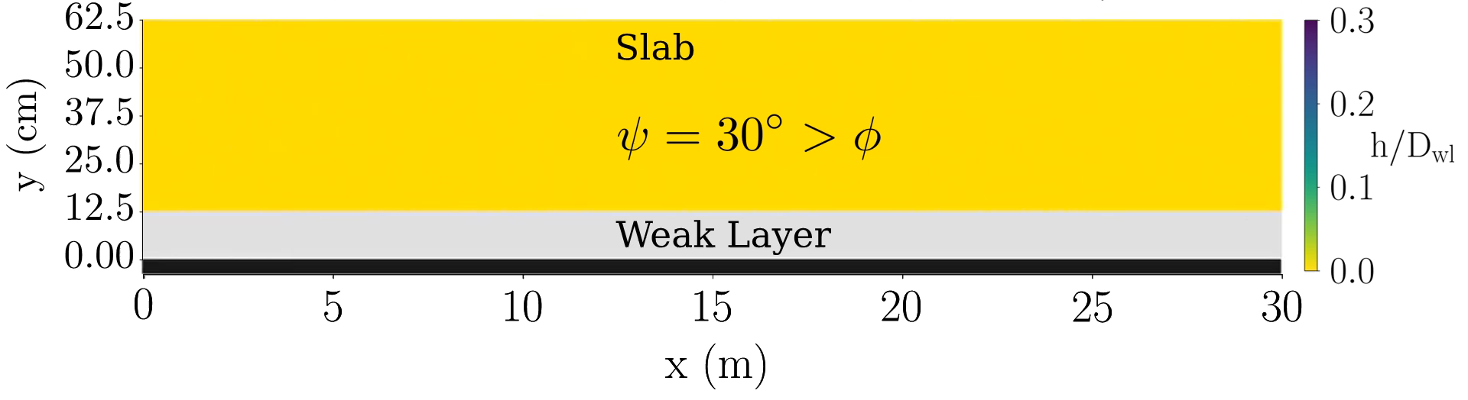
Reminder of Bertil’s presentation
Anti crack to supershear transition within few meters
No bending in the slab and no collapse during supercritical regime
+ 3D simulations have heavy numerical cost
Anti-crack
Super-shear
Motivation for a depth-averaged model

Slide 3
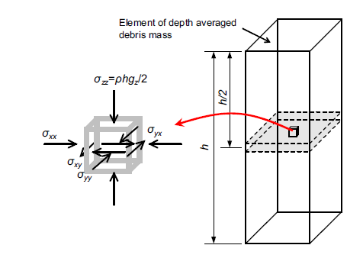





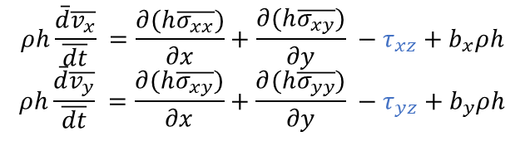


Depth-Averaged MPM
Weak Layer Modelling
Shallow water hypothesis + plane stress
Columns instead of particles (Abe and Konagi, 2016)
Elastic-purely brittle weak layer seen as an external force
$$ρh\frac{\overline{d}\overline{v_{x}}}{\overline{dt}} =\frac{∂(h\overline{σ_{xx}})}{∂x}+\frac{∂(h\overline{σ_{xy}})}{∂y} −τ_{xz}+b_{x}ρh$$
$$ρh\frac{\overline{d}\overline{v_{y}}}{\overline{dt}} =\frac{∂(h\overline{σ_{xy}})}{∂x}+\frac{∂(h\overline{σ_{yy}})}{∂y} −τ_{yz}+b_{y}ρh$$
Shear cohesive force
Weak Layer dammaged : Residual friction
Depth-averaged equations
Shear $τ$
$$τ_{p}$$
Cohesion $C$
$$τ_{r}=σ_{n}tan⁡(φ)$$
$$K_{WL}$$
1
$$u_{c}$$
Displacement $u$

Slide 4



DAMPM PST Simulation with
Purely elastic slab
Elastic-purely brittle WL
Critical length $a_{c}$
Parameters : $L_{y}=1m, L_{x}=40m, ψ=45°$
Numerical « sawing »
Crack propagation
Down-slope
Up-slope
: cohesive weak layer
Crack propagation in super shear mode
: dammaged weak layer

Slide 5
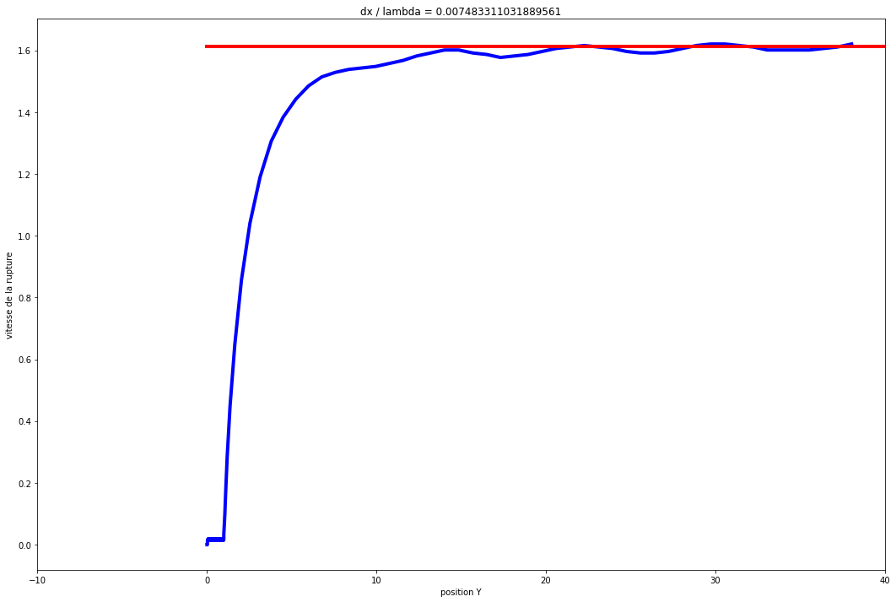
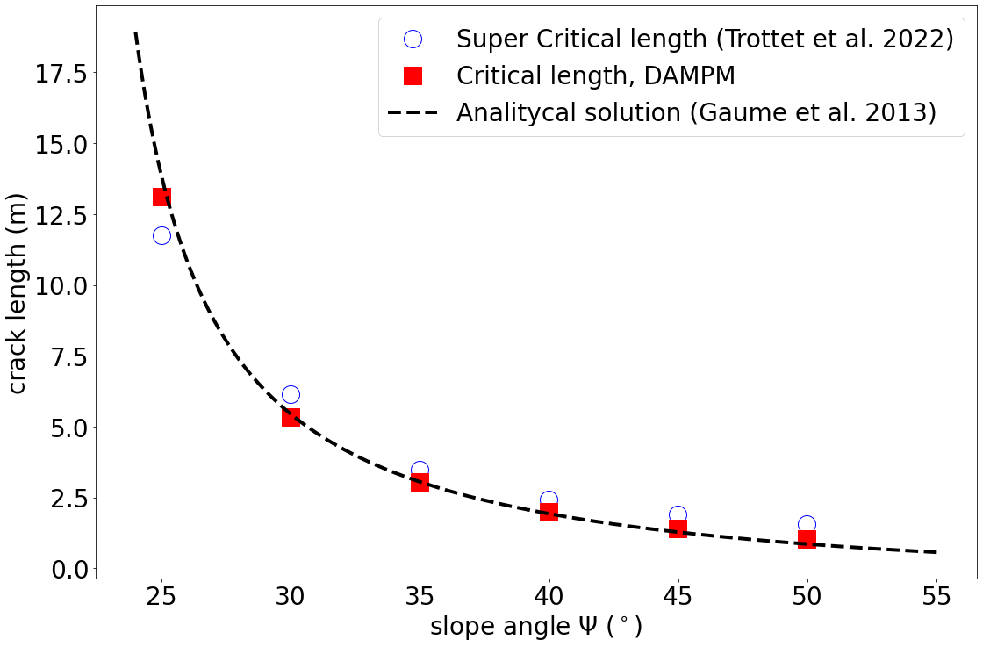

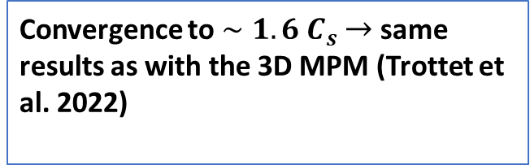
Comparision with 3D model and analytical solutions
Crack velocity
$$C=\sqrt{\frac{E}{ρ}}∼1.6 C_{s}$$
Critical length comparison
Convergence to ${∼1.6 C}_{s}$ $→$ same results as with the 3D MPM (Trottet et al. 2022)
Position x
Quantitative validation for PST simulations

Slide 6

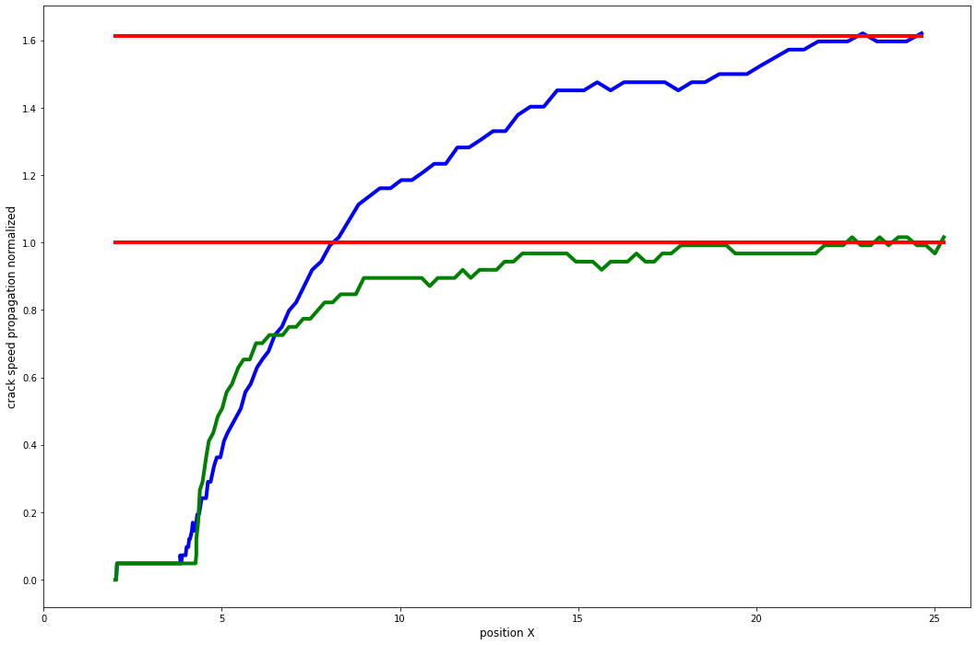


Large scale simualtion with elastic slab
50 x 50 m
Up-slope
Crack velocity
Crack propagation on different directions
$${C=1.6 C}_{S}$$
$${∼C}_{s}$$
: Up-slope crack velocity
: Cross-slope crack velocity
Down-slope
Position
Same results as in 3D Simulations (Trottet et al. 2022)

Slide 7
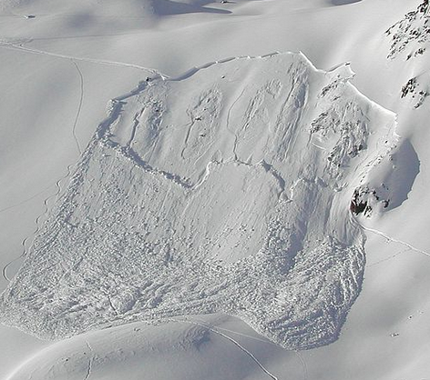

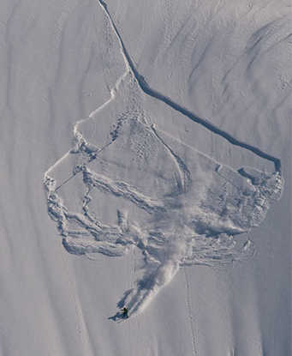
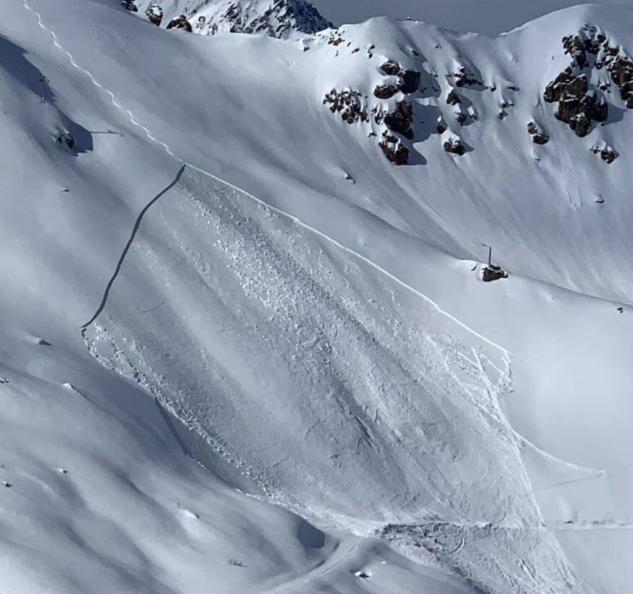
Large scale simulation
Foto : Jürg Schweizer, Isabelle Sabater, montagnes-magazine.com
Plastic model for the slab : Cohesive Modified Cam Clay
Qualitative comparison with real avalanches
Good qualitative comparison on the avalanche shape !

Slide 8


Simulation on more complexe terrain
Up slope
Up slope
down slope
down slope
Crack initiation

Slide 9


Simulation on more complexe terrain
Up slope
Up slope
down slope
down slope
Fast computation of release zone on more complex terrain

Slide 10
Conclusion
Fast model for avalanche release simulation
Quantitative validation with 3D simulations and analytical solutions
Qualitative comparison with large scale and complex terrain simulations
Discussion and future work
Need to match the depth-averaged yield surface to the 3D yield surface in order to mimic staunch wall
Quantitative comparison on complex cases

Slide 11
References
K. Abe and K. Konagi. Numerical simulation for runout process of debris flow using depth-averaged material point method. Soils and Foundations, 56, 2016.
L. Benedetti, J. Gaume, and J.-T. Fischer. A mechanically-based model of snow slab and weaklayer fracture in the propagation saw test. International Journal of Solids and Structures,158:1–20, 2019. ISSN 0020-7683. doi: https://doi.org/10.1016/j.ijsolstr.2017.12.033. URL https://www.sciencedirect.com/science/article/pii/S0020768317305358.
M. Christen, P. Bartelt, J. Kowalski, and L. Stoffel. Calculation of dense snow avalanches in three-dimensional terrain with the numerical simulation program RAMMS. 04 2010.
E. A. de Souza Neto, D. Peric, and D. R. J. Owen. Computational Methods for Plasticity. Springer, 2008. ISBN 978-1-4020-6577-4.
A. de Vaucorbeil, V. P. Nguyen, S. Sinaie, and J. Y. Wu. Chapter two - material point method after 25 years: Theory, implementation, and applications. volume 53 of Advances in Applied Mechanics, pages 185–398. Elsevier, 2020.
J. Gaume, G. Chambon, N. Eckert, and M. Naaim. Influence of weak-layer heterogeneity on snow slab avalanche release: application to the evaluation of avalanche release depths. Journal of Glaciology, 59(215):423–437, 2013. doi: 10.3189/2013JoG12J161.
J. Gaume, T. Gast, J. Terran, A. Van Herwinjen, and C. Jiang. Dynamic anticrack propagation in snow. Nature Communication, 9(3047), 2018.
C. Jiang, C. Schroeder, J. Teran, A. Stomakhin, and A. Selle. The material point method for simulating continuum materials. In ACM SIGGRAPH 2016 Courses, SIGGRAPH ’16, New York, NY, USA, 2016. Association for Computing Machinery.
Z. Kazmi and K. Konagai. Field mesurment and numerical simulation of debris flows from dolomites slopes destabilized during the 2005 kashmie eartquake, pakistan. Journal of earth-quake Engineering, 18:364–388, 2014.
A. Puzrin. Constitutive Modelling in Geomechanics. International series of monographs on physics. Springer, 2012. ISBN 978-3-642-27395-7.
G. Richard. Depth-averaged equations for compressible shallow-water flows and tsunami. preprint at https://hal.inrae.fr/hal-02959509, 2020.
A. Stomakhin, C. Schroeder, L. Chai, J. Teran, and A. Selle. A material point method for snow simulation. ACM Trans. Graph., 32(4), July 2013. ISSN 0730-0301. doi: 10.1145/2461912. 2461948. URL https://doi.org/10.1145/2461912.2461948.
B. Trottet, R. Simenhois, G. Bobillier, A. van Herwijnen, C. Jiang, and J. Gaume. From sub-rayleigh to intersonic crack propagation in snow slab avalanche release. In EGU General Assembly 2021, online, 19–30 Apr 2021, EGU21-8253, 2021.
W. Wu and M. Pastor. Point based numerical methods in geomechanics. ALERT Doctoral School, 56:127, 2020.
X. Zhang, Z. Chen, and Y. Liu. The Material Point Method, A Continuum-Based Particle
Mathod for Extreme Loading Cases. Academic Press, 2017. ISBN 987-0-12-407716-4.

Slide 12
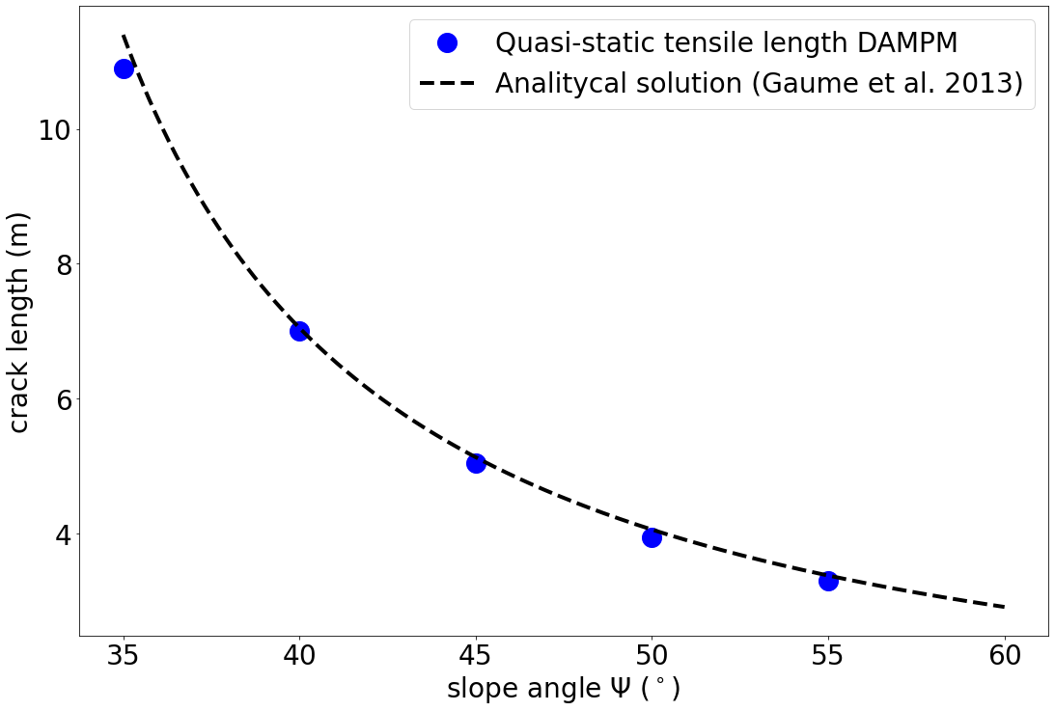


PST Simulation plastic slab Cohesive Modified Cam Clay
Parameters $L_{x}=40m, L_{y}=1m, φ=27°, ψ=45°, σ_{t}=3kPa$
Tensile length $l_{t}$
Higher tensile length
Grpah crack length comparison
Down slope
Up slope
Good match with the analytical tensile length

Slide 13
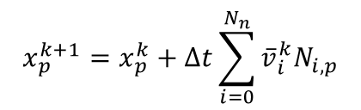

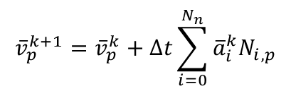
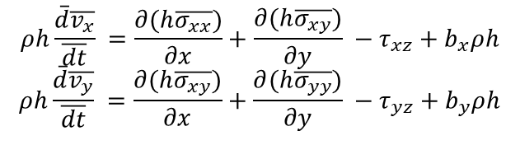
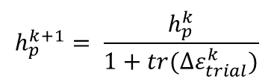
Depth-Averaged MPM
Weak Layer Modelling
Shallow water hypothesis + plane stress
Columns instead of particles (Abe and Konagi, 2016)
Elastic-purely brittle weak layer seen as an external force
$$ρh\frac{\overline{d}\overline{v_{x}}}{\overline{dt}} =\frac{∂(h\overline{σ_{xx}})}{∂x}+\frac{∂(h\overline{σ_{xy}})}{∂y} −τ_{xz}+b_{x}ρh$$
$$ρh\frac{\overline{d}\overline{v_{y}}}{\overline{dt}} =\frac{∂(h\overline{σ_{xy}})}{∂x}+\frac{∂(h\overline{σ_{yy}})}{∂y} −τ_{yz}+b_{y}ρh$$
Shear cohesive force
Weak Layer dammaged : Residual friction
Depth-averaged equations
Shear $τ$
$${\overline{v}}_{p}^{k+1}={\overline{v}}_{p}^{k}+Δt\sum_{i=0}^{N_{n}}{{\overline{a}}_{i}^{k}N_{i,p}}$$
$$τ_{p}$$
Cohesion $C$
$$τ_{r}=σ_{n}tan⁡(φ)$$
$$x_{p}^{k+1}=x_{p}^{k}+Δt\sum_{i=0}^{N_{n}}{{\overline{v}}_{i}^{k}N_{i,p}}$$
$$K_{WL}$$
$$h_{p}^{k+1}= \frac{h_{p}^{k}}{1+tr(Δε_{trial}^{k})}$$
1
$$u_{c}$$
Displacement $u$

Slide 14

DAMPM: A depth-averaged MPM
weak layer failure
slab failure
© Guillet et al. (SLAB)
intact
shear failure
intact
tensile failure

Slide 15
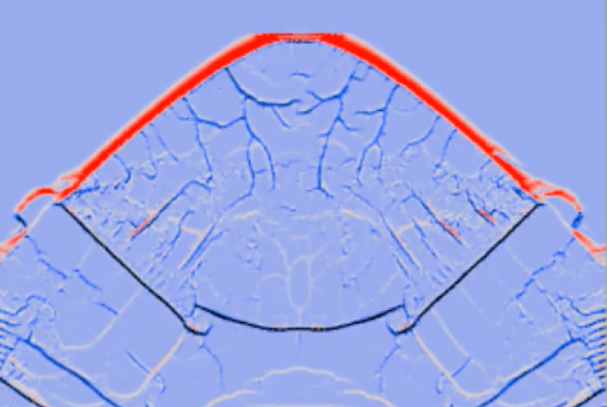


DAMPM: A depth-averaged MPM
$$θ$$
model
reality

