Slide 1

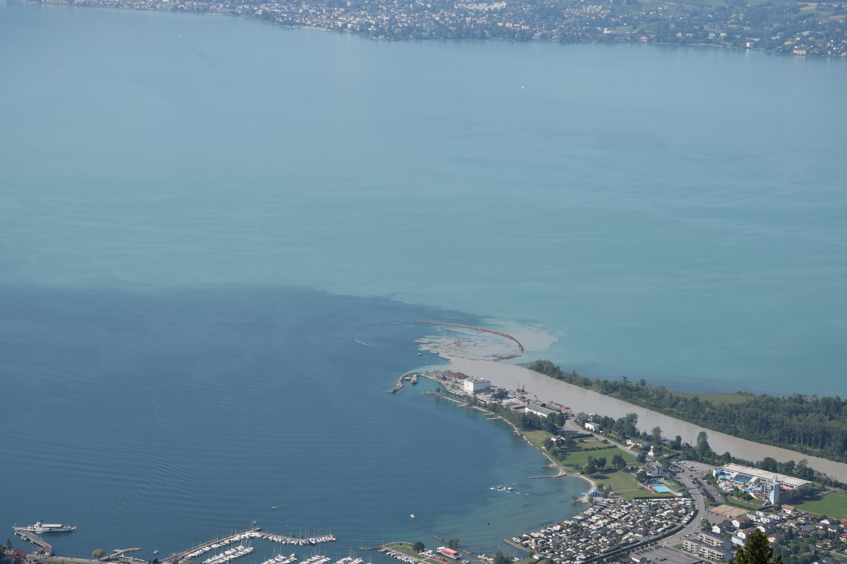



Evidence and possible causes of velocity pulsing in a turbidity current in Lake Geneva
Stan Thorez¹, Koen Blanckaert¹, Ulrich Lemmin², and Andrew Barry²
¹Research Unit of Hydraulic Engineering, Institute of Hydraulic Engineering and Water Resources Management, Faculty of Civil Engineering, Technische Universität Wien, 1040 Vienna, Austria
²Ecological Engineering Laboratory, Environmental Engineering Institute, Faculty of Architecture, Civil and Environmental Engineering, École Polytechnique Fédérale de Lausanne, 1015 Lausanne, Switzerland

Slide 2
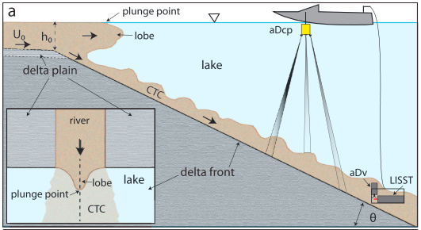
Velocity pulsing?
Kostaschuk et al. (2018): „Turbidity currents that are driven by prolonged river flow and constant supplies of suspended sediment are referred to as continuous turbidity currents and can flow for weeks to months. Continuous turbidity currents are characterized by regular fluctuations in velocity or pulsing even though the river inflow does not fluctuate.”
Sketch of CTC and boat-towed ADCP, Kostaschuk et al. 2018

Slide 3
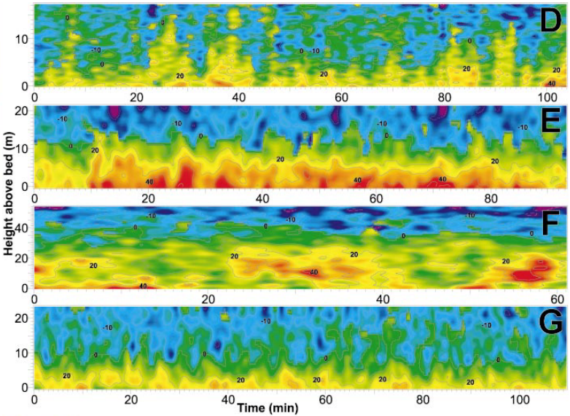
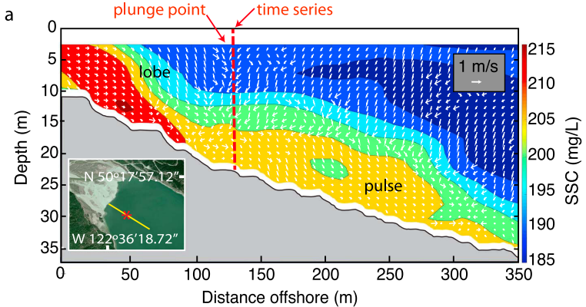
Motivation
Velocity pulsing in turbidity currents…
…is likely to enhance mixing between the influent and ambient water and produce spatial variations in bed erosion and deposition (Kostaschuk et al. 2018)
…was first observed in Lillooet Lake, British Columbia by Best et al. (2005)
Moored ADCP, Best et al. (2005)
Boat-towed ADCP, Kostaschuk et al. 2018

Slide 4
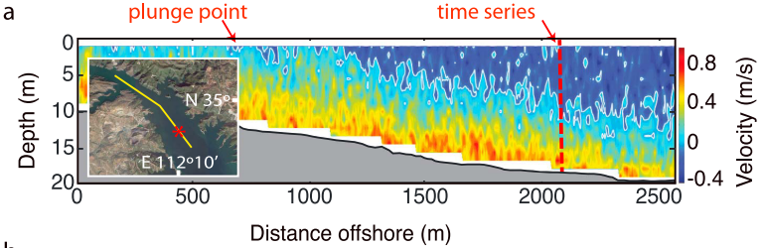
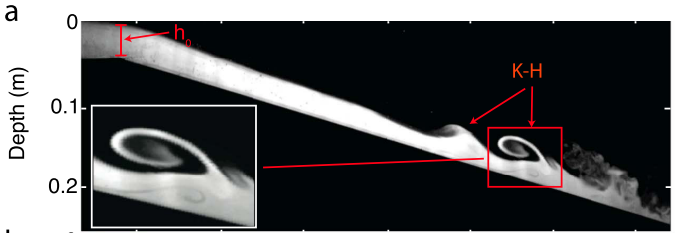
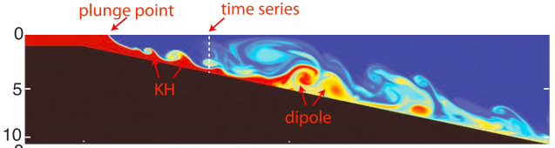
Motivation
Velocity pulsing in turbidity currents…
…was observed again in Xiaolangdi Reservoir, China (Kostaschuk et al. 2018)
…was produced in the laboratory and numerically (Kostaschuk et al. 2018)
→Driving mechanism in the lake unknown
→Hypothesis: pulses result from Rayleigh-Taylor instability generated by shifting surface lobes along the plunge line where the river enters the receiving water body
Boat-towed ADCP, Kostaschuk et al. 2018
! Models and reservoir show different type of pulsing than lake
Lab and numerical, Kostaschuk et al. 2018

Slide 5
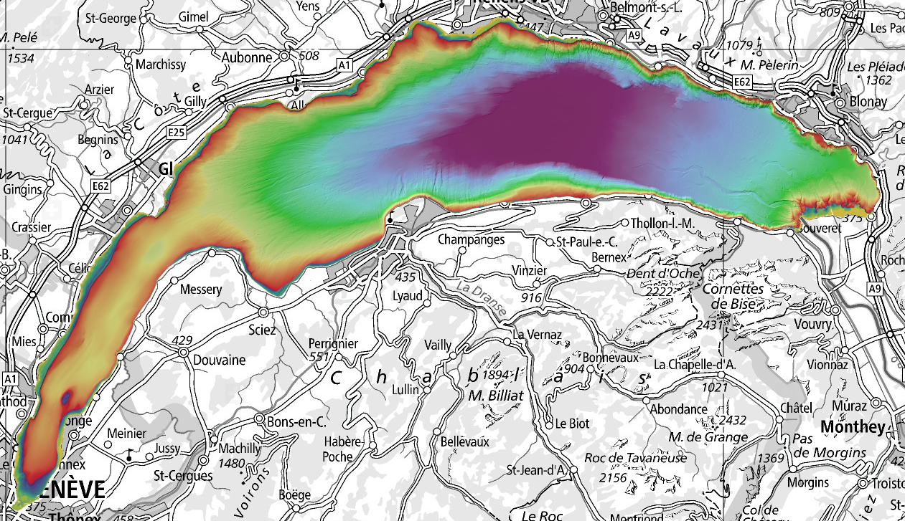
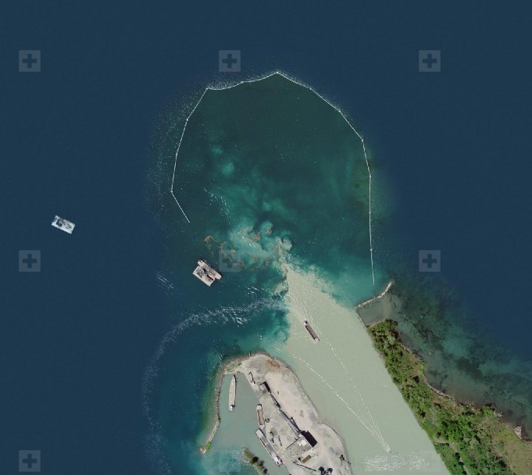
Study site: Rhône inflow into Lake Geneva
Hydrological measuring station on Lake Geneva
High-resolution bathymetry
Wide range of inflow conditions
Lake Geneva
Rhône
Hydrological measuring station on the Rhône River
Laterally unconfined, sediment rich inflow plume
Virtually all boundary conditions are known!

Slide 6
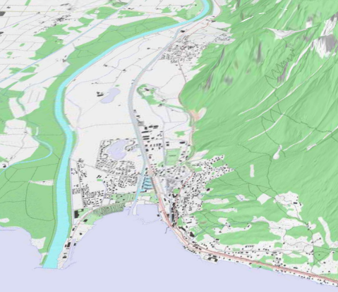
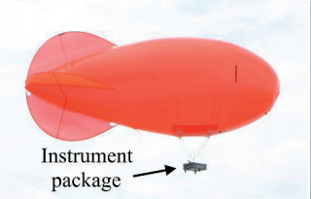
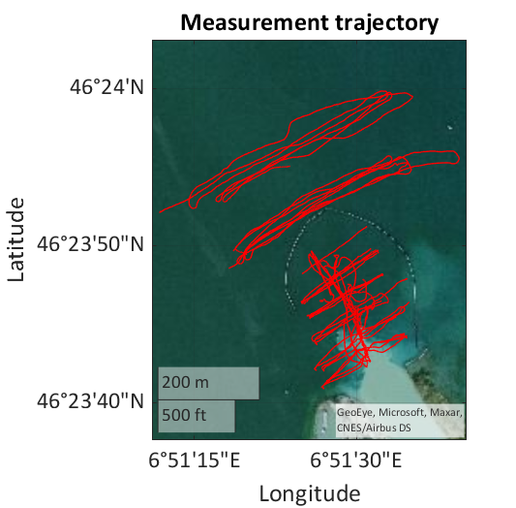
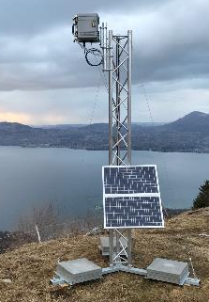

Methods
vessel-mounted ADCP
static remote-sensing camera system
mobile balloon-mounted camera system
→three-dimensional velocity field along transversal and longitudinal transects
→multiple repetitions to catch low magnitude, secondary currents
→event-wise
→two-dimensional surface patterns
→large to intermediate scale processes
→1-10 minute resolution
→continuous: ongoing since June 2019
→two-dimensional surface patterns
→intermediate to small scale processes
→1 second resolution
→event-wise
ADCP
mountain overlooking inflow
balloon
$$\vec{U}$$
Rhône

Slide 7
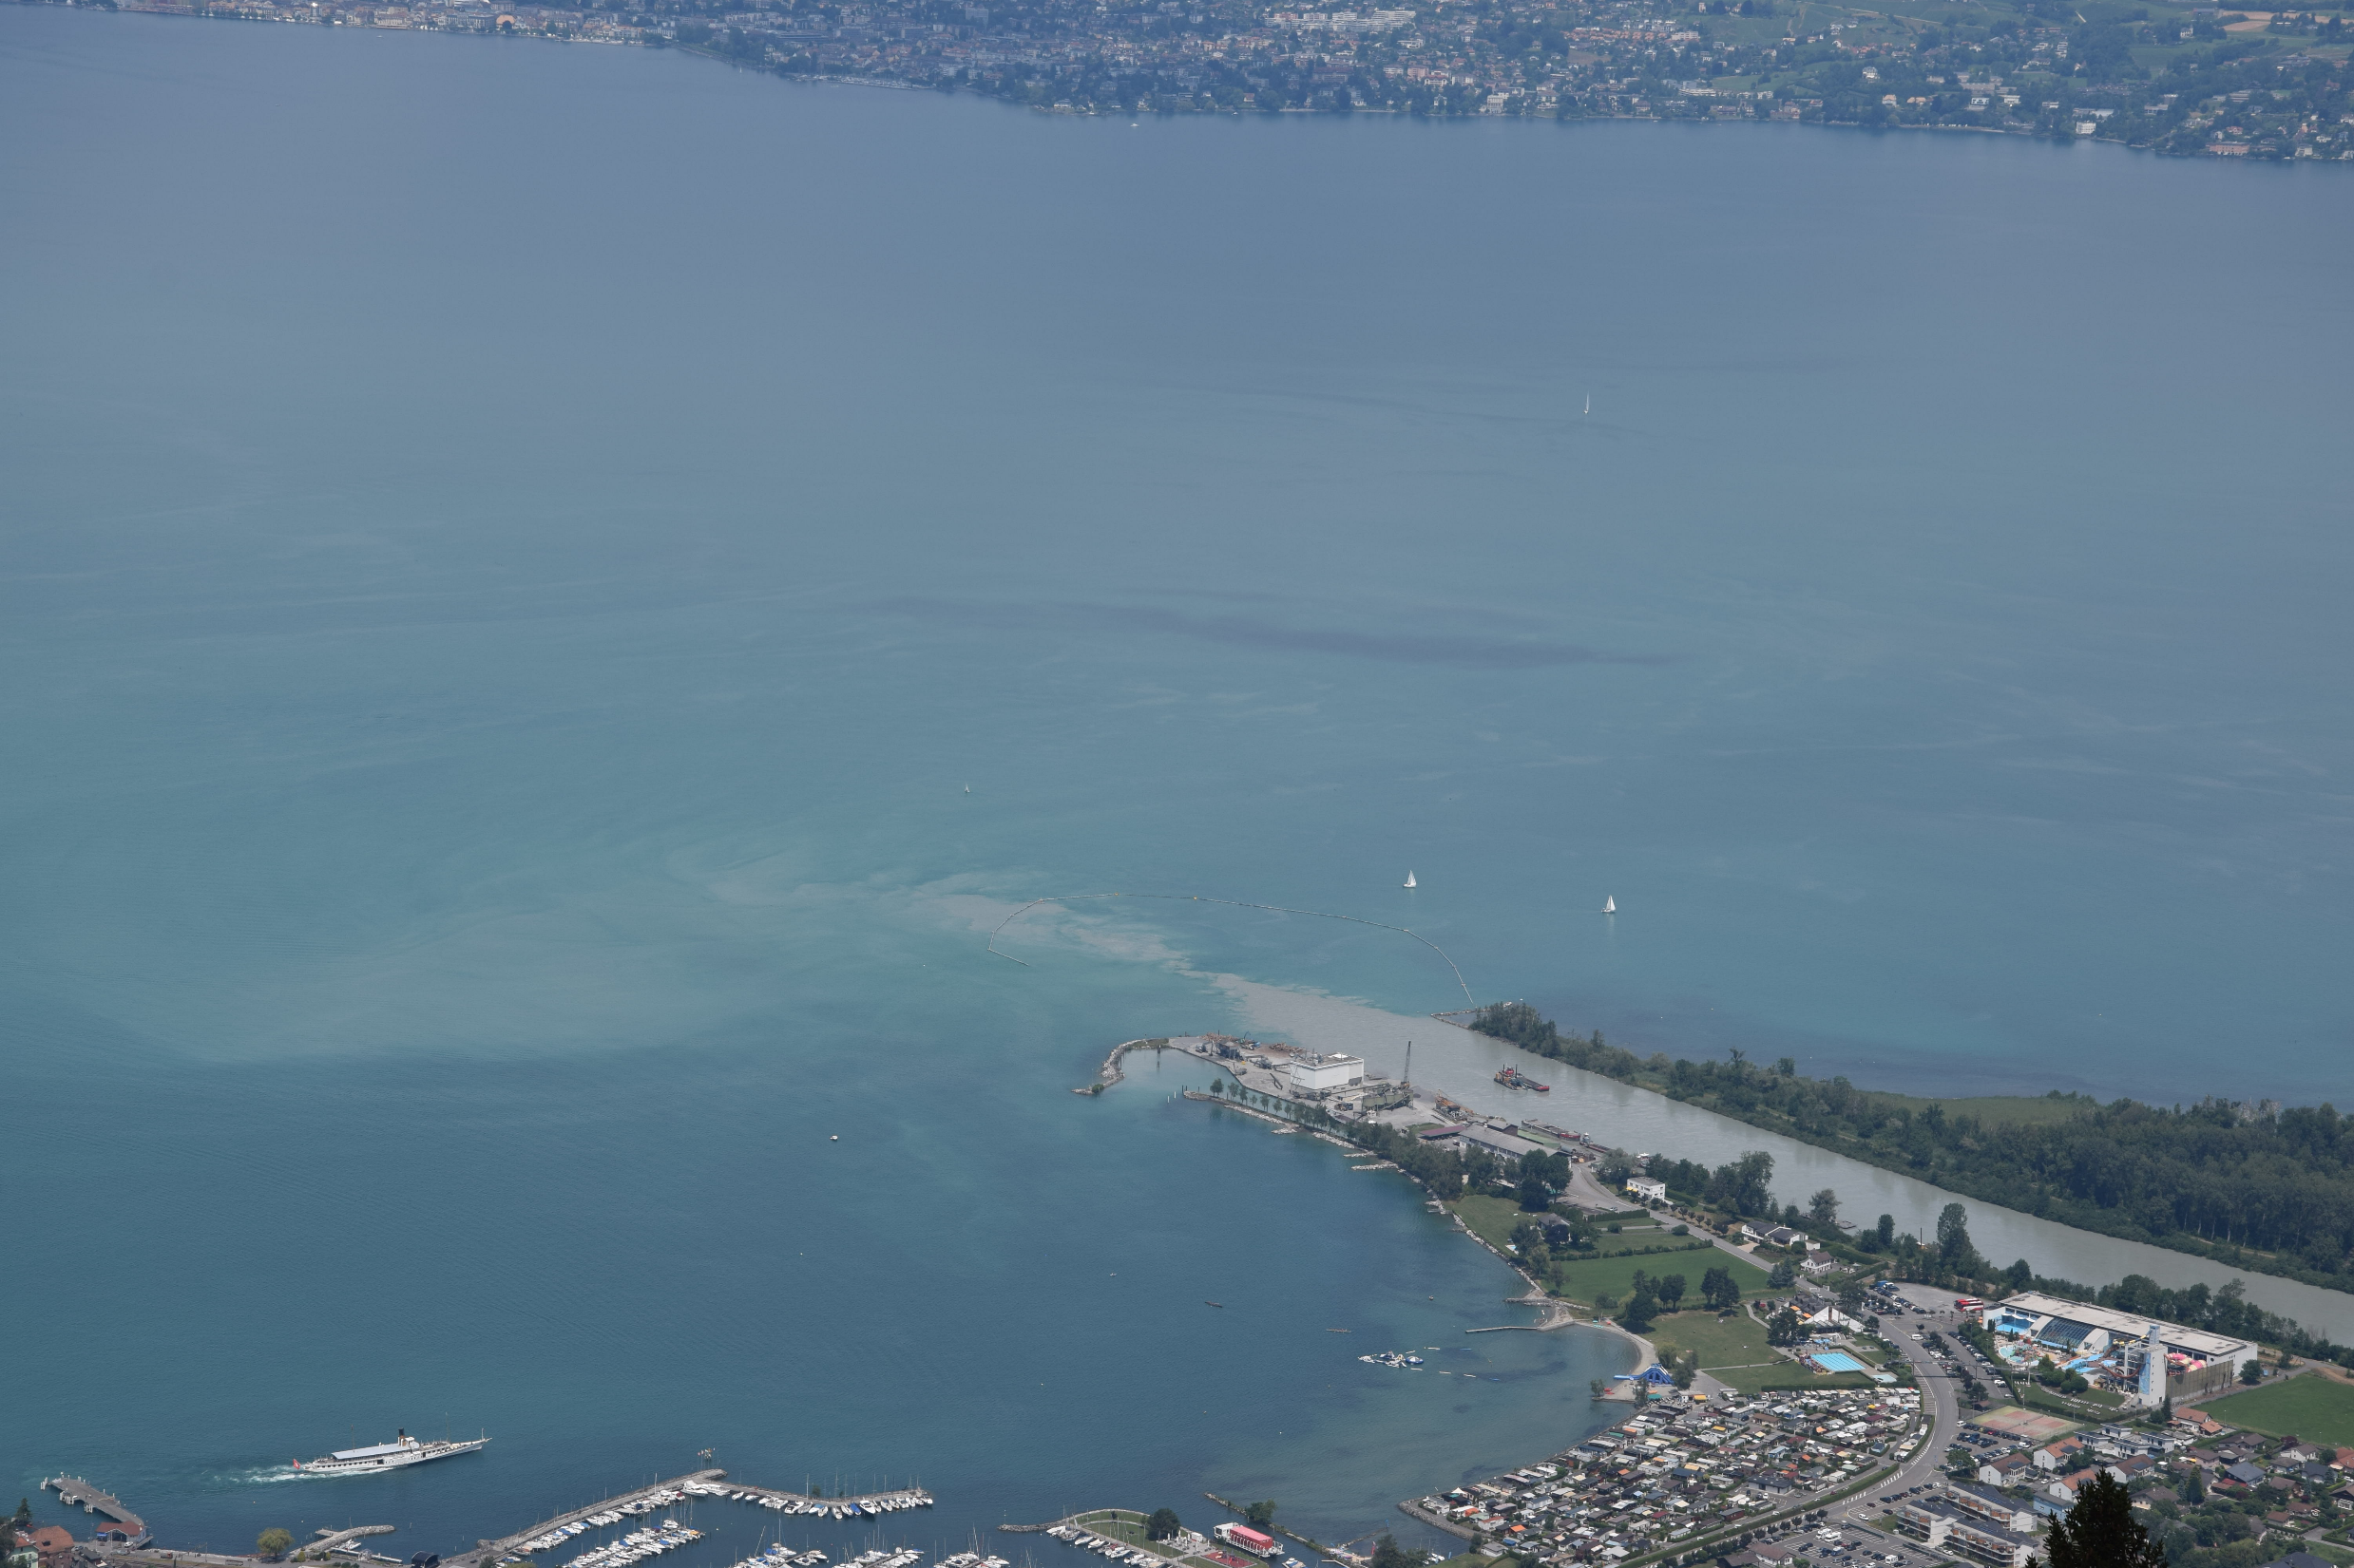
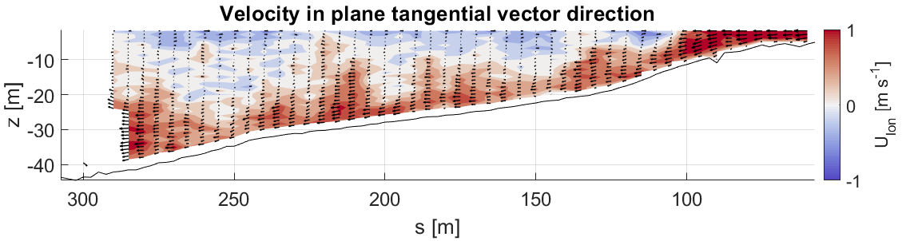
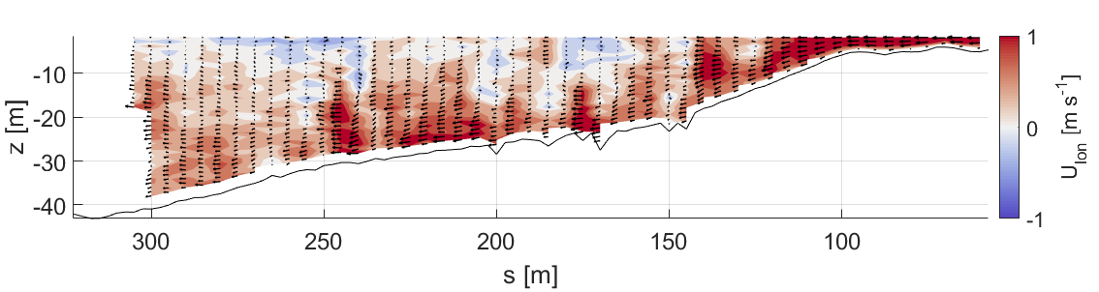
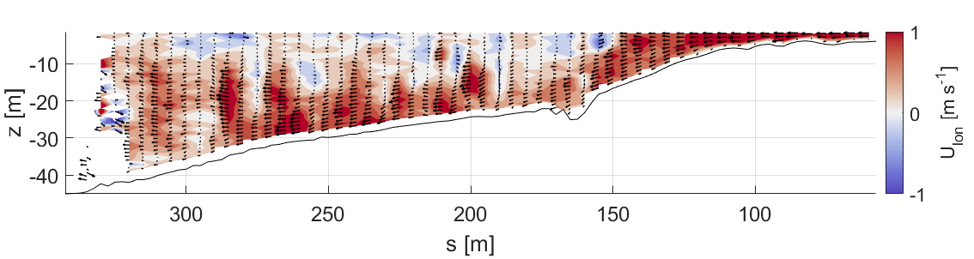

Results: boat-towed ADCP
A
A
Rhône
Fr_{d,0} = $U_{0}/\sqrt{g′h_{0}}$ = 4.0
Regular pulsing visible in longitudinal velocities!
distance from transect start [m]

Slide 8
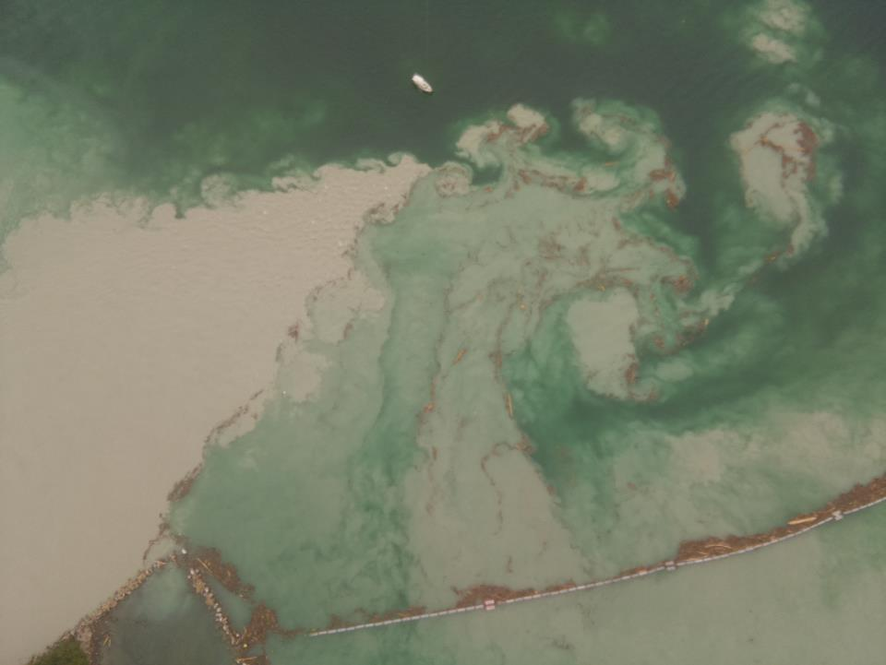
Results: camera systems
static camera system
Fr_{d,0} = 3.75
mobile camera system
F
B
D
E
A
Rhône
static camera system
B
C
Rhône
A
A
Fr_{d,0} = 3.75
Fr_{d,0} = 3.1
Rhône
Process description: A. persistent triangular plume shape; B. large scale circulation; C. surface leaking; D. Kelvin-Helmholtz instability; E. vortex shedding and dipole formation; F. boiling up of sediment rich water downstream of plume
“shifting surface lobes along the plunge line”?

Slide 9
Results: pulsing frequency
Pulsing/shifting frequency [min⁻¹]
DAY | ADCP | Mobile camera | Static camera
26.06.2019 | 0.44 |  | 0.12
 | 0.68
 | 0.66
11.07.2019 | 0.67 | 0.80 | 0.13
 | 0.47 | 0.45
 |  | 0.61
 |  | 0.75
 |  | 0.82
Quantifying velocity pulsing and surface lobe shifting:
→ manually counting velocity pulses
→ automatically counting plunge line shifting in static camera images
→ manually counting plunge line shifting in mobile camera images
Same order of magnitude
Frequency velocity pulsing and surface lobe shifting same order of magnitude:
→ good indication that lobe shifting might drive velocity pulsing in the underflow
Factor 4-6 too low

Slide 10
Conclusions
Multiple high-detail observations confirming existence of velocity pulsing in underflows were made
Combination of static and mobile camera systems and boat-towed ADCP measurements enables the investigation of the driving process behind pulsing
  → lobe shifting/vortex shedding observed at lake surface
  → frequency of lobe shifting in mobile cameras and velocity pulsing same order of magnitude, indicating lobe shifting might indeed be driving process
  → static camera frequency too low to catch lobe shifting?
  Detailed step-by-step comparison of mobile camera image and ADCP velocity data might give more conclusive answers

