Slide 1
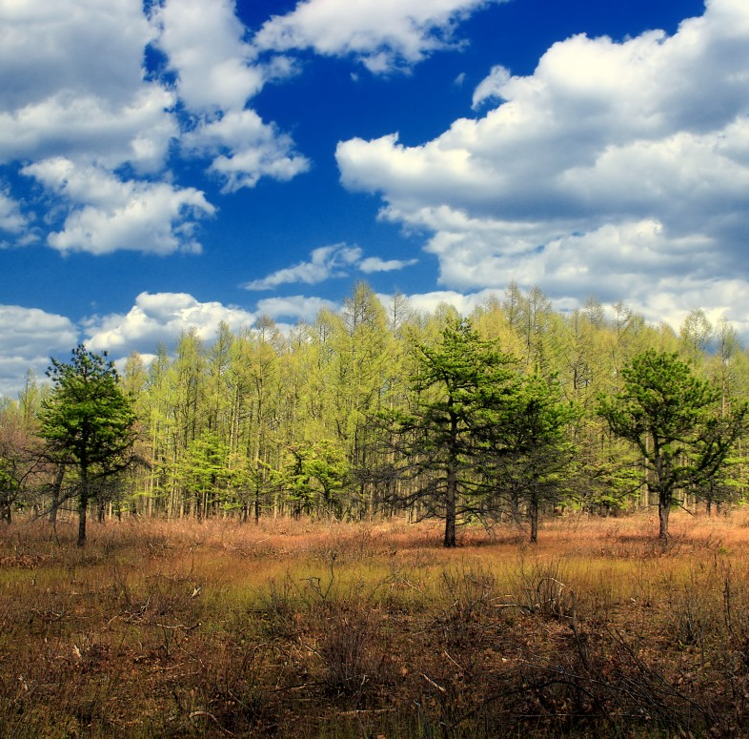
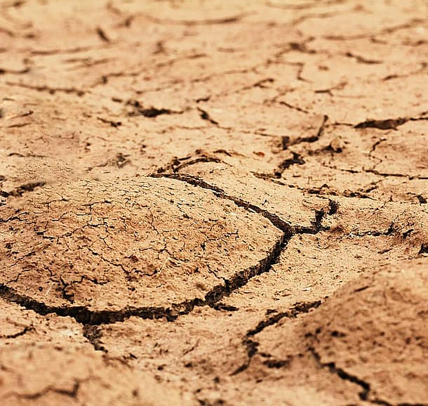




Using local moisture recycling to assess the impact of regreening on the local water cycle in five Mediterranean regions
Jolanda Theeuwen
Arie Staal, Bert Hamelers, Mohsen Soltani, Obbe Tuinenburg and Stefan Dekker
Jolanda.Theeuwen@wetsus.nl
@jtheeu

Slide 2
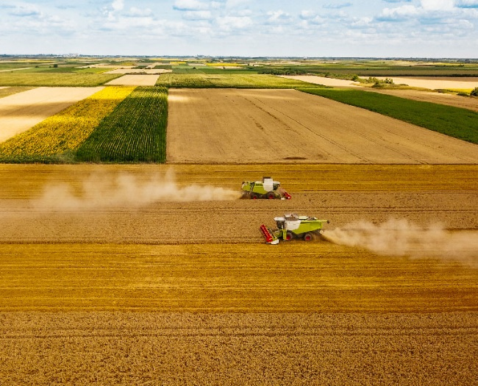
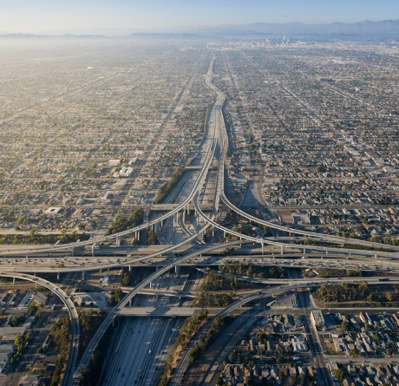
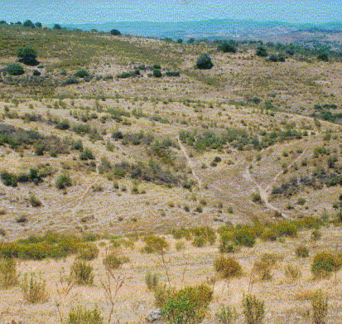
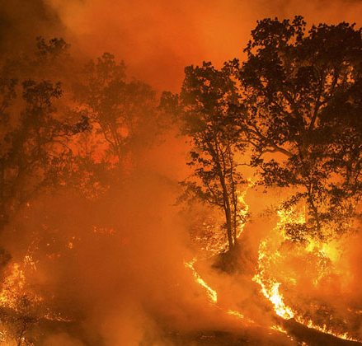
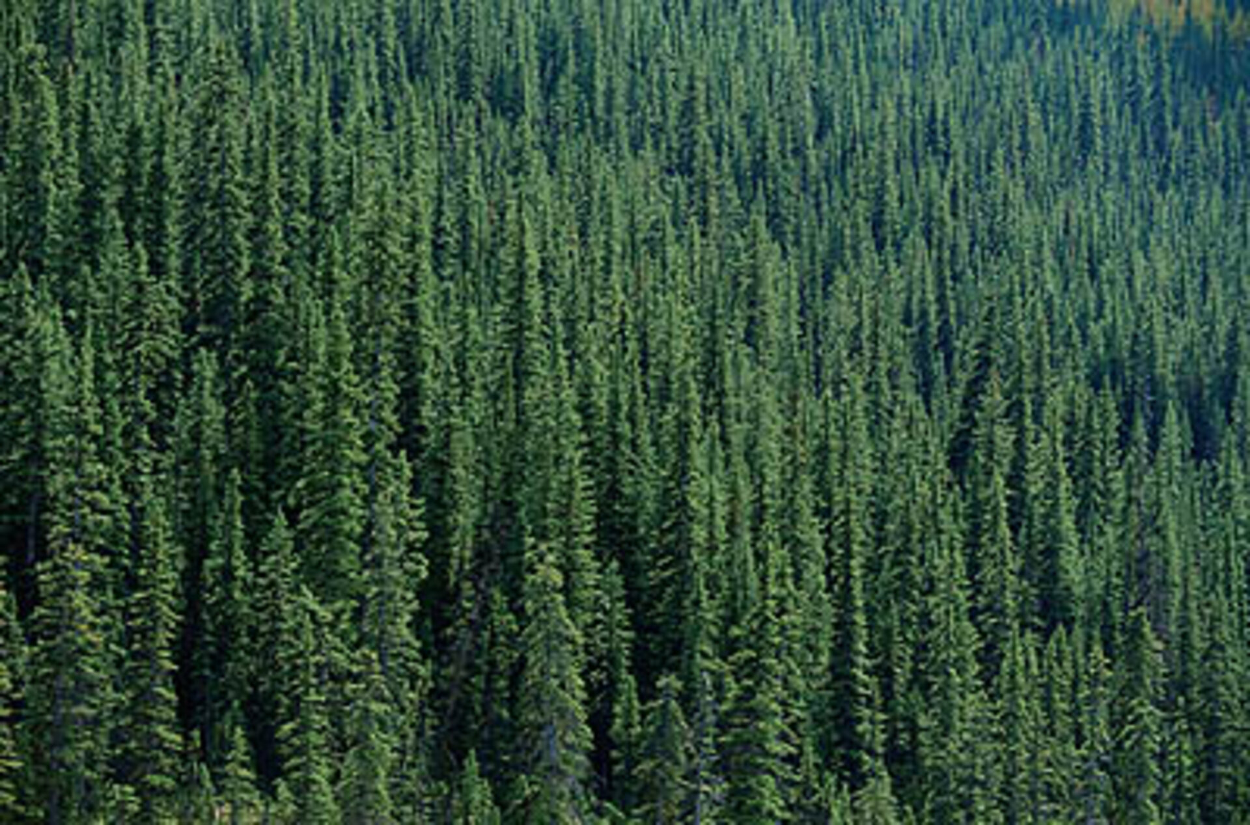
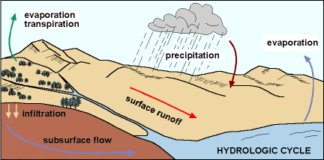
Land use affects the hydrological cycle
2

Slide 3
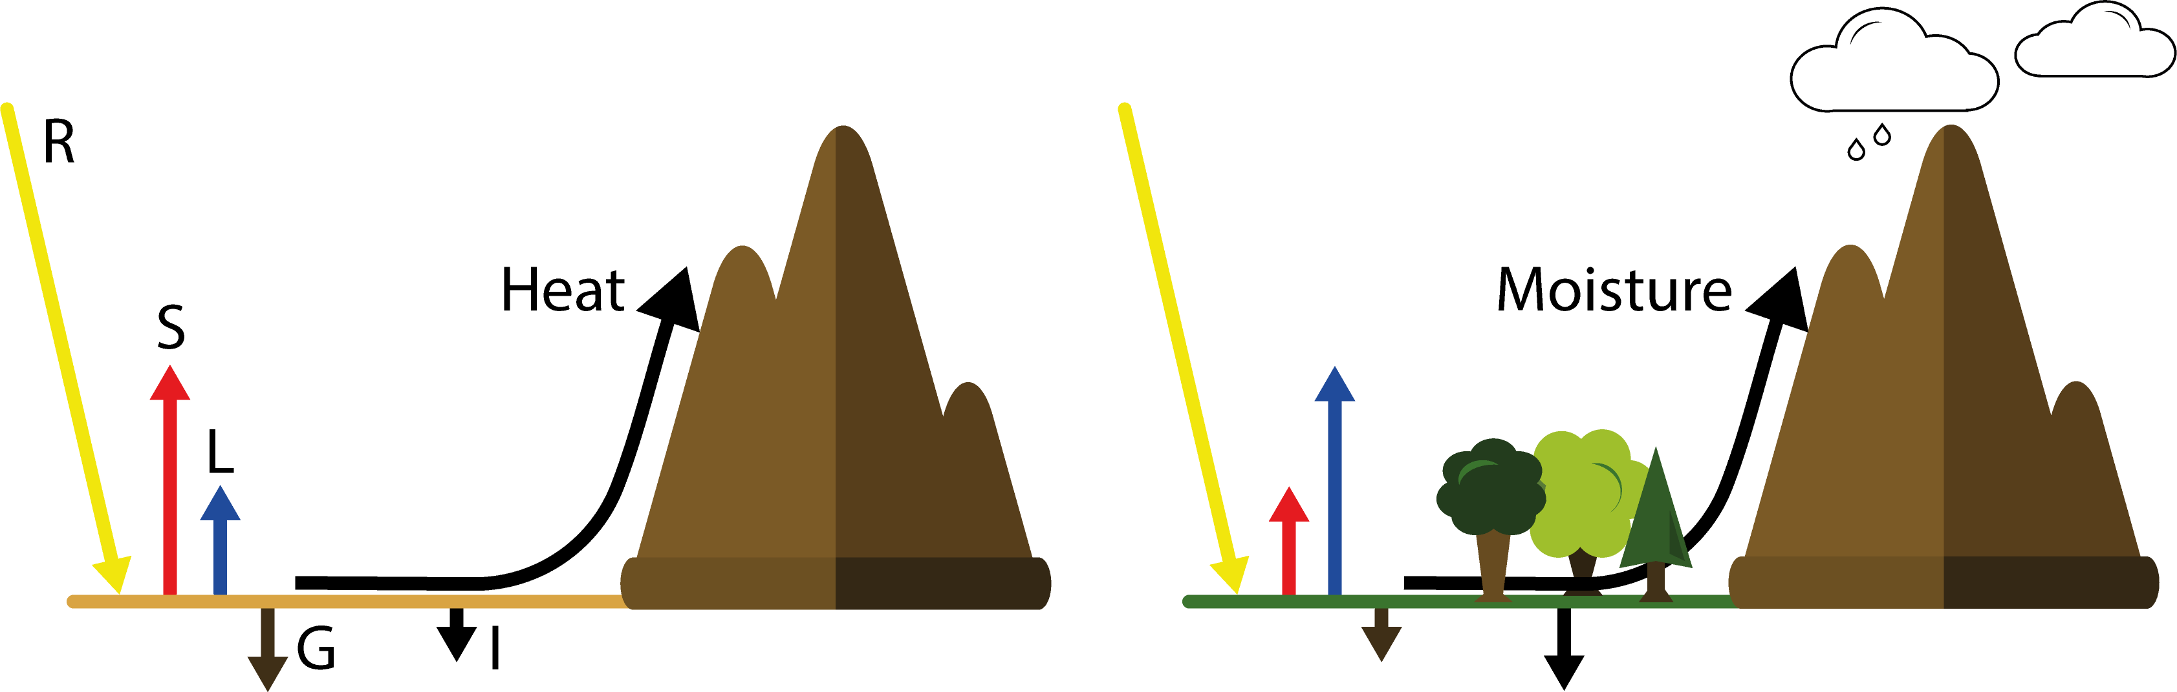
Enhance hydrological cycle through regreening
R = Incoming radiation, S = Sensible heat flux,
L = Latent heat flux, G = Ground flux, I = infiltration
3
Notes:
When an area is regreened the energy balance and hydrological cycle are affected by this. Due to an increase in infiltration and water accessibility more of the incoming energy can be used for evaporation and less energy is used for the sensible heat flux. Enhancing atmospheric moisture and reducing atmospheric temperatures. This promotes cloud formation and rainfall. When air is pushed upward it could condensate and rain forms. However, this could happen locally and remote. If the moisture transports away from the region the area could dry out further. So we are interested in the amount of water that rains out locally. The local moisture recycling ratio.

Slide 4
Enhance hydrological cycle through regreening
R = Incoming radiation, S = Sensible heat flux,
L = Latent heat flux, G = Ground flux, I = infiltration
Local moisture recycling to prevent region from drying
3

Slide 5
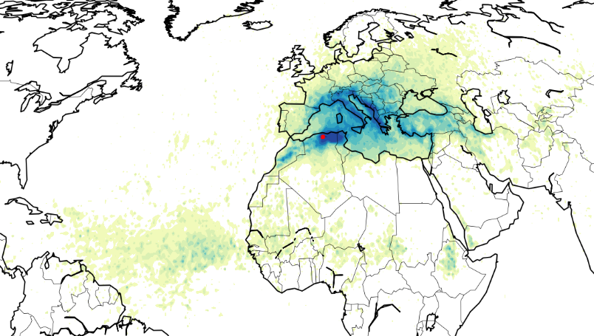


Local moisture recycling ratio
Evaporationshed (2008-2017)
Evaporation source
Target locations
Grid cells of 0.5° $≈$50 km
Tuinenburg et al., 2020
$$LMR= \frac{\sum{P_{target,E_{source}}}}{E_{source}}$$
4
Notes:
Local moisture recycling can be calculated from atmospheric moisture connections that describe where evaporated moisture rains out. This data is available at a spatial scale of 0.5 degrees around the globe. For each grid cell we use the evaporation shed as depicted in the figure to calculate local moisture recycling. The evaporation shed shows where the water evaporated from below the red dot rains out. From this shed we calculate the fraction of evaporated moisture that rains out in the source grid cell and its 8 neighboring grid cells and define this as the local recycling ratio.

Slide 6
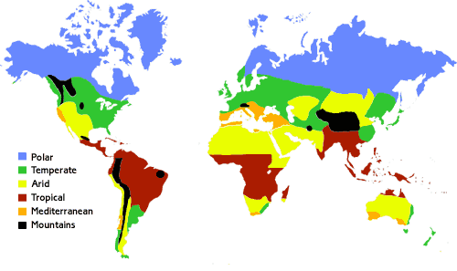
Study areas
Image from UK meteorological office
5

Slide 7
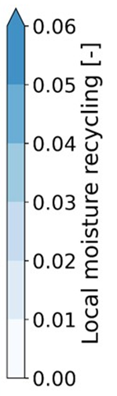
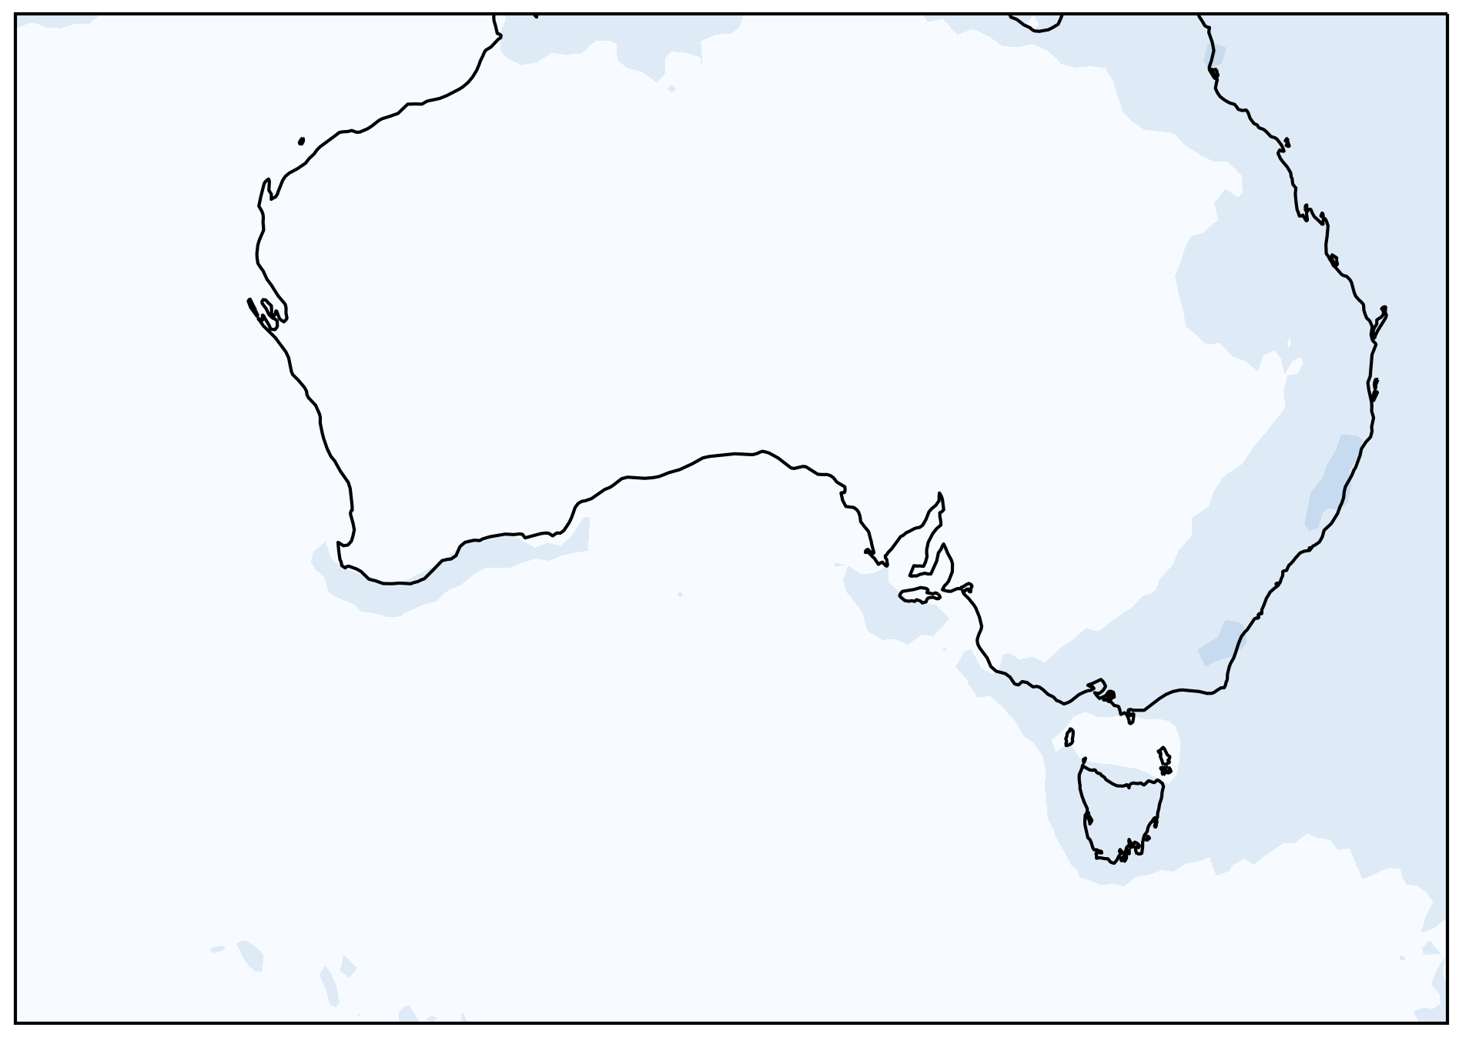
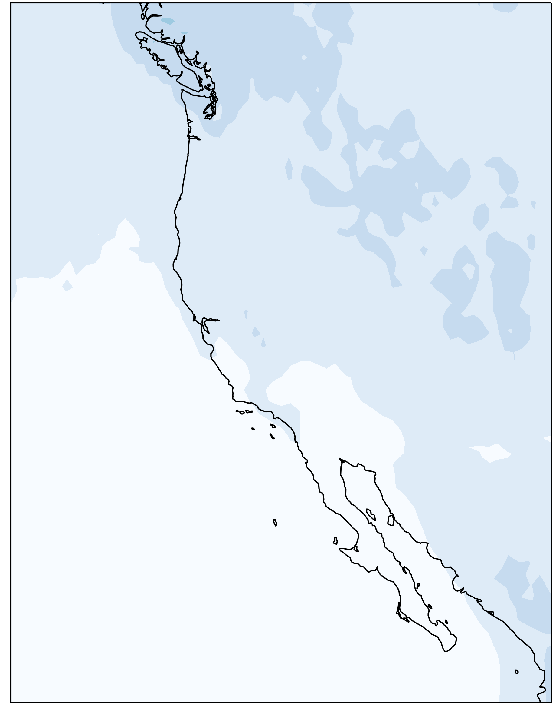
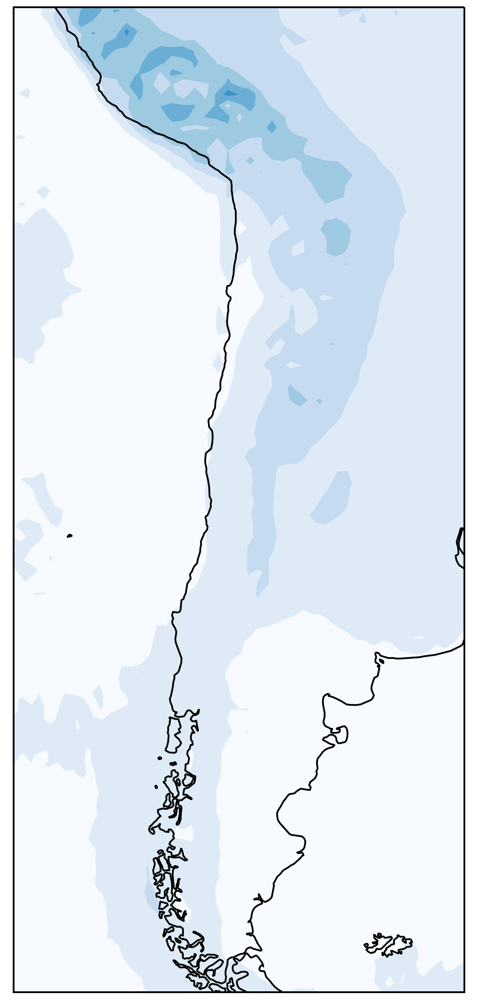
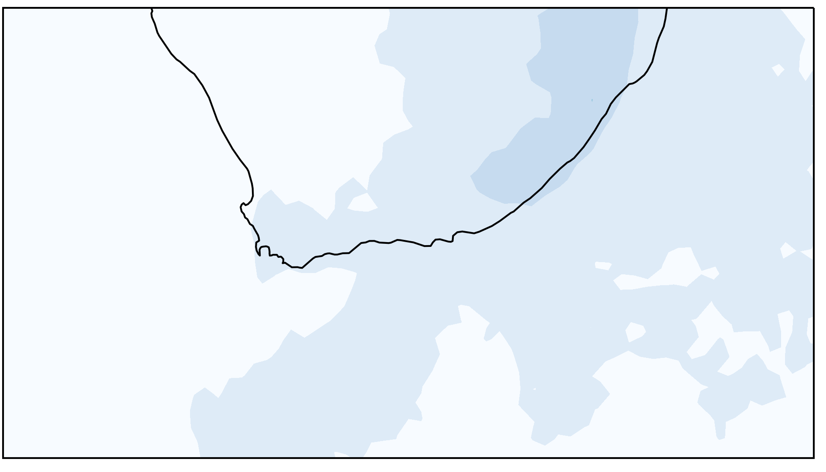
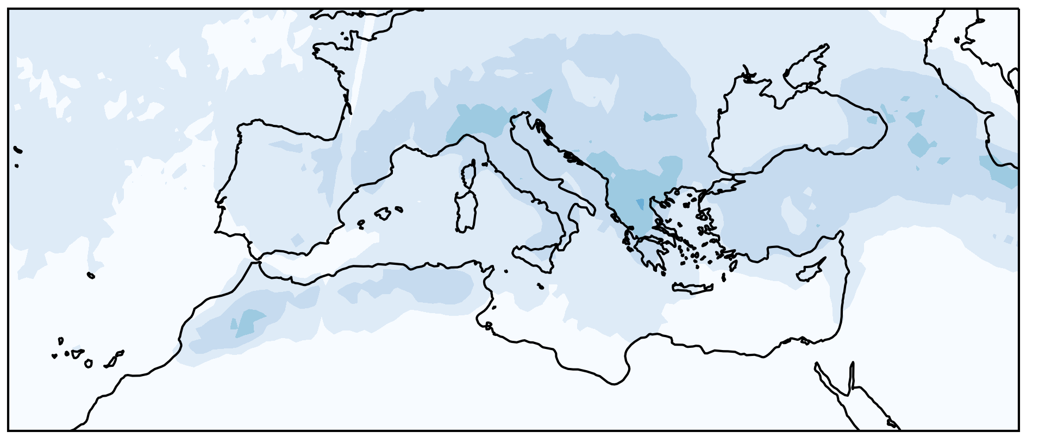
Local moisture recycling varies in and among Mediterranean areas
6
Notes:
---Figuren veranderen en het mediterrane gebied omlijnen.---
Local moisture recycling varies within and amongst the five mediteranean regions. We see especially low values over australia and peaks over mountainous regions like the atlas mountains and the andes. Overall LMR is rather low 1-2% with peaks up to 14% in mediterranean regions in summer.

Slide 8
Finding drivers of local moisture recycling
Methods:
Spearman rank correlation
Principal Component Analyses (PCA)
Data:
Local moisture recycling
Reanalysis data (ERA5)
Local recycling
+
-
7
Notes:
With our analysis we also studied interactions amongst the landscape characteristics, and we find some relations that suggest vegetation could strengthen de local water cycle.
First, we find that LMR promotes precipitation which enhance evaporation over tree canopy and reduces the aridity which both promote LMR strengthening the local water cycle.

Slide 9
Strengthening the local water cycle with regreening
Local recycling
+
-
Tall vegetation
cover
7
Notes:
When we study the impact of vegetation on these variables, we find that tall vegetation cover corresponds to LMR so enhancing tall vegetation, we expect LMR increases. A reason for this could be the impact vegetation has on wind which promotes LMR. Or the impact tall vegetation has on tP which again promotes LMR.
This is a general pattern we find amongst all regions. However, for some this mechanism is expected to be stronger than for others as for different regions different correspondences between LMR and the variables are found.

Slide 10

Strengthening the local water cycle with regreening
Aridity
Precipitation
Local recycling
+
-
Tall vegetation
cover
7
Notes:
When we study the impact of vegetation on these variables, we find that tall vegetation cover corresponds to LMR so enhancing tall vegetation, we expect LMR increases. A reason for this could be the impact vegetation has on wind which promotes LMR. Or the impact tall vegetation has on tP which again promotes LMR.
This is a general pattern we find amongst all regions. However, for some this mechanism is expected to be stronger than for others as for different regions different correspondences between LMR and the variables are found.

Slide 11
Strengthening the local water cycle with regreening
Aridity
Precipitation
Evaporation
Tree canopy
Local recycling
+
-
Tall vegetation
cover
7
Notes:
When we study the impact of vegetation on these variables, we find that tall vegetation cover corresponds to LMR so enhancing tall vegetation, we expect LMR increases. A reason for this could be the impact vegetation has on wind which promotes LMR. Or the impact tall vegetation has on tP which again promotes LMR.
This is a general pattern we find amongst all regions. However, for some this mechanism is expected to be stronger than for others as for different regions different correspondences between LMR and the variables are found.

Slide 12
Strengthening the local water cycle with regreening
Aridity
Precipitation
Evaporation
Tree canopy
Local recycling
+
-
Tall vegetation
cover
7
Notes:
When we study the impact of vegetation on these variables, we find that tall vegetation cover corresponds to LMR so enhancing tall vegetation, we expect LMR increases. A reason for this could be the impact vegetation has on wind which promotes LMR. Or the impact tall vegetation has on tP which again promotes LMR.
This is a general pattern we find amongst all regions. However, for some this mechanism is expected to be stronger than for others as for different regions different correspondences between LMR and the variables are found.

Slide 13


Take home messages
Local moisture recycling can help us plan regreening projects
Regreening could enhance LMR and create a positive feedback strengthening the local water cycle
We need to study the regions separately since each region is characterized by its own combination of variables that drive local recycling
Jolanda.Theeuwen@wetsus.nl @jtheeu
8

