Slide 1

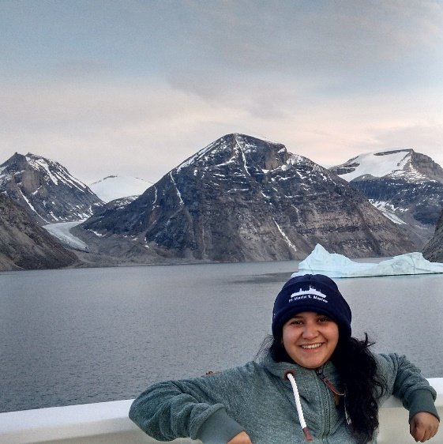


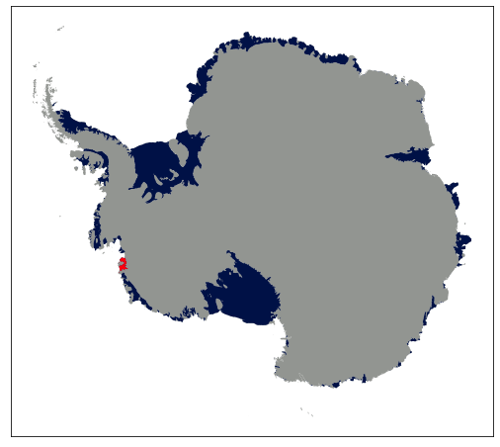
beatriz.recinos@ed.ac.uk www.beatrizrecinos.com @bmrocean
FEniCS_Ice framework applied to three West Antarctic ice streams: Smith, Pope and Kohler Glaciers.
Beatriz Recinos, Dan Goldberg, James R. Maddison and Joe Todd.
Image from NASA's Scientific Visualization Studio

Slide 2

Objective
Quantify the uncertainty in the basal sliding and ice stiffness parameters after inferring them from satellite ice velocity observations.
Propagate their error through time and into projections of sea-level rise contributions or Volume above flotation (VAF, the Quantity of Interest in this study).

Slide 3
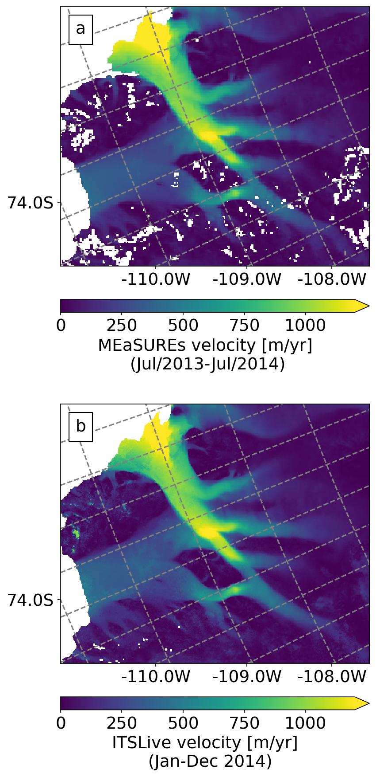
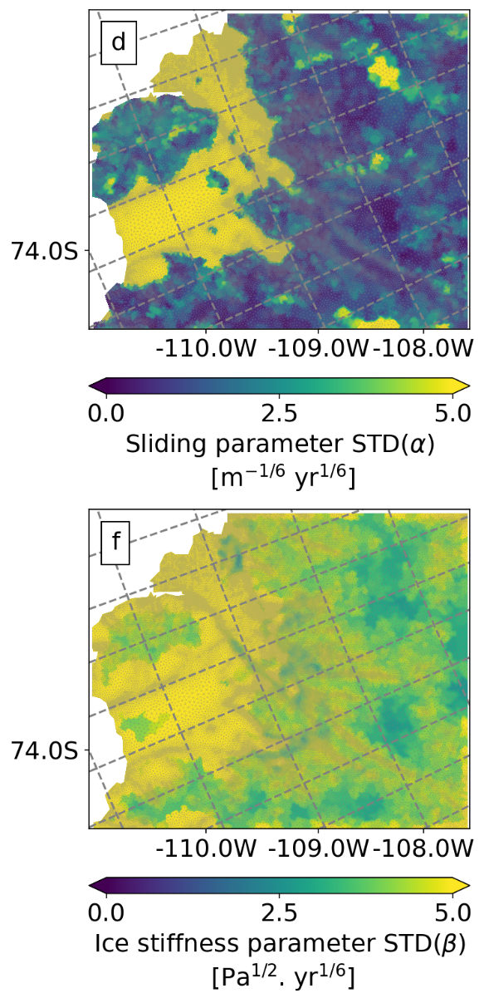

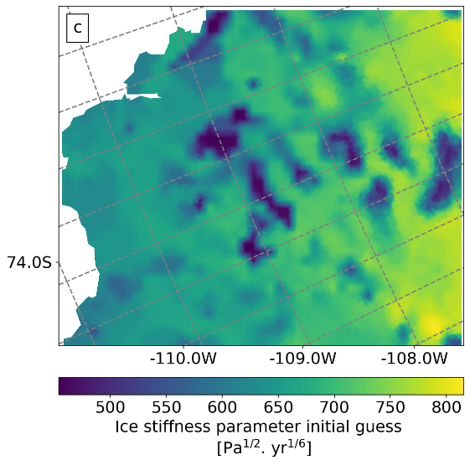
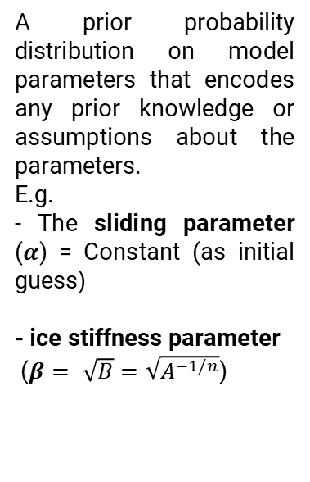
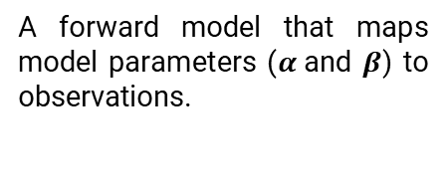
Model concept
We find the posterior probability distribution of the parameters conditioned by the observational data
Satellite ice velocity observations and their uncertainties
A prior probability distribution on model parameters that encodes any prior knowledge or assumptions about the parameters.
E.g.
- The sliding parameter ($α$) = Constant (as initial guess)
- ice stiffness parameter
($β= \sqrt{B}=\sqrt{A^{−1/n}}$)
A forward model that maps model parameters ($α$and $β$) to observations.

Slide 4
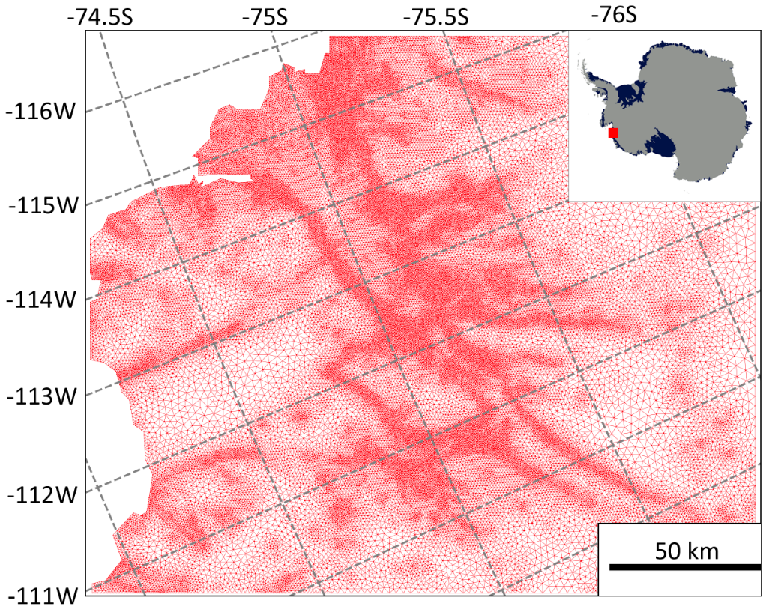
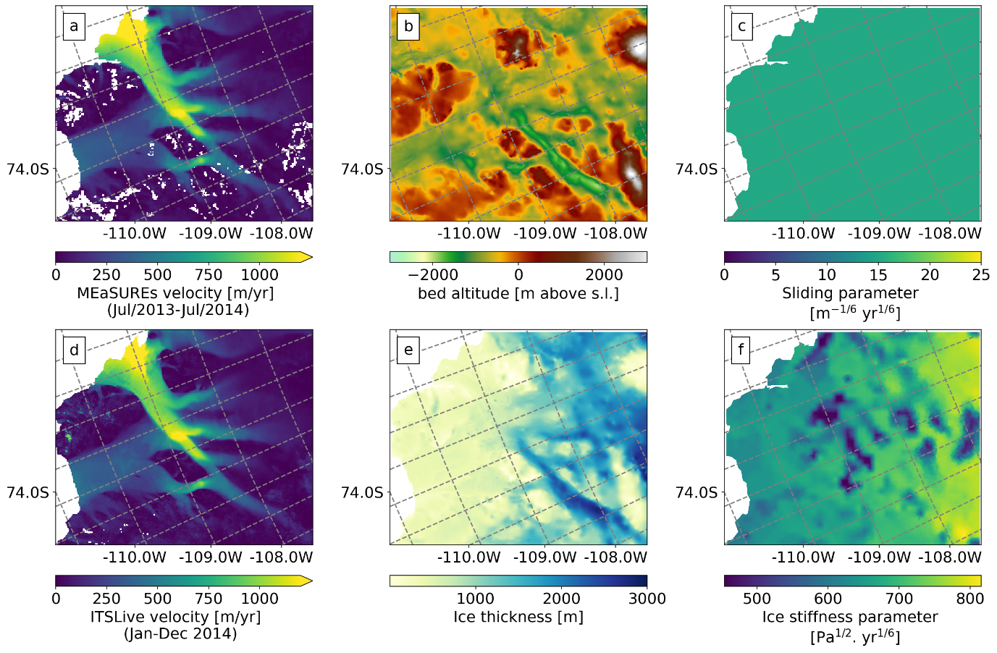
Data input
Satellite ice velocities (gridded and cloud point data) from two different products (MEaSUREs v1.0 2013-2014 and ITSLive Jan-Dec/2014).
Bed topography and ice thickness from BedMachine Antarctica v2.0.
Constant SMB.
Constant Sliding parameter (first guess).
Ice stiffness parameter (first guess): derived from mean basal temperature estimates [F. Pattyn (2010)].
We discretized all input data, by using first-order continuous Lagrange elements on a triangular mesh.
The mesh resolution is highly heterogeneous, depending on observed strain rates.

Slide 5
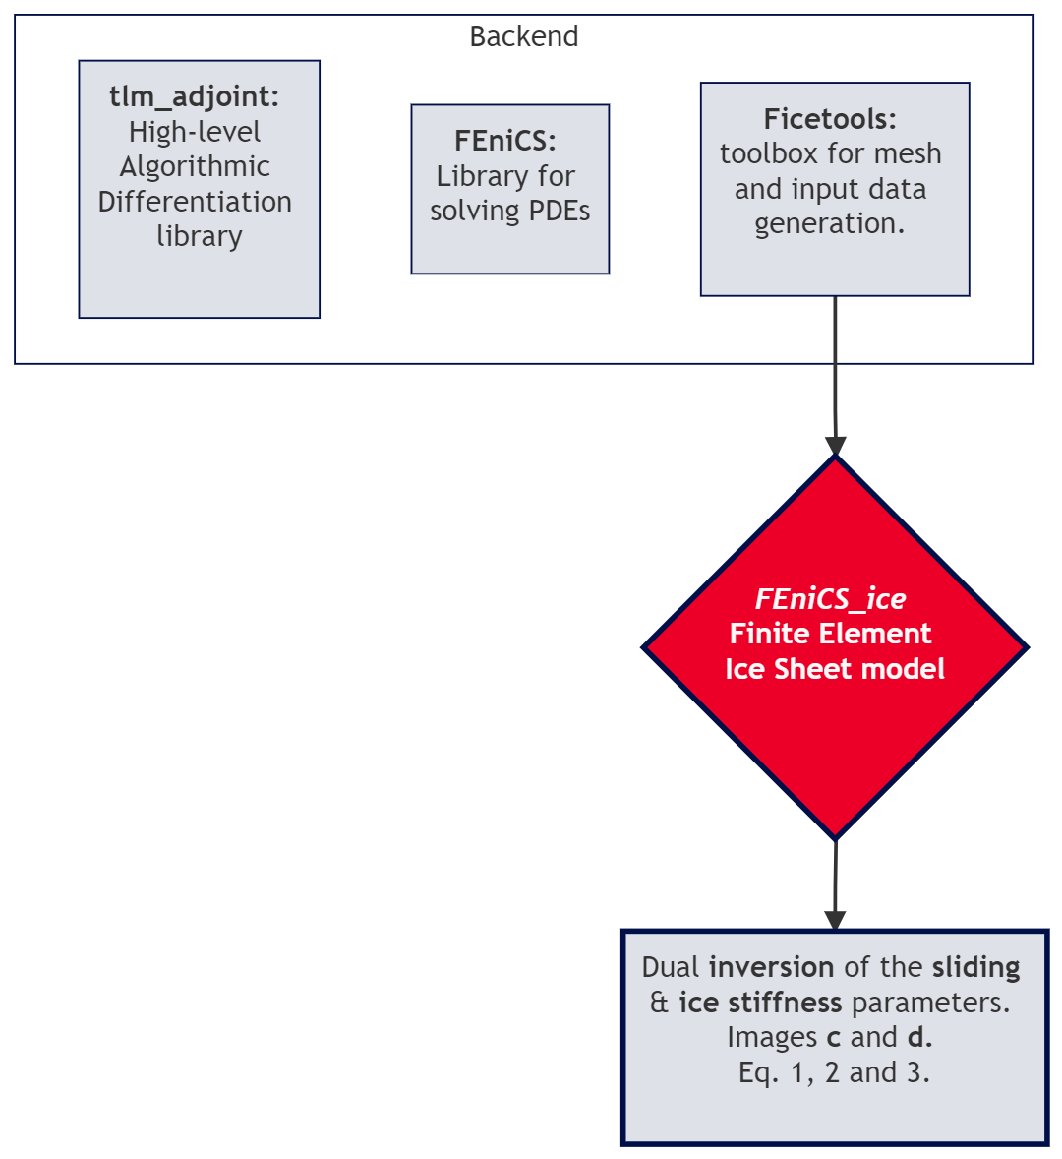
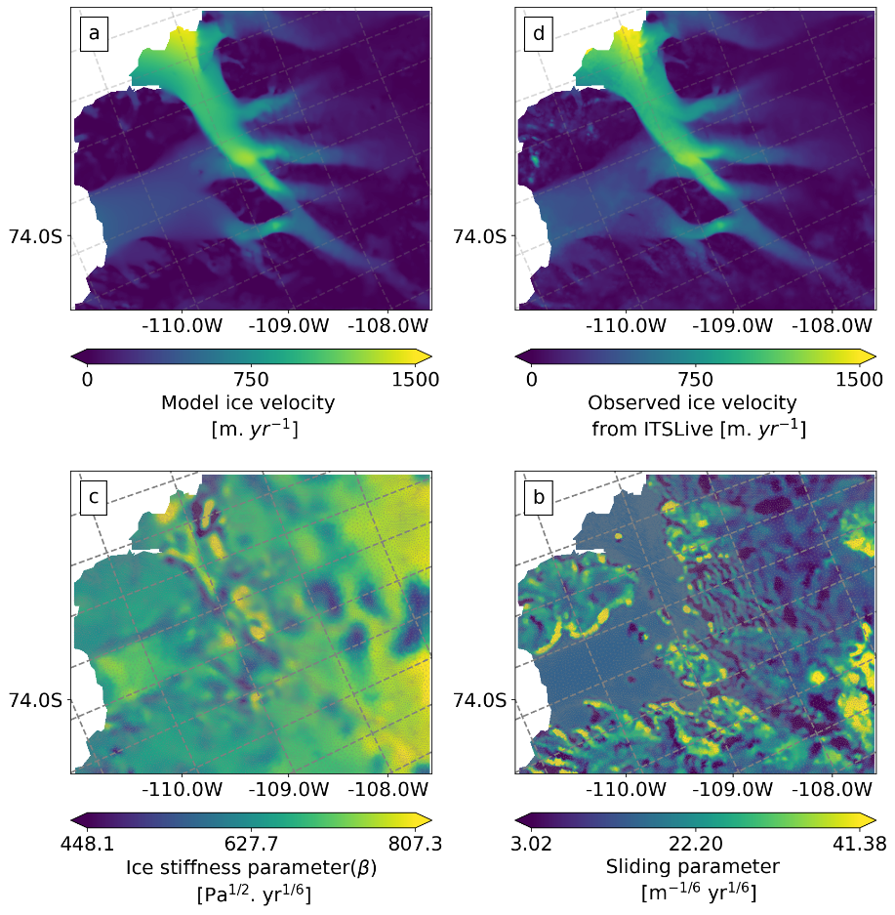


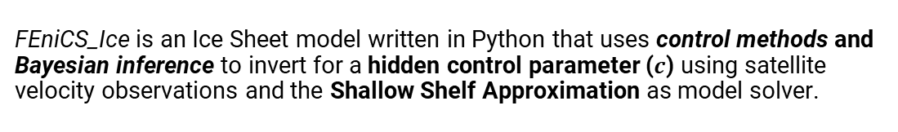
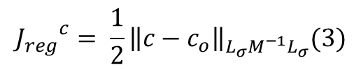
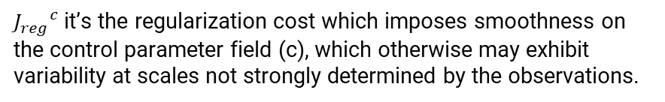
Model stages: Inversion
FEniCS_Ice is an Ice Sheet model written in Python that uses control methods and Bayesian inference to invert for a hidden control parameter ($c$) using satellite velocity observations and the Shallow Shelf Approximation as model solver.
$$J^{c}= {J_{mis}}^{c}+ {J_{reg}}^{c} \left(1\right)$$
${J_{mis}}^{c}$ it’s the observation – model misfit normalised by the error in the observations
$${J_{mis}}^{c}= \frac{1}{2}{\left\|u_{obs}− u_{model} \right\|}_{{Γ_{obs}}^{−1} M {Γ_{obs}}^{−1} }(2)$$
${J_{reg}}^{c}$ it’s the regularization cost which imposes smoothness on the control parameter field (c), which otherwise may exhibit variability at scales not strongly determined by the observations.
$${J_{reg}}^{c}= \frac{1}{2}{\left\|c−c_{o}\right\|}_{L_{σ}M^{−1}L_{σ}}(3)$$

Slide 6
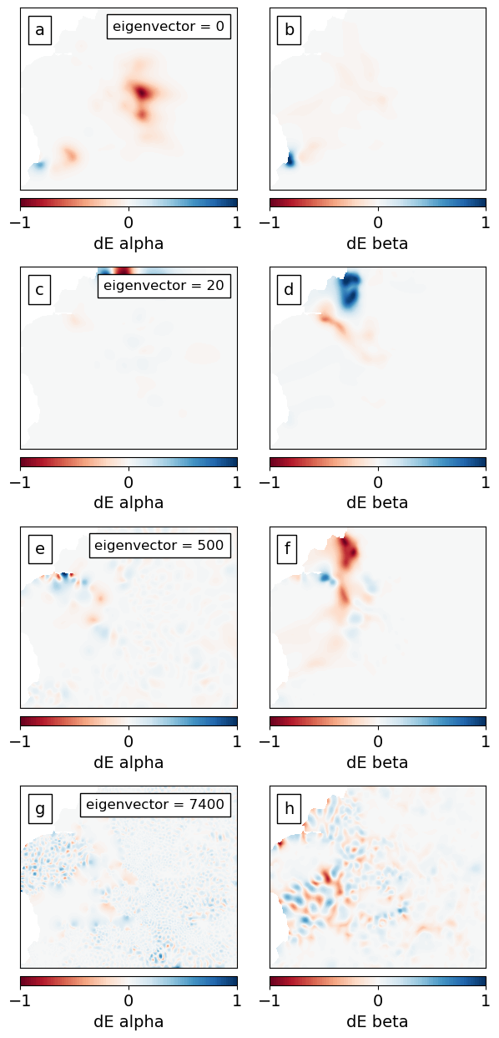
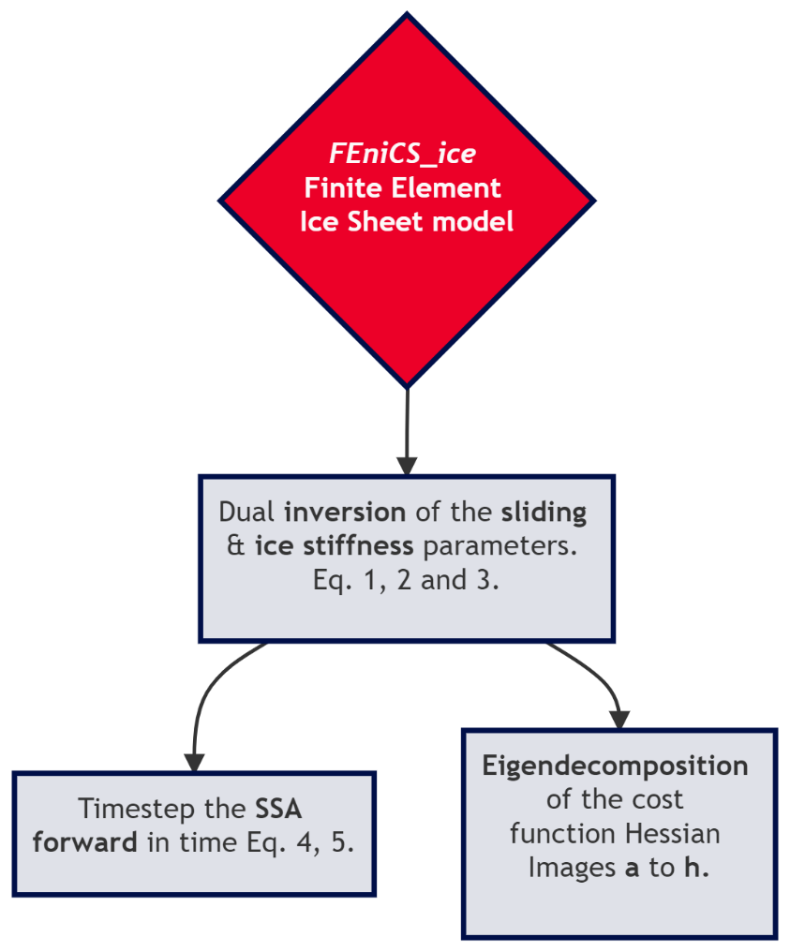
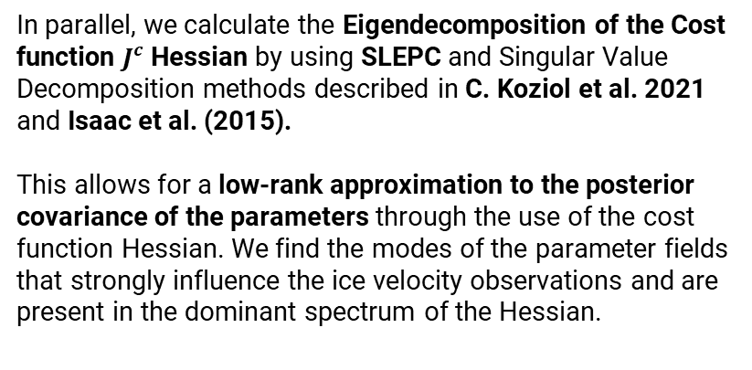
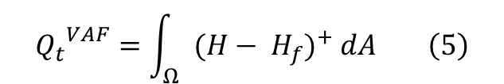

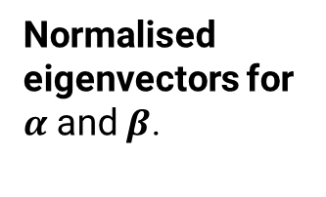
Model stages: Forward and Eigendecomposition
We solve the momentum equation (and SSA) with the inverted parameter distributions of $α$and $β$.
$$H_{t}+ ∇.\left(H u \right)=B \left(4\right)$$
And calculate projections for the QoI Volume above flotation (VAF) over 40 years:
$${Q_{t}}^{VAF}=\int_{Ω}{{(H− H_{f})}^{+} dA} \left(5\right)$$
In parallel, we calculate the Eigendecomposition of the Cost function $J^{c}$ Hessian by using SLEPC and Singular Value Decomposition methods described in C. Koziol et al. 2021 and Isaac et al. (2015).
This allows for a low-rank approximation to the posterior covariance of the parameters through the use of the cost function Hessian. We find the modes of the parameter fields that strongly influence the ice velocity observations and are present in the dominant spectrum of the Hessian.
Normalised eigenvectors for $α$and $β$.

Slide 7
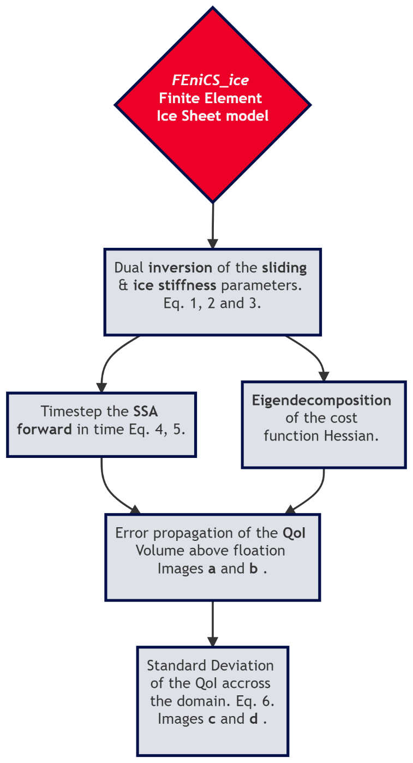
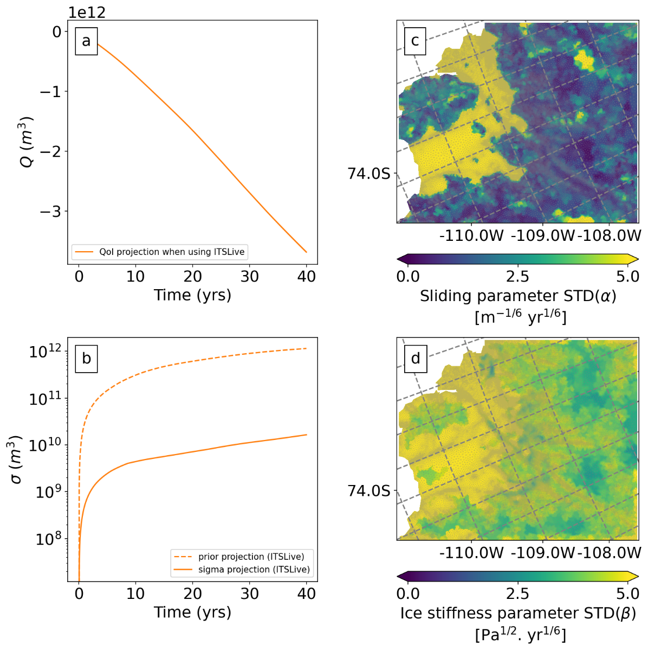

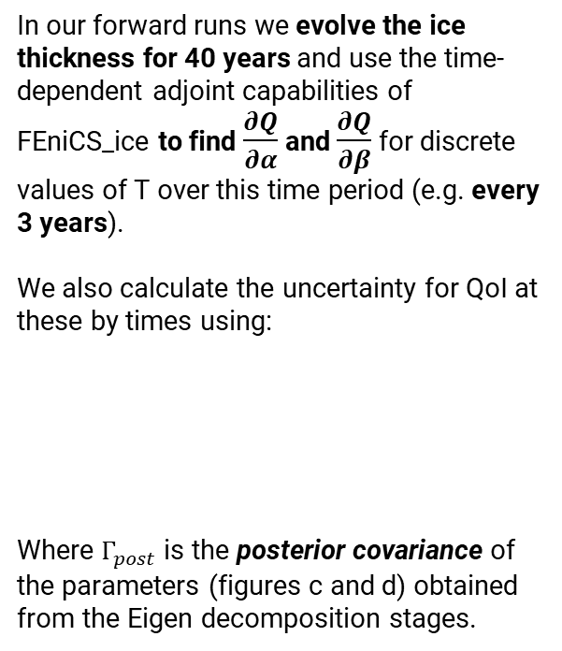
Model stages: Error propagation and STD of $α$ and $β$ estimation
In our forward runs we evolve the ice thickness for 40 years and use the time-dependent adjoint capabilities of FEniCS_ice to find $\frac{∂Q}{∂α}$ and $\frac{∂Q}{∂β}$ for discrete values of T over this time period (e.g. every 3 years).
We also calculate the uncertainty for QoI at these by times using:
Where $Γ_{post}$ is the posterior covariance of the parameters (figures c and d) obtained from the Eigen decomposition stages.
$σ^{2}\left(Q_{T}\right)={\left(\frac{∂Q_{T}}{∂\overline{c}}\right)}^{T} Γ_{post} \left(\frac{∂Q_{T}}{∂\overline{c}}\right)$ (6)
Work in progress QoI uncertainty too small!

Slide 8
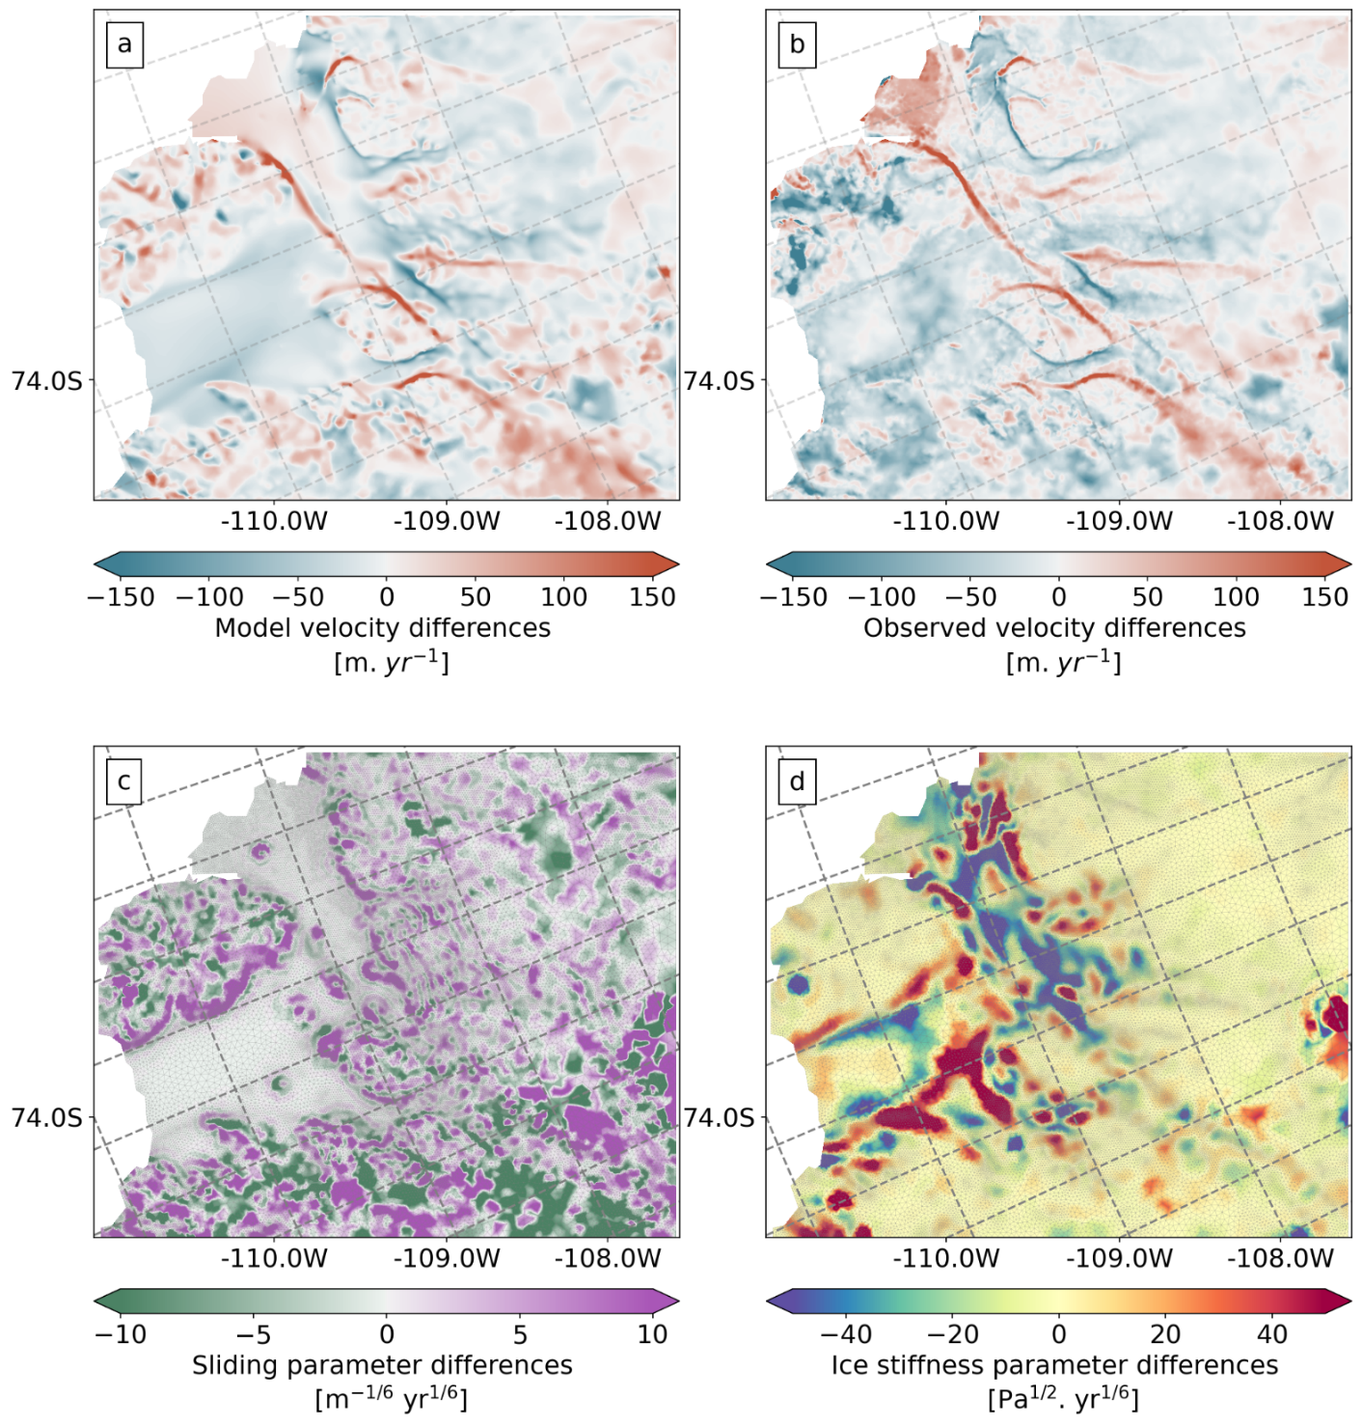
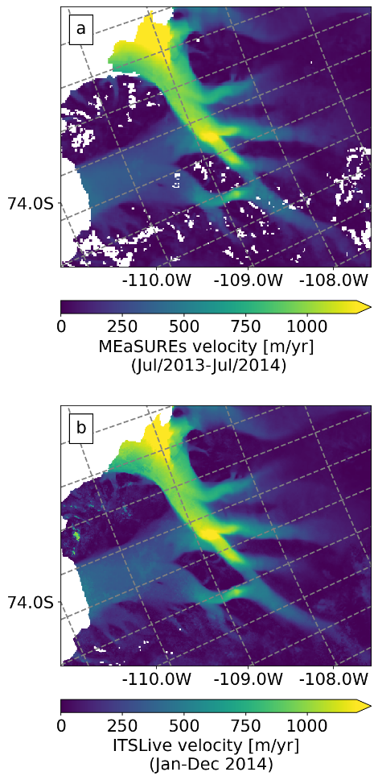
Results
FEniCS_ice workflow with two different satellite velocity products
Differences MEaSUREs – ITSLive
MEaSUREs
Jul/2013 – Jul/2014
ITSLive
Jan – Dec/2014
Notes:
We ran our model workflow by using two different velocity products as input to compare the output differences …
We also investigated the effect of the 6 month offset between both products which turned out to be negligible.
In the right hand side figure, we can see observed velocity differences in panel b. And model velocity differences in a.
Fenics_ice is capable of replicating the differences between the two products, specially at the ice margins.
After inverting for the basal sliding parameter and the ice stiffness parameter using the two products … We compare in panels c and d the differences between the two model outputs for each inverted parameter.
Again we can see significant differences at the ice margins. And specially at the ice shelf in the case of the ice stiffness parameter.
[DAN NOTES: a really important point is that because ITS_LIVE and MEaSUREs differ in the margins AND both have low reported errors there, fenics_ice differs there as well – leading to large differences in beta. All this is shown in the figures, but it’s an important point to remember as people won’t immediately see this.]

Slide 9


Results
FEniCS_ice workflow with two different satellite velocity products
Differences MEaSUREs – ITSLive
Model diff
Obs diff
Grounded ice margins
MEaSUREs
Jul/2013 – Jul/2014
Ice shelf
$α$diff
$β$diff
ITSLive
Jan – Dec/2014
Notes:
We ran our model workflow by using two different velocity products as input to compare the output differences …
We also investigated the effect of the 6 month offset between both products which turned out to be negligible.
In the right hand side figure, we can see observed velocity differences in panel b. And model velocity differences in a.
Fenics_ice is capable of replicating the differences between the two products, specially at the ice margins.
After inverting for the basal sliding parameter and the ice stiffness parameter using the two products … We compare in panels c and d the differences between the two model outputs for each inverted parameter.
Again we can see significant differences at the ice margins. And specially at the ice shelf in the case of the ice stiffness parameter.
[DAN NOTES: a really important point is that because ITS_LIVE and MEaSUREs differ in the margins AND both have low reported errors there, fenics_ice differs there as well – leading to large differences in beta. All this is shown in the figures, but it’s an important point to remember as people won’t immediately see this.]

Slide 10
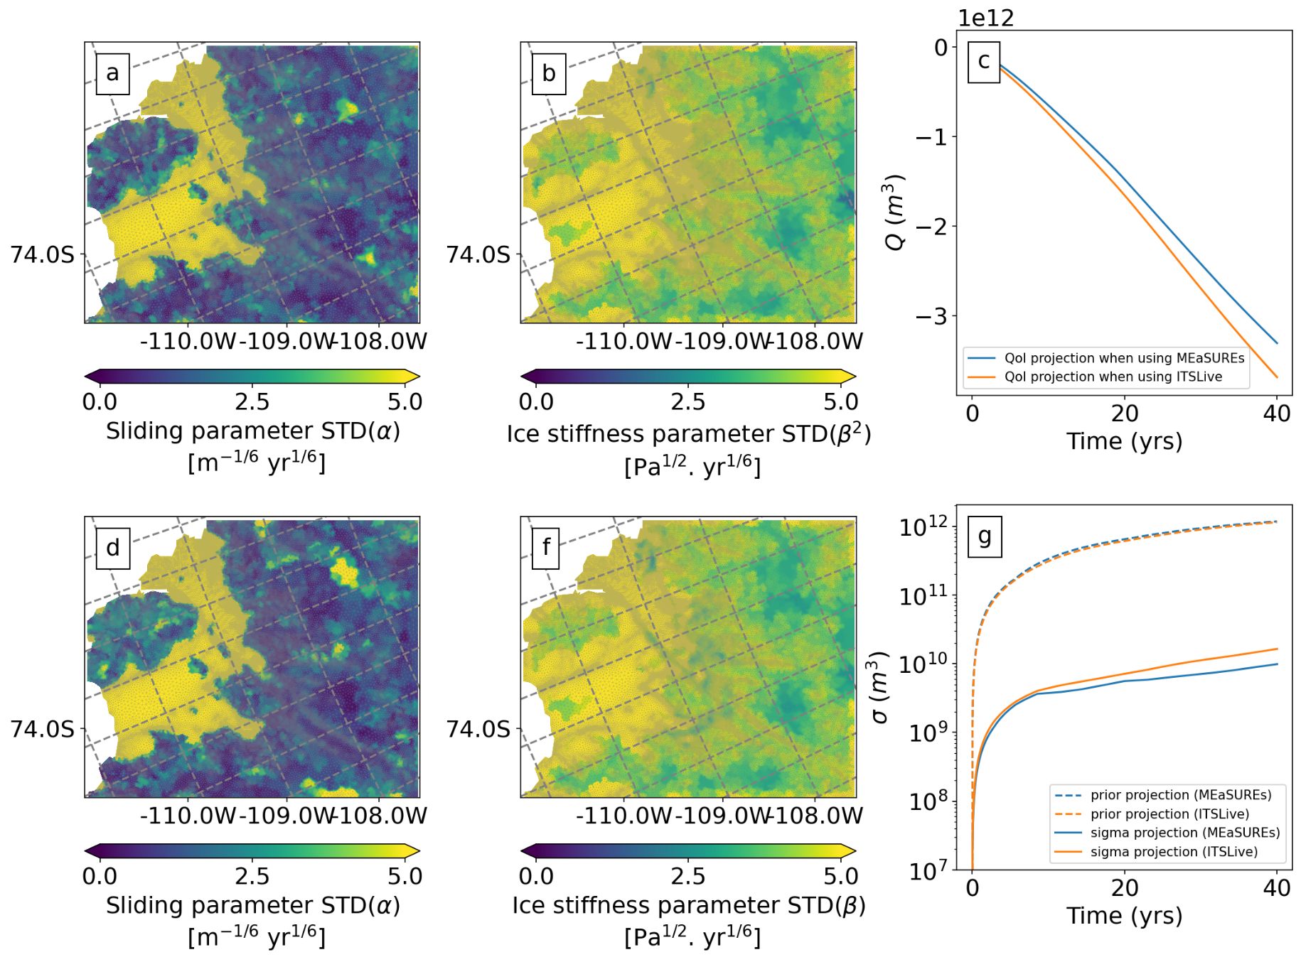
MEaSUREs
Results
11% diff VAF after year 40
Model projections of VAF (c) for the different velocity data products,
and STD of inverted parameters
(a, b, d and f)
ITSLive
Notes:
This differences in inverted parameters also lead to a different posterior probability distribution of the parameter conditioned by the observational data.
And to differences in projections of Volume above flotation. We found a 11 % difference in VAF after running the model for 40 years and using the two velocity products.
However figure G contradict this when it comes to the uncertainty and suggest that on average the VAF projections should show a smaller difference between the products. We are currently investigating why with the given observations STD our error remains small.
[IT IS OK TO MENTION THAT FIG (G) UNDERPREDICTS THIS. FIG (G) WOULD SUGGEST THAT ON AVERAGE FIG (C) SHOULD SHOW A DIFFERENCE OF ABOUT 0.1 %, NOT 11%. WE ARE CURRENTLY INVESTIGATING THE REASONS FOR THIS.]

Slide 11
Conclusions and roadmap
Model diff
Obs diff
Significant differences in satellite velocity products (at ice margins), can lead to differences in projected estimates of Sea Level Rise contributions.
This effect may be less important for stable ice streams (e.g. Smith) but could lead to different results in more active margins e.g. Thwaites
FEniCS_ice is still in development, please check our supplemental materials for future experiments and project goals.
$α$diff
$β$diff
Notes:
FEniCS_ice and this study are still a work in progress so please visit our supplemental materials to have an overview of the model workflow and development priorities.
Significant differences in satellite velocity products (specially at the ice margins), can lead to differences in projected estimates of Sea Level Rise contributions.
This effect may be less important for stable ice streams but could lead to different results in more active margins e.g. Thwaites which we will investigate next.

Slide 12
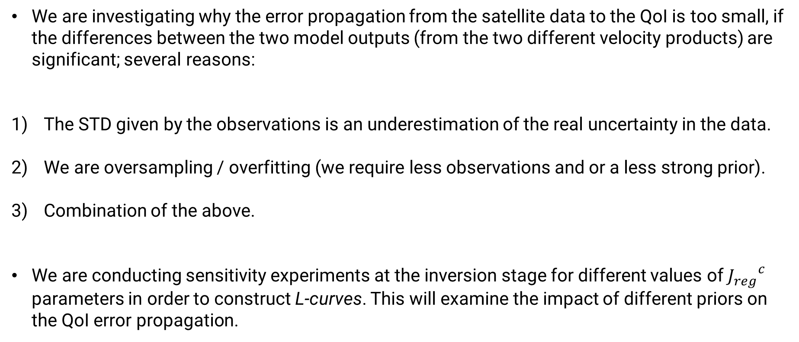
Conclusions and roadmap
We are investigating why the error propagation from the satellite data to the QoI is too small, if the differences between the two model outputs (from the two different velocity products) are significant; several reasons:
The STD given by the observations is an underestimation of the real uncertainty in the data.
We are oversampling / overfitting (we require less observations and or a less strong prior).
Combination of the above.
We are conducting sensitivity experiments at the inversion stage for different values of ${J_{reg}}^{c}$ parameters in order to construct L-curves. This will examine the impact of different priors on the QoI error propagation.

Slide 13
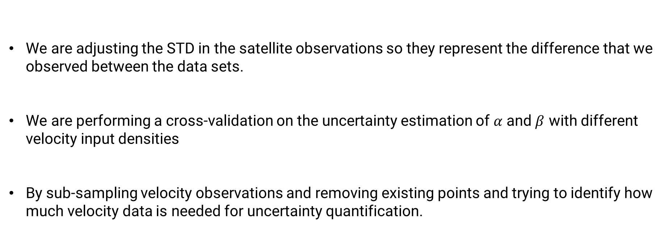
Conclusions and roadmap
We are adjusting the STD in the satellite observations so they represent the difference that we observed between the data sets.
We are performing a cross-validation on the uncertainty estimation of $α$ and $β$ with different velocity input densities
By sub-sampling velocity observations and removing existing points and trying to identify how much velocity data is needed for uncertainty quantification.

Slide 14

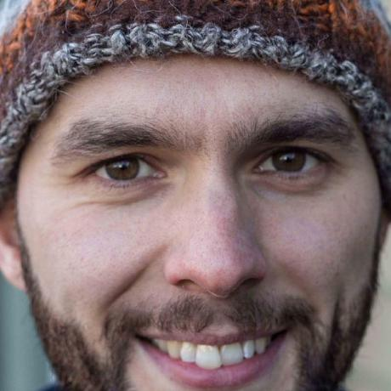

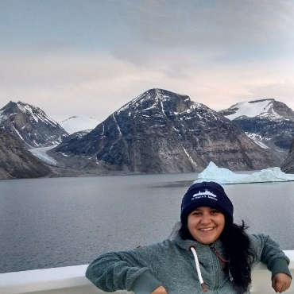
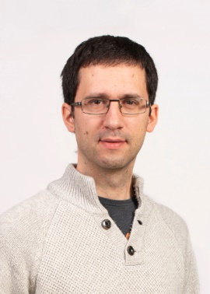
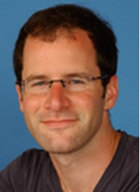
Thank you!
FEniCS ice team
Supplemental Material page:
https://doi.org/10.5194/egusphere-egu22-5859
Or check the model paper:
Koziol, C. P., Todd, J. A., Goldberg, D. N., and Maddison, J. R. (2021). fenics_ice 1.0: A framework for quantifying initialization uncertainty for time-dependent ice sheet models. Geoscientific Model Development, 14(9):5843–5861.
https://doi.org/10.5194/gmd-14-5843-2021
Past (top) and present (bottom) contributors:
Conrad P. Koziol
Joe Todd
Bea Recinos
James R.
Maddison
Daniel Goldberg
In Vienna!
Notes:
Thanks for your attention and if you have more questions, please feel free to write me or go and find Dan who is actually in Vienna. This is how he looks like. He will be happy to answer any questions.
Thanks!

Slide 15
Relevant references:
[1] Alnæs, M., Blechta, J., Hake, J., Johansson, A., Kehlet, B., Logg, A., Richardson, C., Ring, J., Rognes, M. E., and Wells, G. N. (2015). The FEniCS Project Version 1.5. Archive of Numerical Software, 3(100):9–23.
[2] E., R., J., M., and B., S. (2017). Measures insar-based antarctica ice velocity map, version 2.0. Accessed: 2022-04-07.
[3] Gardner, A. S., Moholdt, G., Scambos, T., Fahnstock, M., Ligtenberg, S., van den Broeke, M., and Nilsson, J. (2018). Increased west antarctic and unchanged east antarctic ice discharge over the last 7 years. The Cryosphere, 12(2):521–547.
[4] Isaac, T., Petra, N., Stadler, G., and Ghattas, O. (2015). Scalable and efficient algorithms for the propagation of uncertainty from data through inference to prediction for large-scale problems, with application to flow of thevantarctic ice sheet. Journal of Computational Physics, 296:348–368.
[5] Koziol, C. P., Todd, J. A., Goldberg, D. N., and Maddison, J. R. (2021). fenics_ice 1.0: a framework for quantifying initialization uncertainty for time-dependent ice sheet models. Geoscientific Model Development, 14(9):5843–5861.
[6] Macayeal, D. R. (1992). The basal stress distribution of ice stream E, Antarctica, inferred by control methods. JOURNAL OF GEOPHYSICAL RESEARCH, 97(81):595–603.
[7] Maddison, J. R., Goldberg, D. N., and Goddard, B. D. (2019). Automated calculation of higher order partial differential equation constrained derivative information. SIAM Journal on Scientific Computing, 41(5):C417–C445.
[8] Petra, N., Martin, J., Stadler, G., and Ghattas, O. (2014). A computational framework for infinite-dimensional bayesian inverse problems, part ii: Stochastic newton mcmc with application to ice sheet flow inverse problems. SIAM Journal on Scientific Computing, 36(4):A1525–A1555.
[9] Pattyn, F. (2010). Antarctic subglacial conditions inferred from a hybrid ice sheet/ice stream model. Earth and Planetary Science Letters, 295(3):451–461.

