Slide 1


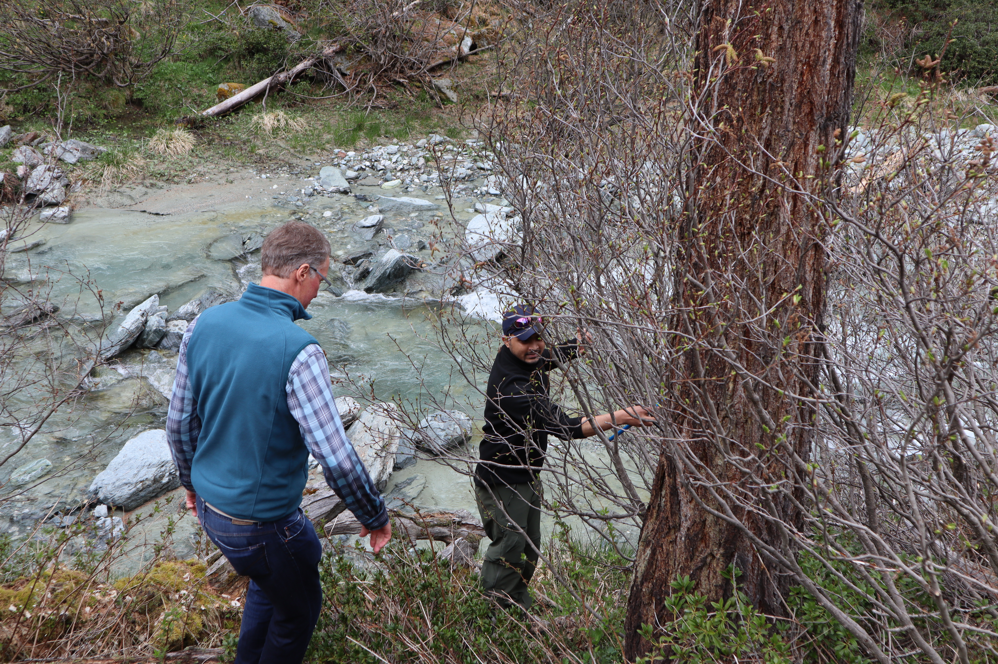
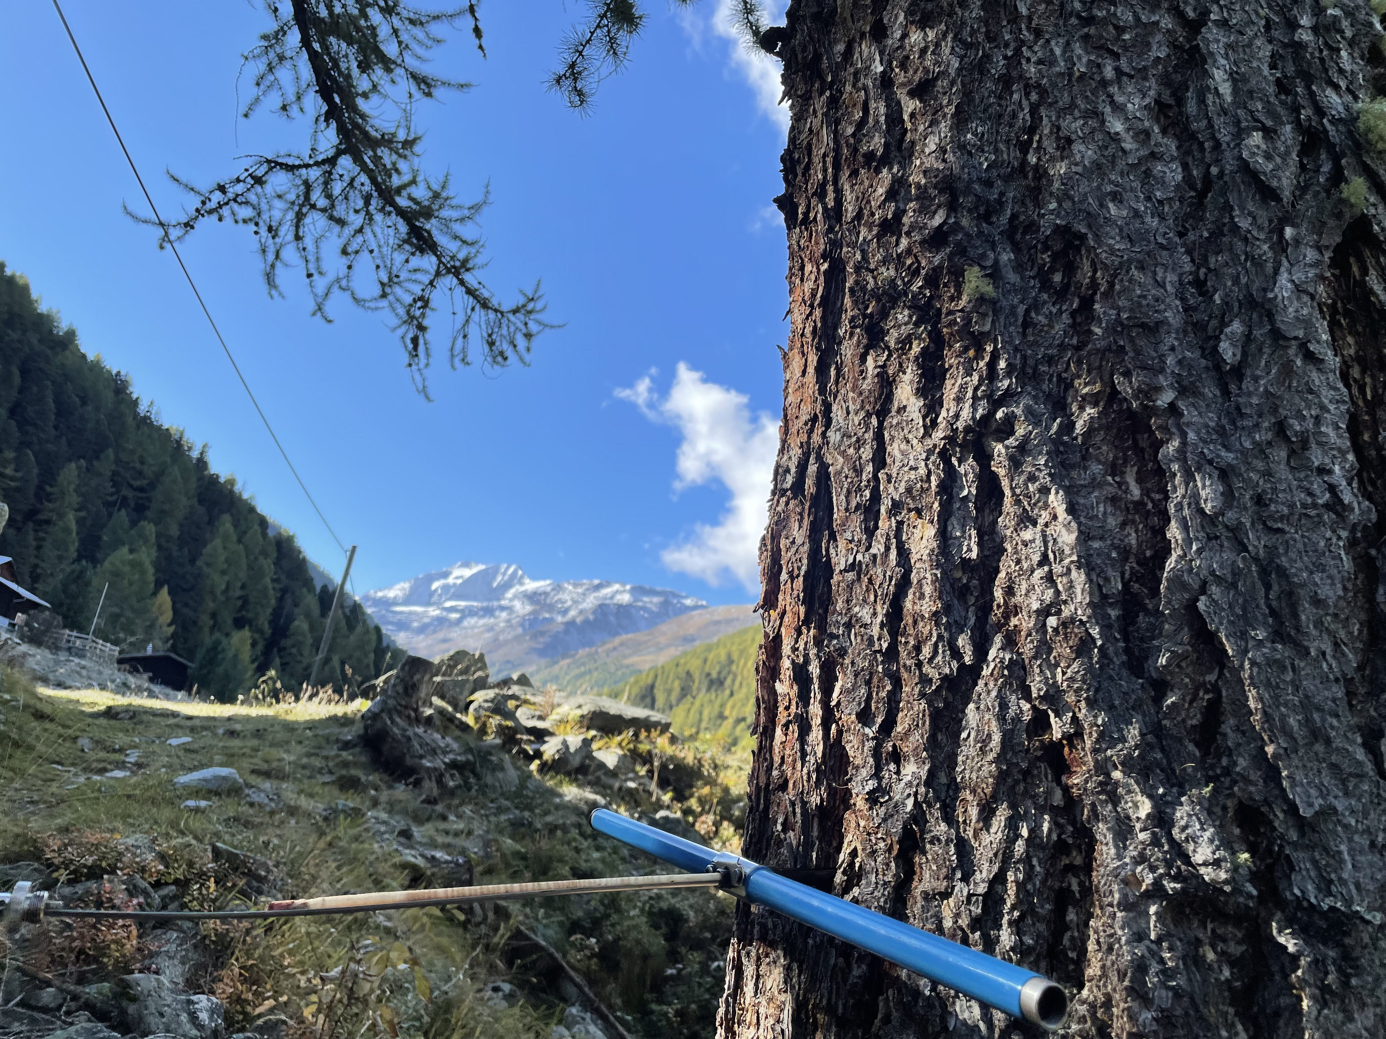

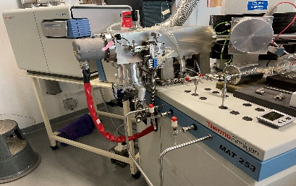
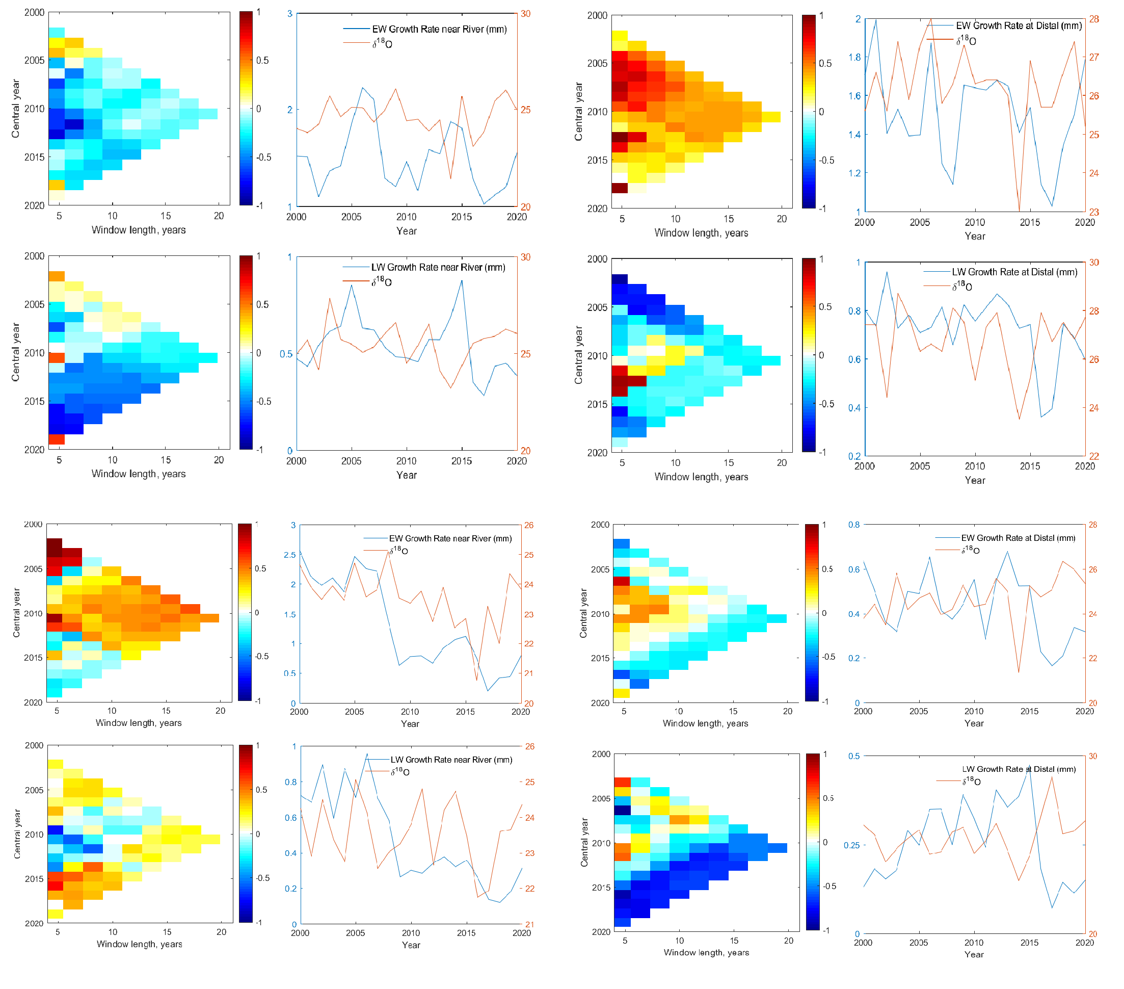



Use of stable isotope signals from tree rings as proxy for tracing the combined effects of climate change and hydropower on glacier-derived water resources in the Turtmänna river basin, Switzerland
Nazimul Islam*, Torsten Vennemann and Stuart N. Lane
Institute of Earth Surface Dynamics (IDYST), University of Lausanne, Switzerland
*nazimul.islam@unil.ch
Session: CL1.2.2
(Interdisciplinary Tree-Ring Research)
May 23, 2022

Slide 2
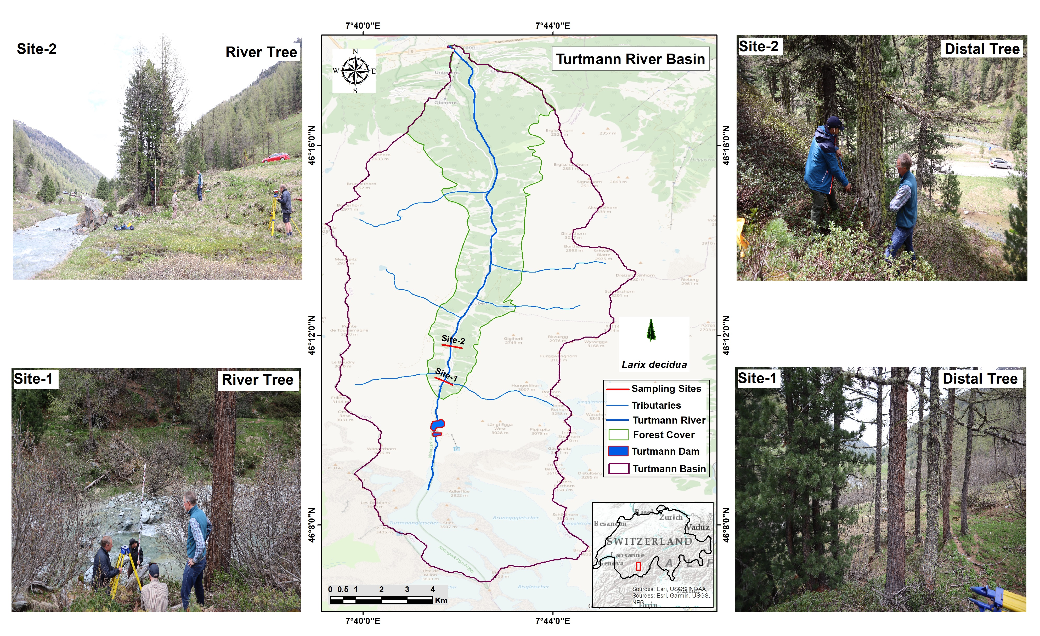
Objectives:
To assess the variations in isotopic compositions in Earlywood (EW) and Latewood (LW) of trees close to the river and distal from the river in two different sites
Site-1: at the proximity to the upstream hydropower dam
Site-2: at the distal from the dam downstream
Expectation: A downstream gradient in the depletion of stable isotopes in tree-rings (without the impact of hydropower)
Background

Slide 3
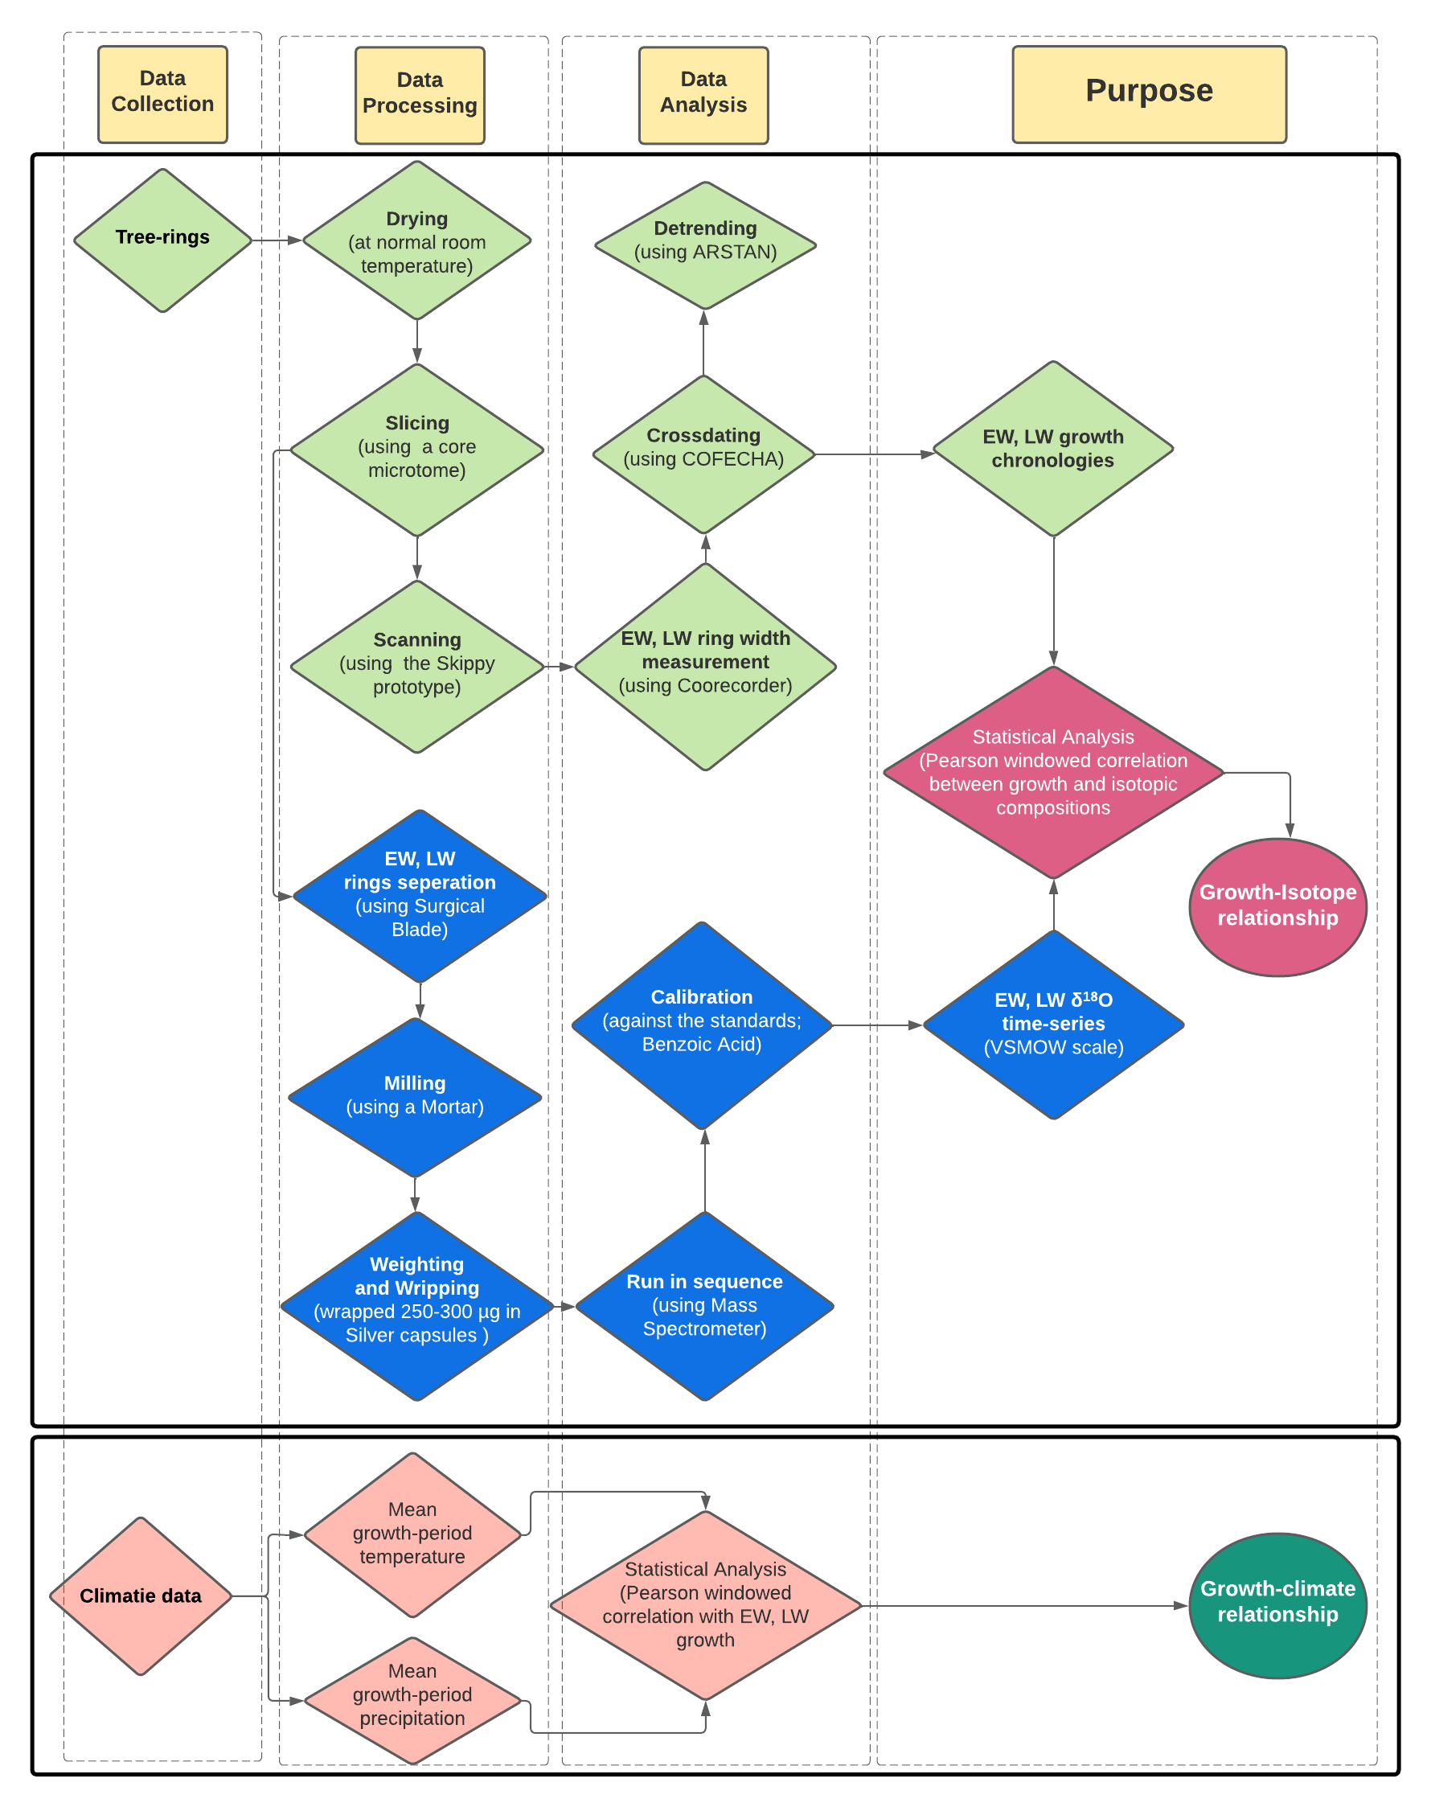
Tree-species: European Larch (Larix Decidua)
Two cores per trees at the DBH (1.15m), proximal to the river and distal from the river.
EW, LW growth chronologies for River Trees and Distal Trees.
Last two decades (2000-2020) of δ¹⁸O time-series from EW and LW rings.
Windowed correlation (Pearson) analysis between;
The EW, LW ring growth and mean growth-period temperature and precipitation (data from MeteoSwiss).
The EW, LW ring growth and their δ¹⁸O isotopic compositions.
Methodology

Slide 4
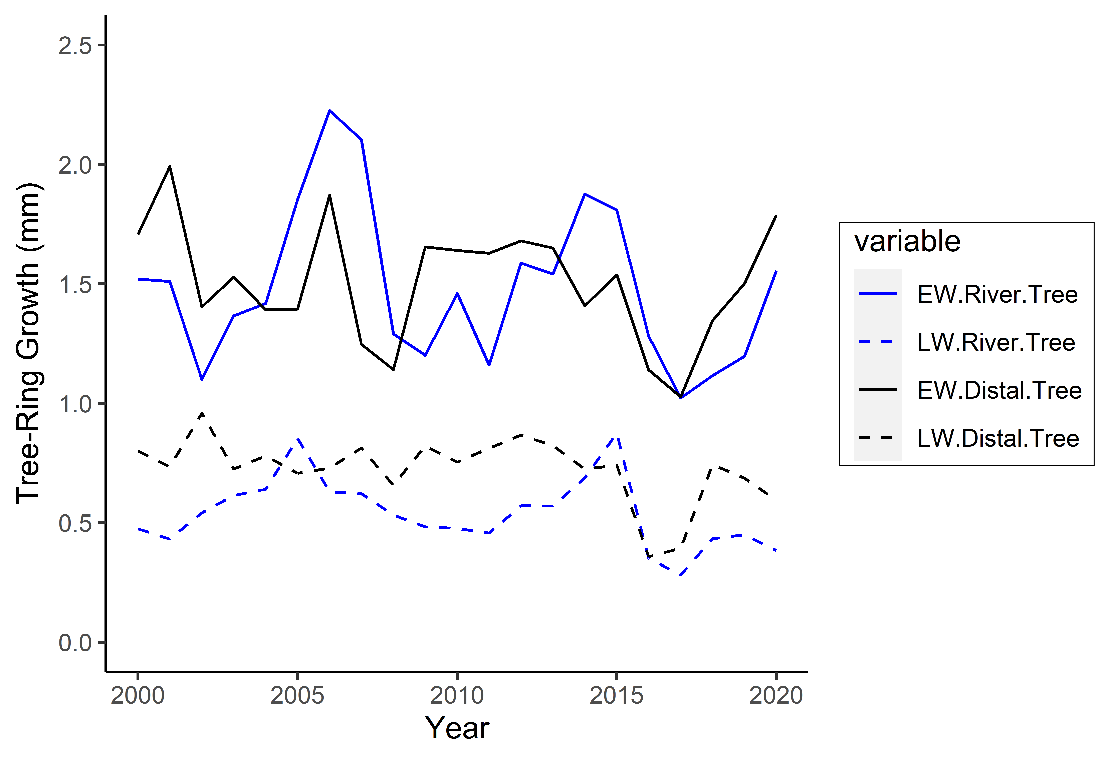
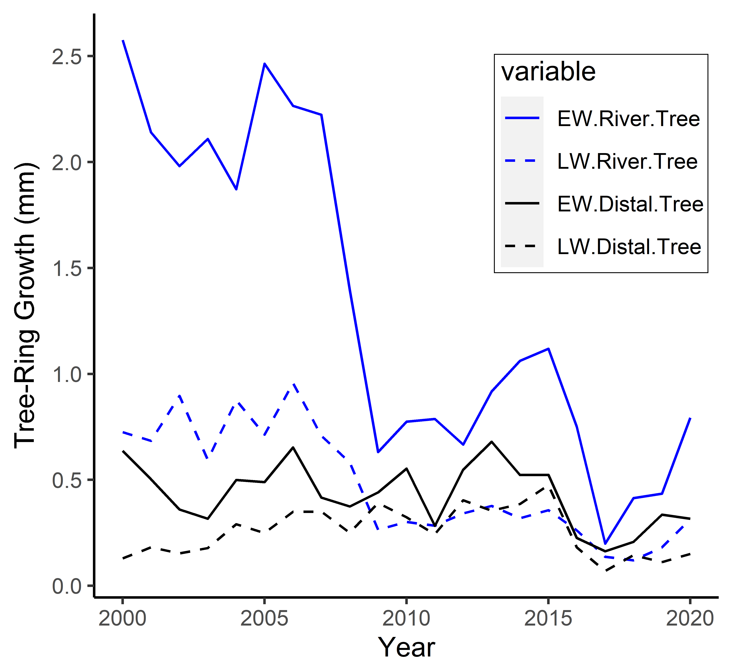
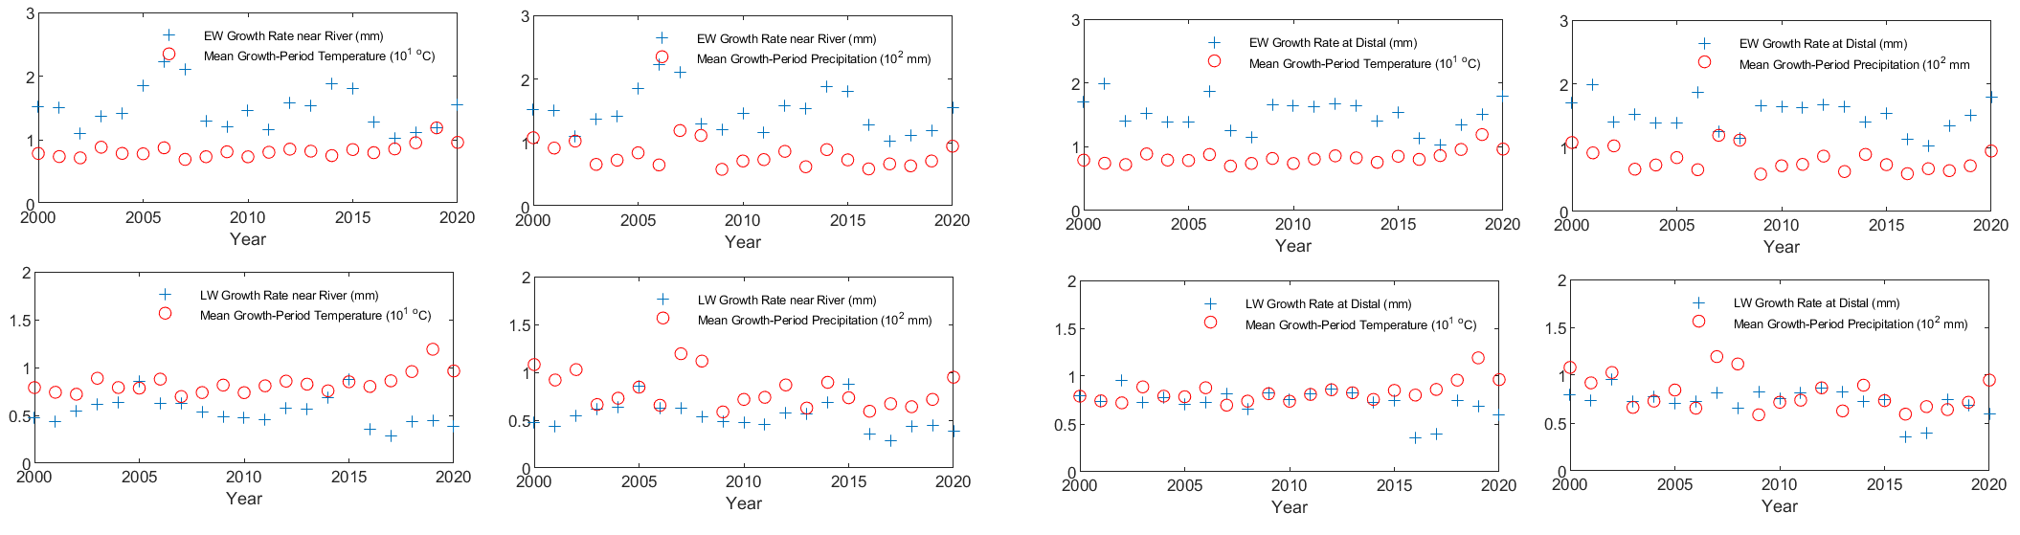
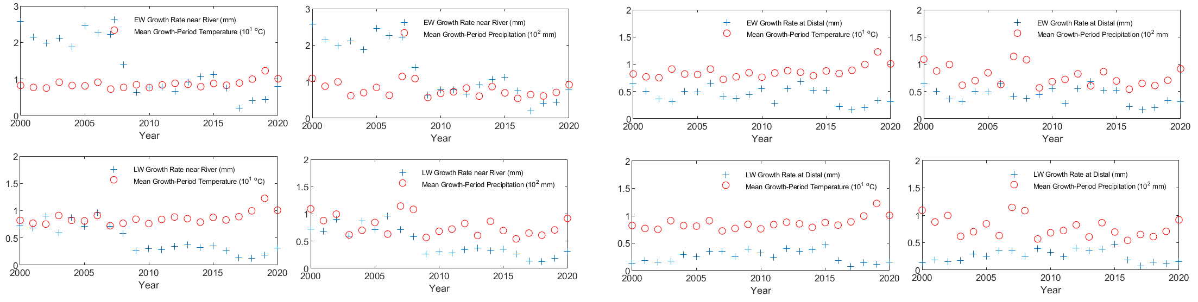
Site-1
Site-2
Key points
Negative correlation with temperature, and positive correlation with precipitation for the river trees.
Positive correlation with temperature, and Negative correlation with precipitation for the distal trees in both sites.
River Trees
Distal Trees
River Trees
Distal Trees
Temp.
Precip.
Temp.
Precip.
Temp.
Precip.
Temp.
Precip.
EW
EW
LW
LW
Results

Slide 5
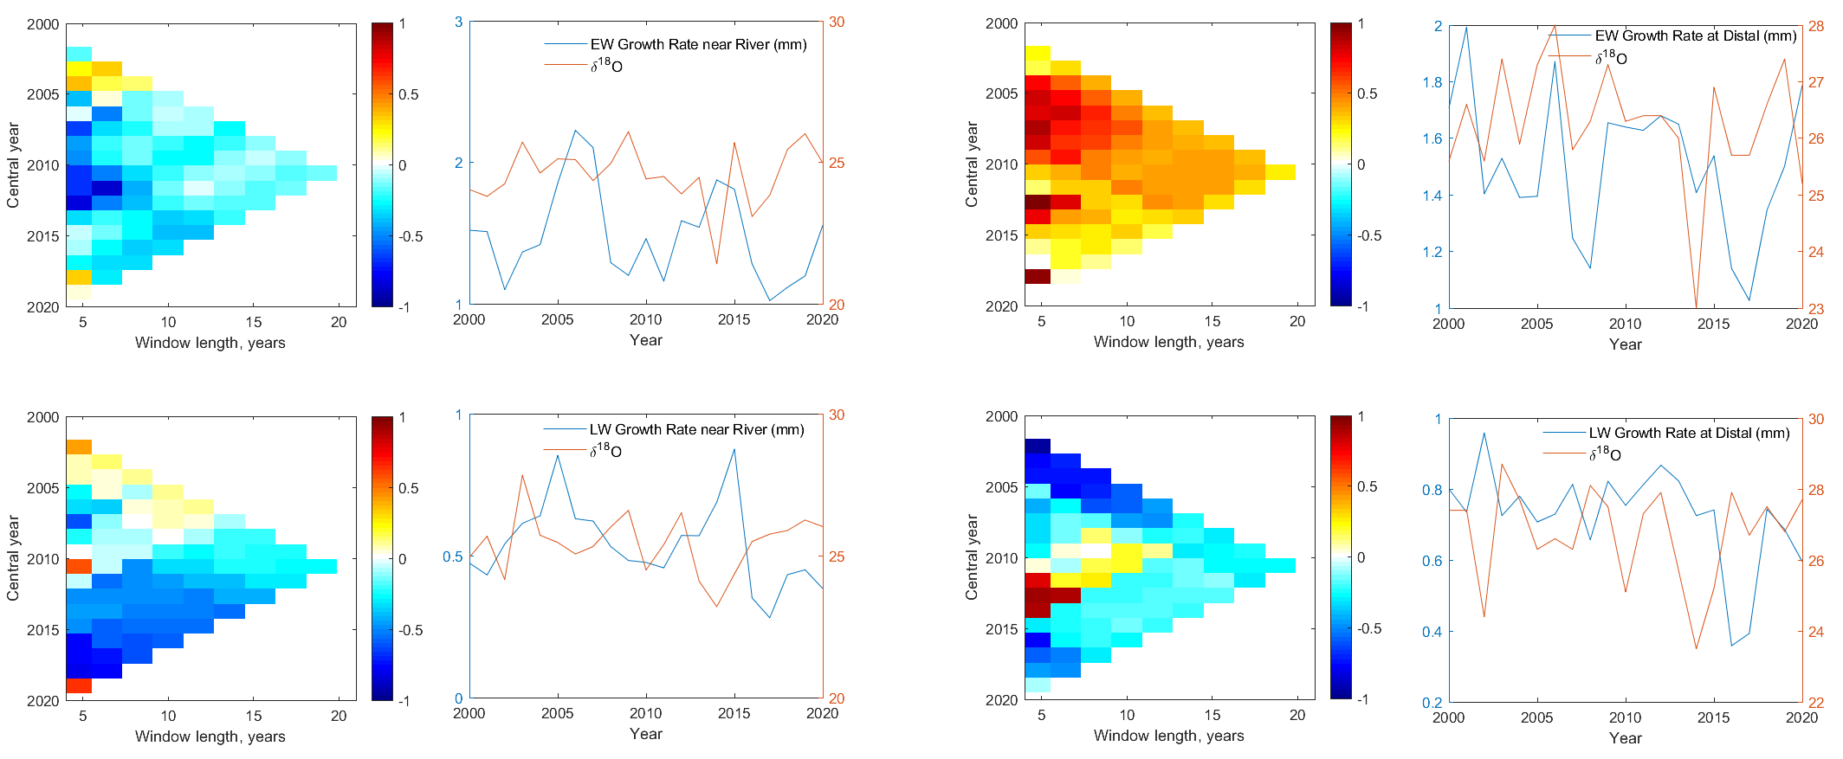
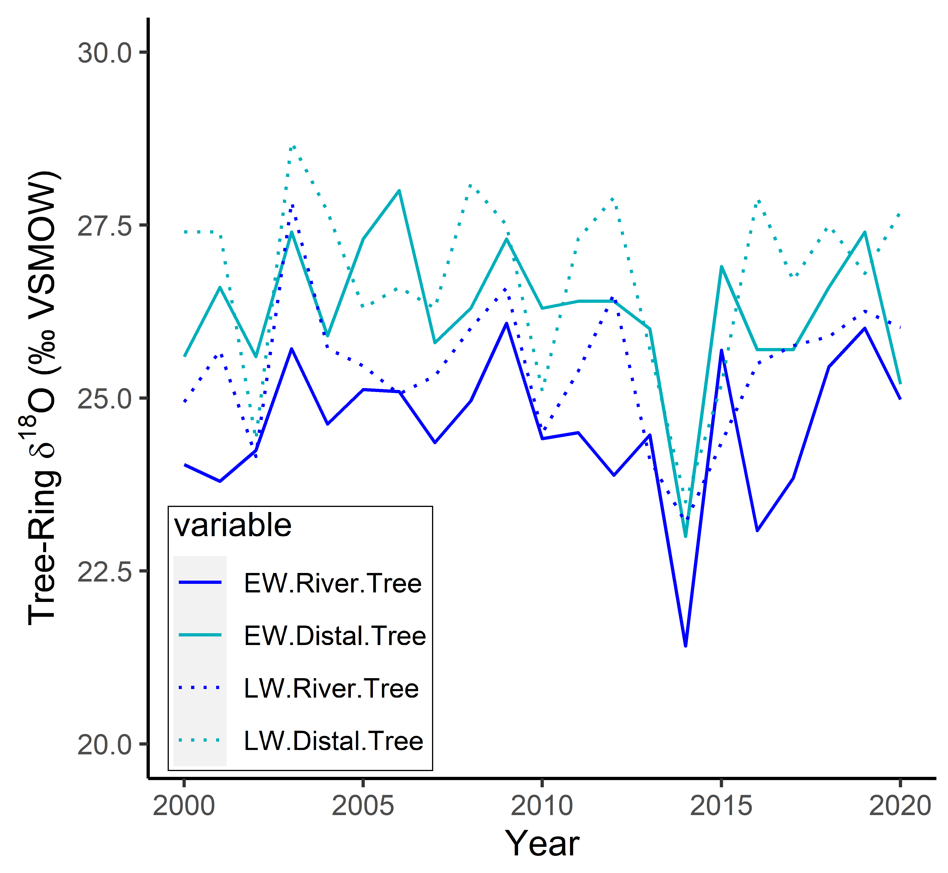
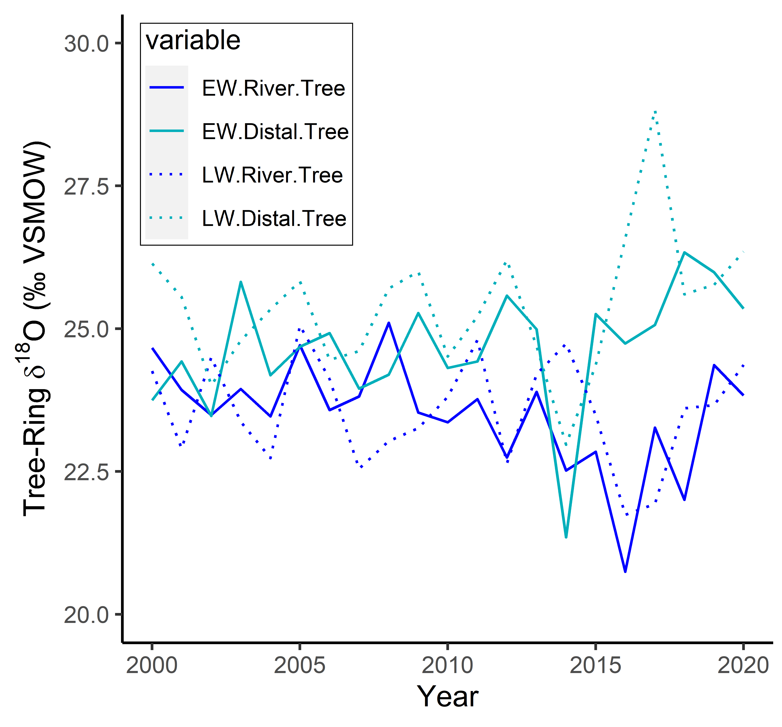
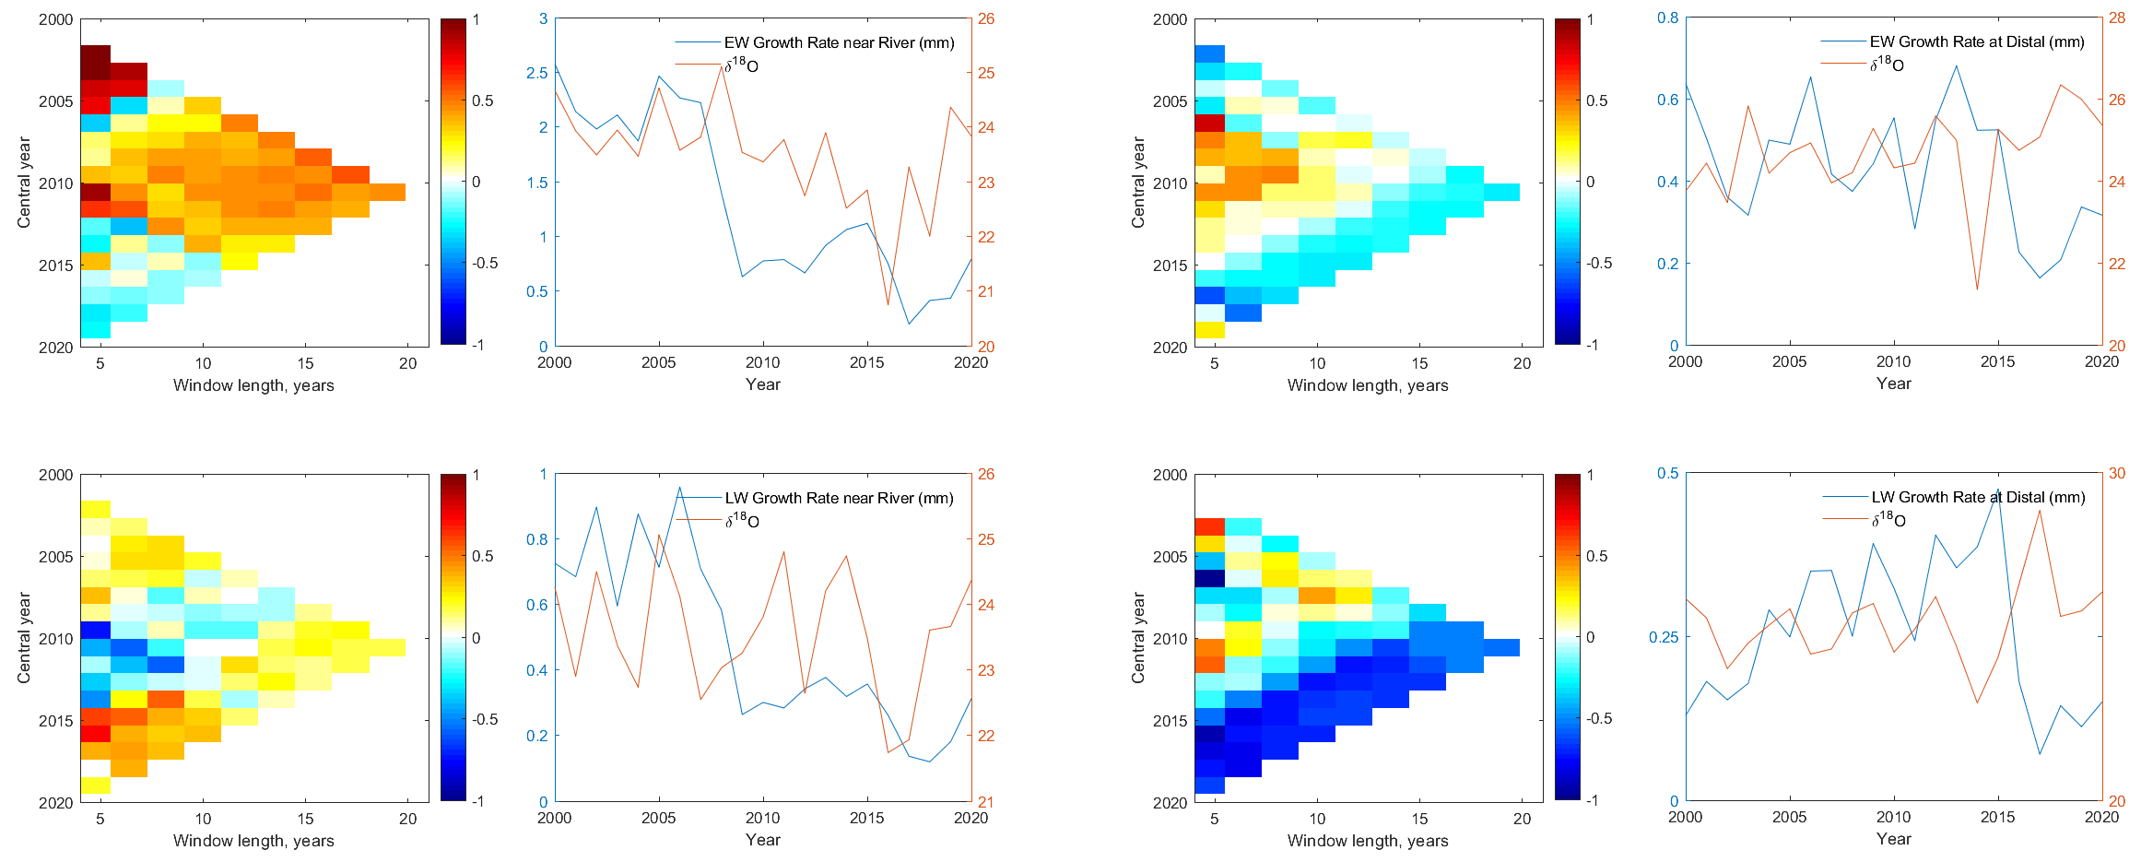
Site-1
7.73°C (i.e. 0.73°C less than last 20-years of average)
River Trees
Distal Trees
δ¹⁸O
EW
LW
Site-2
2014
EW
LW
Results

Slide 6
Growth of the trees close to the river are precipitation limited, distal from the river are temperature limited.
This basin has become drier over the last twenty years.
EW and LW rings recorded the year 2014 (one of the recent coldest years in Switzerland).
Changing climate along-with the upstream hydropower dam in site-1 and unregulated tributaries in site-2 influenced the variations of isotopic compositions in the EW and LW.
Expected downstream gradient in the depletion of δ¹⁸O in tree-ring was not seen (i.e. the hydropower dam has an impact on upstream hydrology and tree-growth in this basin).
Conclusion

Slide 7
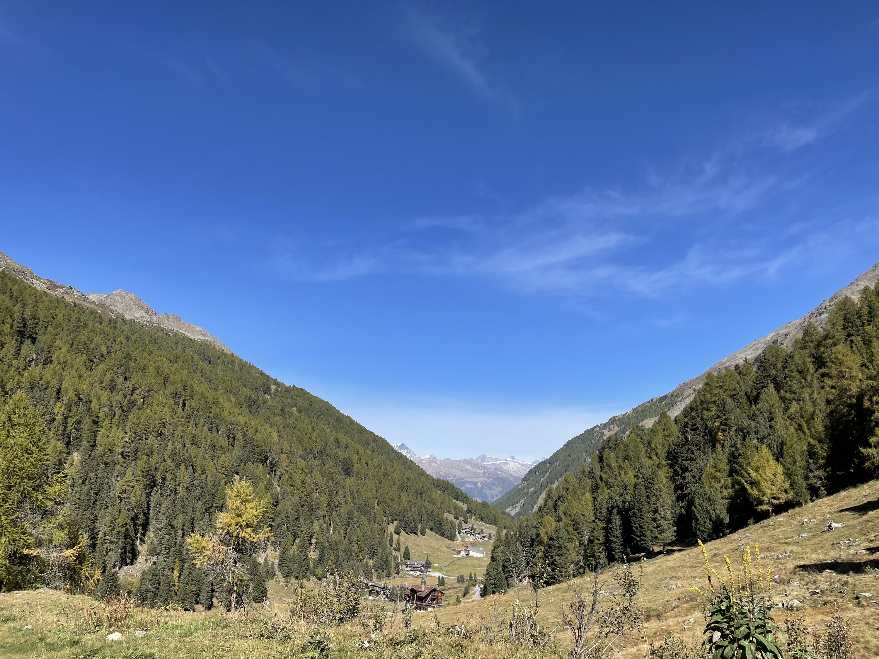
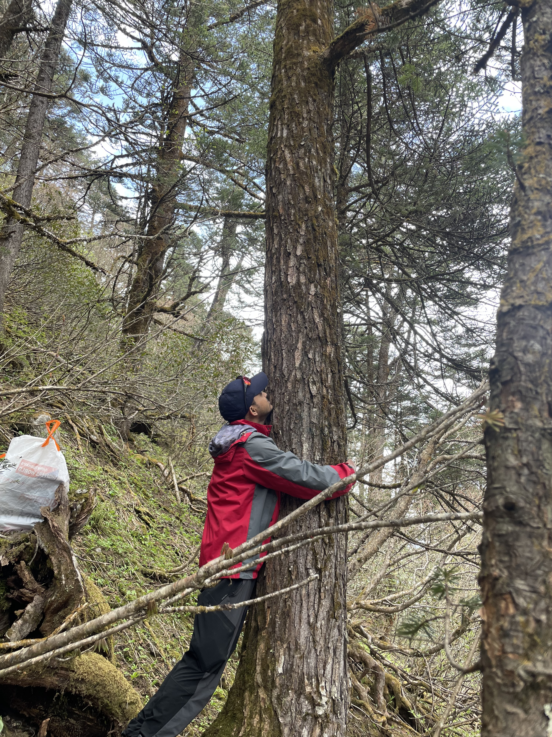



Thank You
Any Questions?
Please vote here
www.geonaz.com
✉
nazimul.islam@unil.ch
@geonaz07
AlpWISE

