Slide 1

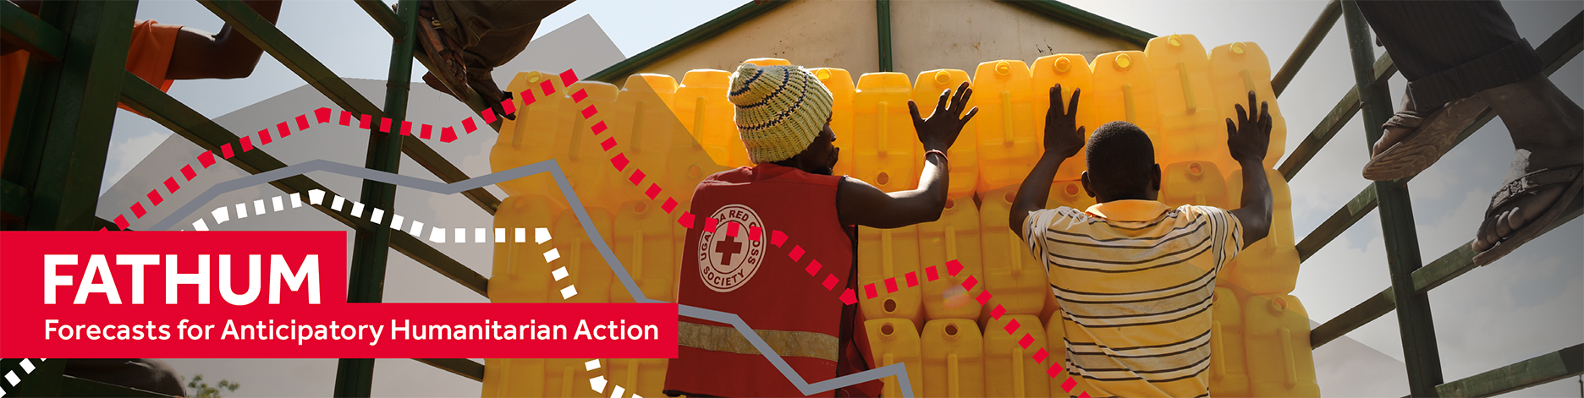
How do we ensure that the humanitarian use of forecasts is robust?
Dr Liz Stephens^{1,2}
+ Faith Mitheu, Linda Speight, Sazzad Hossain, Hannah Cloke and Stefania Giodini
1. Department of Meteorology, University of Reading, UK
2. Red Cross Red Crescent Climate Centre
elisabeth.stephens@reading.ac.uk
@liz_stephens
Notes:
Presenting on FATHUM work which has supported implementation of global flood awareness system for AA in many countries globally

Slide 2
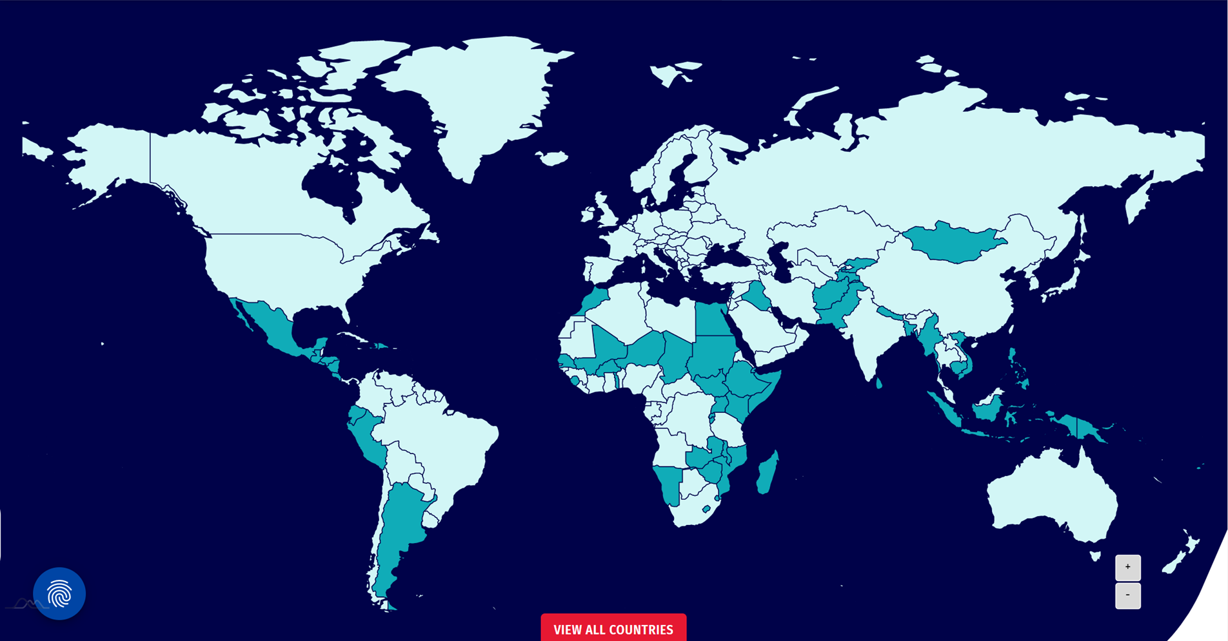
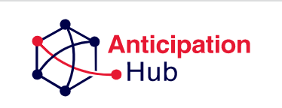
Notes:
52 countries

Slide 3
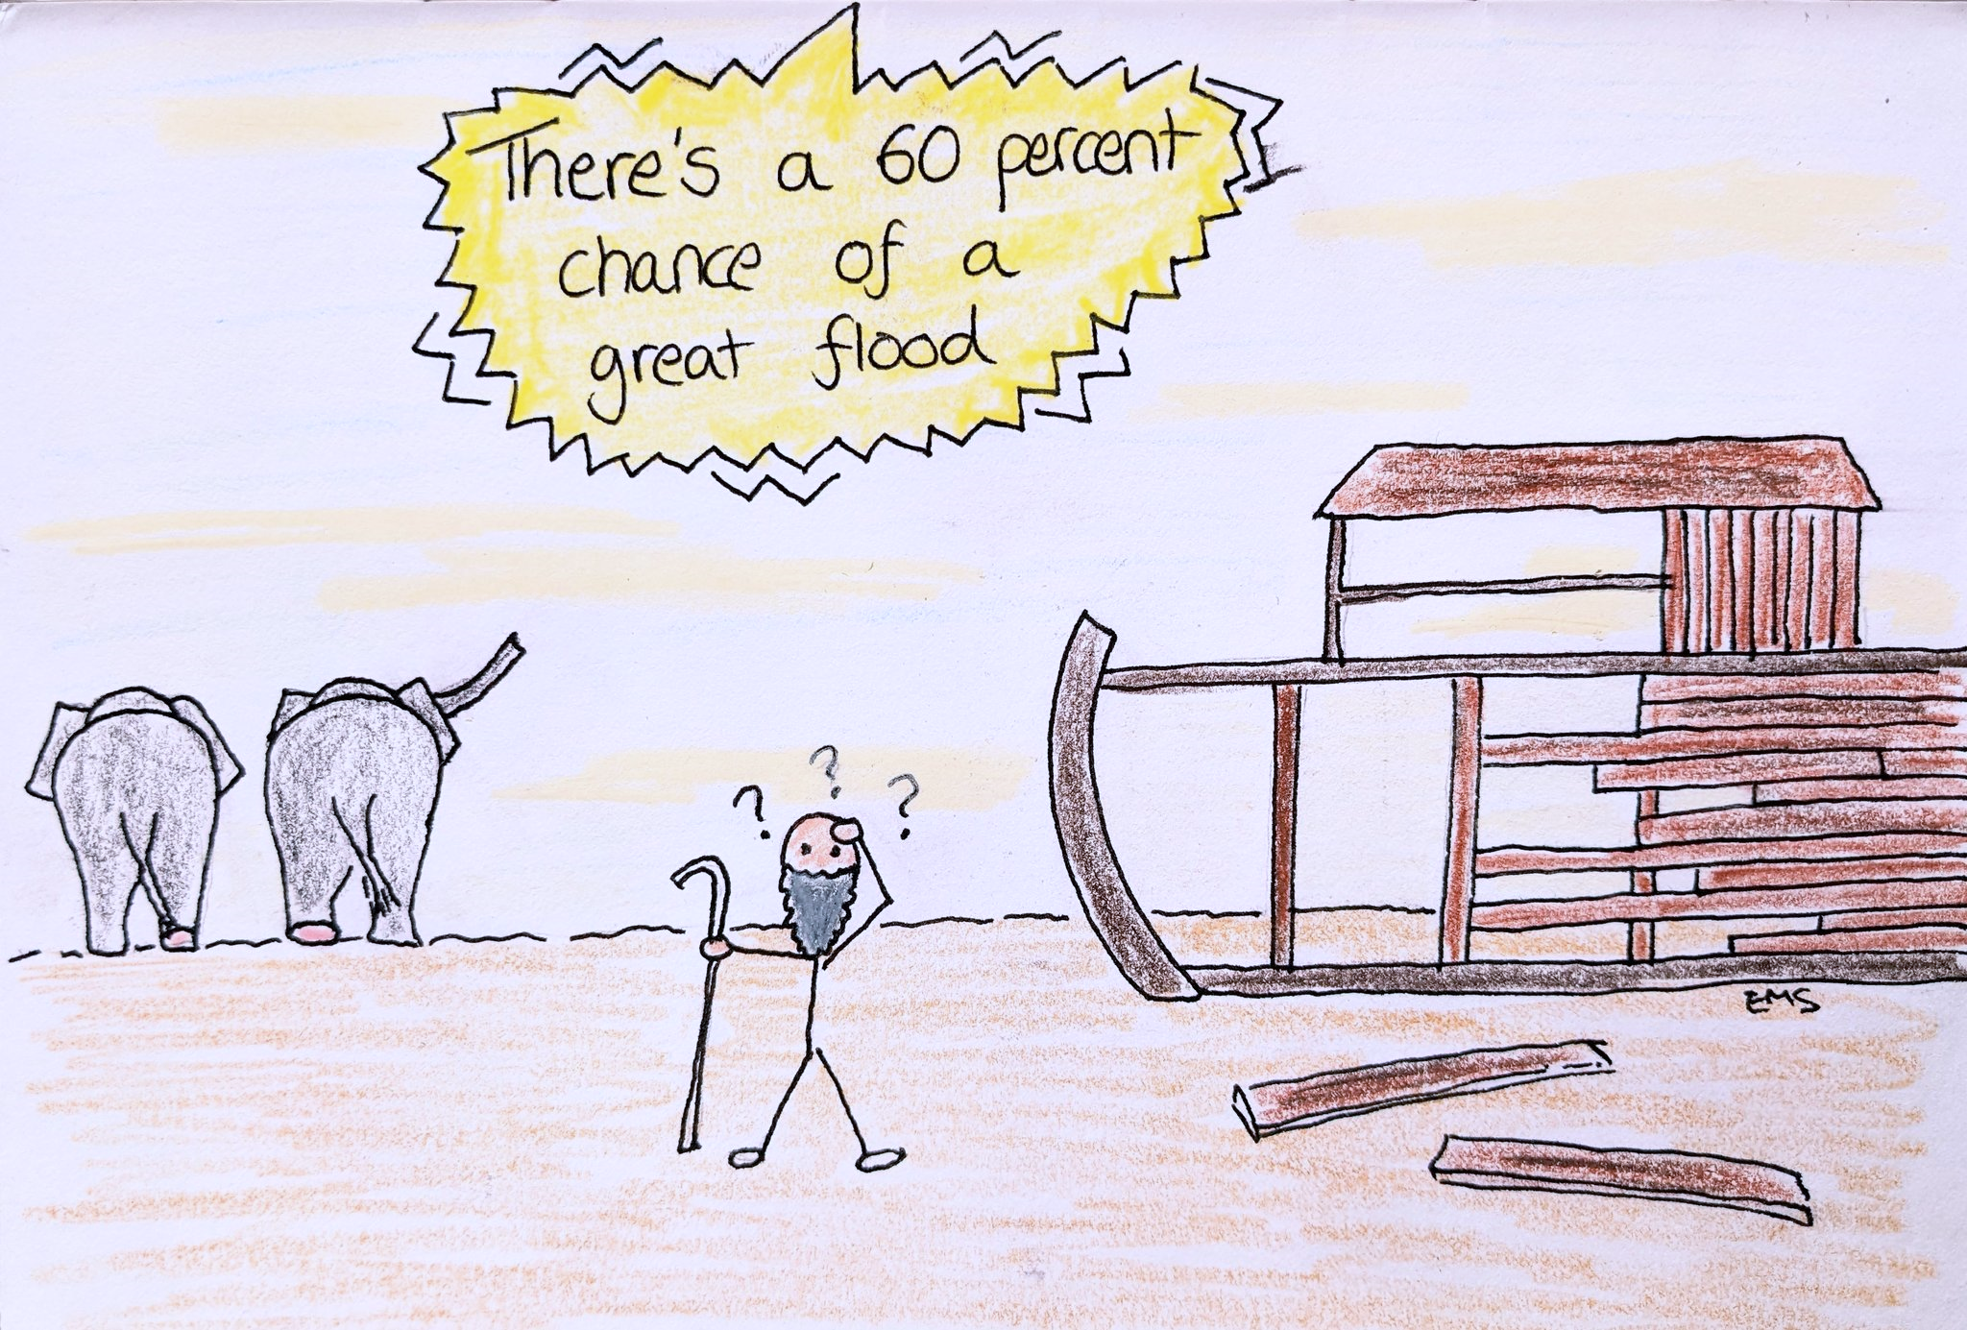
Why is robustness of forecasts important?
“Window of opportunity” for anticipatory action: overlap between time needed to take actions, and lead-time at which forecasts have skill
Limited humanitarian resources
Red Cross Red Crescent Movement: Early Action Protocols with evidence to support robustness of plans.
How to generate evidence?
  Ideal scenario: local forecasting capacity with archived forecasts and good observational data
  Realistic: This is often resource intensive; often relying on reforecast datasets from global producing centres.
Source: @AnticipationCub on Twitter
Notes:
How do we choose a forecasting system? How do we know our humanitarian decisions are robust? What existing information is out there?

Slide 4
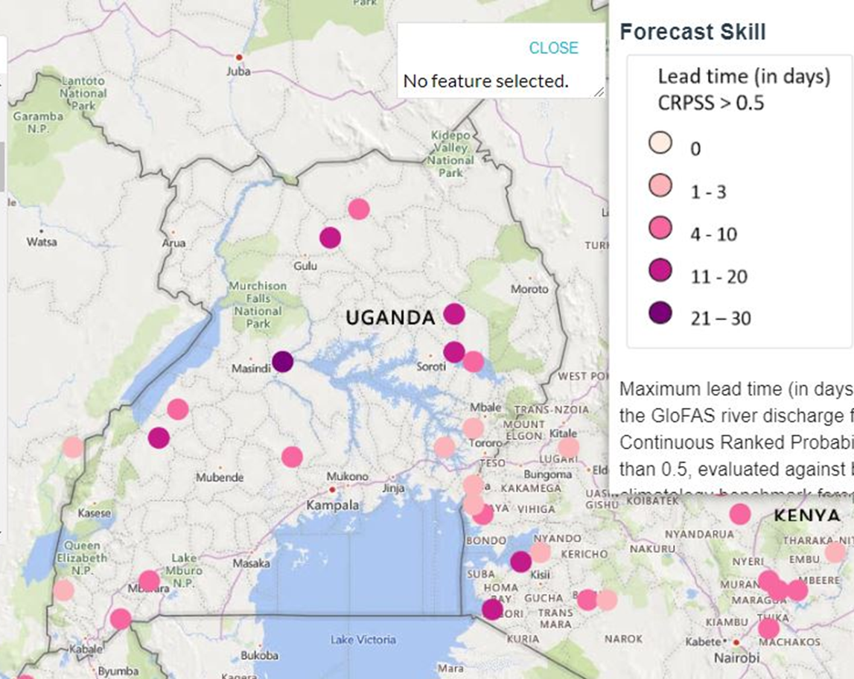
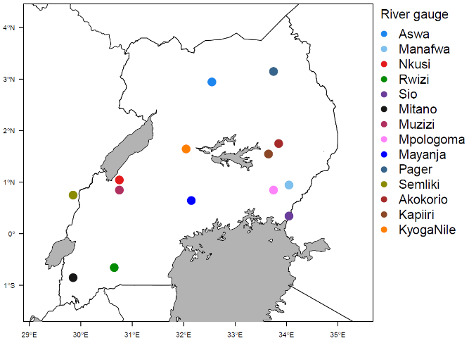
Challenge 1:
Are generic skill assessments useful?
GloFAS Web Interface Skill Assessment
GloFAS / FATHUM Decision-relevant skill assessment
Not good enough
(Thanks to Dr Andrea Ficchi, formerly University of Reading)
Notes:
Decision-blind skill guidance available on the GloFAS platform – is this any use for the decisions we are making?
Here is a comparison of the information provided within the system (on the left), [explain]
And on the right, the stations we have had to eliminate from our decision-making because the skill was not good enough (false alarm ratio greater than 0.5)

Slide 5
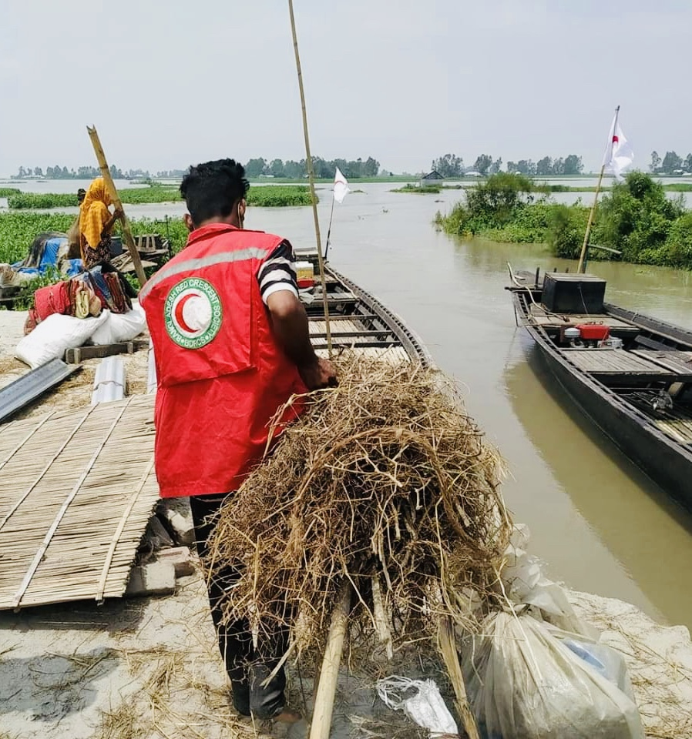
Decision-relevant evaluation
List of Decisions for the Brahmaputra River, Bangladesh
Evacuation of flood-vulnerable people to flood shelters (located in relatively higher land)
Evacuation of livestock to safe place (higher land)
Evacuation of flood-vulnerable people to flood shelter (located in low lying char Islands)
Evacuation of livestock to safe place (char Islands)
Household level preparedness (protecting household goods-wrapping and shifting to a safer place, storing dry foods, storing cooking wood)
Pre-activation trigger for aid distribution by humanitarian agencies
Communication for flood preparedness and response decisions by Government agencies such as disaster management, flood management, agriculture extension at national and sub-national levels
Agriculture (aman rice) planning decisions by farmers (seedbed preparation to transplantation in field)
(by PhD researcher Sazzad Hossain)
Source: Bangladesh Red Crescent
Notes:
What do we need to do? Map out all the decisions in detail. What are their requirements?

Slide 6
Decision-relevant criteria
Decision | Threshold (percentile) | Leadtime (days) | Acceptable delay until flood peak (days) | Acceptable False Alarm Ratio | Acceptable Probability of Detection
Evacuation of flood-vulnerable people to flood shelter (located in relatively higher land) | 99th | 3 | 2 | 0.3 | 0.6
Evacuation of livestock to safe place (relatively higher land) | 99th | 4 | 2 | 0.3 | 0.6
Evacuation of flood-vulnerable people to flood shelter (located in low lying char Islands) | 95th | 3 | 2 | 0.3 | 0.6
Evacuation of livestock to safe place (char islands) | 95th | 4 | 2 | 0.3 | 0.6
Household level preparedness (protecting household goods-wrapping and shifting to a safer place, storing dry foods, storing cooking wood) | 95th | 2 | 2 | 0.3 | 0.6
Pre-activation trigger for aid distribution by humanitarian agencies | 99th | 15 | 10 | 0.5 | 0.5
Communication for flood preparedness and response decisions of the Government agencies such as disaster management, flood management, agriculture extension at national and sub-national levels | 95th | 10 | 3 | 0.5 | 0.5
Agriculture (aman rice) planning decisions by farmers (seedbed preparation to transplantation in field) | 90th | 18 | 7 | 0.5 | 0.5
Acceptability Criteria
(by PhD researcher Sazzad Hossain)
Notes:
We can also consider what is acceptable in terms of the skill (explain why some have stricter requirements than others). Link to the actions being taken.
Accepetability criteria often give more room for the model to be acceptably–wrong!

Slide 7
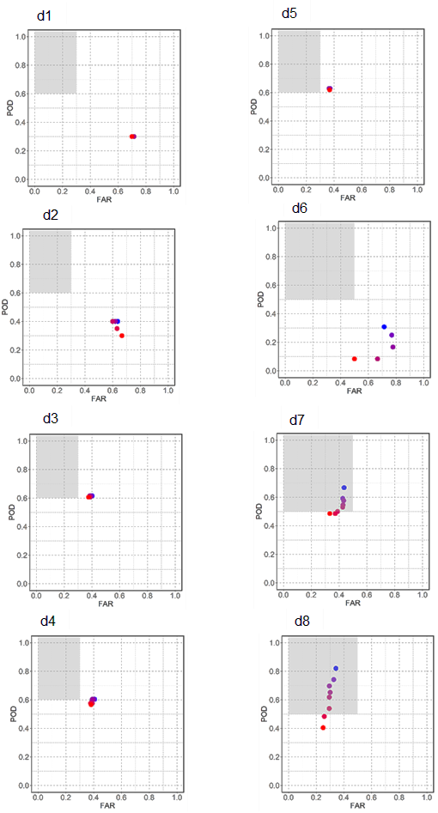
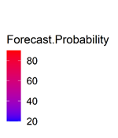
Decision-relevant criteria
☺
X
Evacuation of flood-vulnerable people to flood shelters
(low lying Char Island), 4 days ahead
Communication for flood preparedness and response decisions, 10 days ahead
(by PhD researcher Sazzad Hossain)
Notes:
We can also consider what is acceptable in terms of the skill (explain why some have stricter requirements than others). Link to the actions being taken.

Slide 8
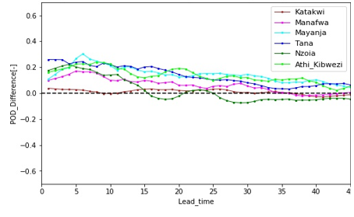
Challenge 2:
What to do in data poor settings?
If there’s no river gauge data, can we assess forecast skill using impact datasets? (e.g. EMDAT, DesInventar)
Skill assessment for some Kenyan / Ugandan rivers was re-run using impact observations rather than river gauge data
Plot on right:
  positive values when POD_gauged>POD_impact
  negative values when POD_gauged<POD_impact
Difference in Probability of Detection in GloFAS when using gauged data compared to impacts databases. (Difference = Score_gauged – Score_impact)
(By PhD researcher Faith Mitheu)
Notes:
There are also other considerations, like developing capacity and ensuring sustainability

Slide 9
Use of impact datasets for forecast evaluation
For these rivers, POD is assessed as lower when using impact datasets.
i.e. GloFAS captures fewer flood events
Reason – impact datasets are often regional; possibly floods in impact data are not river floods
If we only used impact data, we might end up 'throwing out' a forecast that is actually good enough.
However, there are not massive differences, which suggests we can proceed with caution
Difference in Probability of Detection in GloFAS when using gauged data compared to impacts databases. (Difference = Score_gauged – Score_impact)
(By PhD researcher Faith Mitheu)
Notes:
There are also other considerations, like developing capacity and ensuring sustainability

Slide 10
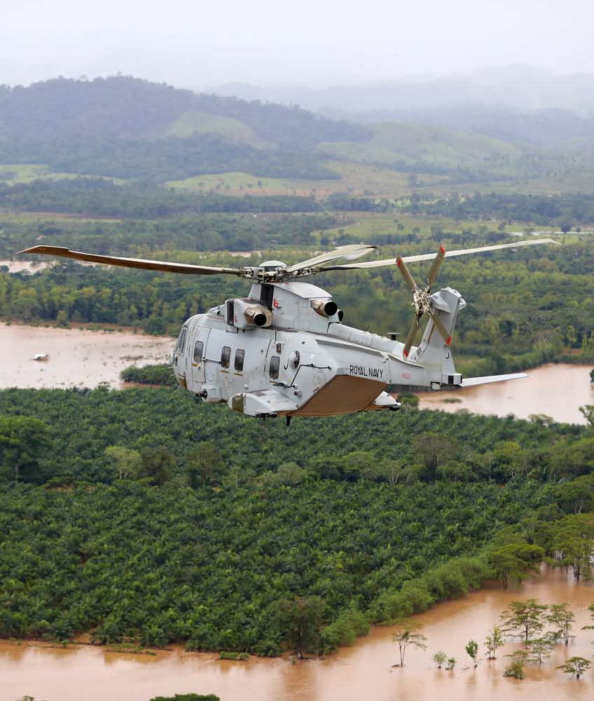
Challenge 3:
Can we use unverified models
in times of imminent crisis?
Using experience of producing Flood Forecast Bulletins for UK Foreign, Commonwealth and Development Office (e.g. for TC Idai 2019, Hurricane Iota 2020, Batsirai, 2022)
Frequently required to give expert assessment of locations where no other forecasts are available
Advantage of GloFAS approach is that knowing the model climatology helps us know when something is extreme
Careful use of terminology and phrasing as well as contextual information can help us navigate the uncertainty
Source: Royal Navy
Notes:
How to use GloFAS when unverified

Slide 11
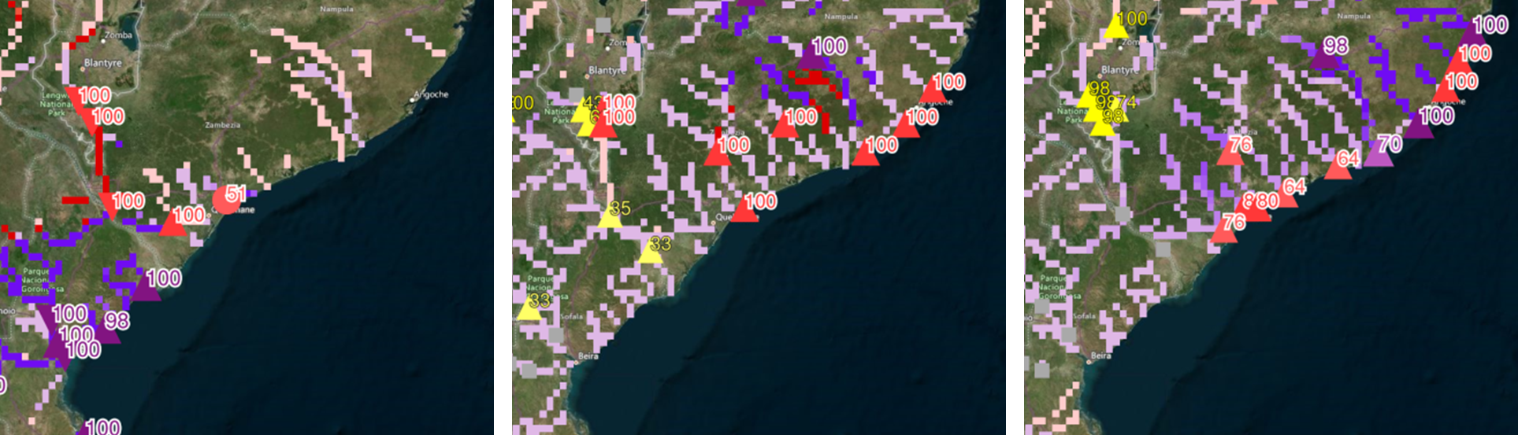
Use of contextual information
GloFAS forecasts for
TC Idai, 2019
GloFAS forecasts for
TC Ana, 2022
GloFAS forecasts for
TC Gombe, 2022
Notes:
How to use GloFAS when unverified

Slide 12
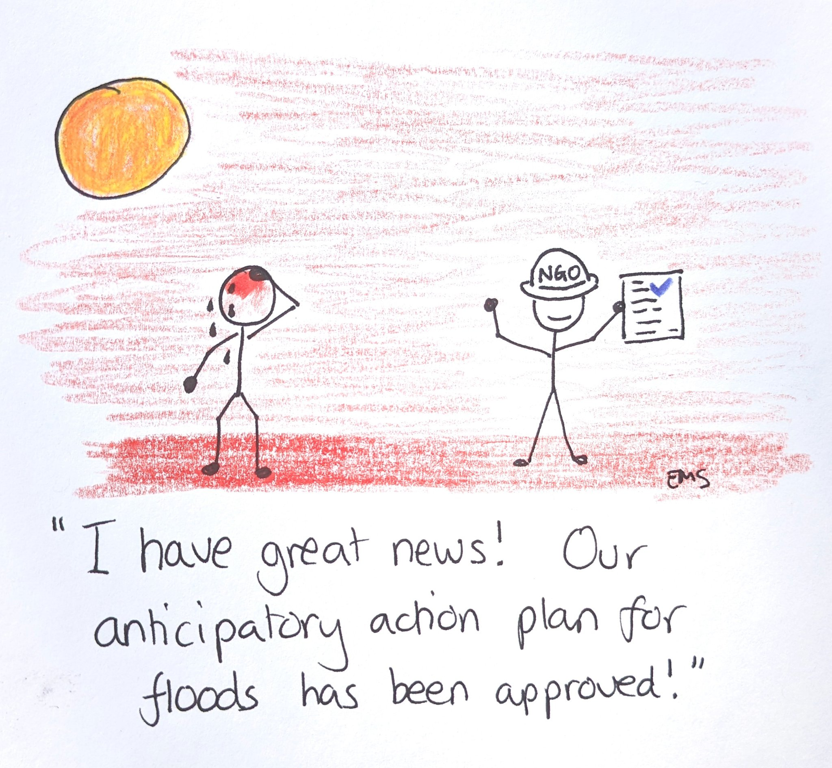
In Summary
When considering robustness of forecast:
Any off-the-shelf assessment of forecast skill is unlikely to provide something useable for our decisions
The decision-making context is important, not just to lead-times and thresholds, but also the criteria for forecast skill
Impact databases may be helpful in data-poor settings – but use with caution
Sometimes unverified models may need to be used, contextual information and careful use of language is key
This definitely applies beyond floods!
Thank you!
Source: @AnticipationCub on Twitter
Notes:
There are also other considerations, like developing capacity and ensuring sustainability

