Slide 1
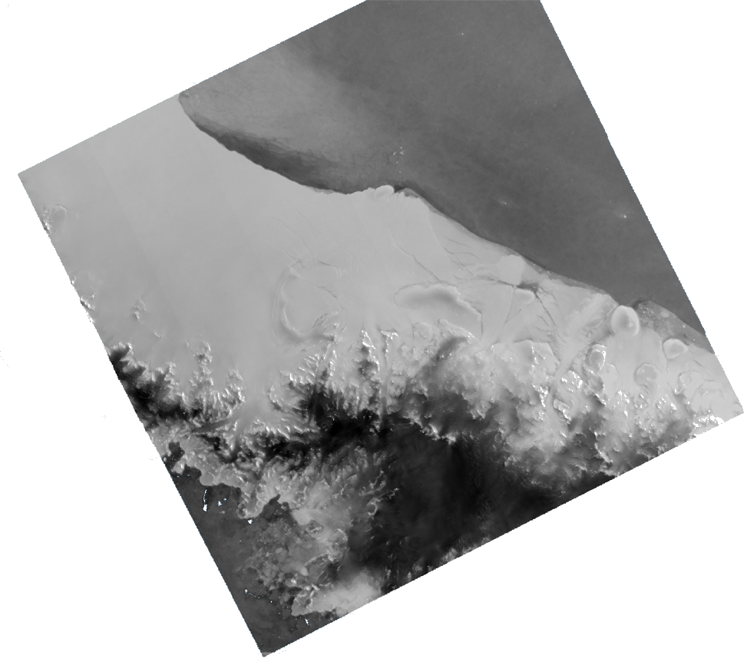






Assimilation of Surface Melt Extent Estimated by Microwave Satellite Into the Regional Climate Model MAR
Case Study over the Antarctic Peninsula
Thomas DETHINNE, Christoph KITTEL,
Quentin GLAUDE, Xavier FETTWEIS & Anne ORBAN

Slide 2
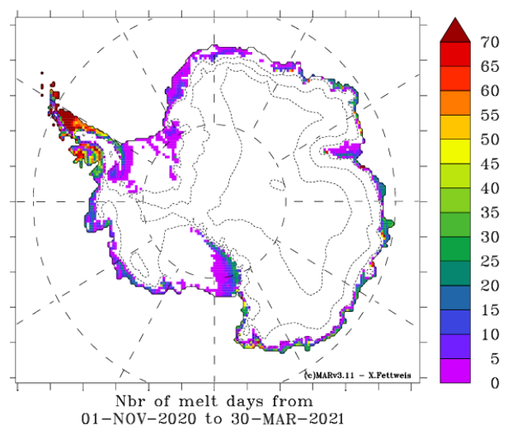
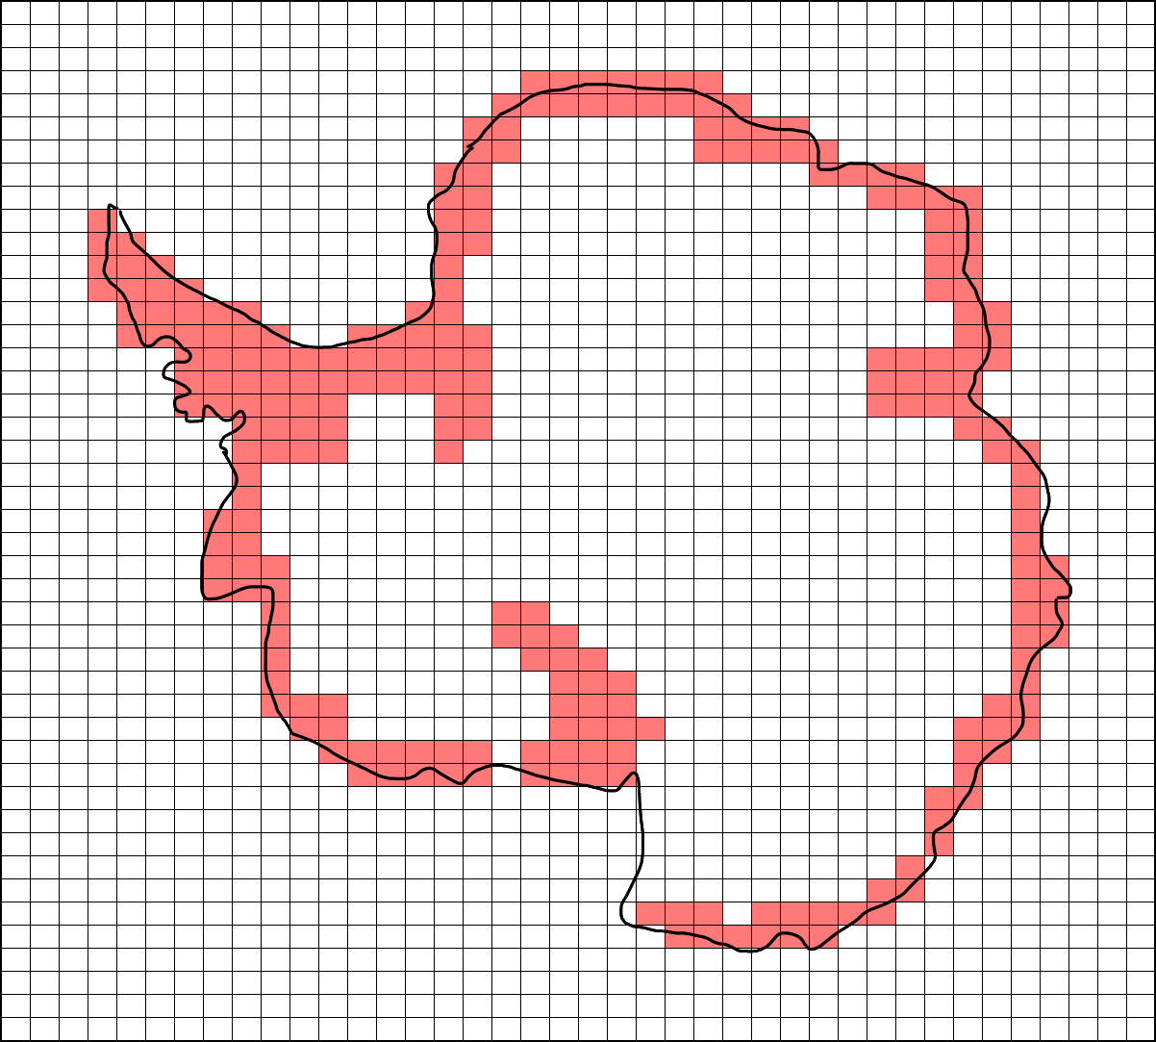




Introduction
Introduction
(Regional Climate Model)
Sets of equations
Uncertainties quantification
+
Better quantification of surface melt
Global Circulation Model
Data
Assimilation
Discussion
(RCM + Assimilation)

Slide 3
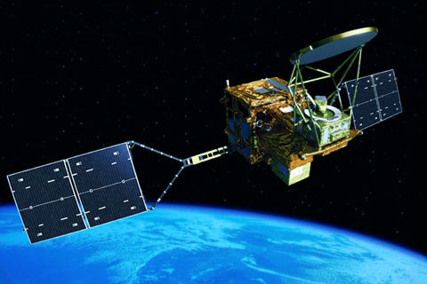
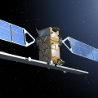
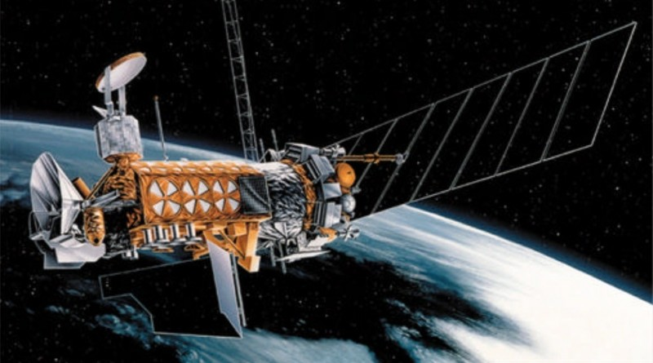



Satellites Used
Microwave Satellites (>GHz)
Capacity to spot the presence of water in the snowpack
Introduction
Passive
Active
AMSR2
GCOM (JAXA)
C-SAR
Data
18,7 GHz → 10km
SENTINEL-1 (COPERNICUS)
5,4 GHz →‘’10’’m (1km)
SSMIS
Assimilation
F-17, F-18 (US Air Force)
19,35 GHz → 25km
Discussion

Slide 4
Assimilation
≈ Forcing by matching the state of liquid water
Introduction
Satellite = MAR ?
Yes
No
Do nothing
Cond. fulfilled ?
Data
Change snowpack T°
Do nothing
Assimilation
Discussion

Slide 5
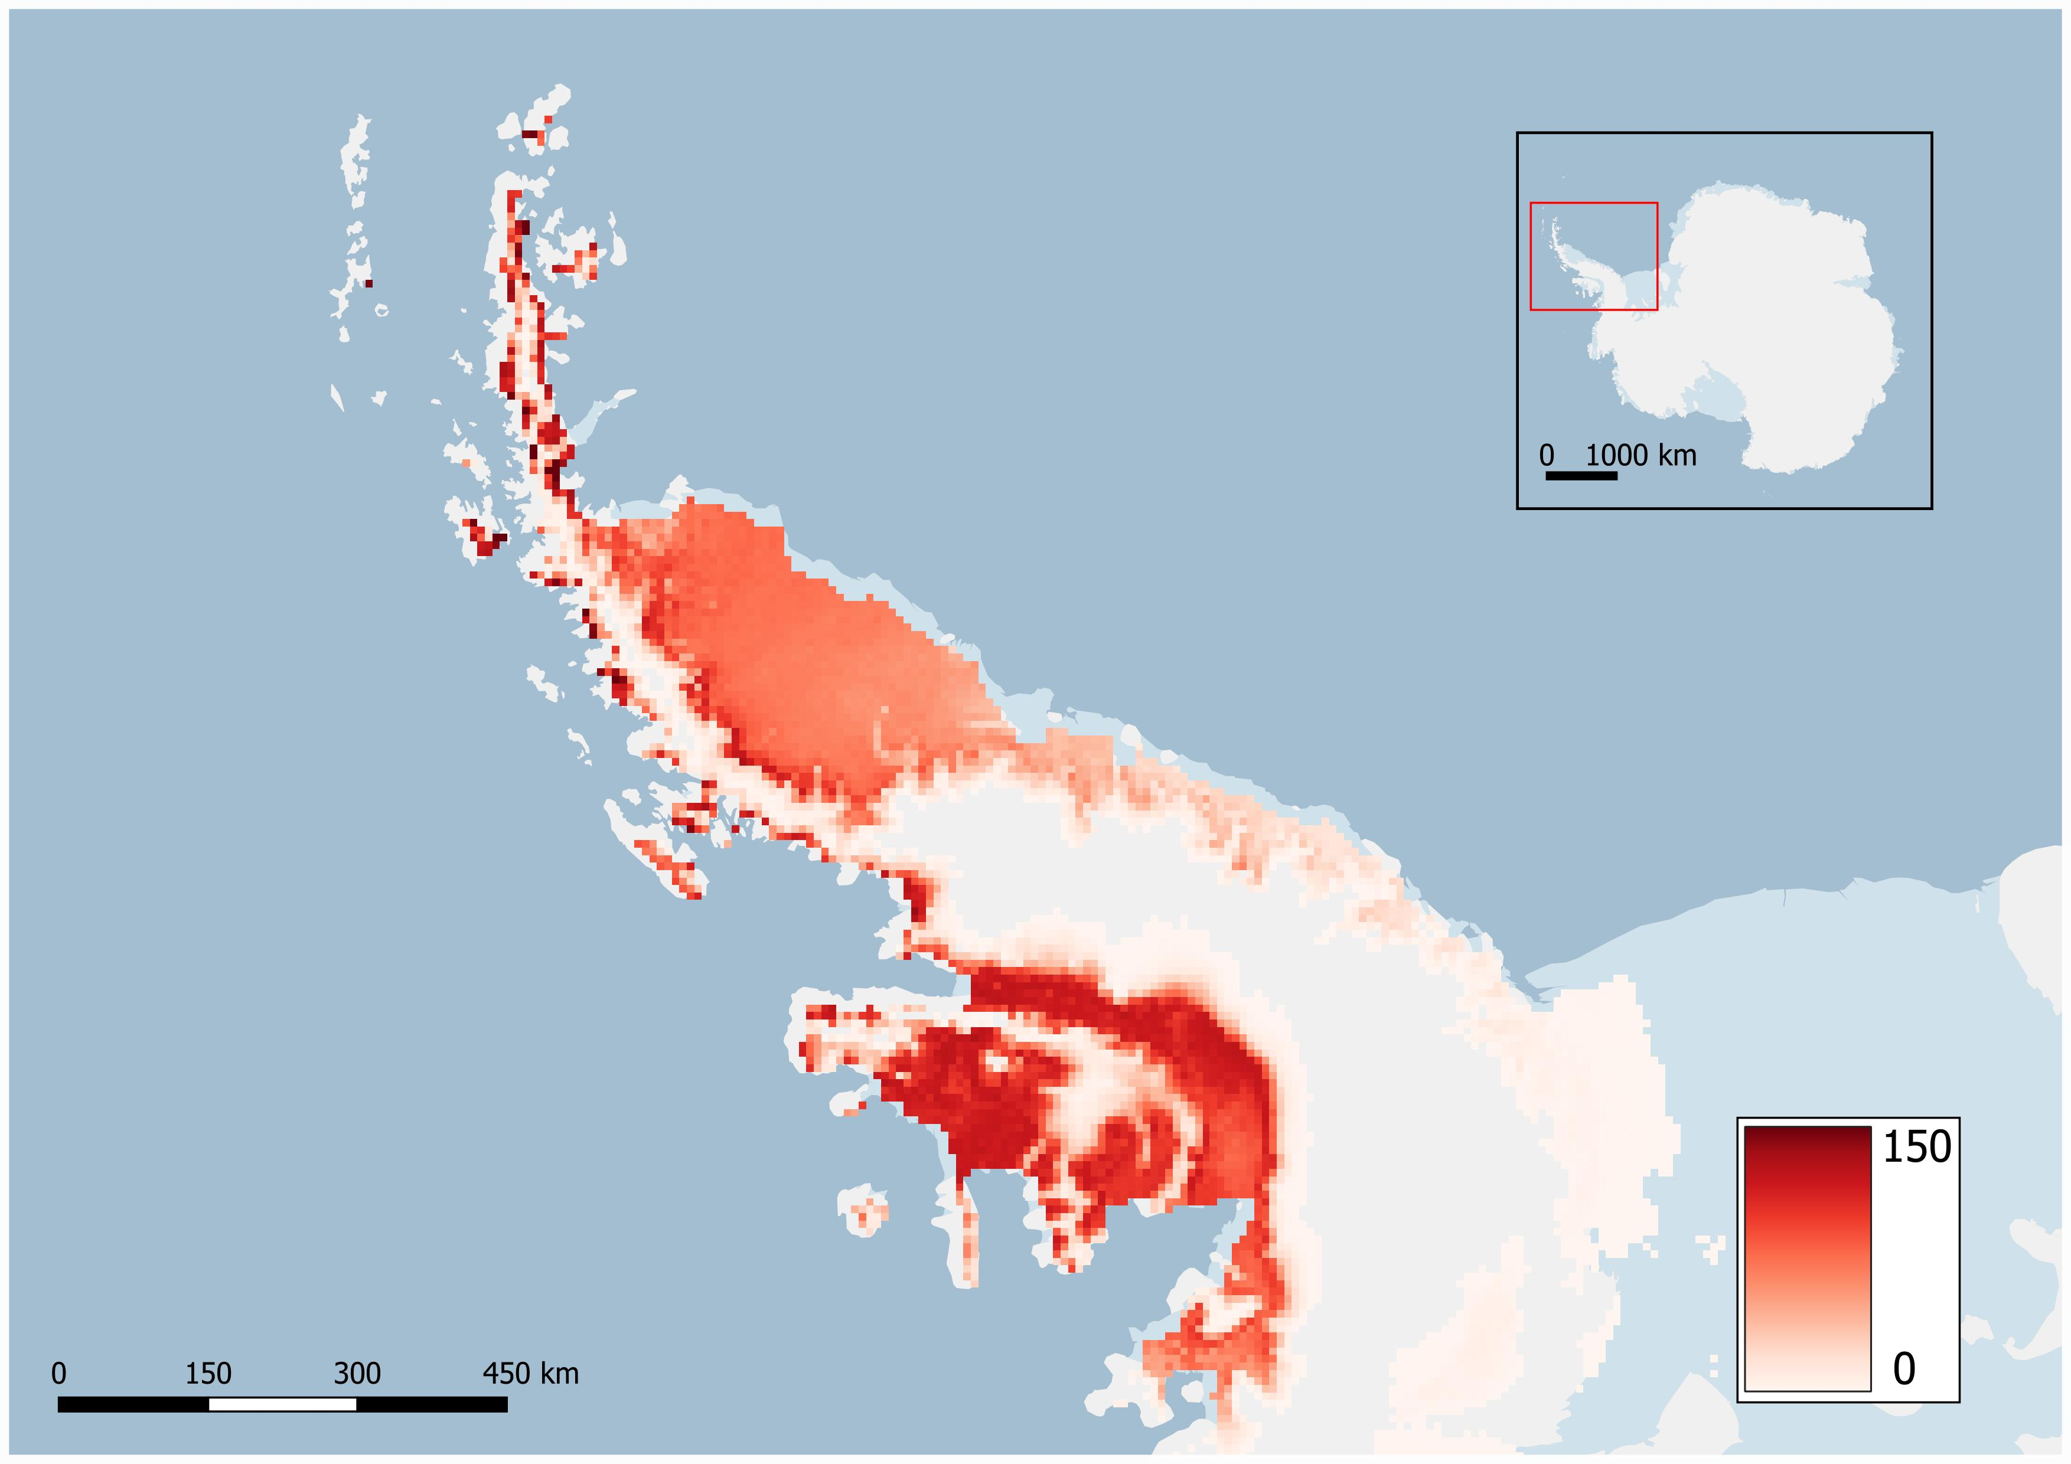
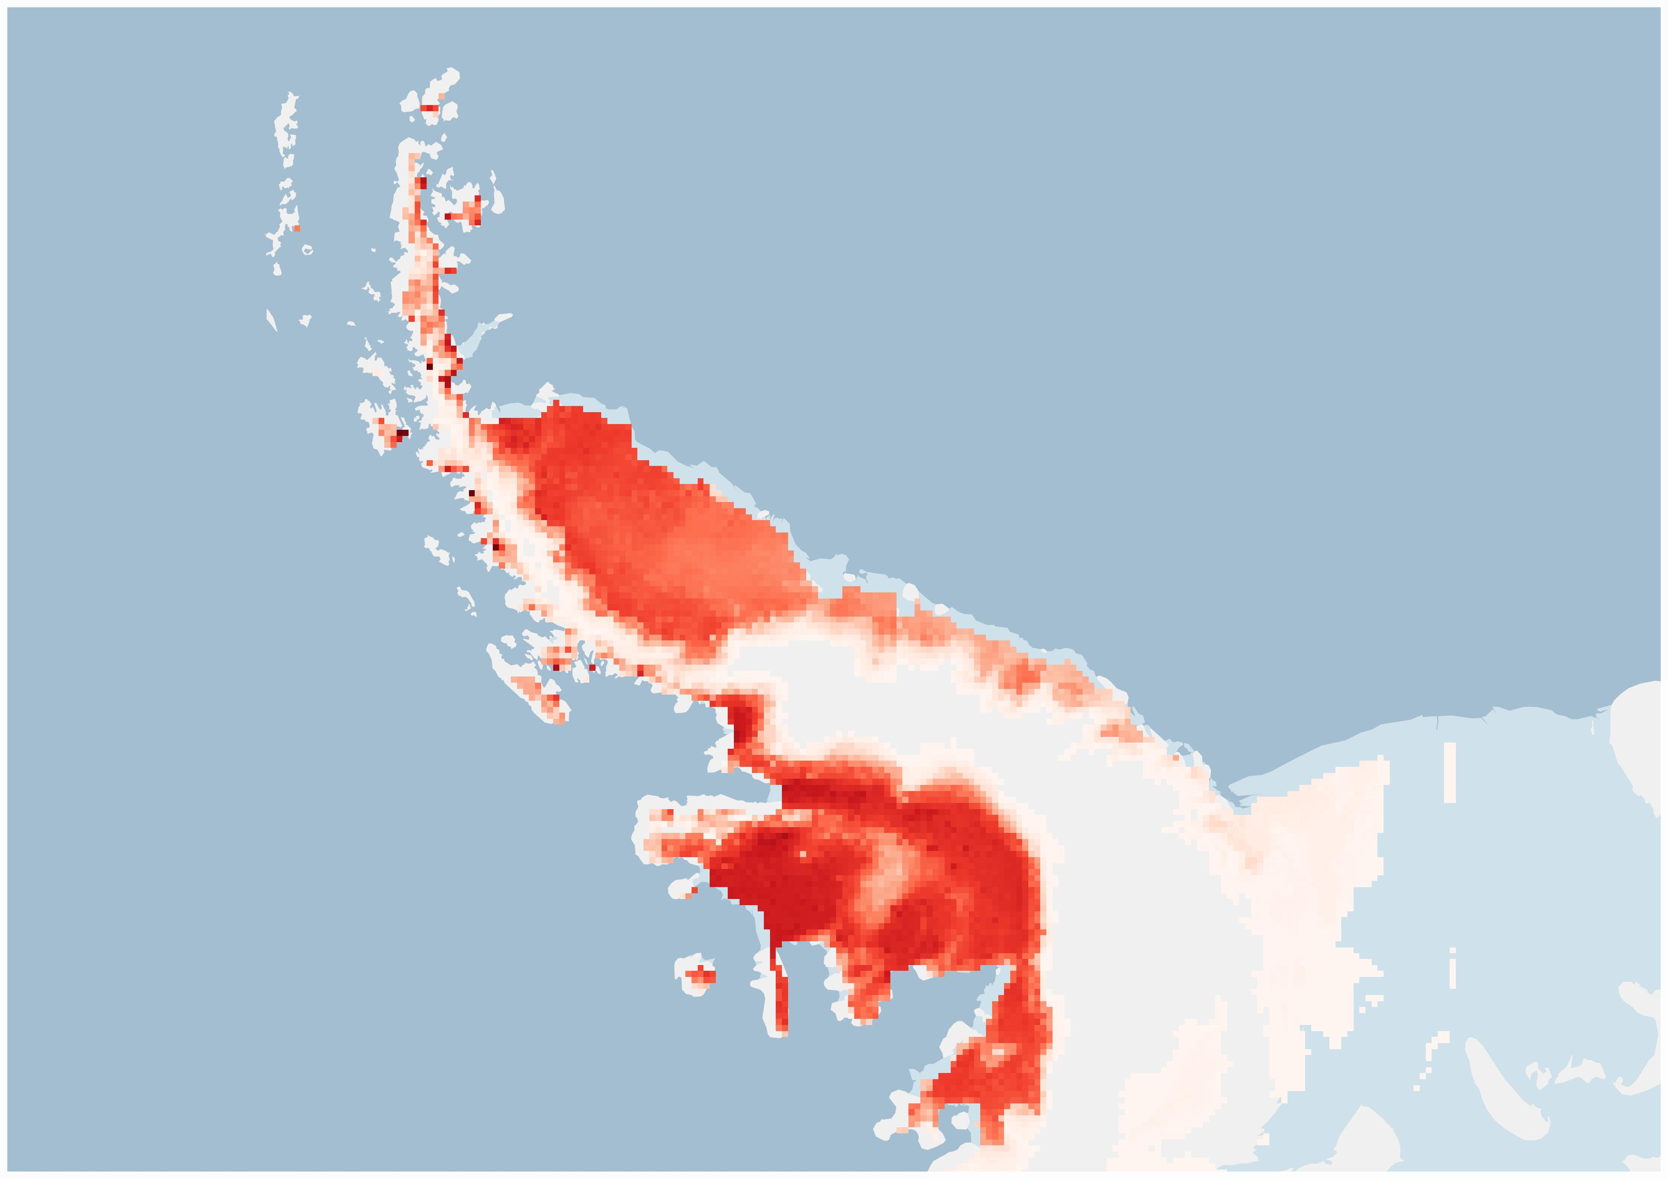
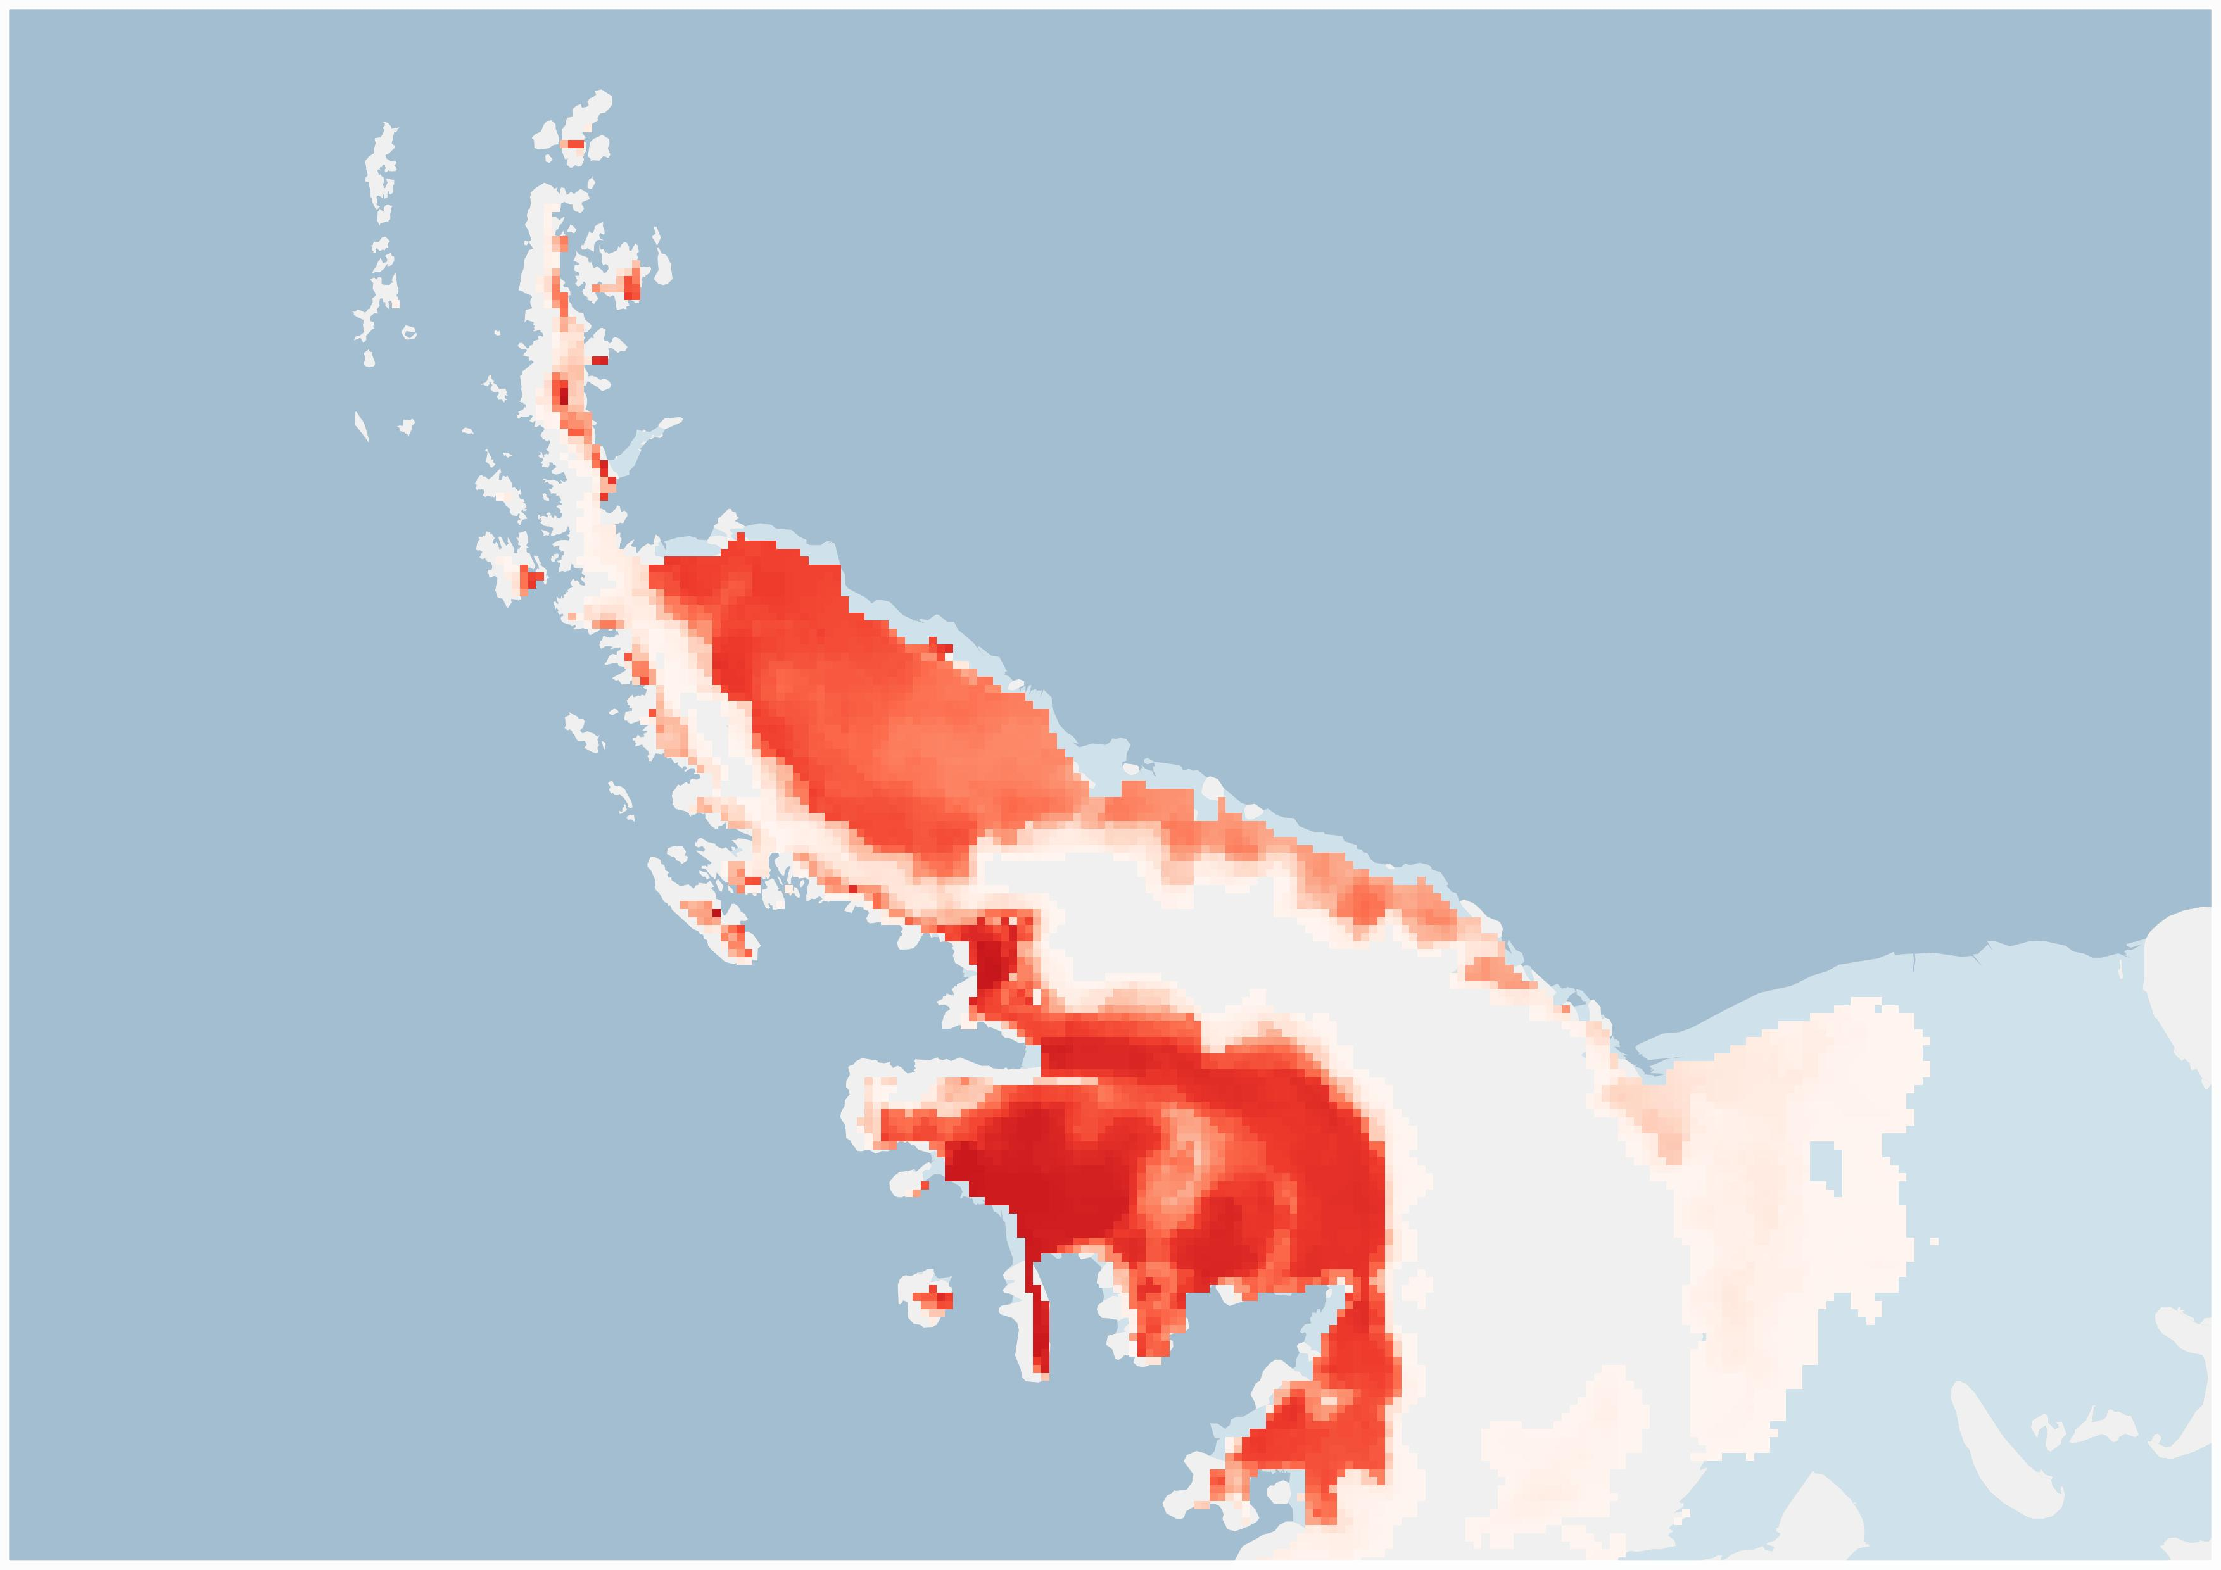
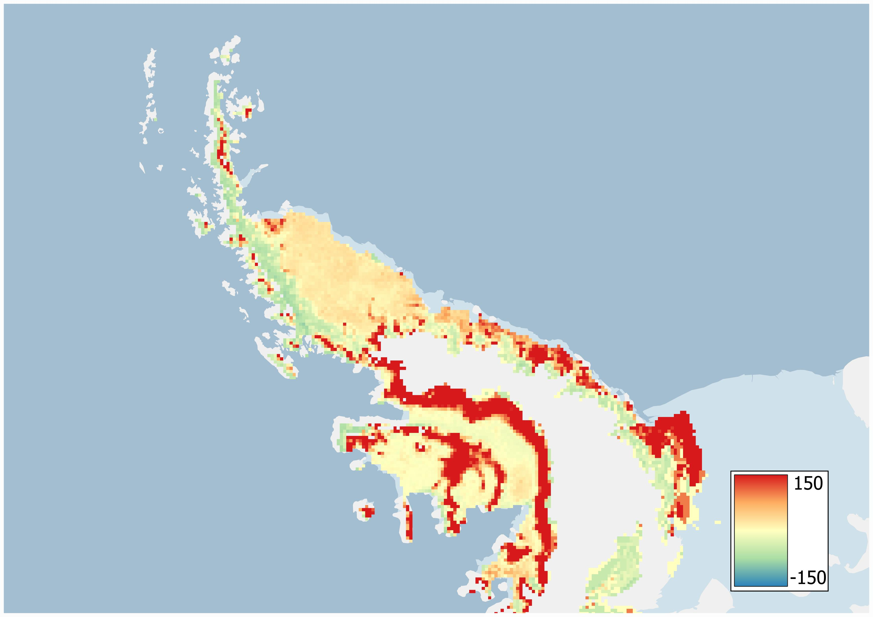
Number of days of melt between the 1/10/2019 and the 30/04/2020
Introduction
MAR
MAR + AMSR2
Data
Assimilation
Differences
(% Melt Days)
AMSR2
Discussion
Basemap : Quantarctica3
[Matsuoka et al., 2021]

Slide 6
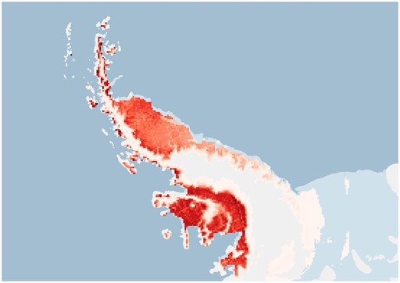
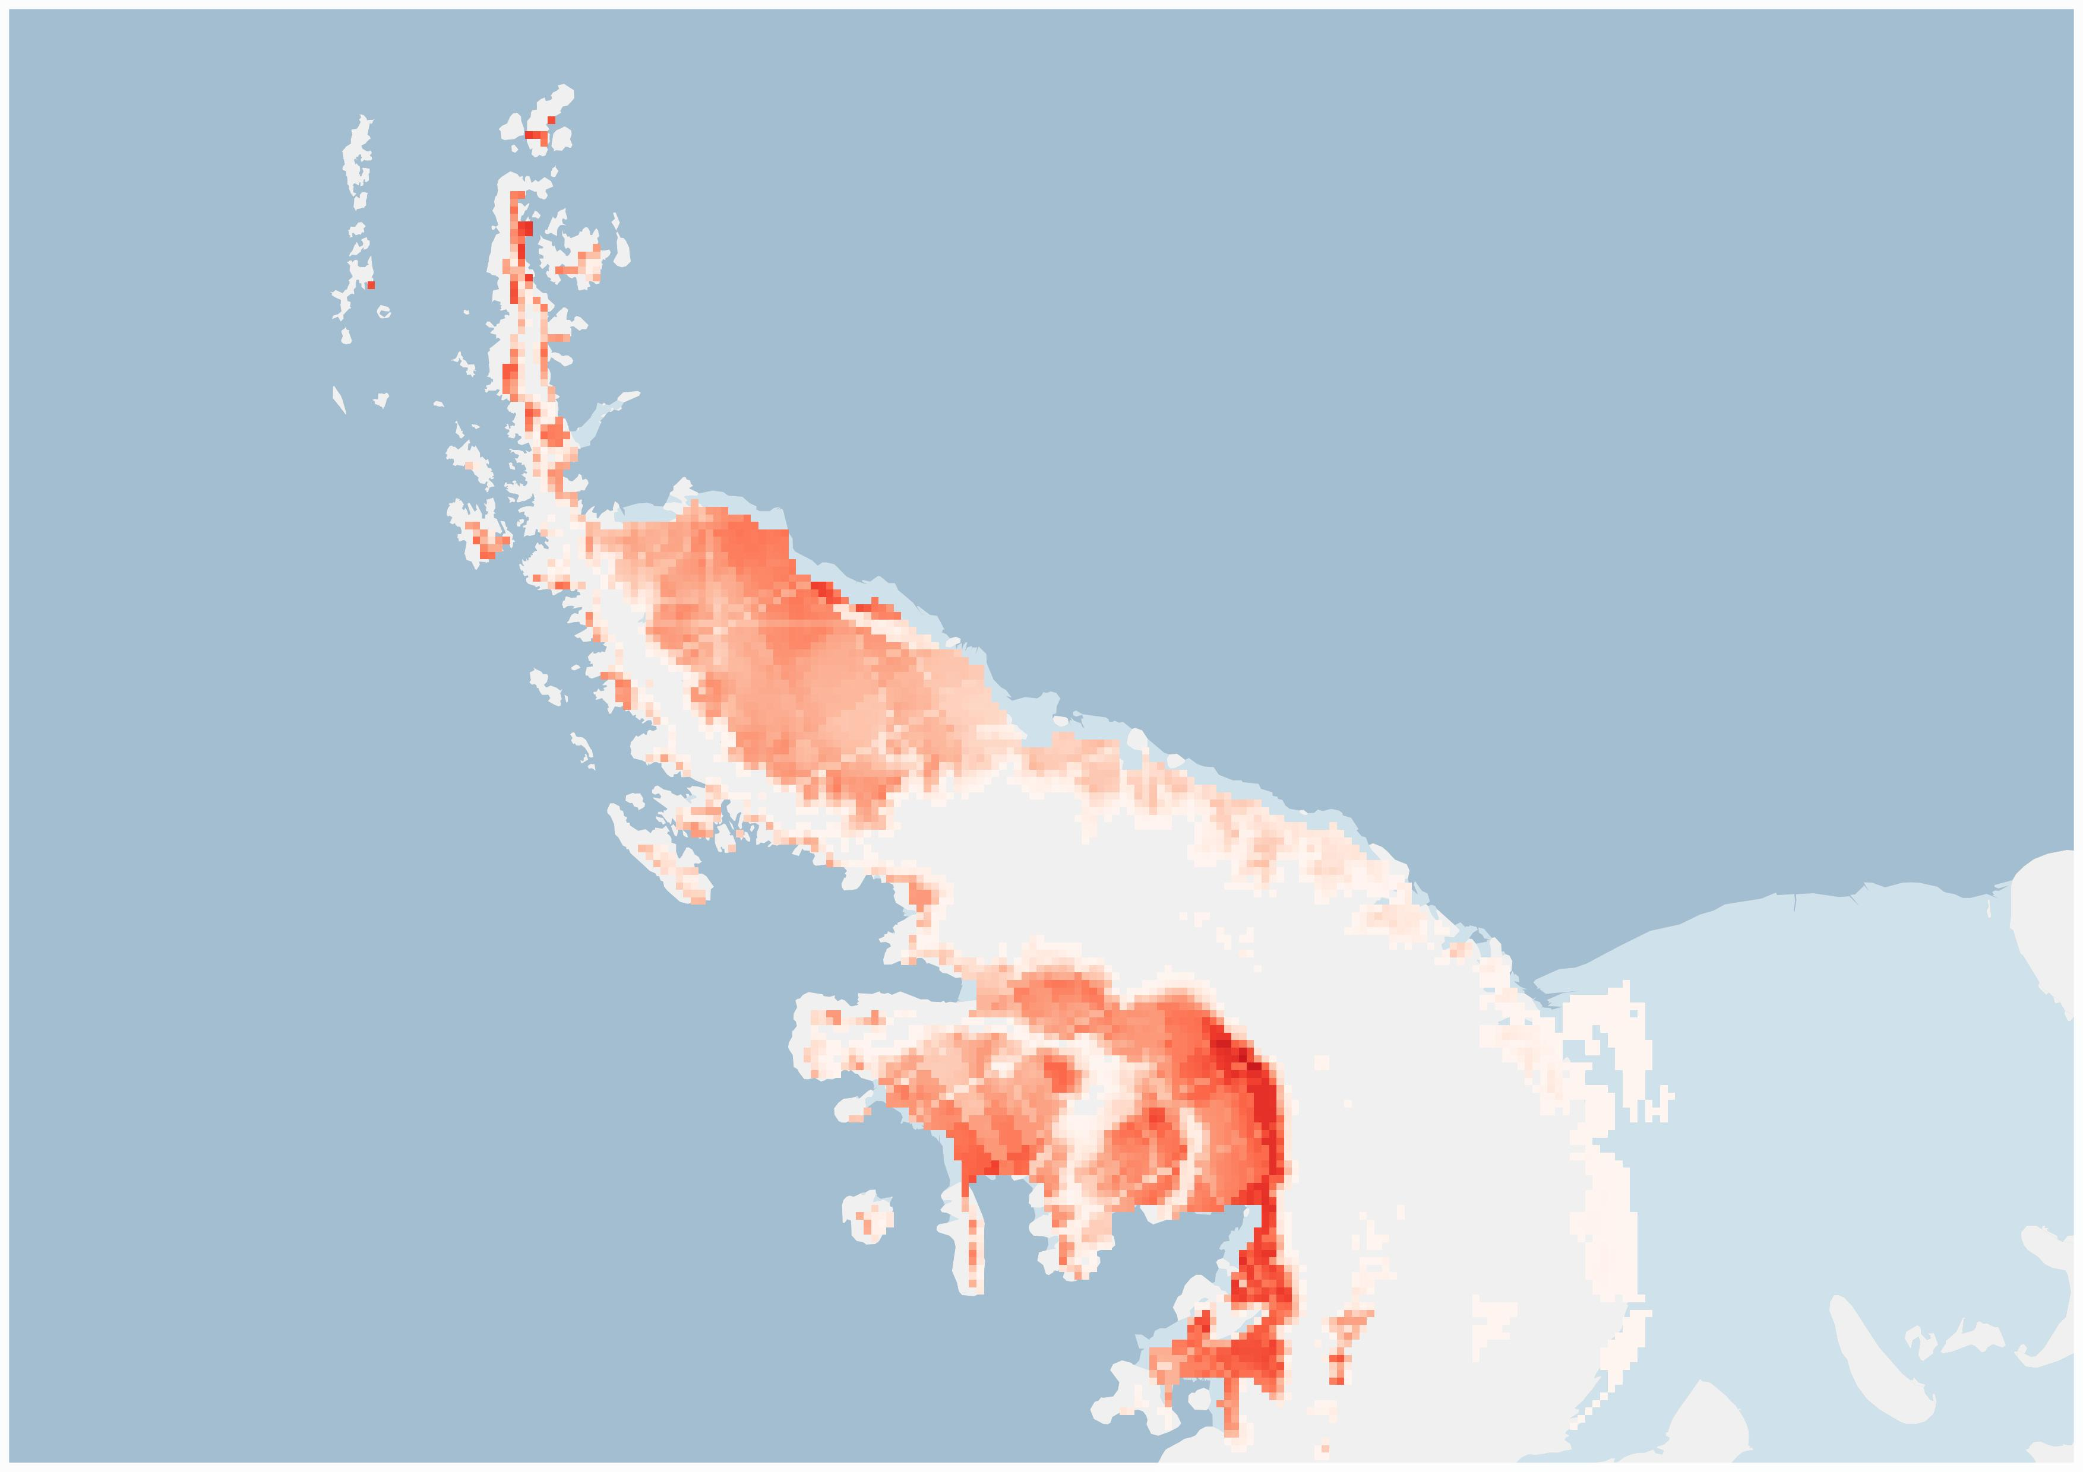
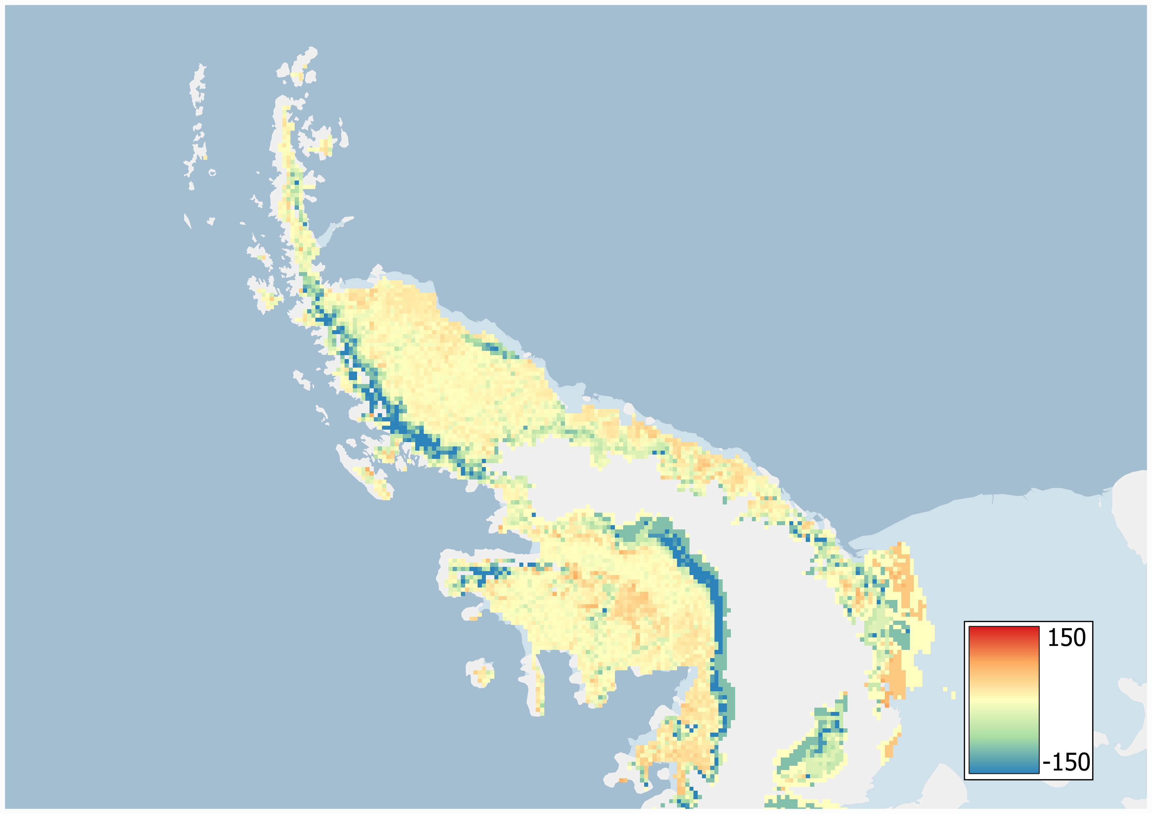
Number of days of melt between the 1/10/2019 and the 30/04/2020
Introduction
MAR
MAR + Sentinel-1
Data
Assimilation
Differences
(% Melt Days)
Sentinel-1
Discussion
Basemap : Quantarctica3
[Matsuoka et al., 2021]

Slide 7
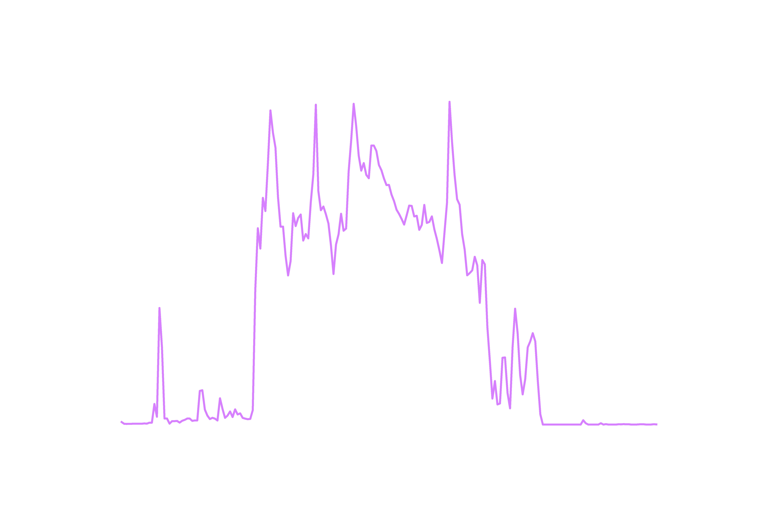
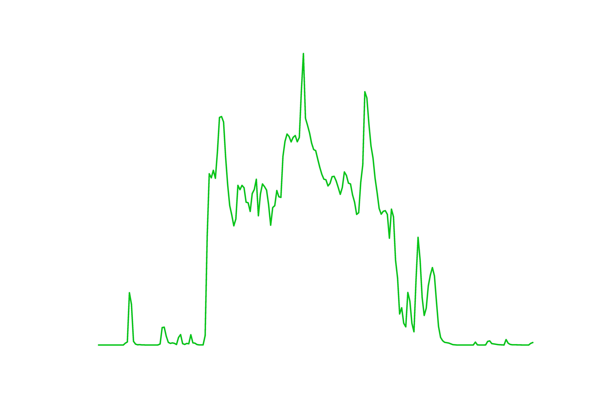
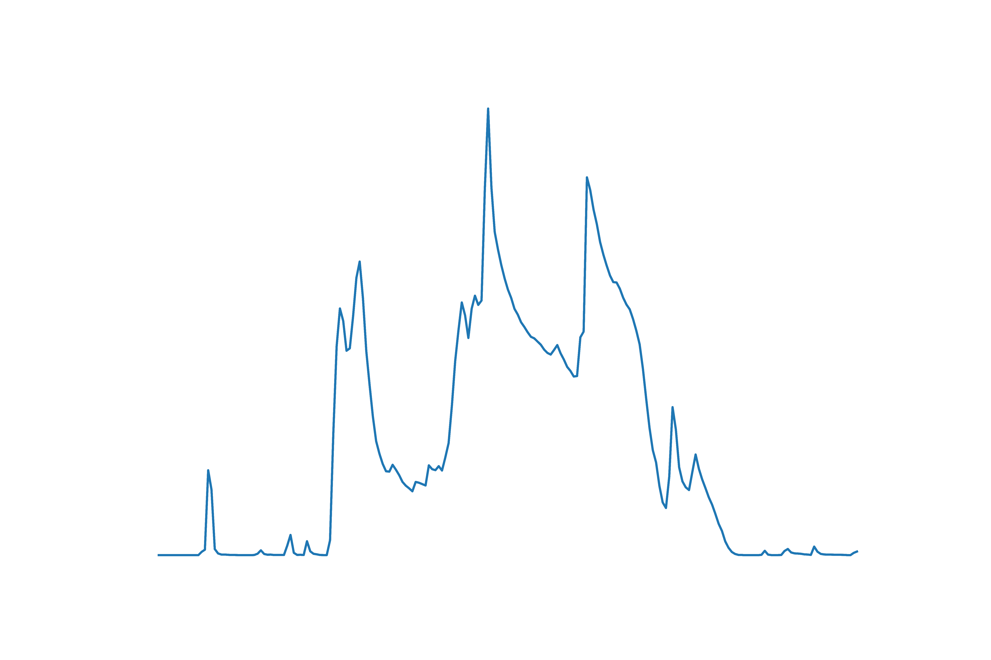
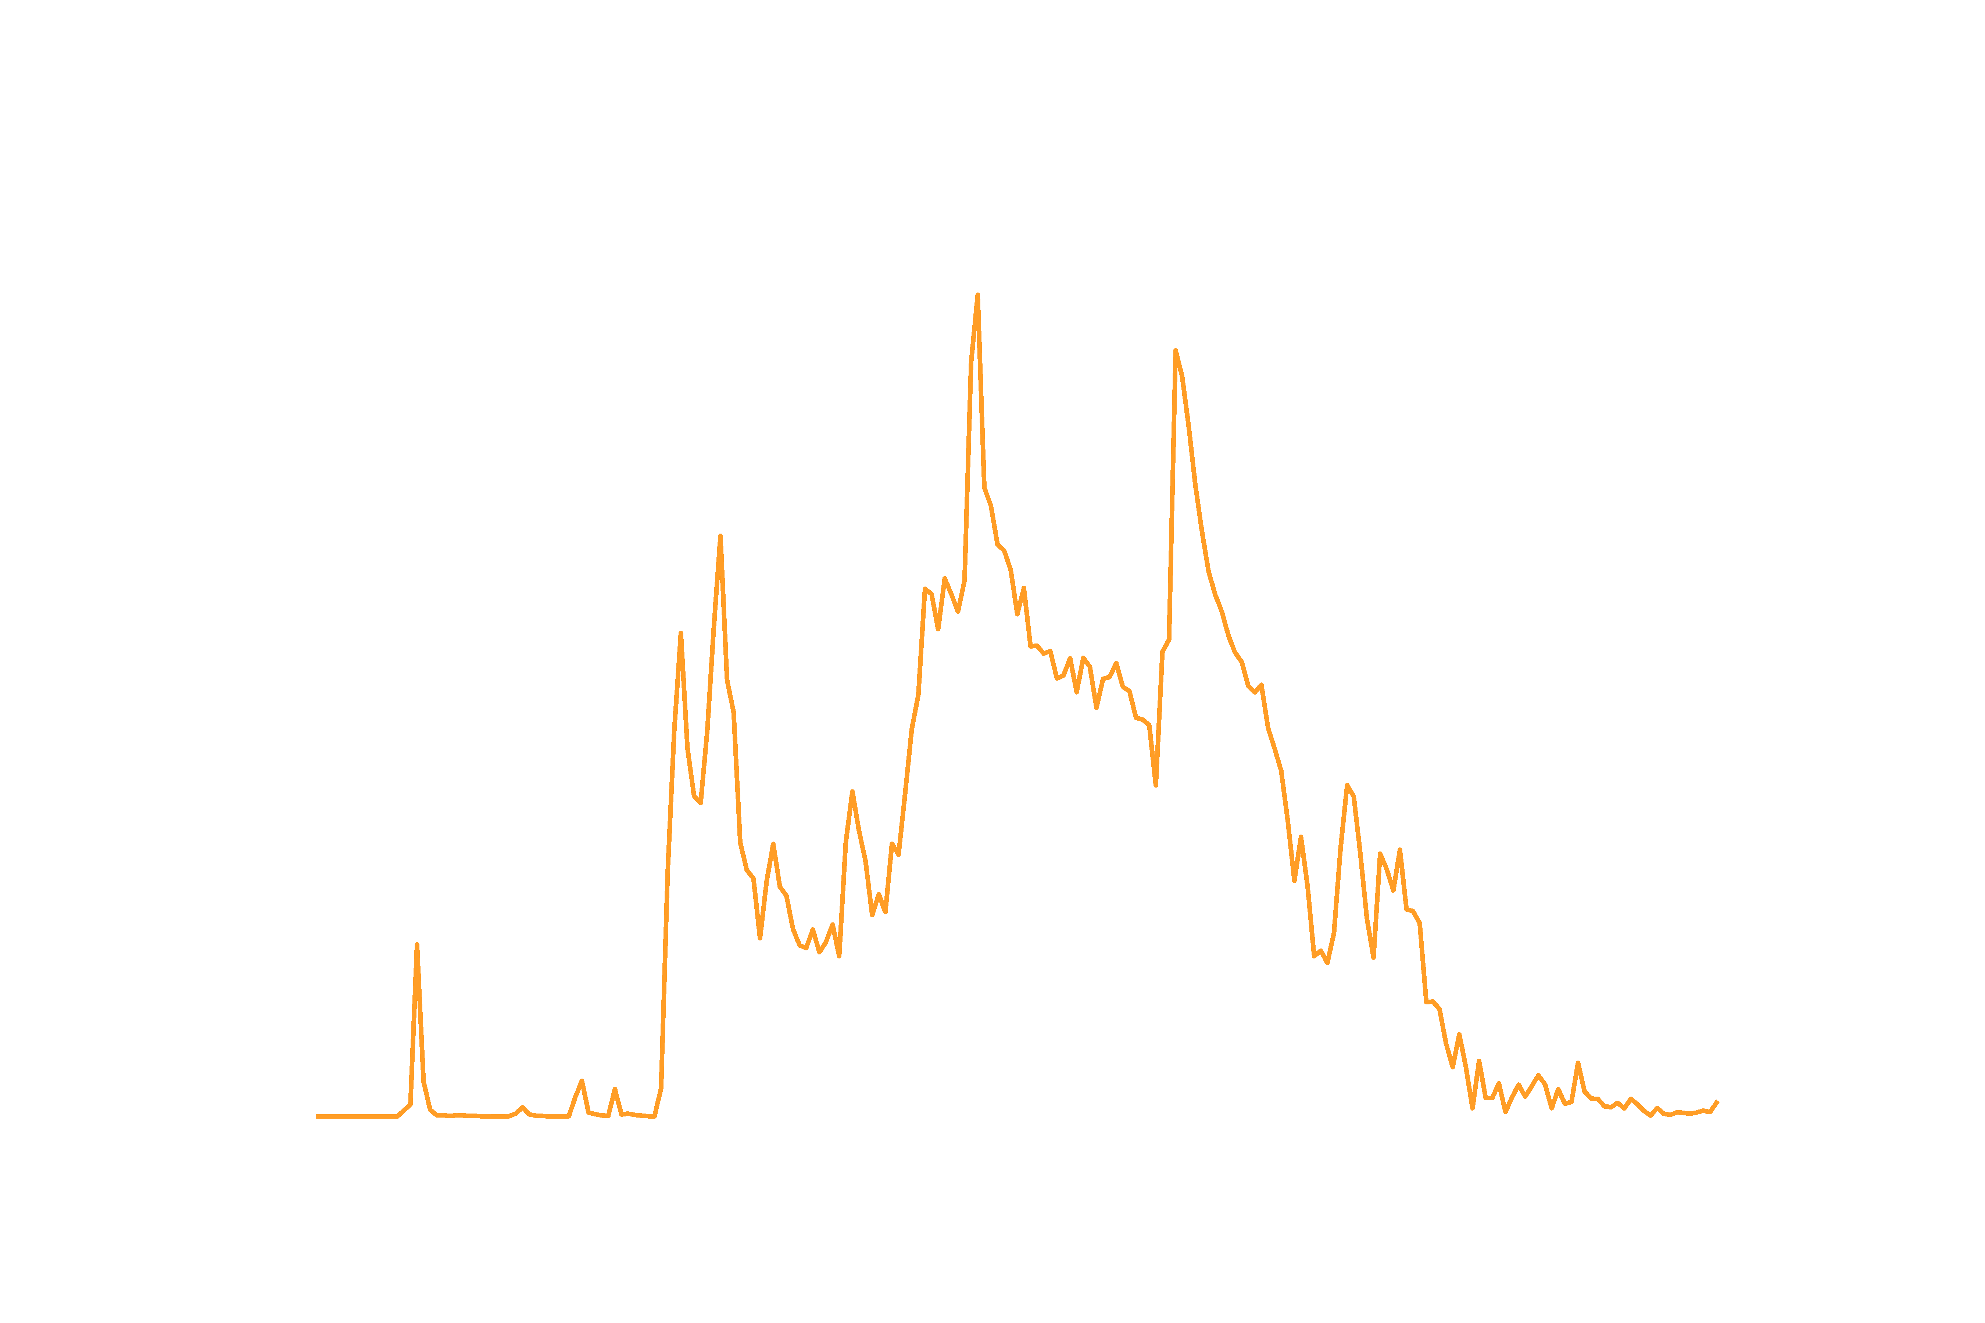

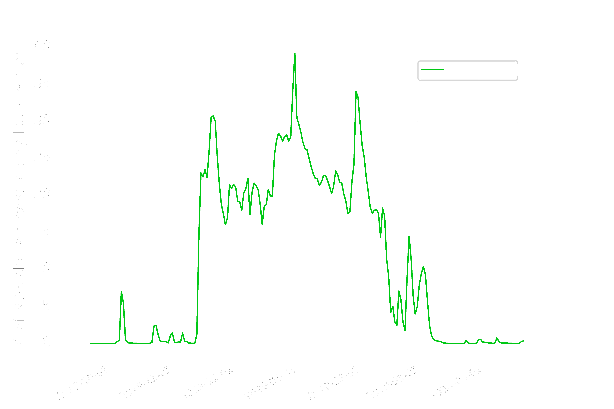
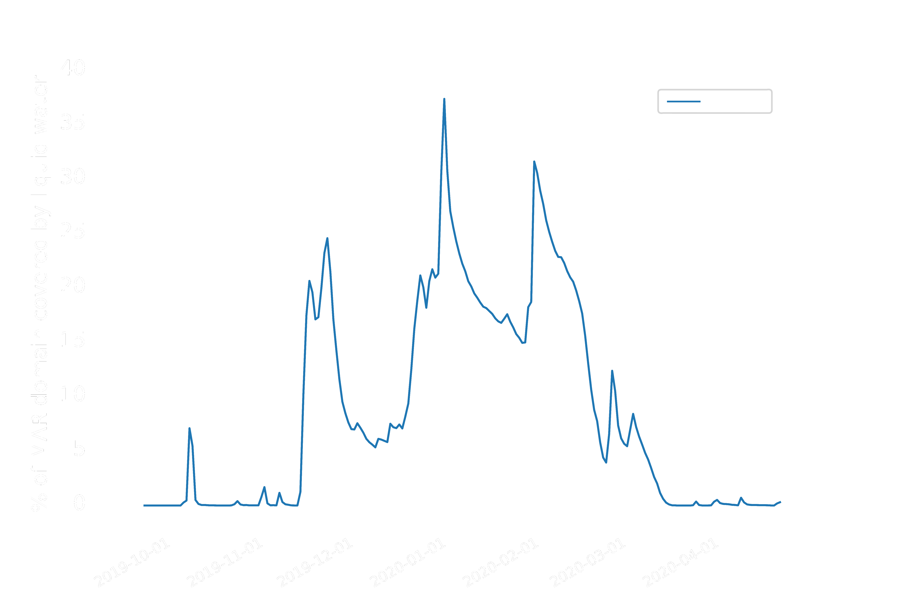
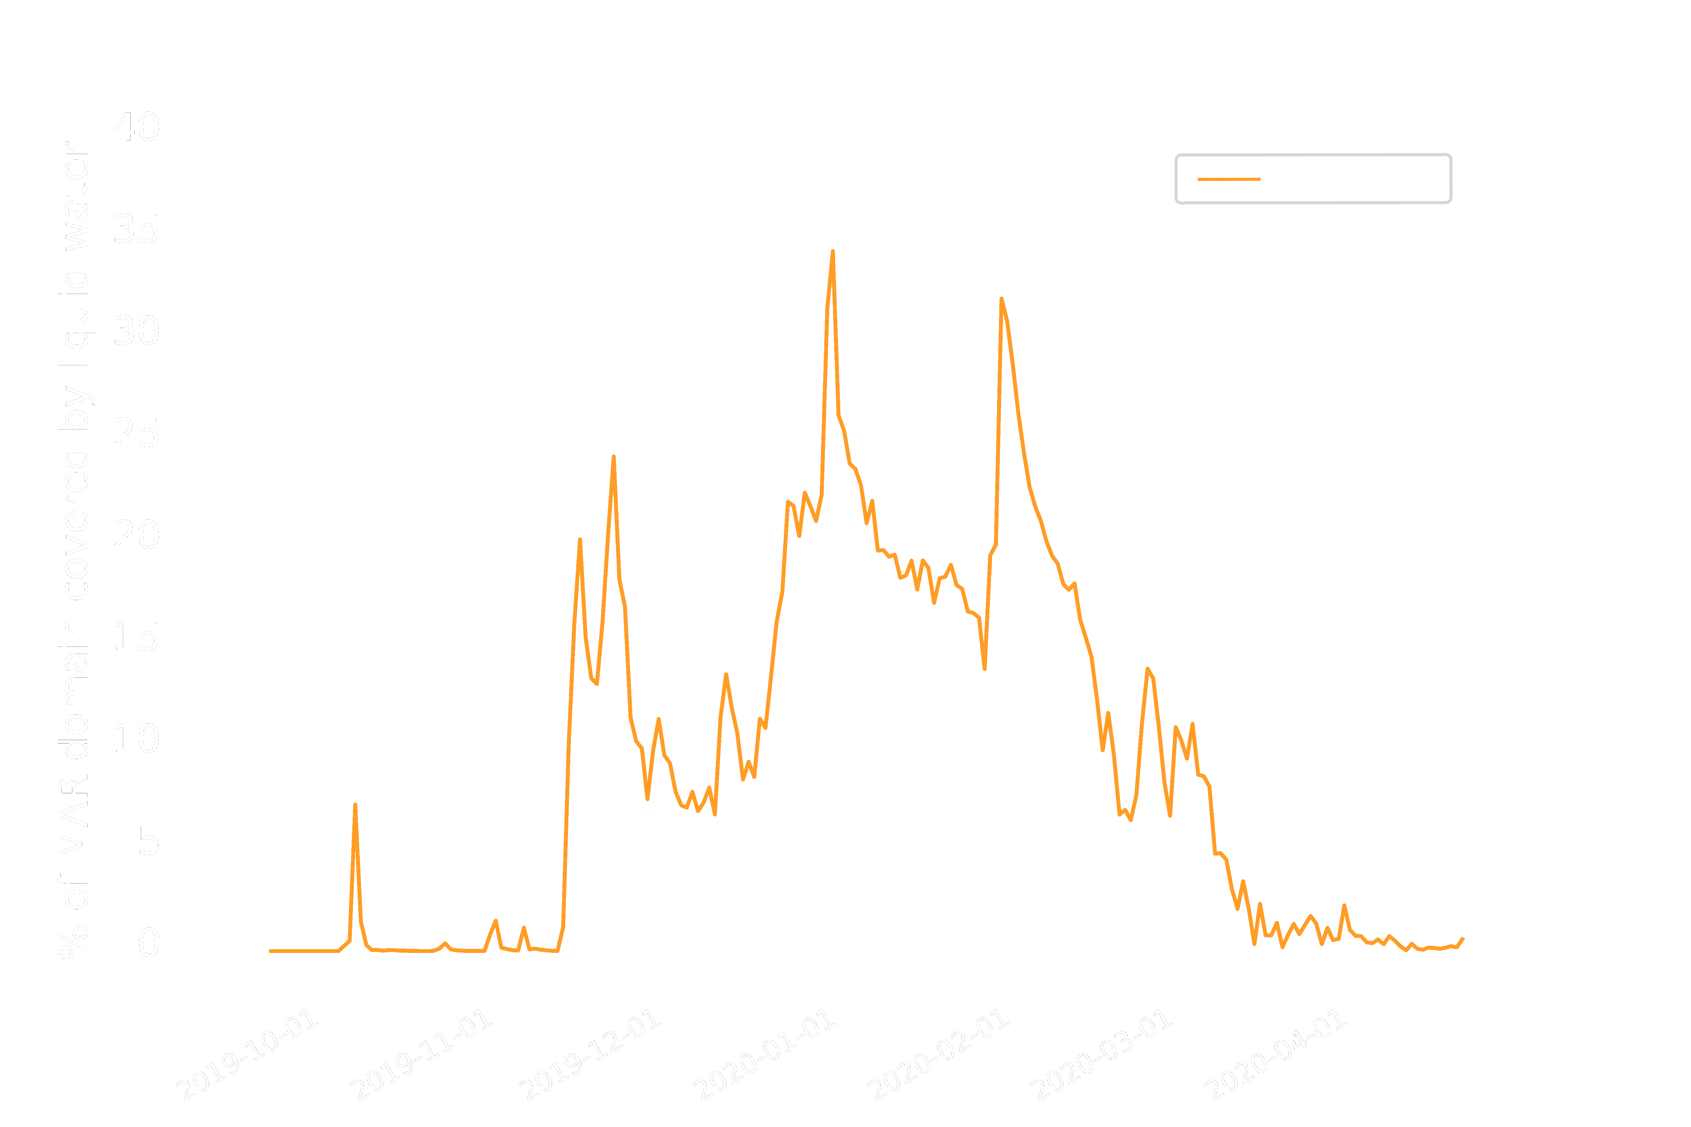
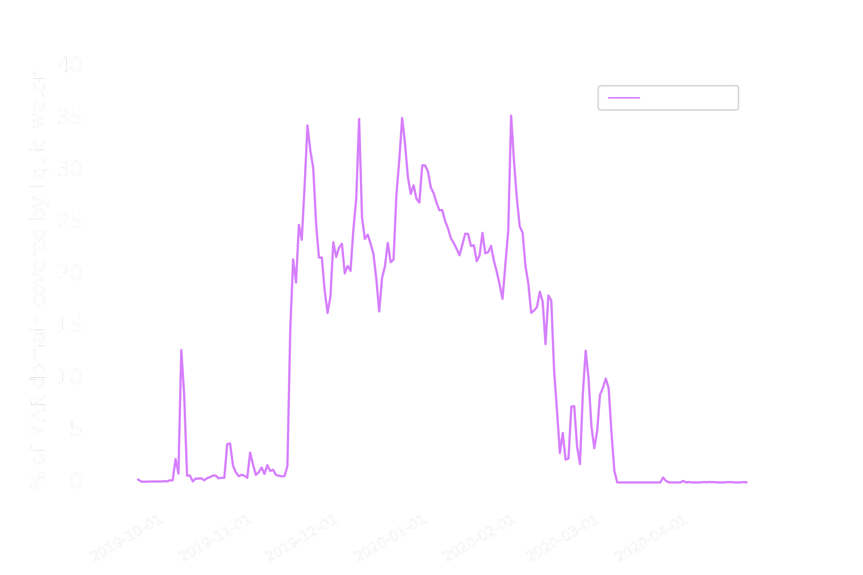
Results
Introduction
Data
Assimilation
Discussion

Slide 8
Perspective
Enhancements for the assimilations:
Introduction
Considering the acquisition time of the satellites
Creating a single mask of surface melt extent by fusing the satellites together
Assimilation of Sentinel-3 derived albedo
Data
Assimilation
Discussion

Slide 9
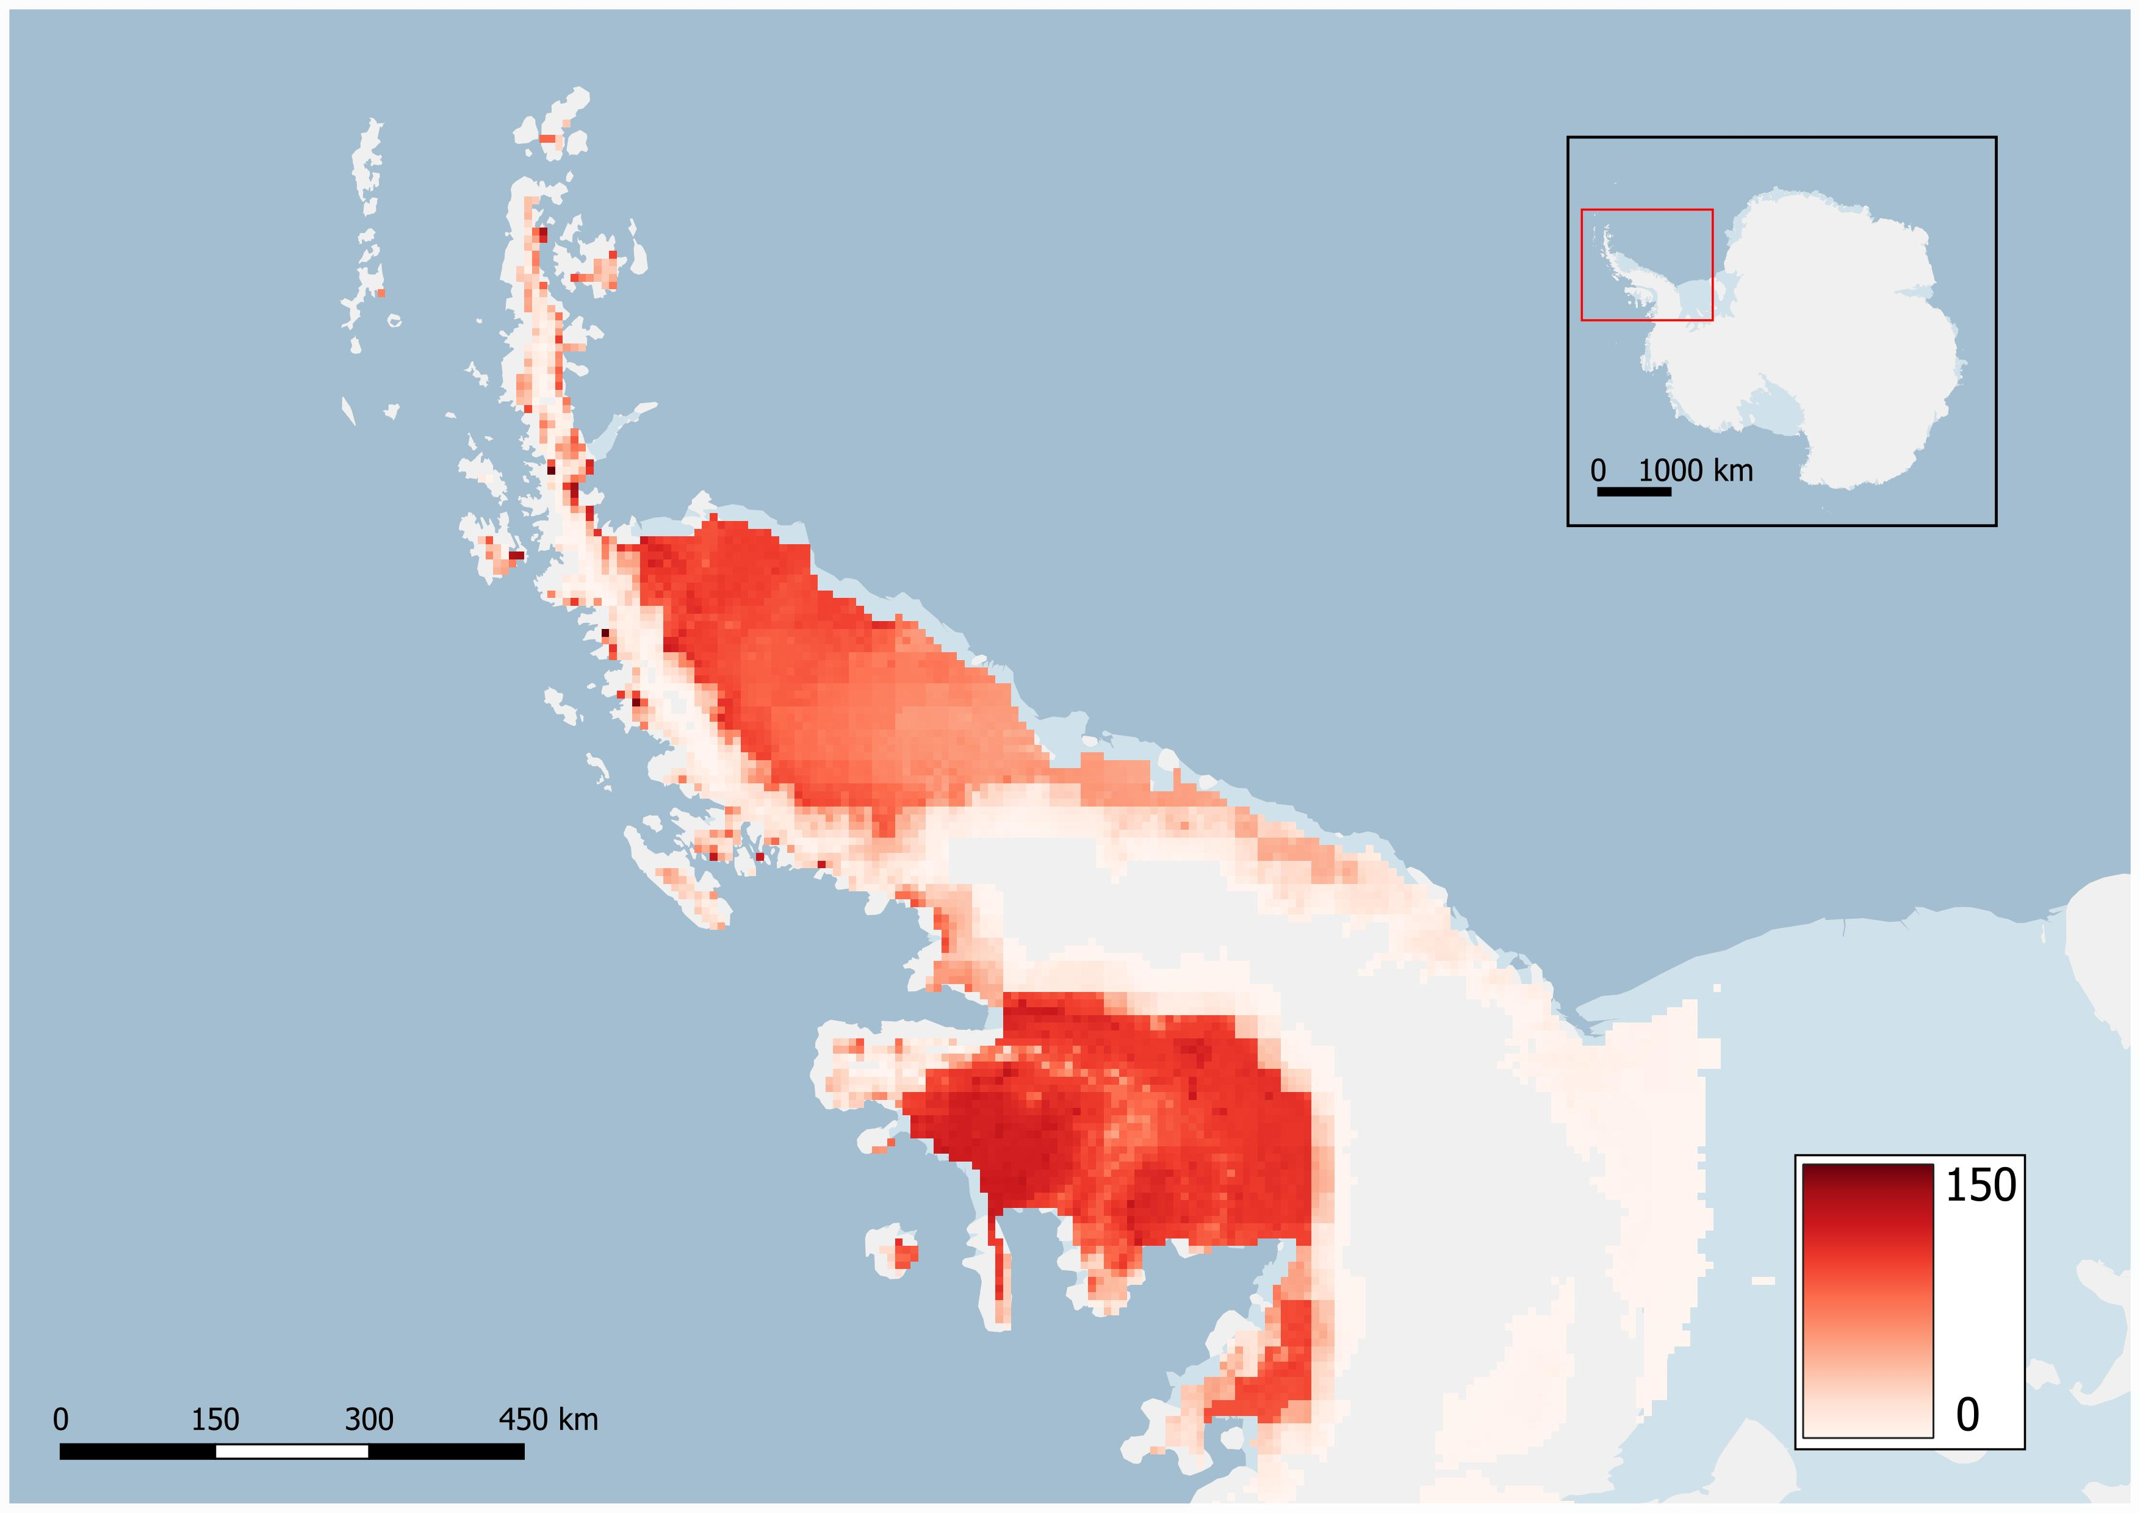
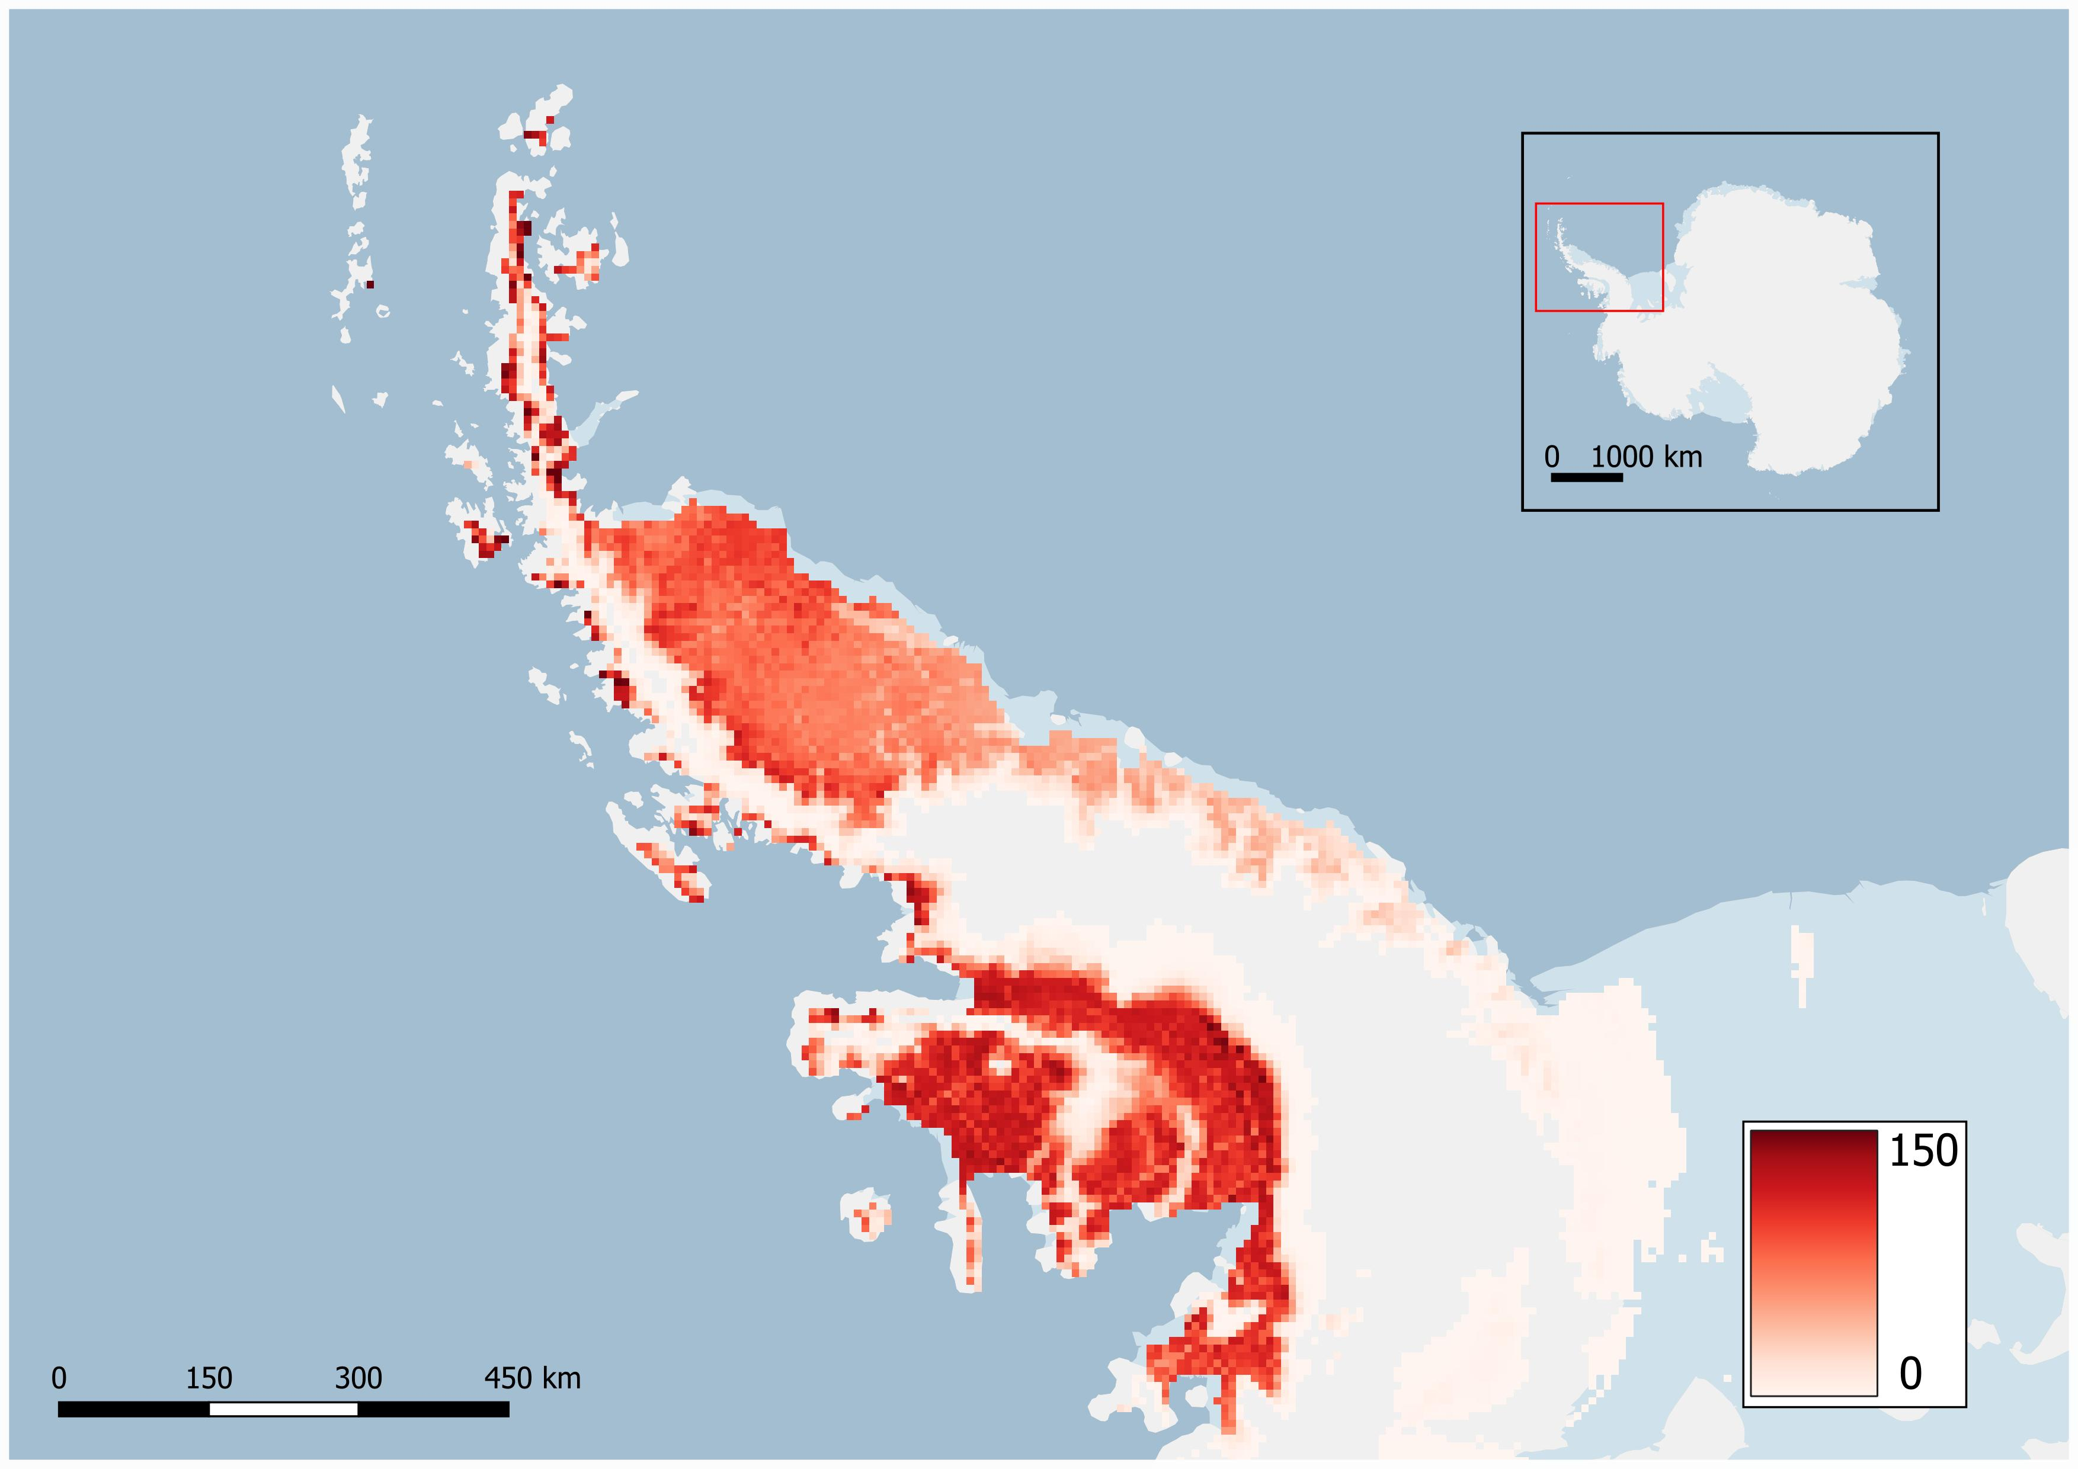
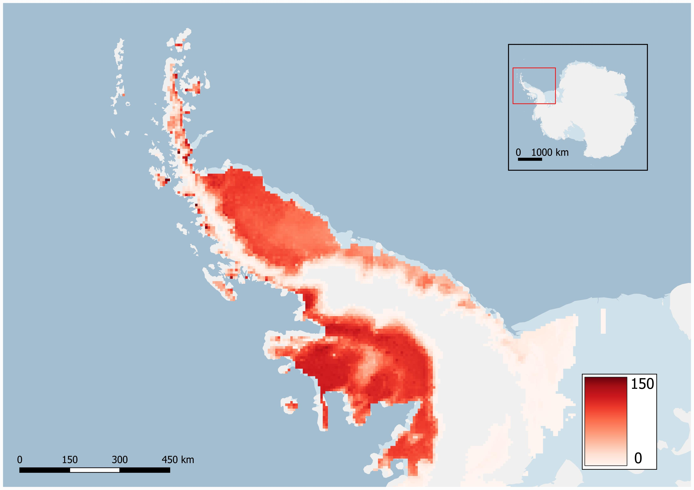

Abstract and contact →

