Slide 1


Identification of the main meteorological factors for the trend of reference evapotranspiration in Sicily, Italy
Tagele Mossie Aschale, Antonino Cancelliere, David J. Peres, and Guido Sciuto
Department of Civil Engineering and Architecture, University of Catania

Slide 2
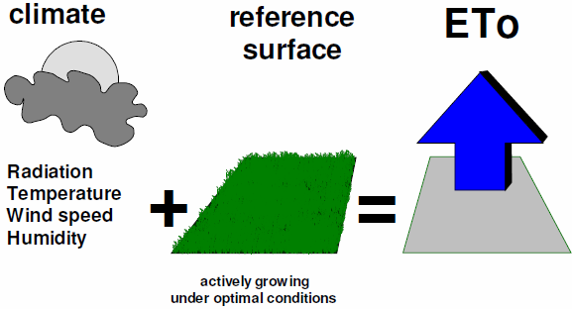
Motivation of the study
Reference evapotranspiration (ETo) is a pivotal part of the hydrological cycle and the most crucial physical processes in natural ecosystems and environmental system in our planet.
The ETo is controlled by relative humidity, windspeed, temperature and solar radiation.
Analyzing the trend of ETo was conducted in different part of Sicily. Unfortunately, the sensitivity and contribution rate of different climatic elements for the trend of ETo remains not fully investigated
Hence, this study analyzed the trend of the above-mentioned climatic elements and ETo. Additionally, it addressed also the contribution rate and sensitivity of the trend of ETO by different climatic elements.

Slide 3
Methodology
The data of this study obtained from the metrological station of the historical town of Piazza Armerina town, Sicily, Italy.
The astronomical location of the meteorological site is 37.382171 N and 14.3666704 E with the altitude of 697 m above sea level.
The data were rainfall, maximum temperature, minimum temperature, average temperature, solar radiation, relative humidity and wined speed for 17 years from December 1st, 2003, to February 28th, 2021 .
The ETo was estimated through the FAO Penman-Monteith method

Slide 4
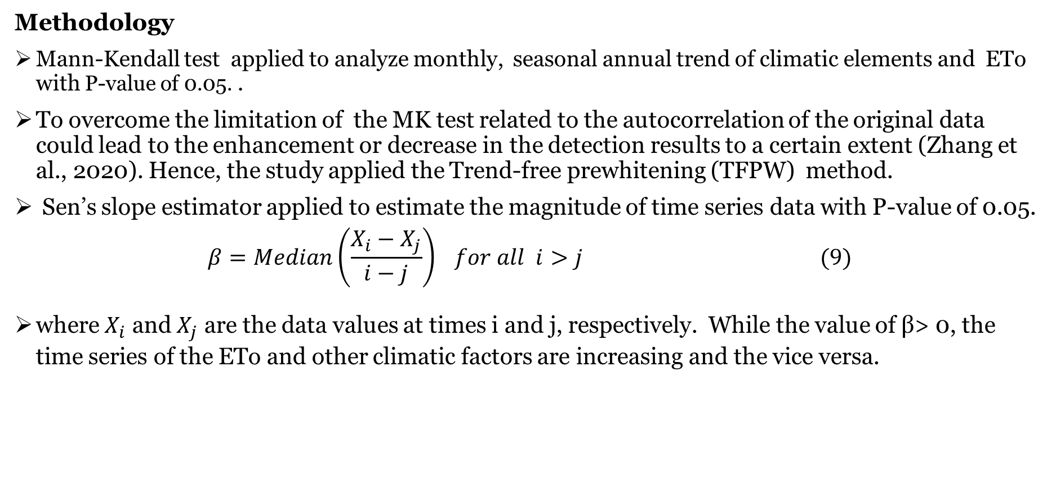
Methodology
Mann-Kendall test applied to analyze monthly, seasonal annual trend of climatic elements and ETo with P-value of 0.05. .
To overcome the limitation of the MK test related to the autocorrelation of the original data could lead to the enhancement or decrease in the detection results to a certain extent (Zhang et al., 2020). Hence, the study applied the Trend-free prewhitening (TFPW) method.
Sen’s slope estimator applied to estimate the magnitude of time series data with P-value of 0.05.
$$β=Median\left(\frac{X_{i}−X_{j}}{i−j}\right) for all i>j (9)$$
where $X_{i}$ and $X_{j}$ are the data values at times i and j, respectively. While the value of β> 0, the time series of the ETo and other climatic factors are increasing and the vice versa.

Slide 5
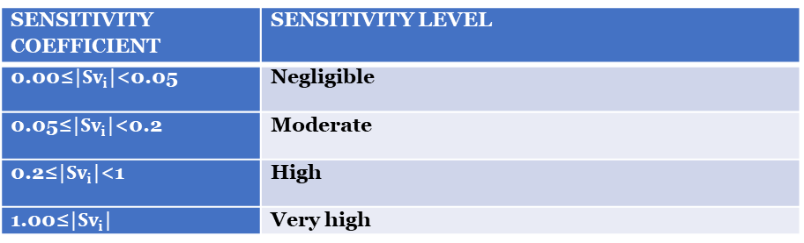
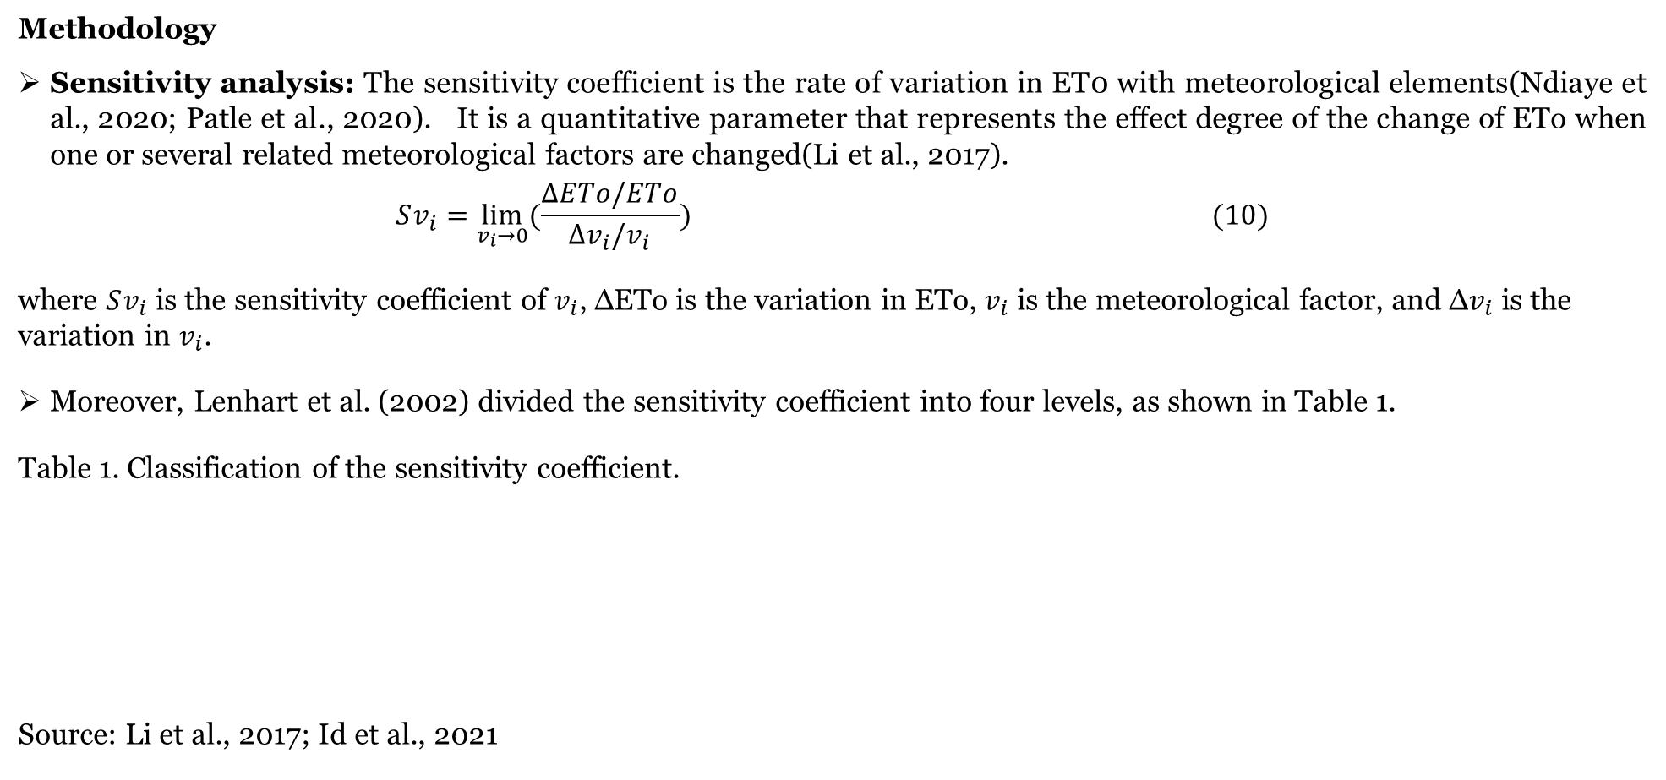
Methodology
Sensitivity analysis: The sensitivity coefficient is the rate of variation in ET0 with meteorological elements(Ndiaye et al., 2020; Patle et al., 2020). It is a quantitative parameter that represents the effect degree of the change of ETo when one or several related meteorological factors are changed(Li et al., 2017).
$$Sv_{i}=\lim_{v_{i}→0}{(\frac{∆ETo/ETo}{∆v_{i}/v_{i}})} (10)$$
where $Sv_{i}$ is the sensitivity coefficient of $v_{i}$, ΔETo is the variation in ETo, $v_{i}$ is the meteorological factor, and Δ$v_{i}$ is the variation in $v_{i}$.
Moreover, Lenhart et al. (2002) divided the sensitivity coefficient into four levels, as shown in Table 1.
Table 1. Classification of the sensitivity coefficient.
Source: Li et al., 2017; Id et al., 2021
Sensitivity coefficient | Sensitivity level
0.00≤|$Sv_{i}$|<0.05 | Negligible
0.05≤|$Sv_{i}$|<0.2 | Moderate
0.2≤|$Sv_{i}$|<1 | High
1.00≤|$Sv_{i}$| | Very high

Slide 6
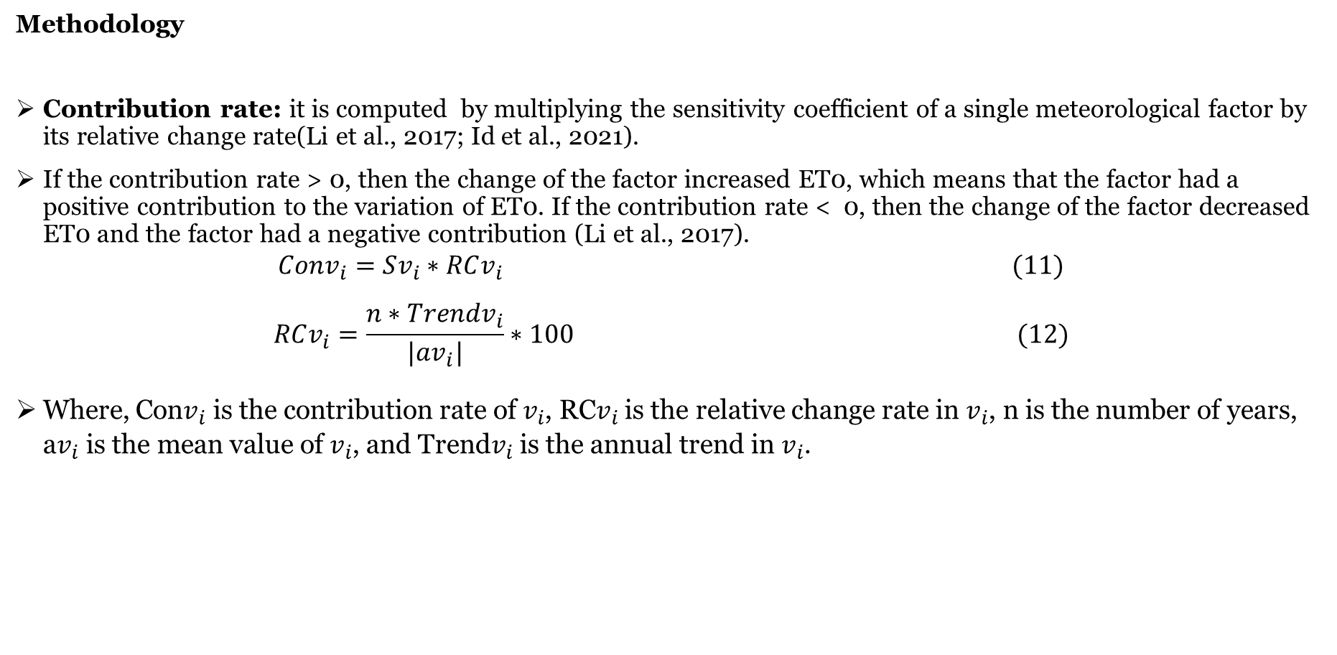
Methodology
Contribution rate: it is computed by multiplying the sensitivity coefficient of a single meteorological factor by its relative change rate(Li et al., 2017; Id et al., 2021).
If the contribution rate > 0, then the change of the factor increased ET0, which means that the factor had a positive contribution to the variation of ET0. If the contribution rate < 0, then the change of the factor decreased ET0 and the factor had a negative contribution (Li et al., 2017).
$$Conv_{i}=Sv_{i}∗RCv_{i} (11)$$
$$RCv_{i}=\frac{n∗Trendv_{i}}{|av_{i}|}∗100 (12)$$
Where, Con$v_{i}$ is the contribution rate of$v_{i}$, RC$v_{i}$ is the relative change rate in $v_{i}$, n is the number of years, a$v_{i}$ is the mean value of $v_{i}$, and Trend$v_{i}$ is the annual trend in $v_{i}$.

Slide 7
Results
Table 2 MK trend test result with 95% significance level
 | Jan | Feb | Mar | Apr | May | Jun | Jul | Aug | Sep | Oct | Nov | Dec | Win | Spr | Sum | Aut | Annual
T_{max} | 1.1 | 1.19 | 2.27 | 1.44 | 0.91 | 1.77 | 1.61 | 1.69 | 2.43 | 0.78 | 1.69 | 1.86 | 1.77 | 2.14 | 1.98 | 1.49 | 1.31
T_{min} | 0.08 | 0.95 | 0.99 | 0.62 | -0.49 | -0.21 | 1.19 | 2.18 | 2.14 | 0.01 | 1.36 | -0.37 | 0.12 | 0.33 | 1.03 | 1.4 | 1.19
T_{mean} | 0.12 | 1.03 | 1.94 | 1.36 | 0.29 | 0.45 | 1.69 | 1.77 | 2.35 | 0.29 | 1.77 | 0.62 | 0.95 | 2.51 | 2.18 | 1.49 | 1.58
SR | -0.95 | -0.54 | -0.7 | 0.62 | -1.65 | -0.33 | -0.78 | -1.2 | -1.07 | -1.44 | -2.02 | 0.95 | -0.12 | -0.87 | -0.91 | -2.6 | -1.44
WS | 2.68 | 0.99 | 1.03 | 1.28 | 2.76 | 2.18 | 2.97 | 1.73 | 0.77 | 0.95 | 2.39 | 2.23 | 2.76 | 2.02 | 0.95 | 0.86 | 0.95
HU | 0.41 | 0.5 | 2.27 | 2.27 | 2.12 | 2.84 | 3.17 | 2.39 | 2.12 | 2.02 | 1.22 | 2.02 | 0.86 | 2.21 | 2.03 | 1.31 | 1.31
ETo | -1.85 | -0.95 | -1.11 | 0.45 | -1.28 | -0.62 | 0.54 | 0.21 | 0.45 | 0.04 | - | -0.95 | -0.54 | -0.78 | -0.21 | -0.54 | -0.78
 |  |  |  |  |  |  |  |  |  |  | 2.51
RF | -0.04 | 0.45 | -0.62 | -1.19 | 0.29 | -0.49 | 0.46 | 0.64 | -0.21 | 0.33 | 0.95 | 0.5 | -1.28 | -0.29 | -0.04 | -2.6 | -1.61
Win= winter; Spr=spring; Sum=summer; Aut=Autumn Red color text = showed decreasing/increasing trend

Slide 8
Results
Table 3 Sen’s slope estimator
 | Jan | Feb | Mar | Apr | May | Jun | Jul | Aug | Sep | Oct | Nov | Dec | Win | Spr | Sum | Aut | Annual
T_{max} | 1.1 | 1.19 | 0.1 | 1.44 | 0.91 | 1.77 | 1.61 | 1.69 | 0.14 | 0.78 | 1.69 | 1.86 | 1.77 | 0.1 | 0.09 | 1.49 | 1.31
T_{min} | 0.08 | 0.95 | 0.99 | 0.62 | -0.49 | -0.21 | 1.19 | 0.09 | 0.07 | 0.01 | 1.36 | -0.37 | 0.12 | 0.33 | 1.03 | 1.4 | 1.19
T_{mean} | 0.12 | 1.03 | 1.94 | 1.36 | 0.29 | 0.45 | 1.69 | 1.77 | 0.1 | 0.29 | 1.77 | 0.62 | 0.95 | 0.07 | 0.06 | 1.49 | 1.58
SR | -0.95 | -0.54 | -0.7 | 0.62 | -1.65 | -0.33 | -0.78 | -1.2 | -1.07 | -1.44 | 0.09 | 0.95 | -0.12 | -0.87 | -0.91 | -0.076 | -1.44
WS | 0.054 | 0.99 | 1.03 | 1.28 | 0.038 | 0.021 | 0.043 | 1.73 | 0.77 | 0.95 | 0.04 | 0.042 | 0.037 | 0.029 | 0.95 | 0.86 | 0.95
HU | 0.41 | 0.5 | 0.711 | 0.543 | 1.16 | 0.741 | 1.012 | 0.824 | 0.816 | 0.61 | 1.22 | 0.412 | 0.86 | 0.84 | 0.942 | 1.31 | 1.31
ETo | -1.85 | -0.95 | -1.11 | 0.45 | -1.28 | -0.62 | 0.54 | 0.21 | 0.45 | 0.04 | -0.79 | -0.95 | -0.54 | -0.78 | -0.21 | -0.54 | -0.78
RF | -0.04 | 0.45 | -0.62 | -1.19 | 0.29 | -0.49 | 0.46 | 0.64 | -0.21 | 0.33 | 0.95 | 0.5 | -1.28 | -0.29 | -0.04 | -14.019 | -1.61
Sen’s Slope estimator magnitude result temperature in c°; rainfall in mm; radiation in MJ/m2; wind speed in m/s; and relative humidity in %.

Slide 9
Results
Sensitivity coefficient and contribution rate
Table 4. Sensitivity coefficient of climatic factor for ETo
Figure 1: contribution rate of climatological factors
Climatological element | Sensitivity coefficient |x| | Sensitivity level
Solar radiation | |0.53| | high
Maximum temperature | |1.35| | Very high
Minimum temperature | |-0.28| | High
Mean temperature | |1.46| | Very high
Relative humidity | |-2.24| | Very high
Wind speed | |0.02| | Negligible

Slide 10
Conclusion
There was both seasonal and monthly significant trend in all parameters except minimum temperature and ETo.
The sensitivity of ETo also showed that relative humidity, mean temperature and maximum temperature showed high level of sensitivity for ETo. While the minimum temperature and solar radiation confirmed high sensitivity level of ETo and the wind speed sensitivity level for ETo was negligible.
In terms of the contribution of the climatic factors for ETo trend, humidity, solar radiation, and minimum temperature contributed negatively for ETo.
It need more spatial coverage study for better understanding about the sensitivity and contribution of climatic elements for ETo over the Mediterranean hot summer climate of Sicily.

