Slide 1


Coupling terrestrial laser scanning and UAV photogrammetry with geoelectrical data for better time-lapse hydrological characterisation of an active landslide.
Jimmy Boyd, Jonathan Chambers, Paul Wilkinson, Maria Peppa, Arnaud Watlet, Matt Kirkham, Lee Jones, Russell Swift, Phil Meldrum, Sebastian Uhlemann, Jessica Holmes, Andrew Binley

Slide 2
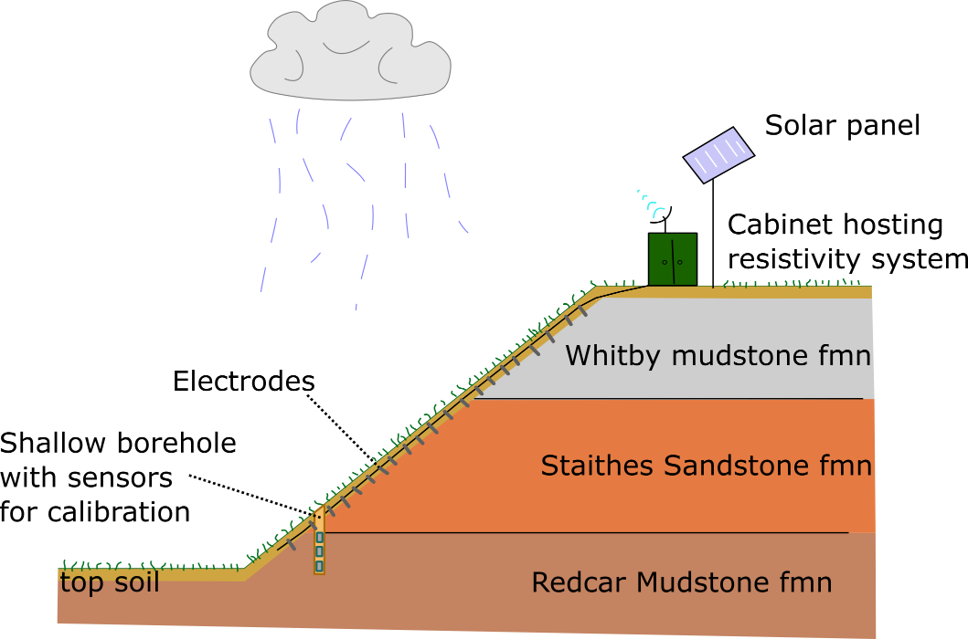
Why use geoelectrical methods on a landslide?
Majority of landslides are moisture induced.
The electrical properties of geological materials depend on lithology, porosity, saturation, pore fluid conductivity and temperature.
Changes in the near surface electrical resistivity driven largely driven by changes in the moisture content.
Electrical properties of near surface materials can be monitored at a site scale using geoelectrical methods.
2

Slide 3
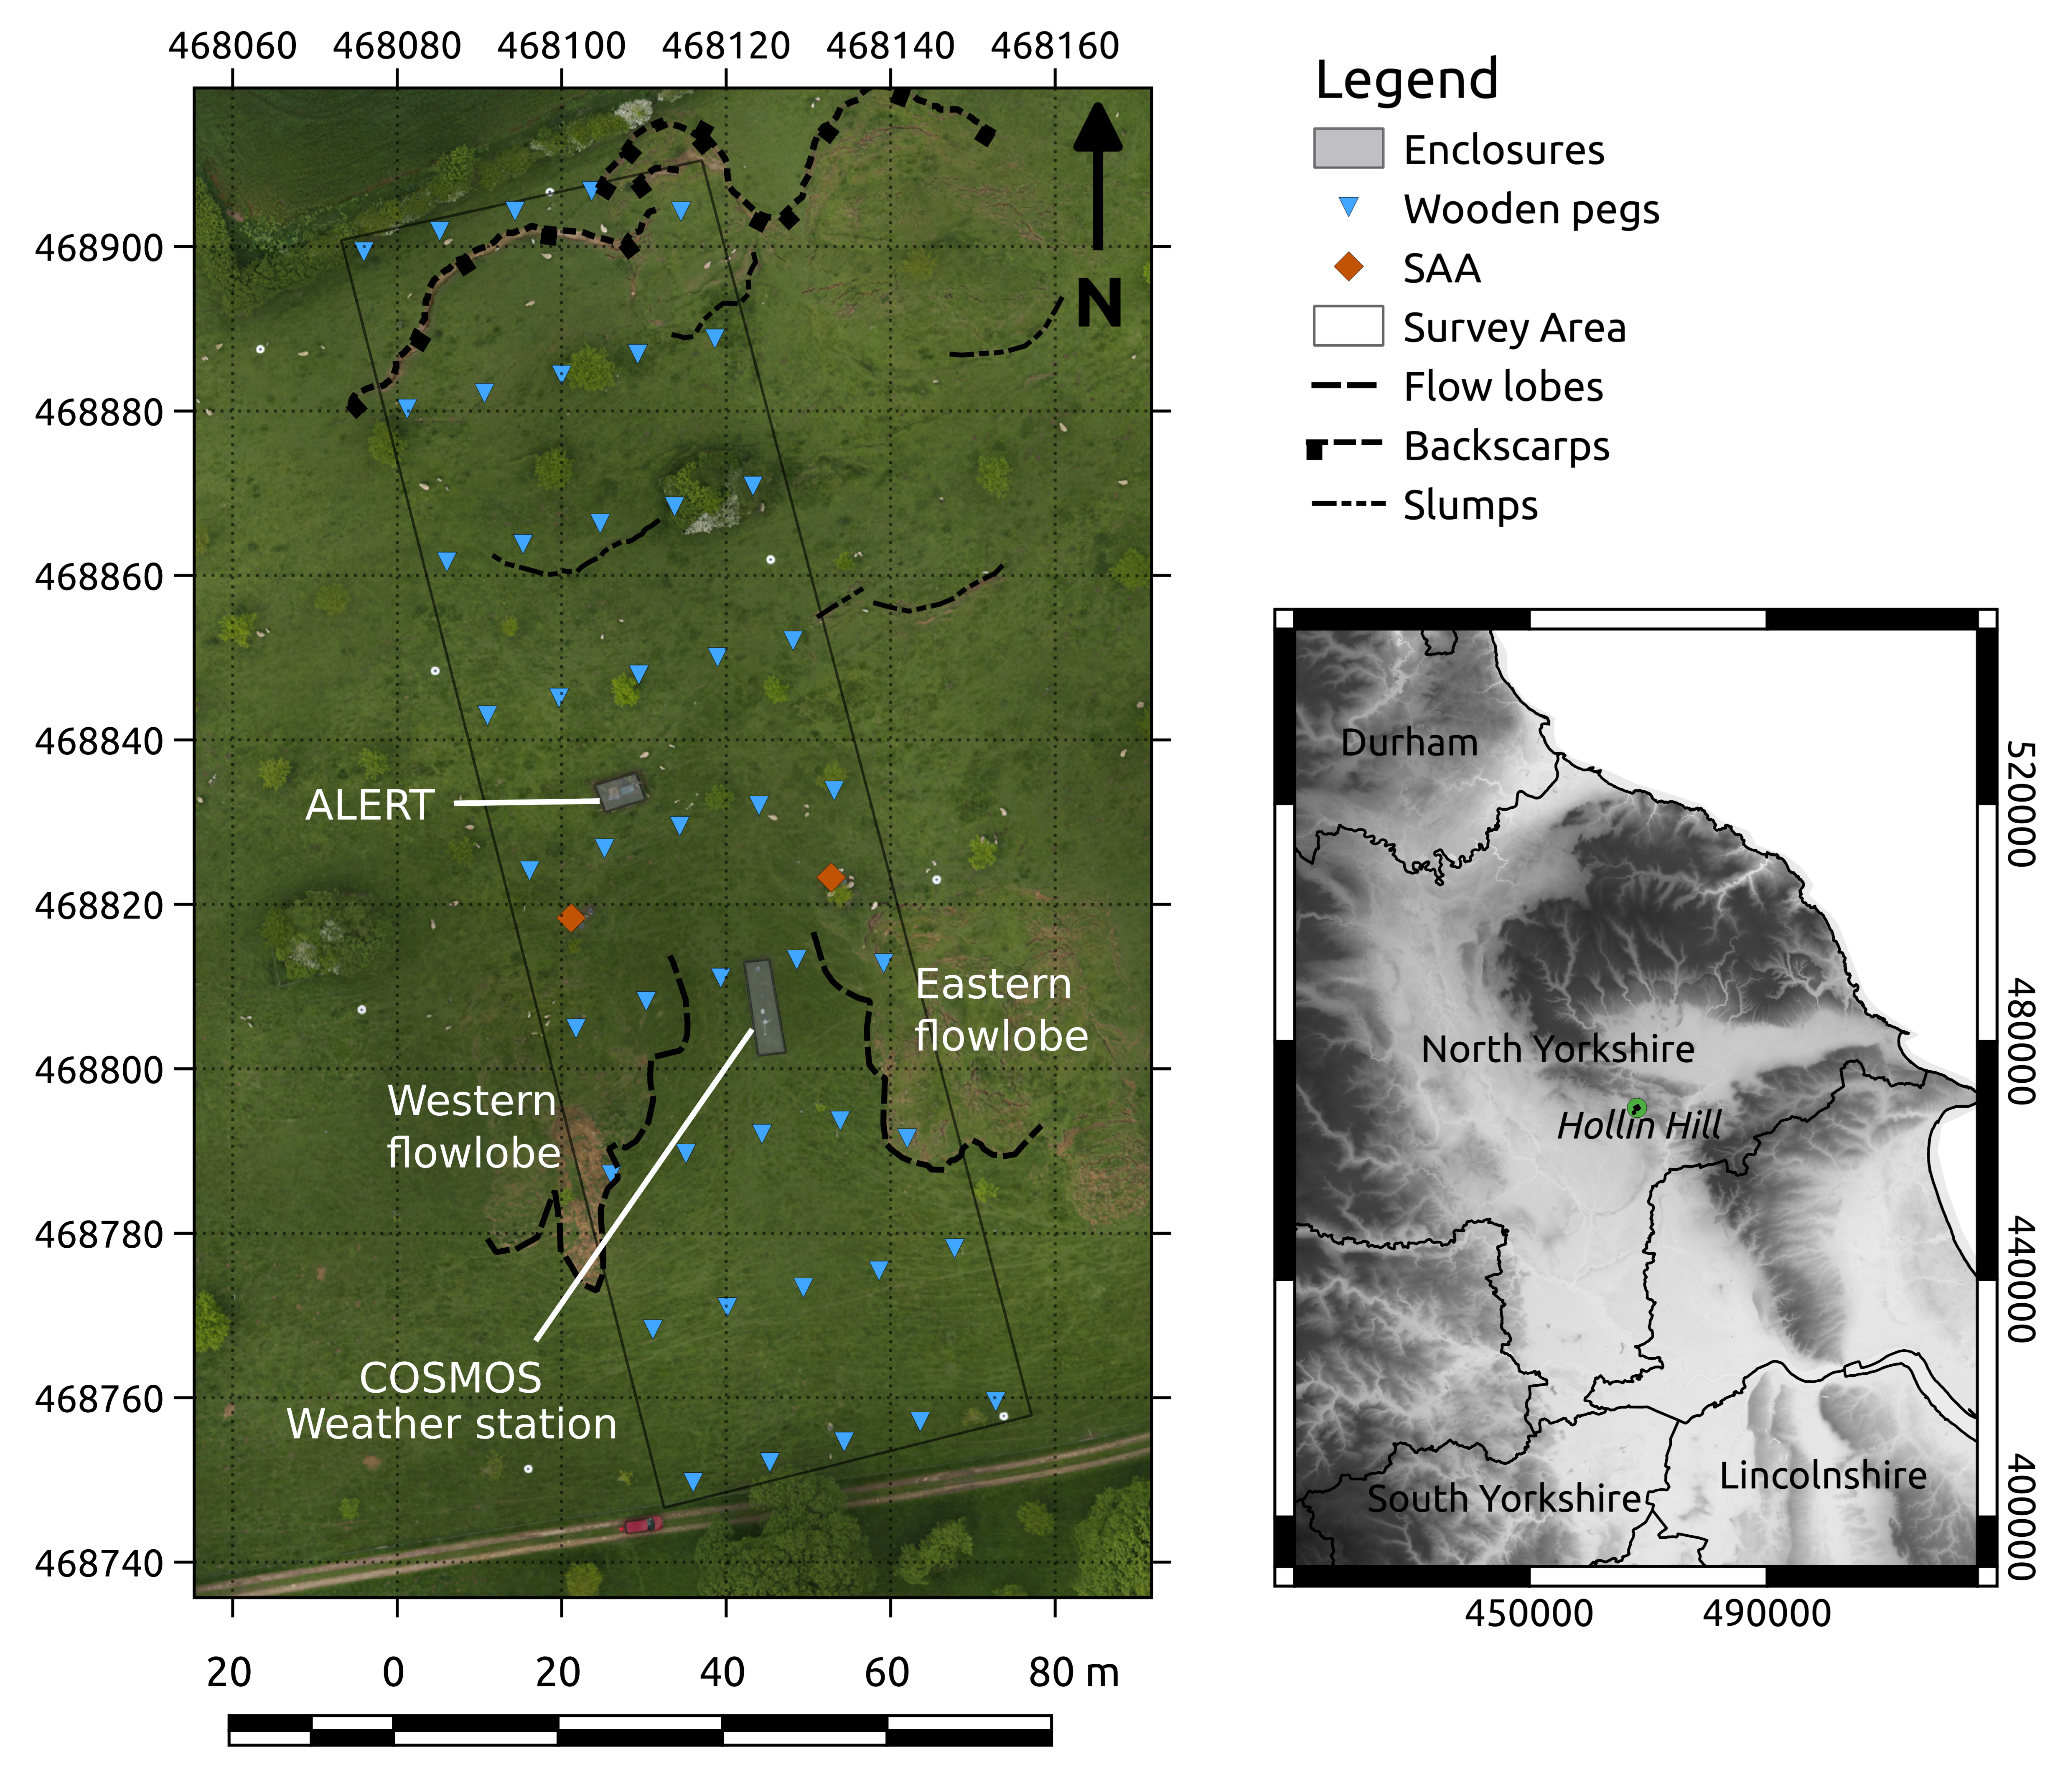
Case Study Hollin Hill
Field site
Instrumented since 2008.
Monitored with a geo-electrical monitoring system between 2008 and 2018, and 2020 to present.
COSMOS weather station present on slope since 2014.
Various downhole sensors including shape acceleration arrays, piezometers and temperature probes.
(Boyd et al. 2021)

Slide 4
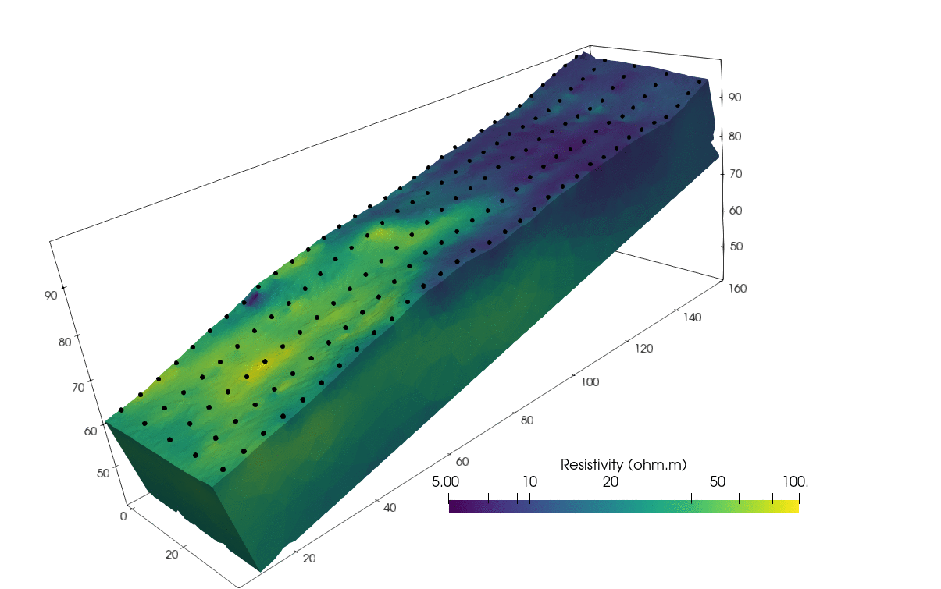
Ground model development
Field site
Mudstone
Geoelectrical monitoring data can be modelled (or inverted) to produce resistivity volumes.
Here geophysics illuminates two major units in the landslide body.
Geological information suggests that there is a clay rich sandstone unit towards the base of the slope, and an unstable mudstone unit towards the top of the slope.
Sandstone
- electrode
4

Slide 5
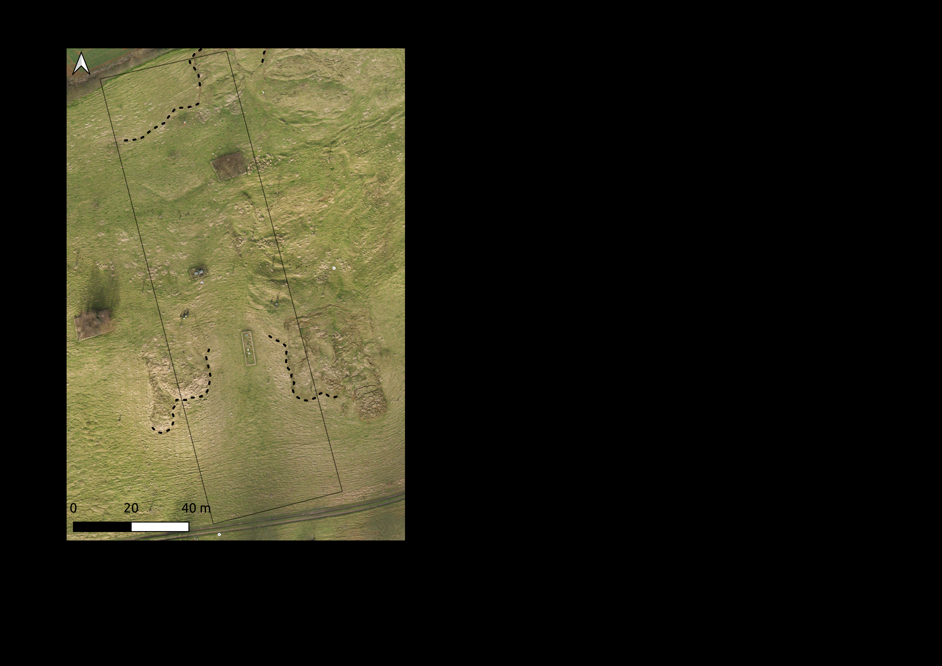
Problem
Field site
In order to model electrical resistivity the surface of the slope needs to be reasonably well defined. For the duration of monitoring (since 2008).
However electrodes move with the deforming surface, hence we tracked movements with GPS surveys of marker pegs.
Landslide had been surveyed with LIDAR and fixed wing UAV surveys to study changes in slope topography.

Slide 6
Terrestrial LiDAR
UAVs
Light detection and ranging.
Ground based method, in this case both tripod (stationary) and mobile (backpack) systems were used throughout the years of monitoring.
Measures travel times for laser pulses between ground and sensor(s).
Raw data is a point cloud, noise produced by vegetation is filtered.
Millimetric resolution.
Produces a digital elevation model (DEM).
Unmanned aerial vehicle surveys (fixed wing in this case).
Raw data is georeferenced photographs.
Reconstructs ground morphology through structure from motion photogrammetry.
Vegetation filtered.
Net result is a digital elevation model of studied object.
Centimetre resolution.
(Peppa et al. 2019)

Slide 7
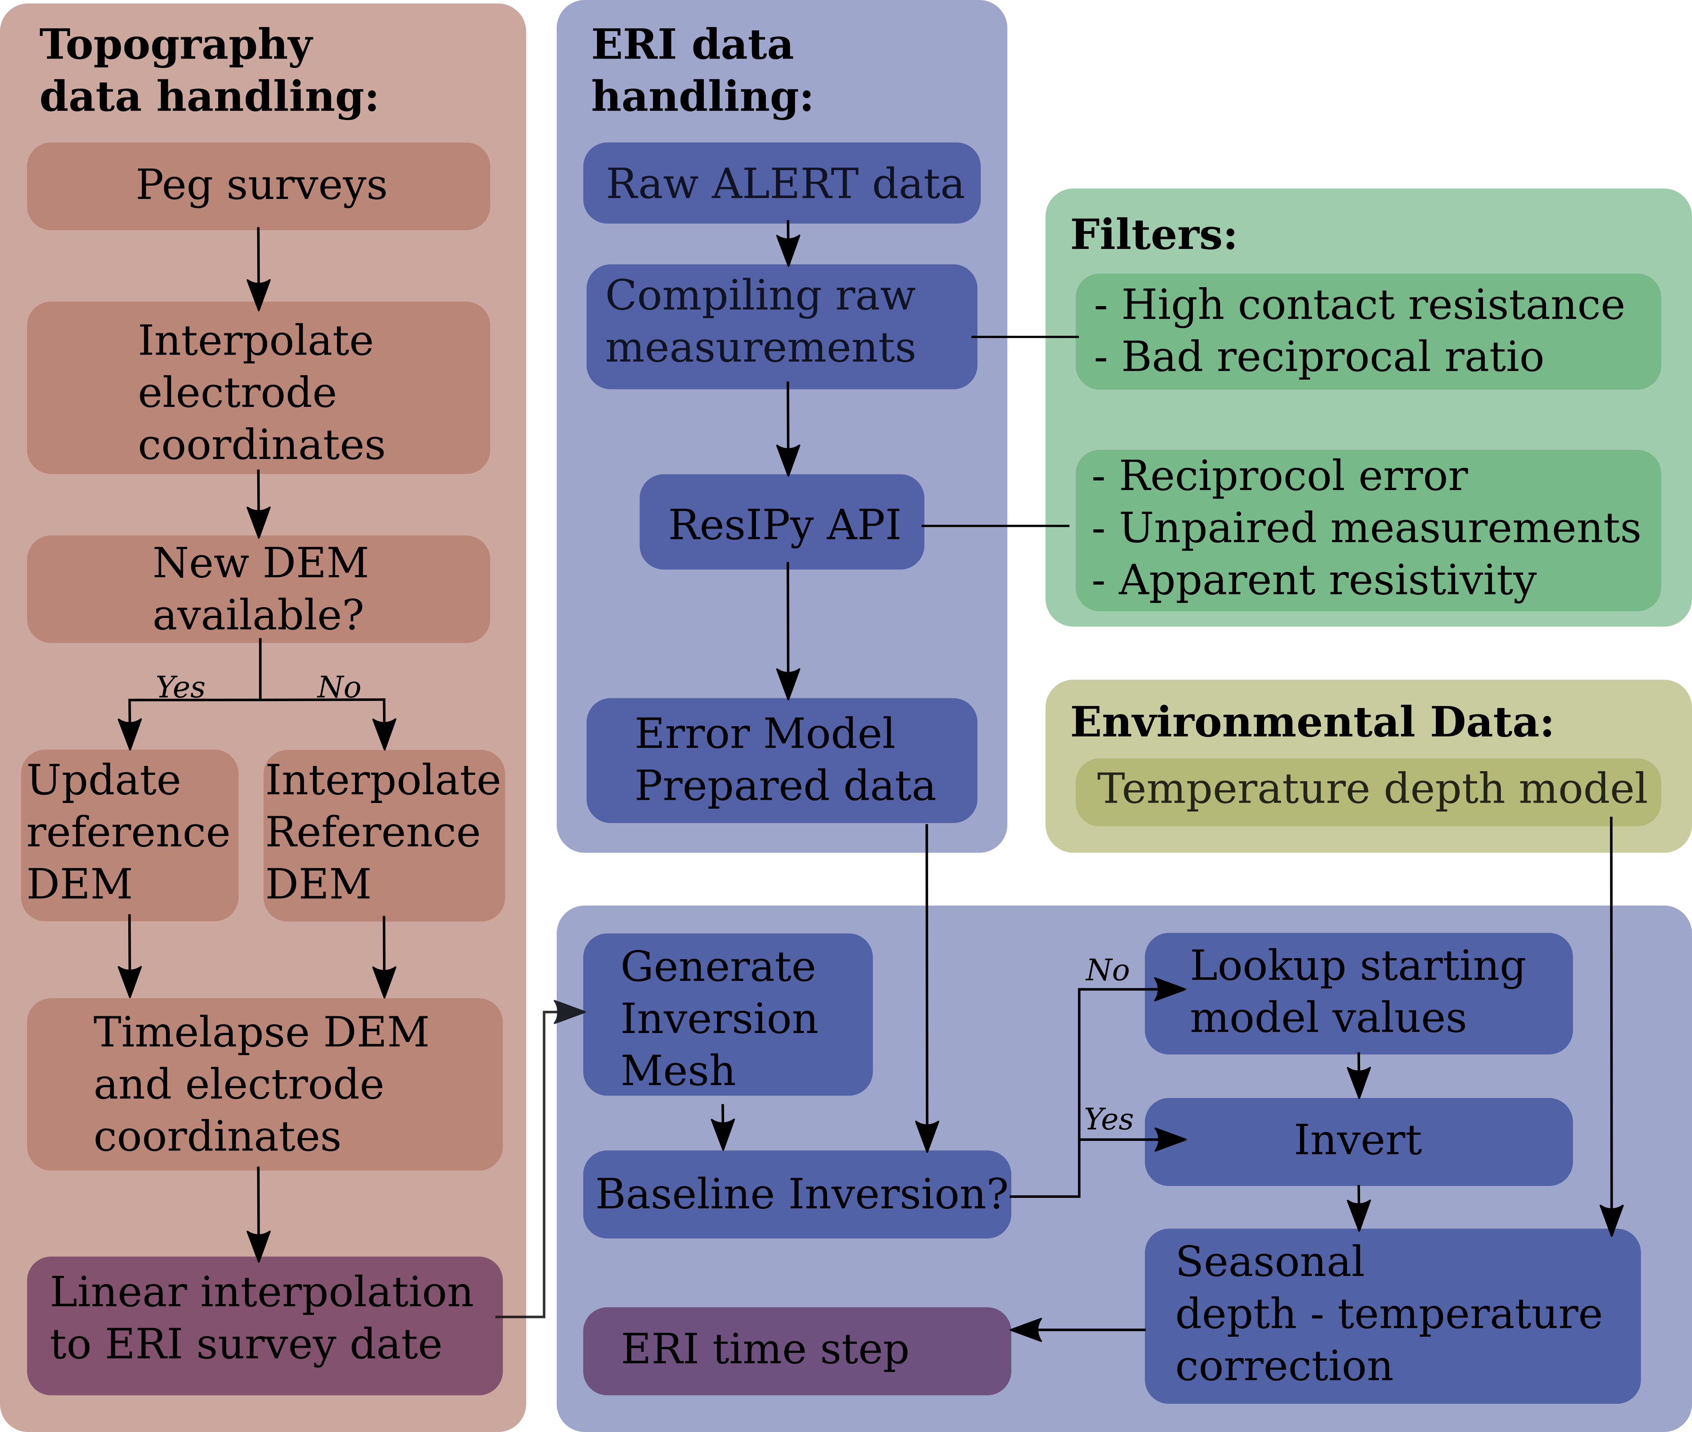
Workflow summary
Methodology

Slide 8
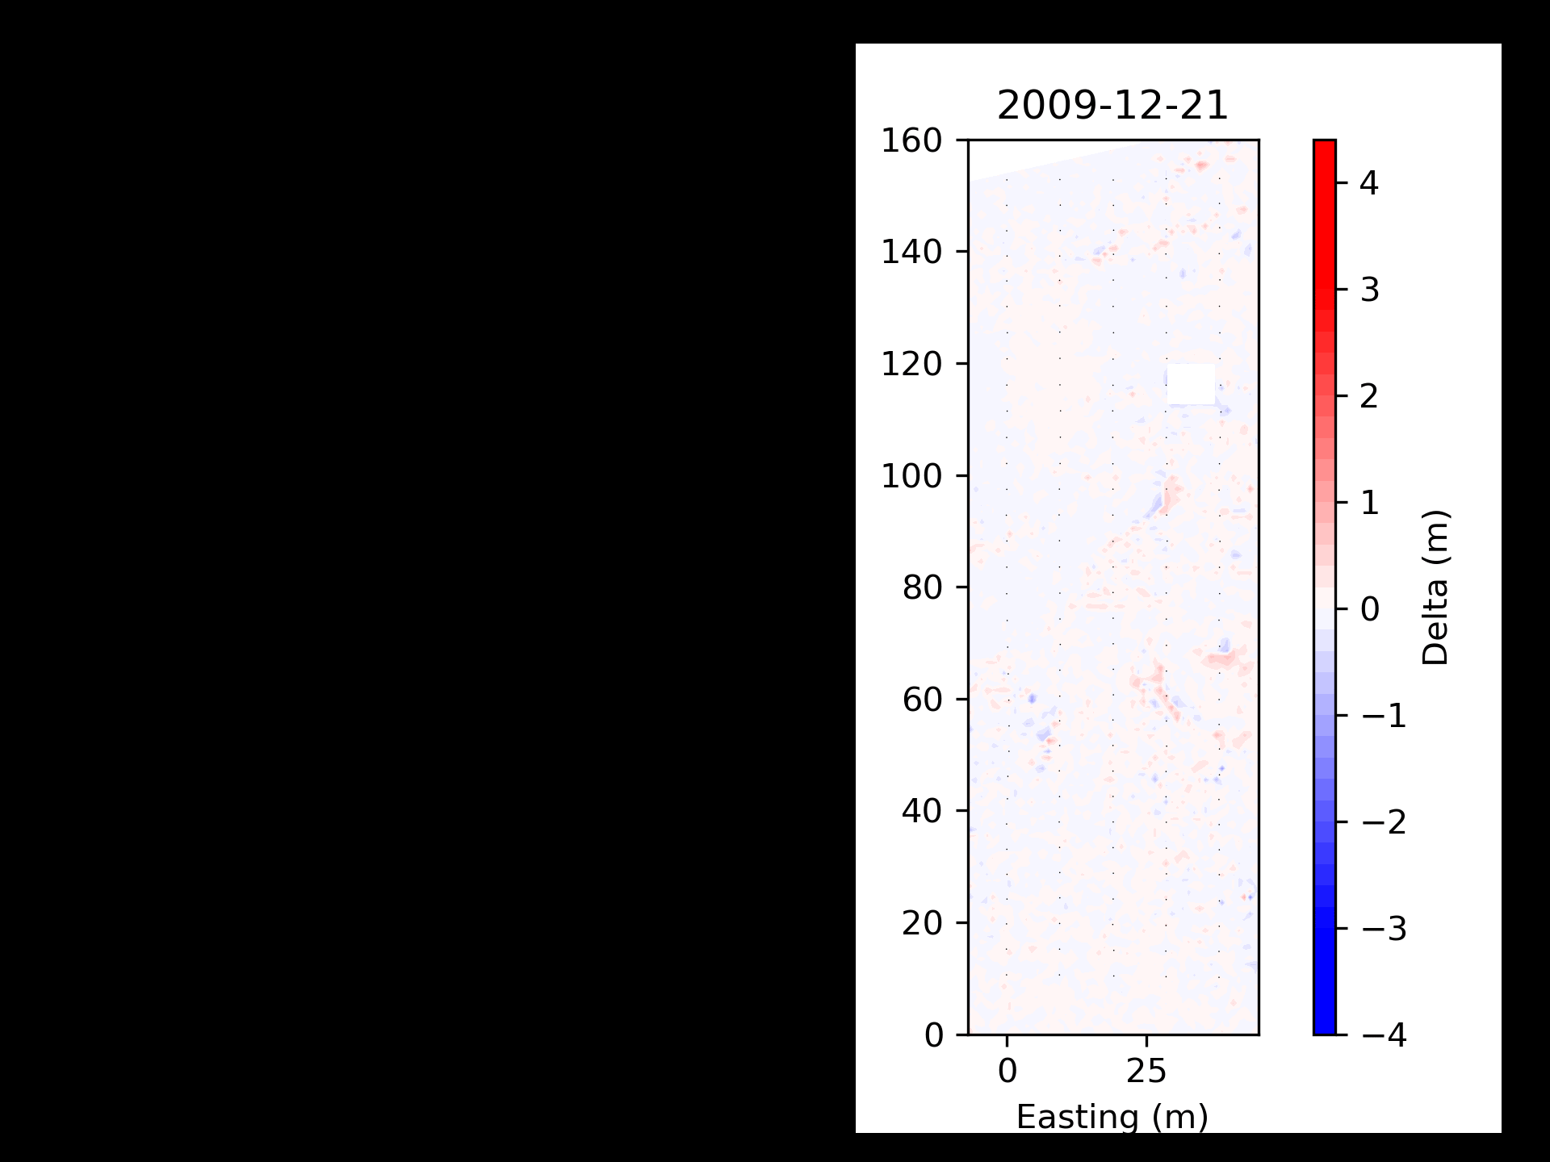
Combining methods
methodology
UAV and LIDAR surveys give a time series of DEMs.
Peg movement data gives a time series of lateral movements.
Interpolation over a grid using thin plate splines allows for mapping of electrode movements in four dimensions.
Electrode and model elevations periodically recalibrated with timelapse DEM.

Slide 9
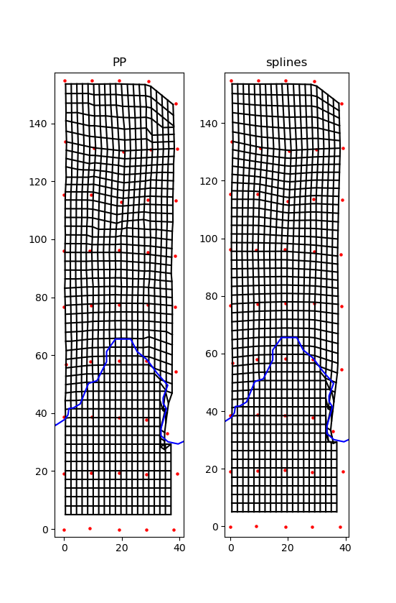
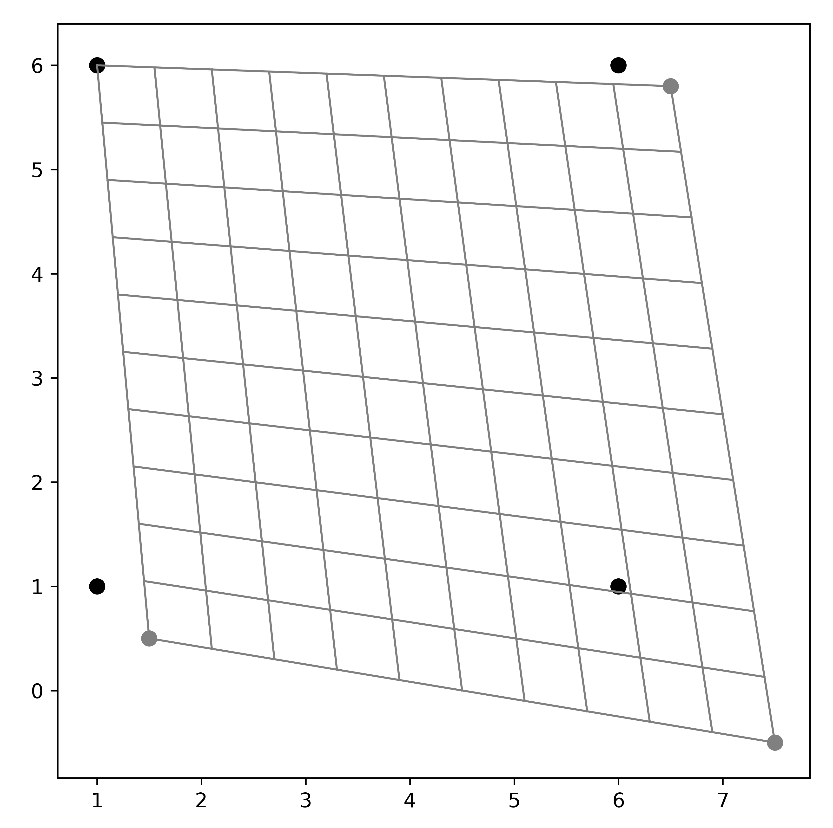
Mesh distortion graphics
Piecewise planer (PP) interpolation
method versus thin plate splines
Methodology
Additional constraint placed to honour flow lobe boundaries
Thin plate spline interpolations act
on irregular grid squares

Slide 10
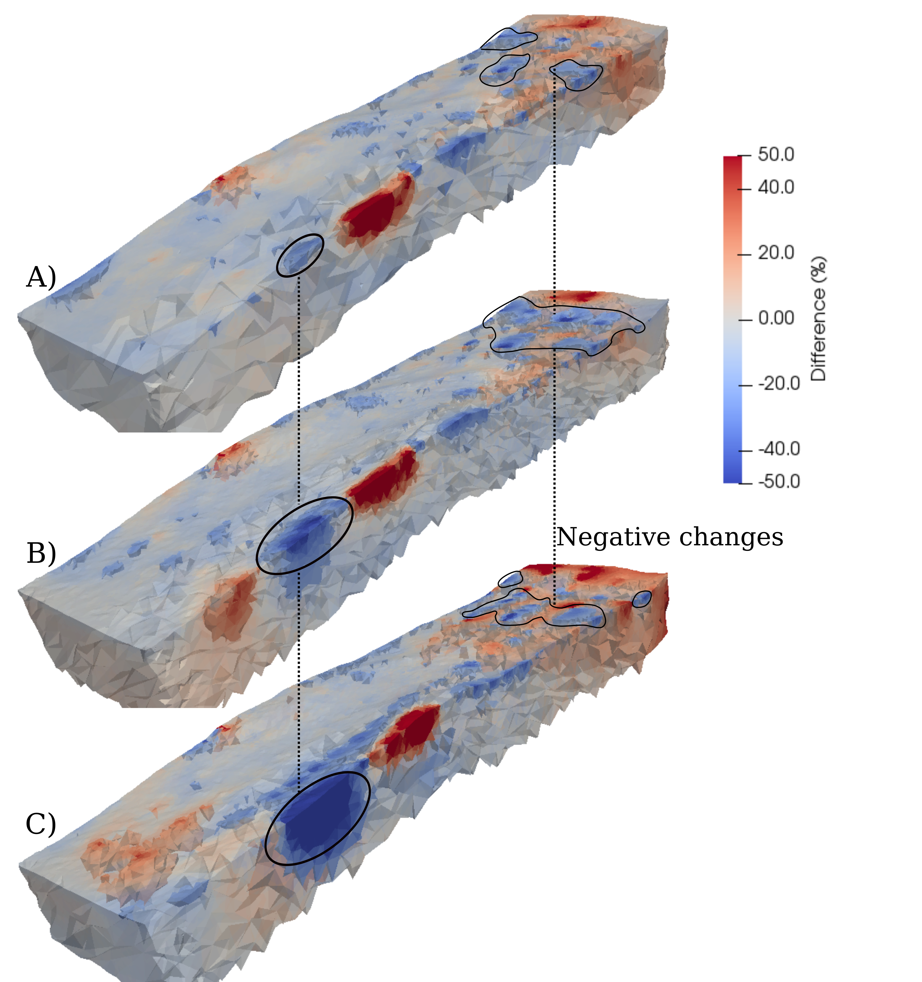
Importance of the time-lapse DEM
Further discussion
Modelled data in 2017 in when:
A) both electrode displacements and topographic changes modelled.
B) only electrode displacements modelled.
C) Assuming starting electrode positions and topography.
Scale of resistivity anomalies is different for the 3 scenarios, importantly not accounting for slope movements increases the likelihood for processing artefacts which could be mis-interpreted.

Slide 11
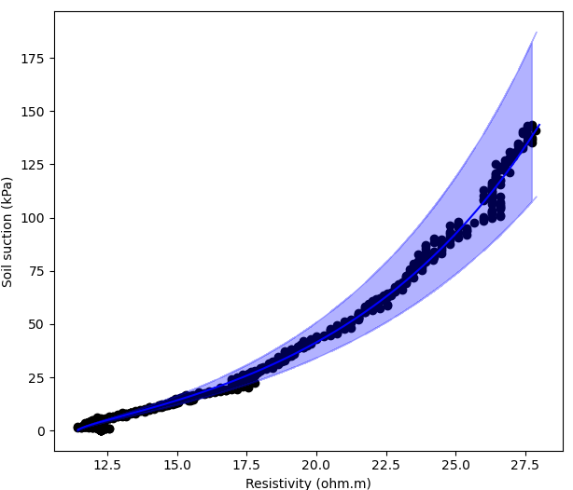
Suction – Resistivity relationship
Further discussion
Why?
Has physical meaning in the geotechnical field.
Directly influences unsaturated shear strength (Lu and Likos. 2006; Crawford and Byson. 2018).
Can be used for pressure based hydrological modelling.
Offers a direct link between resistivity and suction.

Slide 12
Round up
Conclusions
Used UAV and LIDAR and peg movement data to create a time series of DEMs for the field site (Hollin Hill).
Processed geoelectrical data with a baseline constraint, to create a time series of geophysical (electrical resistivity) volumes.
Time series DEMs can be used to understand landslide kinematics at this site.
Additionally, time series geophysics illuminates subsurface processes.
Possible to relate geophysical measurements to other geotechnical parameters (e.g. gravimetric moisture content, negative pore pressure estimation).

Slide 13
References
BOYD, J., CHAMBERS, J., WILKINSON, P., PEPPA, M., WATLET, A., KIRKHAM, M., JONES, L., SWIFT, R., MELDRUM, P. & UHLEMANN, S. 2021. A linked geomorphological and geophysical modelling methodology applied to an active landslide. Landslides, 1-16.
CRAWFORD, M. M. & BRYSON, L. S. 2018. Assessment of active landslides using field electrical measurements. Engineering Geology, 233, 146-159.
LU, N. & LIKOS, W. J. 2006. Suction Stress Characteristic Curve for Unsaturated Soil. Journal of Geotechnical and Geoenvironmental Engineering, 132, 131-142.
MERRITT, A. J., CHAMBERS, J. E., MURPHY, W., WILKINSON, P. B., WEST, L. J., GUNN, D. A., MELDRUM, P. I., KIRKHAM, M. & DIXON, N. 2013. 3D ground model development for an active landslide in Lias mudrocks using geophysical, remote sensing and geotechnical methods. Landslides, 11, 537-550.
PEPPA, M. V., MILLS, J. P., MOORE, P., MILLER, P. E. & CHAMBERS, J. E. 2019. Automated co‐registration and calibration in SfM photogrammetry for landslide change detection. Earth Surface Processes and Landforms, 44, 287-303.

Slide 14
Any questions?
Thank you
14

