Slide 1


Identifying links between hydroclimatic variability and economical components using stochastic methods
Ilias Arvanitidis, Marianna Diamanta, G.-Fivos Sargentis, Theano Iliopoulou, Panayiotis Dimitriadis, and Demetris Koutsoyiannis
Department of Water Resources and Environmental Engineering, School of Civil Engineering, National Technical University of Athens, Greece

Slide 2
Introduction
Historically water has been a driving force for economic growth
Breaking down the relationship between GDP and water resources availability
We attempt to perform analysis in both temporal and spatial scale
How sensitive are modern economies to hydroclimatic variability?
Development of water infrastructure: Leads to desensitization?
Occurrence of hydroclimatic extremes: Is GDP regressing? Do they limit growth?
Spatial analysis by using the Köppen climate index
Decoupling the water-food relationship as part of the perplexed WEF nexus.

Slide 3
Gross Value Added: Agriculture Forestry & Fishing
1960-2020 yearly time series
Gross value added (GVA) is an economic productivity metric that measures the contribution of a corporate subsidiary, company, or municipality to an economy, producer, sector, or region
In the agriculture sector it shows the added value minus the intermediate internal consumption plus the subsidies given.

Slide 4
Per capita

Slide 5
Irrigated agriculture
Only 9 countries exceed the 32% benchmark in irrigated agricultural land (as a % of total agricultural land)
Nearly half of the countries lie down the 4.6% level
Globally, approximately 70% of freshwater withdrawals are irrigating agriculture areas and ~20% are used for industrial purposes

Slide 6
The role of water infrastructure
Level of water stress: Freshwater withdrawal as % of available freshwater resources
Half of the world’s countries use lower than 10% of their water resources
Some countries exceed the 100 threshold by water imports or desalination

Slide 7
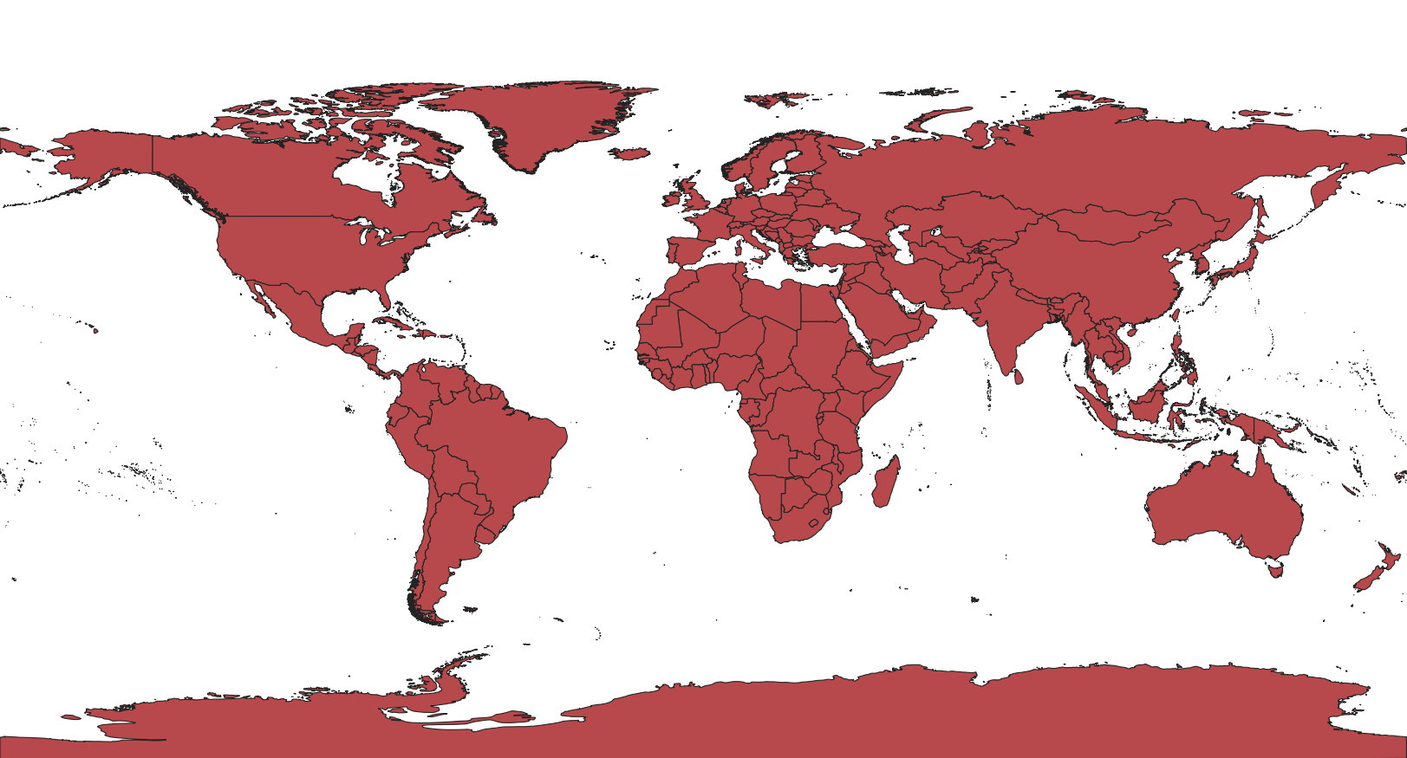
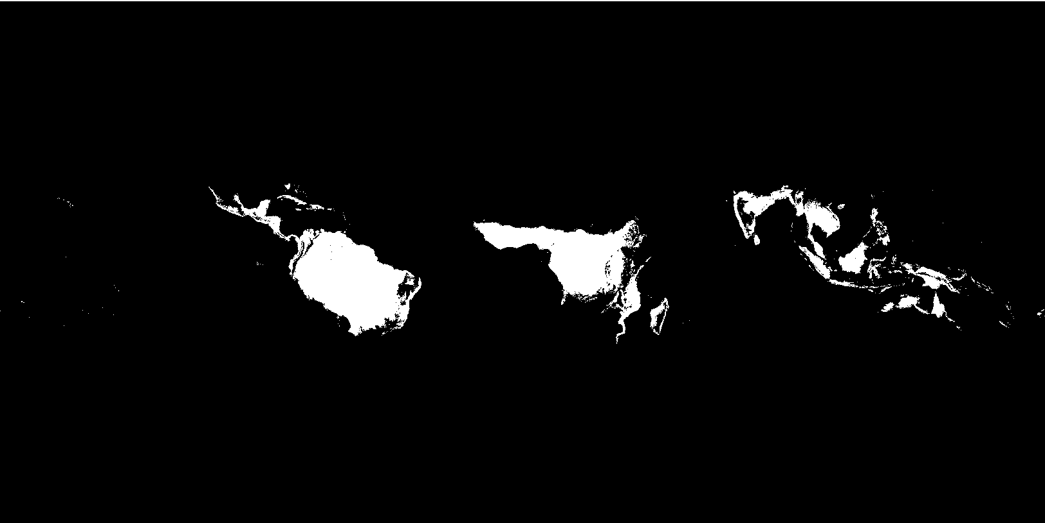
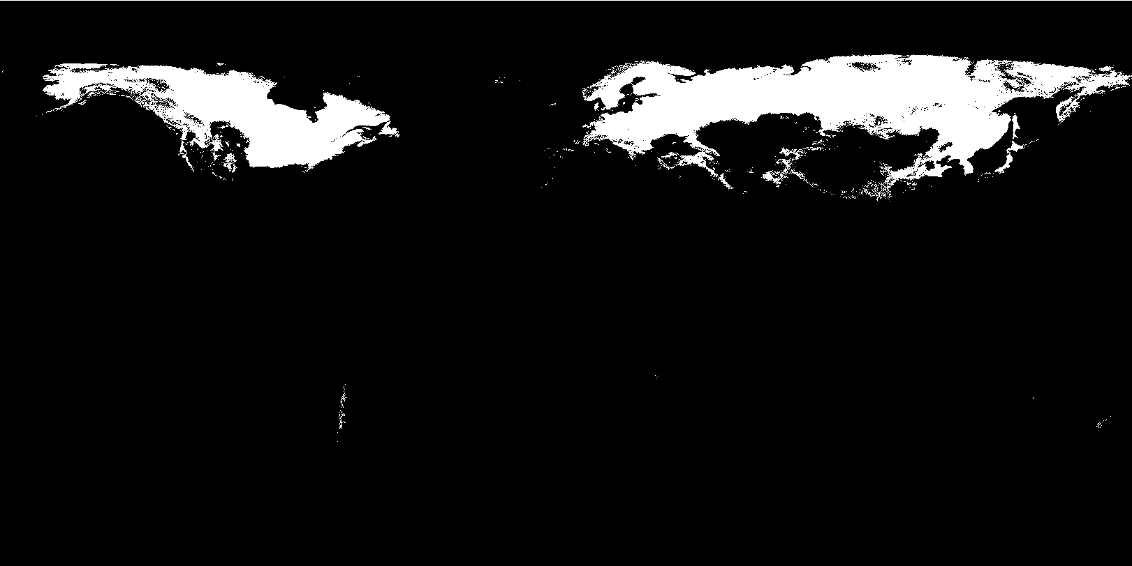
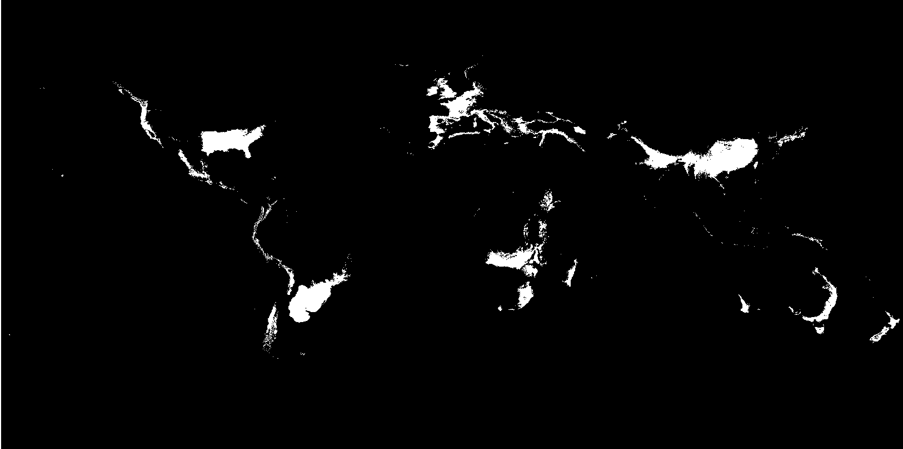
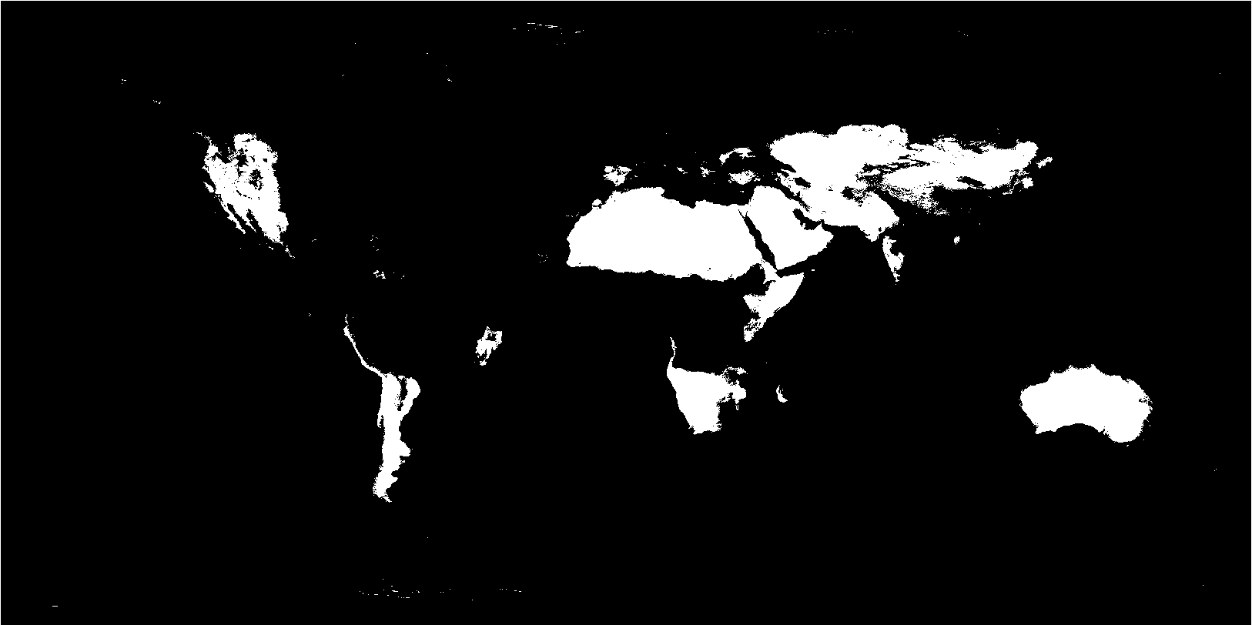
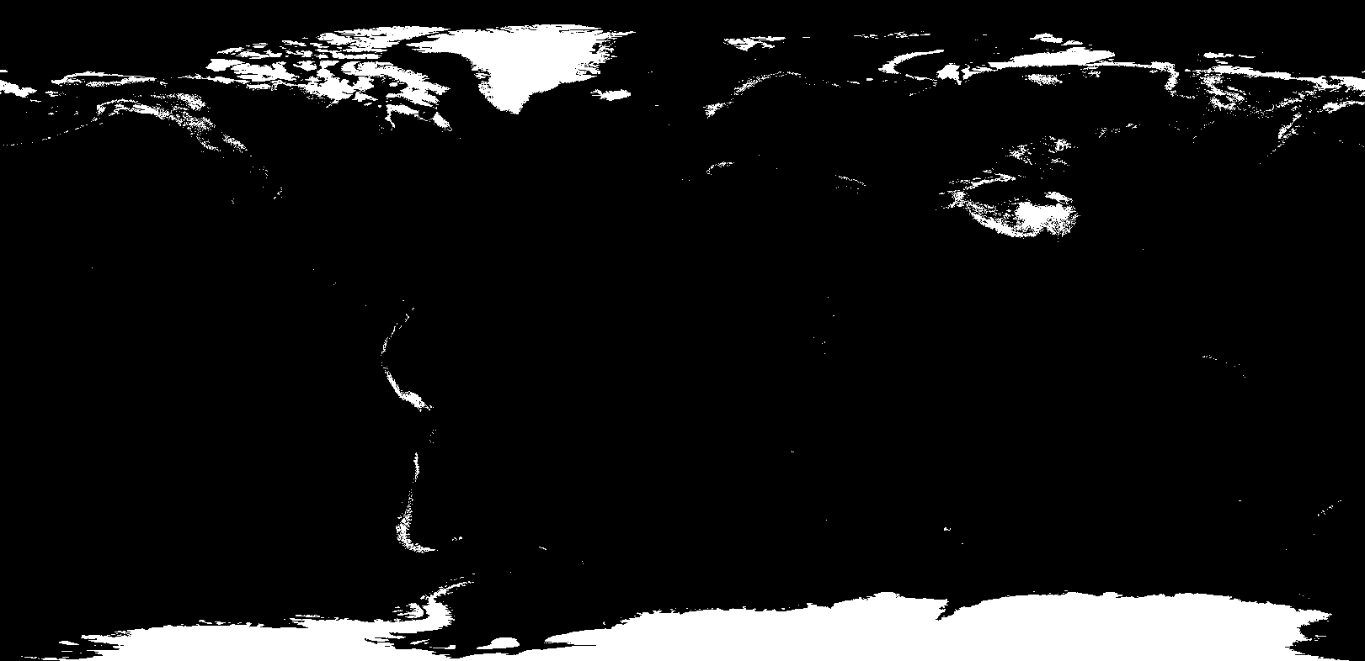
Köppen-Geiger climate classification

Slide 8
Köppen-Geiger climate classification

Slide 9
The case of Botswana
Irrigated land: 0.0035%
Level of water stress: 1.6
Köppen index: 100% B (dry)

Slide 10
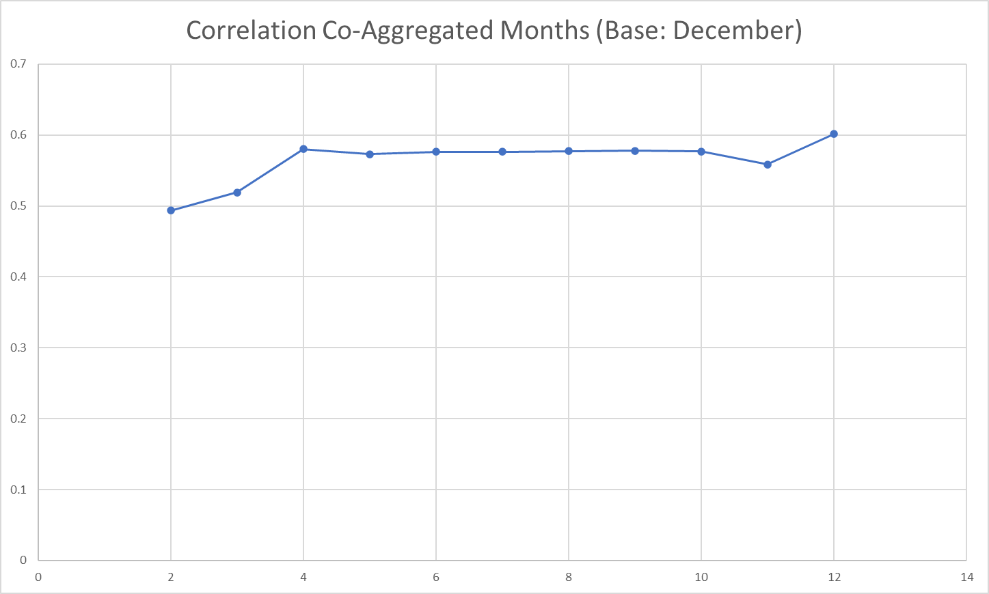

Slide 11
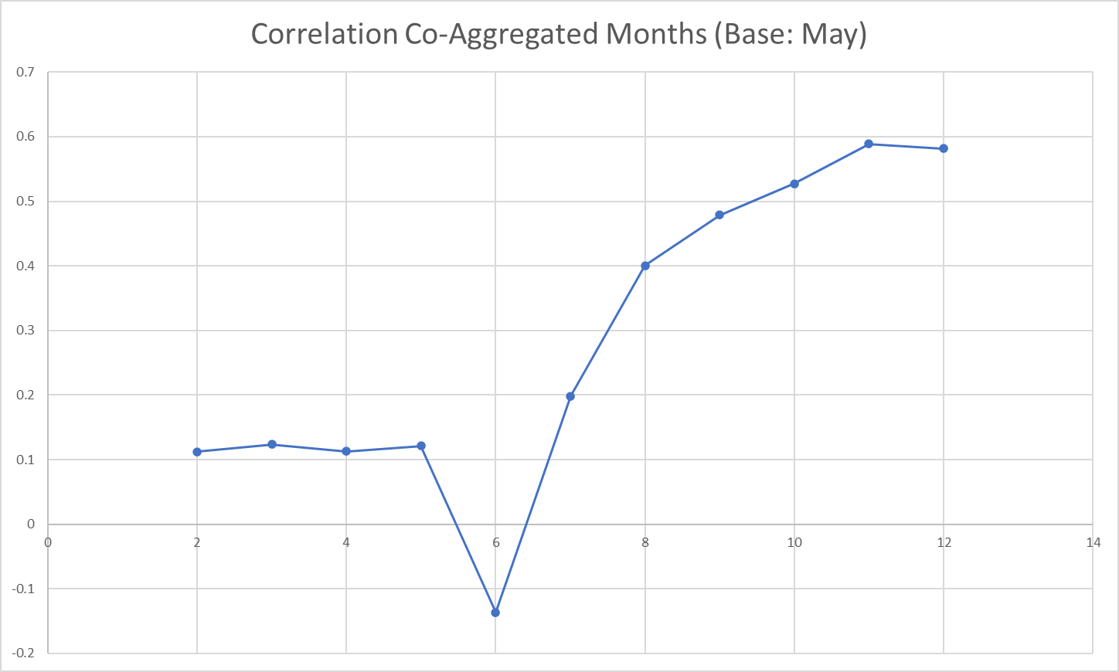

Slide 12
The case of France
Irrigated Agri Land: 4.9%
Level of Water Stress: 29.39
Köppen index: 91% C (temperate)
7% D (continental)

Slide 14
Conclusions
GVA has an increasing trend in absolute values for most countries, yet this trend is less pronounced when normalized with the population
Developing countries with poor water infrastructure seem to be more sensitive to hydroclimatic variability
The same countries for the same reasons keep small and incomplete data and the multi-scale (time) analysis becomes difficult
The crop-mix of each agricultural sector may be related taking into account smaller time frames
Finding a holistic index for measuring the water infrastructure of each economy will provide a foundation for more rigorous analysis
Type B (dry) Köppen index countries: present strong correlation during the wet periods
Land use competition between water-energy-food sectors must be taken into account in the generic water resource-GDP relationship

Slide 15
Bibliography
Beck, H.E., N.E. Zimmermann, T.R. McVicar, N. Vergopolan, A. Berg, E.F. Wood Present and future Köppen-Geiger climate classification maps at 1‑km resolutionScientific Data 5:180214, doi:10.1038/sdata.2018.214 (2018)
Sargentis, G.-F.; Defteraios, P.; Lagaros, N.D.; Mamassis, N. Values and Costs in History: A Case Study on Estimating the Cost of Hadrianic Aqueduct’s Construction. World 2022, 3, 260-286. https://doi.org/10.3390/world3020014
Sargentis, G.-F.; Siamparina, P.; Sakki, G.-K.; Efstratiadis, A.; Chiotinis, M.; Koutsoyiannis, D. Agricultural Land or Photovoltaic Parks? The Water–Energy–Food Nexus and Land Development Perspectives in the Thessaly Plain, Greece. Sustainability 2021, 13, 8935. https://doi.org/10.3390/su13168935
Koutsoyiannis, D. (2011) Scale of water resources development and sustainability: small is beautiful, large is great. Hydrol. Sci. J. 56(4), 553–575. \
Vörösmarty, C. & McIntyre, P & Gessner, Mark & Dudgeon, David & Proussevitch, Alexander & Green, Pamela & Glidden, Stanley & Bunn, Stuart & Sullivan, Caroline & Reidy Liermann, Catherine & Davies, Peter. (2010). Global Threats to Human Water Security and River Biodiversity. Nature. 468. 334. 10.1038/nature09549.
G. Karakatsanis, E. Kontarakis, P. Dimitriadis, T. Iliopoulou, and D. Koutsoyiannis, Hydroclimate and agricultural output in developing countries, European Geosciences Union General Assembly 2018, Geophysical Research Abstracts, Vol. 20, Vienna, EGU2018-13059-1, European Geosciences Union, 2018.

Slide 16
Questions

