Slide 1
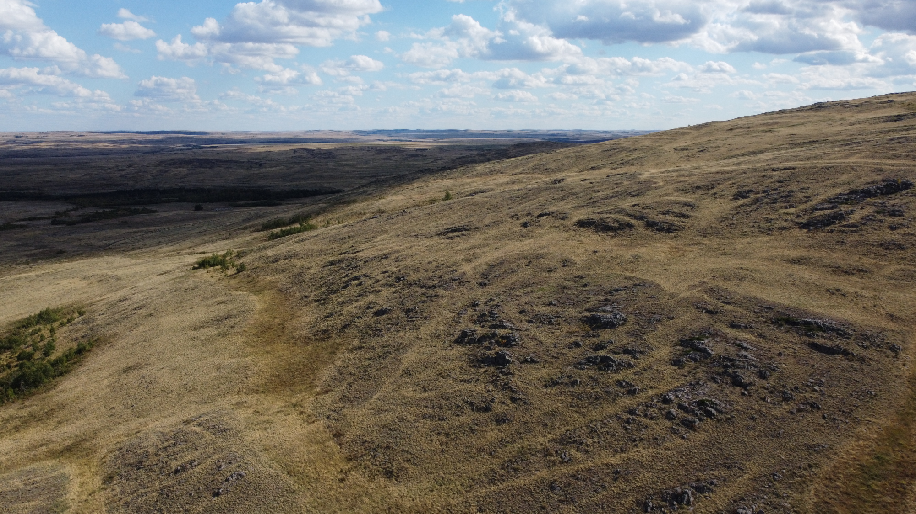
Formation History of the Cheka Pluton of Alkaline Granitoids (Southern Urals)
Petr Shestakov, Alexandr Tevelev, Natalia Pravikova, Ekaterina Volodina, Alexandra Borisenko, Alexei Kazansky, and Egor Koptev
Lomonosov Moscow State University

Slide 2
Study objectives
Identify paleostress directions through analysis of fracture patterns
Identify magma flow direction through application of petromagnetic method
Develop a deformation model for the Cheka pluton
Materials used:
180 fractures measurements from 5 locations
64 core samples for the petromagnetic study from 6 locations
Complementary satellite and aerial images

Slide 3
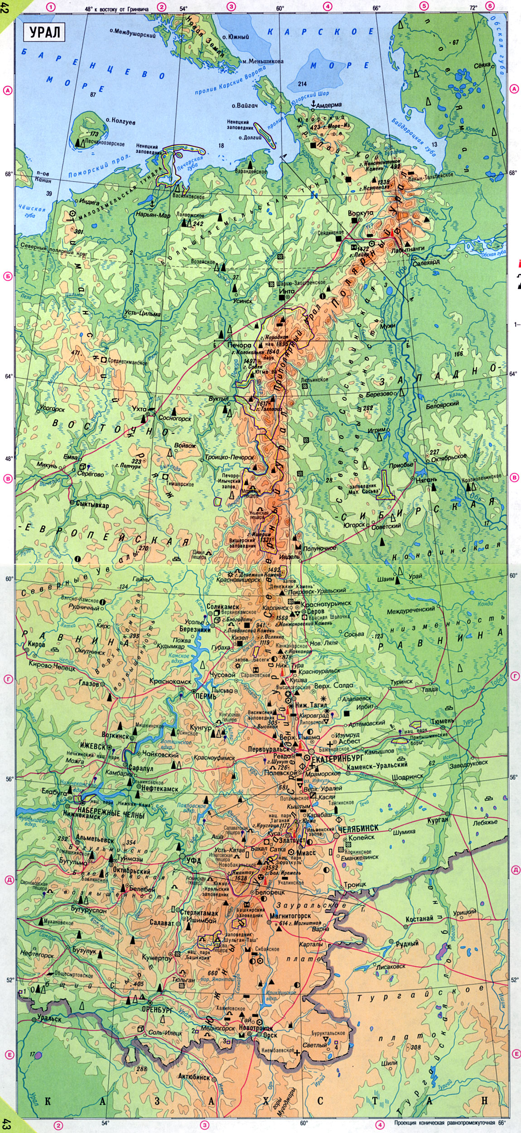
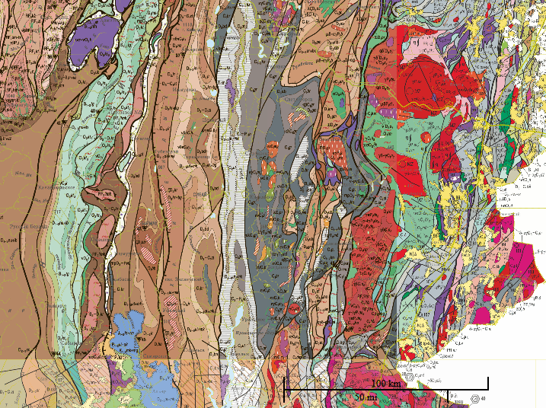
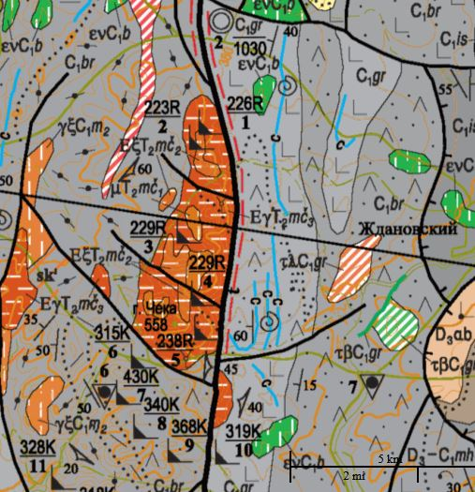
Location of the Cheka pluton

Slide 4
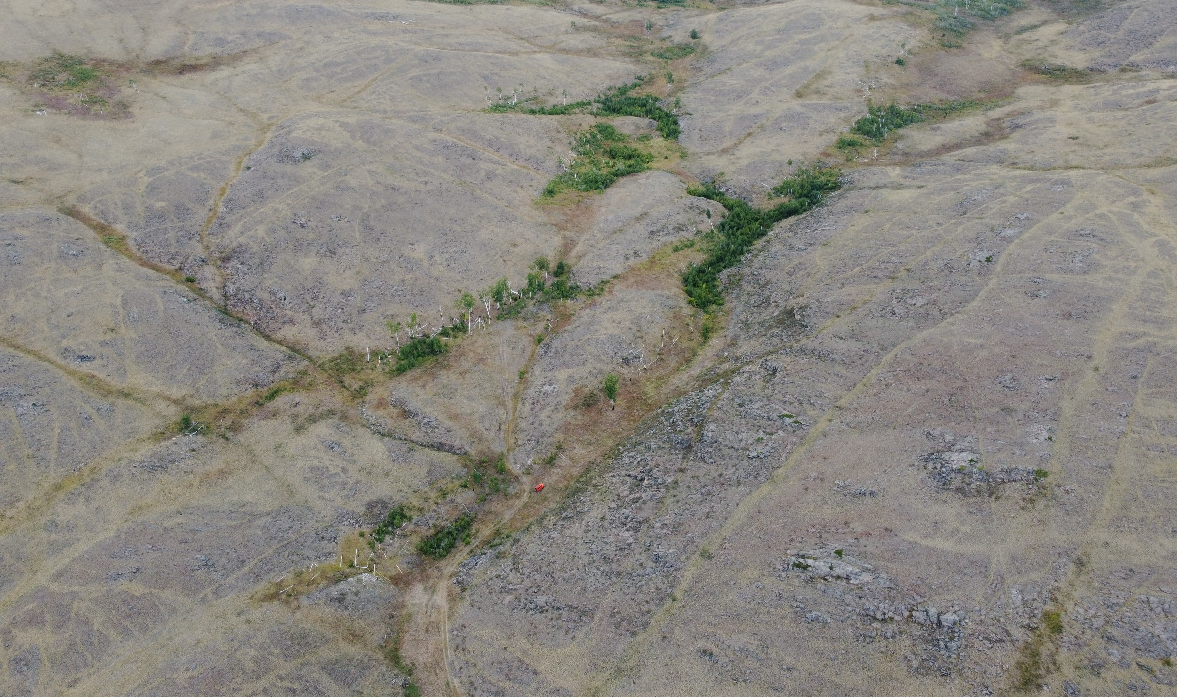
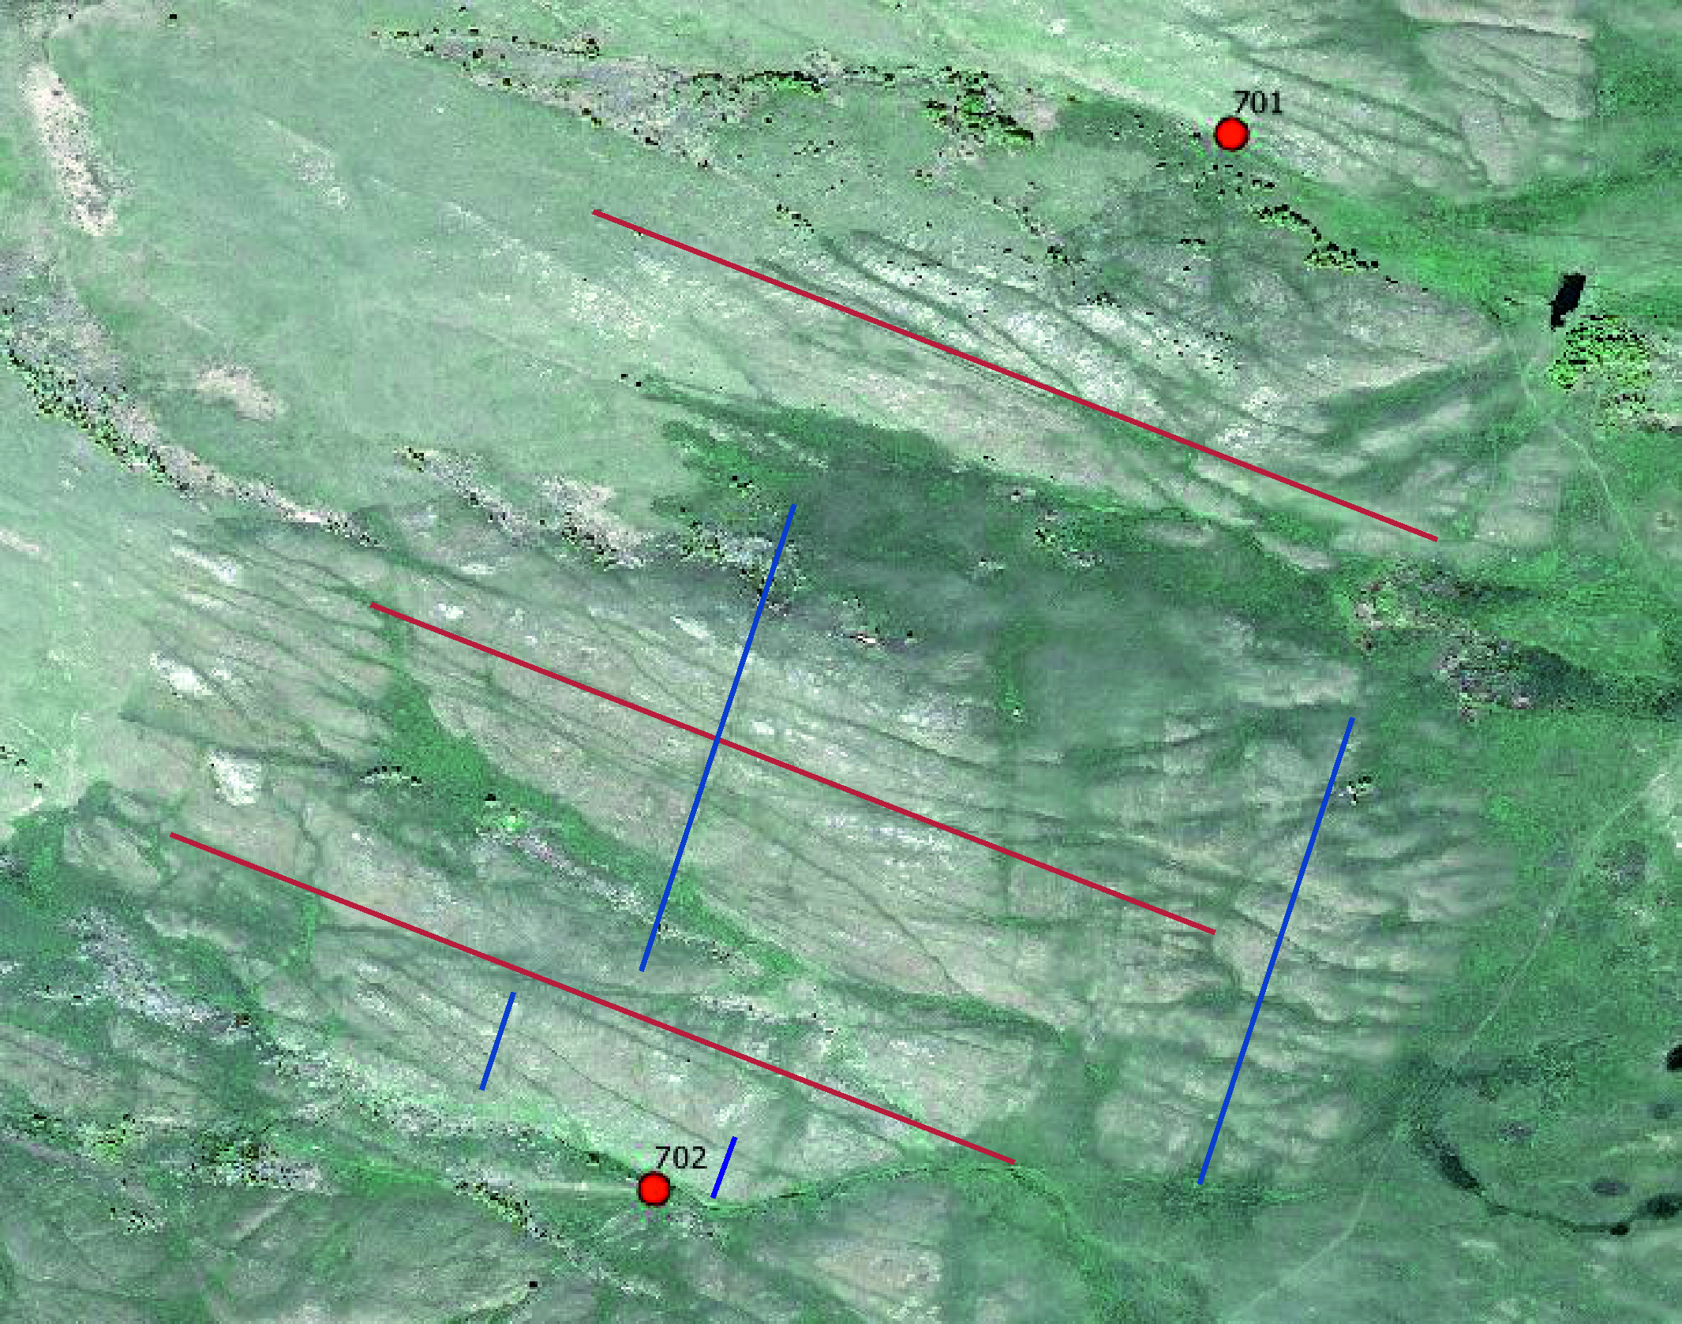
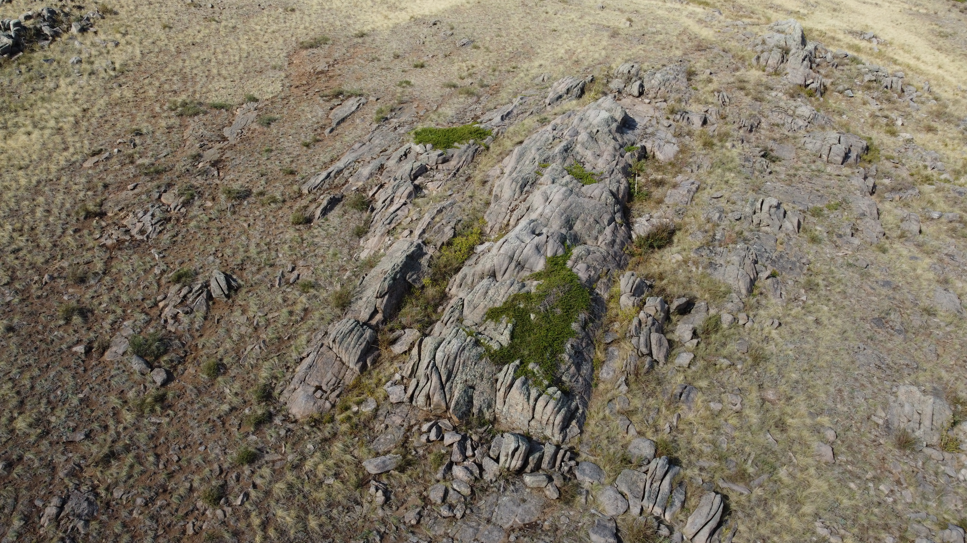
Major fractures
Major fracture (facing west)
Major fractures of the Cheka pluton (satellite image provided by Geoportal)
Major fracture (facing north)

Slide 5
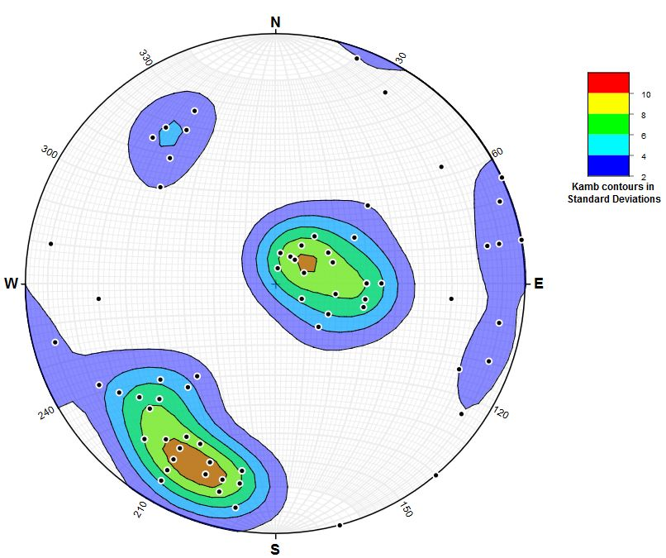
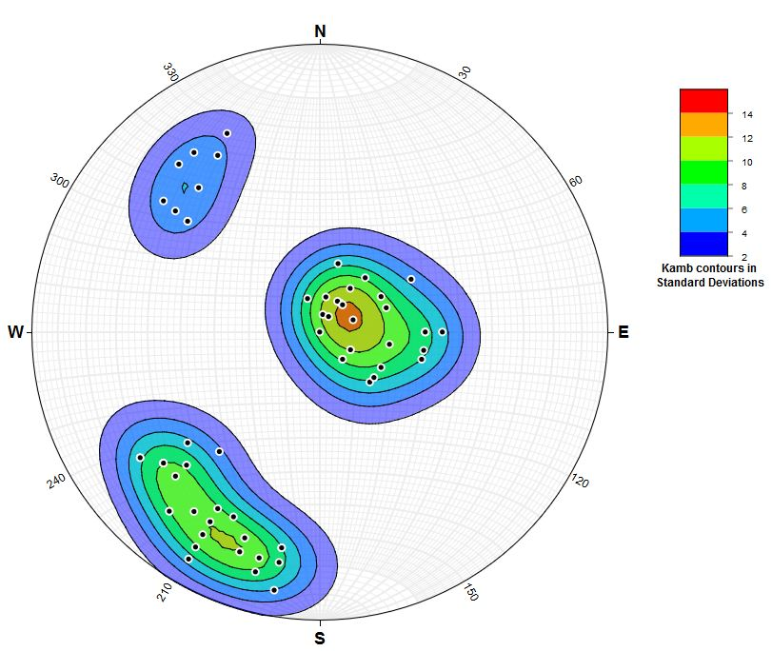
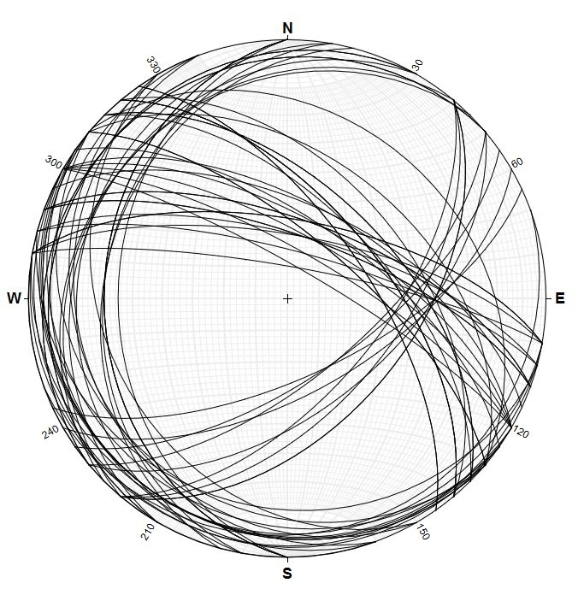
Prototectonic fracture separation
Q
L
S
Prototectonic fractures at locations 701 and 702 (planes)
Prototectonic fractures at all locations (poles)
Prototectonic fracture poles at locations 701 and 702

Slide 6
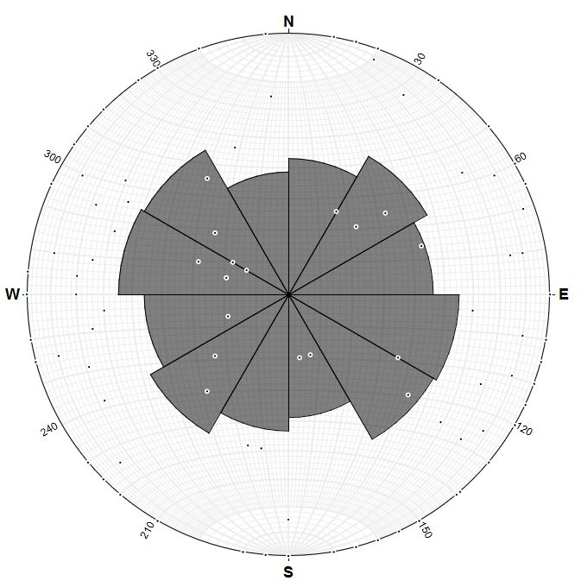
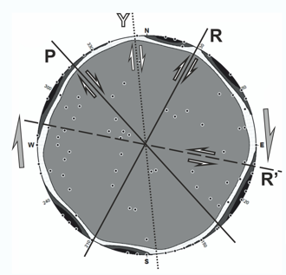
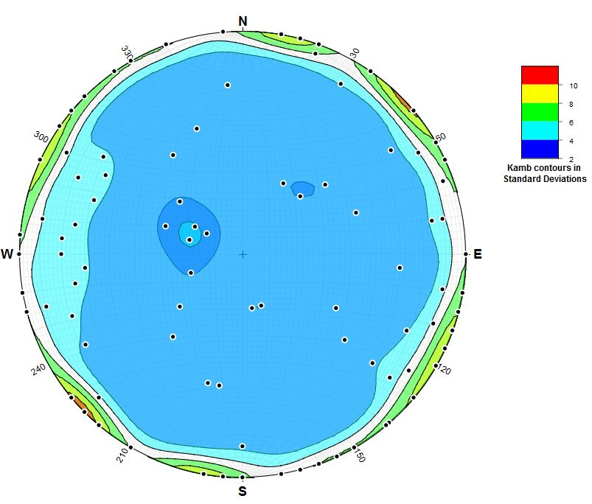
Tectonic fractures separation and analysis
Y
P
R
R’
σ¹
σ³
Tectonic fractures at all locations
Separation of dominant plane orientations
Analysis of tectonic fractures

Slide 7
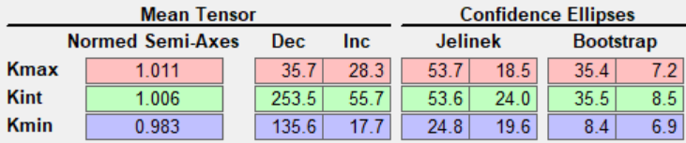
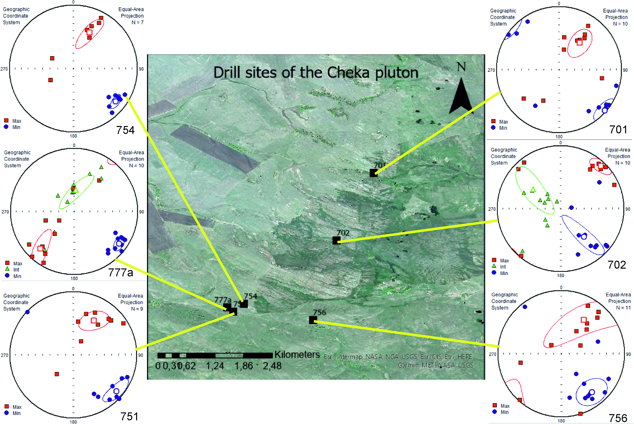
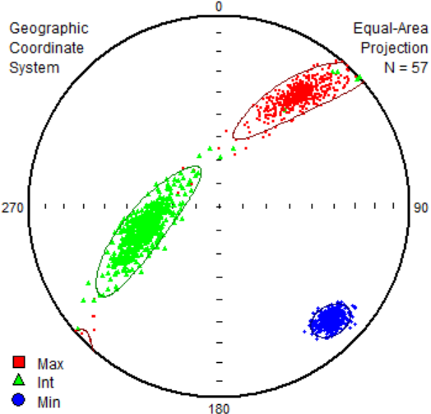
Petromagnetic studies
Magma flow orientation - 35,7° (based on Kmax и Kmin axis)
All locations have similar results
Raw petromagnetic study results
(Anisoft 5.1 software)
Petromagnetic study results
(Anisoft 5.1 software; satellite image from “Geoportal”)

Slide 8
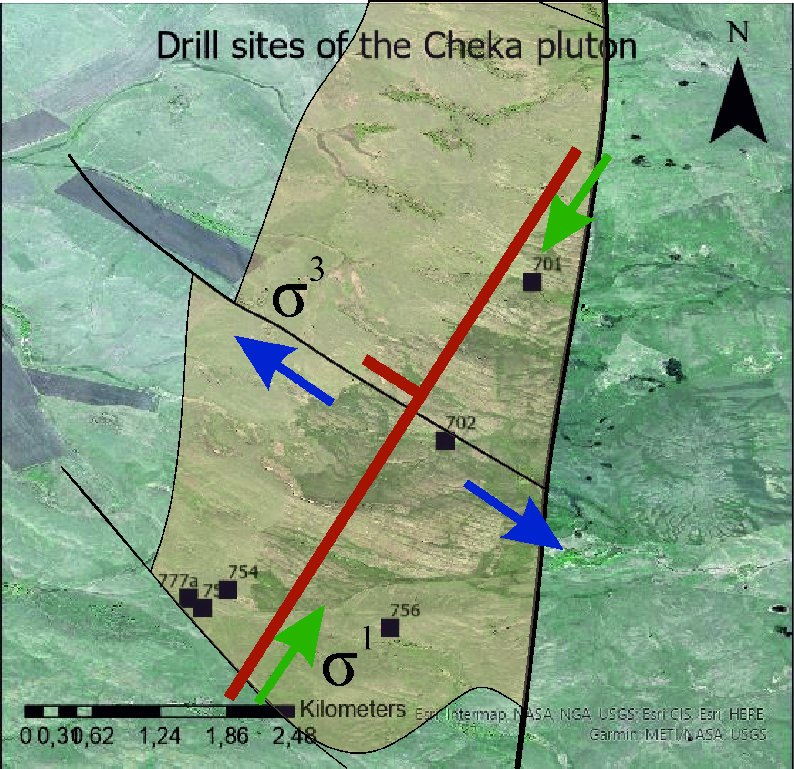
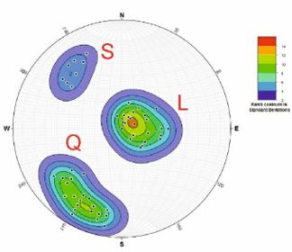
Conclusion: Deformation model
Fracture types identified as S, Q and L (based on the direction of magma flow)
Orientation of compression (39°) and magma flow (36°) are almost identical
Deformation model was created
Poles of S, Q, L prototectonic fractures
(stereonet software)
Deformation model of the Cheka pluton
(paleostress directions and magma flow orientation)

Slide 9
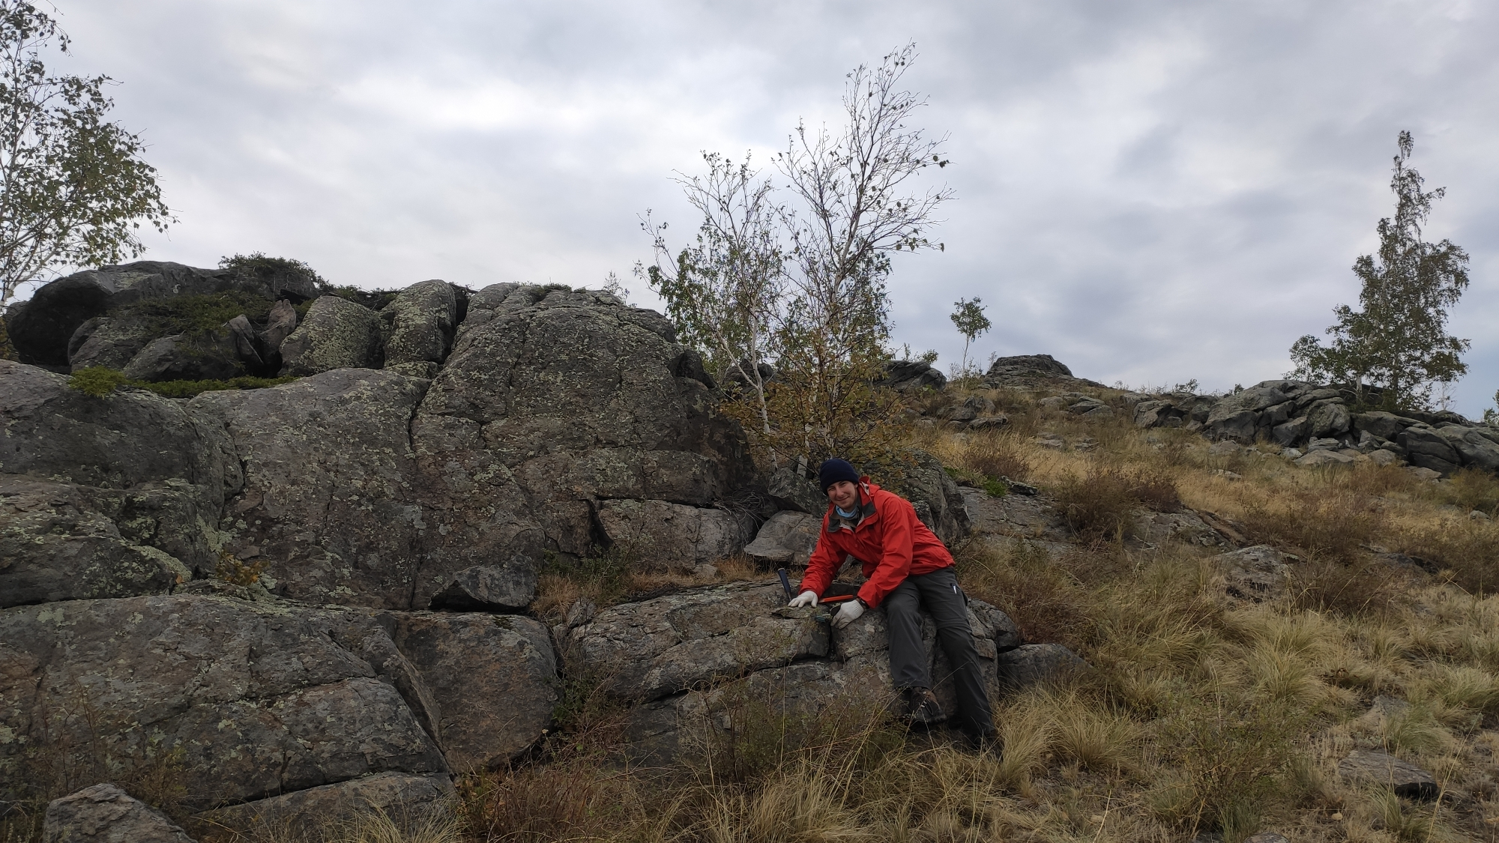
Thank you for your attention!
Acknowledgments
This study was funded by the Russian Foundation for Basic Research and Czech Science Foundation through the research project №19-55-26009. Remote sensing data provided by the Centre of collective usage ‘Geoportal’, Lomonosov Moscow State University (MSU).

