Slide 1


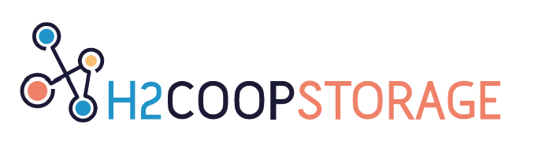
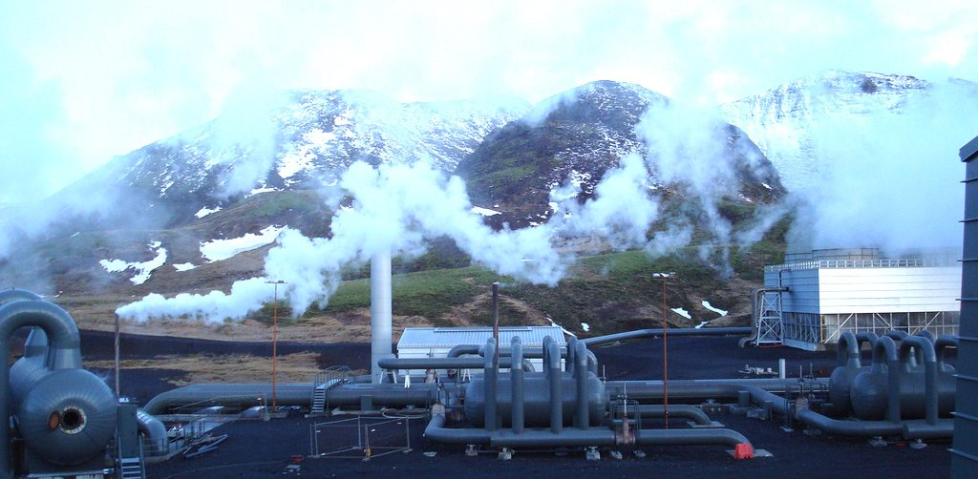
Opportunities and drivers for hydrogen production from renewable energy in Iceland.
Constructing of a causal loop diagram from stakeholders perspective in Iceland.
Robin Perruchoud, Guillaume Vögeli, David F. Finger
08.07.2020
Advisor ETH: Michael Stauffacher
EGU General Assembly 2022, Vienna, Austria 26.05.2022

Slide 2

Introduction
Iceland is a country very rich in (renewable) energy
Icelandic electricity generation : 83 % hydropower, 27 % geothermal
Geothermal base load production induces an unused electricity surplus
The possibility of storing the excess in the form of hydrogen is being assessed

Slide 3
Goals and research questions
What is the structure and behavior of the emerging Icelandic green hydrogen production system according to its stakeholders?
What are the main challenges and opportunities for H₂ deployment in Iceland?
What are the potential future developments of the system?

Slide 4
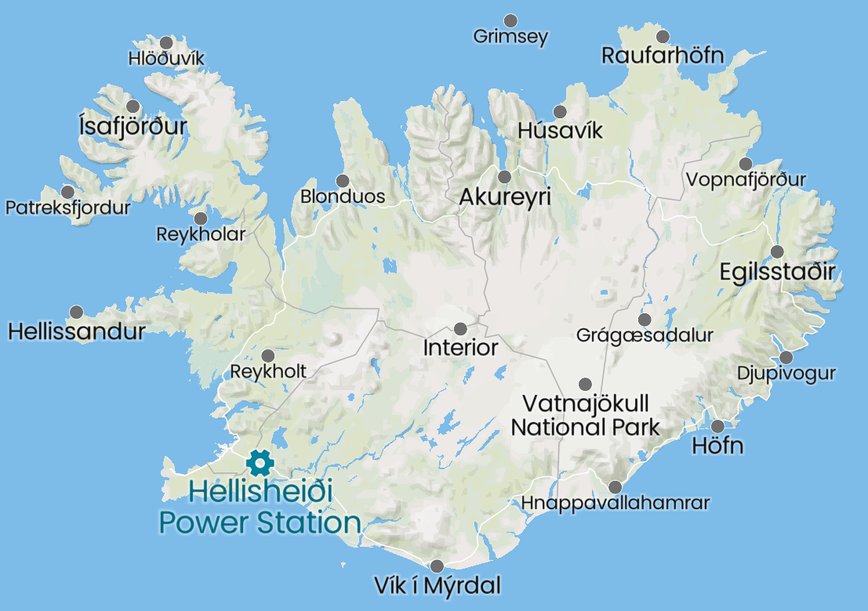
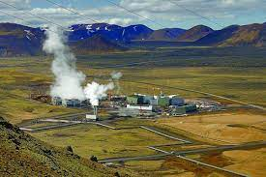
Methods: Case study
30 km east of Reykjavik, Iceland
Uses geothermal energy to produce electricity (300 MW) and heat
An electrolyzer was installed in order to provide H₂ for transportation (pilot project)
Position of the Hellisheidi power station, Mapcarta, Retrieved from : https://mapcarta.com/W296910352/Map
Hellisheidi Geothermal Power Project, Hengill, Renewable Technology, Retrieved from : https://www.renewable-technology.com/projects/hellisheidi-geothermal-power-project-hengill/

Slide 5


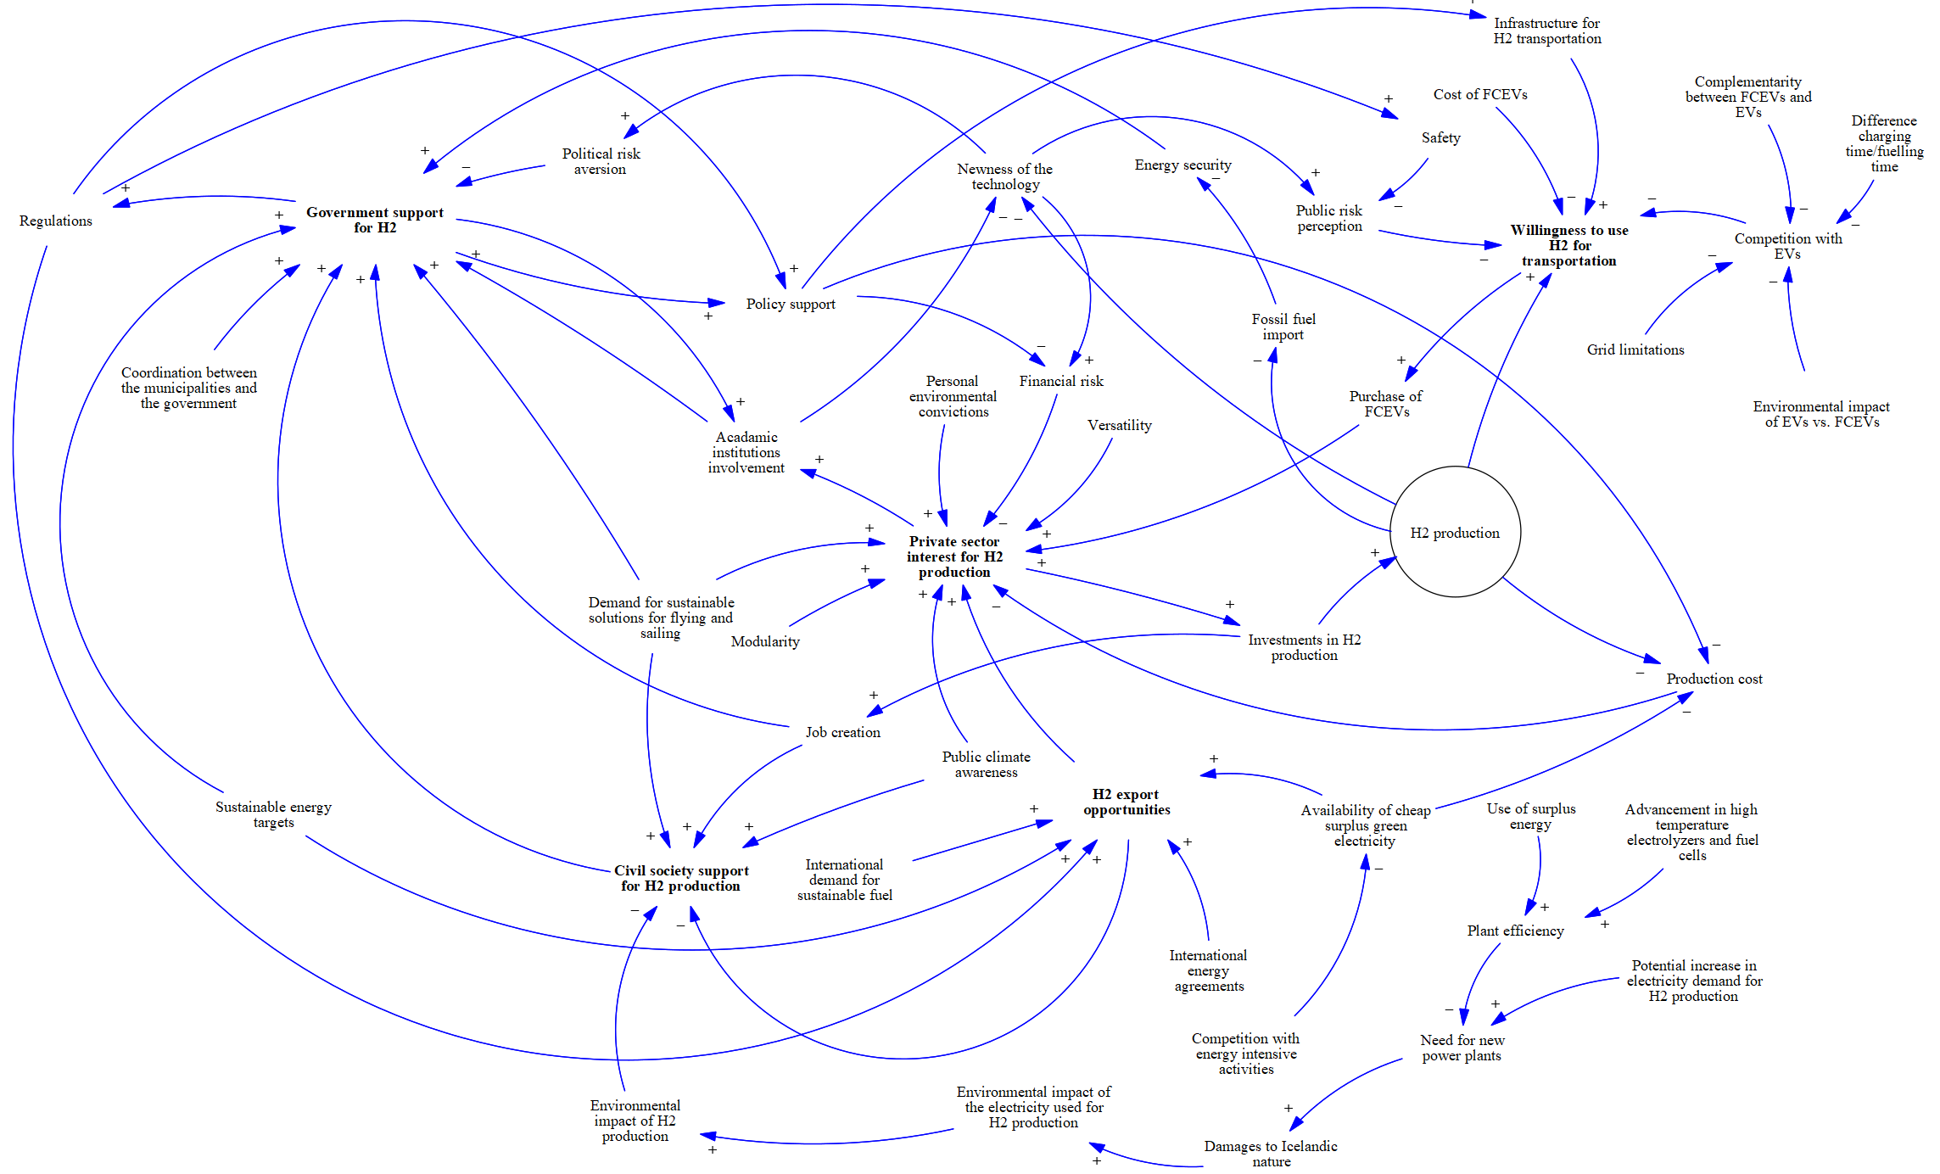
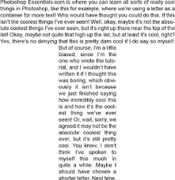
Methods
Theoretical background :
System dynamics, especially Causal Loop Diagrams (CLD)
Mental database
Audio
data
Textual data
CLD
Interview
Transcription
Modelling
Person Thinking Man Thinking – Thought, PngKey Commons, Retrieved from : https://www.pngkey.com/maxpic/u2w7y3w7r5a9u2w7/
How to shape text like any english capital alphabet, StackExchange Commons, Retrieved from : https://i.stack.imgur.com/ILQ42.gif
Audio datei, CleanPNG Commons, Retrieved from : https://de.cleanpng.com/png-uorxkk/

Slide 6
Results: Overall CLD

Slide 7
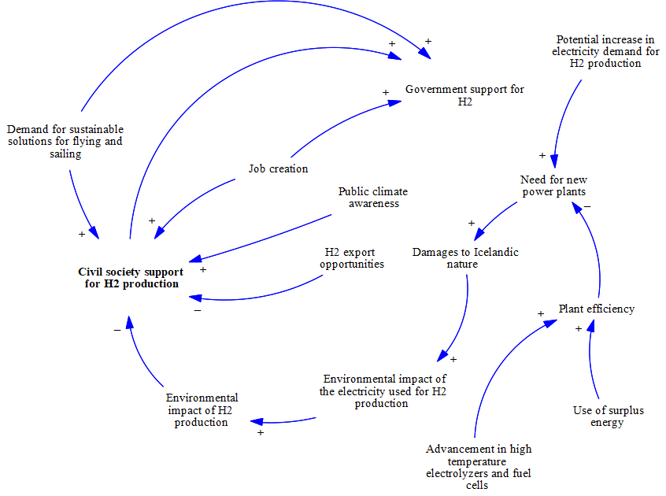
Results: Civil society sub-diagram
Nature protection is a hot topic in Iceland
An increase in electricity production would trigger a decrease in public support
This effect is counter-balanced via the increase in efficiency

Slide 8
Implications and conclusion
Causal loop modelling allows to visualize key aspects of the system
Several feedback loops were identified
Stakeholders perceive the system as sensitive to several external factors (technology cost, competition, foreign demand…)
Coordination between stakeholders is essential!
Long-lasting and stable policies are needed to avoid abrupt changes

Slide 9


Thank you for your attention!
Credit: Kai Boggild (distributed via imaggeo.egu.eu)
Abstract QR Code

Slide 10
Some important references
Voegeli, G., & Finger, D. C. (2021). Disputed dams: Mapping the divergent stakeholder perspectives, expectations, and concerns over hydropower development in iceland and switzerland. Energy Research & Social Science, 72, 101872.
Sterman, J. (2002). System dynamics: Systems thinking and modeling for a complex world. Massachusetts Institute of Technology. Engineering Systems Division.
Luna-Reyes, L. F., & Andersen, D. L. (2003). Collecting and analyzing qualitative data for system dynamics: Methods and models. System Dynamics Review: The Journal of the System Dynamics Society, 19 (4), 271296.
Kim, H., & Andersen, D. F. (2012). Building condence in causal maps generated from purposive text data: Mapping transcripts of the federal reserve. System Dynamics Review, 28 (4), 311328.
Freeman, C. (1991). Innovation, changes of techno-economic paradigm and biological analogies in economics. Revue économique, 211231.

Slide 11
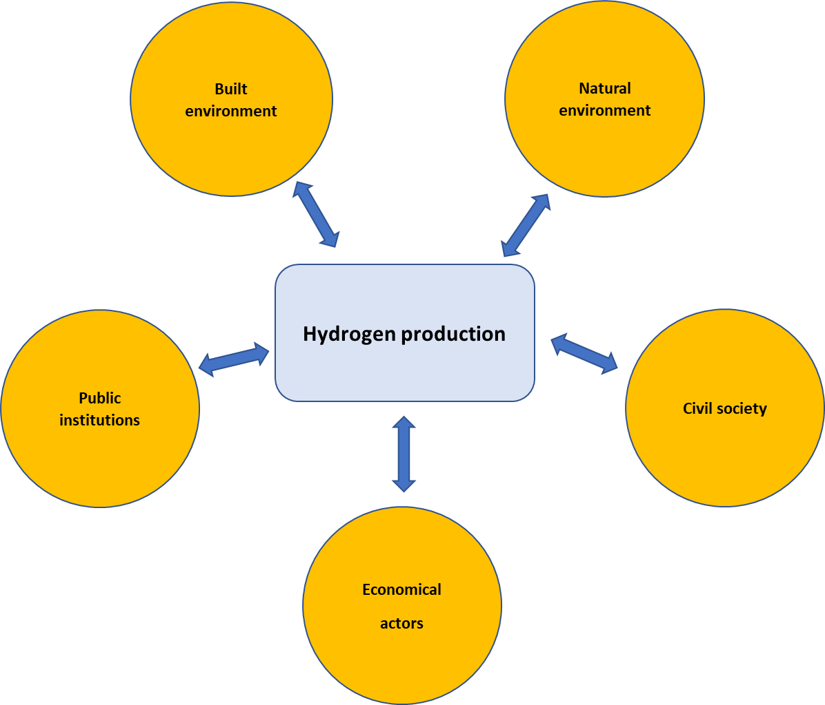
Methods
8 semi-structured interviews with relevant stakeholders
Overall system diagram is shown to the respondent to enhance the causal mapping
Adapted from: Freeman, C. (1991). Innovation, changes of techno-economic paradigm and biological analogies in economics. Revue économique, 211-231.

Slide 12
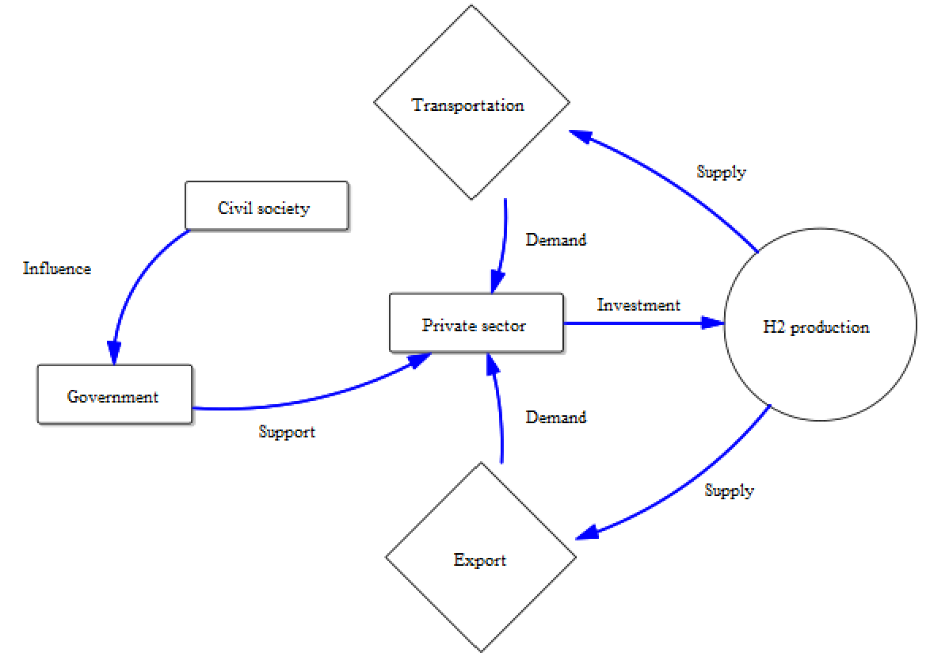
Results: Simplified diagram
Notes:
So that’s the basic structure of the emerging hydrogen sector in Iceland, according to its stakeholders. So if we go over it very quickly, we have first civil society that influences the government into supporting the energy sector to invest in H2 production. Finally the sources of demand are transportation and exports. So keep in mind that’s only the main mechanisms at play, there are of course many more interactions that take place.

Slide 13
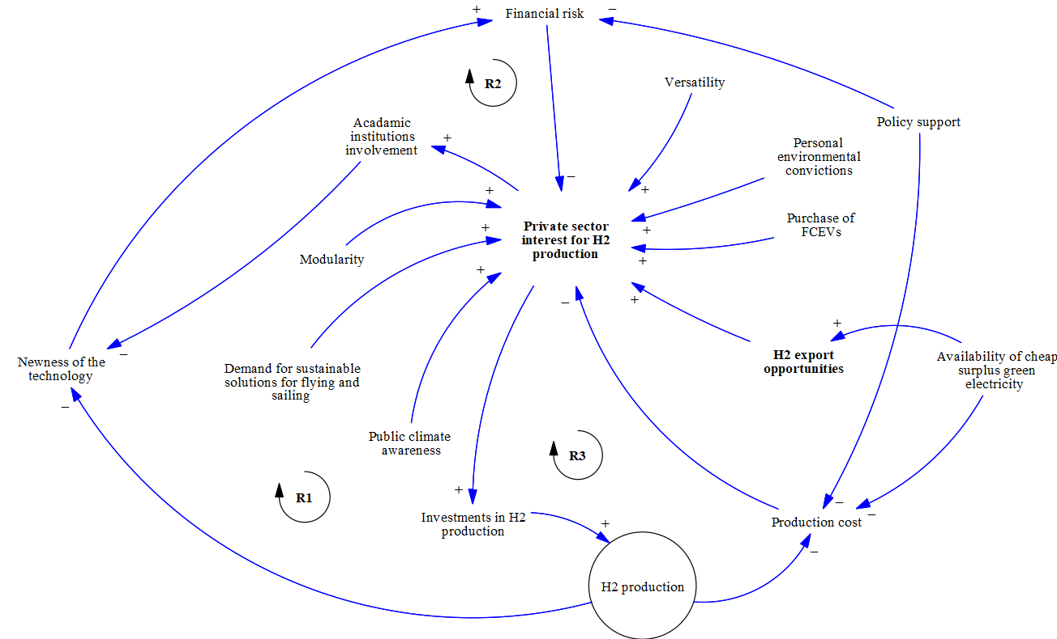
Results: Private sector diagram
Availability of cheap surplus energy is a determinant factor
Policy support decreases financial risk
Several reinforcing feedback loops

Slide 14
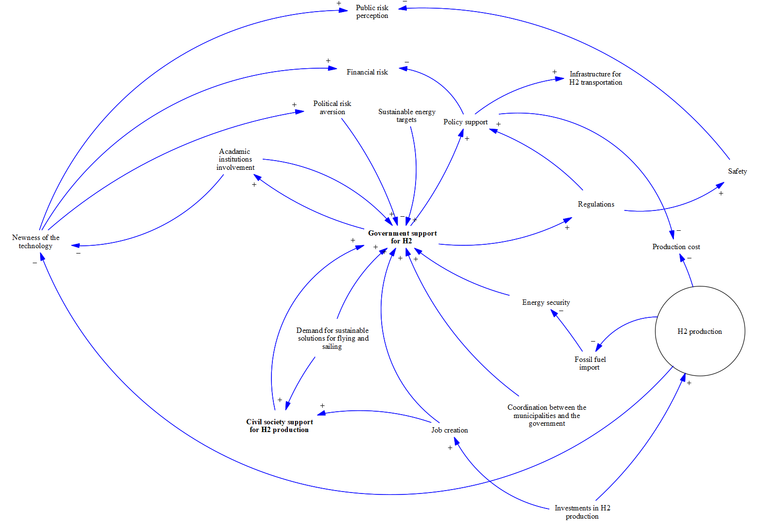
Results: Government diagram
Sustainable energy targets and energy security are important drivers
Academic institutions play a supporting role
Regulations is a significant variable

Slide 15
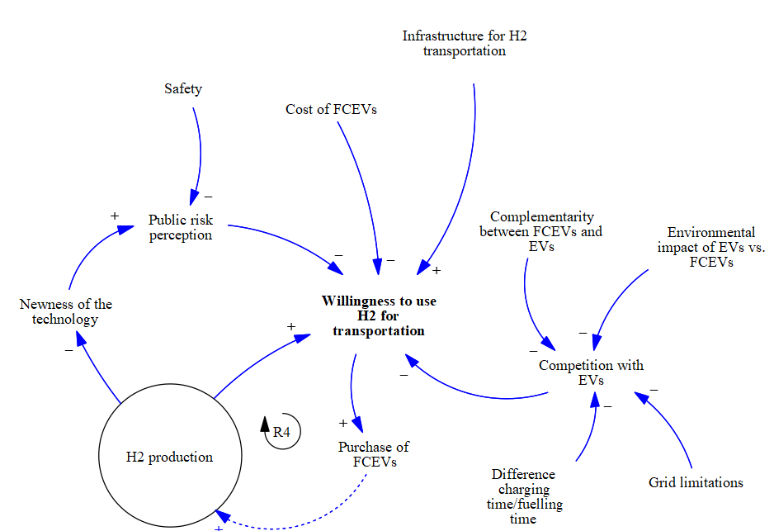
Results: Transport diagram
Transportation is the main source of domestic demand
Competition with EVs is a major factor
Overall really dependent on external factors

Slide 16
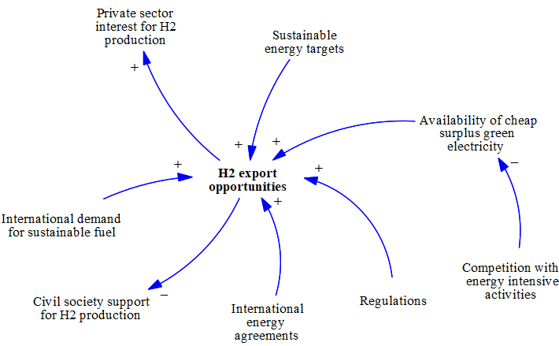
Results: Export diagram
Exporting attracts a lot of interest from companies
Regulations and energy agreements ease the process

