Slide 1

Parametrization of vineyard's physiology and phenology with the crop model IVINE
Claudio Cassardo And Valentina Andreoli
Dept. of Physics, Univ. of Torino, TUrin, Italy
claudio.cassardo@unito.it

Slide 2
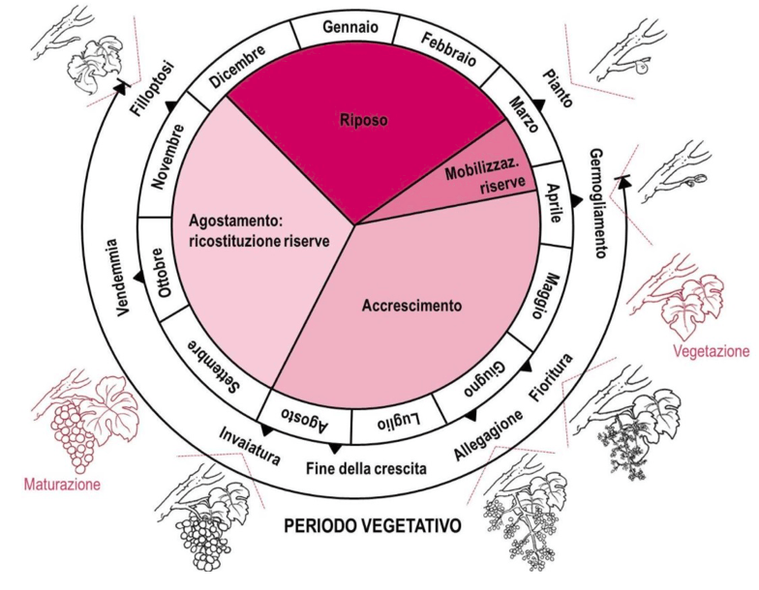
IVINE (Italian Vineyard Integrated Numerical model for Estimating physiological values)
(Andreoli et al., 2019)
INPUT DATA BOUNDARY CONDITIONS
- Soil characteristics (thickness and number of layers, texture) - Meteorological: 1-hour, 1948-2014 (from GLDAS, UTOPIA)
and hydrological parameters - Soil layers: 1-hour, 1948-2014 (from GLDAS, UTOPIA)
- Geographical coordinates - Treatments of vines (thinning, pruning)
- Variety characteristics of the variety, density of vines
        IVINE
  OUTPUT DATA (daily)
- Yield and berry sugar concentration
- Leaf development (LAI)
- Phenological stages (Julian days)
(BBCH scale: Biologische Bundesanstalt, Bundessortenamt and CHemical industry)
        Exit from dormancy (1 BBCH) Beginning of ripening (81 BBCH)
        Budding (7 BBCH) Veraison (83 BBCH)
        Flowering (65 BBCH) Harvest (89 BBCH)
        Fruit set (71 BBCH)
(Fregoni, 2013)

Slide 3
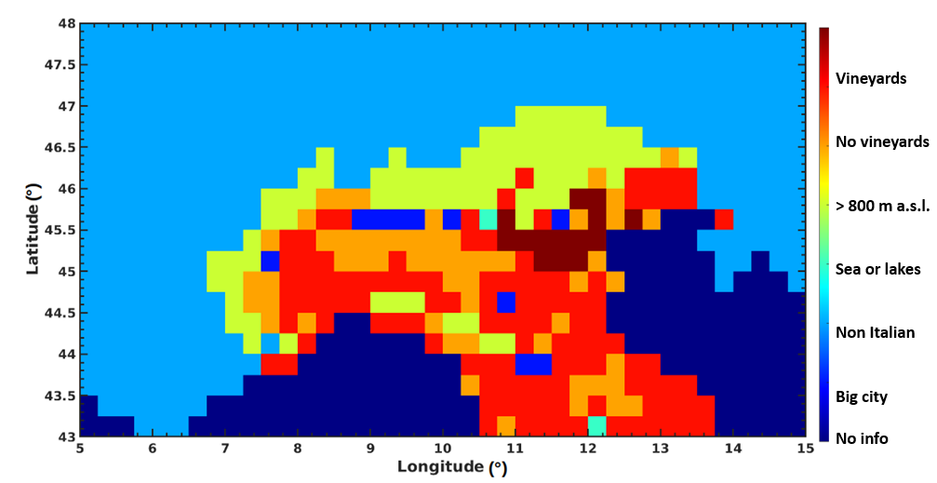
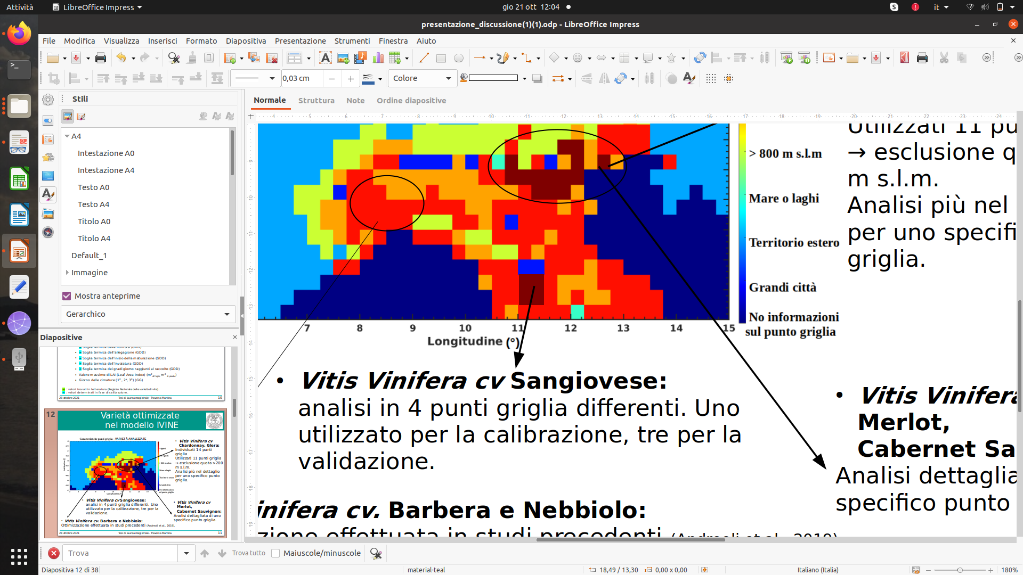
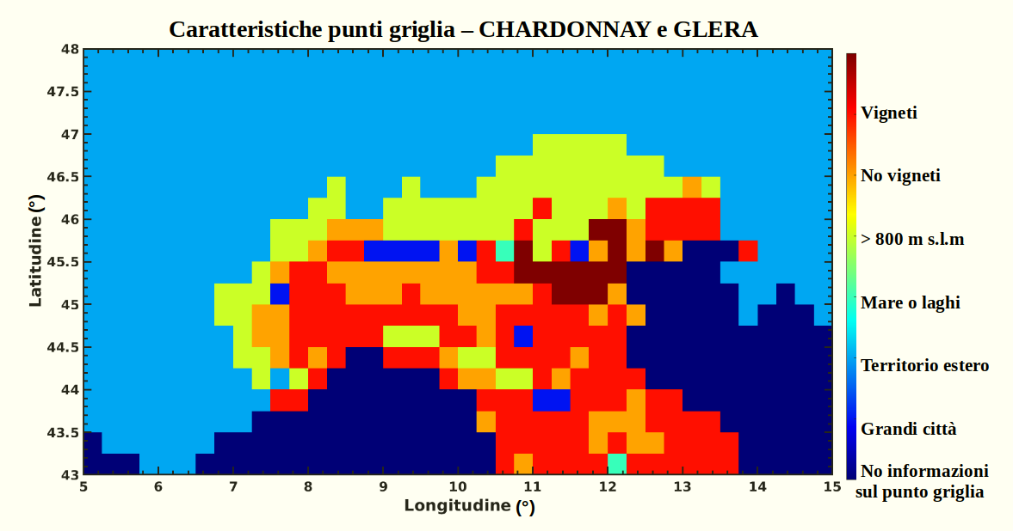
Optimized varieties in the IVINE model
(BioVenezia), (ExtendaVitis), (AgroAmbiente.info), (catalogoviti.politicheagricole.it)
ANALYZED VARIETIES
Vitis Vinifera cv Chardonnay, Glera:
14 grid points identified
Used 11 grid points, initially excluding elevations > 200 m a.s.l.
Vitis Vinifera cv Sangiovese:
Analysis in 4 different grid points (one used for calibration, three for validation)
Vitis Vinifera cv Merlot, Cabernet Sauvignon:
Detailed analysis on specific grid points
Vitis Vinifera cv Barbera and Nebbiolo:
Optimization carried out on several vineyards (Andreoli et al., 2019)

Slide 4
Parameters and thermal thresholds optimization
Parameters and thresholds | Chardonnay | Glera | Merlot | C. Sauvignon | Sangiovese
STUD | 100 | 100 | 100 | 100 | 100
→ STG | (5.5±0.3)10³ | (5.0±0.4)10³ | 5700 | 7300 | 5400
→ STF | (2.19±0.13)10² | (2.35±0.15)10² | 230 | 235 | 250
→ STA | 80 | 55 | 75 | 75 | 50
→ STIM | 650 | 550 | 550 | 600 | 650
→ STIV | 40 | 40 | 40 | 40 | 40
STR | 400 | 400 | 400 | 400 | 400
→ GGR | 1250 | 1350 | 1350 | 1300 | 1400
→ NGPp | 25 | 21 | 20 | 25 | 11
→ NAGP | 120 | 130 | 105 | 120 | 160
→ CZM | 19 | 17 | 20.5 | 20 | 23
→ CZIM | 6 | 6 | 6.5 | 7 | 11
→ CZI | 7 | 8 | 9.5 | 9 | 12
STUD (thermal threshold for exit from dormancy, in GDH); STG (thermal threshold for budding, in GDH); STF (thermal threshold for flowering, in GDD); STA (thermal threshold for fruit set, in GDD); STIM (thermal threshold for the beginning of ripening, in GDD); STIV (thermal threshold for veraison (GDD); STR (thermal threshold for harvest (GDD); GGR (degrees day on harvest day (GDD); NGPp (number of bunches per potential plant); NAGP (number of berries per potential bunch); CZM (maximum sugar content, in °Brix);
CZIM (sugar content at the beginning of ripening, in °Brix); CZI (maximum sugar content on veraison, in °Brix)

Slide 5
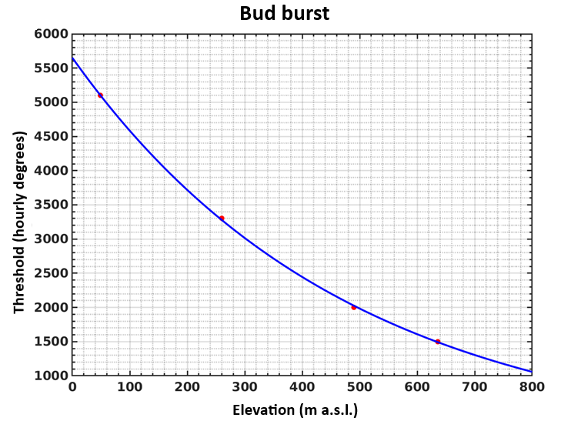
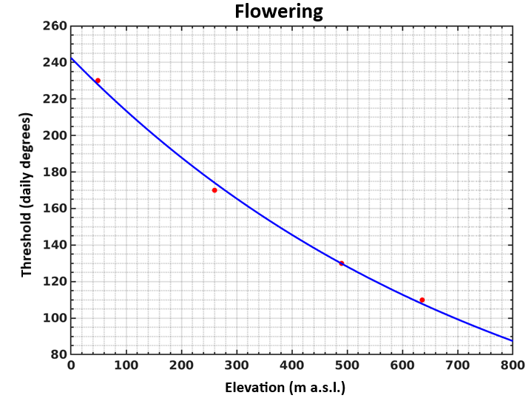


Thermal thresholds vs elevation
$$y_{bud burst}=5651 e^{−0.002 h}$$
$$y_{flowering}=243 e^{−0.0013 h}$$
Using the data observed at grid points located at different elevations, the thermal thresholds decrease exponentially as the altitude increases. It happens for all phenological phases depending only on thermal thresholds
At higher altitudes, the phenological phases anticipate

Slide 6
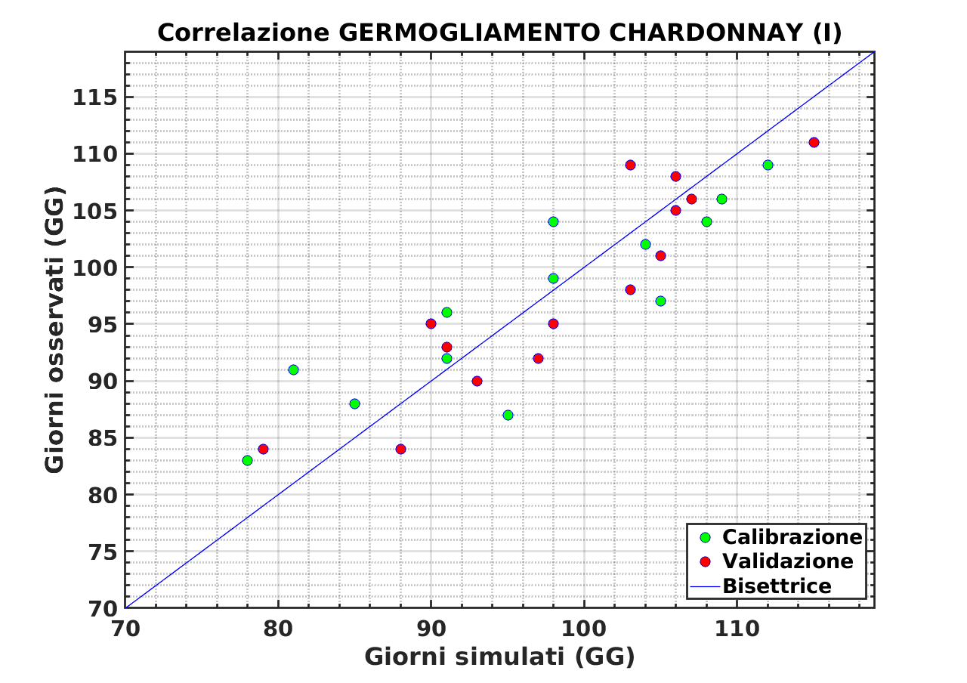
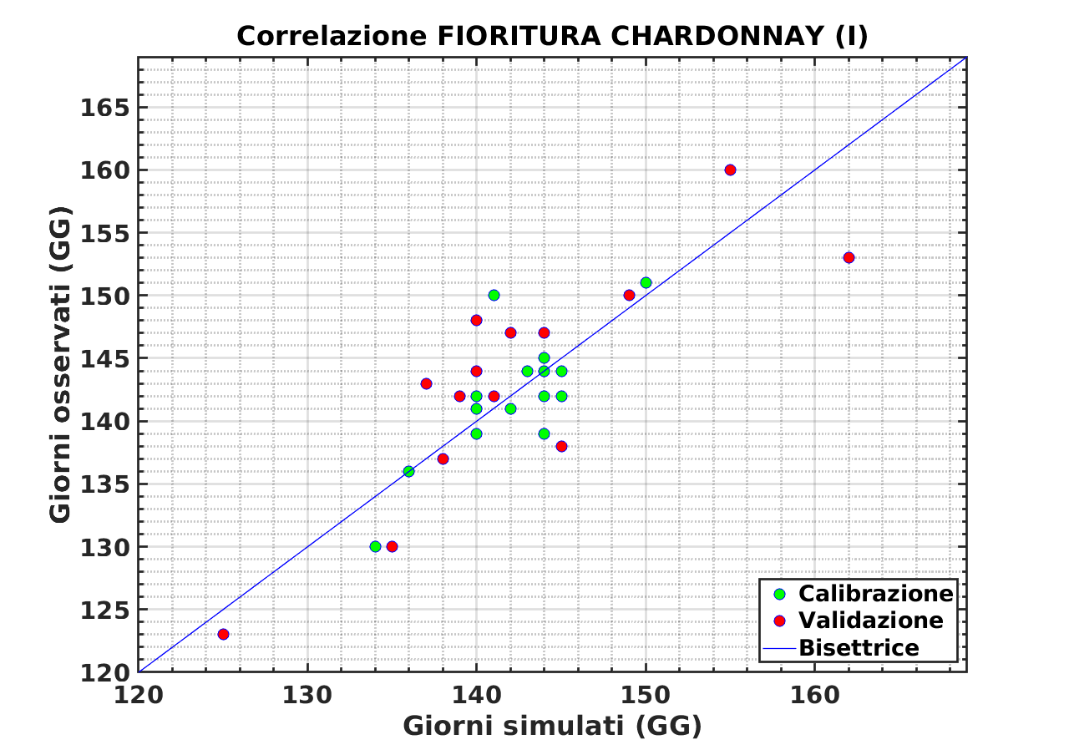
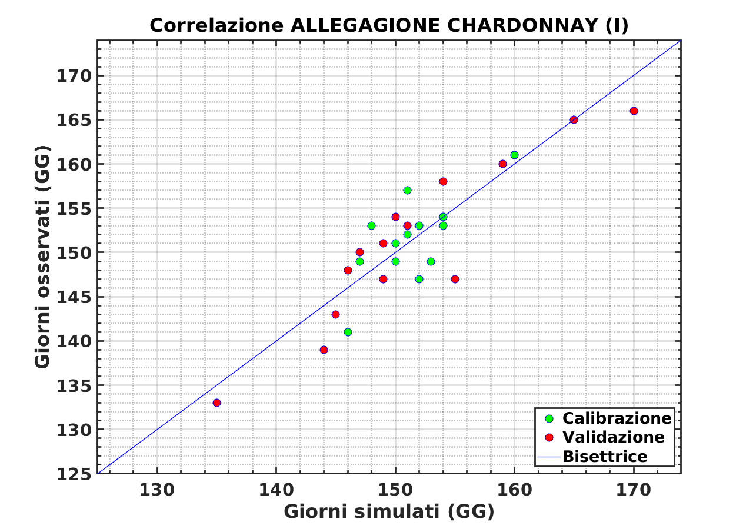

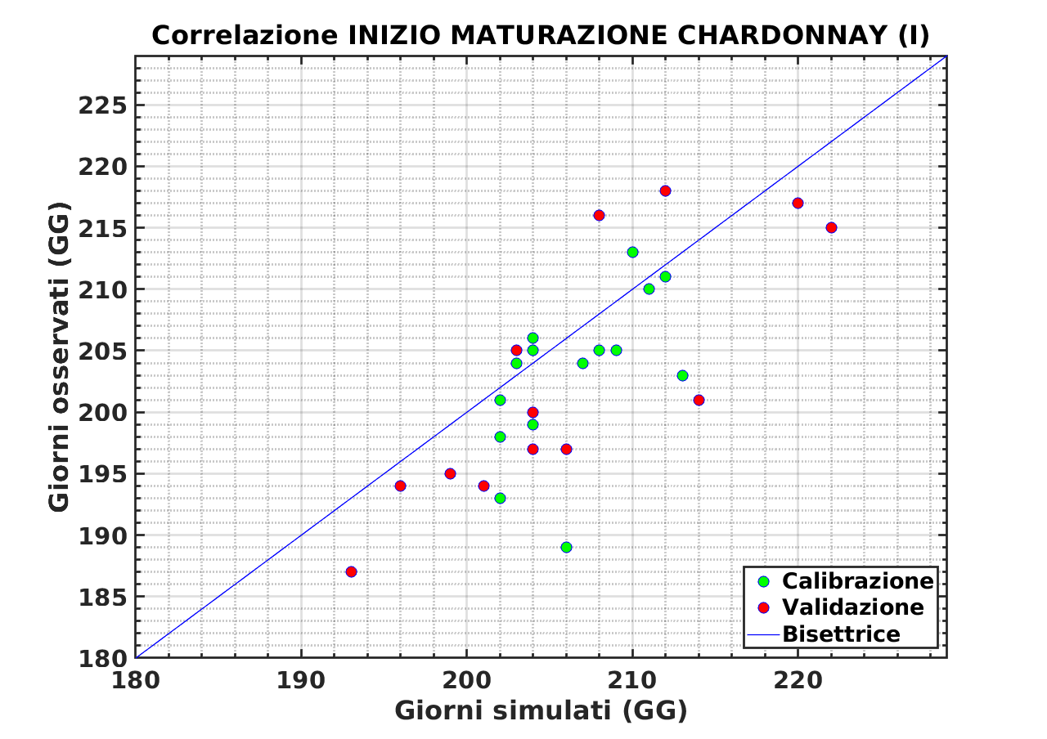
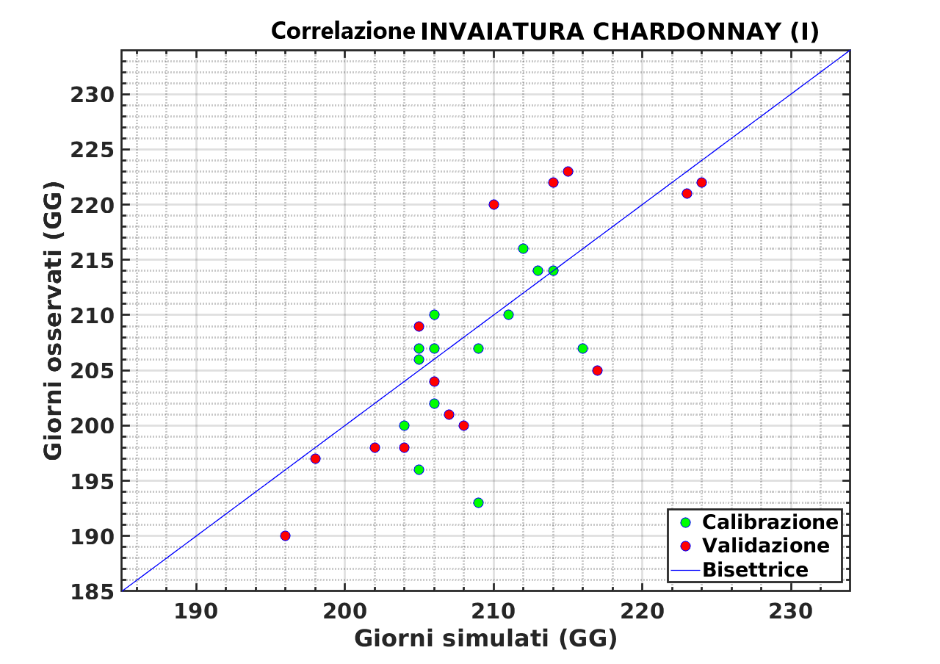
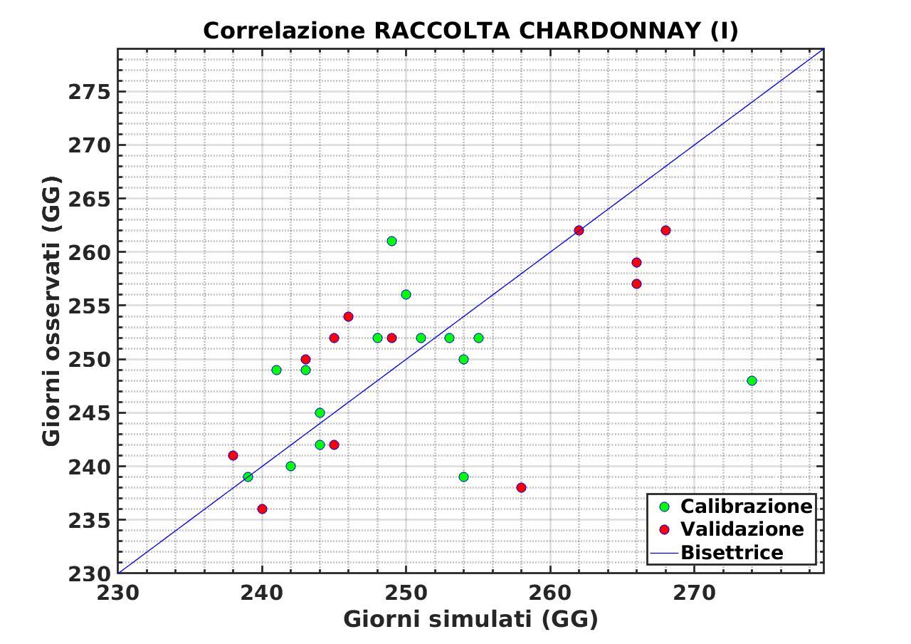
Correlation between data observed and simulated by IVINE- at a specific grid point -
Bud burst Flowering Fruit set
Observed days (Julian days) Observed days (Julian days)
Observed days (Julian days) Observed days (Julian days)
Observed days (Julian days) Observed days (Julian days)
Chardonnay
Beginning of ripening Veraison Harvest
Simulated days (Julian days) Simulated days (Julian days) Simulated days (Julian days)
Multiple phenological phases analyzed
Uniform distribution around the bisector line, homogeneous distribution of observed and simulated data

Slide 7
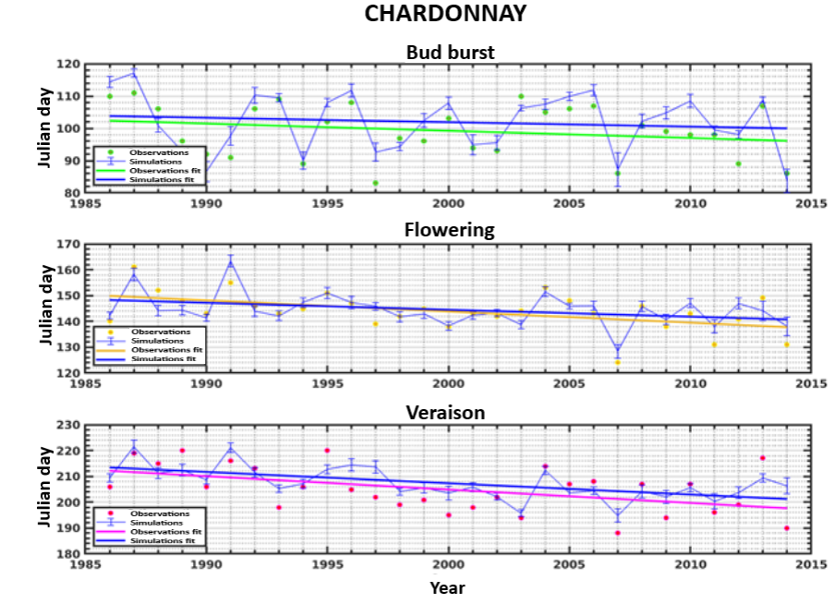
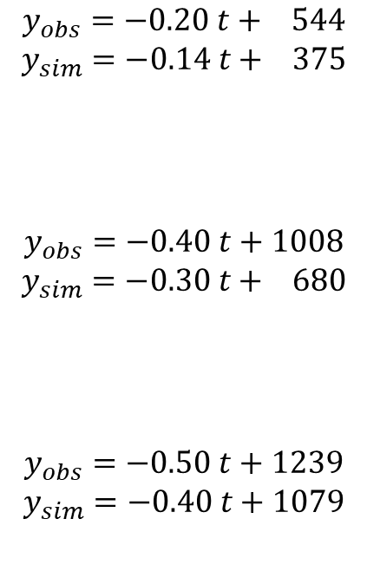
Time trend of the phenological phases from 1986 to 2014
In 29 years:
-4-6 days
-9-12 days
-12-15 days
$$y_{obs}=−0.20 t+ 544$$
$$y_{sim}=−0.14 t+ 375$$
$$y_{obs}=−0.40 t+1008$$
$$y_{sim}=−0.30 t+ 680$$
$$y_{obs}=−0.50 t+1239$$
$$y_{sim}=−0.40 t+1079$$

Slide 8
On the difference between observed and simulated data
Stages | Chardonnay | Glera | Merlot | C. Sauvignon | Sangiovese
Bud burst | (6±3) days | (3±4) days | (5±3) days | (5±4) days | -
Flowering | (5±4) days | (3±5) days | (3±3) days | (3±2) days | (3±3) days
Fruit set | (3±2) days | (2±2) days | (3±2) days | (3±2) days | (7±4) days
Beginning of ripening | (5±4) days | (4±3) days | (4±4) days | (5±4) days | (10±6) days
Veraison | (5±4) days | (5±4) days | (3±4) days | (5±4) days | -
Harvest | (6±6) days | (4±2) days | (9±7) days | (9±7) days | -
The largest error occurs for harvest phase (real date could vary according to vinery choices)
Larger errors for Sangiovese than for other varieties

Slide 9
Conclusions
ACTIVITY CARRIED OUT:
1. Search of observations of phenological phases and pheno-physiological characteristics of different vine varieties.
2. Verification of the dependence between meteorological data and phenological phases
Analysis of the occurrence of phenological phases for each variety. Calibration of parameters for each variety. Validation of IVINE using observations.
Analysis of long-term time trend of phenological phases simulated by IVINE
RESULTS:
The IVINE crop model was optimized for the Vitis Vinifera cv following varieties: Chardonnay, Glera, Merlot, Cabernet Sauvignon and Sangiovese
The phenological stages of bud-burst and flowering are particularly temperature-dependent. The veraison phase depends also on soil temperature and moisture
A new set of parameters needed by IVINE was set for all above-mentioned varieties
The days in which a phenological phase occurs, simulated by the IVINE model, are increasingly anticipated over the years. Such variations are often statistically significant

