Slide 1

Forced Air and Water Flow in Porous Media – Dynamics, Saturation Degree, and Phase Distribution
Ilan Ben-Noah
Postdoc, Institute of Environmental Assessment and Water Research (IDAEA), Spanish National Research Council (CSIC), Barcelona, Spain.
In this presentation:
Darcy-scale experiments of steady air injection into water-saturated media, a dimensionless meta-analysis.
Ben-Noah I., B. Berkowitz, & S.P. Friedman, submitted (WRR)

Slide 2
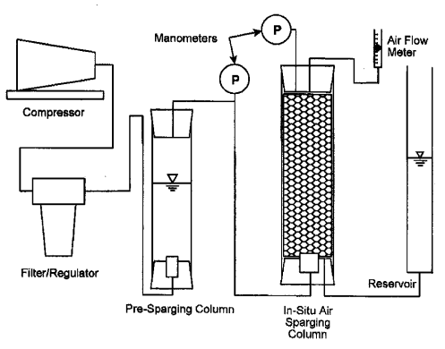
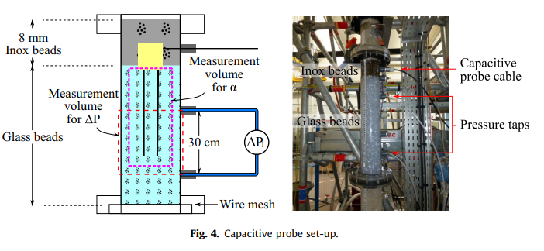
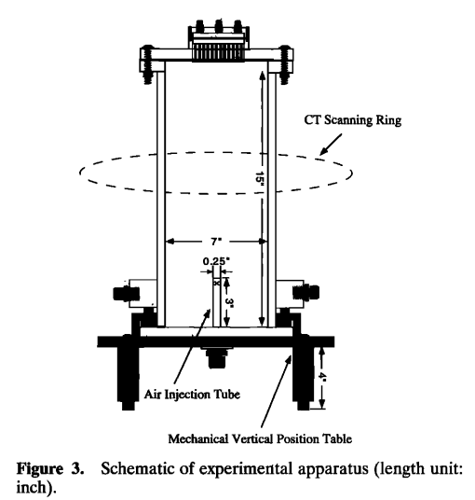
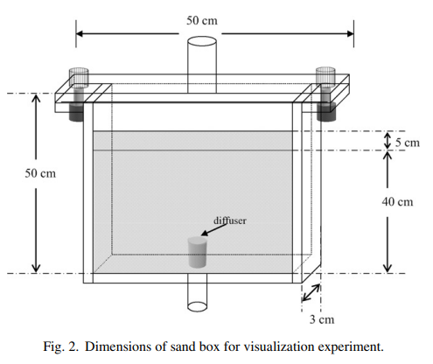
Darcy-scale meta-analysis
Ref. | N | *d (mm) |  | **v_{a} (cm s⁻¹) |  | Geometry
 |  | Min | Max | Min | Max
Brooks et al. (1999) | 32 | 0.78 | 3.00 | 0.27 | 25.67 | Column (1D)
Chao et al. (2008) | 6 | 0.40 | 1.71 | 25.94 | 39.15 | 2D
Chen et al. (1996) | 3 | 0.42 | 0.42 | 0.64 | 1.11 | Cylinder
Chikhi et al. (2016) | 30 | 4.00 | 8.00 | 0.05 | 49.61 | Cylinder
Chu et al. (1983), (from Fig. 5 in Tung & Dhir, 1988) | 15 | 9.90 | 9.90 | 10.25 | 101.29 | Cylinder
Geistlinger et al. (2009) | 21 | 0. 50 | 2.00 | 0.14 | 10.60 | 2D
Ji et al. (1993) | 6 | 0. 75 | 4.00 | . | . | 2D
Lazik et al. (2008) | 11 | 0. 38 | 0.38 | 0.42 | 4.65 | 2D
Peterson et al. (1999) | 10 | 1.10 | 4.38 | . | . | 2D
Tung & Dhir (1988) | 59 | 5.80 | 19.00 | 1.19 | 79.93 | Cylinder
Van De Ven & Mumford (2019) | 13 | 0.071 | 0.071 | . | . | 2D
Brooks et al. (1999)
Chikhi et al. (2016)
Chen et al. (1996)
Chao et al. (2008)

Slide 3
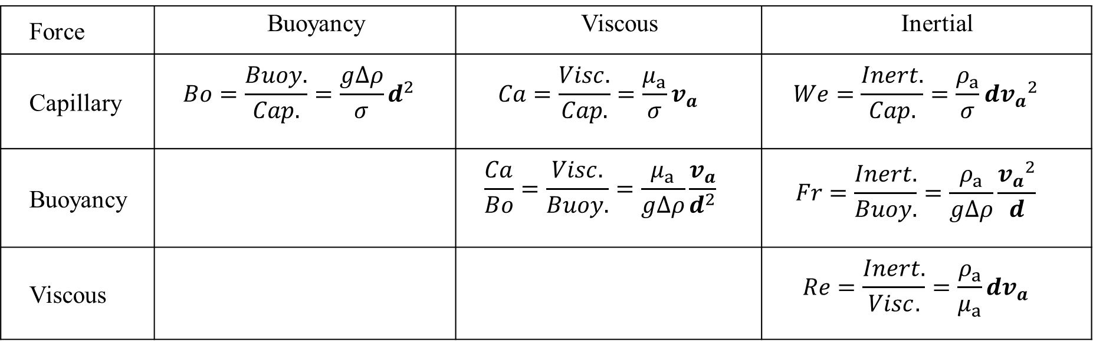
Darcy-scale meta-analysis
Dimensional analysis
π numbers:
Force | Buoyancy | Viscous | Inertial
Capillary | $$Bo=\frac{Buoy.}{Cap.}=\frac{g∆ρ}{σ}d^{2}$$ | $$Ca=\frac{Visc.}{Cap.}=\frac{μ_{a}}{σ}v_{a}$$ | $$We=\frac{Inert.}{Cap.}=\frac{ρ_{a}}{σ}d{v_{a}}^{2}$$
Buoyancy |  | $$\frac{Ca}{Bo}=\frac{Visc.}{Buoy.}=\frac{μ_{a}}{g∆ρ}\frac{v_{a}}{d^{2}}$$ | $$Fr=\frac{Inert.}{Buoy.}=\frac{ρ_{a}}{g∆ρ}\frac{{v_{a}}^{2}}{d}$$
Viscous |  |  | $$Re=\frac{Inert.}{Visc.}=\frac{ρ_{a}}{μ_{a}}dv_{a}$$
v_{a} mean air velocity [cm s⁻¹], d grain diameter [cm], σ = 72.75 dyn cm⁻¹ surface tension, g = 981 cm s⁻² gravitational acceleration constant, μ_{a} = 1.85⸱10⁻⁴ poise dynamic viscosity of air, ρ_{a} = 1.2⸱10⁻³ gr cm⁻³ air density, and ρ_{w} = 1 gr cm⁻³ water density. Δρ = ρ_{w} − ρ_{a} density difference.

Slide 4
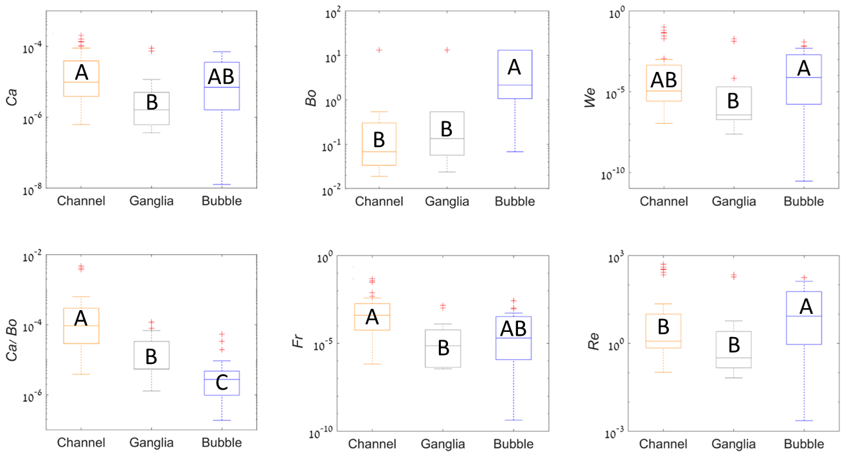
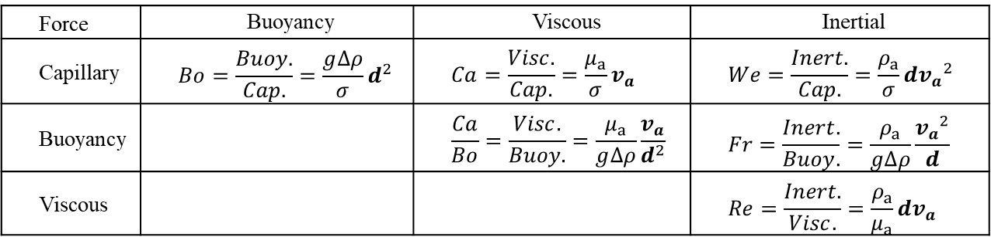
Darcy-scale meta-analysis
Dimensional analysis
π numbers:
Force | Buoyancy | Viscous | Inertial
Capillary | $$Bo=\frac{Buoy.}{Cap.}=\frac{g∆ρ}{σ}d^{2}$$ | $$Ca=\frac{Visc.}{Cap.}=\frac{μ_{a}}{σ}v_{a}$$ | $$We=\frac{Inert.}{Cap.}=\frac{ρ_{a}}{σ}d{v_{a}}^{2}$$
Buoyancy |  | $$\frac{Ca}{Bo}=\frac{Visc.}{Buoy.}=\frac{μ_{a}}{g∆ρ}\frac{v_{a}}{d^{2}}$$ | $$Fr=\frac{Inert.}{Buoy.}=\frac{ρ_{a}}{g∆ρ}\frac{{v_{a}}^{2}}{d}$$
Viscous |  |  | $$Re=\frac{Inert.}{Visc.}=\frac{ρ_{a}}{μ_{a}}dv_{a}$$
Kruskal-Wallis
non-parametric
analysis of
variances:
v_{a} mean air velocity [cm s⁻¹], d grain diameter [cm], σ = 72.75 dyn cm⁻¹ surface tension, g = 981 cm s⁻² gravitational acceleration constant, μ_{a} = 1.85⸱10⁻⁴ poise dynamic viscosity of air, ρ_{a} = 1.2⸱10⁻³ gr cm⁻³ air density, and ρ_{w} = 1 gr cm⁻³ water density. Δρ = ρ_{w} − ρ_{a} density difference.

Slide 5
Darcy-scale meta-analysis
air saturation degree (media’s mean):
S_{a}=13.86Ca^{0.37}Bo^{0.08}

Slide 6
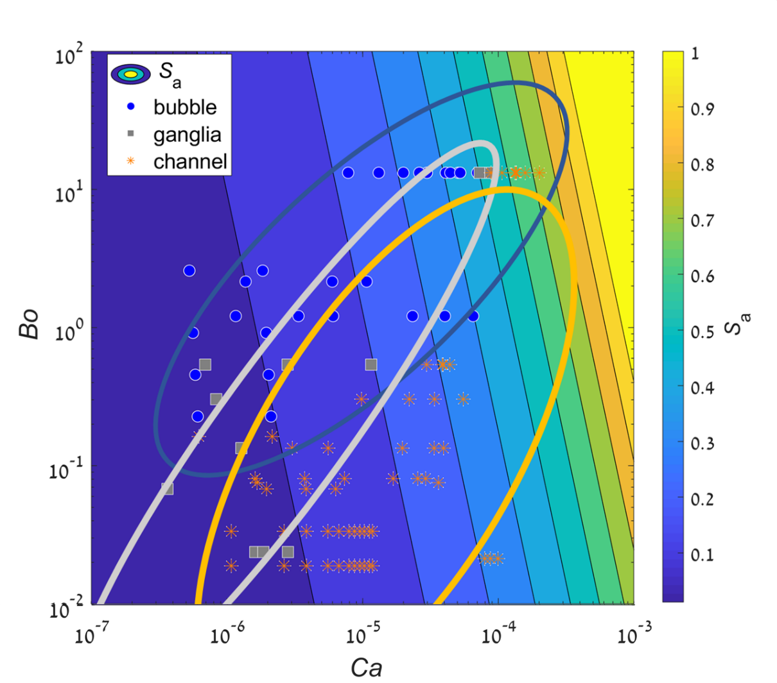
Darcy-scale meta-analysis
Ca-Bo phase diagram:

Slide 7
Conclusions
We demonstrate the strong coupling between flow dynamics and phase saturation during steady air injection into vertically oriented and background (initially) saturated granular media.
We present a simple evaluation of the effects of the steady air flow velocity and of the media’s grain diameter on the air flow patterns
  viscous and buoyancy forces increase air saturation while capillary forces decrease the saturation degree.
  Our findings also suggest a significant effect of inertial forces in coarse granular media (glass beads).
  However, the effects of the air saturation and flow dynamics cannot be easily evaluated as these are strongly correlated.
Recent experimental studies of nearly simultaneous steady air and water injection into microfluidic devices allow a morphological analysis of the phase distribution
  e.g., water-filled pore size distribution, coordination number distribution
  decoupled from the flow dynamics, i.e., for different saturation degrees of the same capillary number and vice-versa.

Slide 8
Collaborators
Dr. Shmulik P. Friedman, Institute of Soil, Water and Environmental Sciences, The Volcani Center, Agricultural Research Organization, Rishon LeZion 7505101, Israel.
Prof. Brian Berkowitz, Department of Earth and Planetary Sciences, Weizmann Institute of Science, Rehovot 7610001, Israel.
Prof. Marco Dentz, Institute of Environmental Assessment and Water Research (IDAEA), Spanish Council of Scientific Research (CSIC), Barcelona, Spain.
Dr. Juan J. Hidalgo, Institute of Environmental Assessment and Water Research (IDAEA), Spanish Council of Scientific Research (CSIC), Barcelona, Spain.
Thanks

Slide 9
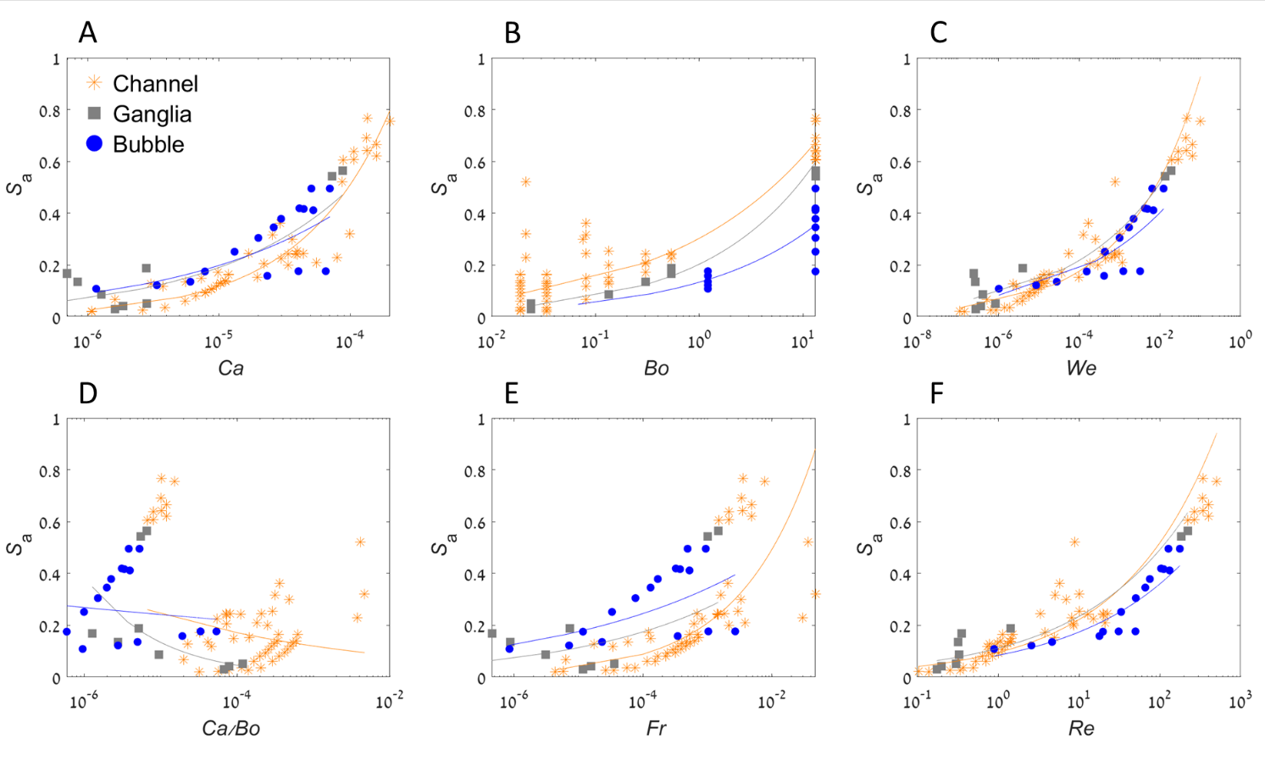

Slide 10
