Slide 1
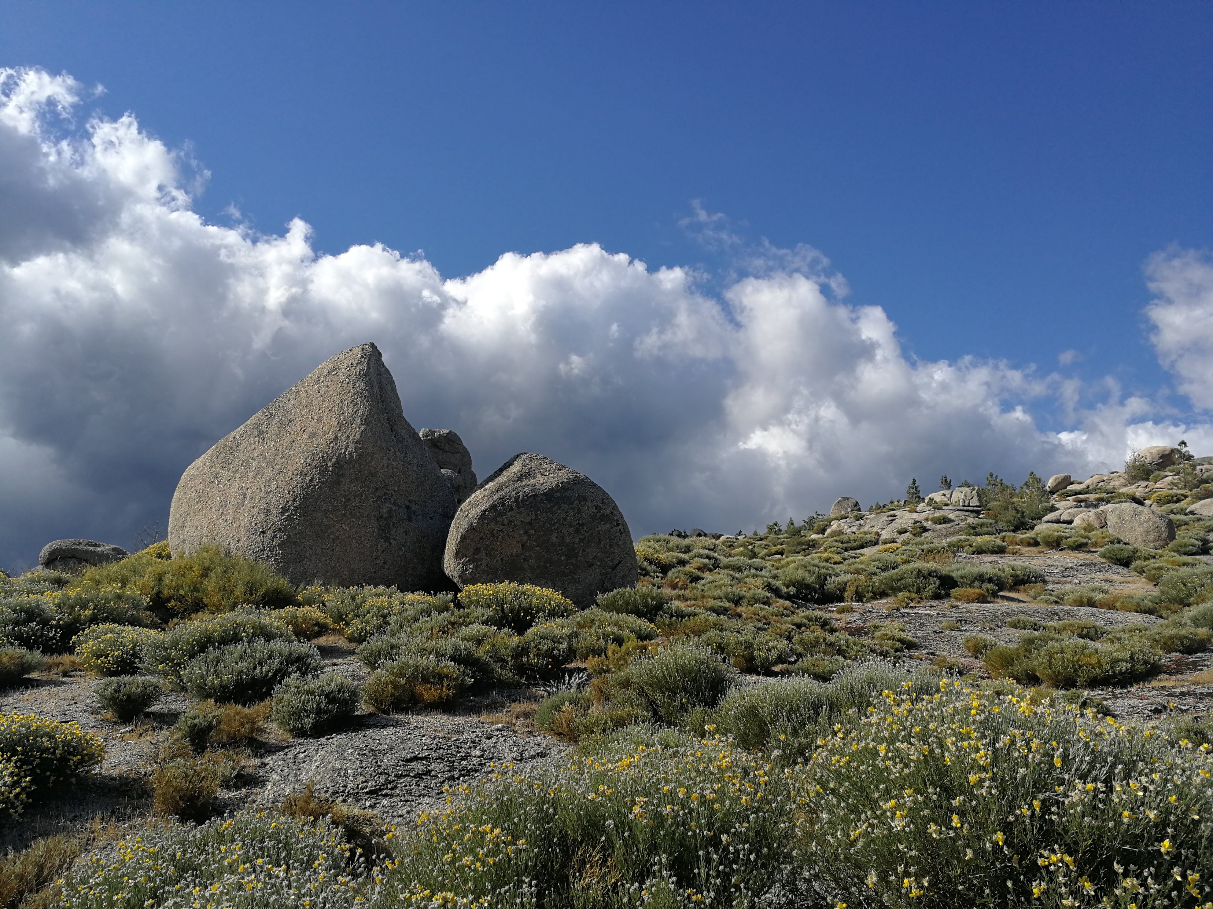


Disclosing the redox conditions in Central Portugal magmatism: the Manteigas granodiorite case study
Cláudia Cruz . Joana M. Dias . Eric Font . Fernando Noronha . Helena Sant’Ovaia
26 . May . 2022
> This presentation contains new data acquired after the abstract submission <
Notes:
Hello,
My name is Claudia and my presentation is about “Disclosing the redox conditions in Central Portugal magmatism: the Manteigas granodiorite case study.

Slide 2

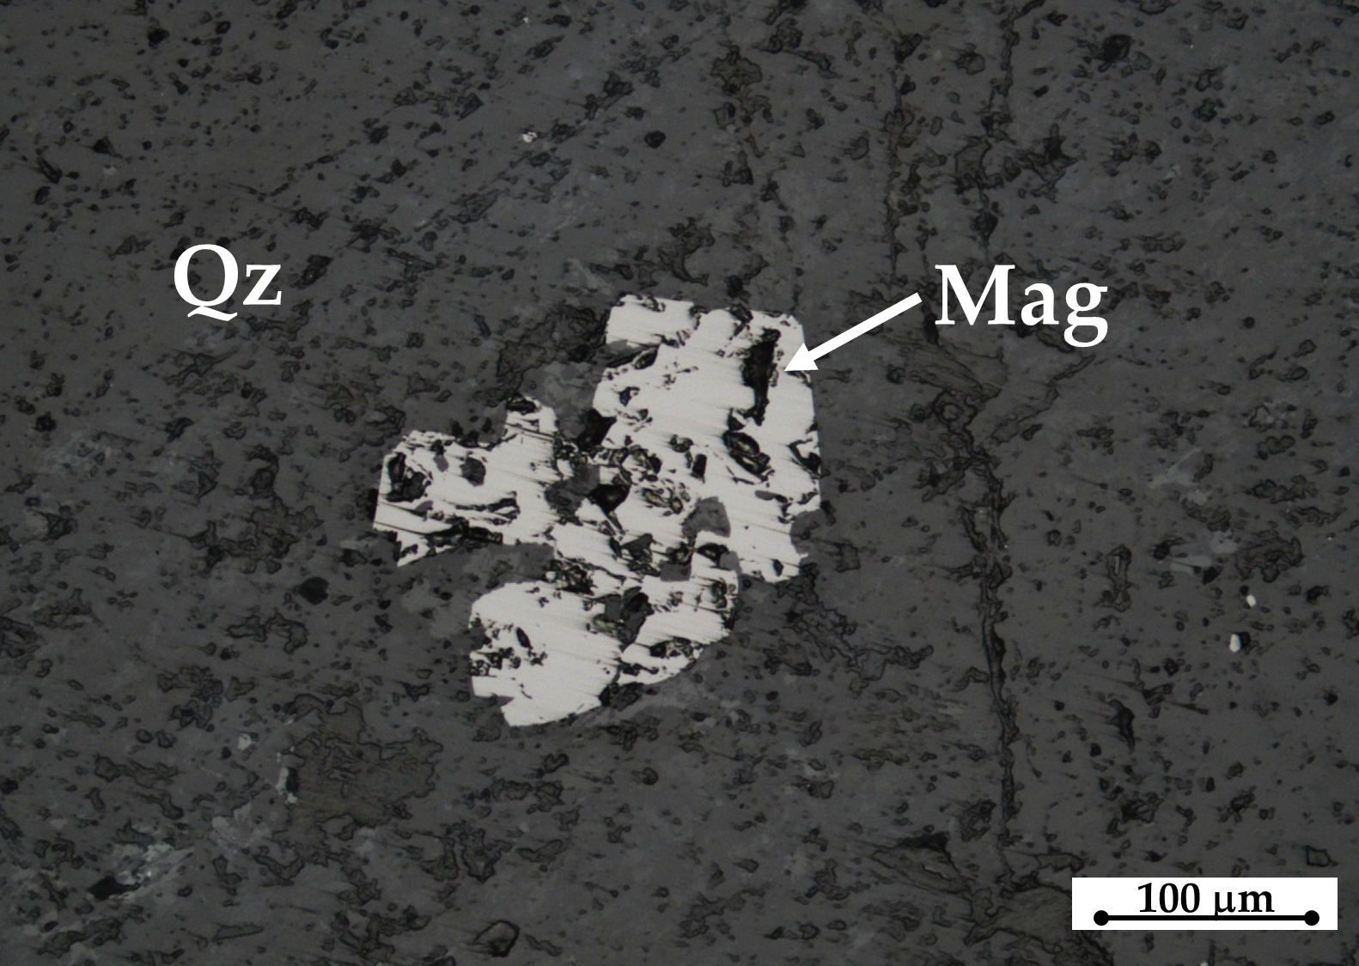
The main goal is to characterize the ferromagnetic minerals present in the Manteigas granodiorite
Presence of magnetite in granitoids
Is rare in the Iberian Peninsula
Suggests a deep magma origin and the presence of melt-oxidized conditions
Notes:
The main goal of this work is to characterize the ferromagnetic minerals present in the Manteigas granodiorite
It should be noted that the presence of magnetite in granitoids is rare in the Iberian Peninsula and suggests a deep magma origin and the presence of melt-oxidized conditions.
Its occurrence depends on the redox conditions of the magma at the time of crystallization (oxidizing conditions)

Slide 3
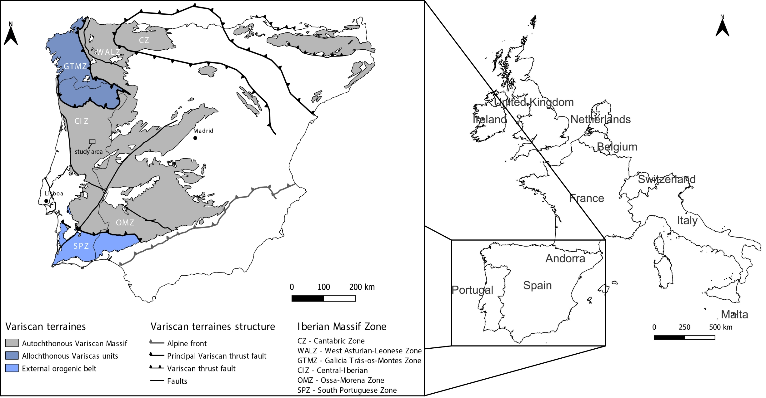

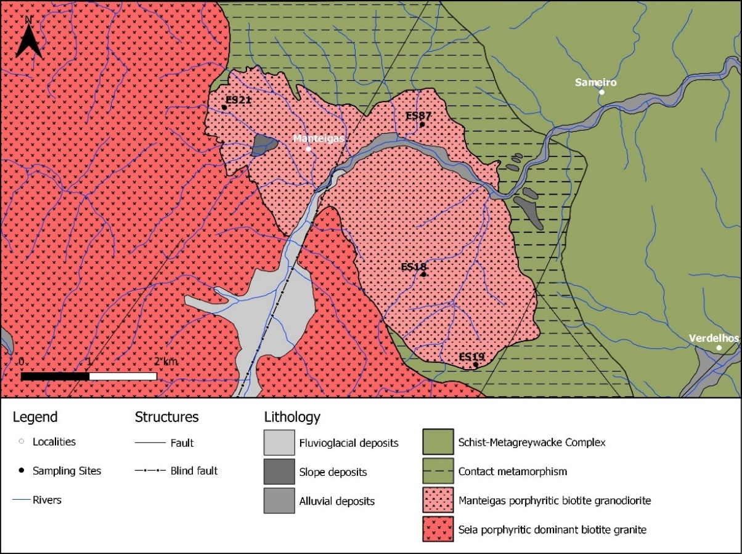
Manteigas granodiorite:
Located at:
Central Iberian Zone
Serra da Estrela region
Central Portugal
Manteigas
granodiorite
Neiva, A.M.R.; Williams, I.S.; Ramos, J.M.F.; Gomes, M.E.P.; Silva, M.M.V.G.; Antunes, I.M.H.R. Lithos;, 2009 (111), pp. 186–202
Characterized by:
Medium- to coarse-grained slightly porphyritic biotite
Dated as Ordovician
²³⁵U/²⁰⁷Pb ~ 481 ± 5.9 Ma*
*Neiva et al. 2009
Notes:
Regarding the geological setting,
The Manteigas granodiorite is located “here” in the Central Iberian Zone, in the Serra da Estrela region (Central Portugal)
And it is characterized by a medium- to coarse-grained slightly porphyritic biotite rock and is dated as Ordovician.
Uranium-lead dating gives an age of: four hundred and eighty-one plus or minus five point nine million years.

Slide 4

Identify the magnetic mineralogy
Petrography
Isothermal Remanent Magnetization
Determine the Saturation isothermal remanent magnetization (SIRM) value
&
Identified the magnetic components by fitting IRM curves
Notes:
The methodologies used in this study were: petrography, and isothermal remanent magnetization.
IRM – The samples are first demagnetized. Thus, the samples were exposed to an alternating field comparable to a sinusoid, whose magnitude decreased over time. Then, the magnetic field (H) was applied to the sample, always in the same direction and at room temperature. The resulting remanent magnetization was measured at each induction step until saturation was reached.
Frequency-Dependent Susceptibility (KfD%) - KfD% = ((Klf − Khf) / Klf) × 100% - Two field frequencies with 0.46 kHz and 46 kHz were applied for the measurements of the low-field magnetic susceptibility, at low frequency, Klf, and at high frequency, Khf.
AMS - A low magnetic field (0.3 mT) is applied to the samples in different directions and at room temperature

Slide 5

[Previous studies]
Anisotropy of magnetic susceptibility (AMS)*
*Sant’Ovaia et al. 2010
Areas with low K_{m} values  K_{m} < 1000 μSI
Areas with high K_{m} values  K_{m} ≥ 1000 μSI
Manteigas is a
magnetite-type granitoid
Sant’Ovaia, H.; Olivier, P.; Ferreira, N.; Noronha, F.; Leblanc, D. J. Struct. Geol. 2010, 32, 1450–1465.
K_{m} < 1000 μSI
K_{m} ≥ 1000 μSI
K_{m} – Magnetic susceptibility
Notes:
Previous studies of AMS show that the Manteigas granodiorite has areas with high and areas with low Km values.
In this figure, the pink stars represent the sites with high Km values, and on the other hand, the blue stars, indicate the areas with low values.
The presence of high values points out that Manteigas is a magnetite-type granitoid

Slide 6
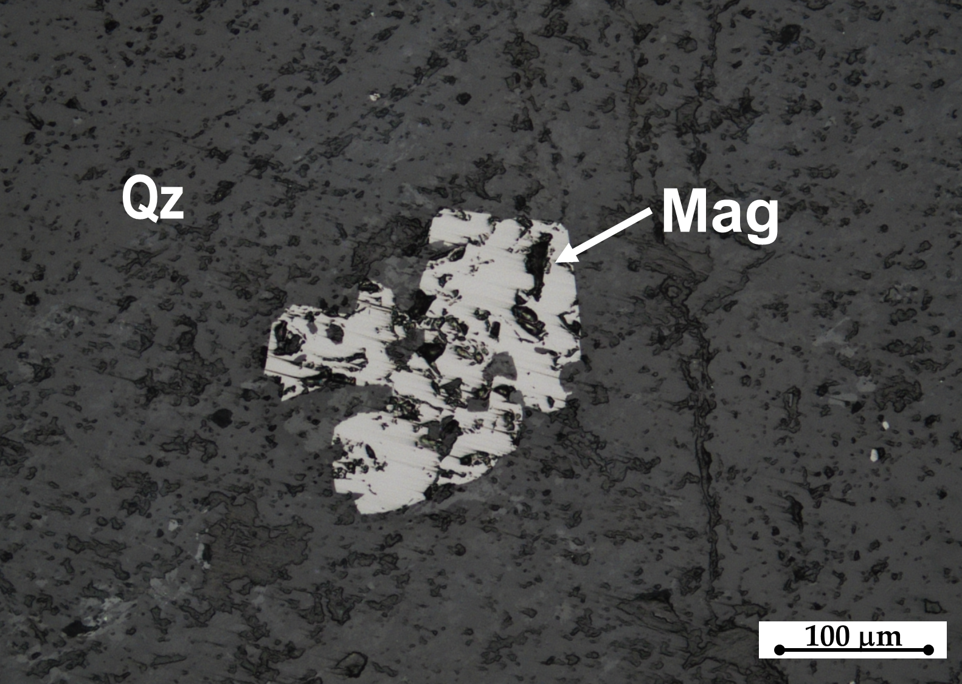
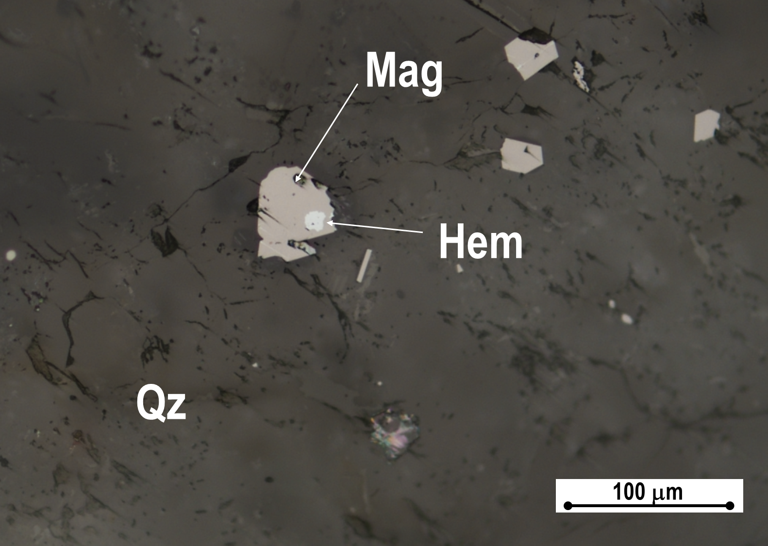
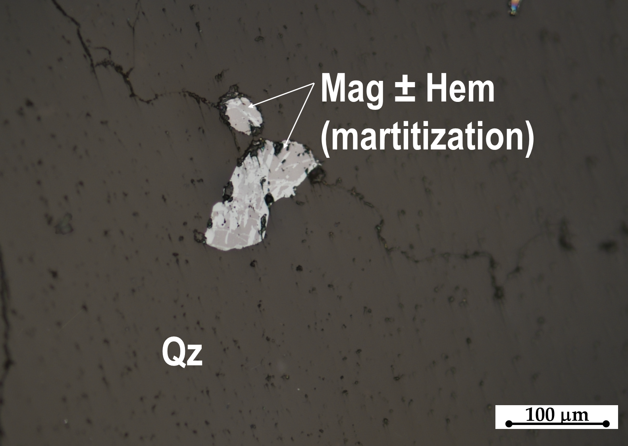
Petrographic studies
Magnetite
Hematite
In sites with
high K_{m} values
In sites with
low K_{m} values
Notes:
Petrographic studies point out that Manteigas has both magnetite “as you can see here”, and hematite “represented here”.
Sometimes, and “as you can see here”, the magnetite is partially or completely oxidized to hematite.

Slide 7
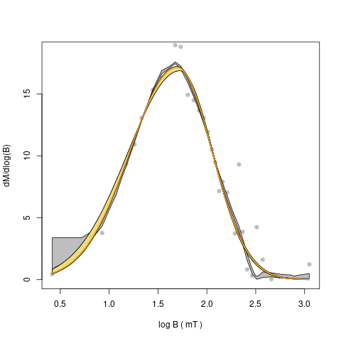
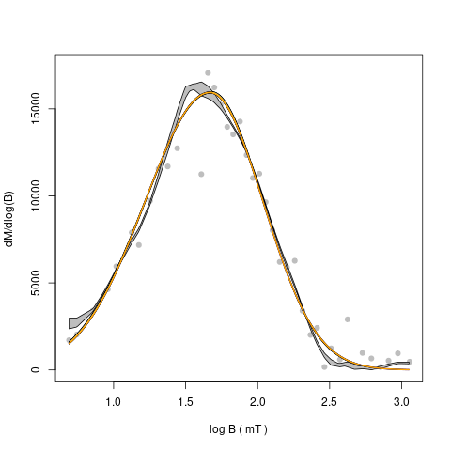
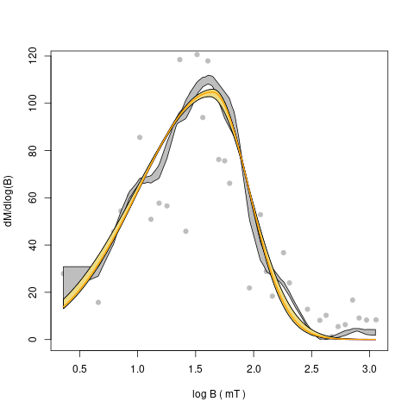
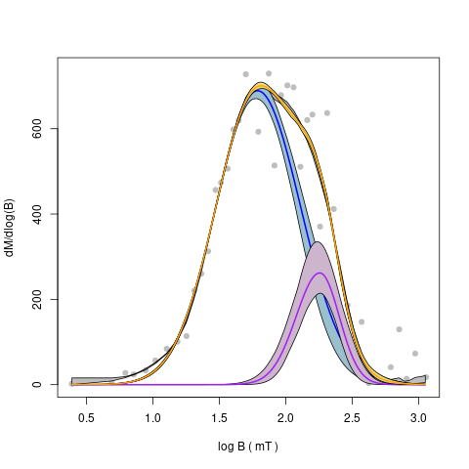
Isothermal remanent magnetization
(IRM)
Samples with high K_{m} values (K_{m} ≥ 1000 μSI)  1 magnetic component
magnetite
Samples with low K_{m} values (K_{m} < 1000 μSI)  2 magnetic components
magnetite
magnetite
±
hematite
Highlighting the
martitization processes
hematite
Notes:
Through the analyses of the IRM curves, we concluded that in samples with high Km values only one magnetic component is observed, namely magnetite.
On the other hand, in samples with low Km, both magnetite and hematite are observed.
Coercivity is the ability of a mineral to resist an external magnetic field without becoming demagnetized. For example, a material with high coercivity has a higher resistance to demagnetization.

Slide 8
Isothermal remanent magnetization
(IRM)
The presence of magnetite and hematite were identified by SIRM and Coercivity (B_{1/2}) values
28 mT < B1/2 < 60 mT
B1/2 ~ 174 mT
Magnetite
Hematite
SIRM – Saturation isothermal remanent magnetization
B_{1/2} – Coercivity
Notes:
The presence of magnetite and hematite were identified by the SIRM and Coercivity values;
Observing this chart, we notice that the , component 1 has high SIRM values and a coercivity between twenty-eight and sixty, which is characteristic of magnetite.
On the other hand, component 2 has low SIRM values and a much higher Coercivity equal to one hundred and seventy-four.
Coercivity is the ability of a mineral to resist an external magnetic field without becoming demagnetized. For example, a material with high coercivity has a higher resistance to demagnetization.

Slide 9

Manteigas granodiorite has areas with high and areas with low K_{m} values
In areas with high K_{m} values only magnetite was detected
In areas with low K_{m} values both magnetite ± hematite are present, and the hematite results from oxidation of primary magnetite
Manteigas belongs to a magnetite-series rocks
The magma was crystalized under oxidizing conditions
This study shows that even in samples where magnetic susceptibility values preclude the presence of magnetite, this mineral may be present in small grains and at low concentrations, when it is partially oxidized to hematite (martite pseudomorphism).
Notes:
As conclusion, this study indicates that:
Manteigas has areas with high and áreas with low Km values
In áreas with high Km values only magnetite was detected
Manteigas is a magnetite-type granitoid which means that the magma was crystalized under oxidizing condictions
And that in áreas with low Km values, both magnetite and hematite are present, and the hematite results from oxidation of primary magnetite
In summary, this study shows that even in samples where magnetic susceptibility values preclude the presence of magnetite, this mineral may be present in small grains and at low concentrations, when it is partially oxidized to hematite

Slide 10


Thank you!
claudiacruz@fc.up.pt
Acknowledgments: This work is supported by national funding awarded by FCT—Foundation for Science and Technology, I.P., projects UIDB/04683/2020 and UIDP/04683/2020. Cláudia Cruz is a contracted researcher under the UIDP/04683/2020 project.

