Slide 1


SFB 1070
Institute of Geography · Chair of Soil Science and Geomorphology
Unravelling archaeological settlement, landscape, and resource use
patterns with machine learning in Kurdistan (Iraq)
Mathias Bellat^{1,2}, Benjamin Glissmann^{1,3}, Tobias Rentschler^{1,2,4},
Karsten Schmidt^{1,2,4}, Paola Sconzo¹, Peter Pfälzner^{1,3}, Thomas Scholten^{1,2,5}
¹ SFB 1070 ResourcesCulture ² Department of Geosciences, Chair of Soil Science and Geomorphology, ³ Institute for Ancient Near Eastern Studies (IANES)
⁴ eScience-Center ⁵ Cluster of Excellence Machine Learning: New Perspectives for Science
Eberhard Karls University of Tübingen, Tübingen, Germany
EGU General Assembly, Vienna 23 – 27 May 2022, Session: Geomorphology, "Towards the Anthropocene: human-landscape interaction and geoarchaeological challenges "
Notes:
Expliquer le type de site

Slide 2
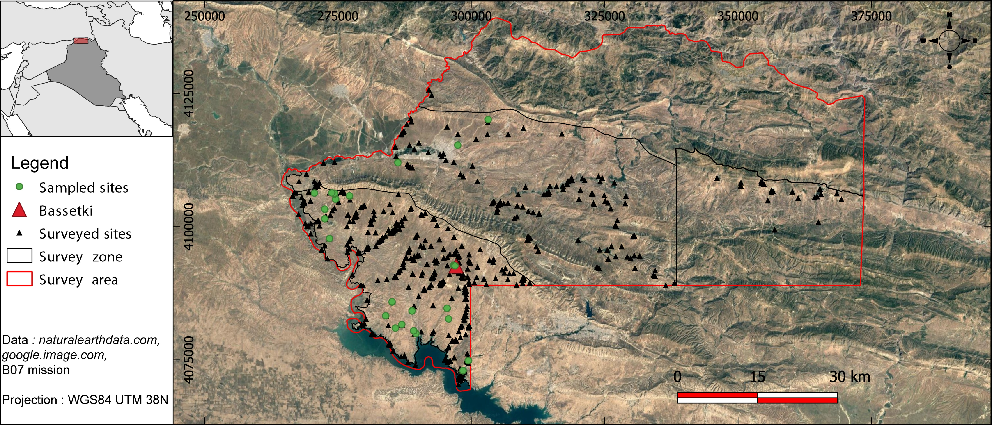
SFB 1070
INTRODUCTION
Materials & Methods
Results
Discussion
Conclusion
ResourceCultures
Network of knowledges, technics, practices, peoples, places and objects/medias
Resource Complexe
State and process at the same time
Historical contingence of heterogenous practices
Resource Assemblage
Grasp the overlaps, recurrent phenomena and inherent dependencies
Diversity of resource cultures in space and time
Resource
Cultures
Settlements Patterns
Study area with sampled sites
“Resource hunting” strategy from Mesopotamian empires (monopole, acculturation...)
Local indigenous uses of resources (close environment)
How can new methods in soil sciences help us in revealing settlement pattern in Iraqi Kurdistan?

Slide 3
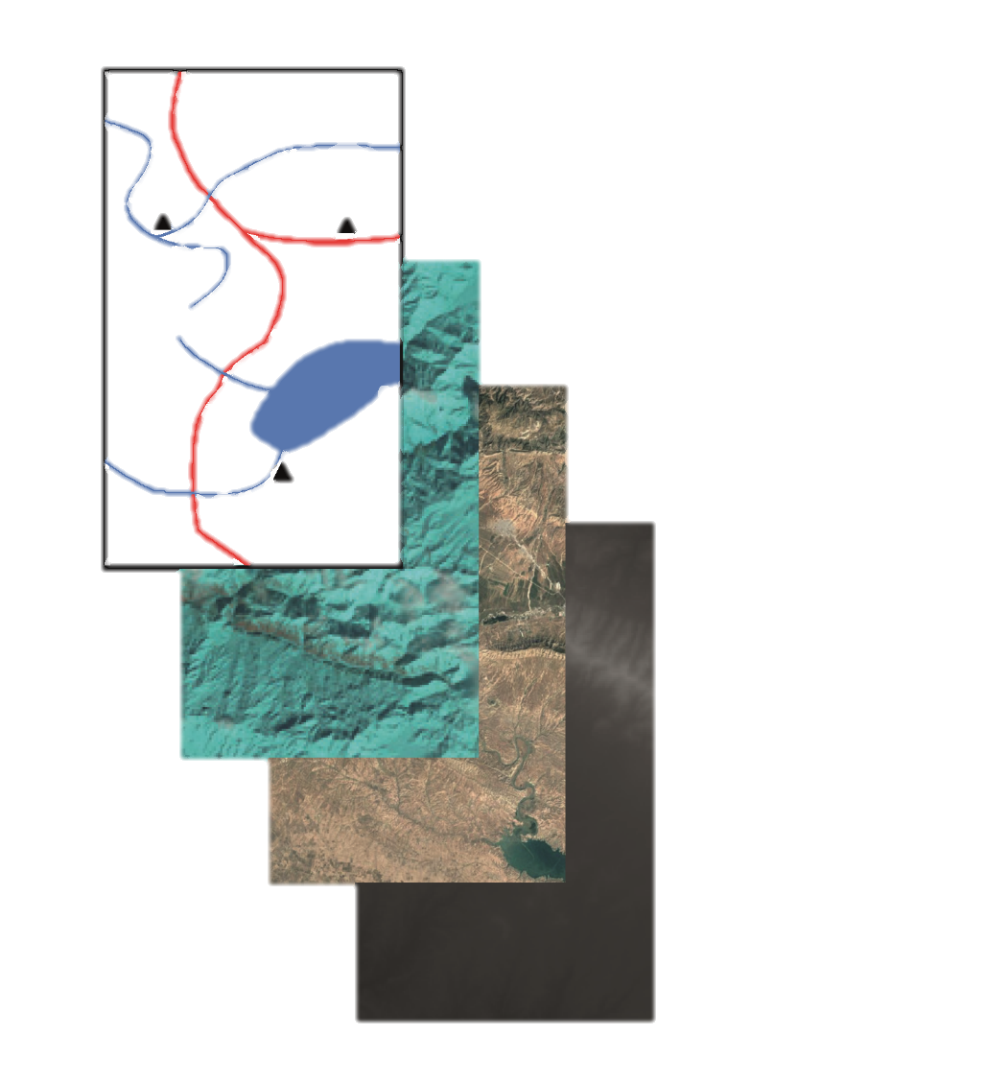
SFB 1070
Introduction
MATERIALS & METHODS
Results
Discussion
Conclusion
Vector: Sites, roads, rivers, mining spot...
Over 4.400 km² surveyed
> 350 sites
21 sites sampled
Spectral data: Landsat 8/9, Sentinel 2, ASTER (NIR, color, thermal bands...)
Orhto-images : Copernicus, CORONA, HEXAGON
Others raster: SPOT, SRTM, Models (precipitation, temperature...)
Prepare data (ICP, FTIR, ML)
Probability map of site
Validate classification
Add news information's (Natural component, vectors data)
Analyse the patterns for each periods and sites type
Multisource data
Three steps of the methodology

Slide 4
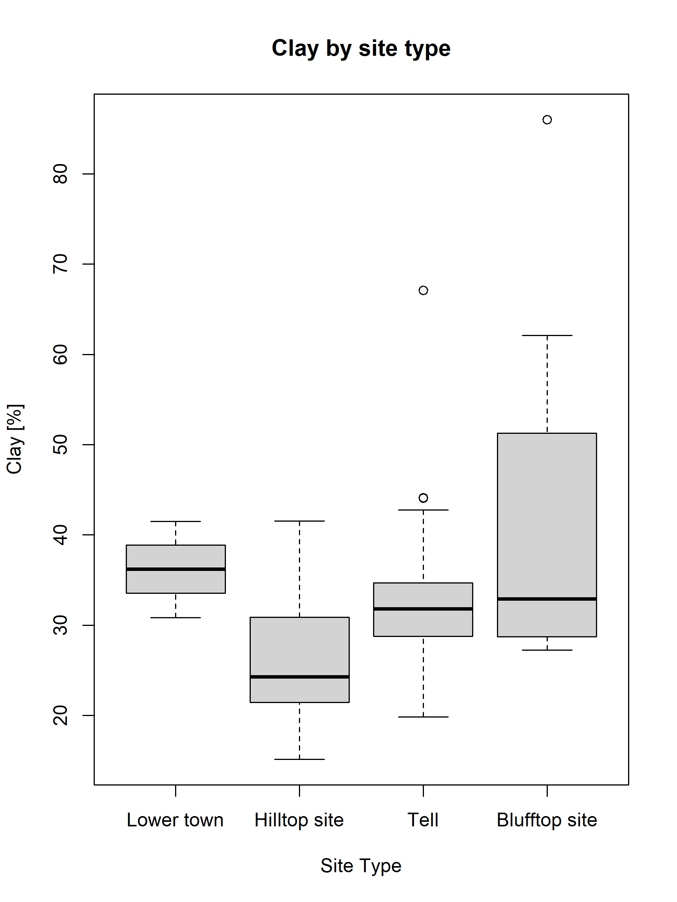
SFB 1070
ANOVA of clay content linked to site type
Introduction
Materials & Methods
RESULTS
Discussion
Conclusion
Anova on clay content per site type Pr(>F) = 0.002
Tukey HSD table points out significant differences between
Hilltop/Blufftop sites (p.value = 0.0012)
Hilltop/Tell sites (p.value = 0.0266)
Clay content as a significant influence on site type
Clay content by site type (n = 66)

Slide 5
SFB 1070
Introduction
Materials & Methods
Results
DISCUSSION
Conclusion
Prediction map and features rating (Menze and Ur, 2012)

Slide 6
SFB 1070
Introduction
Materials & Methods
Results
Discussion
CONCLUSION
Machine learning combined with statistics can underline unseen relation between sites and their environments
Multi-proxy and multi-scalar analysis needs Big data but not necessarily heavy costs
Next steps will be the realization of complex predictive maps, settlements patterns analysis for the whole corpus
Based on new methodology and later archaeological interpretation we are able to defines ResourceCultures in link with the settlement patterns and resources uses

Slide 7
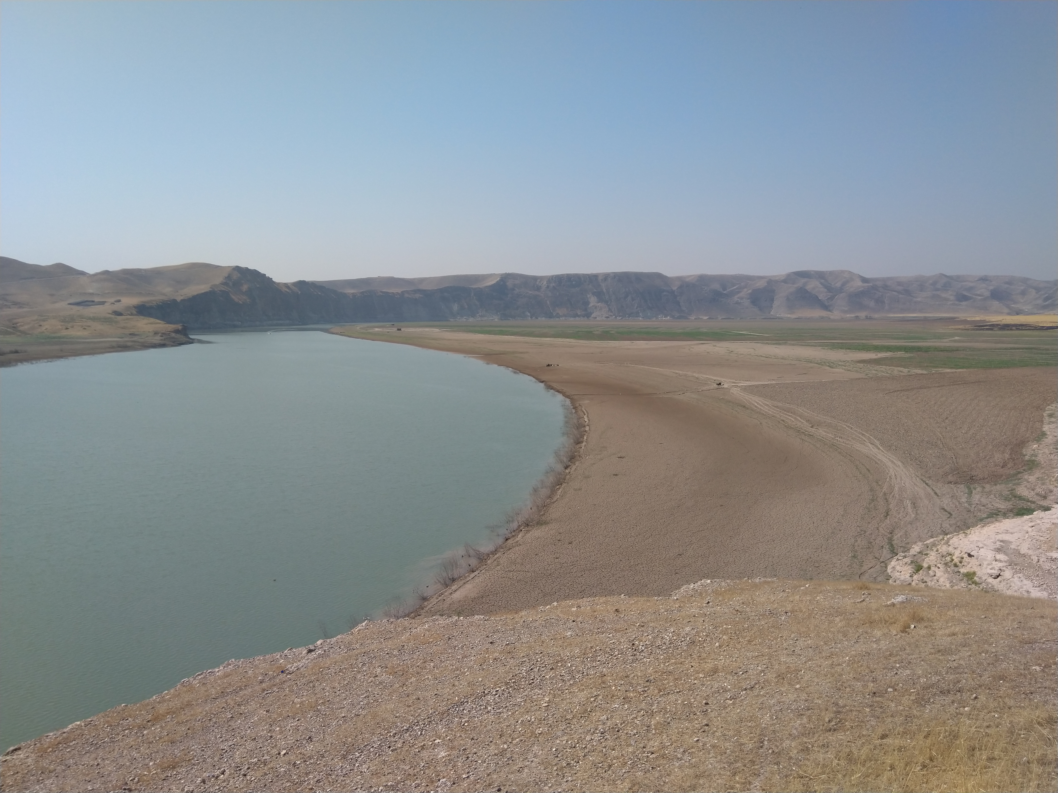
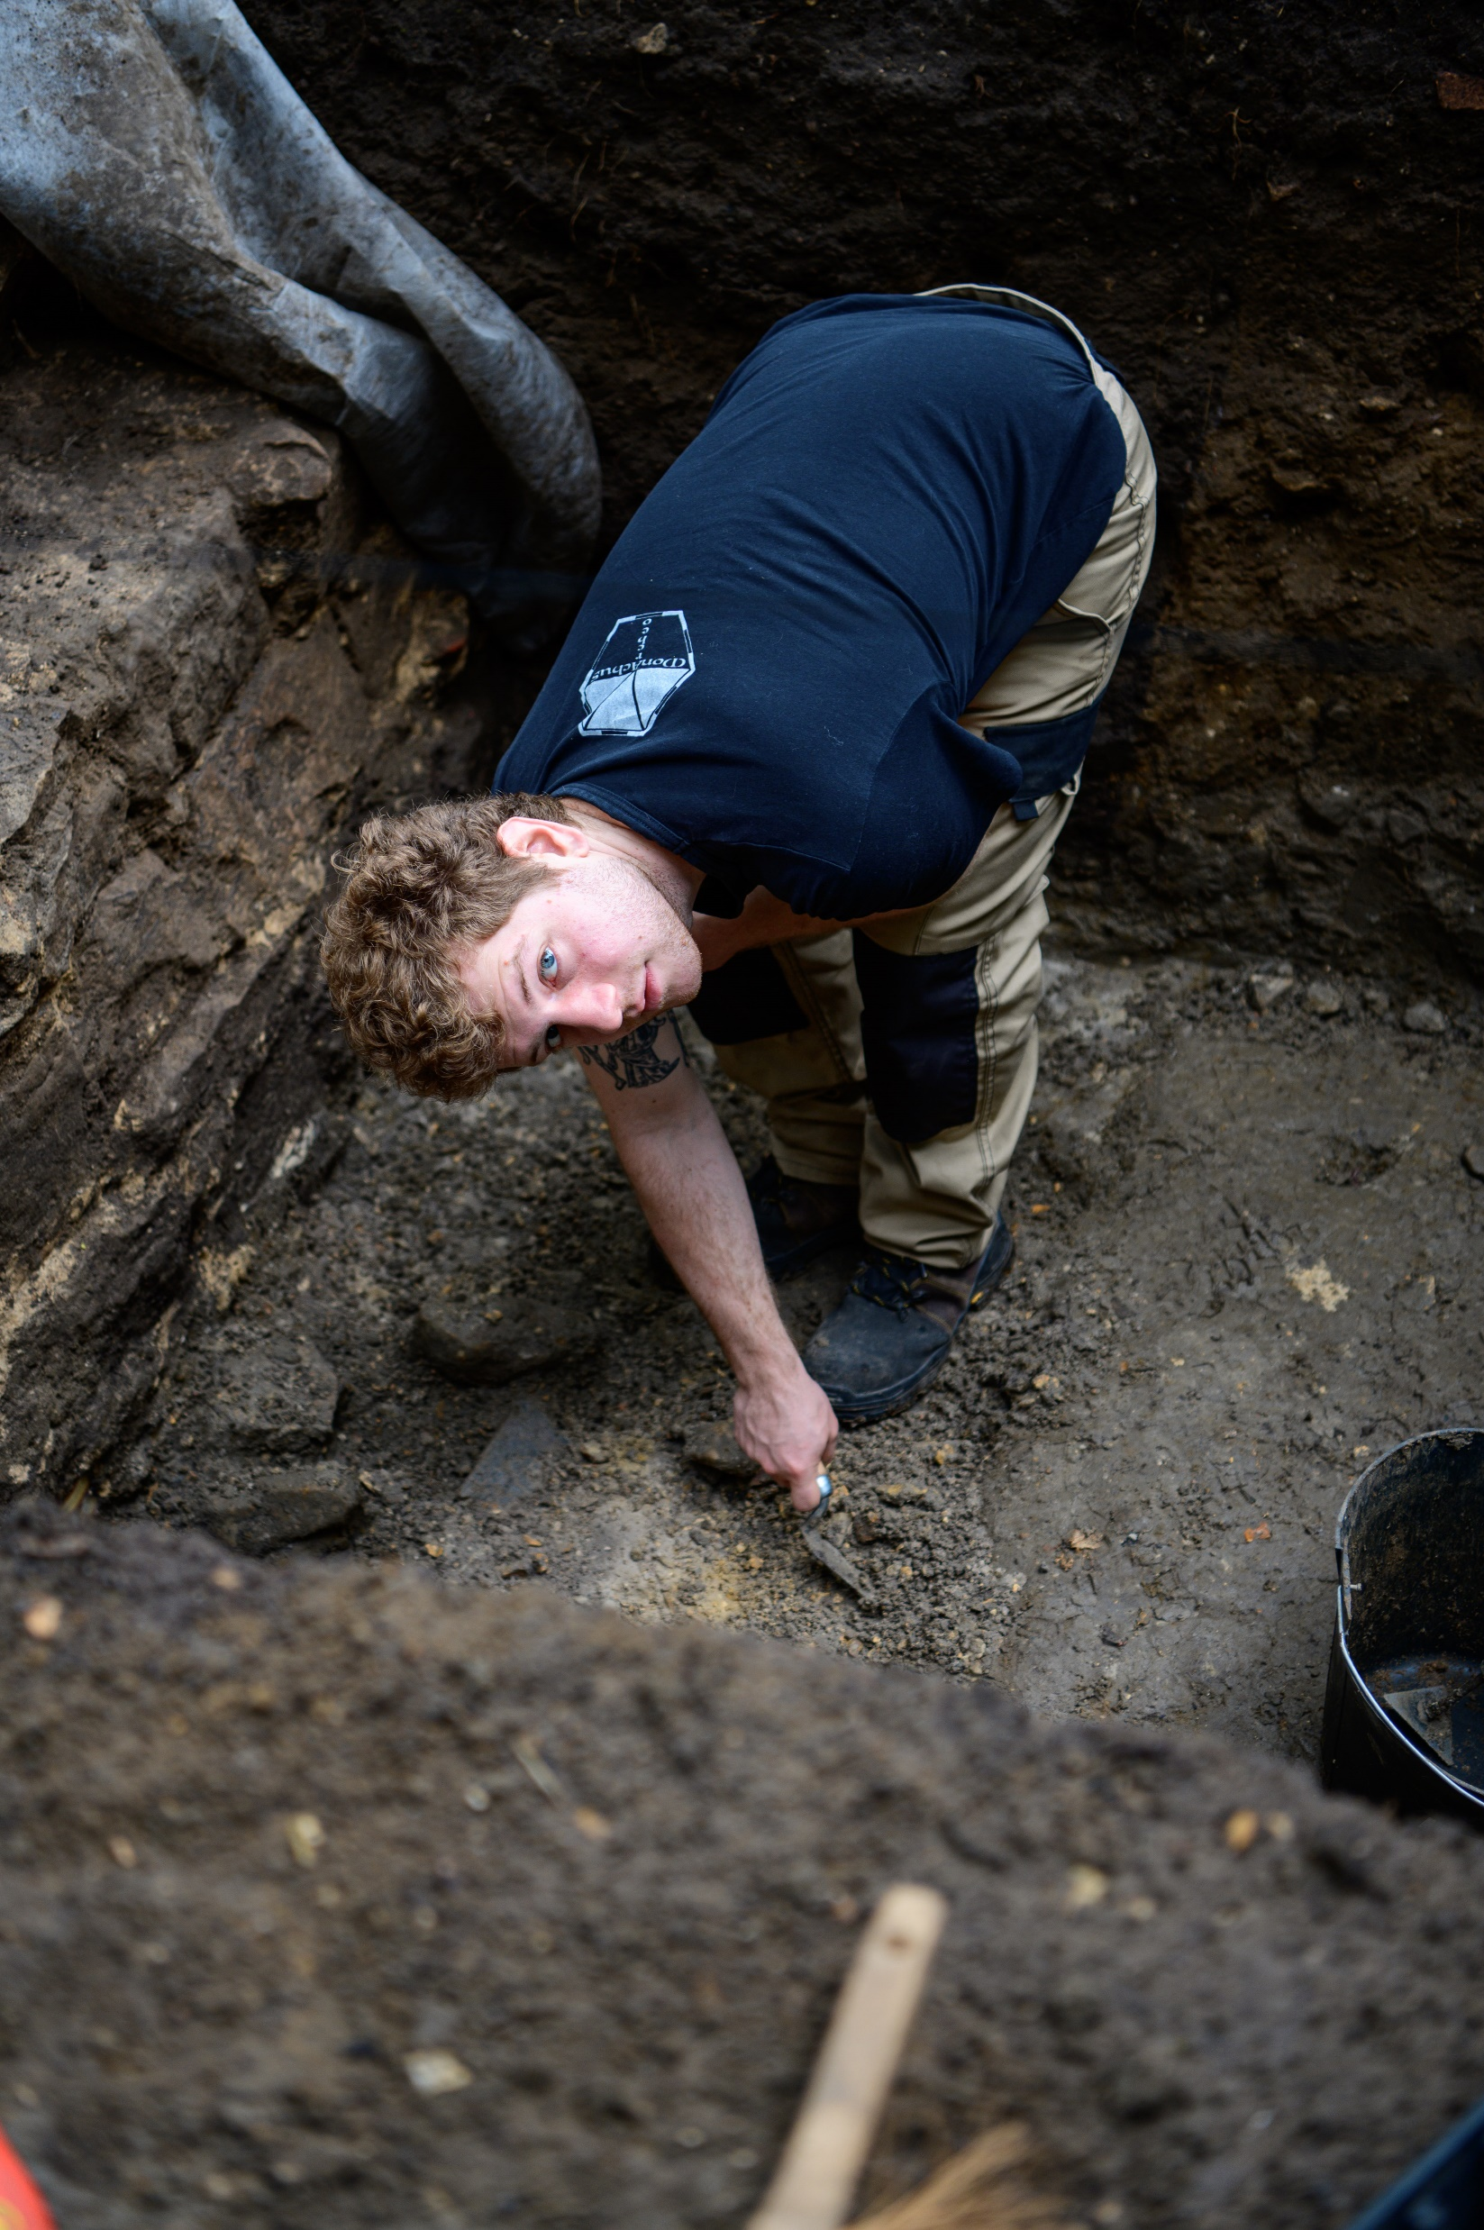

Thank you for your attention
mathias.bellat@uni-tuebingen.de

