Slide 1

Fine-scale electric fields and Joule heating from observations of the Aurora
Patrik Krcelic, Robert Fear, Daniel Whiter, Betty Lanchester, Anasuya Aruliah, Mark Lester, Larry Paxton

Slide 2
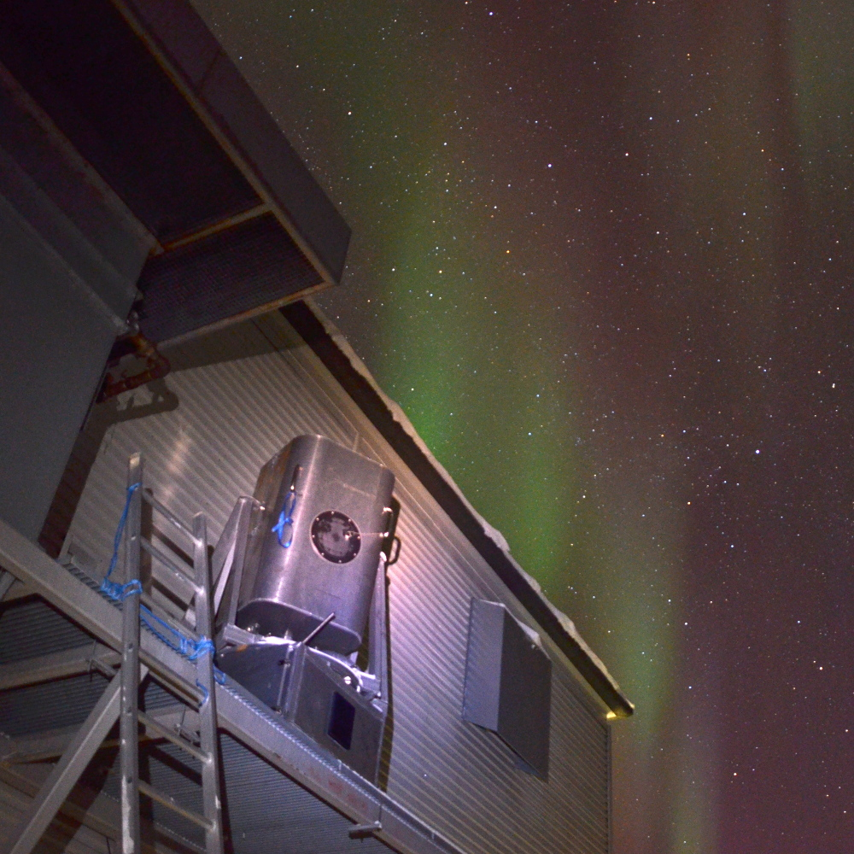
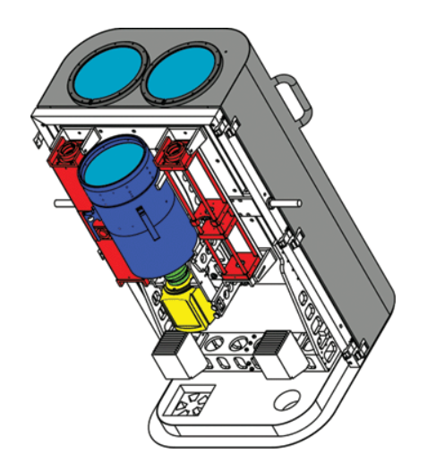
ASK-Auroral Structure and Kinetics
Multi-monochromatic imager
Located on Svalbard
Temporal resolution – 20 FPS, 32 FPS
3 wavelengths - 2 prompt emissions
- 1 metastable emission
Ashrafi, 2007
Dahlgren et al. 2008, 2015

Slide 3
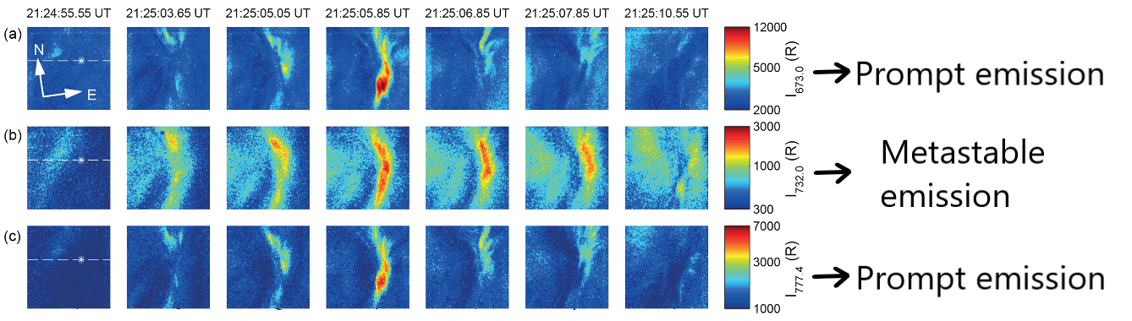
Prompt and metastable emissions
Effective lifetime of prompt emission species – few ns
Effective lifetime of metastable emission species – 5 s (afterglow)
ASK 1
ASK 2
ASK 3
Tuttle et al. 2020

Slide 4
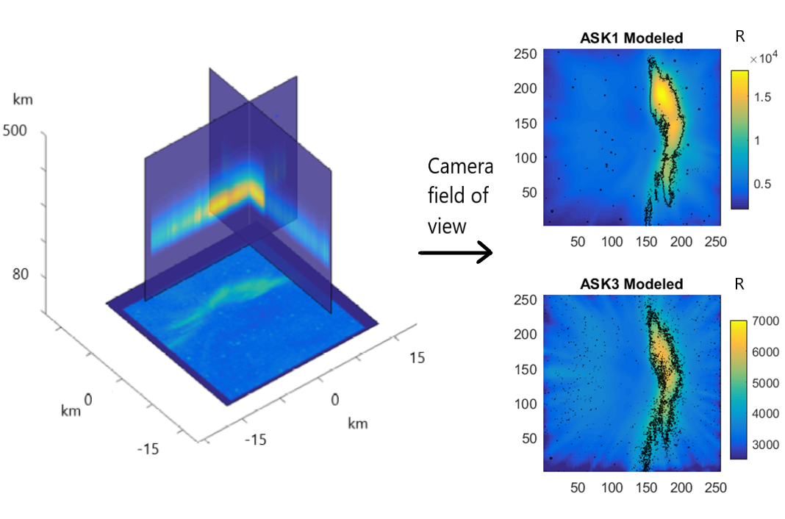
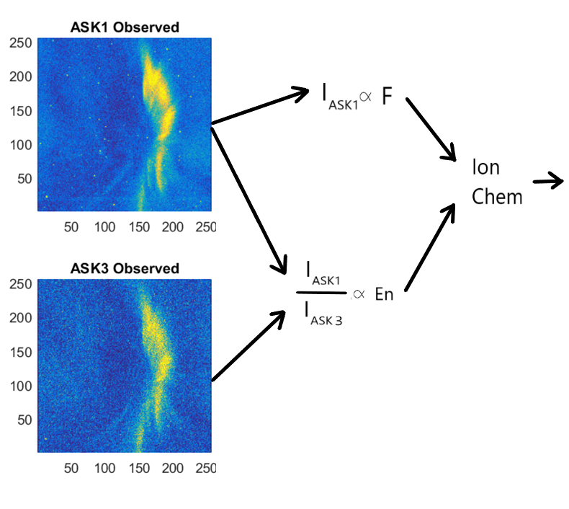
Modeling Process
Southampton Ion chemistry model (Lanchester et al., 2009)
Volume emission rates

Slide 5
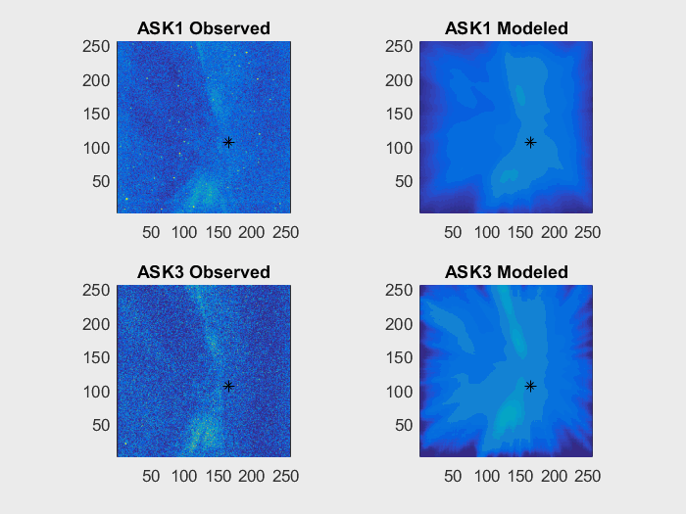

Slide 6
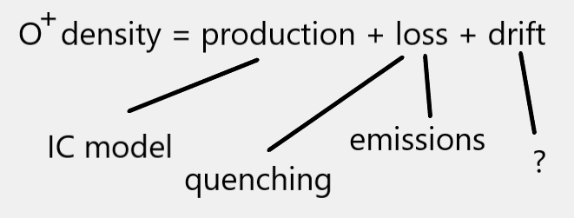
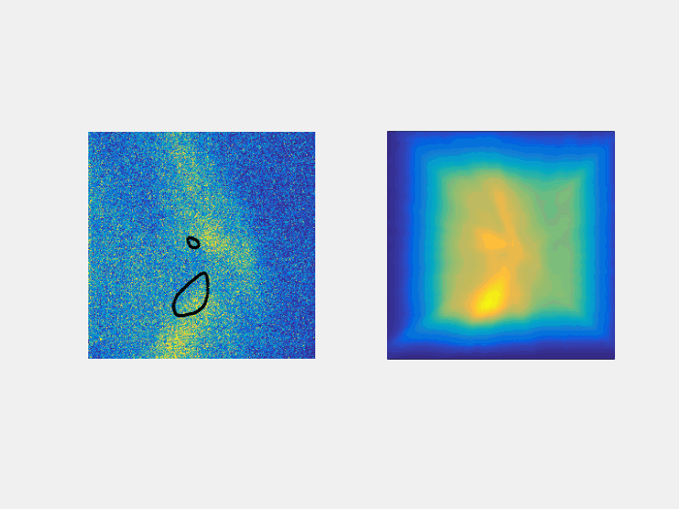
Drift velocities estimates
ASK2 Observed
ASK2 Modeled
Minimisation of mean square error between modeled and observed images
High resolution drift velocities

Slide 7
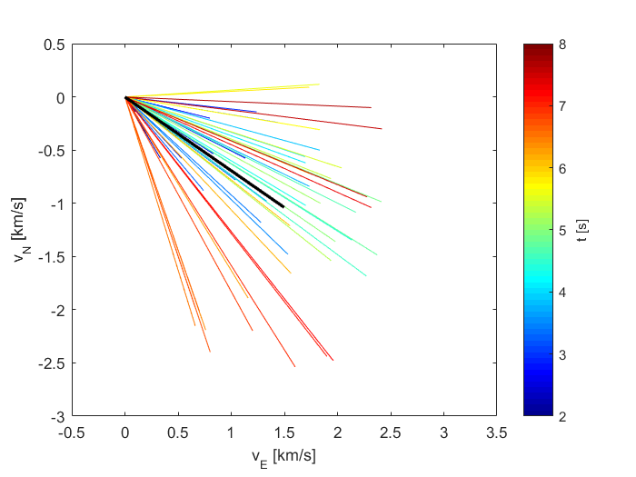
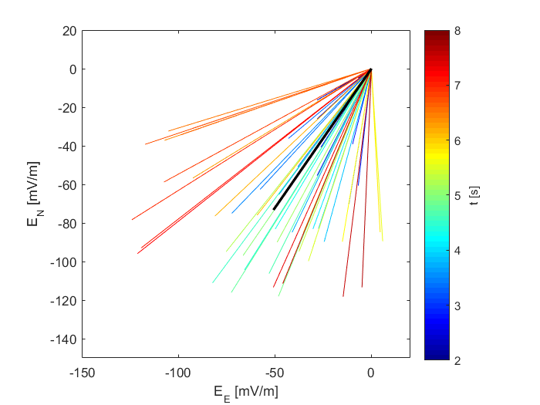
Flow model Results
Velocities
Electric fields

Slide 8
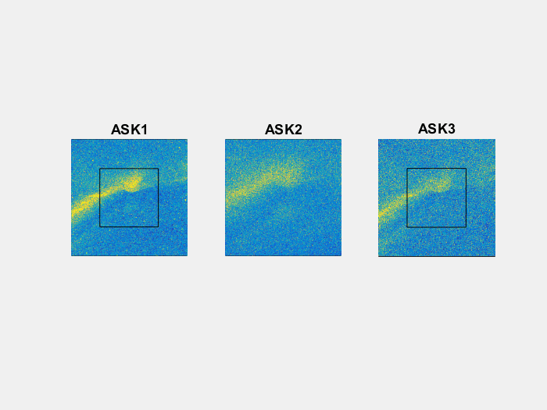
21.12.2014

Slide 9
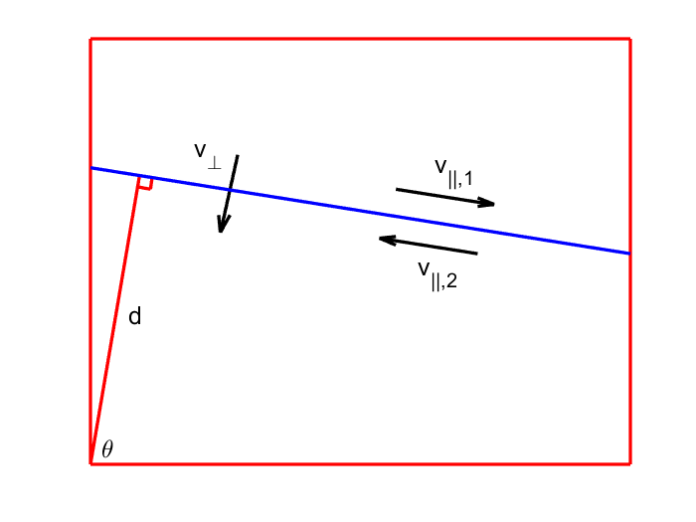
Next step – Applying method for more complicated cases
Auroral spatial structure drifts
Double flow model –Two different velocities on each side of the arc
Separatrix – line separating two regimes of drift velocity
Across the arc velocity – equal on both sides of the arc

Slide 10
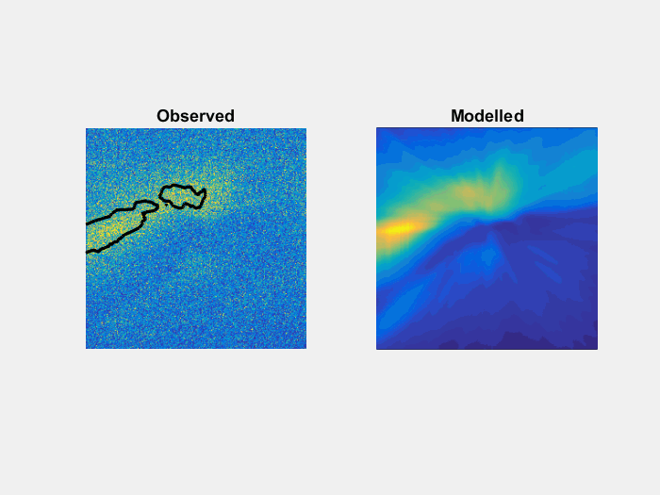
Modeled velocities

Slide 11
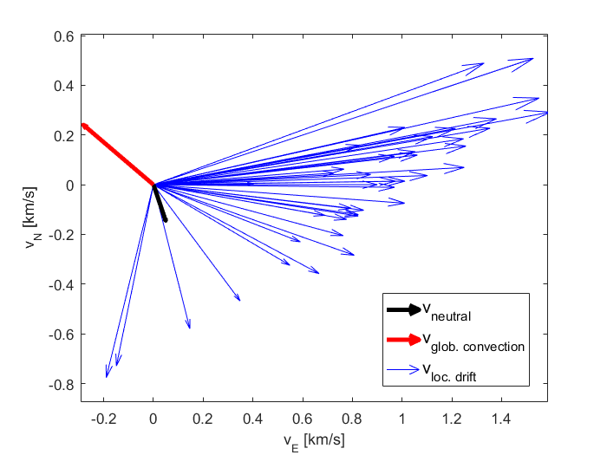
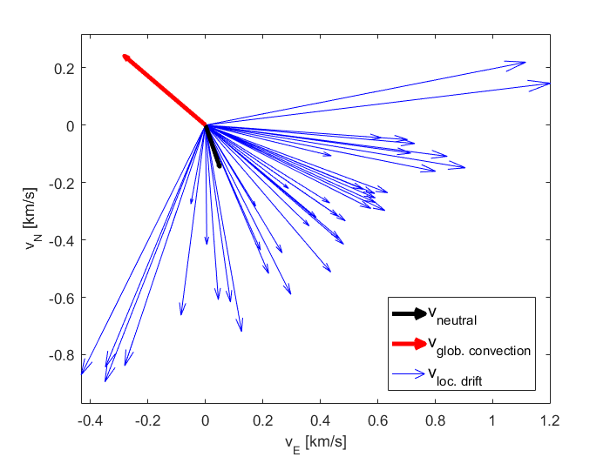
Velocities
North Region
South Region

Slide 12
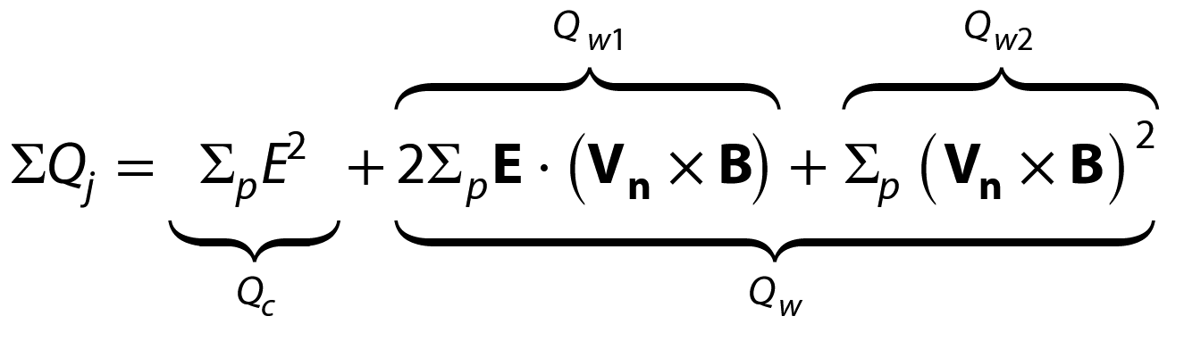
Height integrated Joule heating estimation
Underestimates of the Joule heating (locally)
Electric fields
Height integrated Pedersen conductivity
Neutral wind velocities from the UCL SCANDI instrument (Aruliah, 2009)
Billet et al., 2018

Slide 13
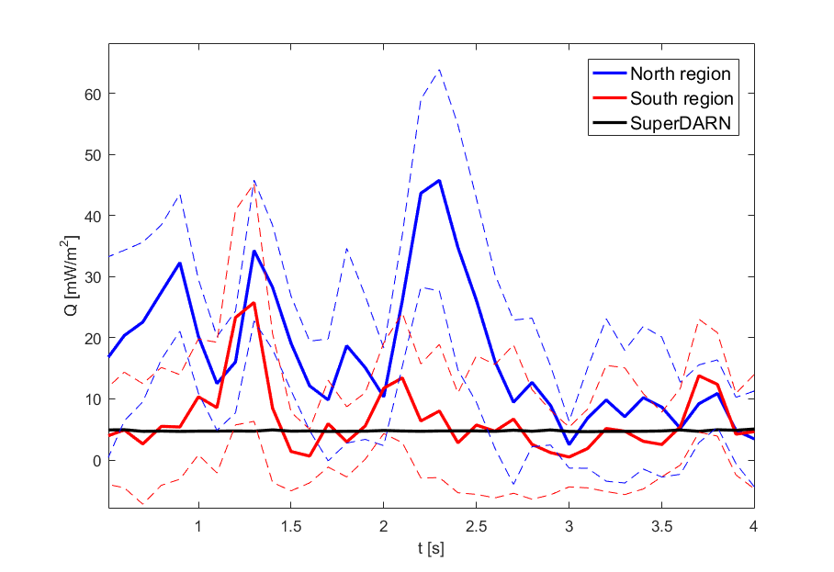

Slide 14
Conclusions
With described method we able obtain high temporal and spatial resolution electric fields
Much larger local Joule heating
– peak differences 5-10 times larger than
SuperDARN
– global atmospheric models – sub grid physics
Submitted to JGR – publicly available at: doi.org/10.1002/essoar.10511324.1

