Slide 1


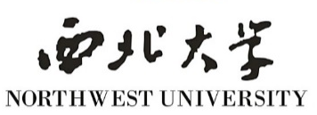
The study of detrital zircon geochronology, geochemistry and tectonic-sedimentary significance of Upper Triassic Yanchang Formation in central and western Ordos Basin
Reported by Ke Wu
Country: China
Affiliation: NORTHWEST UNIVERSITY
Date: Fri, 27 May

Slide 2
Content
Introduction
Experimental Section
Results and Discussion
Conclusion
1
2
3
4

Slide 3
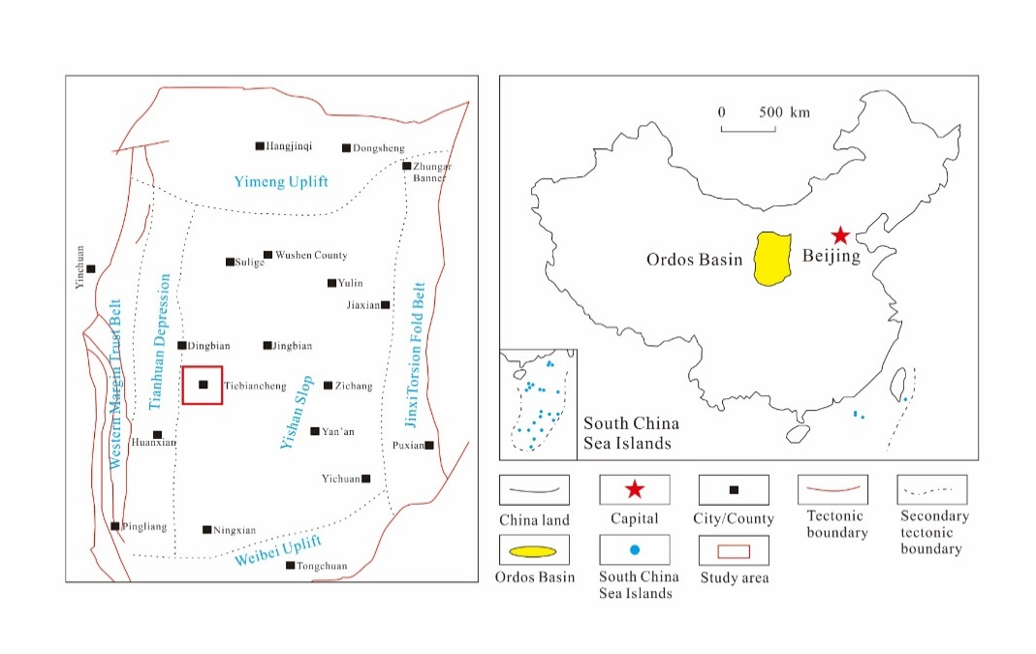
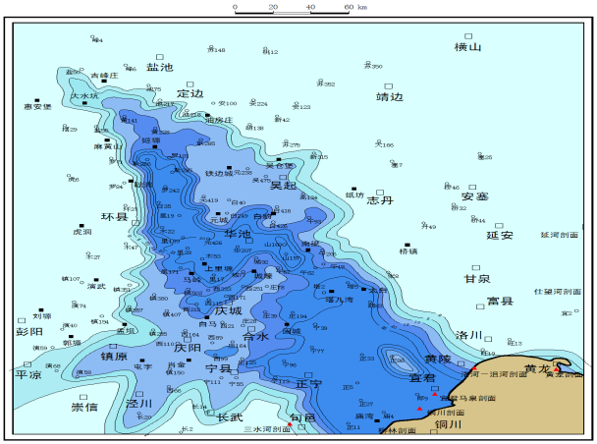
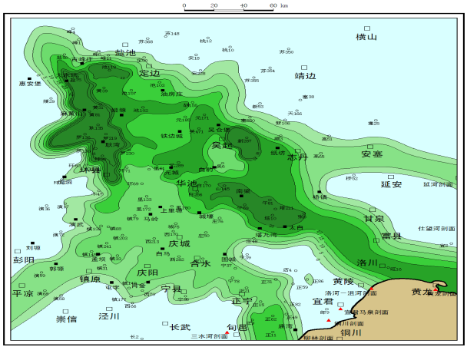
Introduction
Topic background
Unconventional oil and gas have become an important part of global oil and gas resources.
The Ordos Basin is the second largest sedimentary basin in China. The tight oil of Upper Triassic Yanchang Formation in the Ordos Basin is a typical representative of Chinese continental tight oil.
The tight oil in the central and western in Ordos Basin has the advantages of wide distribution, high oil saturation, and large total resources
Geographical location of the central and western in Ordos Basin
Thickness map of Chang 7 black shale and dark mudstone

Slide 4
Introduction
Research purposes
Research on the Origin judgment of zircon of Upper Triassic Yanchang Formation in central and western Ordos Basin;
Research on zircon age structure of Upper Triassic Yanchang Formation in central and western Ordos Basin;
Research on provenance Direction of Upper Triassic Yanchang Formation in central and western Ordos Basin
Research on tectonic-sedimentary significance of Upper Triassic Yanchang Formation in central and western Ordos Basin

Slide 5
Content
Introduction
Experimental Section
Results and Discussion
Conclusion
1
2
3
4

Slide 6
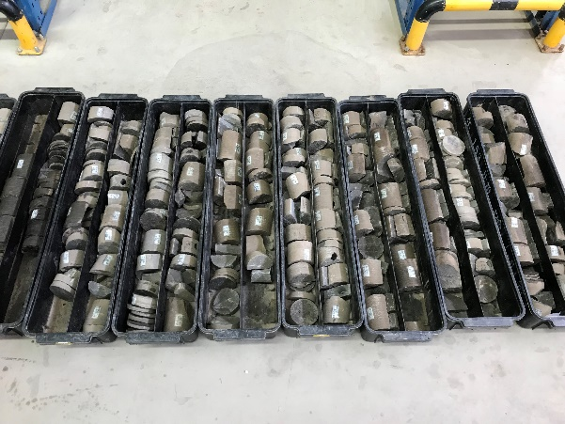
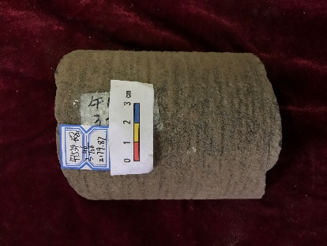
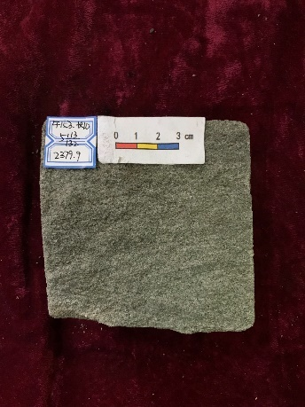
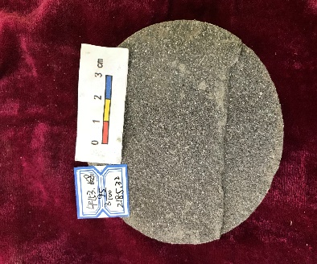
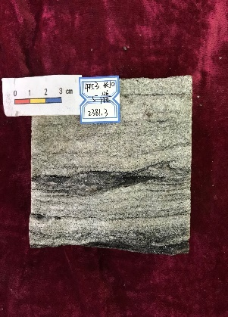
Experimental Section
Experimental materials and method
Experimental method and number
Method | Lithology | Rare Earth Element | Detrital zircon geochronology
Number of samples | sandstone | 200 | 2（×100points）
Core samples of drilling

Slide 7
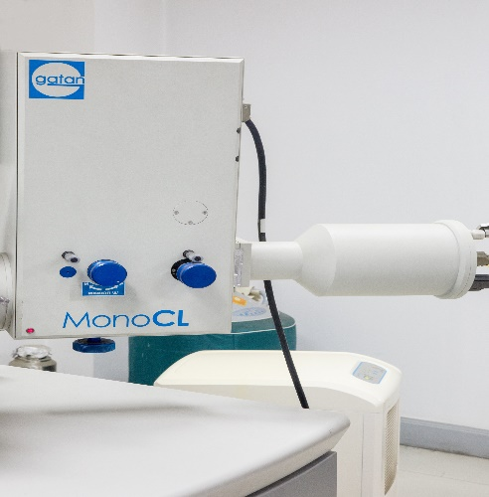
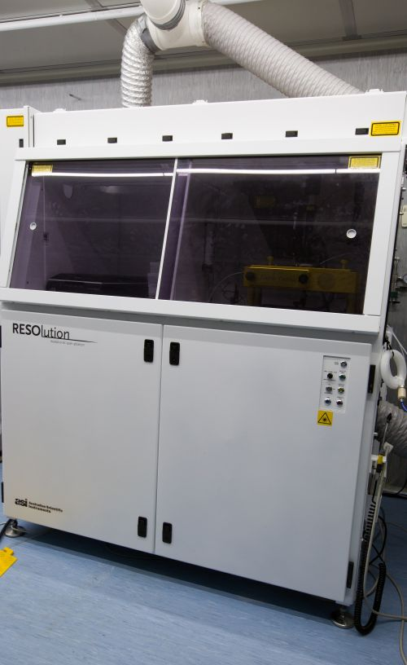

Experimental Section
Experimental equipment
Zircon dating
Cathodofluorescence spectrometer)
Laser Ablation System
Laser Ablation - Inductively Coupled Plasma Mass Spectrometry

Slide 8
Content
Introduction
Experimental Section
Results and Discussion
Conclusion
1
2
3
4

Slide 9
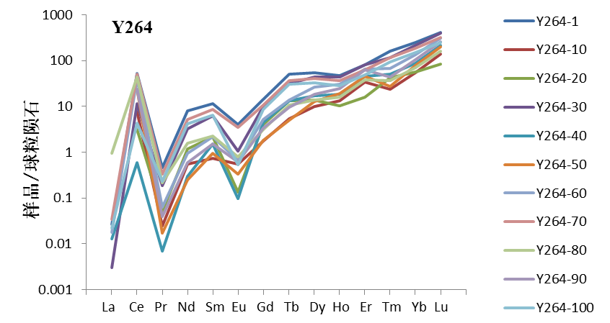
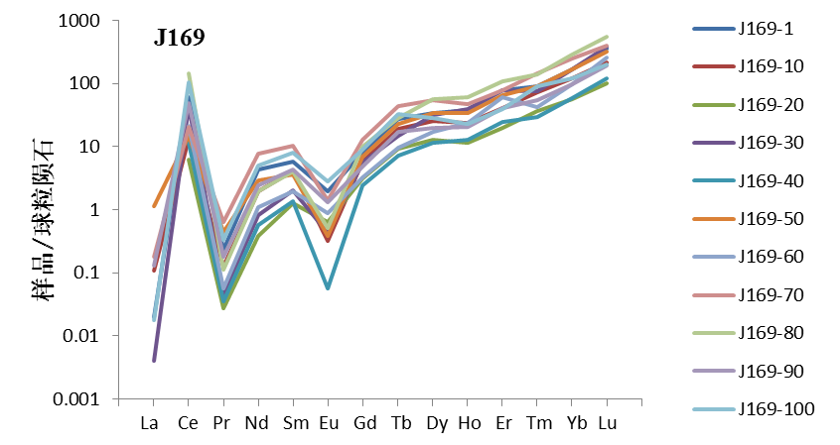
Results and Discussion
Rare Earth Elements

Slide 10
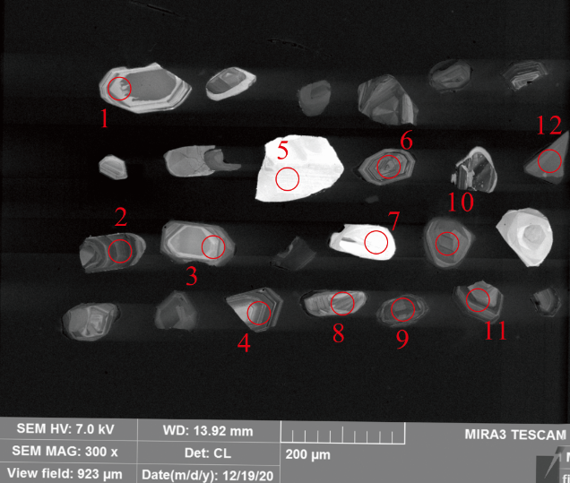
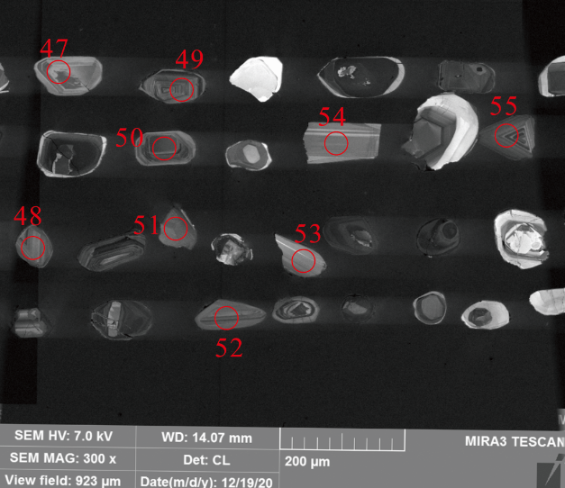
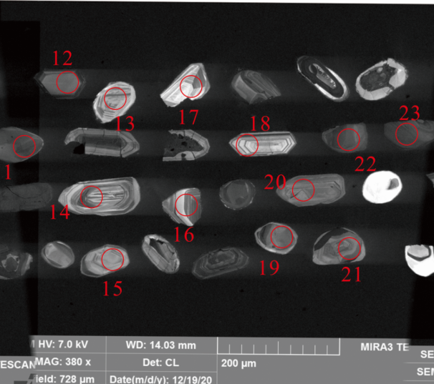
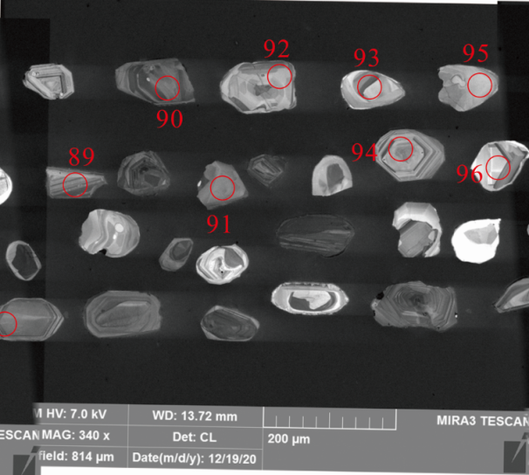
Results and Discussion
Detrital zircon geochronology
Part of detrital zircon CL images and test locations

Slide 11
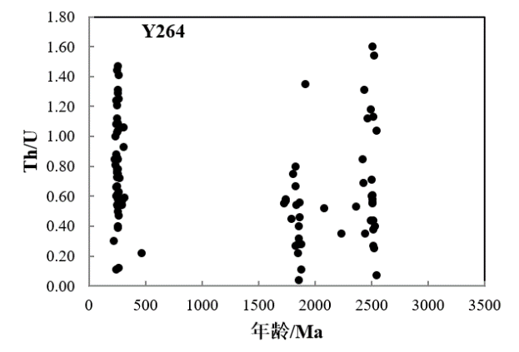
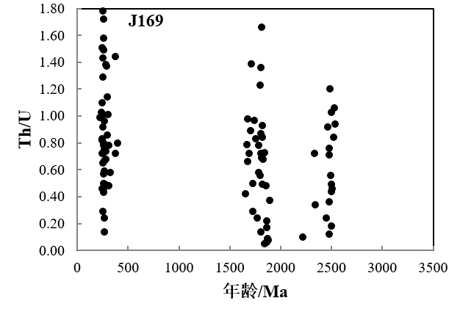
Results and Discussion
Detrital zircon geochronology
Zircon Type Discrimination Criteria
Th/U | Th/U＞0.4 | 0.1<Th/U<0.4 | Th/U<0.1
type | magmatic zircon | magmatic zircon affected by metamorphism | metamorphic zircon
NO.1
NO.2
Th/U＞0.4，81%
Th/U＞0.4，81%
Age/Ma
Age/Ma
Sample Th/U value and distribution characteristics

Slide 12
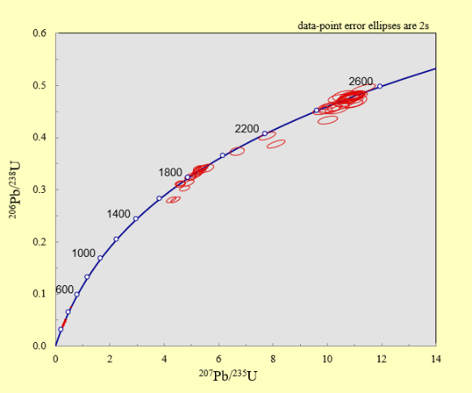
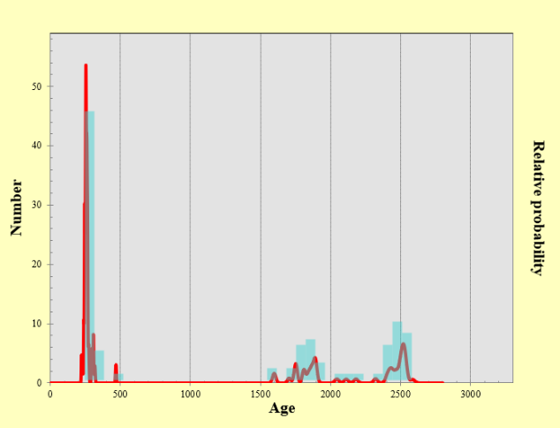
Results and Discussion
Detrital zircon geochronology
NO.1 Zircon Age Harmony Diagram
NO.1 Zircon age distribution histogram

Slide 13
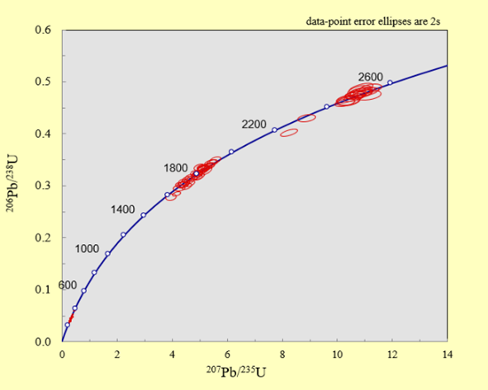
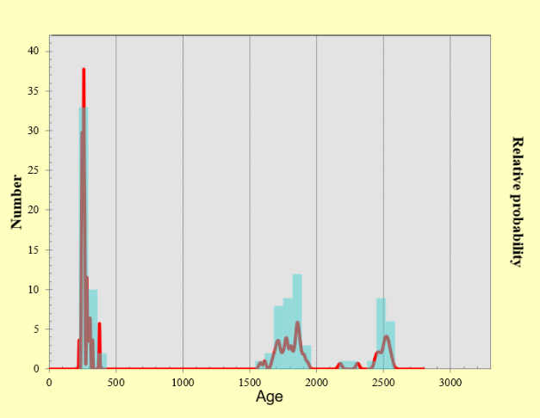
Results and Discussion
Detrital zircon geochronology
NO.2 Zircon Age Harmony Diagram
NO.2 Zircon age distribution histogram

Slide 14
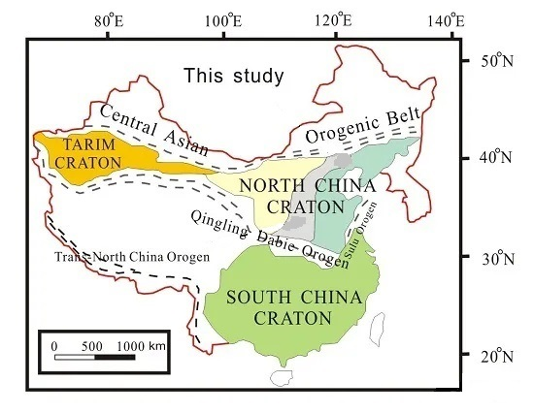
Results and Discussion
Discussion
Ordos Basin
Western
North China Craton
Eastern
Central
Map of the North China Craton

Slide 15
Results and Discussion
Discussion
Yinshan Mountains(Northeast)
Helan Mountain and Alxa Massif
(Northwest)
After Middle Jurassic
Daqingshan - Uralan Mountains
(Northeast)
Luliang Mountains
(East)
Beginning of the Late Cretaceous
Liupan and Qilian Mountains
(Southwest)
After the Late Triassic
Qinling orogenic belt
(South)
Ordos Basin Provenance Direction Map

Slide 16
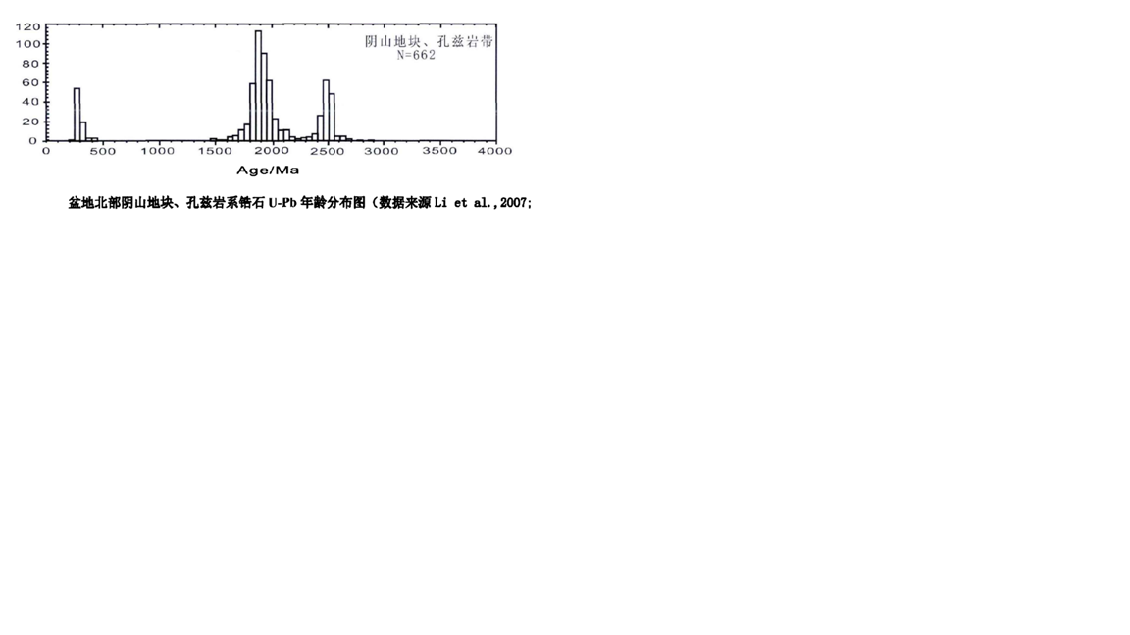
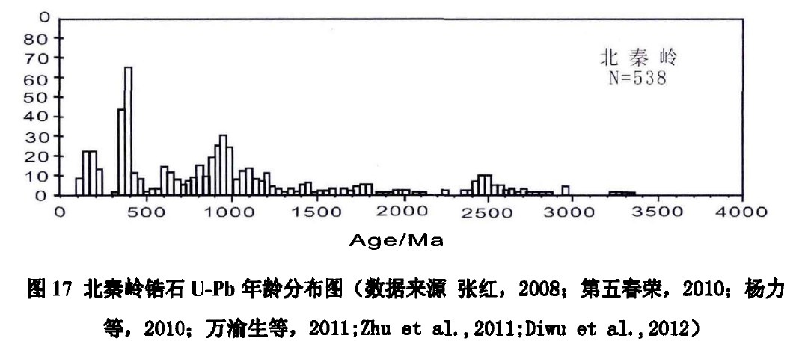
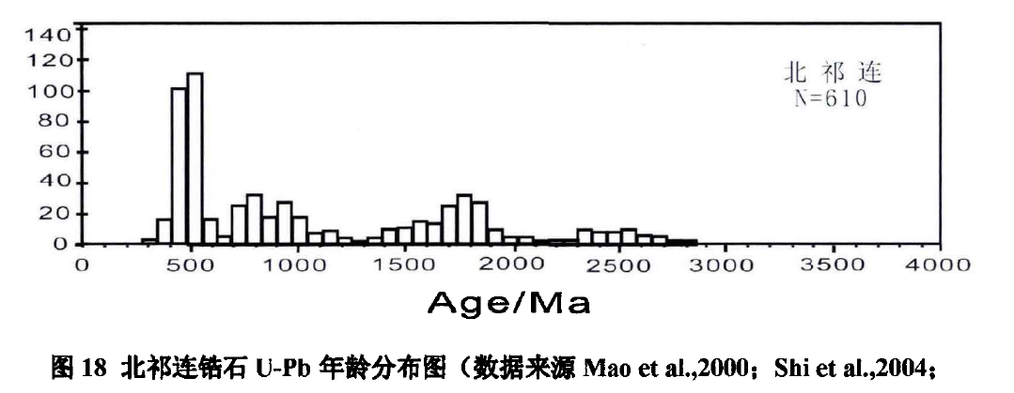
Results and Discussion
Discussion
2629-2336 Ma peak age:2503Ma
1915-1652 Ma peak age:1853Ma
378.1-208.1 Ma peak age:258.6Ma
Yinshan Mountains in the north,
Daqingshan Mountains in the northeast
Qinling orogenic belt
Liupan and Qilian Mountains
Age distribution of zircon from research area
Age distribution of zircon from potential provenance

Slide 17
Content
Introduction
Experimental Section
Results and Discussion
Conclusion
1
2
3
4

Slide 18
Conclusion
（1）The zircon in the central and western Ordos Basin is dominated by magmatic zircon, with a small amount of metamorphic zircon. Zircon dating test results are reliable.
（2）The zircon in the central and western Ordos Basin has three age groups. First age group is the late Neoarchean-early Paleoproterozoic. Second age group is the Late Paleoproterozoic-Early Mesoproterozoic. Last age group is the Upper Devonian-Upper Triassic.
（3）The provenance direction of the central and western parts of the Ordos Basin comes from the Yinshan and Daqingshan mountains in the northeastern part of the basin.
（4） Three age groups indicate the impact of different tectonic movements on the study area. First age group indicates the formation time of the basement of the North China Craton. Second age group indicates the Lvliang movement caused the tectonic evolution of the Ordos Basin. Last age group indicates the Hercynian movement caused the tectonic evolution of the Ordos Basin. The Ordos Basin opens the stage of ocean basin shrinkage. Started a powerful hydrocarbon generation model, which reserves huge oil and gas resources for the Triassic Yanchang Formation.

Slide 19
Thanks

