Slide 1
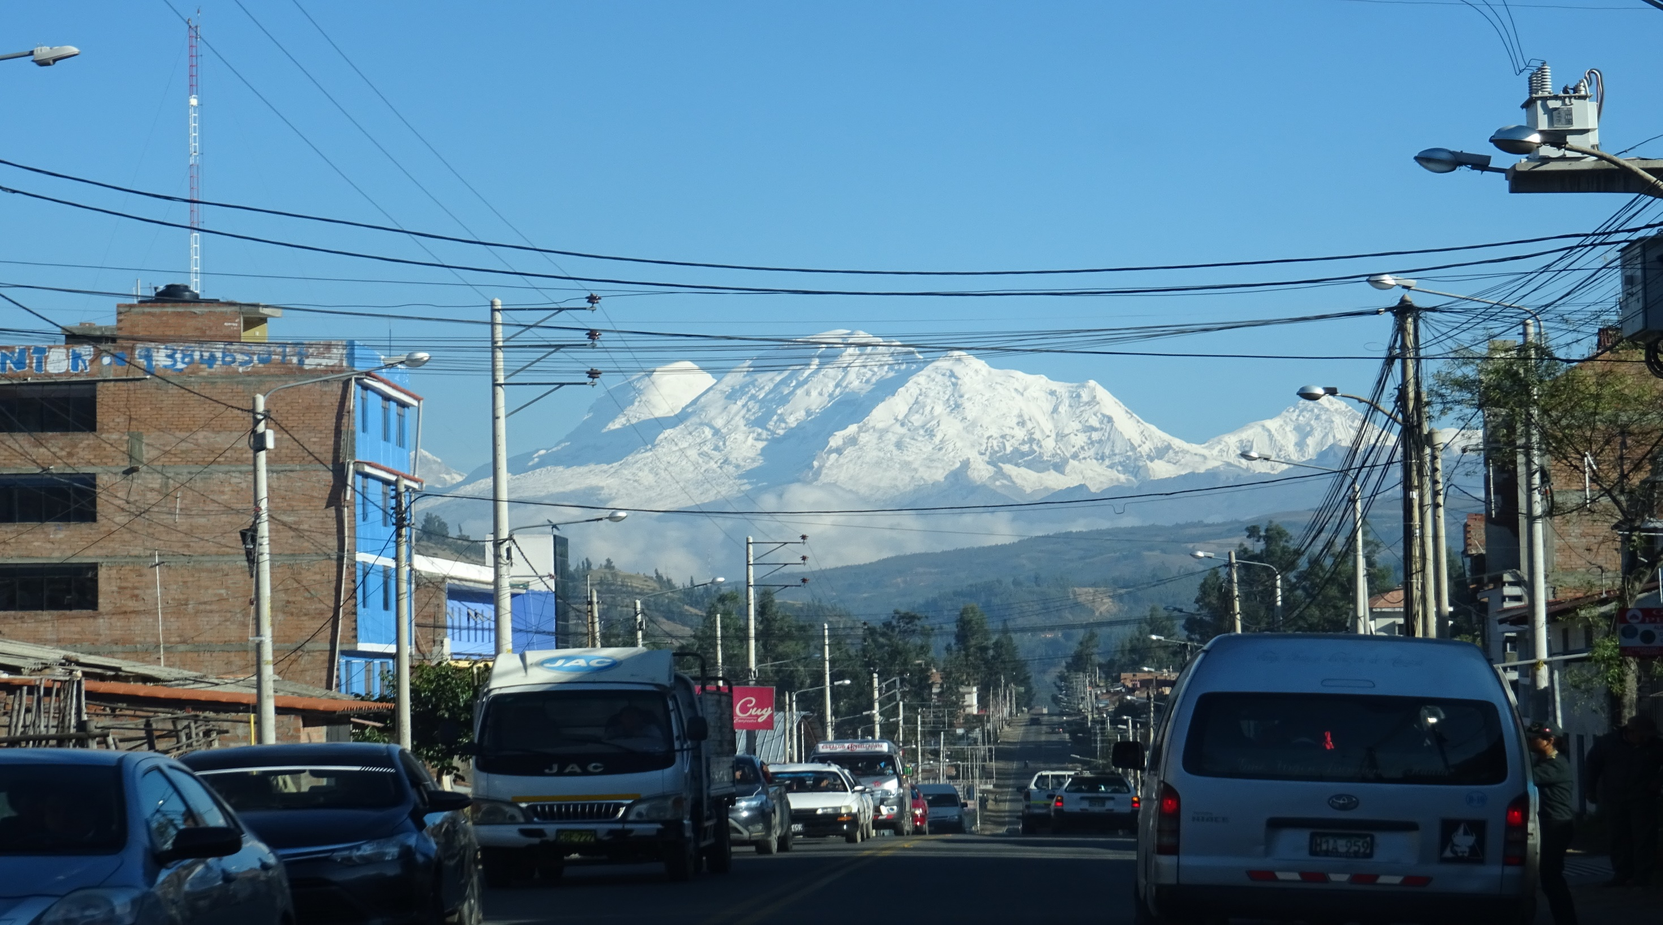





Evaluating Sediment Source Contributions in a River Catchment Impacted by Glacial Melt and Land Use Change, The Rio Santa, Peru
jessica.kitch@plymouth.ac.uk
Jessica Kitch, Caroline Clason, Sally Rangecroft, Sergio Morera, Shirley Contreras, Will Blake
Jessica Kitch, Caroline Clason, Sally Rangecroft, Sergio Morera, Shirley Contreras, Will Blake

Slide 2
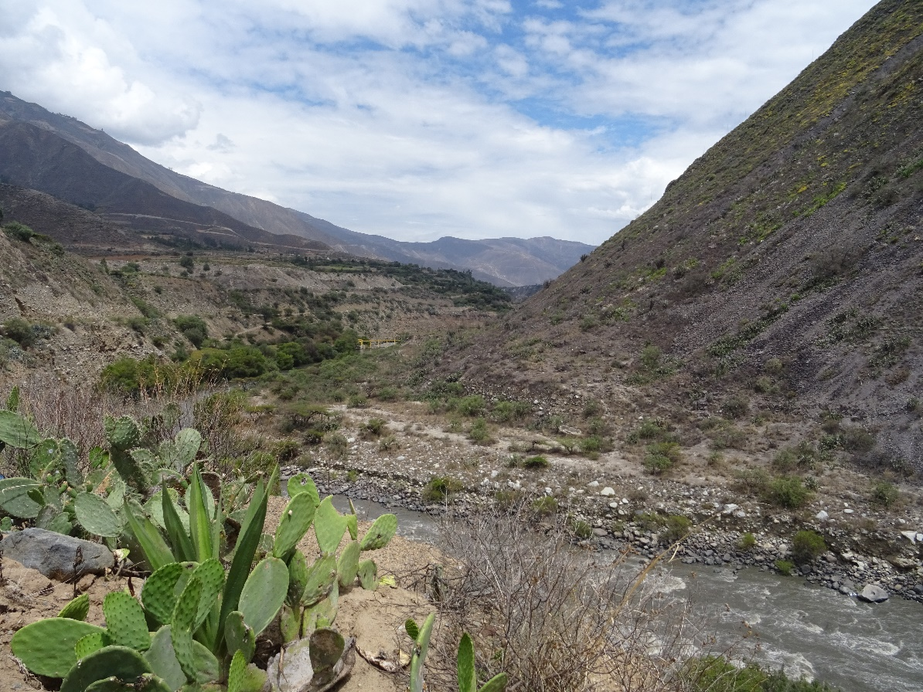
Aims and Objectives
This study aims to better understand the sediment dynamics of a catchment in Peru, and the implications of sediment in regards to the security nexus
The current investigation focuses on the in channel sediment of the Rio Santa and the Ranrahirca sub-catchment
To better understand sediment dynamics sediment fingerprinting will be used
What are the sources contributing to sediment in the Rio Santa?
Jessica Kitch, Caroline Clason, Sally Rangecroft, Sergio Morera, Shirley Contreras, Will Blake
Jessica Kitch, Caroline Clason, Sally Rangecroft, Sergio Morera, Shirley Contreras, Will Blake

Slide 3
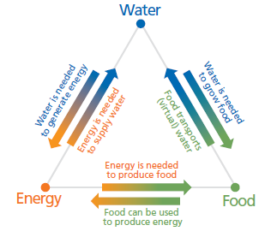
Soil Erosion Problem
Rates of soil erosion are unsustainable
Greater volumes of soil leave catchments in comparison to production rates
Water, food and energy security are linked to and effected by soil erosion
Sediment can be a carrier of pollutants, and this can effect drinking water supplies
Sediment can cause issues with hydroelectric dams and thus energy production
Thinner soils result in less fertile soils and thus impacting food security through a reduction in crops
flores.unu.edu​
Jessica Kitch, Caroline Clason, Sally Rangecroft, Sergio Morera, Shirley Contreras, Will Blake
Jessica Kitch, Caroline Clason, Sally Rangecroft, Sergio Morera, Shirley Contreras, Will Blake

Slide 4
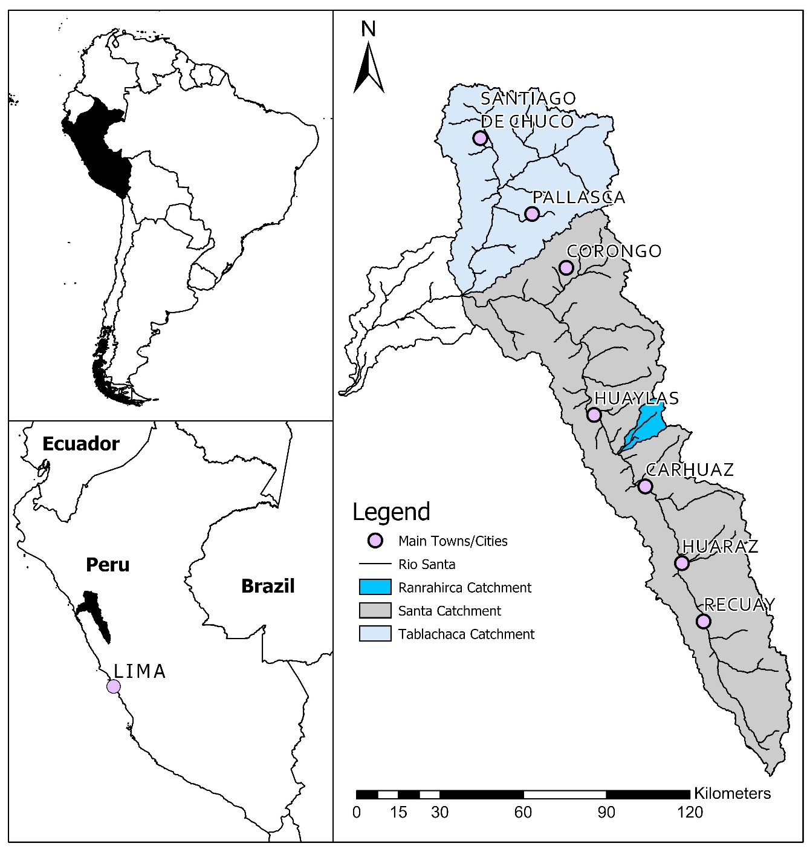
Rio Santa Catchment
Cordillera Blanca
The Rio Santa catchment is located in the Ancash region of Peru
The main channel is situated between the glaciated Cordillera Blanca and non-glaciated Cordillera Negra
Samples were collected in November 2019 from the main channel and tributaries of the Cordillera Blanca and the Cordillera Negra
  The samples taken were of deposited sediment
  A total of 169 samples were taken
Sampling in the Ranrahirca sub-catchment was conducted in 2020
  A total of 103 samples were taken
Cordillera Negra
Jessica Kitch, Caroline Clason, Sally Rangecroft, Sergio Morera, Shirley Contreras, Will Blake
Jessica Kitch, Caroline Clason, Sally Rangecroft, Sergio Morera, Shirley Contreras, Will Blake

Slide 5



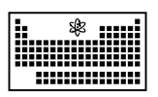
Sample Analysis and MixSIAR Unmixing Model
Samples were initially analysed using Wavelength Dispersive X-ray Fluorescence (WD XRF) as this provides geochemical data
The MixSIAR model is then run in RStudio using the geochemical data
The geochemical composition of source samples was compared to the mix samples
The mixing model then apportioned the sediment sources
Research, consultancy, training, teaching, ISO9001:2008 accreditation
Contact: william.blake@plymouth.ac.uk
Milling, mixing, pressing
Elemental analysis
Sieved sample (<63µm)
Pellet
(Sample : Wax > 4:1 )
Geochemistry
(Via WD XRF )
Jessica Kitch, Caroline Clason, Sally Rangecroft, Sergio Morera, Shirley Contreras, Will Blake
Jessica Kitch, Caroline Clason, Sally Rangecroft, Sergio Morera, Shirley Contreras, Will Blake

Slide 6
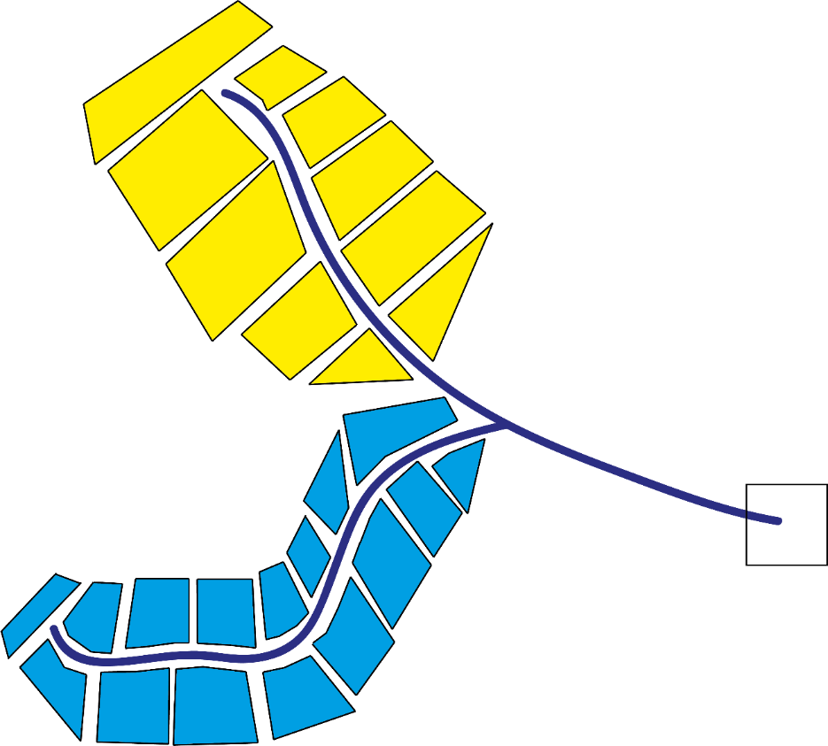
Sediment Fingerprinting Concept
For example, a catchment could have 2 sources of sediment
Sediment fingerprinting can identify the fingerprint that is present in the downstream sediment (mix)
The main contributor to the sediment mix can also be identified
Statistical models are used to unravel the multiple sources using geochemical fingerprints
The MixSIAR mixing model was used in this study (Stock et al., 2018)
?
? =
or
or
A mix
Jessica Kitch, Caroline Clason, Sally Rangecroft, Sergio Morera, Shirley Contreras, Will Blake
Jessica Kitch, Caroline Clason, Sally Rangecroft, Sergio Morera, Shirley Contreras, Will Blake

Slide 7
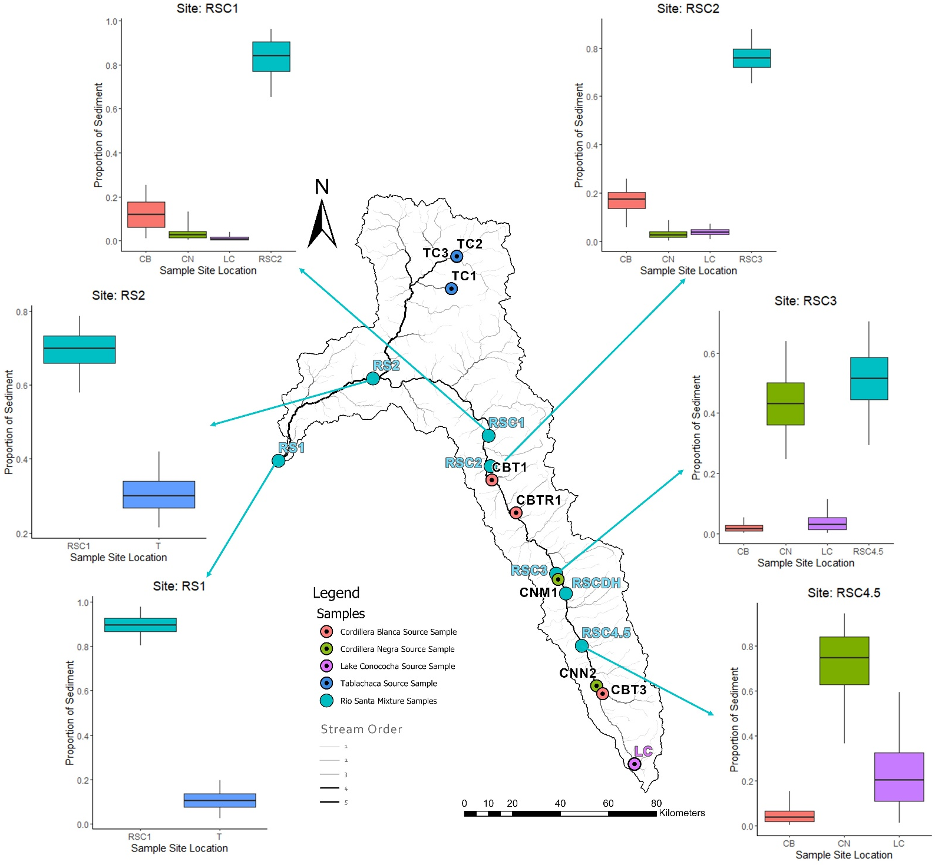
Rio Santa Catchment Results
4
3
Cordillera Negra (non-glaciated) is the greater contributor to in channel sediment upstream as seen in plots 1 and 2
Channel sediment is then the greater contributor (all material in channel up to sample point) downstream, as seen in plots 2, 3 and 4
At RSC2, channel sediment still has the stronger signature but the Blanca (glaciated) is a greater contributor than the Negra (non-glaciated)
This remains the same at site RSC1
With every downstream site the contribution from Lake Conococha lessens
After the confluence at sites RS1 and 2, the Rio Santa is a greater contributor to sediment compared to the Tablachaca. As seen in plots 5 and 6
5
2
6
1
Jessica Kitch, Caroline Clason, Sally Rangecroft, Sergio Morera, Shirley Contreras, Will Blake
Jessica Kitch, Caroline Clason, Sally Rangecroft, Sergio Morera, Shirley Contreras, Will Blake

Slide 8
Cumulative Contribution to Sediment
CN (Cordillera Negra) is the greater contributor to sediment throughout the Rio Santa catchment
The contribution to sediment from CB (Cordillera Blanca) increases greatly downstream of RSC3
The Contribution of LC (Lake Conococha) decreases downstream
MixSIAR Mix | Source code | Cumulative
RSC1 | CB | 0.291485724
 | CN | 0.566376433
 | LC | 0.141305843
RSC2 | CB | 0.20250688
 | CN | 0.63987552
 | LC | 0.1566176
RSC3 | CB | 0.044088
 | CN | 0.801152
 | LC | 0.15476
RSC4.5 | CB | 0.049
 | CN | 0.721
 | LC | 0.23
Jessica Kitch, Caroline Clason, Sally Rangecroft, Sergio Morera, Shirley Contreras, Will Blake
Jessica Kitch, Caroline Clason, Sally Rangecroft, Sergio Morera, Shirley Contreras, Will Blake

Slide 9
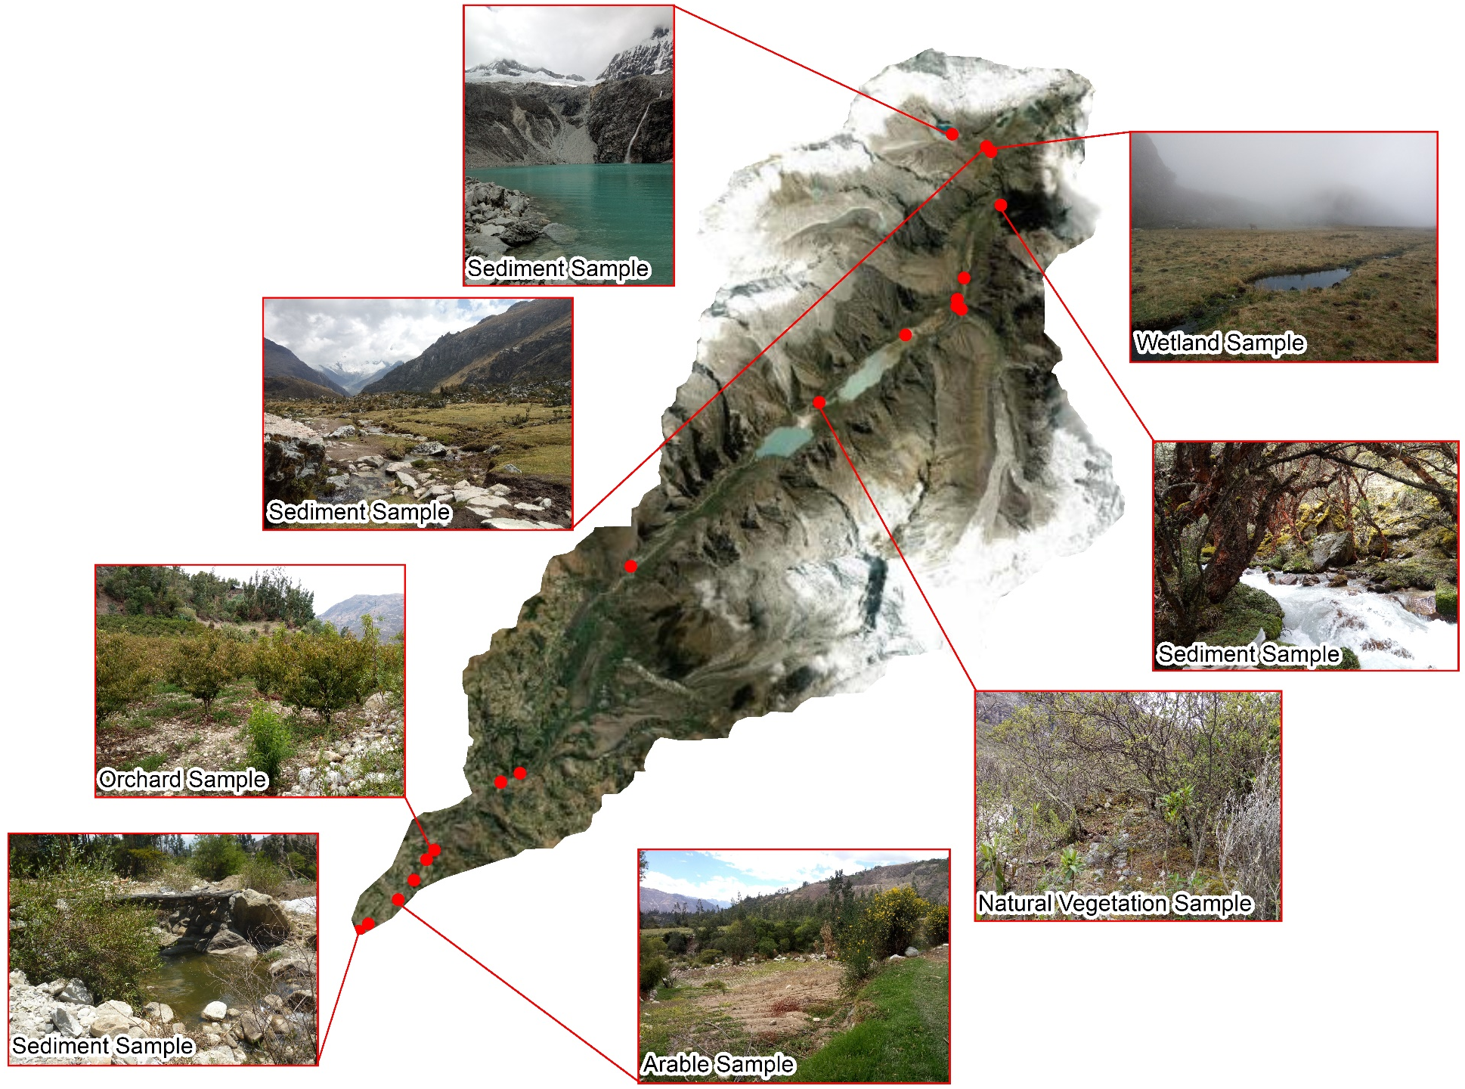
Ranrahirca Sub-Catchment Sampling
The sub-catchment focus was land use and soil erosion
Land use determined sample locations and included arable, channel bank, forest, natural vegetation, orchards, roads and wetland
Sites were determined using a land cover map produced from GPS data and google earth
Jessica Kitch, Caroline Clason, Sally Rangecroft, Sergio Morera, Shirley Contreras, Will Blake
Jessica Kitch, Caroline Clason, Sally Rangecroft, Sergio Morera, Shirley Contreras, Will Blake

Slide 10
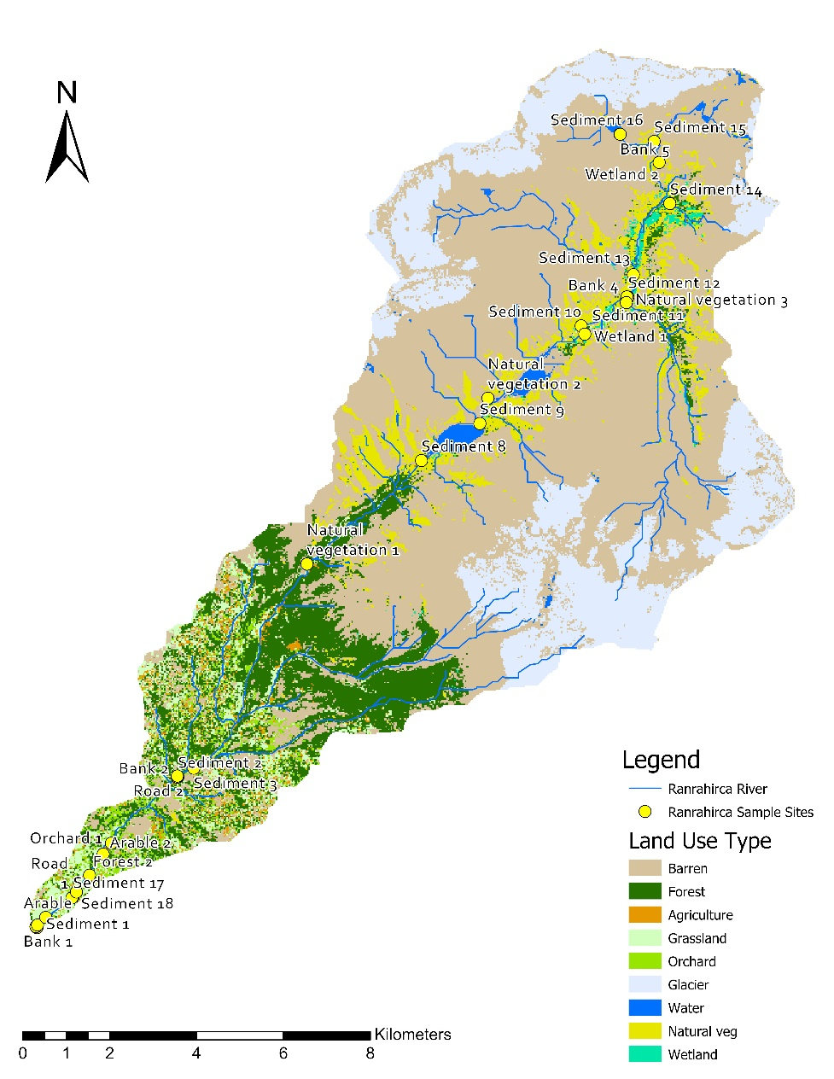
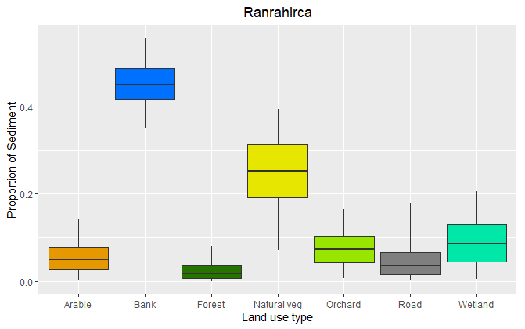
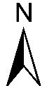
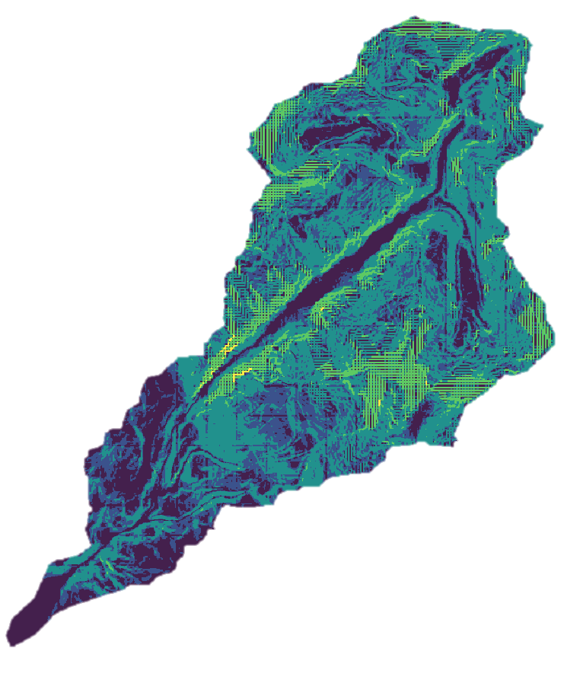


Ranrahirca Sub-catchment Results
Preliminary results suggest the greater contributors to sediment include channel bank and natural vegetation
Majority of the natural vegetation can be found in the north of the catchment where slopes are steeper and natural vegetation can be sparse on these slopes, leaving slopes more susceptible to soil erosion
Channel bank is the greatest contributor, suggesting channel incision may be occurring within this sub-catchment.
Jessica Kitch, Caroline Clason, Sally Rangecroft, Sergio Morera, Shirley Contreras, Will Blake
Jessica Kitch, Caroline Clason, Sally Rangecroft, Sergio Morera, Shirley Contreras, Will Blake

Slide 11
Conclusion
For the Rio Santa, the non-glaciated Cordillera Negra starts as the greater contributor to sediment
Downstream of the Rio Santa the main contributor is the glaciated Cordillera Blanca
After the confluence for the Rio Santa and Tablachaca, the greater contributor to sediment is the Rio Santa, contradicting previous studies in this catchment
The main contributors to sediment at the sub-catchment level in the Cordillera Blanca, is channel bank and natural vegetation. The likely factor contributing to soils eroding under natural vegetation is slope and sparse vegetation cover in some areas. Therefore, increasing vegetation cover in these areas could reduce soil erosion and increase slope stability
Samples were taken during the wet season, and therefore only show a snap shot of the catchment for this time of year. This may have also influenced the results regarding natural vegetation, as during the wet season there are additional streams found on the slopes.
Furthermore, due to the nature of the study catchment, some samples could not be taken due to access issues or a lack of material for channel sediment
Jessica Kitch, Caroline Clason, Sally Rangecroft, Sergio Morera, Shirley Contreras, Will Blake
Jessica Kitch, Caroline Clason, Sally Rangecroft, Sergio Morera, Shirley Contreras, Will Blake

Slide 12
Thank you
Any Questions?
Contact: jessica.kitch@plymouth.ac.uk
https://sigmaperu.wordpress.com
Jessica Kitch, Caroline Clason, Sally Rangecroft, Sergio Morera, Shirley Contreras, Will Blake

