Slide 1



The Relationship Between Soil Moisture and Drought Monitoring Using Sentinel-3 SLSTR Data in Lower Eastern Counties of Kenya
Ghada Sahbeni¹, Peter K. Musyimi ^{1, 3}, Balázs Székely¹, and Tamás Weidinger²
¹ Eötvös Loránd University, Department of Geophysics and Space Science, H-1117 Budapest Pázmány Péter stny 1/C, Hungary.
² Eötvös Loránd University, Institute of Geography and Earth Sciences, Department of Meteorology, H-1117 Budapest Pázmány Péter stny 1/A, Hungary.
³ Karatina University, Department of Humanities and Languages, P.O BOX 1957-10101, Karatina, Kenya. E-mail: pemusyimi@gmail.com musyimipeter@student.elte.hu

Slide 2
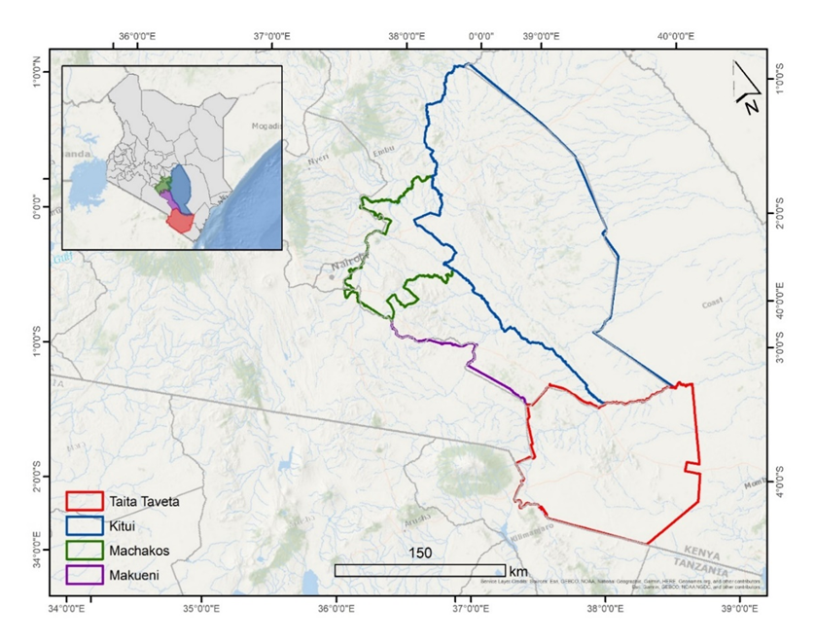
Objective
Study Area
Analyze the relationship between soil moisture and drought using Sentinel-3 SLSTR data in lower eastern counties of Kenya.
Kitui County: semi-arid to arid, poorly distributed rainfall, recurrent droughts.
Machakos county: arid and semiarid climate, elevation ranges from 400 m to 2100 m above sea level.
Makueni county: arid and semi-arid, severe water scarcity, food insecurity, low adaptive capacity and resilience to climate change.
Taita-Taveta county: semi-humid to semi-arid, recurrent droughts
Essential Climate Variables (ECVs) of interest
1. Land Surface Temperature (LST)
2. Fractional Vegetation Cover (FVC)
3. Total Column Water Vapor (TCWV)
Figure 1: Study area’s geographic location

Slide 3
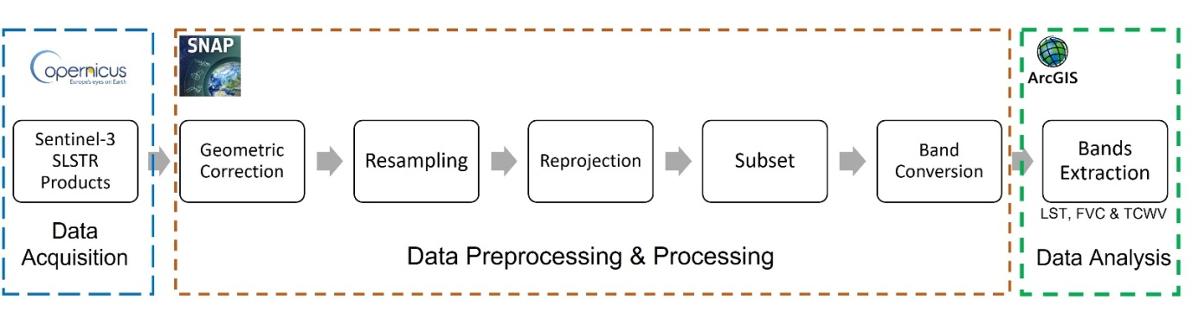
Methodology
- Sentinel-3 SLSTR data acquired on four dates: April 2019, September 2019, April 2021, and September 2021.
- Wettest (April) and driest month (September) preceding the short rainy season.
Figure 2: Methodological Diagram of the study

Slide 4
Land Surface Temperature
$$L_{sensor} = τ∗ε∗L_{Ts} + L_{u} + τ∗\left(1 − ε\right)∗L_{d}\text{ (}\text{Vlassova} \text{et} \text{al}\text{., 2014)}$$
L_{sensor} = Top of atmosphere radiance
L_{Ts} = Radiance related to the surface temperature of a black object as per Planck's law
T_{s} = LST
L_{u} and L_{d} = Upwelling and downwelling atmospheric radiances
τ = Atmospheric transmissivity
ε = Land surface emissivity. Radiance is expressed in W∙sr ⁻¹ ∙m −2 ∙μm ⁻¹

Slide 5
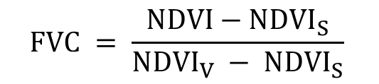
Fractional Vegetation Cover
$$FVC = \frac{NDVI−NDVI_{S}}{{NDVI}_{V} − {NDVI}_{S}}$$
(Jing et al., 2011)
NDVI = Weighted average of the Normalized Difference Vegetation Index between vegetated and non-vegetated areas.
NDVIs = Normalized vegetation difference index of bare soil
NDVIv = Vegetation index of the total vegetation cover
NDVIv and NDVIs significantly affect the inversion precision of FVC

Slide 6
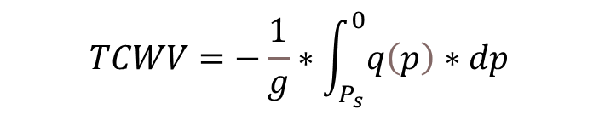
Total Column Water Vapor
$$TCWV=−\frac{1}{g}∗\int_{P_{s}}^{0}{q\left(p\right)∗dp}$$
(EUMETSAT and ECMWF, 2014)
g = Gravitational constant (9.8 m/s2)
q(p) = Mixing ratio (g/kg) of water vapor in hPa at pressure level p
ps = Surface air pressure in hPa

Slide 7
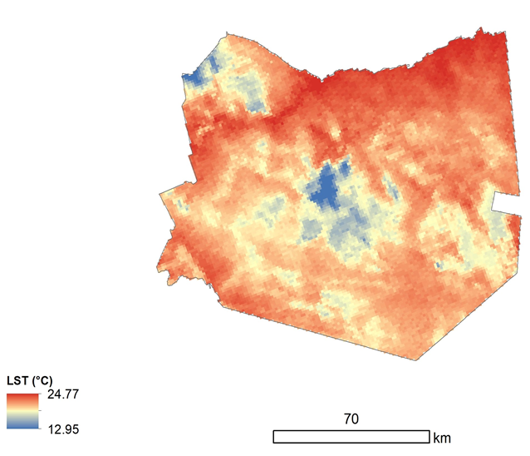
Scale Variations of the Essential Climate Variables (ECVs)
Land Surface Temperature (LST)
Results
Figure 3: LST variation, September 2021 in Taita Taveta County, Eastern Kenya.

Slide 8
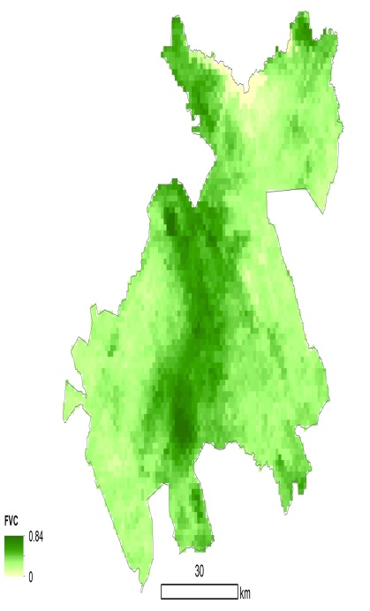
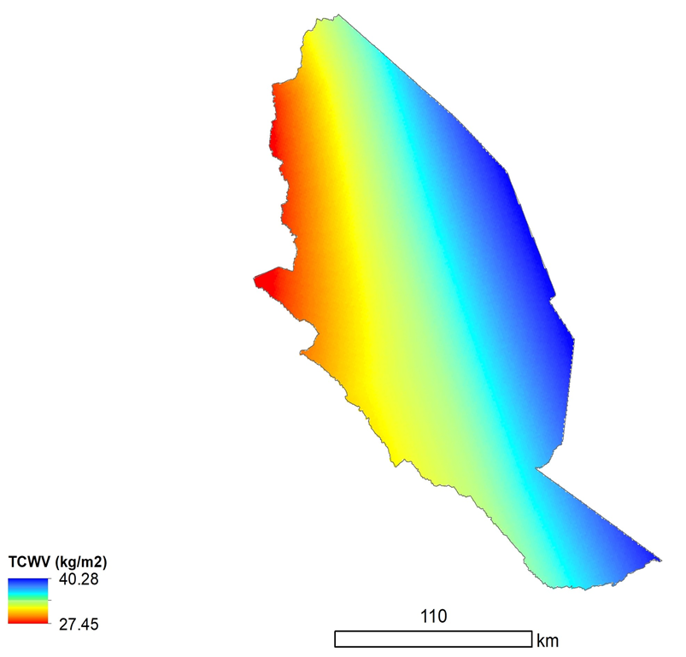
Fractional Vegetation Cover (FVC)
Total Column Water Vapor (TCWV)
Figure 4: FVC variation, September 2021 in Machakos County, Eastern Kenya
Figure 5: TCWV variation, September 2021 in Kitui County, Eastern Kenya

Slide 9
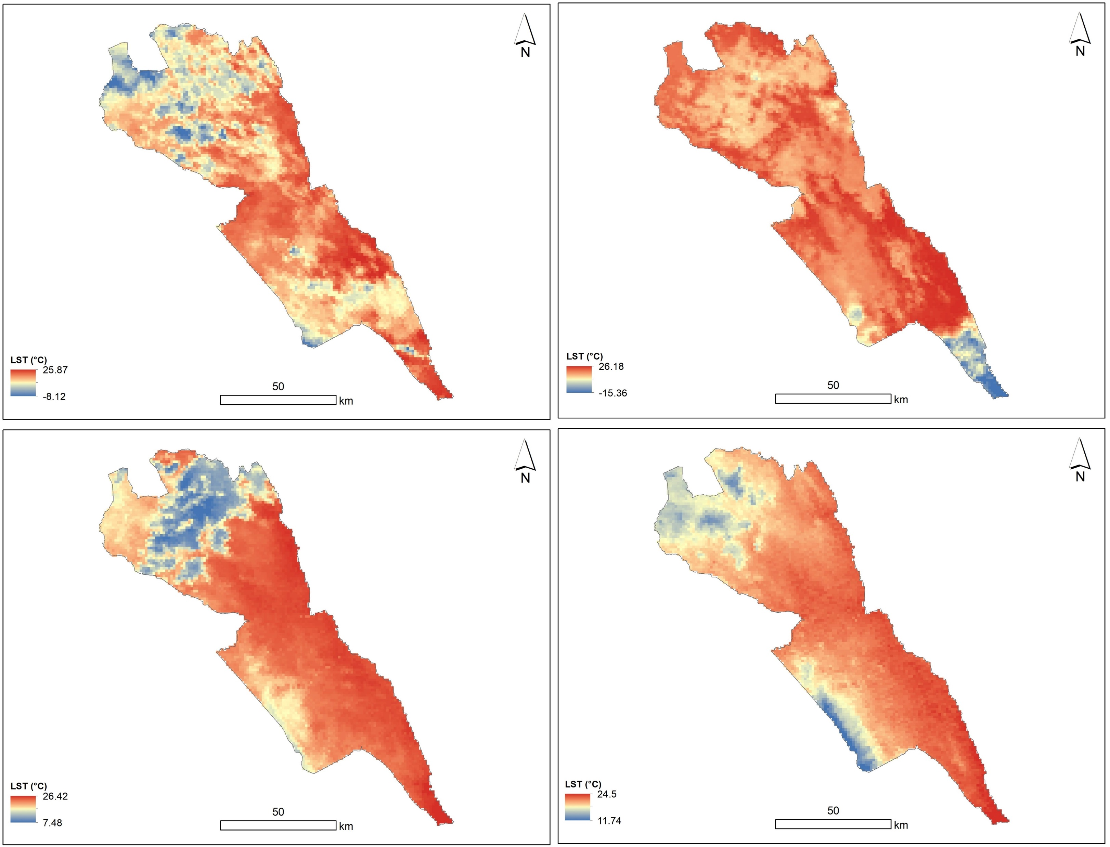
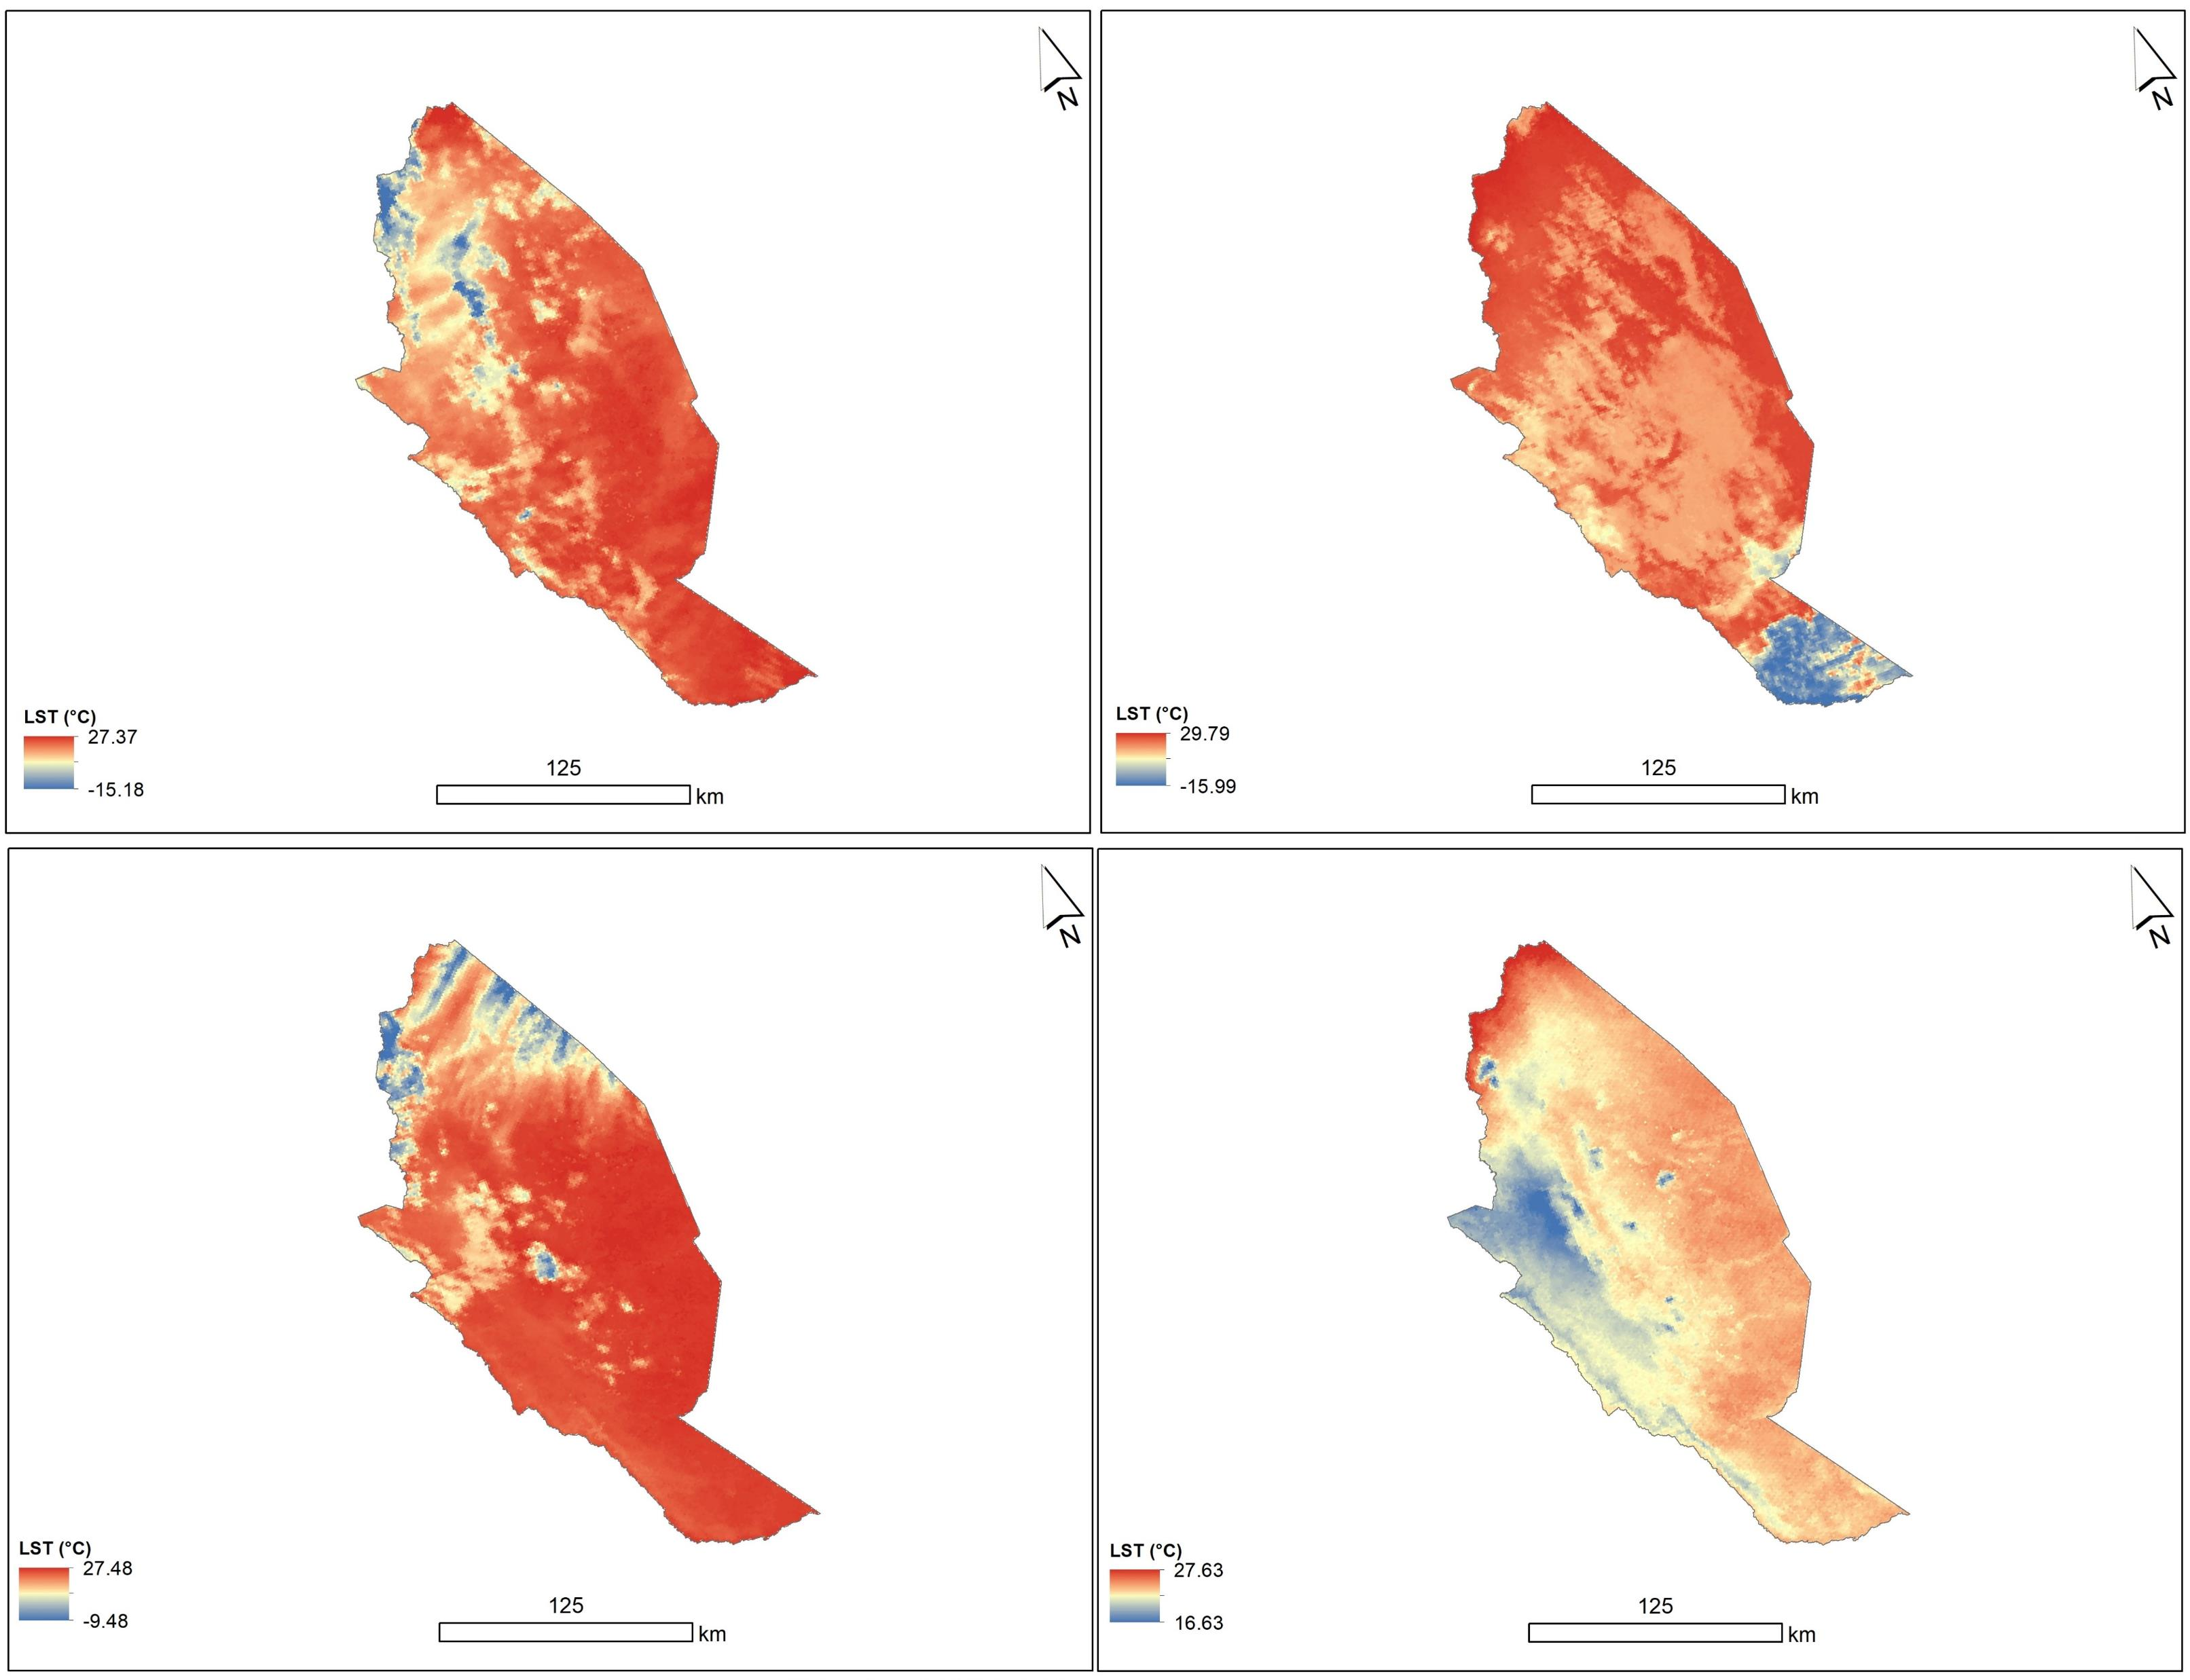
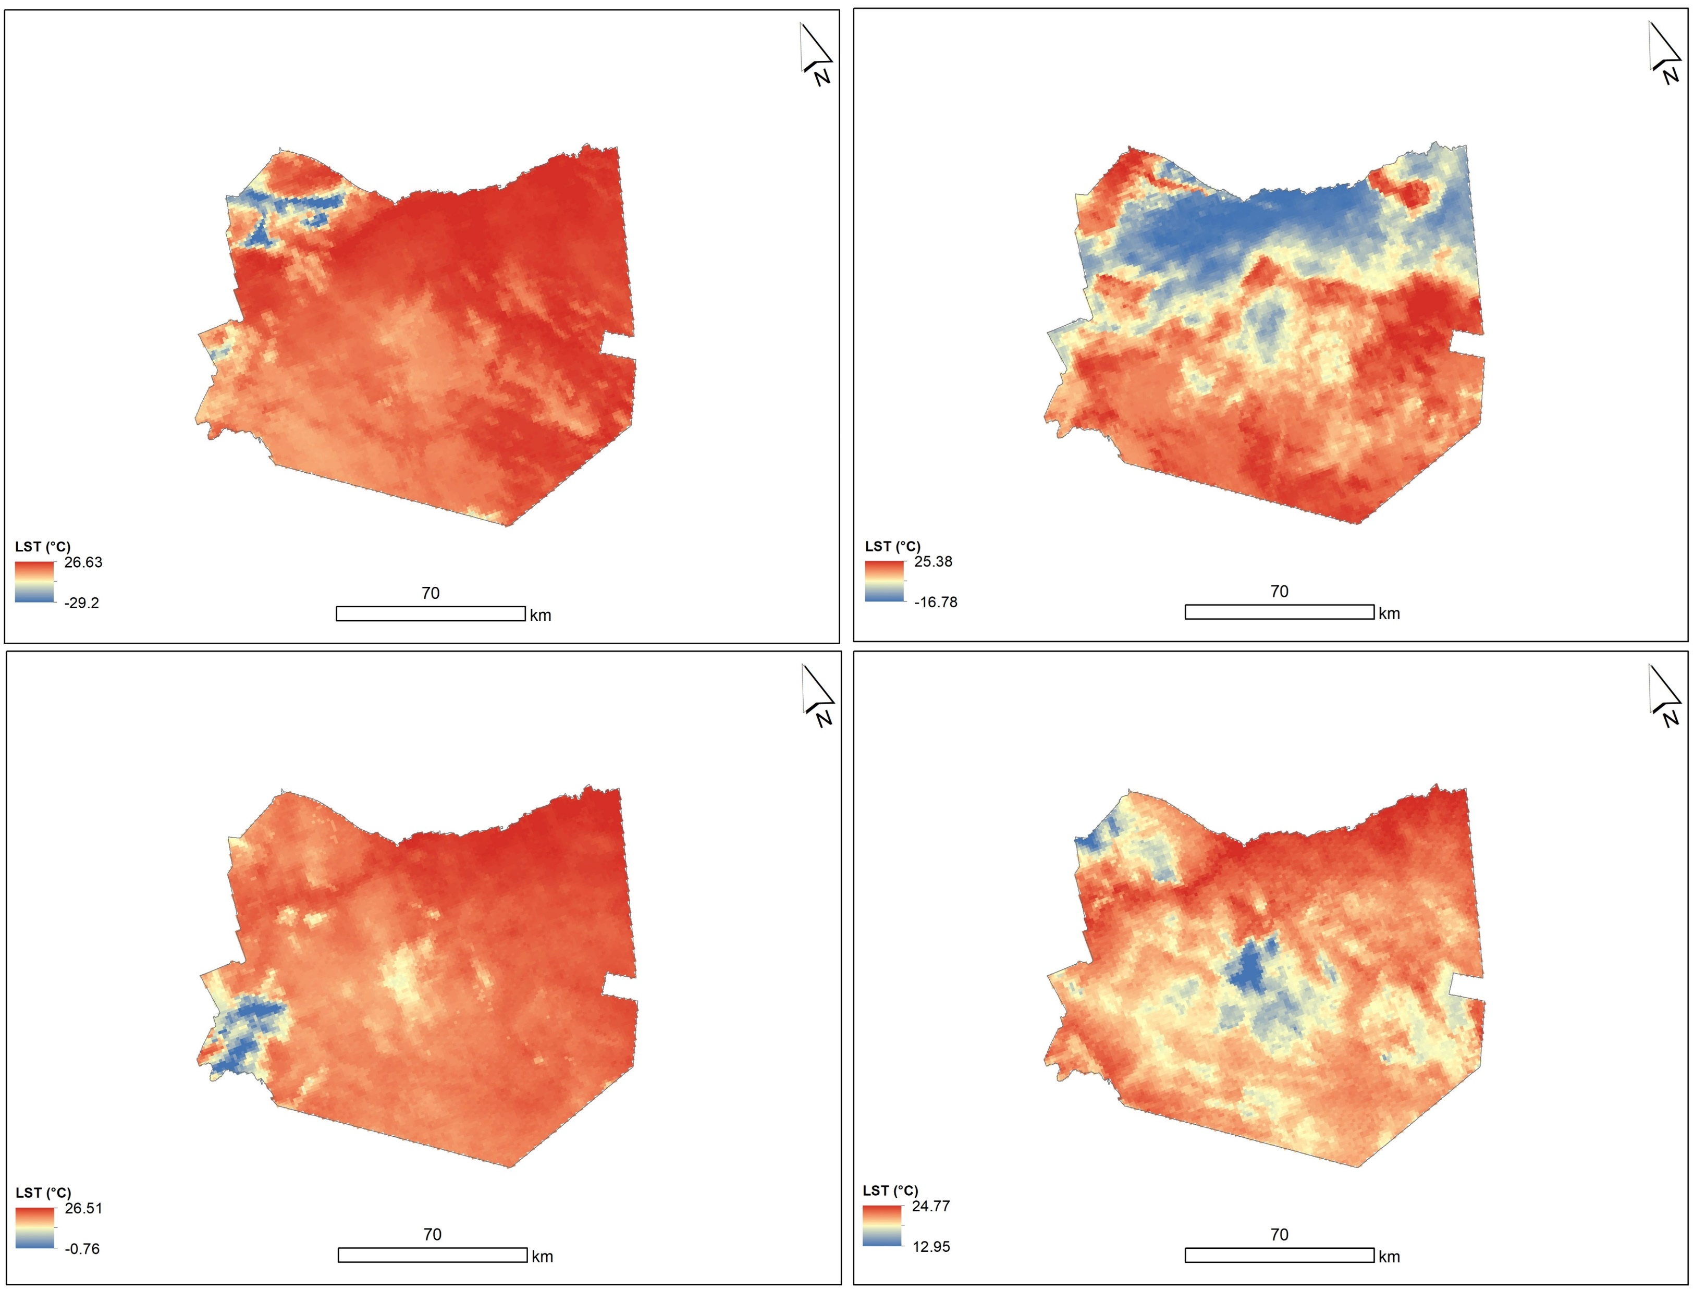
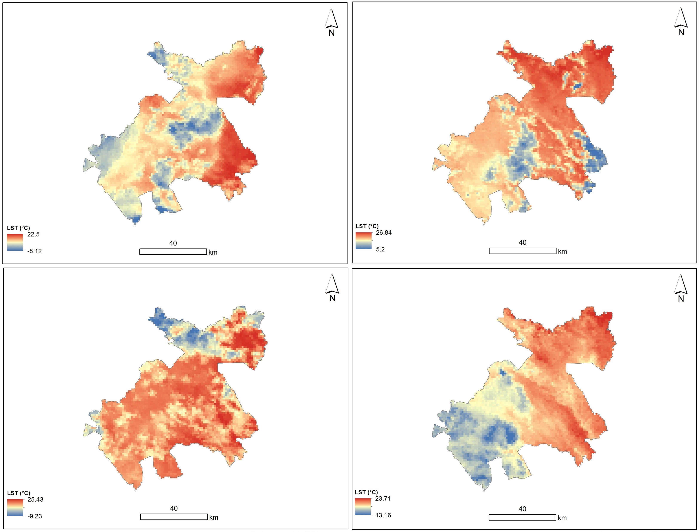
Land Surface Temperature (LST)
April
September
April
September
2019
LST has drastically changed over time, with Kitui county having the highest estimates of 27 °C and 29 °C in April and September 2019.
The increased heating leads to greater evaporation and thus surface drying(soil moisture loss), thereby increasing the intensity and duration of drought( Trenberth, 2011)
The heterogeneity of LST between the two seasons in 2019 and 2021 is caused by a remarkable change in vegetation cover across the counties.
LST using remote sensing technology helped determine the degree of desertification and/or drought in an area(Qiao et al, 2021)
2021
2019
2021
Figure 6. LST variation between 2019 and 2021 in four different counties, Eastern Kenya.

Slide 10
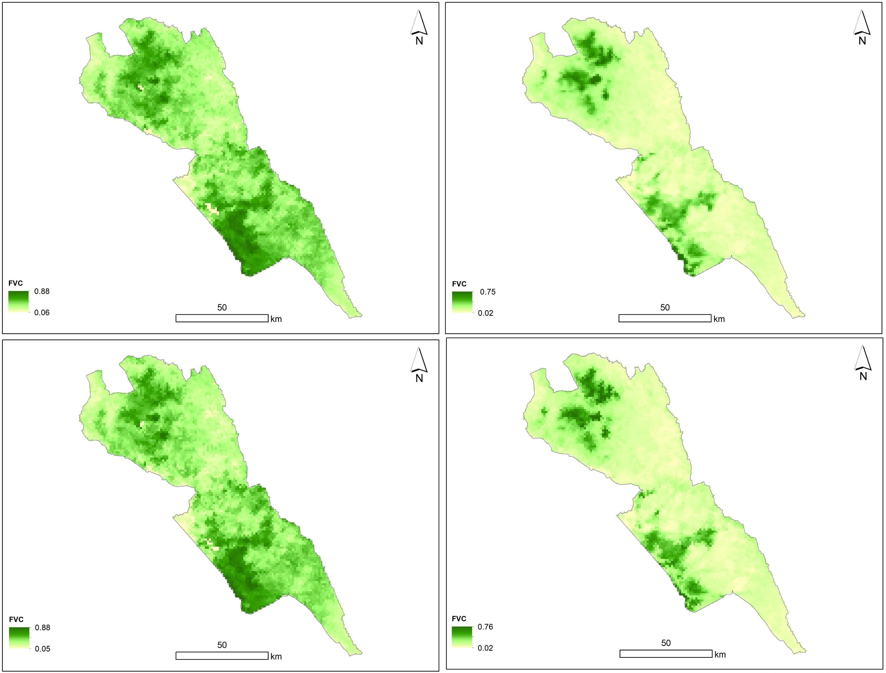
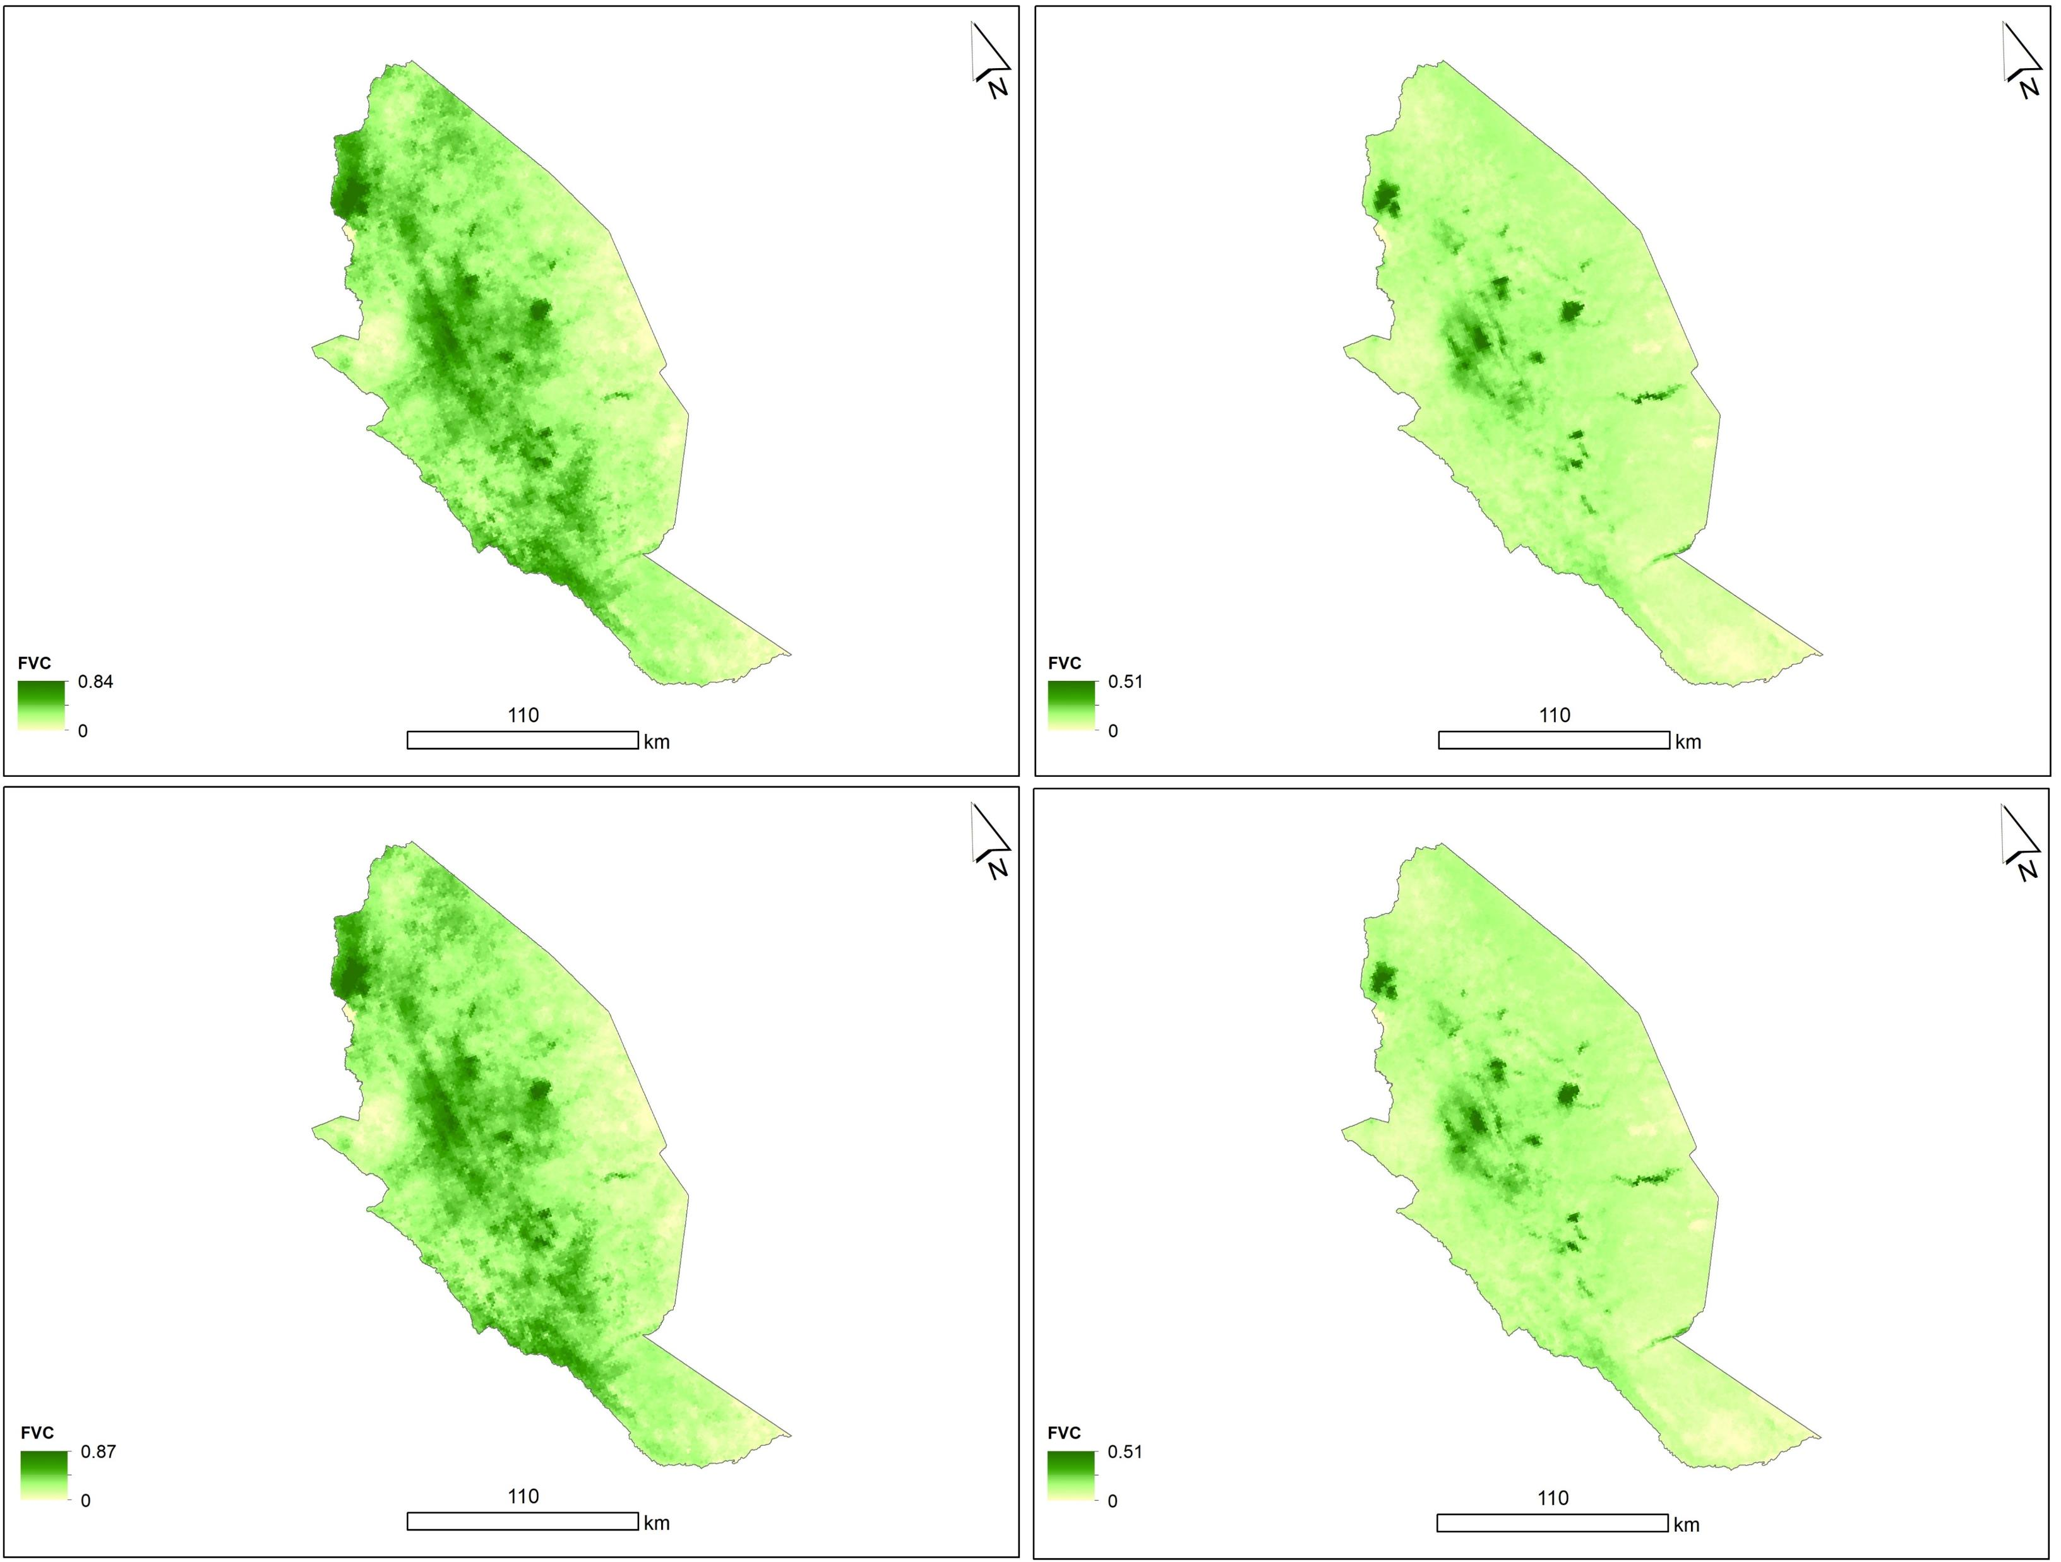
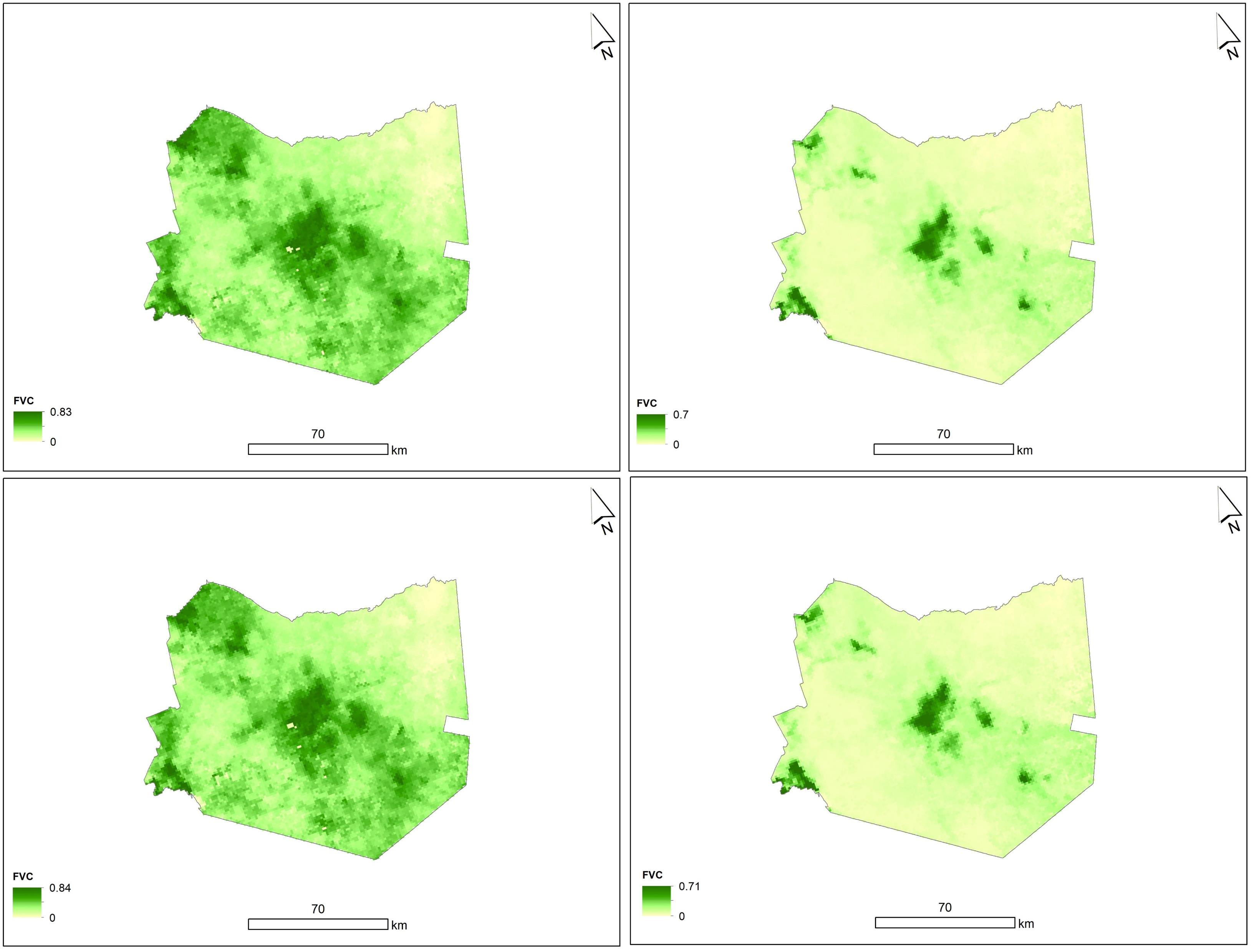
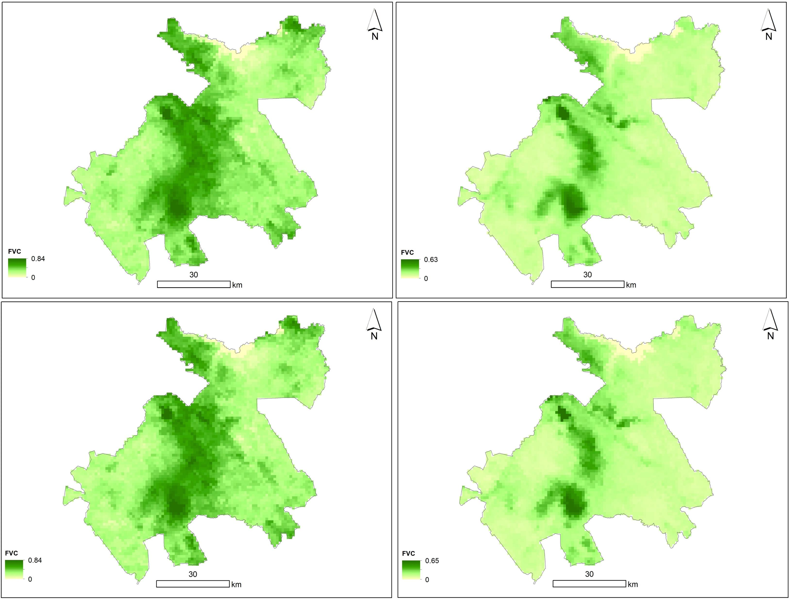
April
September
April
September
Fractional Vegetation Cover (FVC)
2019
The distribution pattern of vegetation cover across the counties varied slightly during the two periods of wet and dry seasons.
e.g., a slight increase of FCV between April 2019 and April 2021, (84%) to (87%), same in the dry season at (51%) for Kitui County.
Vegetation monitoring using remote sensing technology helped determine the extent of desertification in an area(Qiao et al, 2021)
2021
2019
2021
Figure 7: FVC variation between 2019 and 2021 in four different counties, Eastern Kenya.

Slide 11
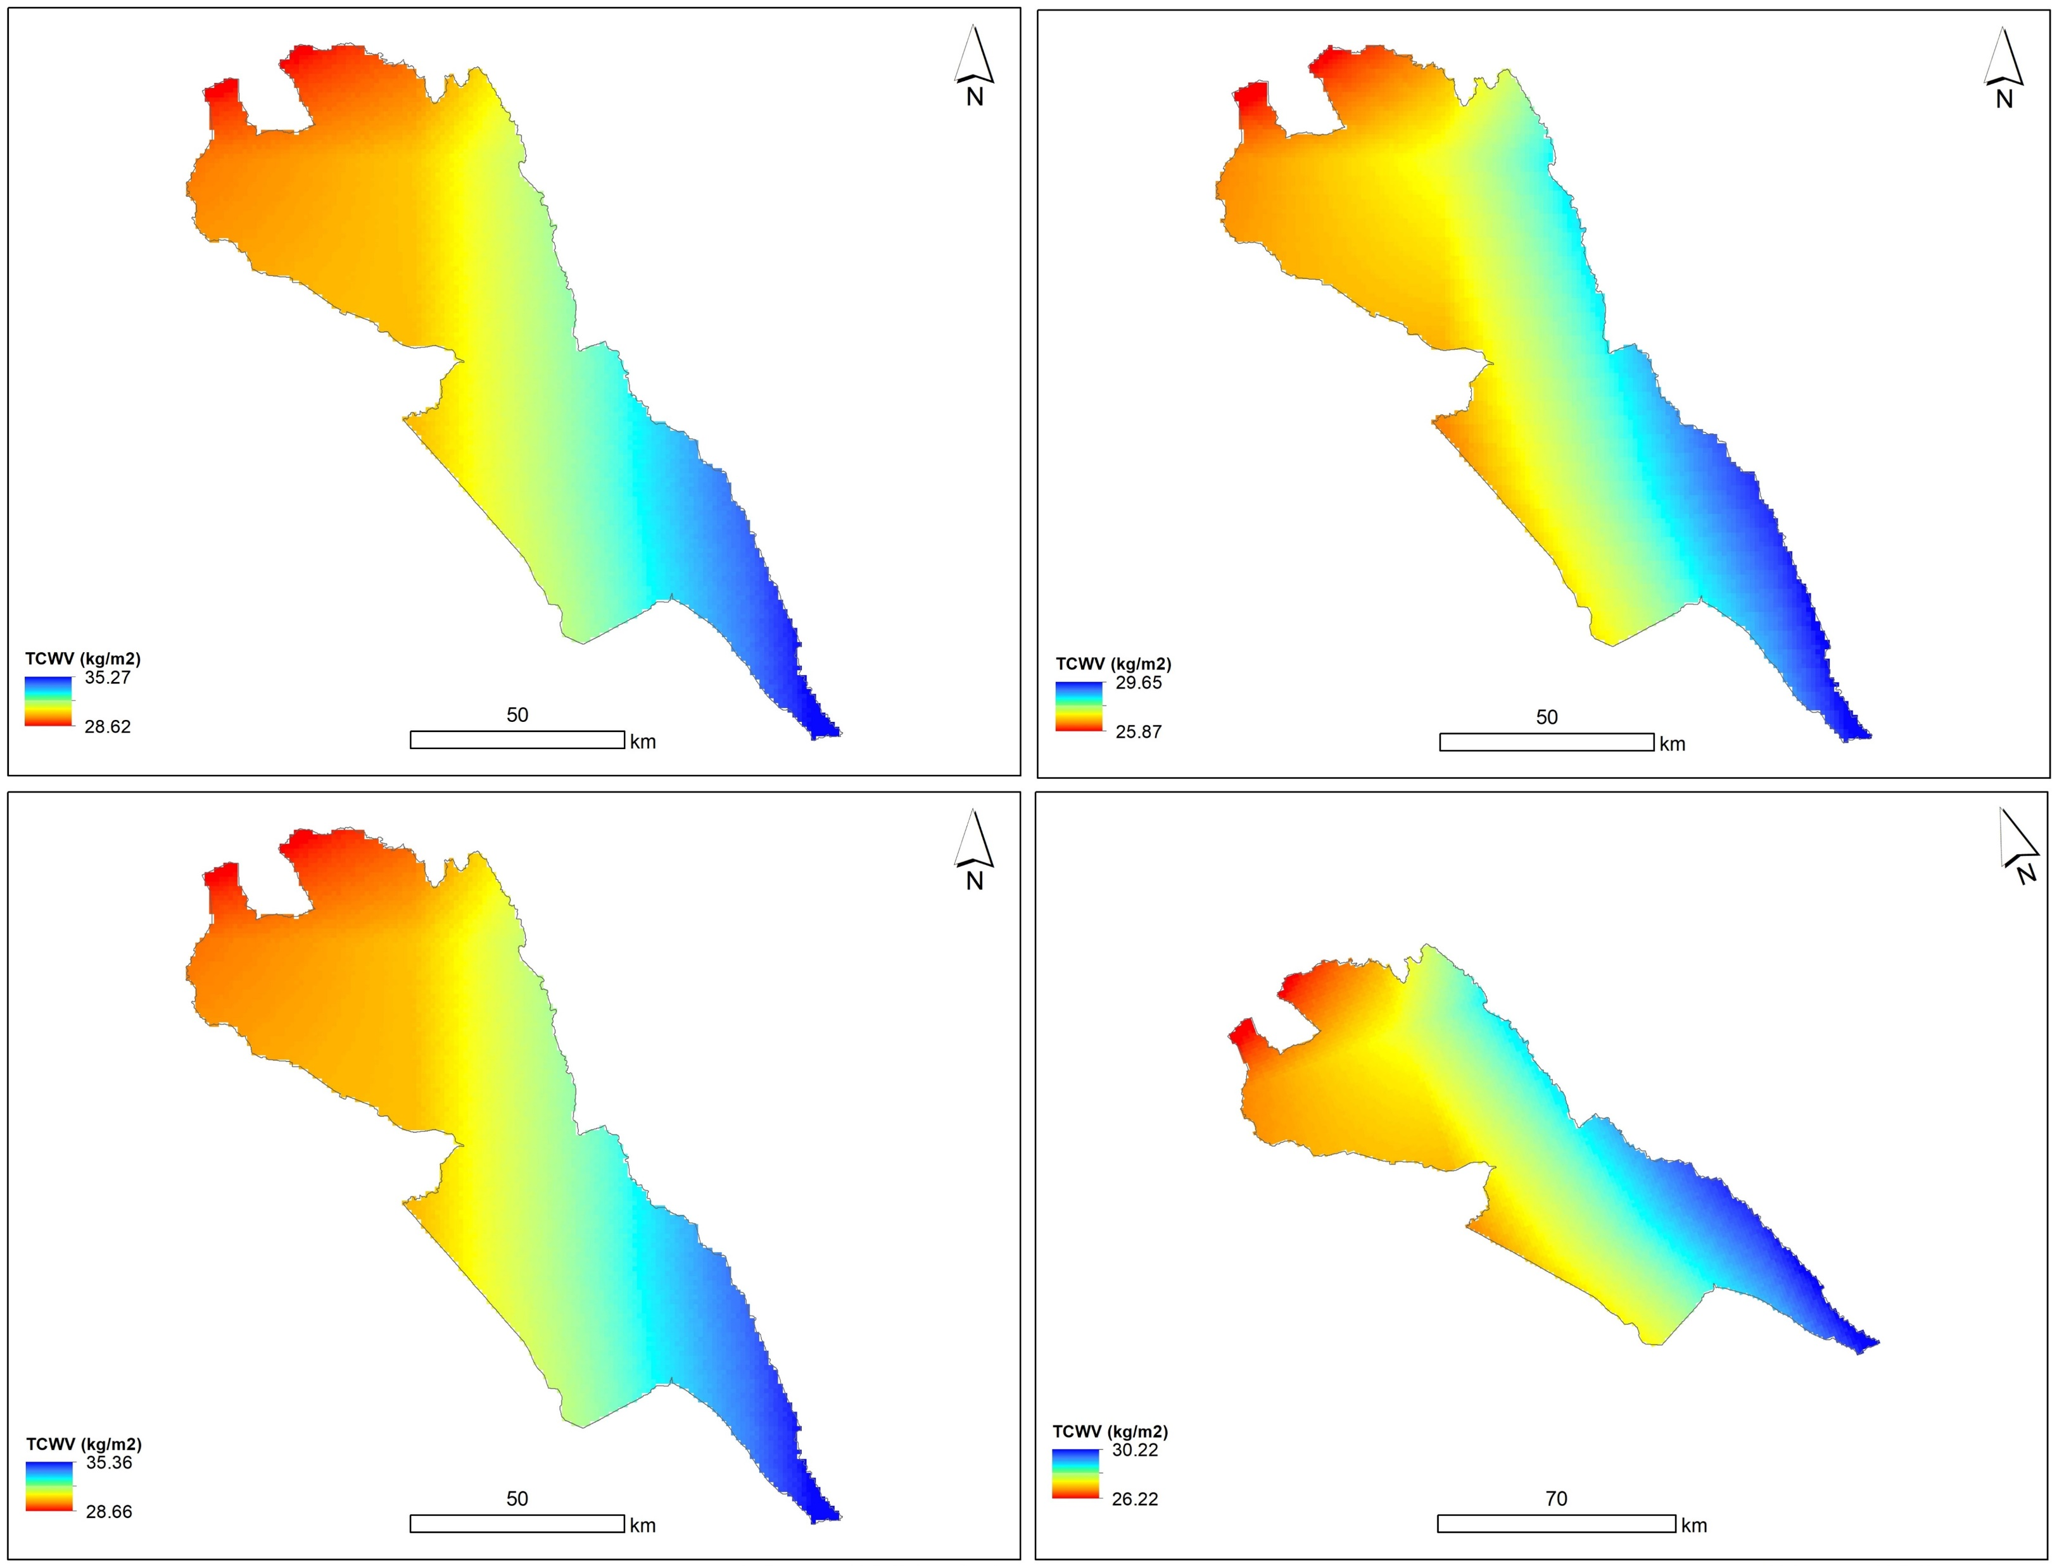
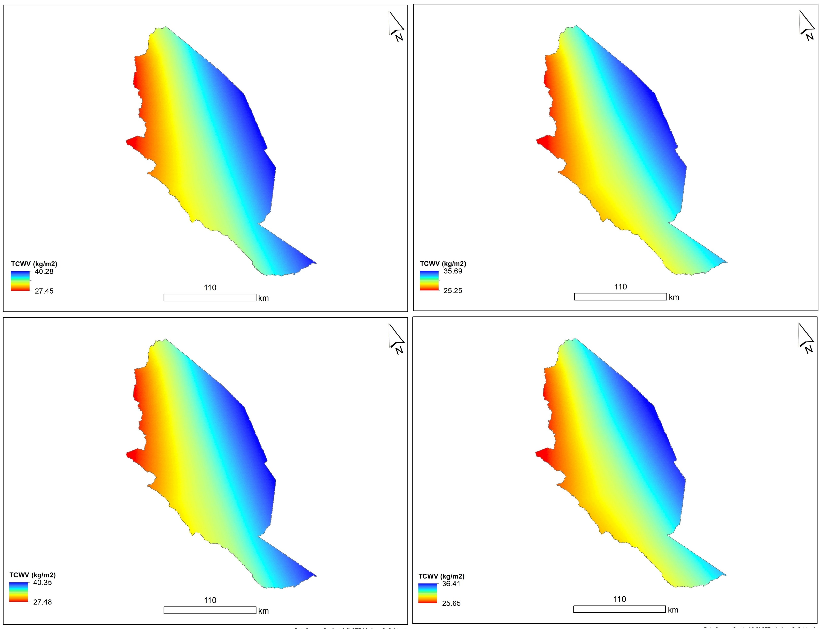
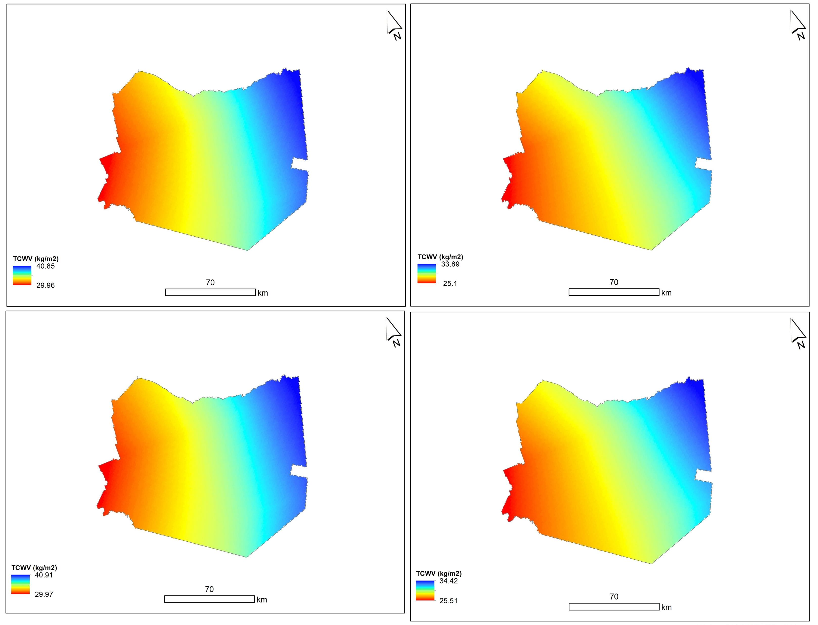
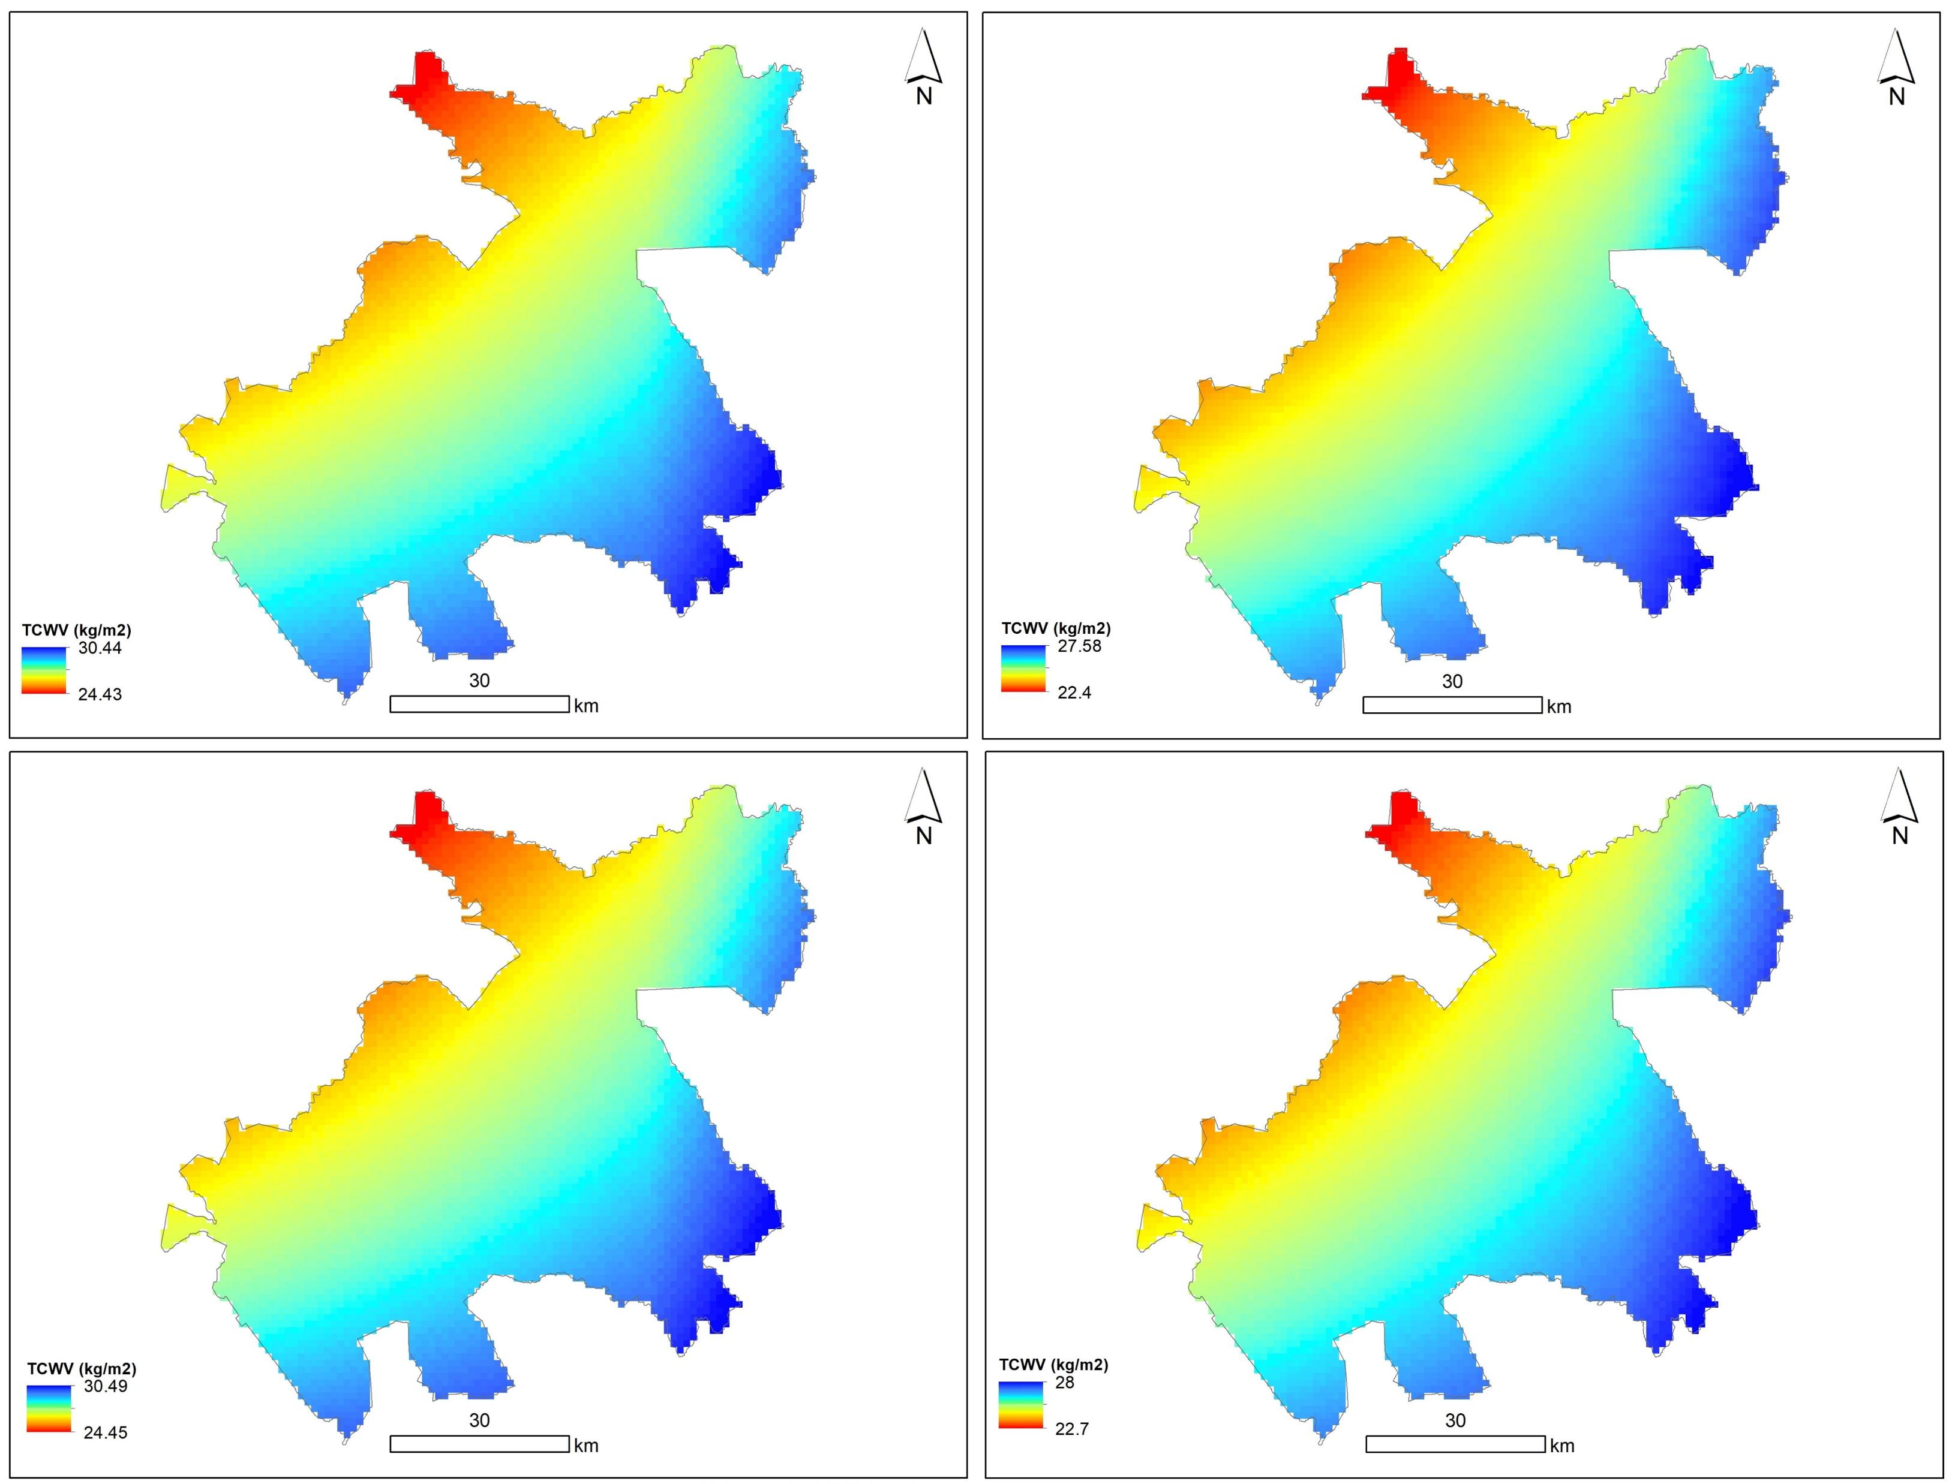
Total Column Water Vapor (TCWV)
April
September
April
September
2019
A significant spatial variation of TCWV was noticed across different counties,
The lowest value of 22mm in Machakos county while Taita Taveta County had the highest estimates ranging from 30mm to 41mm during the wettest season of 2021.
The estimates in the four counties are high as expected in the tropics compared to other areas.
As noted by (Trenberth, 2011 ) in the tropics, the precipitation patterns tend to copy TCWV trends, which was evident in the four semi-arid counties understudy
2021
2019
2021
Figure 8: TCWV variation between 2019 and 2021 in four different counties, Eastern Kenya.

Slide 12
Conclusions
Sentinel-3 SLSTR imagery is efficient to assess vegetation changes, land surface temperature, and total column water vapor between wet and dry seasons.
Short-term drought episodes (on a monthly scale) and their effects on vegetation density dynamics were observed across the four counties.
Between dry and wet seasons there was observed a decrease in FVC from 2019 to 2021 across the four counties (mostly ranging between 40% and 60%) across the counties, with a few exceptions where the values were high (80% - 100%).
Similar patterns in LST variation, as well as TCWV, were observed across counties, evidently revealing potential implications of food insecurity and water scarcity locally.
IMPORTANCE
This study enhances our understanding of
Ecological changes in arid climates
Malfunctioning and degradation caused by climate change.

Slide 13
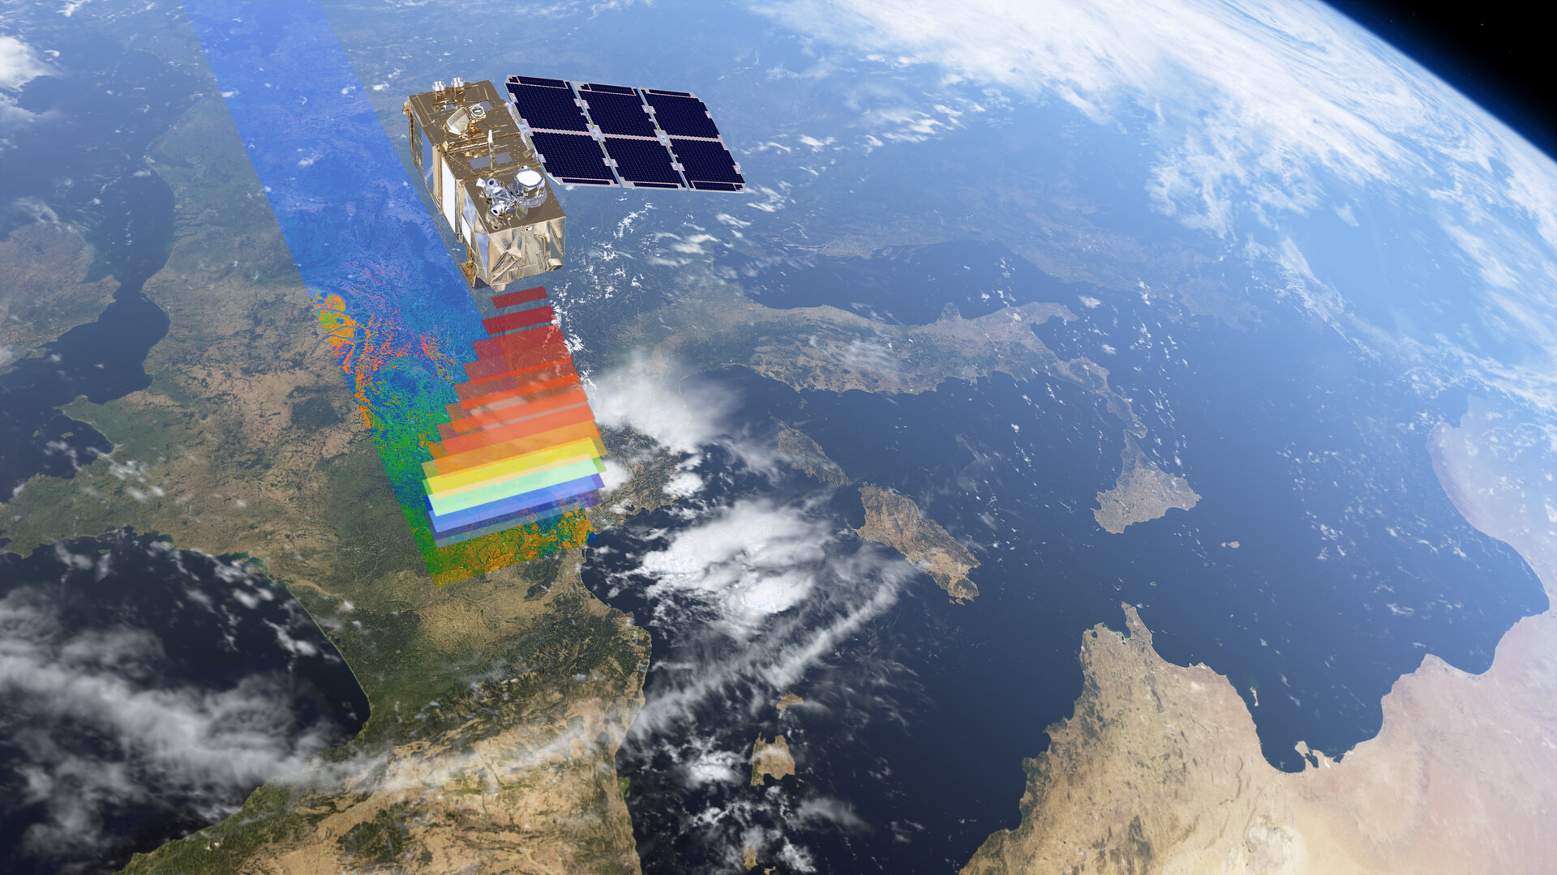
Thank You!

Slide 14
References
Borges, J., Higginbottom, T.P., Symeonakis E, and Jones, M., 2020: Sentinel-1 and Sentinel-2 Data for Savannah Land Cover Mapping: Optimizing the Combination of Sensors and Seasons. Remote Sensing, 12(23):3862. https://doi.org/10.3390/rs12233862
ESA. 2022: Sentinel-3 SLSTR User Guide, Retrieved from: https://sentinel.esa.int/web/sentinel/user-guides/sentinel-3-slstr
ESA. 2021: User Guides: Sentinel-3 SLSTR. Retrieved from: https://sentinels.copernicus.eu/web/sentinel/user-guides/sentinel-3-slstr/overview/geophysical-measurements/land-surface-temperature
EUMETSAT and ECMWF., 2014: Product Tutorial on the SEVIRI Physical Retrieval products of NWC SAF. http://www.eumetrain.org/data/3/359/navmenu.php?tab=2&page=1.0.0
Qiao, R., Dong, C., Ji, S., & Chang, X. 2021: Spatial Scale Effects of the Relationship between Fractional Vegetation Coverage and Land Surface Temperature in Horqin Sandy Land, North China. Sensors (Basel, Switzerland), 21(20), 6914. https://doi.org/10.3390/s21206914
Trenberth, E. K., 2011: Changes in precipitation with climate change, Contribution to CR Special 25 'Climate services for sustainable development, Climate Research, 47: 123–138. https://doi.org/10.3354/cr00953
Jing, X., Yao, W.Q., Wang, J.H., and Song, X.Y., 2011: A study on the relationship between dynamic change of vegetation coverage and precipitation in Beijing's mountainous areas during the last 20 years. Mathematical and Computer Modeling, 54, 1079–1085.
Vlassova, L., Perez-Cabello, F., Nieto, H., Martín, P., Riaño, D., and De la Riva, J., 2014: Assessment of Methods for Land Surface Temperature Retrieval from Landsat-5 TM Images Applicable to Multiscale Tree-Grass Ecosystem Modeling. Remote Sensing, 6(5), 4345–4368. https://doi.org/10.3390/rs6054345
Zhao, Y., and Zhou, T., 2020: Asian water tower evinced in total column water vapor: a comparison among multiple satellite and reanalysis data sets. Climate Dynamics, 54, 231–245 .https://doi.org/10.1007/s00382-019-04999-4

