Slide 1

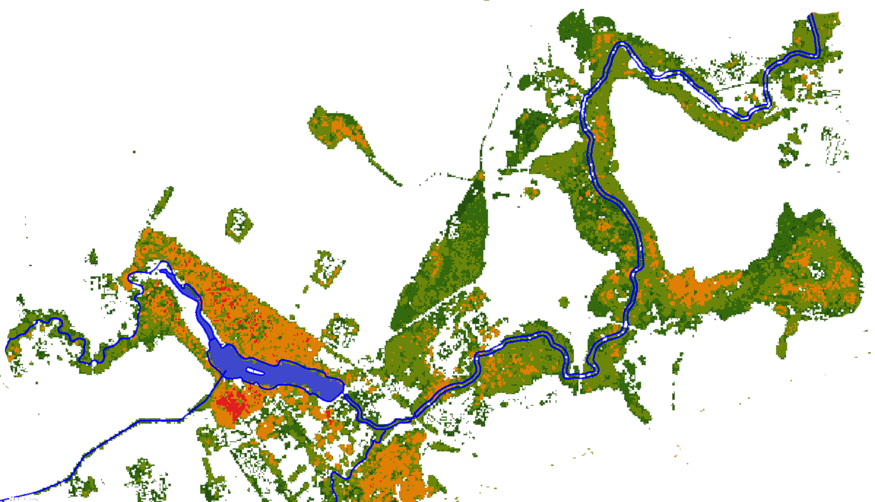




Machine learning-based modeling of stream nutrients at national level in a data-scarce region
Holger Virro¹,Alexander Kmoch¹,Marko Vainu², Evelyn Uuemaa¹
¹Landscape Geoinformatics Lab, University of Tartu, Estonia
² Institute of Ecology, Tallinn University, Estonia
evelyn.uuemaa@ut.ee
@LGeoinformatics
@evelynuuemaa

Slide 2

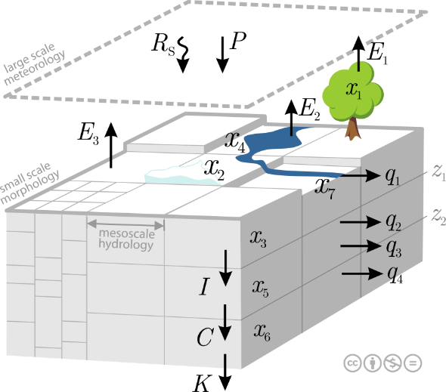
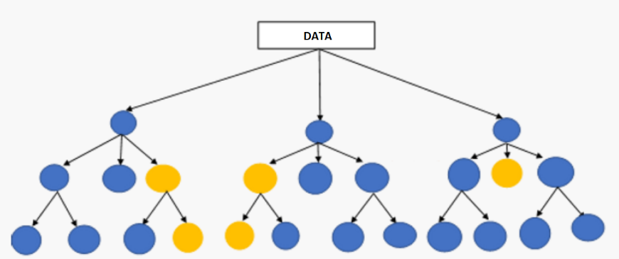
The challenge
Process-based nutrient models are very complex, requiring a lot of input parameters and computationally expensive calibration.
Moreover, process-based modeling is rather challenging to apply in large-scale, i.e. national, regional and global studies.
Potential alternative solution: machine learning-based modelling

Slide 3
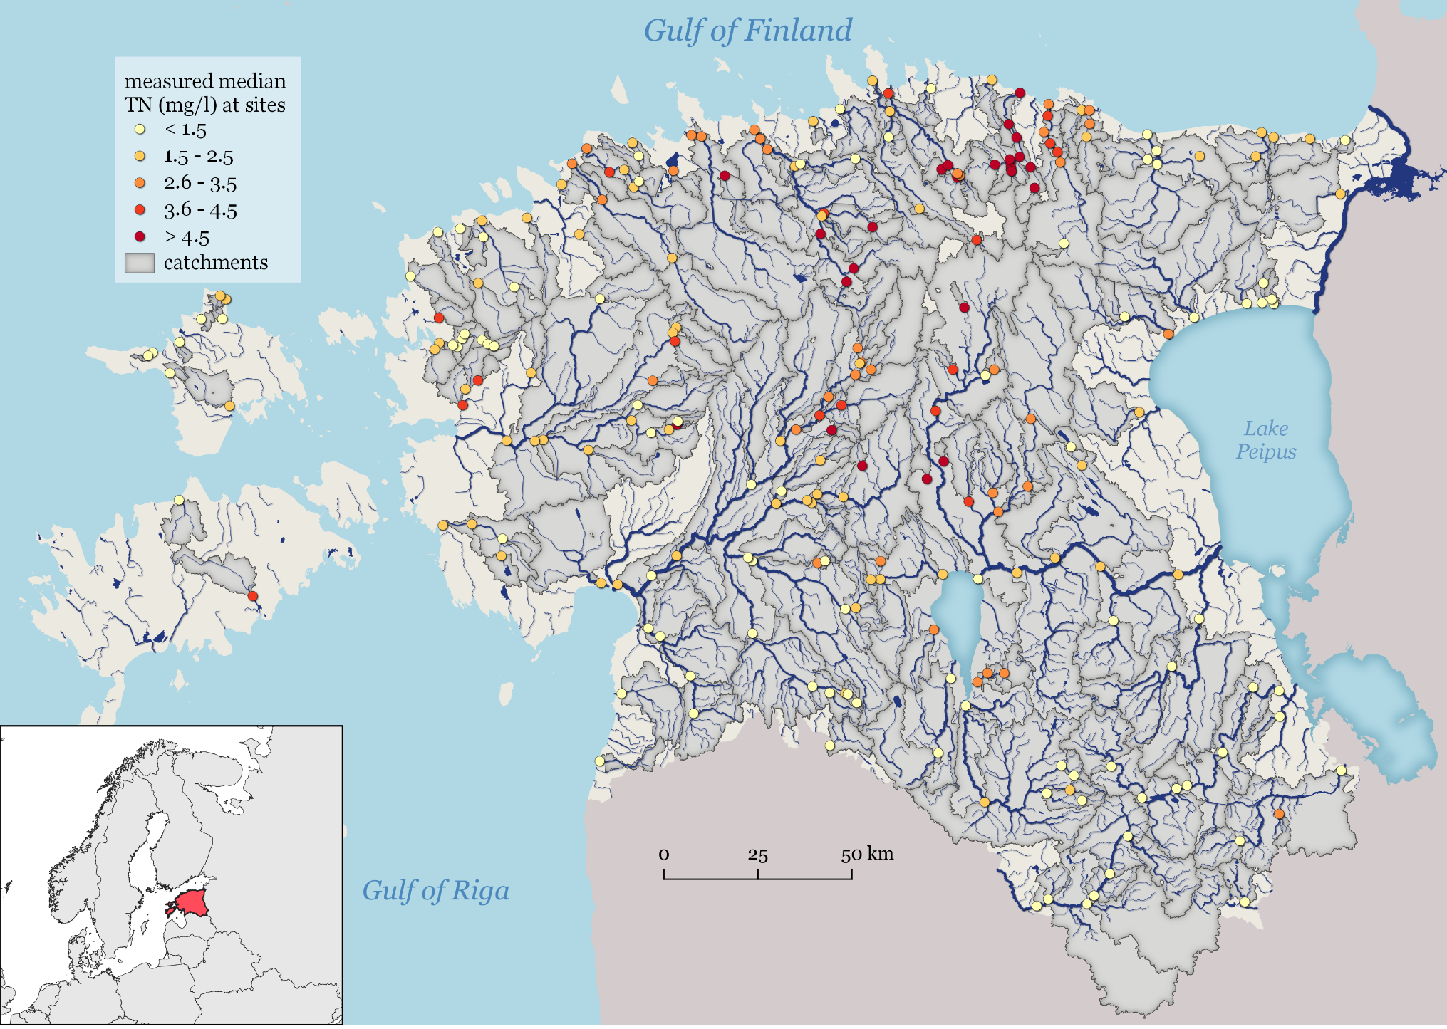
The aim
To model annual total nitrogen (TN) and total phosphorus (TP) concentrations at national level using an ML approach.

Slide 4
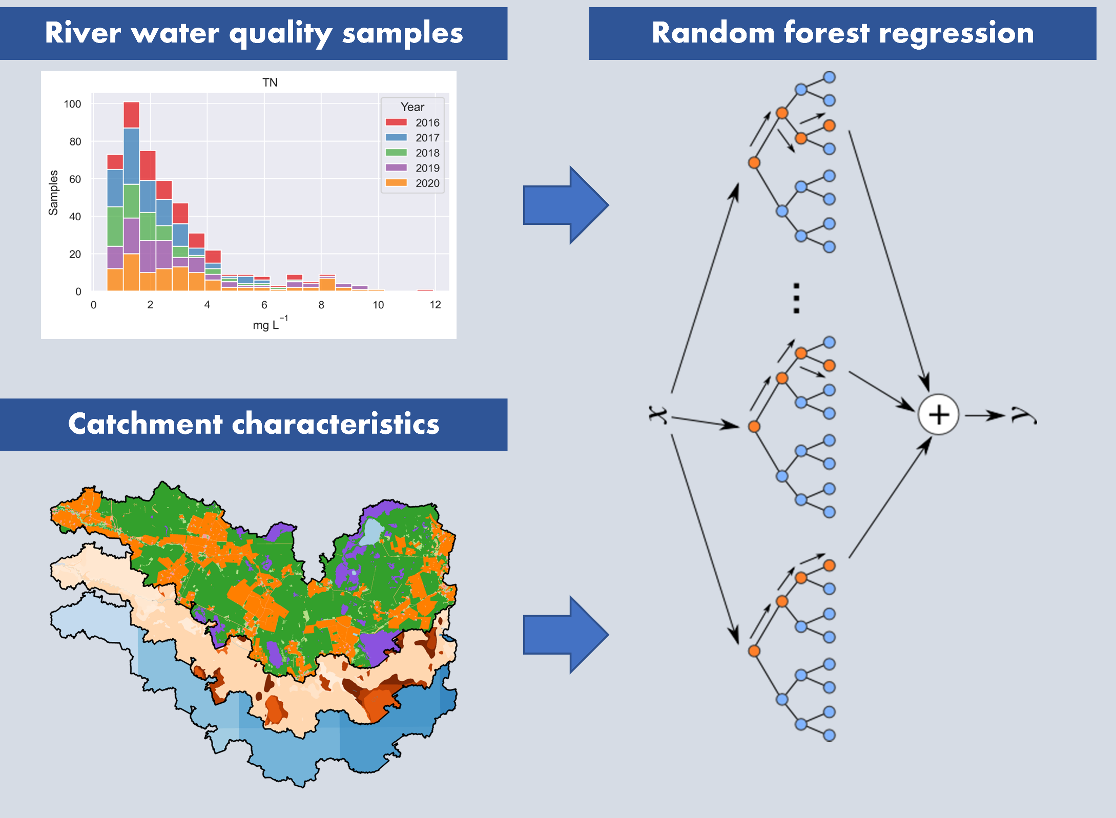
Data and methods
TN and TP measurements from 242 catchments
82 environmental variables as predictors
Random forest regression
70% for training and 30% for validation
Feature selection strategy

Slide 5
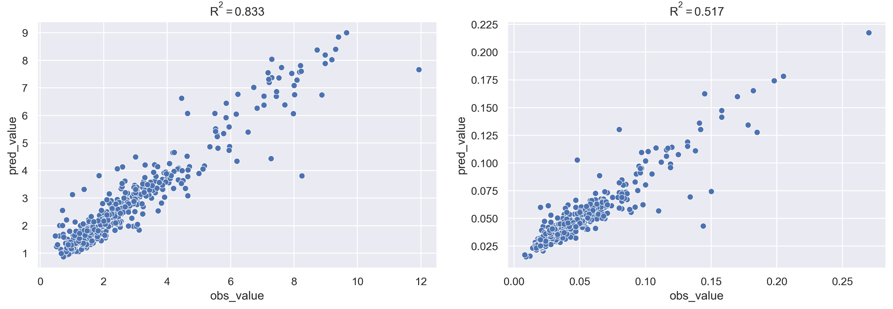
Results
Total Nitrogen
Total Phosphorus

Slide 6
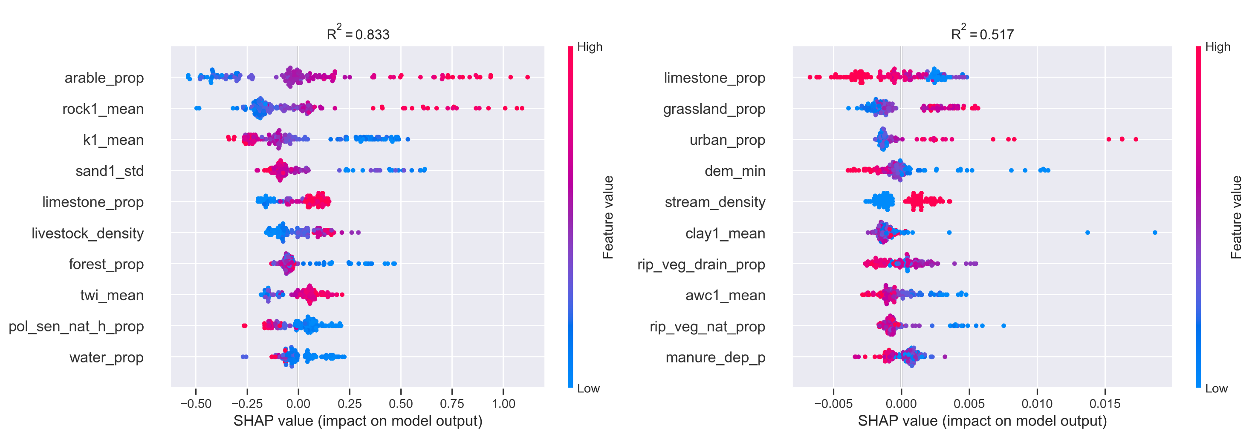
Total Nitrogen
Total Phosphorus

Slide 7
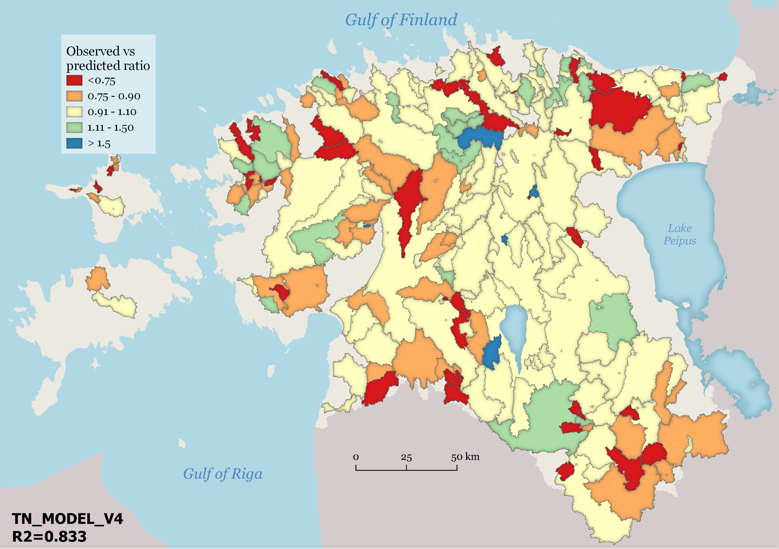
Spatial distribution of the ratio between observed and predicted values in catchments for the best TN model
Overestimation
< 1
Underestimation
>1

Slide 8
Conclusions
The models achieved a performance comparable to existing process-based approaches
Data used as predictors in RF models is easier to obtain than in process-based models
The models enable to give a robust estimation for nutrient losses at national level and allows to capture the spatial variability of the nutrient runoff
The models offer superior scalability and reusability to process-based ones

Slide 9

Thank you!
evelyn.uuemaa@ut.ee
@evelynuuemaa
@LGeoinformatics

