Slide 1


Cenozoic relative movements of Greenland and North America by the closure of the North Atlantic – Arctic plate circuit: Labrador Sea, Davis Strait, Baffin Bay and the Eurekan Orogen
Annabel Causer¹
Graeme Eagles², Lucía Pérez-Díaz³, Jürgen Adam¹
Royal Holloway, University of London, Egham, UK
Alfred Wegener Institute, Bremerhaven, Germany
Oxford University, Oxford, UK

Slide 2
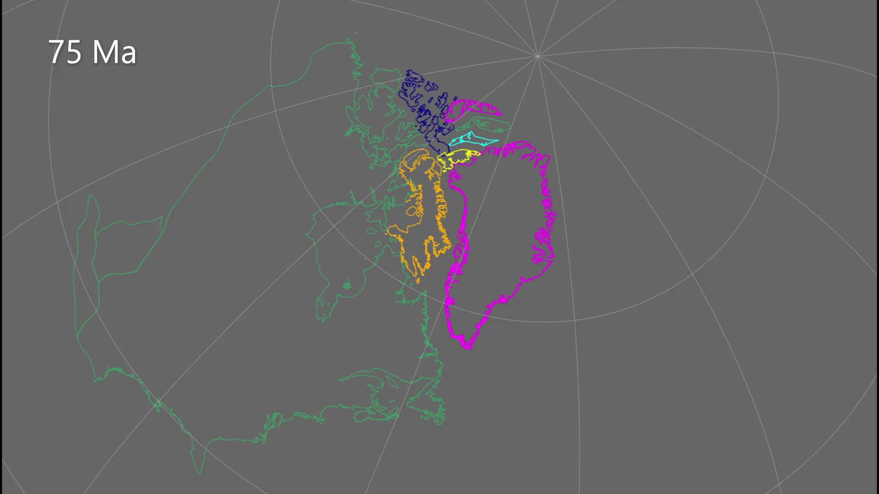
Greenland and North America Plate Model Animation
Play animation
Time step reconstruction showing the relative movement of Greenland and North America using our new model, including the Eastern Canadian Arctic from the Late Cretaceous to Eocene – Oligocene boundary. Polygon shapes are those of Gion et al. (2017). GPlates software was used to create the animation.
Cenozoic relative movements of Greenland and North America by closure of the North Atlantic – Arctic plate circuit: The Labrador Sea, Davis Strait, Baffin Bay and Eurekan Orogen

