Slide 1




Konik A.A.^{1,2} Zimin A.V.^{1,2}
Saint-Petersburg State University, Saint-Petersburg, Russian Federation¹ (st080933@student.spbu.ru)
Shirshov Institute of Oceanology of RAS, Moscow, Russian Federation² (zimin2@mail.ru)
Seasonal and long-term variability of the characteristics surface frontal zones of the Barents and Kara seas
EGU General Assembly 2022

Slide 2
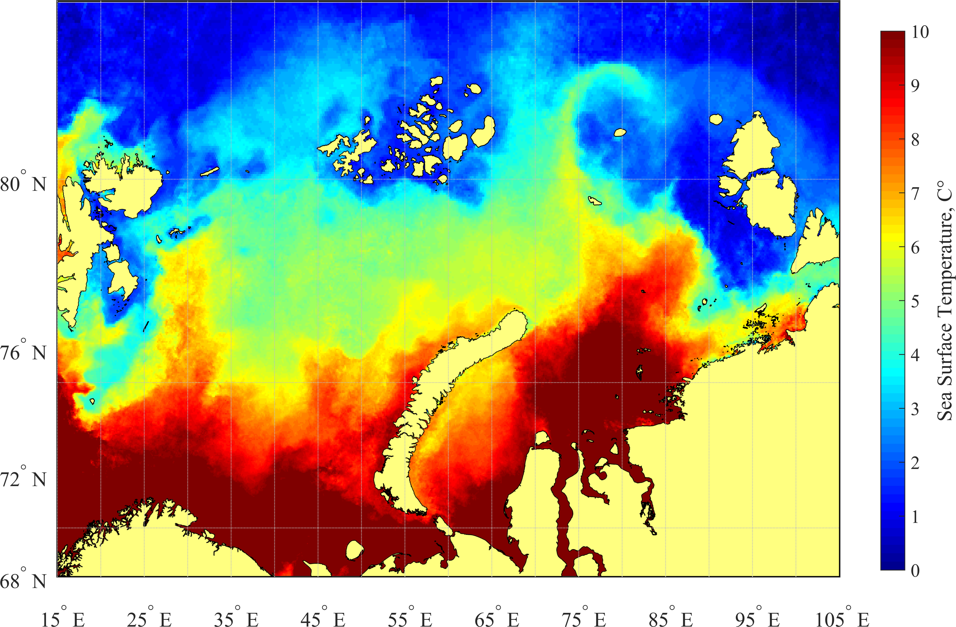
Region and Subject of the research
Franz Joseph Land
The Polar frontal zone (PFZ) is formed due to advection at the border of warm and salty Atlantic waters and cold and desalinated Arctic waters;
The River Plumes Frontal Zone (RPFZ) is the border area between the river and sea waters of the Kara Sea. It is formed at the boundary of the fresh surface layer (FSL);
The Arctic frontal zone (AFZ) is formed as a result of exposure to relatively cold waters near the ice edge and waters remote from the edge in the marginal ice zone (MIZ) of the Barents and Kara Seas.
MIZ
AFZ
Sev. Zemlya
AFZ
Svalbard
BARENTS
SEA
RPFZ
Novaya Zemlya
FSL
Siberian coast
PFZ
KARA
SEA
Yenisei
Scandinavian
Ob Bay
Fig. 1. PFZ area (square dots), FSL (fresh surface layer, stroke), RPFZ area (solid line), AFZ area (dashed line) and MIZ (long stroke) in the Kara and Barents Seas according to the average monthly SST data of the Suomi NPP VIIRS radiometer in August 2020

Slide 3
Data and methods
DATA
Frontal zones – data from satellite measurements of temperature (MODIS Aqua and Suomi VIIRS), salinity (SMAP) and sea level (AVISO);
Eddies structures – radar images Envisat ASAR and Sentinel 1A/B;
Atmospheric oscillations are the values of the NAO, SCAND and POL indices.
METHODS
Cluster analysis by Ward and k-means method for frontal zone;
Detection of manifestations on the surface of the radar for eddies structures;
Composite analysis of maps of the positions of frontal zones and eddies;
Cross-correlation analysis of frontal zones parameters with NAO, SCAND and POL atmospheric indices.
Fig. 2. Data for detecting frontal zones (SST, SSS, ADT); calculation grid for cluster analysis (black dots); final areas of use of cluster analysis results for PFZ (red line), RPFZ (green line), AFZ (blue line); station diagram (triangles) with the direction of movement (from 1 to 47 stations) r/v "Professor Levanidov" during oceanographic measurements

Slide 4
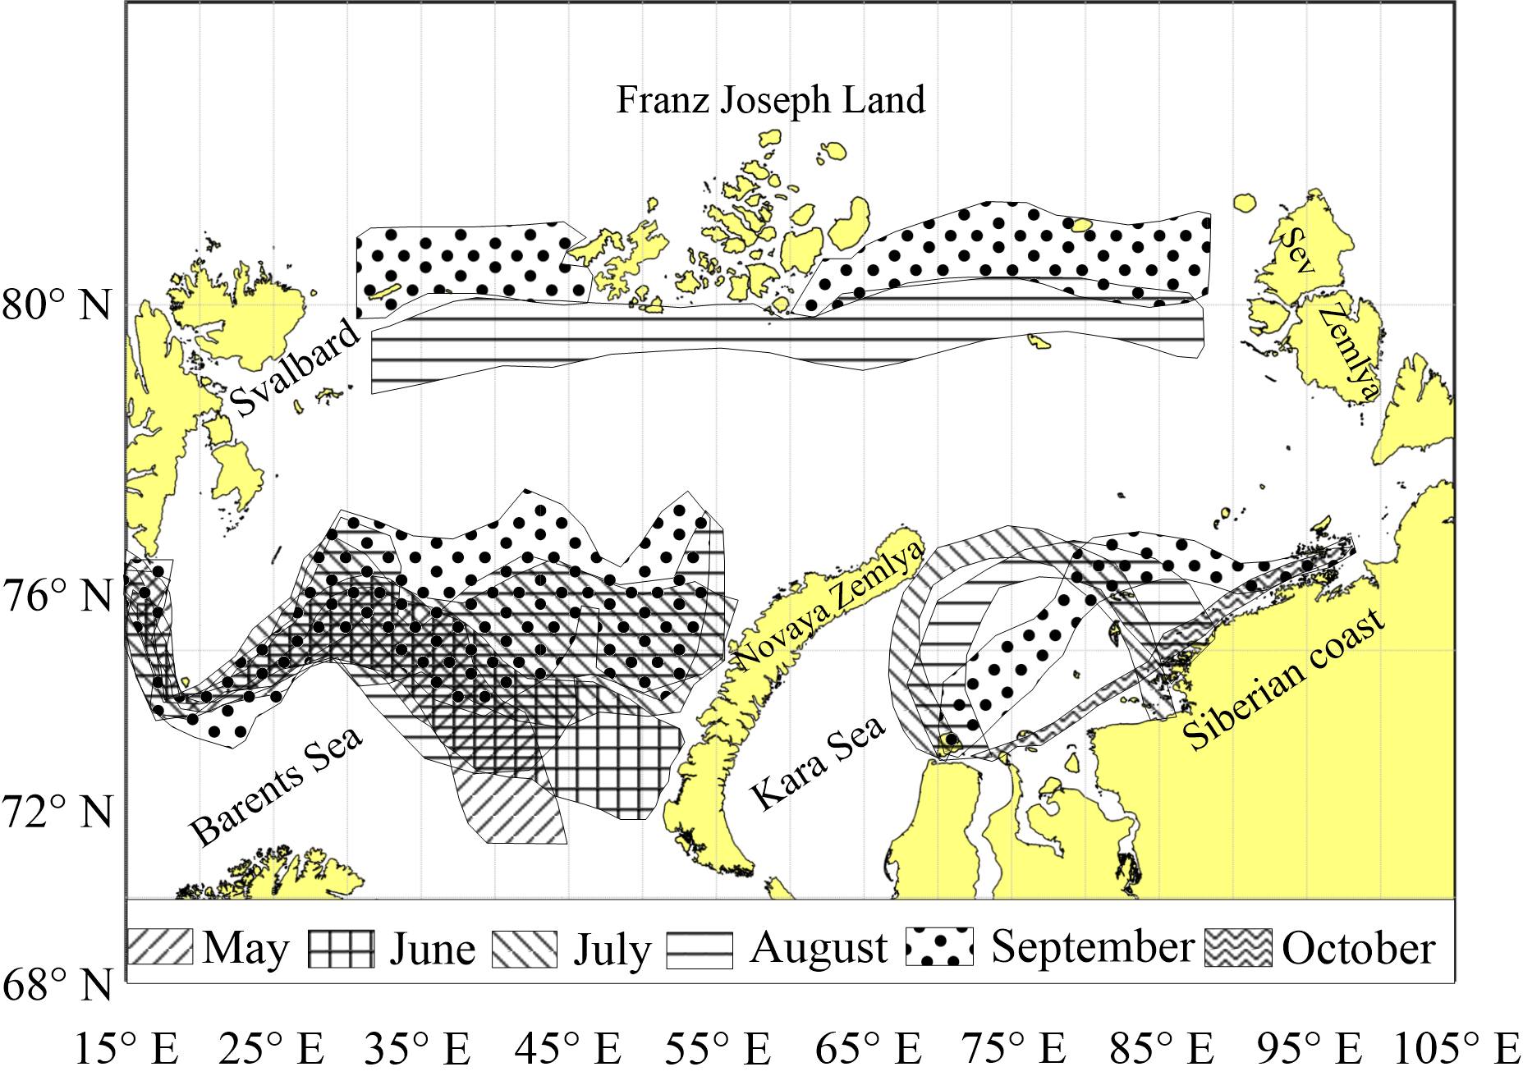
Results – seasonal variability frontal zones of Barents and Kara Seas
a)
b)
c)
Fig. 3. Seasonal position (a) and quantitative estimates (b, c) PFZ, RPFZ and AFZ for the period from 2002 to 2020.

Slide 5
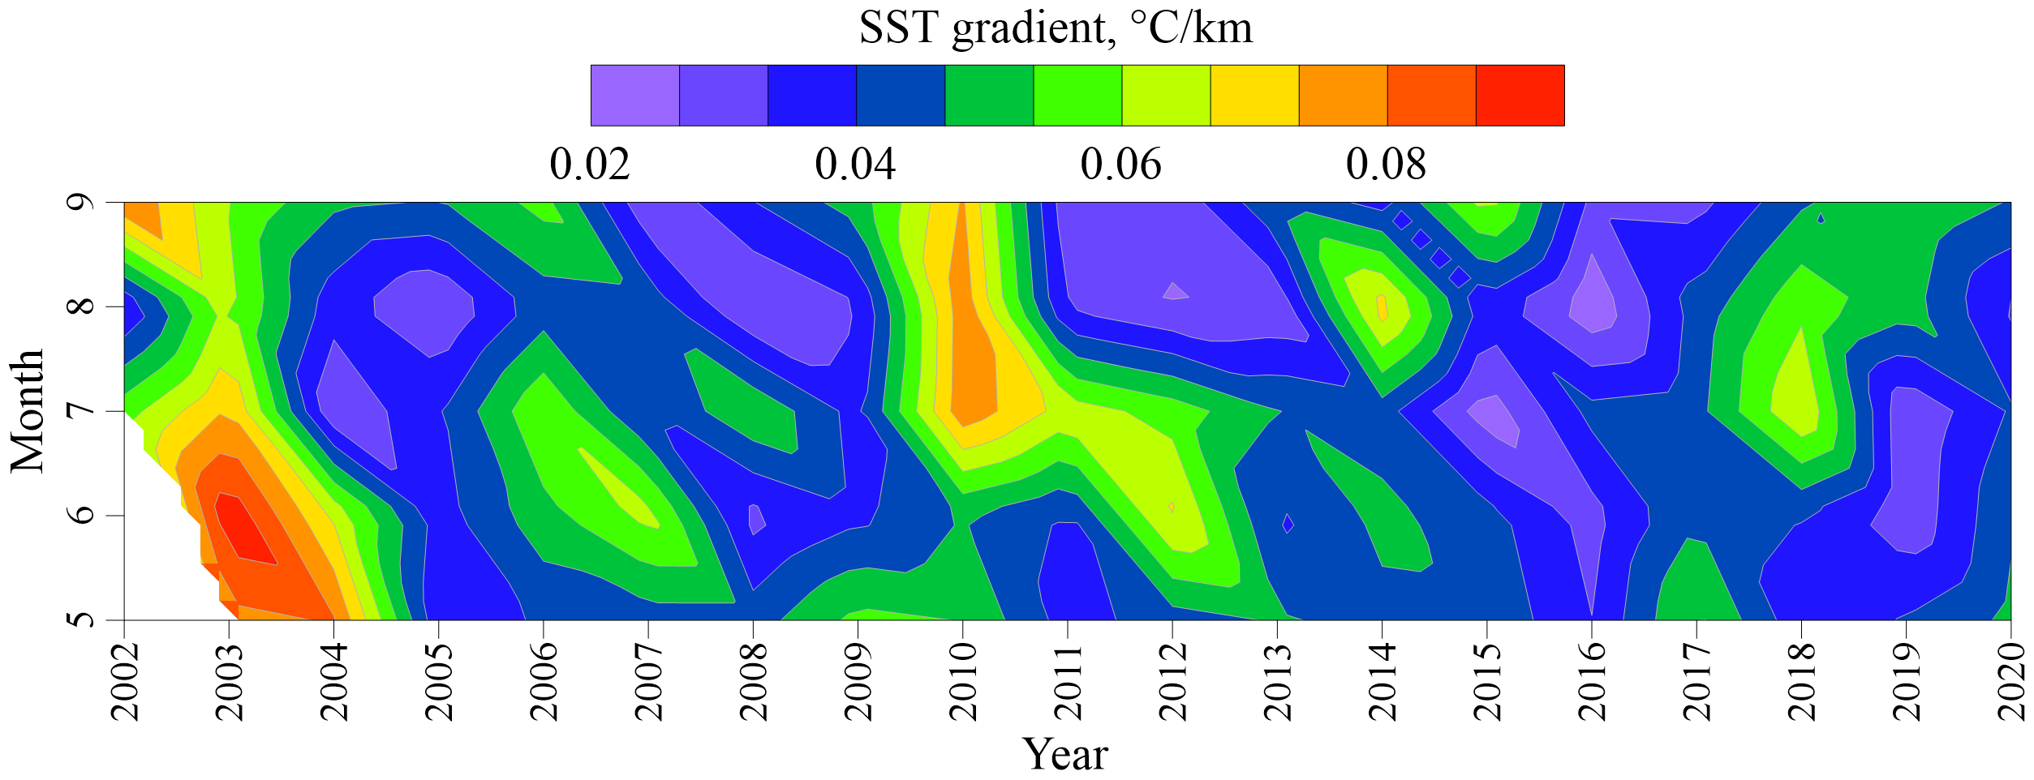
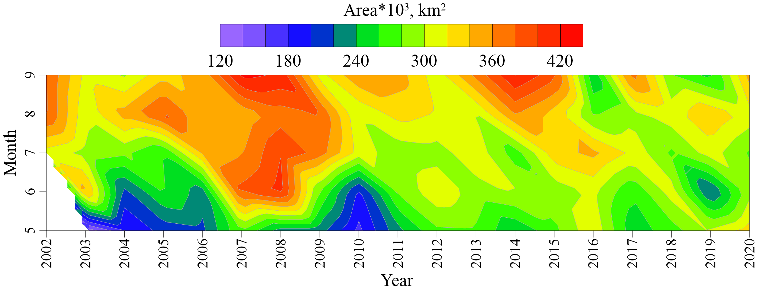
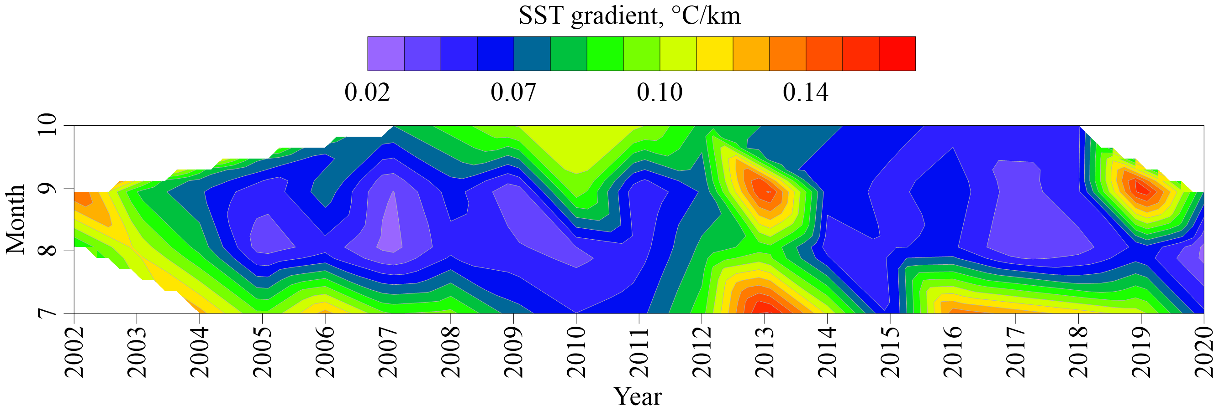
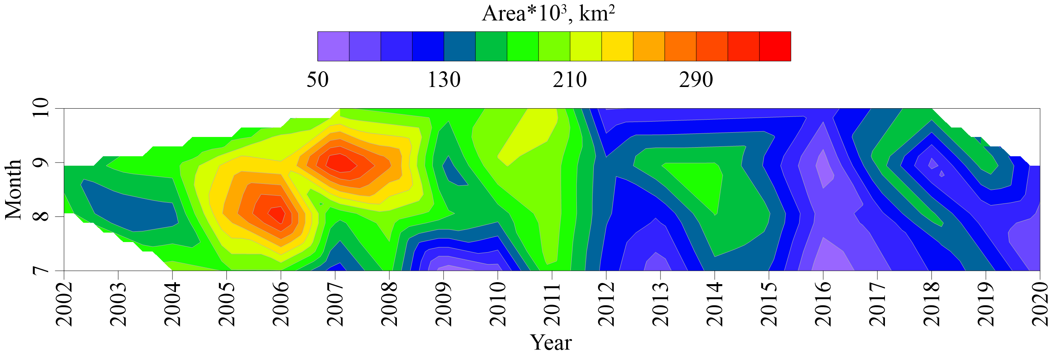
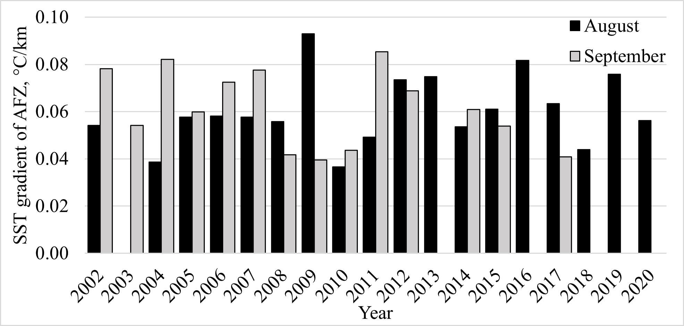
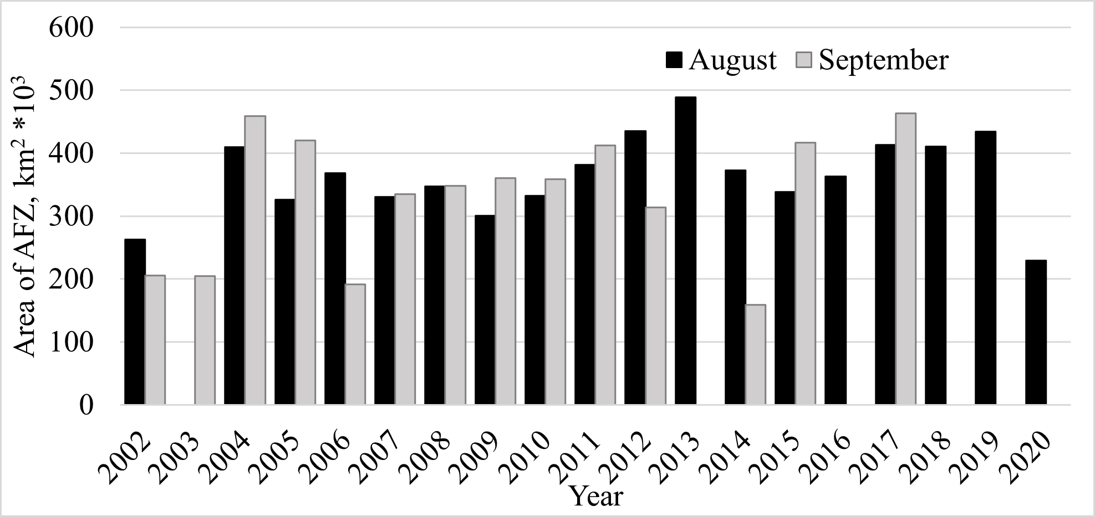
Results – long-term variability frontal zones of Barents and Kara Seas
a)
d)
b)
e)
c)
f)
Fig. 4. Interannual characteristics of the main frontal zones of the Barents and Kara Seas: SST gradients of PFZ (a), RPFZ (b) and AFZ (c); area of PFZ (d), PRFZ (e), and AFZ (f);

Slide 6
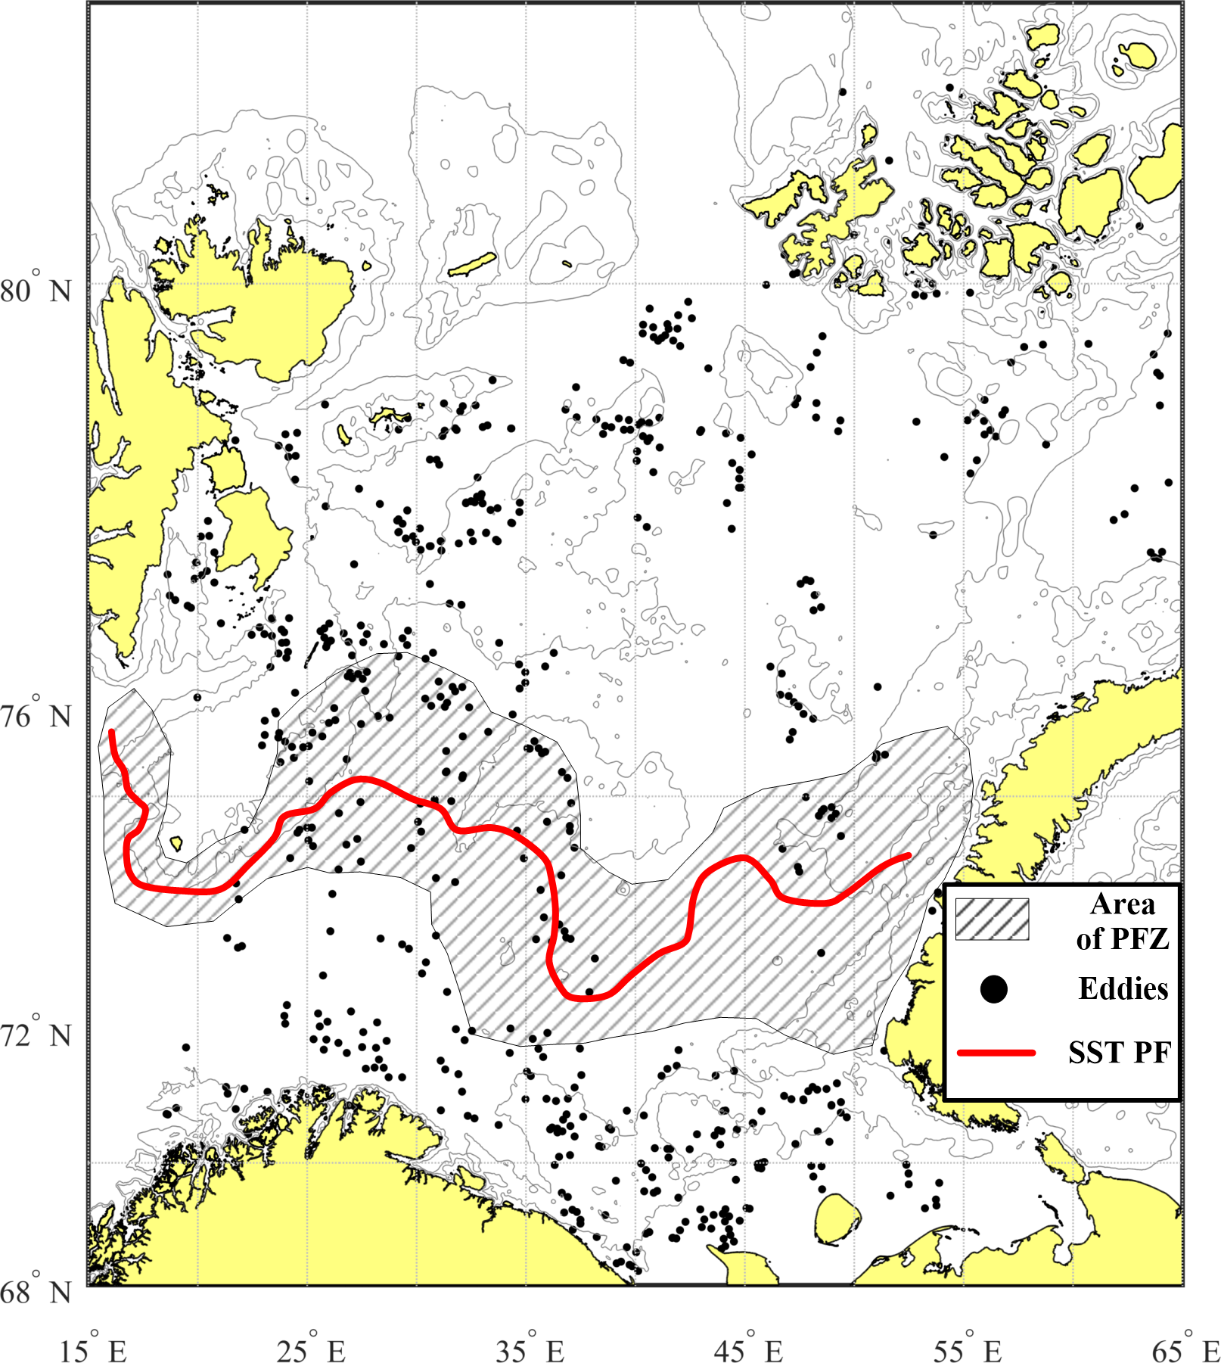
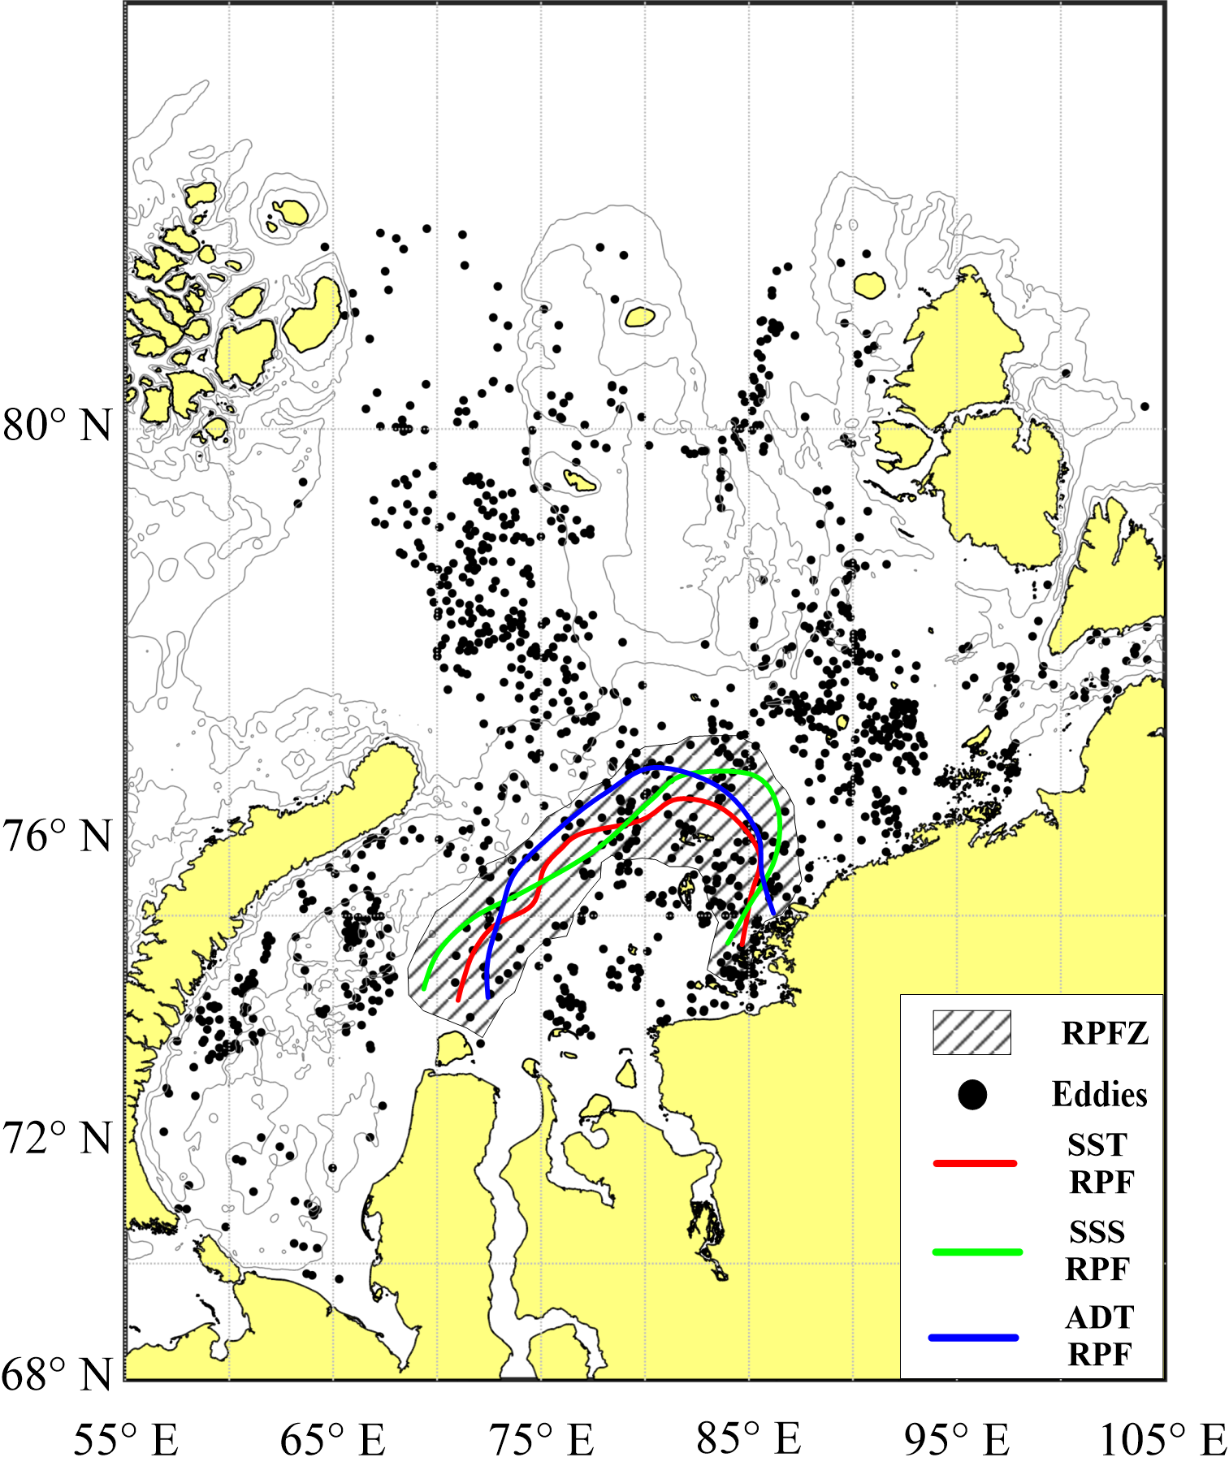
Results — eddies structures and atmospheric oscillation
The intensification of eddies manifestations in the PFZ and RPFZ region during the period of their "maximum" repeatability may depend on small values of the SST gradient, which increase the likelihood of baroclinic instability.
Fig. 5. Composite maps of PFZ according to SST, SSS, and eddies structures for August 2009 (a) and of RPFZ according to SST, SSS, ADT and eddies structures for August 2020 (b).
Сross-correlation
𝑟= 0.65 — between the summer values of the SCAND index and the summer value of the RPFZ area;
𝑟= 0.50 — between the winter values of the NAO index and the summer value of SST in AFZ.

Slide 7
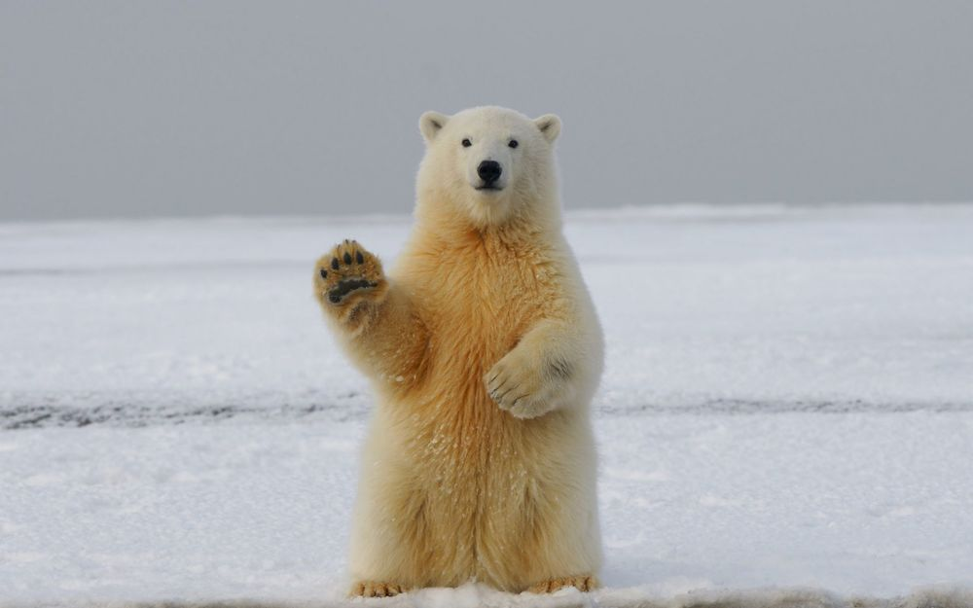
Email – konikrshu@gmail.com
Thanks for your attention!

