Slide 1
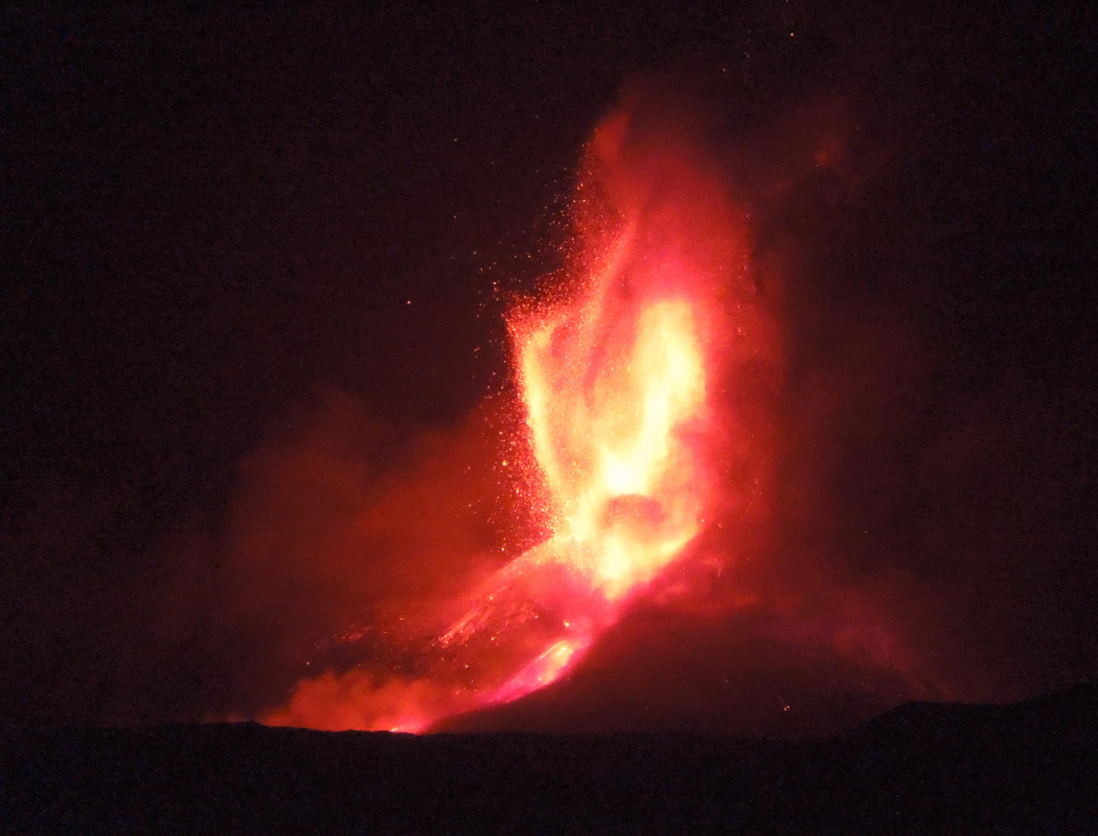

EuroMoonMars EMM-Etna Campaign 2021
Logistics and mission protocol
L. Schlarmann^{1,2}, A. Ehreiser^{3,2}, K. McGrath^{4,2}, G. Brady^{4,2}, C. Mohan^{4,2}, H. Reilly^{4,2}, P. Lakomiec^{5,2}, G. De Palma^{6,2},
C. Hönes^{7,2}, Y. Rusticus^{7,2}, B. Foing^{7,2}, and A. Wedler⁸
¹University of Vienna, ²ILEWG, EuroMoonMars, ³Universität Heidelberg,
⁴TU Dublin, ⁵University College London, ⁶University of Bari, ⁷Leiden Observatory & VU Amsterdam,⁸DLR Institute of Robotics & Mechatronics

Slide 2
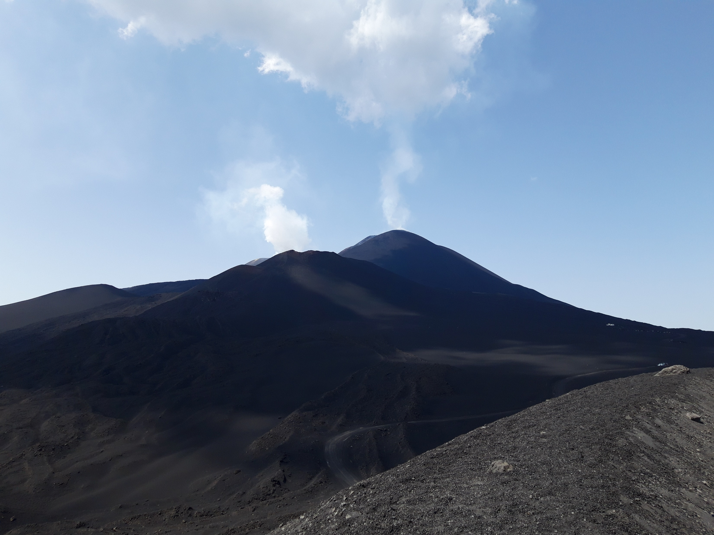
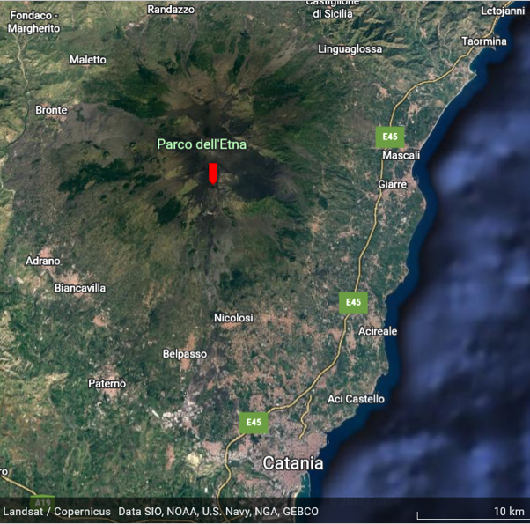
Introduction
6th – 11th of July 2021 on Mt. Etna
Objectives of the scouting campaign:
  Simulate landing of a rover on Etna
  Explore Mt. Etna as a Mars analogue
  Test instruments in preparation of the ExoMars mission
Carried out at DLR ARCHES 2022 site Cisternazza and Cratere del Laghetto

Slide 3
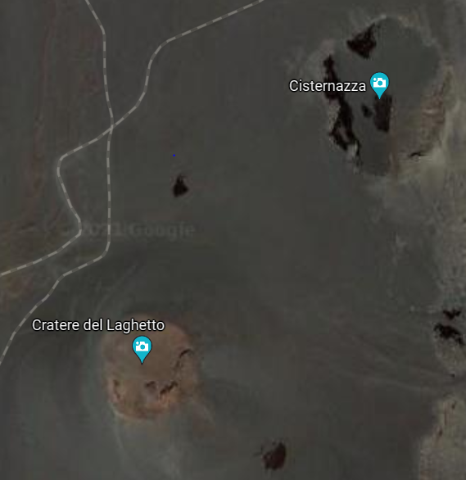
Introduction
6th – 11th of July 2021 on Mt. Etna
Objectives of the scouting campaign:
  Simulate landing of a rover on Etna
  Explore Mt. Etna as a Mars analogue
  Test instruments in preparation of the ExoMars mission
Carried out at DLR ARCHES 2022 site Cisternazza and Cratere del Laghetto

Slide 4
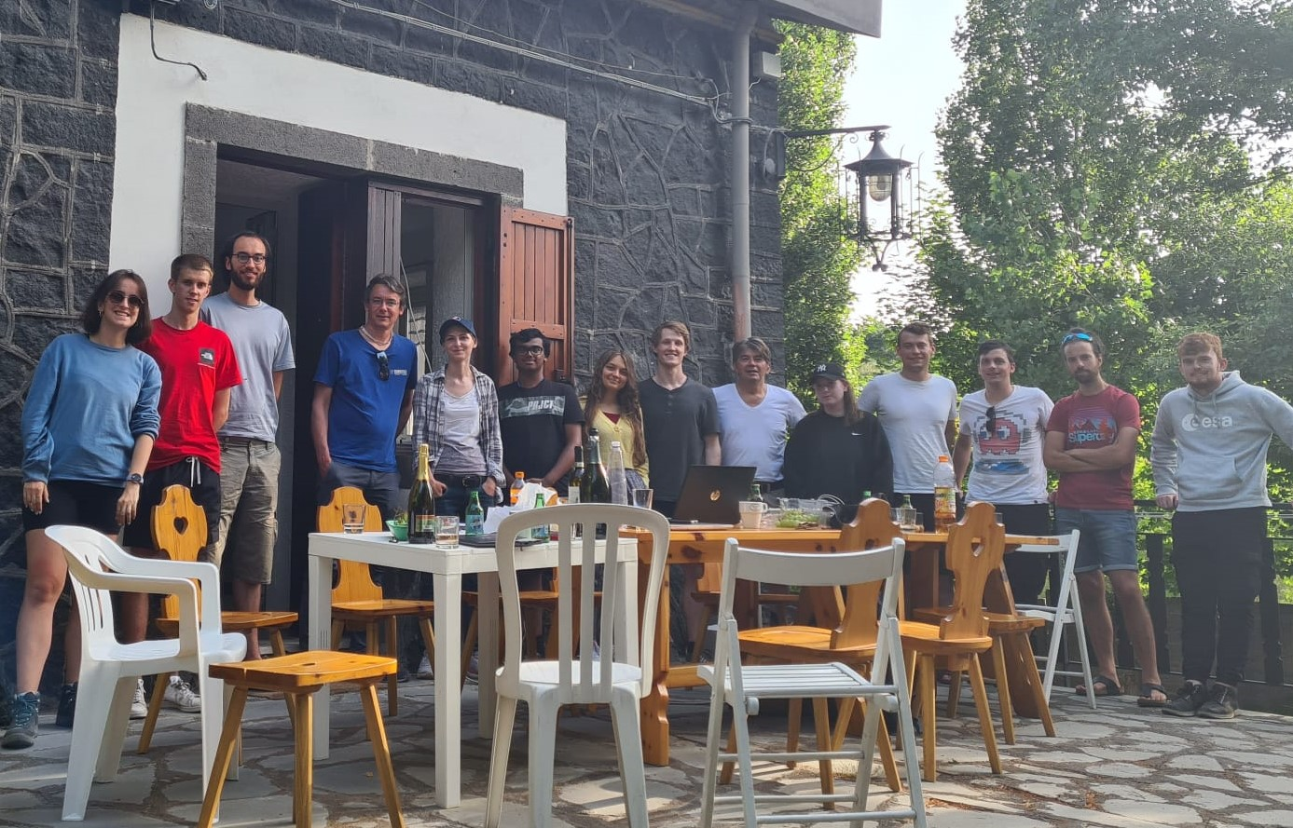
Crew & Tasks
11 participants:
  TU Dublin
  LEAPS (Leiden/ESA Astrophysics Program for Summer Students )
  VU Amsterdam
Every crew member had their distinctive role:
  Planner, Data officer, Geologist, Outreach officer, …

Slide 5
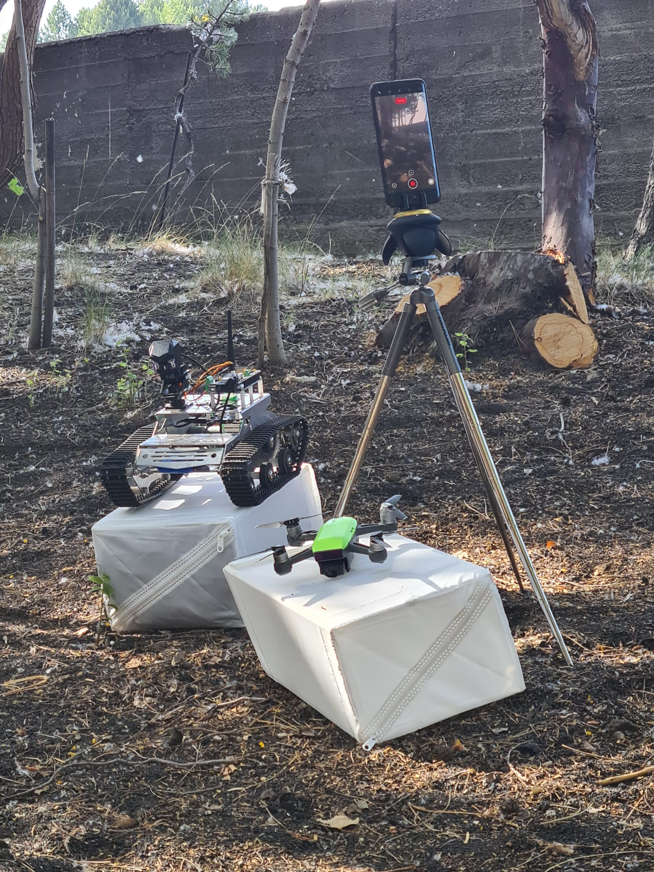
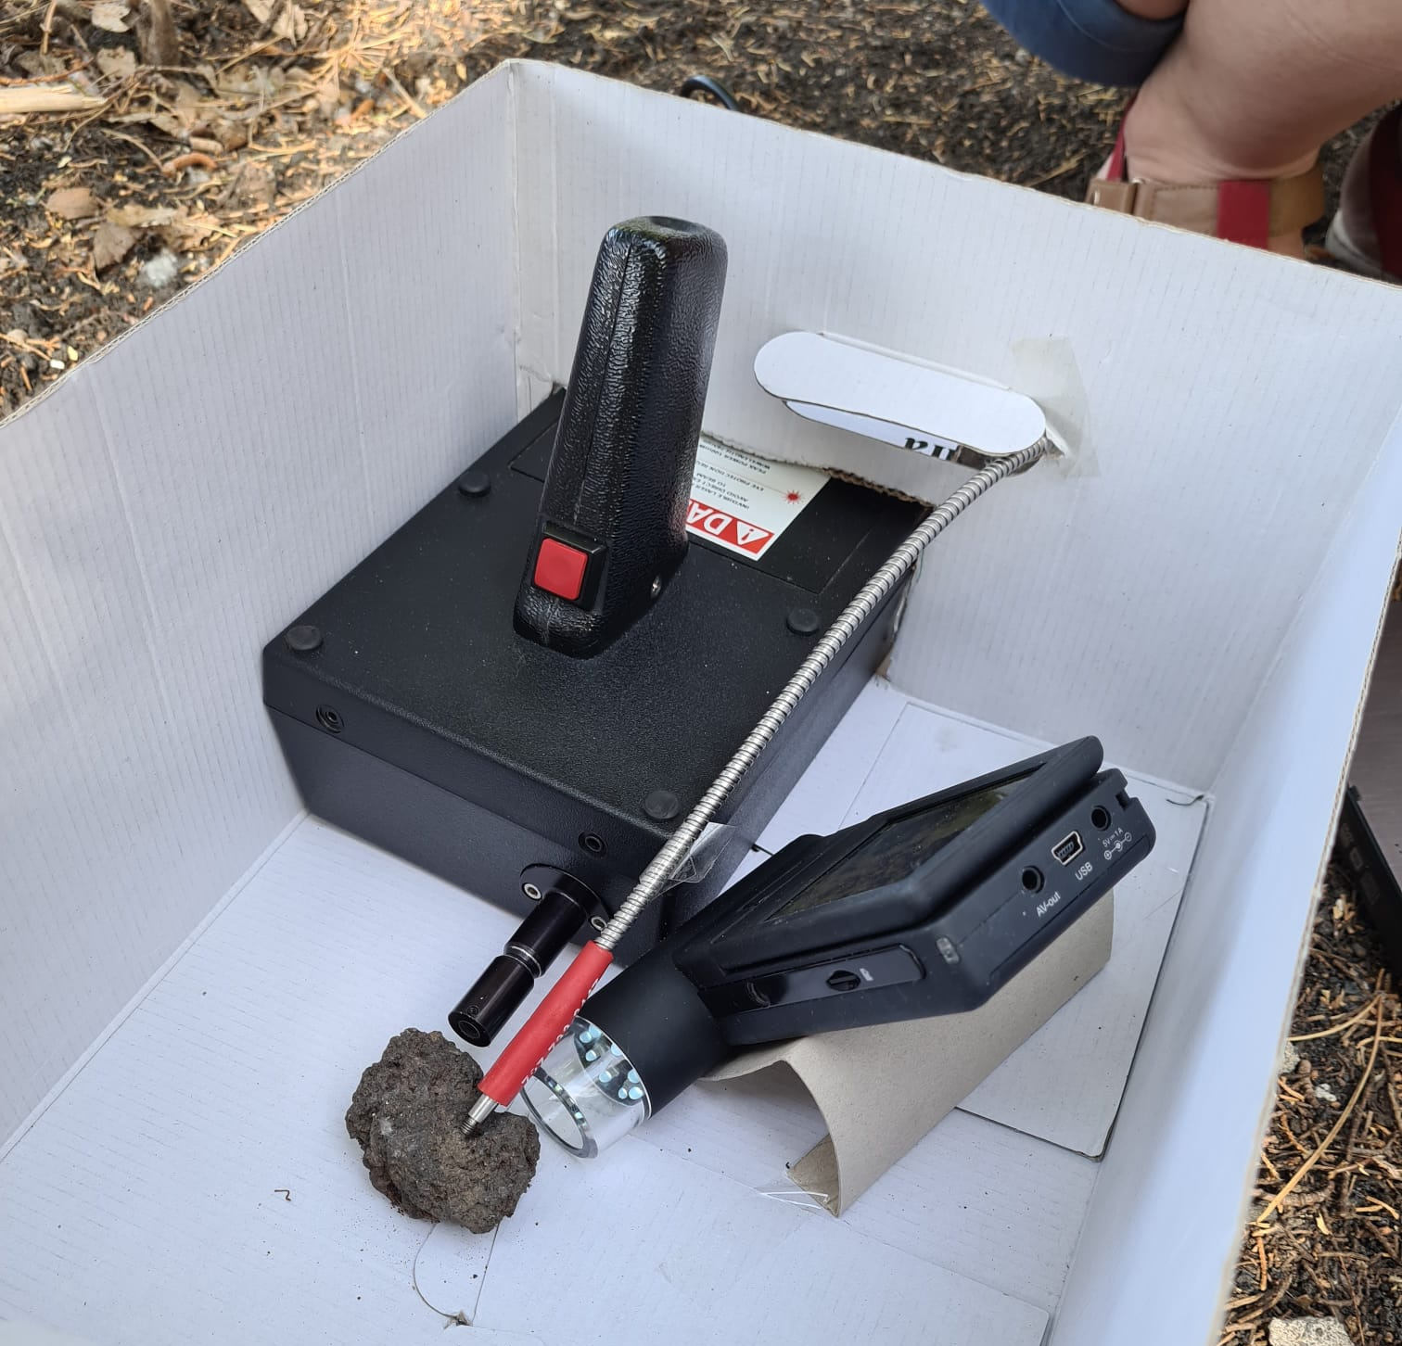
Equipment & Instruments
REMMI rover
Drone
360° Panoramic Camera (PanCam)
UV-Vis-NIR Spectrometer
Portable Microscope
Field Raman
Radio Jove Antenna

Slide 6
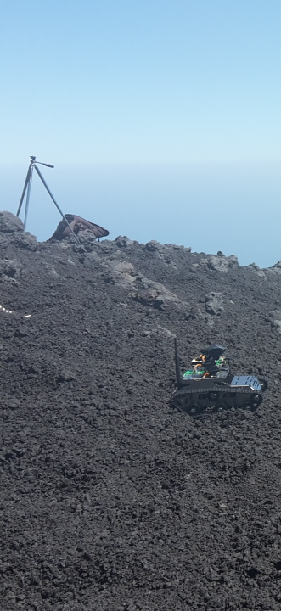
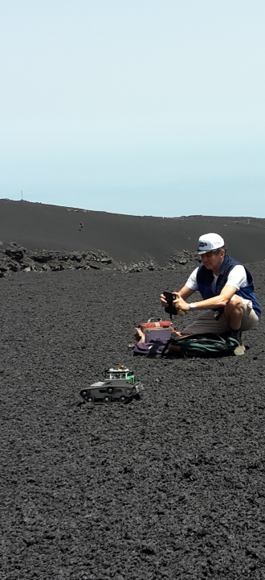
Mission protocol
Pre-Mission
Satellite images of landing site
Mission
Land/Set-up Earth Lab (Scientist)
Position Drone
Set up Pancan & Radio Jove
Take images of landing site
Launch rover to specified areas by Earth lab
Earth Lab
Set up Raman, Spectrometer and Microscope
Choose sample site from images
Analyse samples & determine mineral and structural composition
Close-up images of collected samples
Post Mission
Data Officer collect all data from the day
Journalist collect all images & footage of the day
Write individual daily report

Slide 7
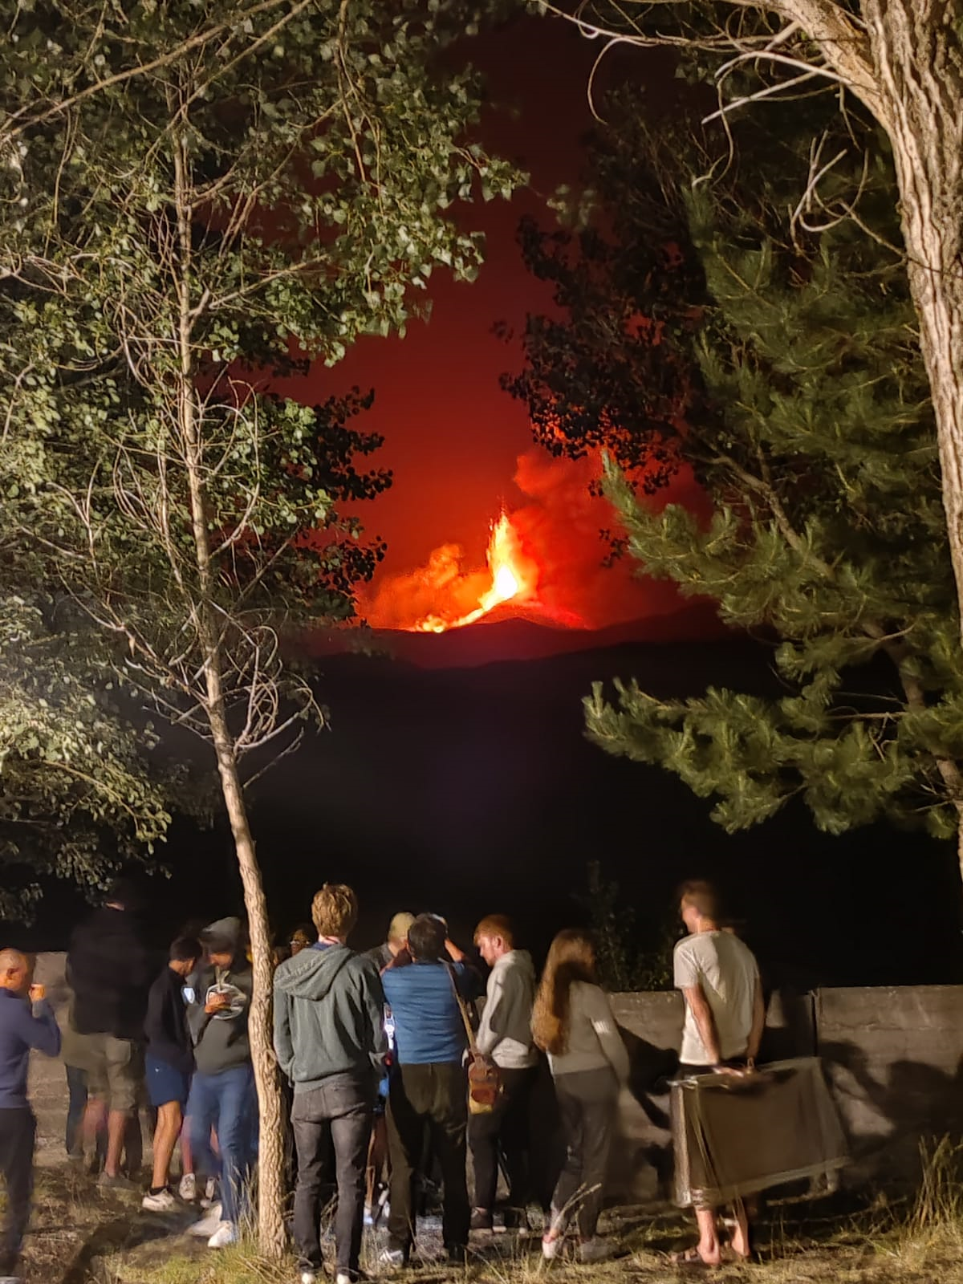
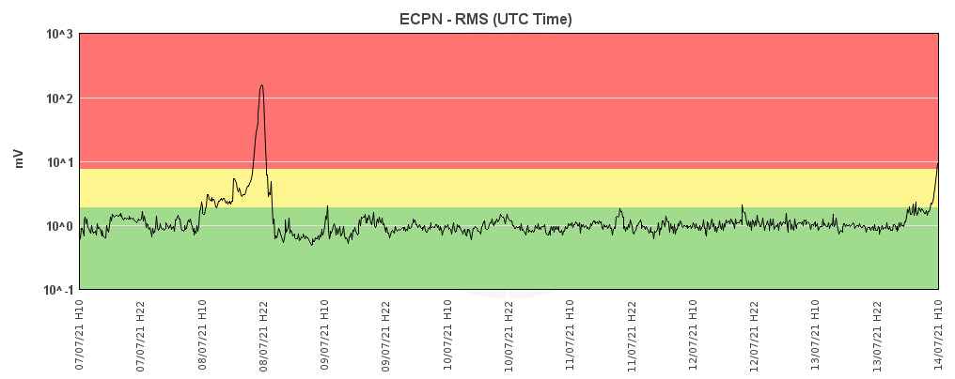
Health & Safety
Etna was very active during the campaign
Two lava fountaining episodes
Status of the volcano was checked regularly
Istituto Nazionale di Geofisica e Vulcanologia-Osservatorio Etneo (INGV-OE)

Slide 8



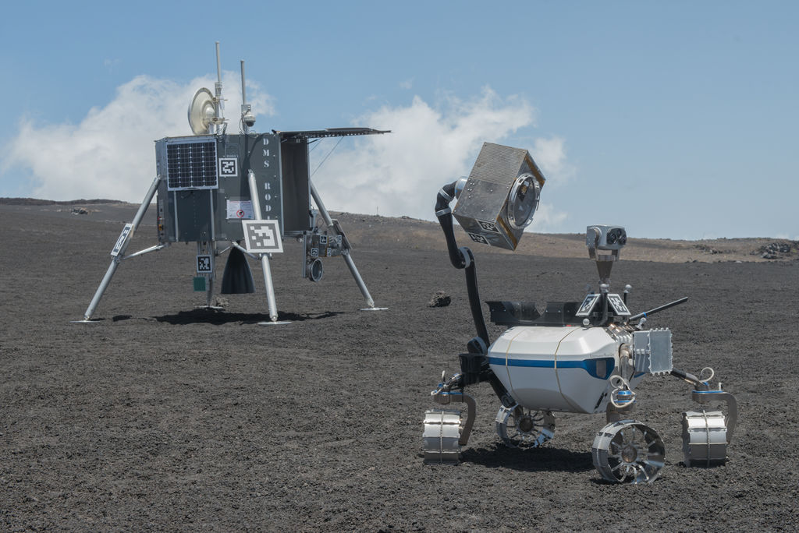
DLR ARCHES 2022
Autonomous Robotic Networks to Help Modern Societies (ARCHES)
Demonstration missions in July 2022:
  Autonomous Drone ARDEA
  Scout Rover
  Interact Rover
  The LRU 1 & LRU 2
  Rodin Lander
Credit: DLR

Slide 9
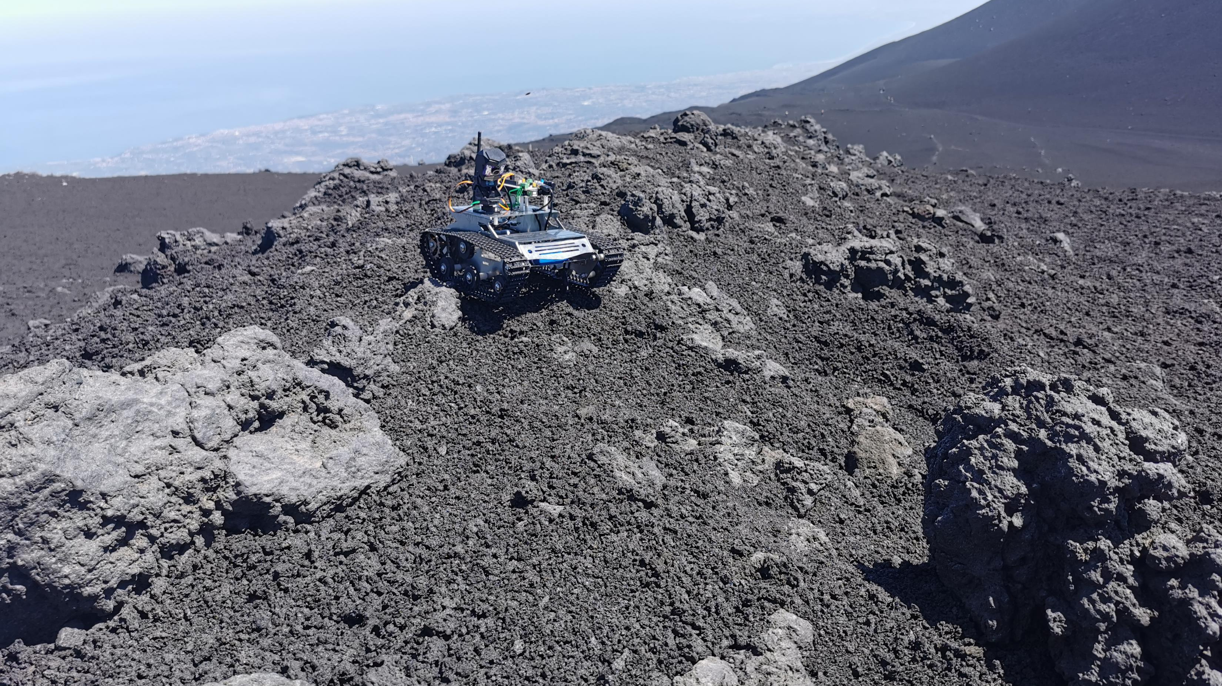
Thank you for your attention!

