Slide 1




In situ estimation of effective rock elastic moduli by seismic ambient vibrations Bohemian Cretaceous Basin, Czech Republic
Jozef Müller (jozef.mueller@uni-jena.de)
Jan Burjánek, PhD
(burjanek@ig.cas.cz)

Slide 2
Goals
Non-invasive ambient noise investigation of rock structures
In situ estimate of elastic moduli (E, G)
Competent sandstones at the Konice site
Ambient noise array measurement
Study of behaviour and local response of a rock tower
Kapelník rock tower
On-site noise measurements and beam theory (using the E, G)

Slide 3
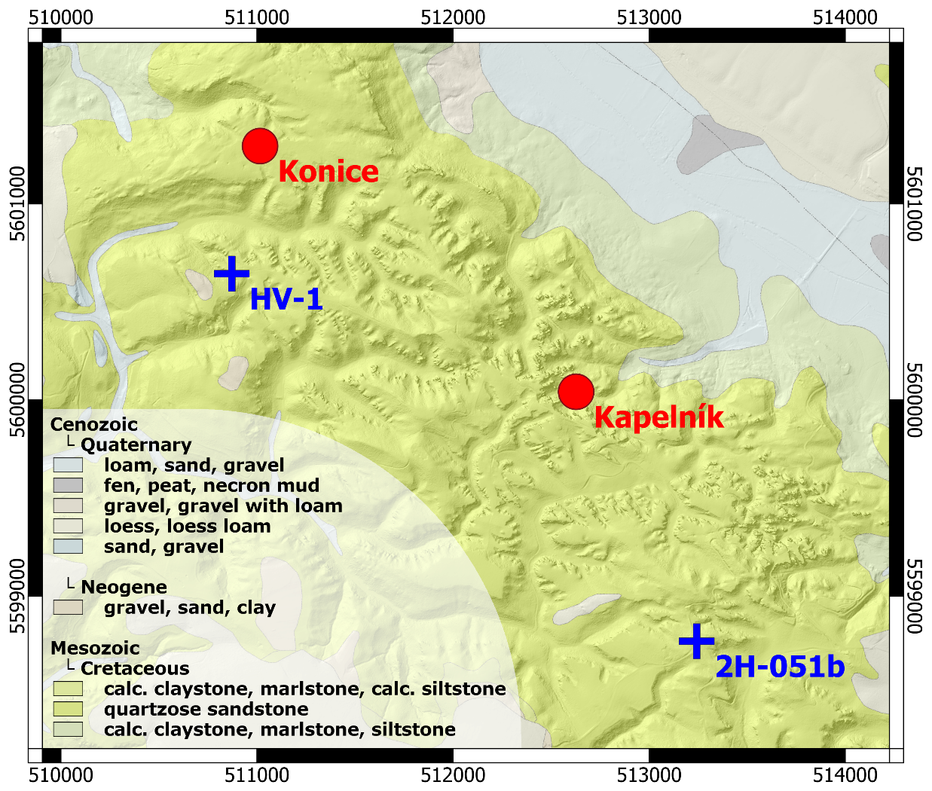
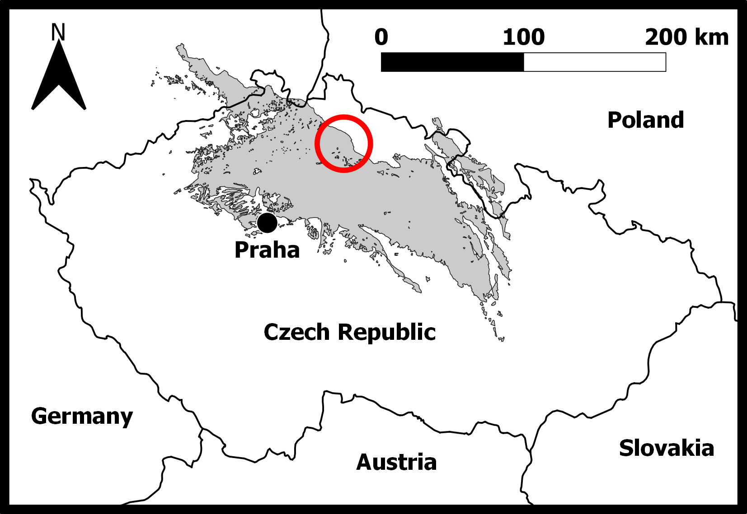
Study area
Bohemian Cretaceous Basin
C oniacian sandstones
Turonian claystones
Subhorizontal strata
≈ 1-D model
Red dots: investigated sites
Blue crosses: boreholes

Slide 4
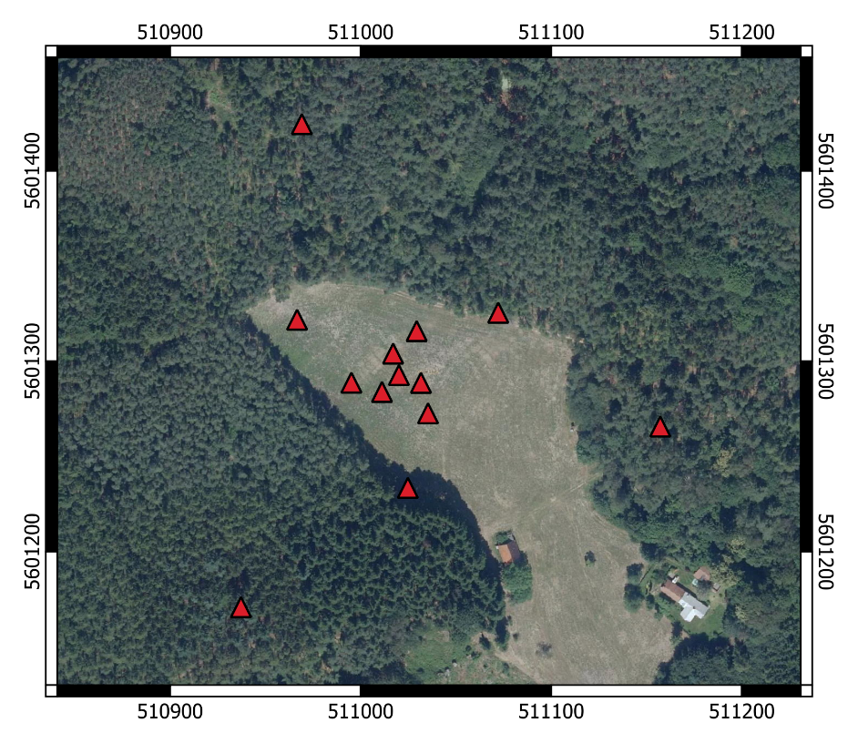
1) Konice Array Measurement
[Right] Array geometry
Seismometers in shallow pits
Station positions measured with a DGPS
Two hours of 3C ambient noise recordings

Slide 5
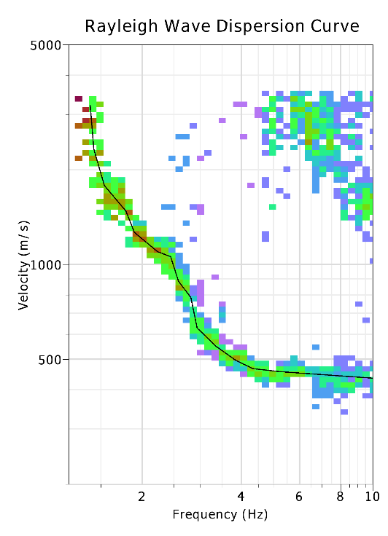
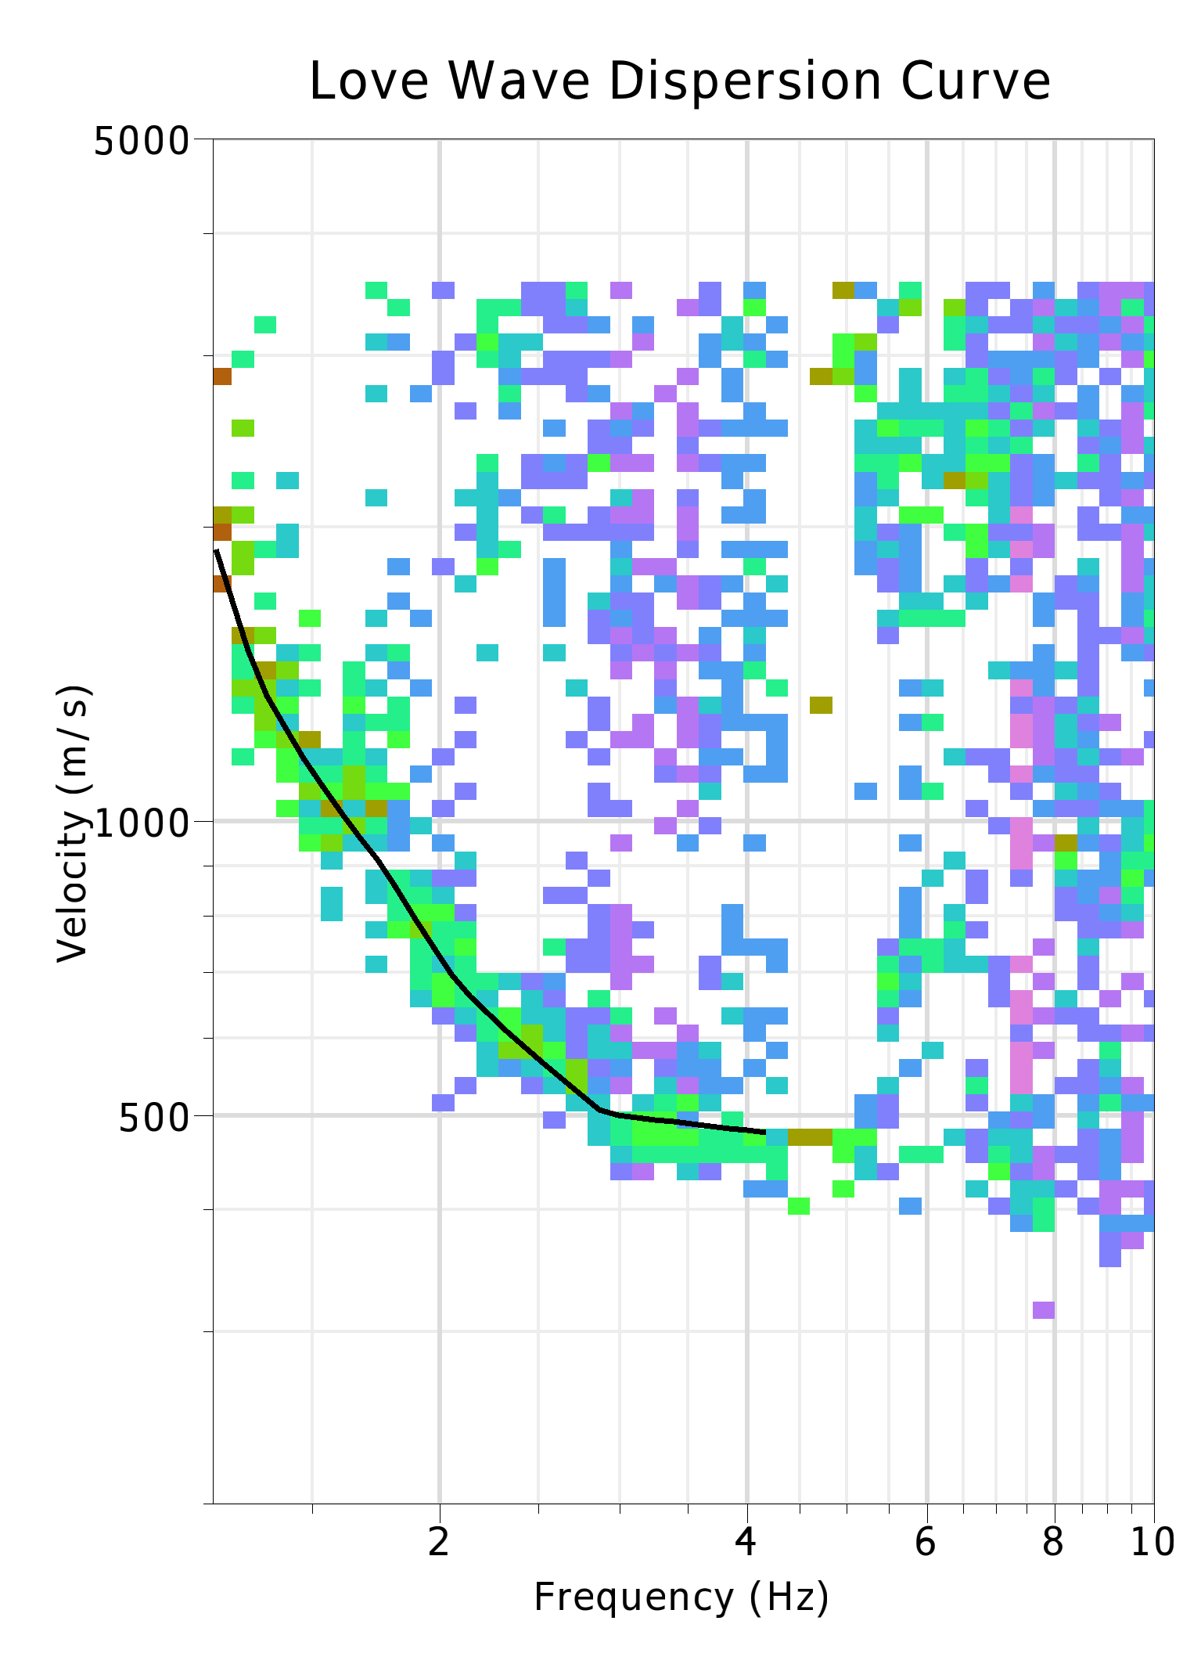
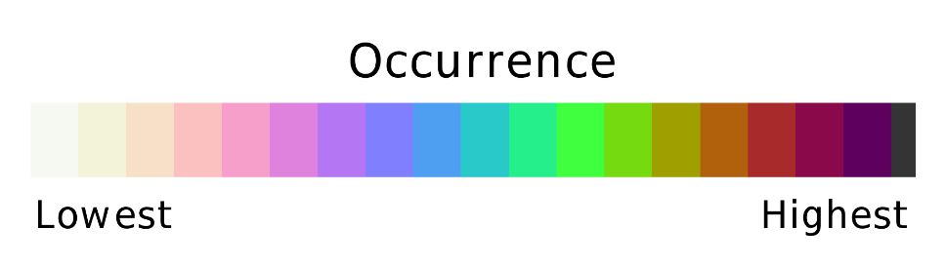
1) Dispersion Curves
Frequency-wavenumber array analysis
Wathelet et al. (2020)*
[Left] Rayleigh wave dispersion curve
[Right] Love wave dispersion curve
Both represent fundamental modes
*Wathelet, M., Chatelain, J.-L., Cornou, C., Di Giulio, G., Guillier, B., Ohrnberger, M., Savvaidis, A., 2020.
Geopsy: A user-friendly open-source tool set for ambient vibration processing. Seism. Res. Lett. 91, 1878-1889

Slide 6
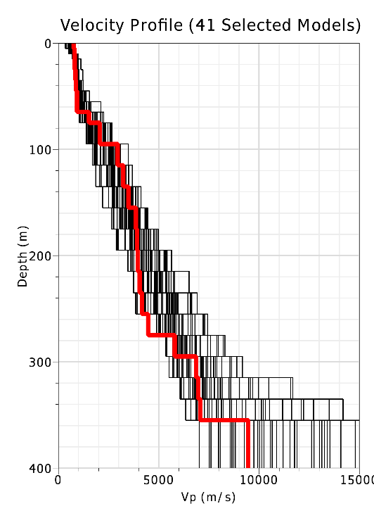
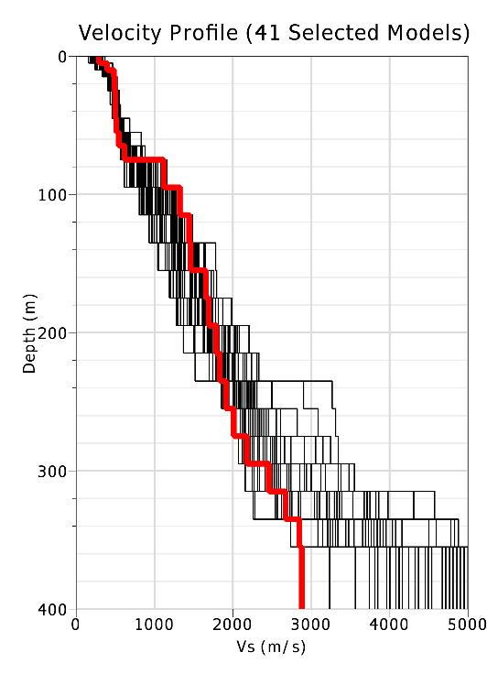
1) Inverted Velocity Profiles
[Left] Depth profile of P-wave velocities
[Right] Depth profile of S-wave velocities
P-wave velocities were determined thanks to low Poisson’s ratio and consideration of the Rayleigh wave ellipticity
Expected sandstone-claystone interface in depth of around 80 m
Poor resolution
Poor resolution

Slide 7
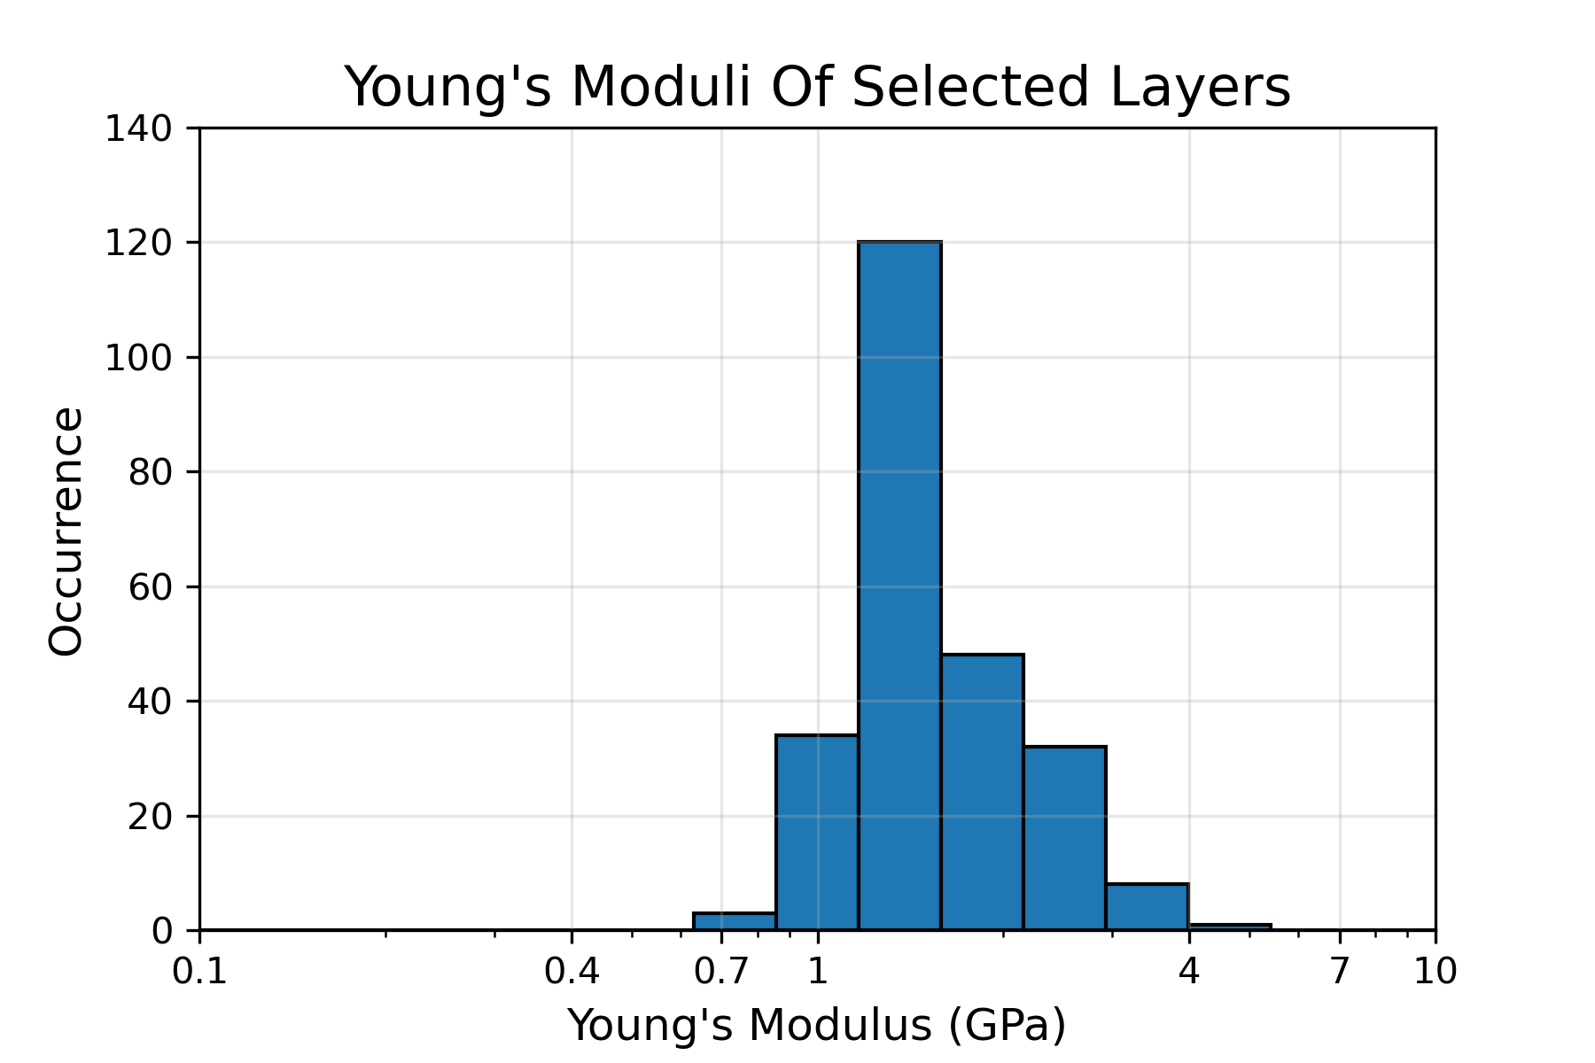
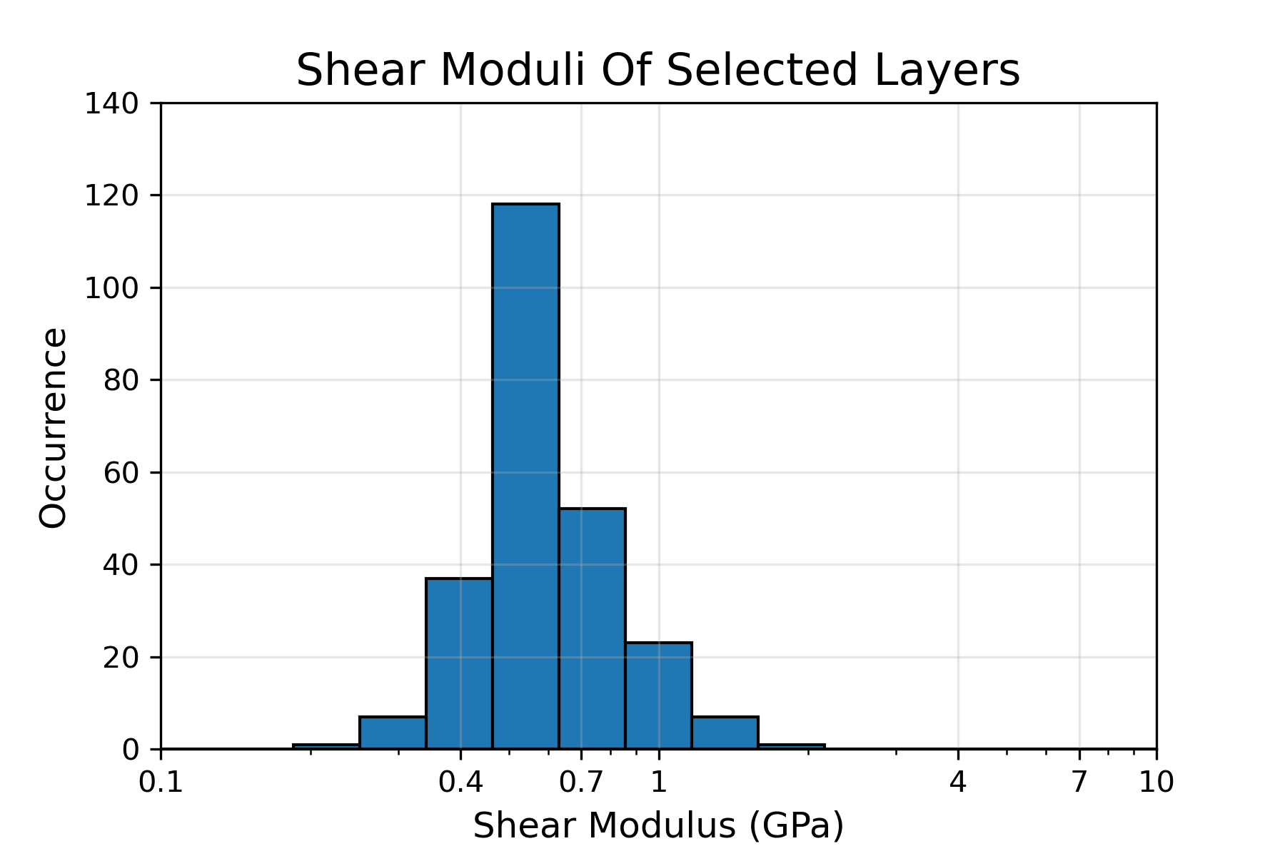
1) Elastic Moduli
Histograms of elastic moduli of the sandstone formation at Konice (15 m to 75 m)
Young’s modulus
Shear modulus
Mean: 1.53 GPa
Mean: 0.59 GPa

Slide 8
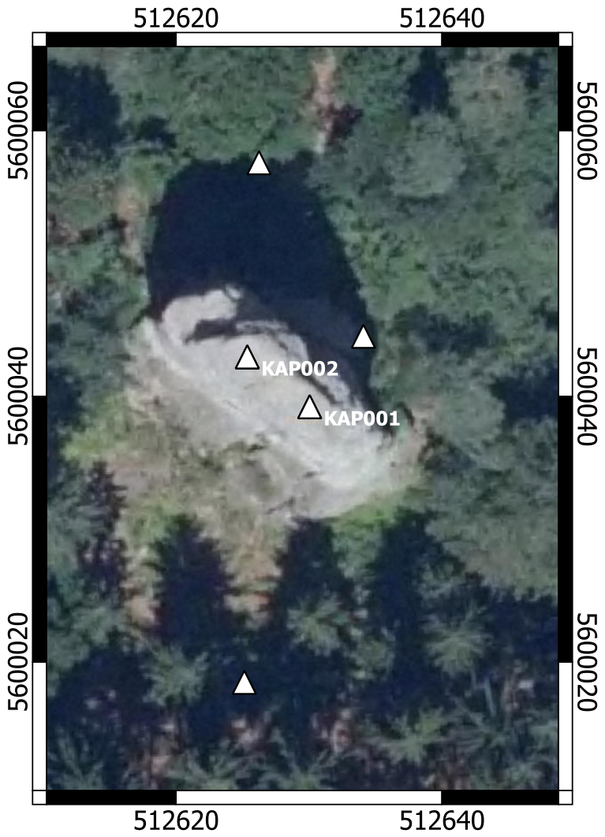
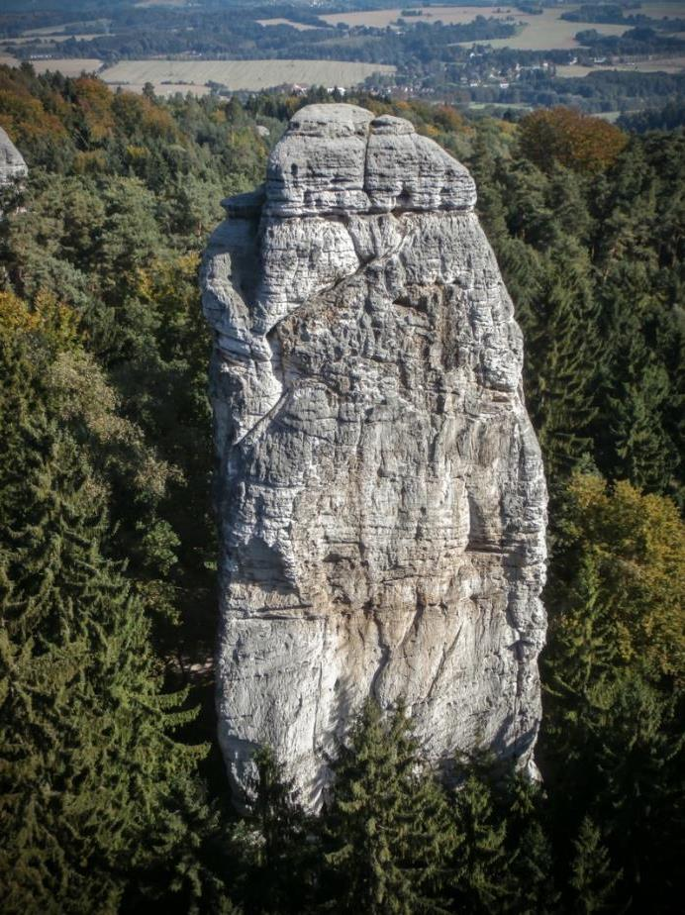
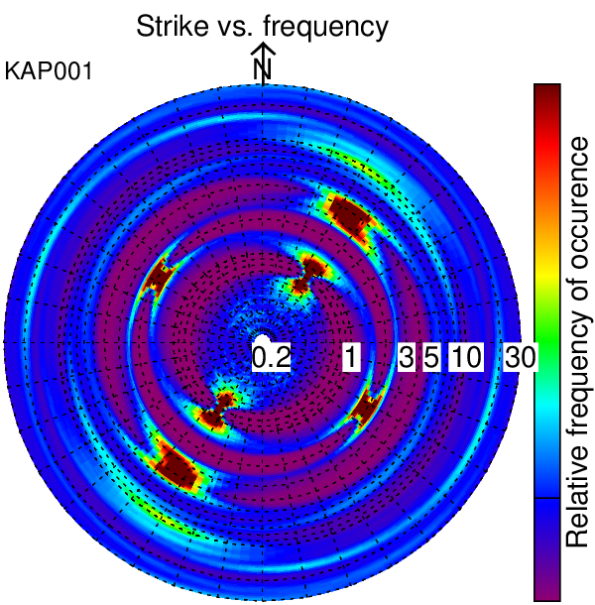
2) Kapelník
Below: result of a particle motion polarisation analysis from recording at the top of the tower
Kapelník rock tower
outfanatic.com
outfanatic.com

Slide 9
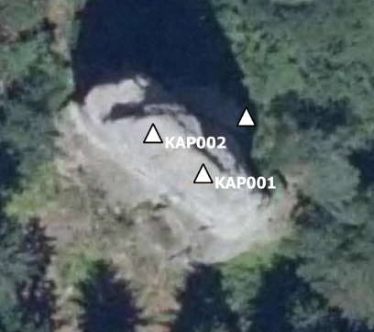
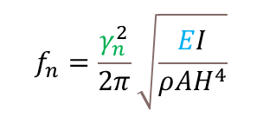
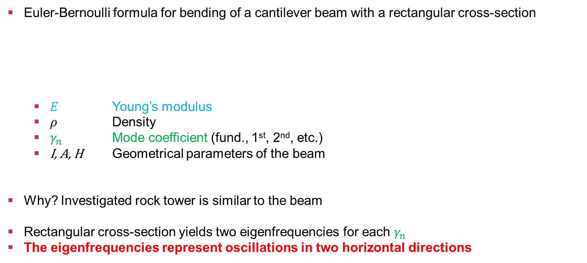
2) Model Eigenfrequencies
Euler-Bernoulli formula for bending of a cantilever beam with a rectangular cross-section
$E$ Young’s modulus
$ρ$ Density
$γ_{n}$ Mode coefficient (fund., 1st, 2nd, etc.)
I, A, H Geometrical parameters of the beam
Why? Investigated rock tower is similar to the beam
Rectangular cross-section yields two eigenfrequencies for each $γ_{n}$
The eigenfrequencies represent oscillations in two horizontal directions
$$f_{n}=\frac{γ_{n}^{2}}{2π}\sqrt{\frac{EI}{{ρAH}^{4}}}$$

Slide 10
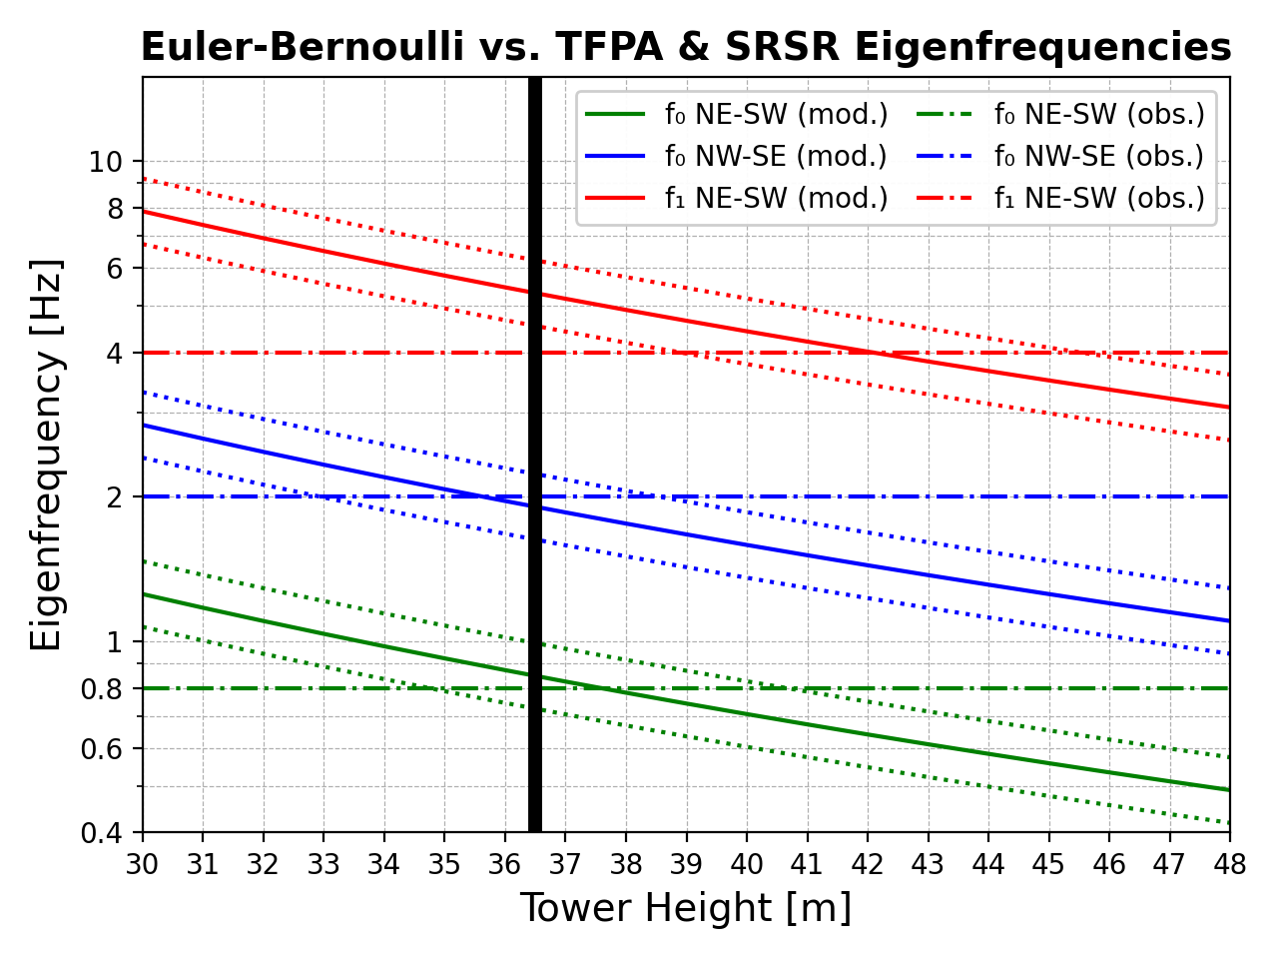
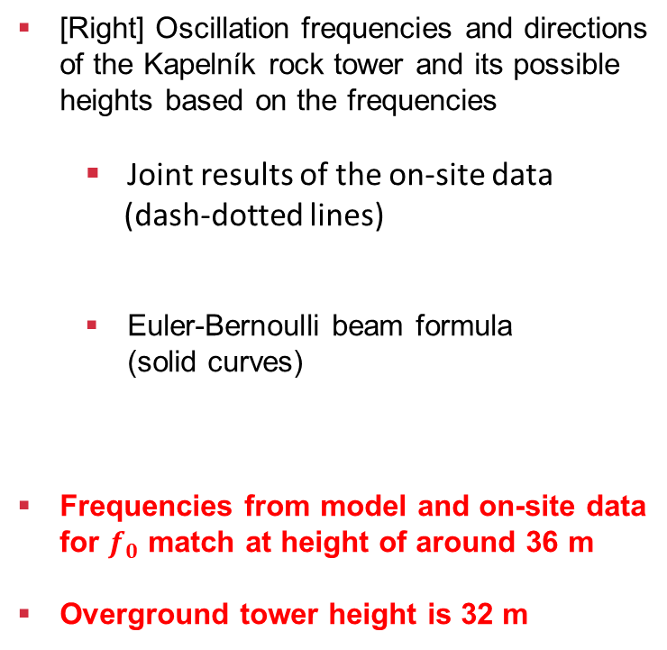
2) On-site vs. Calculated Data
[Right] Oscillation frequencies and directions of the Kapelník rock tower and its possible heights based on the frequencies
Joint results of the on-site data
(dash-dotted lines)
Euler-Bernoulli beam formula
(solid curves)
Frequencies from model and on-site data for $f_{0}$ match at height of around 36 m
Overground tower height is 32 m

Slide 11
Conclusion
Konice
Non-invasive estimate of effective E and G of competent sandstone strata
Kapelník rock tower
Successful combination of on-site and model data
Determination of eigenfrequencies and directionalities of oscillations
Proof of concept for possible monitoring of other rock structures
Submitted as Müller, J., Burjánek, J., 202X. In situ estimation of effective rock elastic moduli by seismic ambient vibrations (under review)

Slide 12
Thank You For Your Attention

