Slide 1


ML emulation of a local-scale UK climate model
Henry Addison
Supervised by Peter Watson & Laurence Aitchison
and further guided by Lizzie Kendon (Met Office) and Suman Ravuri (DeepMind)
Notes:
Hello, I’m Henry a 2nd year PhD student at the University of Bristol’s Interactive AI centre and I’m working with these other great people on how AI can be used to help climate scientists.

Slide 2
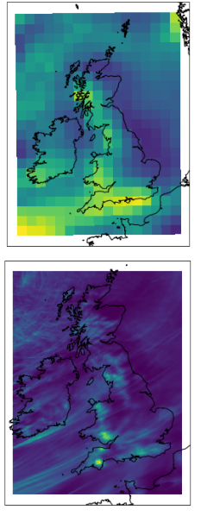
The problem
Can we learn hi-res precipitation from coarse, GCM climate variables?
High-resolution climate simulations are expensive
New probabilistic ML methods could complement simulations with more hi-res samples
Notes:
So what’s actually the problem I’m trying to solve?
I’m trying to use machine learning to learn a mapping from coarse GCM inputs to high-resolution precipitation output.
To keep a global climate simulation computational feasible, it must be limited to 25km resolution at best.
So we turn to dynamical downscaling and regional climate models. The Met Office produced the first national-level, convection-permitting 2.2km projections but these were very expensive so required some trade-offs.
To put some rough numbers on the computation costs each 20 year chunk covered by a simulation run in this dataset requires about 6 months compute time.
My aim is to apply recent advances in probabilistic ML to these high-resolution projections and learn a stochastic mapping from the coarse variables of a global model in order to create more high-resolution samples much much more cheaply.

Slide 3
Dataset: Met Office UKCP18
Projections over UK & Ireland
  GCM @ 60km
  CPM @ 2.2km
12 CPM ensemble members
  60 years each (3 x 20 year chunks)
  1 emission scenario
  Daily (and sub-daily available)
Notes:
Here’s some more detail about the dataset I’m using for this downscaling problem:
60km global model and 2.2km CPM covering UK & Ireland
Hi-res model has just 12 ensemble members for 1 emission scenario over 60 years
I’m starting on daily data but sub-daily is available
I should also note to ease the computational requirements at this stage I’m restricting my focus to an area around London.

Slide 4
Approach
Training: coarsened CPM variables → hi-res CPM precip
Sampling: GCM variables → hi-res CPM-like precip
Evaluating: both
Make sure to use variables which are well-represented in GCMs and cause rainfall
  Wind
  Temperature
  Humidity
Notes:
So we have some data, how do we fit a model, evaluate it and produce some more samples?
The outputs of the CPMs and GCMs aren’t completely aligned in time which means it doesn’t make sense to train using GCM data as our input and CPM data as our target.
Instead I’m following a perfect model approach and training using coarsened CPM data as the input so I know it will be aligned temporally with the output.
Once the model is trained, I can then use the GCM data as input to generate samples using the ML model. This means I need to be careful with the variables I use as the conditioning input as ideally they should be as well-represented in a GCM as a CPM and also I don’t want to throw away human expert knowledge so I want to use variables that are known to cause rainfall. This means I’m starting off looking at variables related to wind, temperature and humidity.
The ML model is evaluated on how well it does both with CPM inputs and with GCM inputs. To evaluate for extremes, I’m holding out 10% of the data based on the wettest days and a few days either side.
In both cases, extreme precipitation can be evaluated in terms of climatological statistics, so things like mean and variance and intensity-duration-frequency curves aggregated over large areas and time ranges.
In the case of samples using coarsened CPM input we can also see how well the samples output by the ML model match the corresponding hi-res CPM precipitation, which means using more weather-forecasting type metrics such as Critical Success Index and Fractional Skill Score.

Slide 5
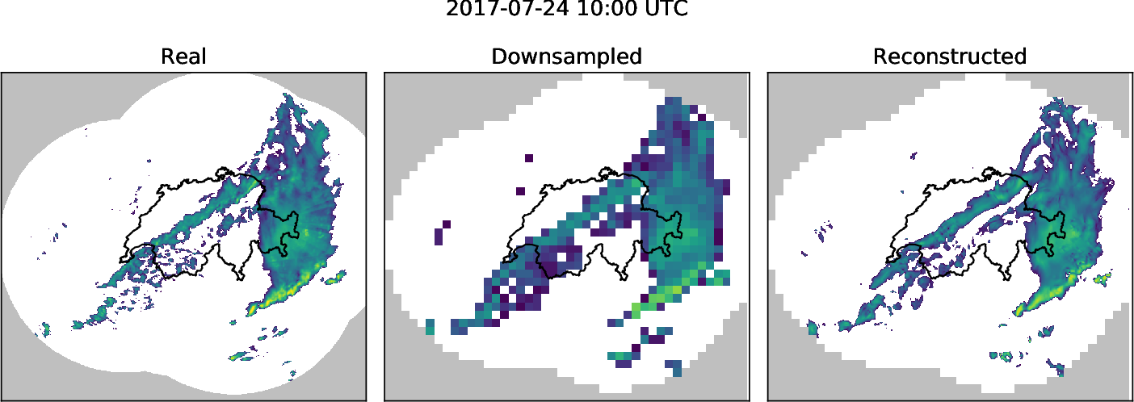
Score-based Generative Models
Deep Generative Model
Offer good trade-offs
Multiple stochastic samples
Sample diversity
Sample sharpness
Sampling cost
Leinonen, J. et al. 2020. ‘Stochastic Super-Resolution for Downscaling Time-Evolving Atmospheric Fields With a Generative Adversarial Network’. IEEE Transactions on Geoscience and Remote Sensing, 1–13.
Notes:
I won’t go into too much technical detail but the ML models I’m investigating are a conditioned version of a class of deep learning models called score-based generative models which are also known as diffusion models or noise-conditioned score networks. These models have been shown to work well for similar problems like super-resolution and in-painting in the domain of natural images.
There’s a couple of points I’d like to emphasize:
You may have come across conditional GANs which have seen some successes in related climate and weather applications like this work by Leinonen et al. One big attraction of conditional generative models is for a single conditioning input of coarse variables, you can get lots of samples out so we’re not limited to one set of outputs like with a simulation run.
Unlike GANs these new models offer potential for better sample diversity without affecting sample sharpness or sampling cost too much (for my purpose).

Slide 6


Samples from PoC precip-to-precip model
CPM precip
Coarsened CPM
ML model precip samples
8x
16x
Notes:
For sanity checking the ML method, I used it for precip-to-precip downscaling. Here are some samples from a couple of scale factors.
at 8x, one sample looks quite like the truth so the model able to infer that this is a likely possibility even though coarse data does not show it
At 16x this samples don’t match the CPM output so well suggesting the higher importance of stochasticity for this larger scale factor.

Slide 7
Future work
Samples conditioned on variables from large ensembles of coarse climate models
Sub-daily frequency and temporal sequences
More extreme Extremes: 1-in-100 years
Long-range spatial correlations
Any questions or suggestions? henry.addison@bristol.ac.uk
Notes:
In the long term I’m very interested in if the model trained using the UKCP18 dataset can be generalized further to produce high-resolution samples based on inputs from other climate models, eventually those which haven’t yet been dynamically downscaled which could aid with decisions in where to target limited resources.
I’ve been working with daily means but other temporal resolutions are available and there may be value in predicting sequences rather than just one-off snapshots.
Also I’m interested in how to get further into the extremes – I talked about a 10% hold-set but that’s not very extreme.
And similarly I’d like to check if the ML model is able to predict sensible-looking long-range spatial correlations.
Thank you very much for listening. I’m sorry I can’t be at EGU in person but please do get in contact with us if you’ve any questions, comments or suggestions – there’s my email address and there should be a link in the conference programme notes too

Slide 8
Key references
Gadat, S et al. 2021. ‘Regional Climate Model Emulator Based on Deep Learning: Concept and First Evaluation of a Novel Hybrid Downscaling Approach’, TSE Working Paper, n. 21-1233..
Gutiérrez, J. M. et al. 2019. 'An intercomparison of a large ensemble of statistical downscaling methods over Europe: Results from the VALUE perfect predictor cross-validation experiment', International Journal of Climatology, 39: 3750-85.
Kendon, E. J. et al. 2021. ‘Update to the UKCP Local (2.2km) projections: Science report’, Met Office Hadley Centre, Exeter, UK.
Ravuri, Suman et al. 2021. 'Skillful Precipitation Nowcasting using Deep Generative Models of Radar’.
Vandal, T. et al. 2018. 'Intercomparison of machine learning methods for statistical downscaling: the case of daily and extreme precipitation', Theoretical and Applied Climatology, 137: 557-70.
Met Office Hadley Centre, UKCP18 Local Projections at 2.2km Resolution for 1980-2080, Centre for Environmental Data Analysis, 2019. [Online]. Available: https://catalogue.ceda.ac.uk/uuid/d5822183143c4011a2bb304ee7c0baf7 (visited on 09/06/2021).
Met Office Hadley Centre, UKCP18 Global Projections at 60km Resolution for 1900-2100, Centre for Environmental Data Analysis, 2018. [Online]. Available: https://catalogue.ceda.ac.uk/uuid/97bc0c622a24489aa105f5b8a8efa3f0 (visited on 09/06/2021).

