Slide 1
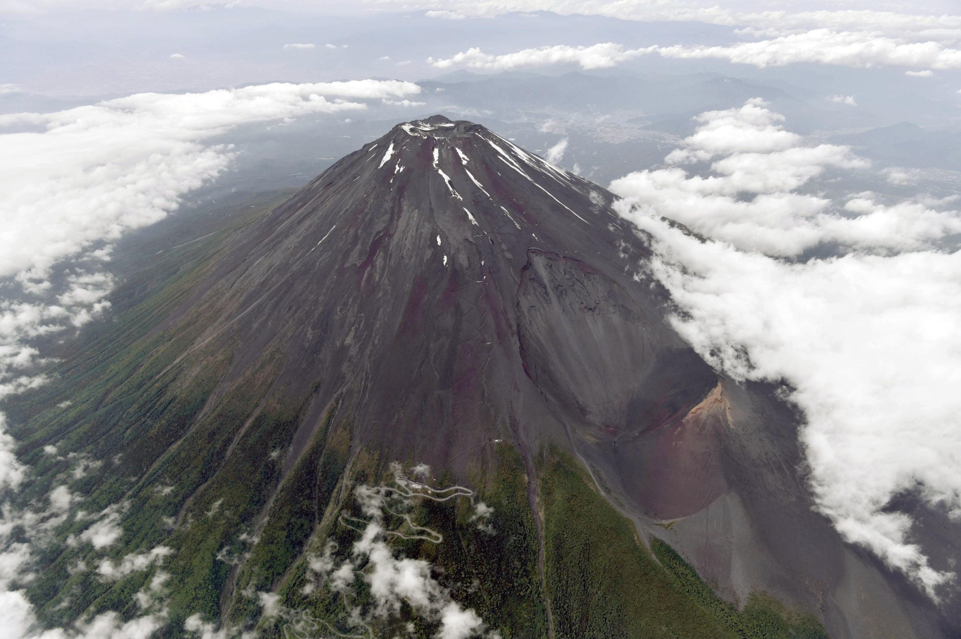
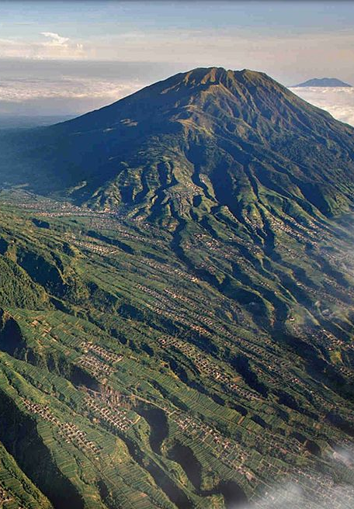


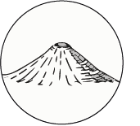
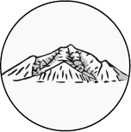
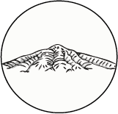




Quantifying the morphometry and drainage patterns of composite volcanoes:
A comparison of the Japanese and Indonesian volcanic arcs
Roos M. J. van Wees, Daniel O'Hara, Pablo Grosse, Gabor Kereszturi, Pierre Lahitte, and Matthieu Kervyn
Session GM2.8
Intact stage
Planezes stage
Residual Stage
Erosion patterns are influenced by
age, climate, tectonics and the original morphology
(Ollier, 1988)
25 / 11 / 2021
Fuji in Japan
Contact:
Roos.van.Wees@vub.be
Merapi, Merbabu &
Unguran in Indonesia
Japantimes.co.jp
Werner, 2013

Slide 2
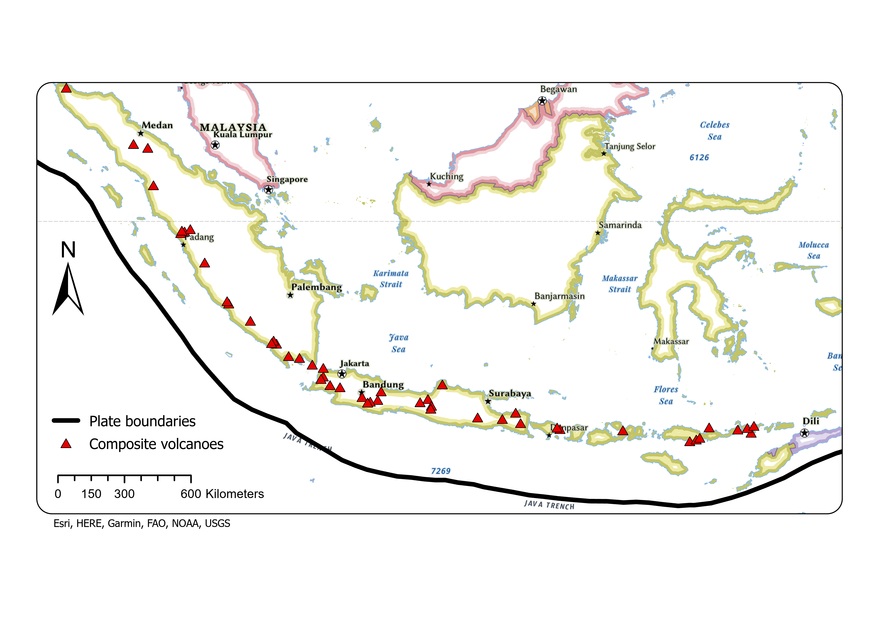
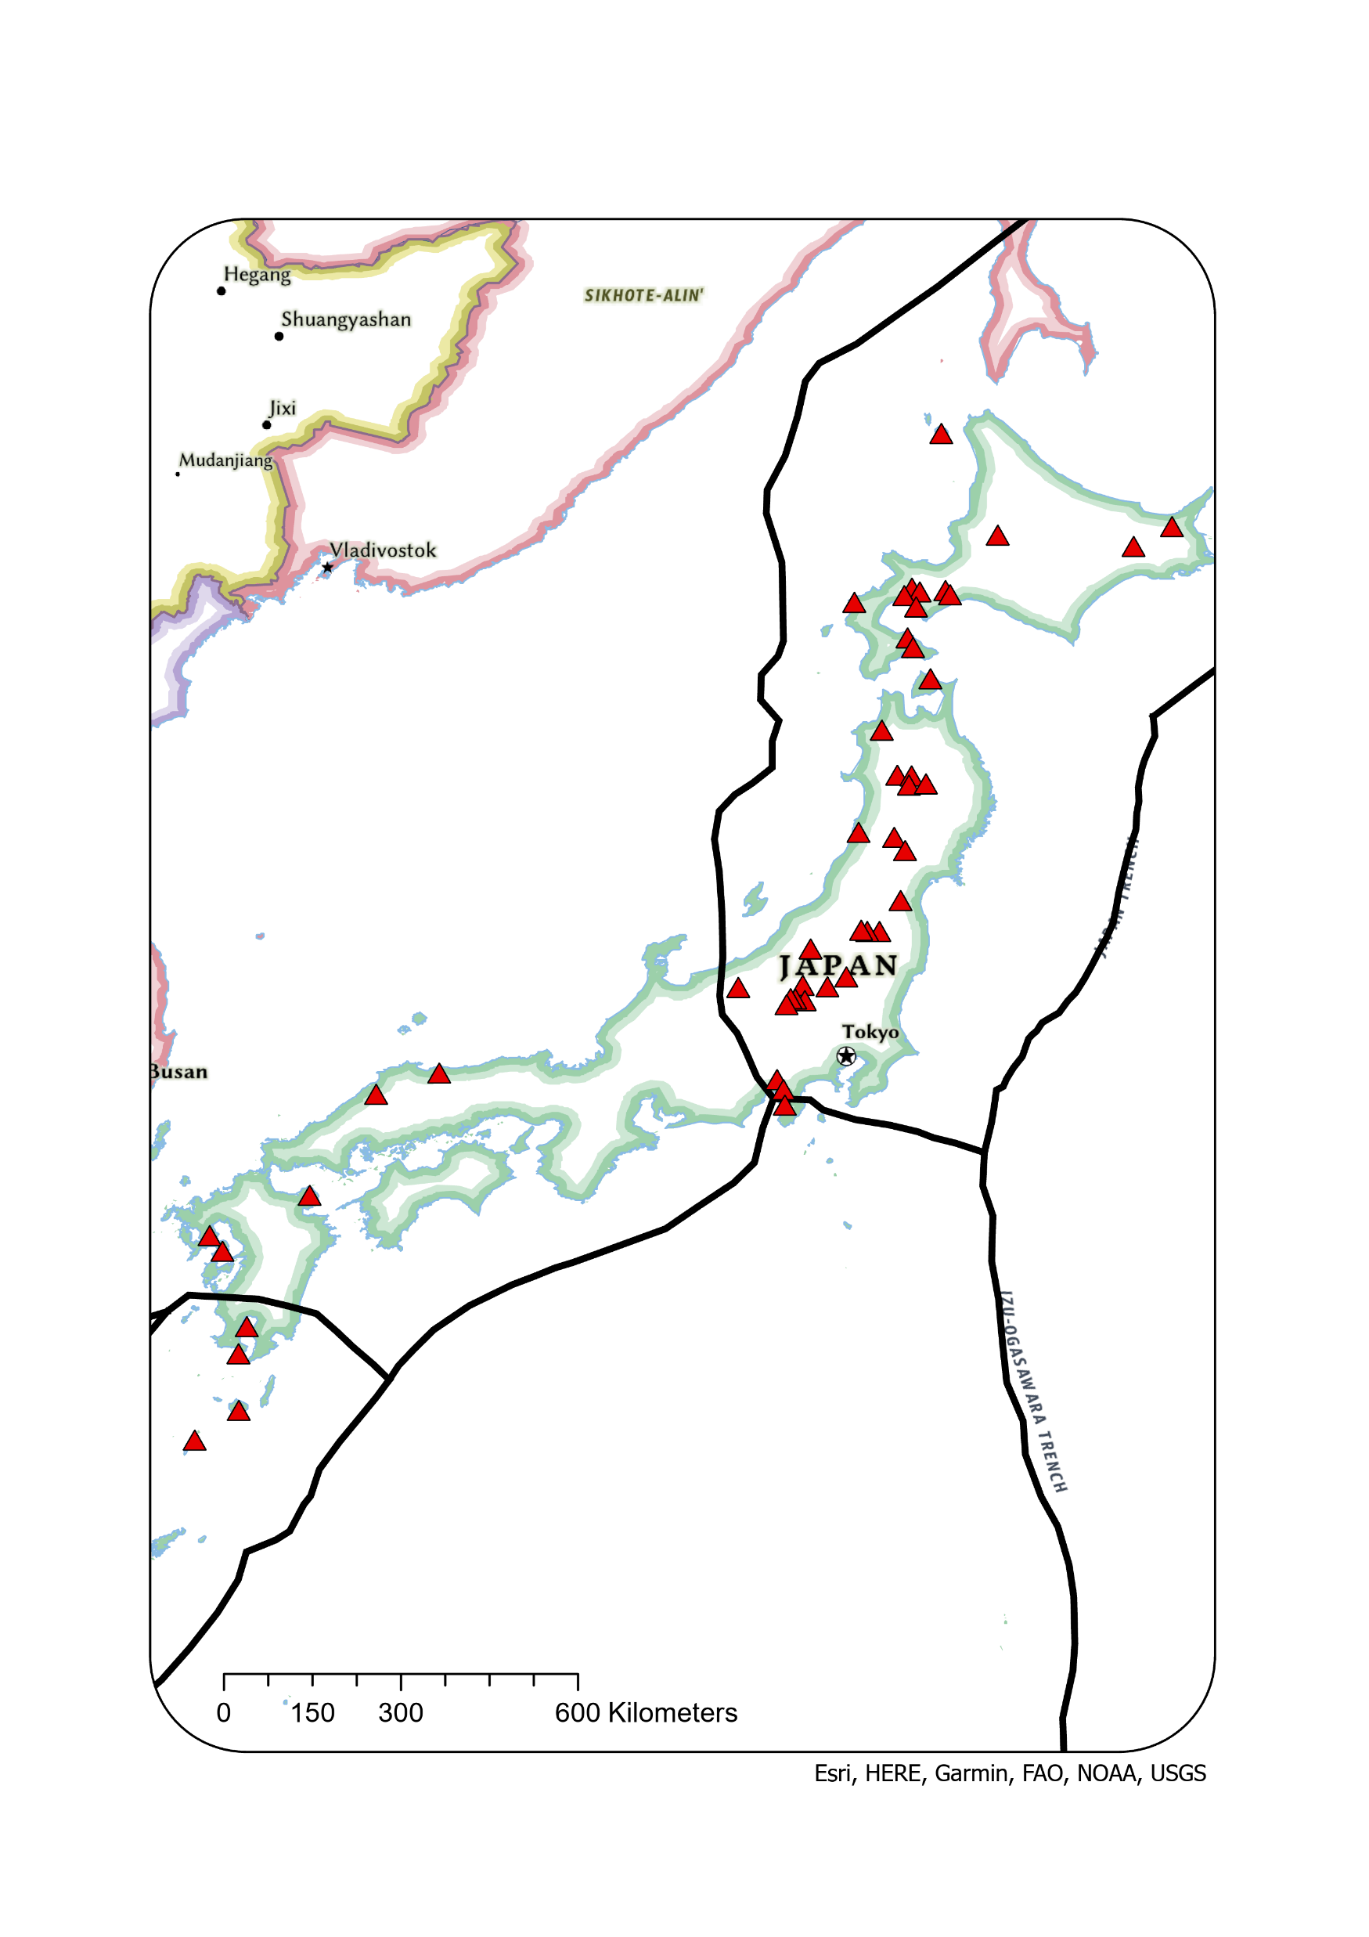
Indonesia
Japan

Slide 3
Digital Elevation Model: TanDEM-X 30m
Manual delineation
With assisting 3° of slope contour lines
MATLAB
MorVolc
DrainageVolc
(Grosse et al., 2009)
Geometric Parameters
Drainage Parameters
1. Height basel width ratio
2. Irregularity Index (II)
3. Current volume (km³)
4. Normalized Eroded volume
1. Normalized Basin width
2. Drainage Density (DD) (m⁻¹)
3. Hacks Law Exponent (m⁻¹)

Slide 4
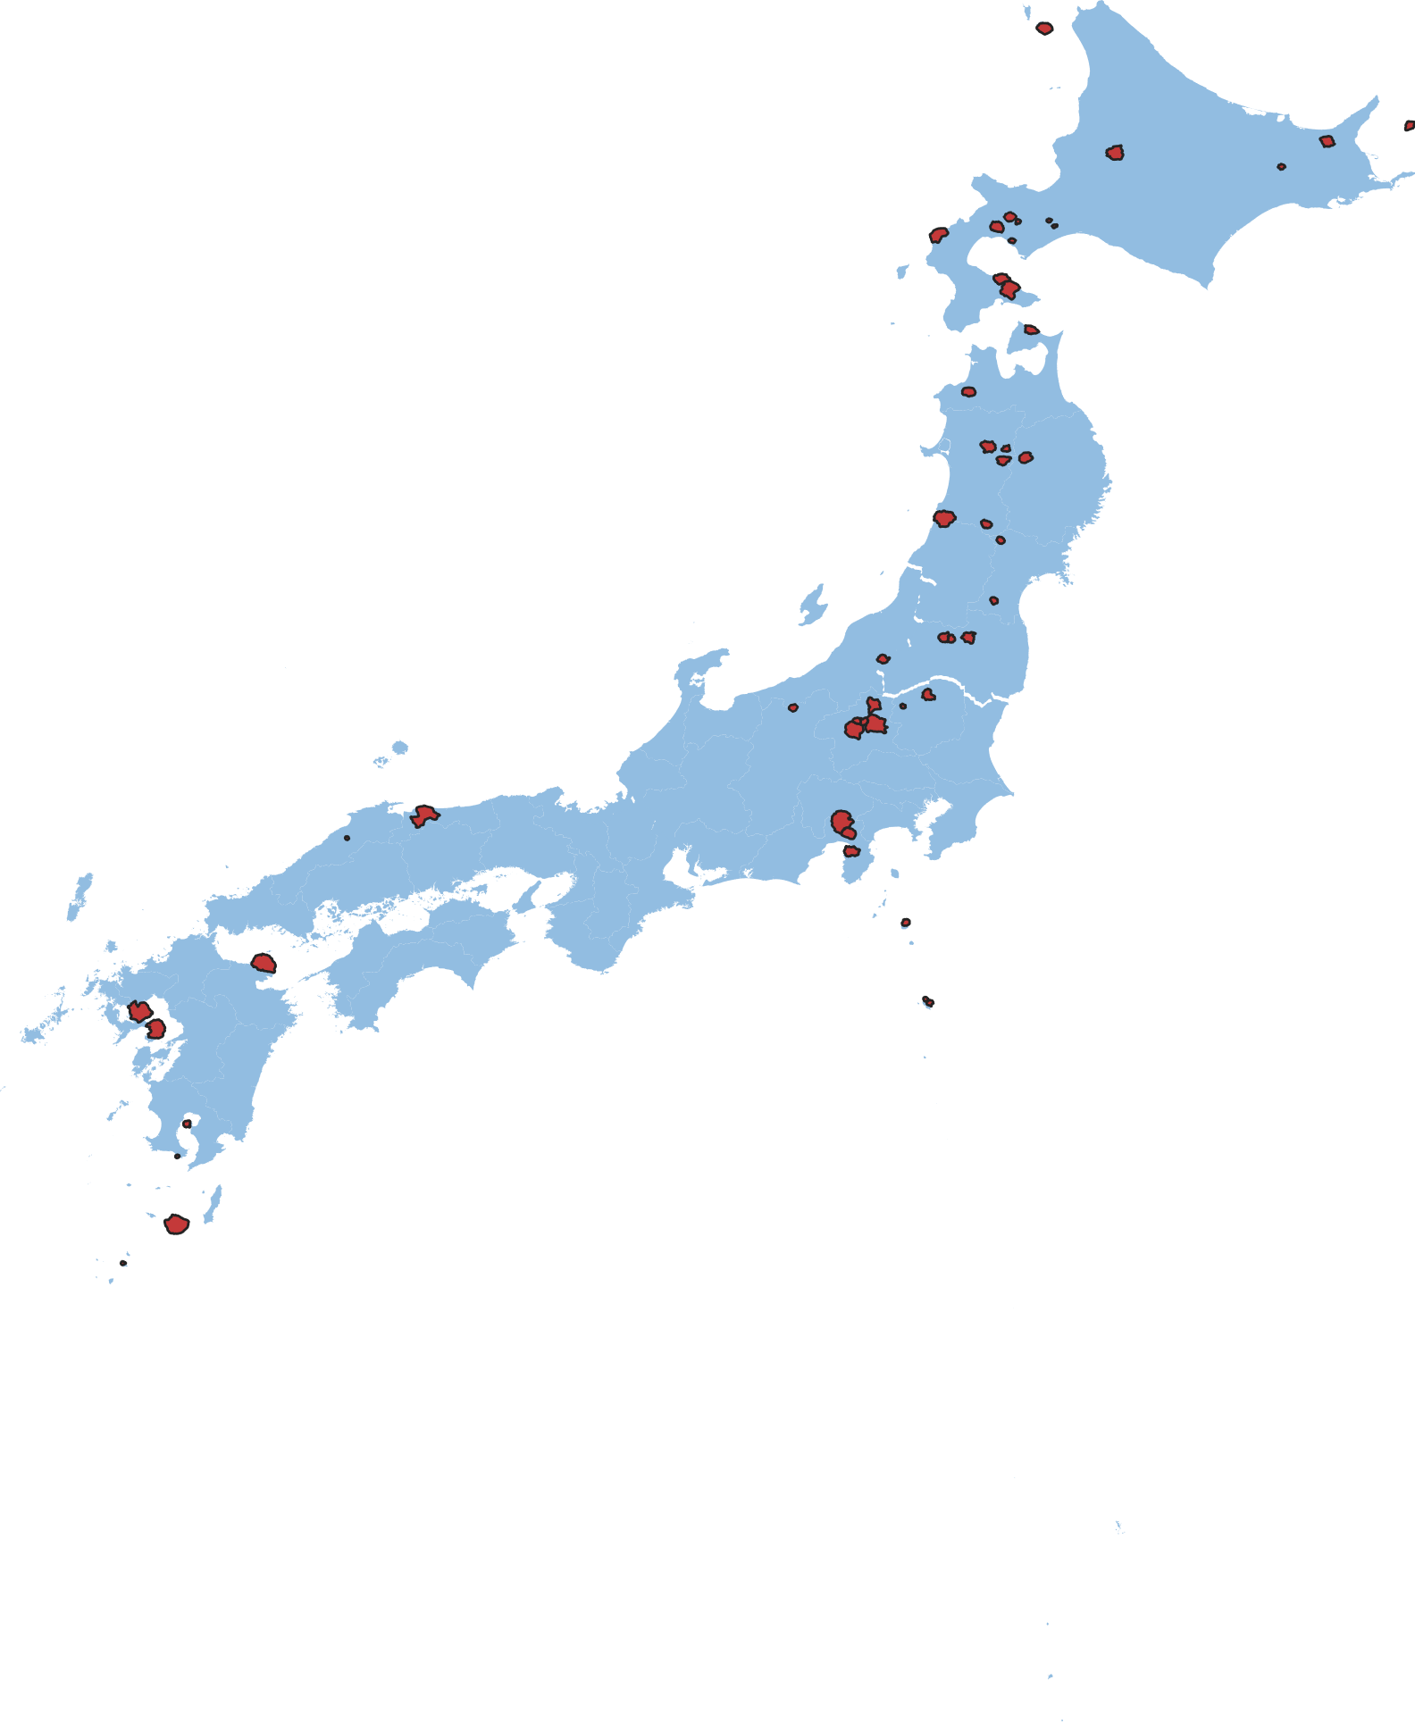
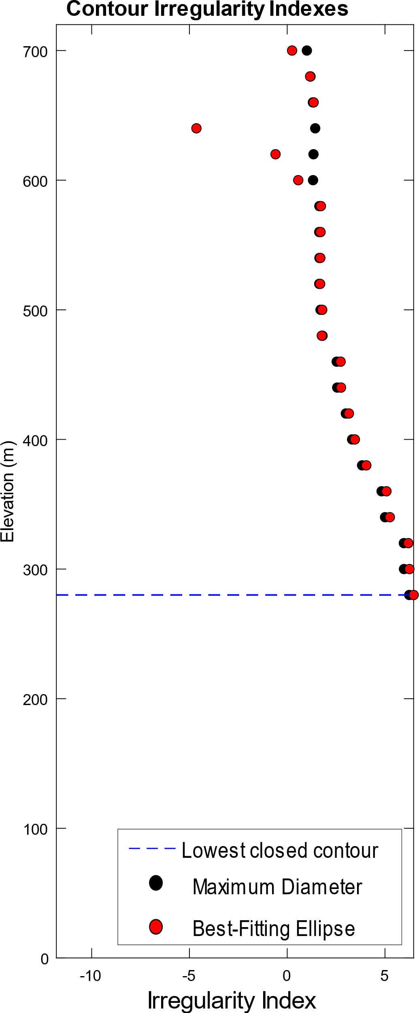
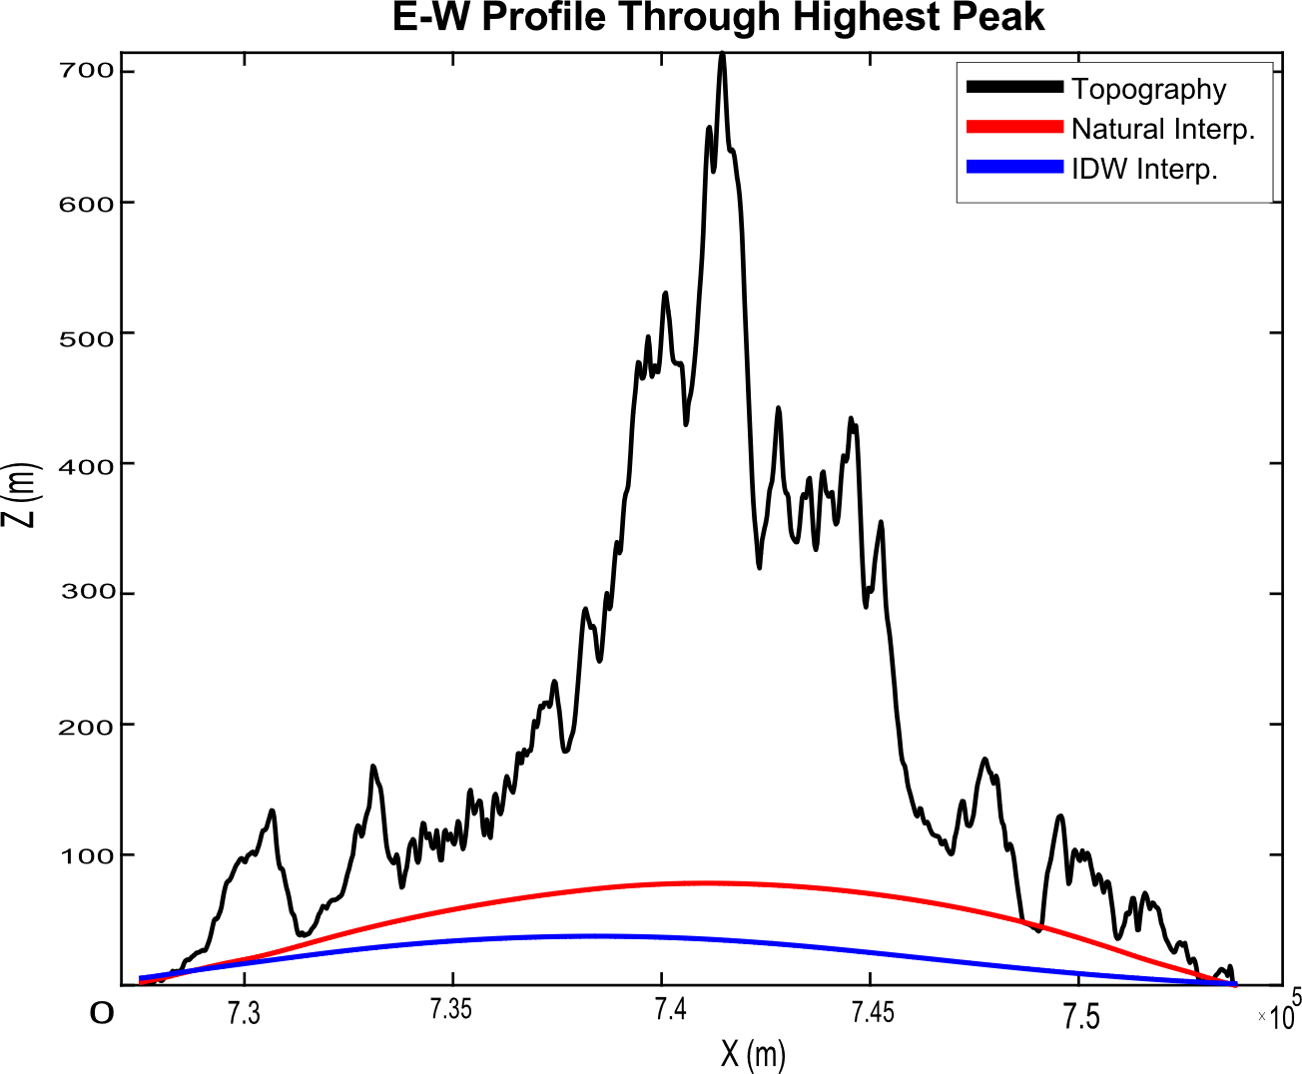


Geometric Parameters
2. Irregularity Index (II) : Complexity of contours
$di=\frac{p}{2A}\sqrt{(A/\text{π}}$)
$II=dicontour−(diellipse−1$)
(Grosse et al., 2009; 2012)
1. Height / Basel width ratio
Futago
20m contour interval
Height
Basel Width

Slide 5
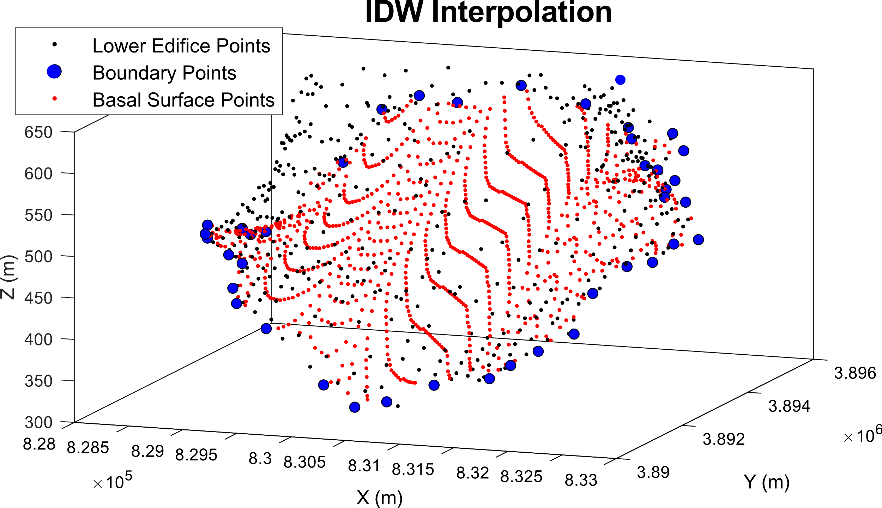
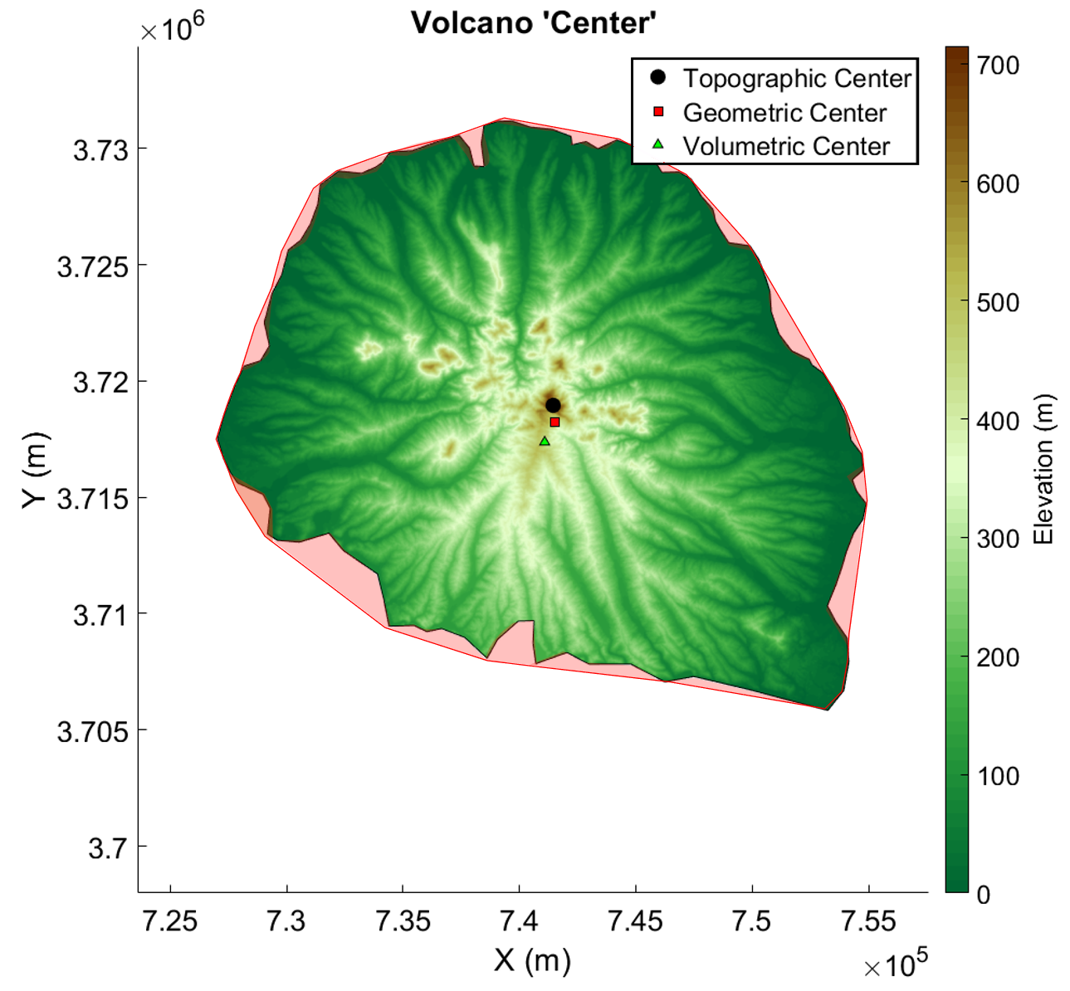
Geometric Parameters
3. Current volume (km³): Current DEM volume – Inverse distance basel volume
4. Normalized Eroded volume:
eroded volume./(eroded volume+ current volume)
Convex hull for every contour
(Convex hull from O’Hara and Karlstrom, 2020)

Slide 6
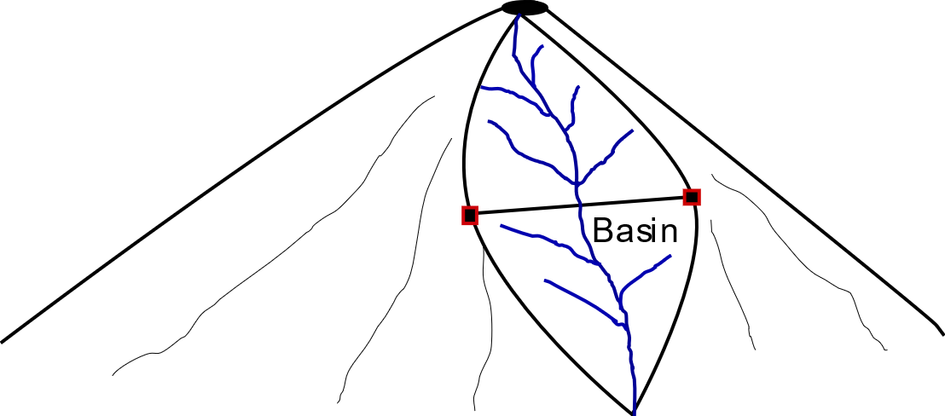
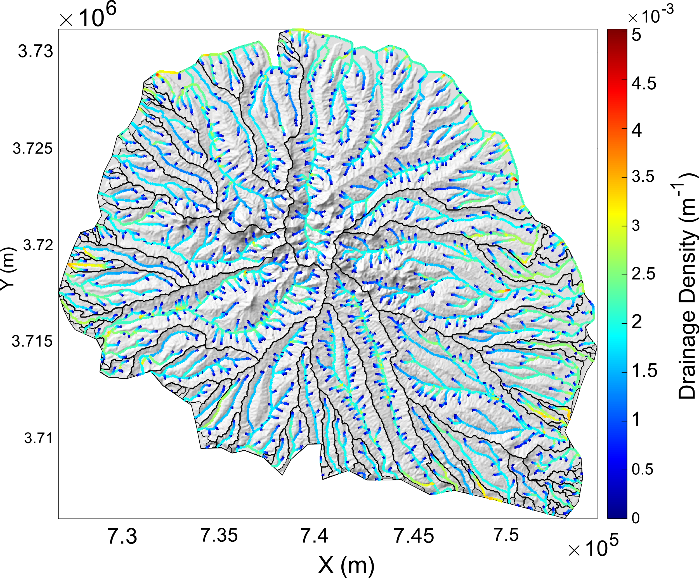
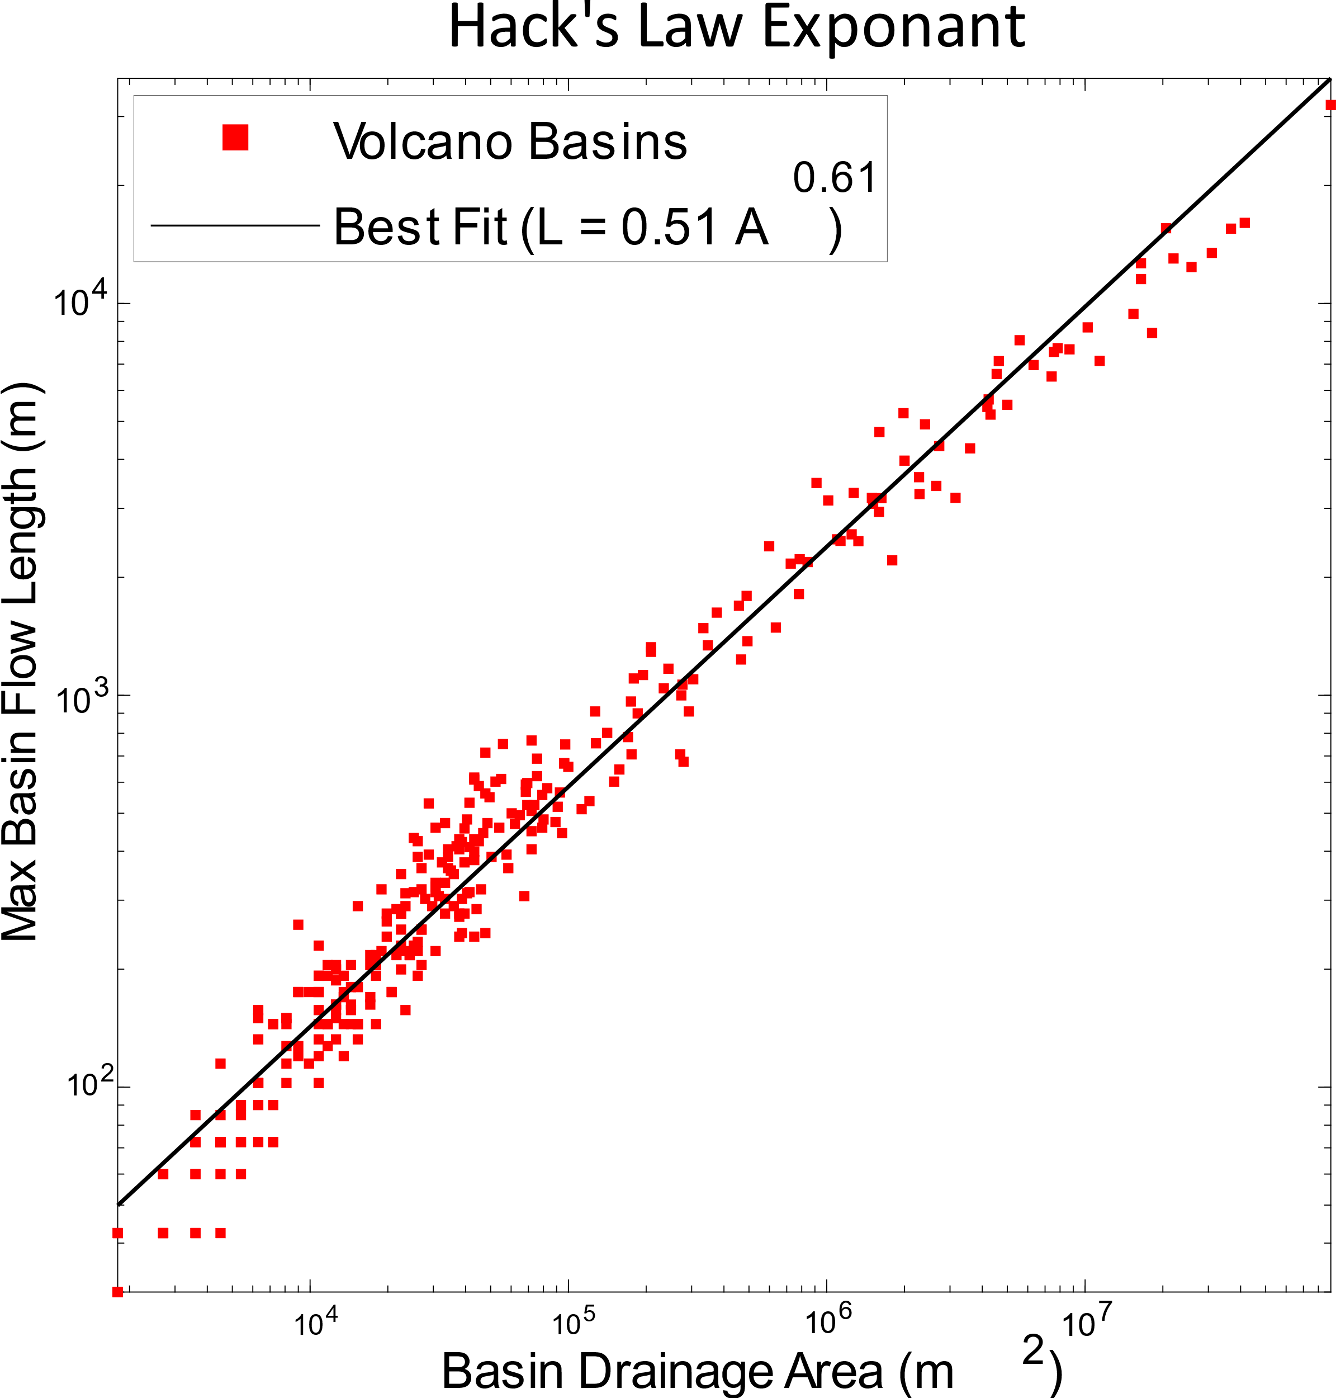
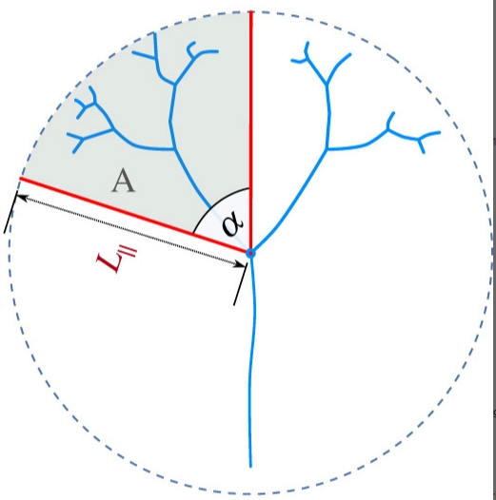
Drainage Parameters
1. Mean of maximum Basin width
2. Drainage density
3. Hacks Law exponant
Measured from source – output line
Cumulative length of channels (m) / Whole drainage area of the edifice (m²)
²)

Slide 7
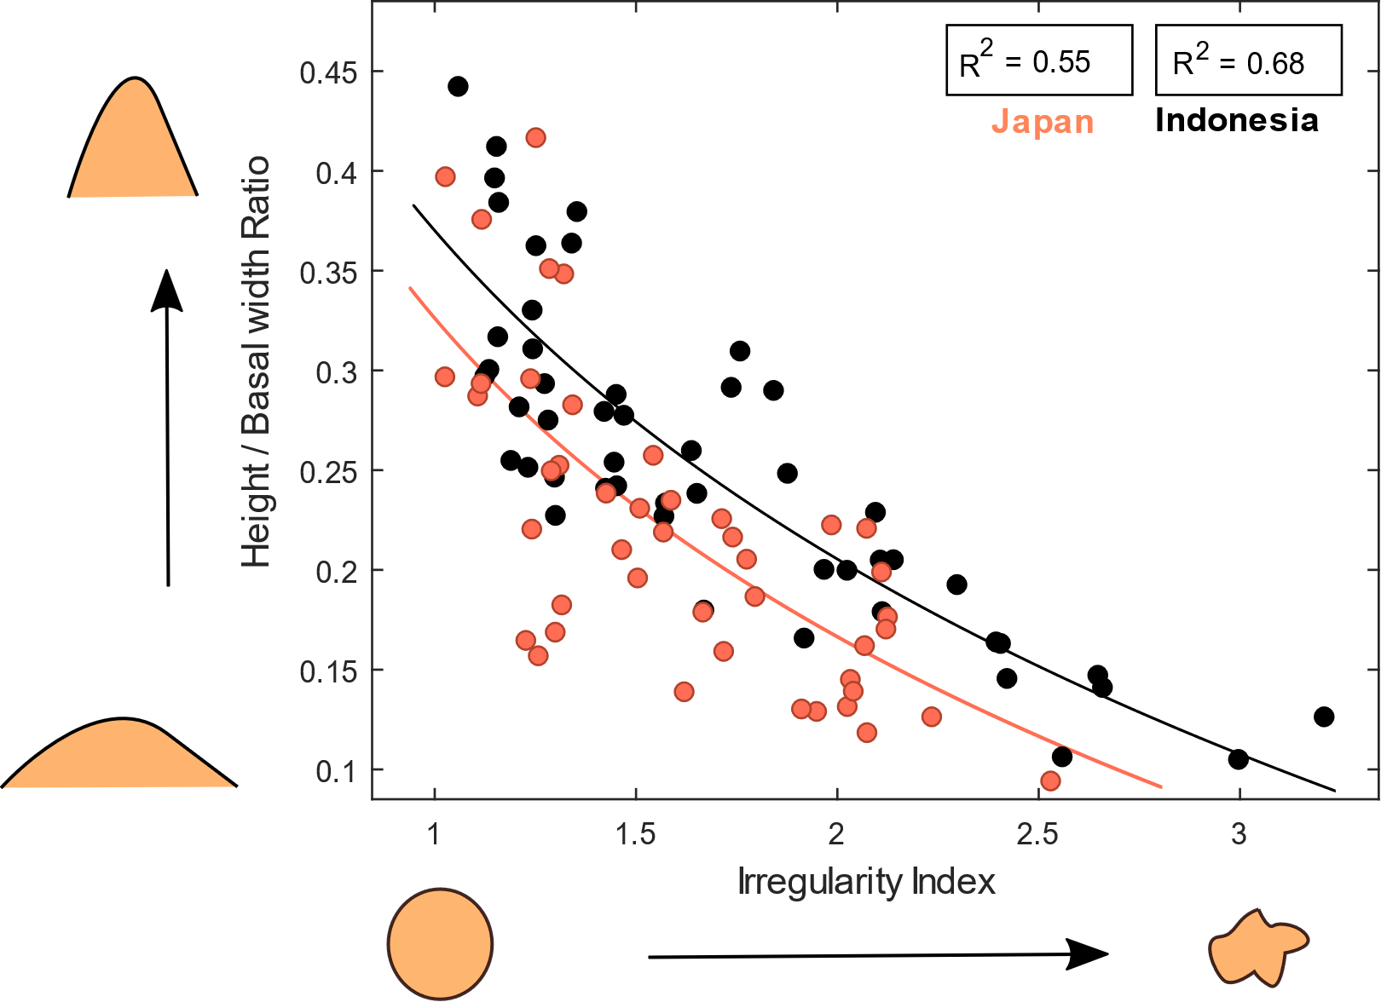
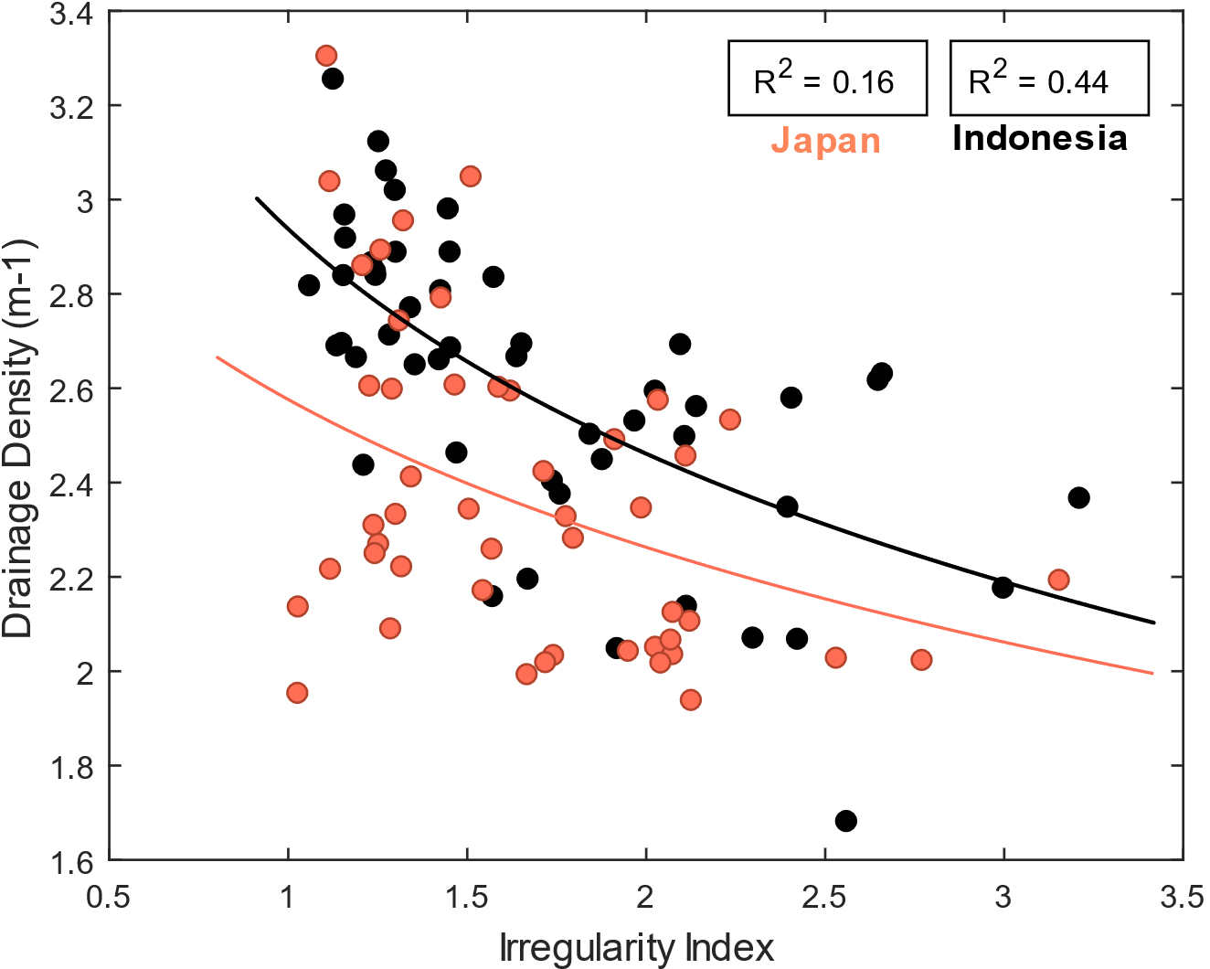
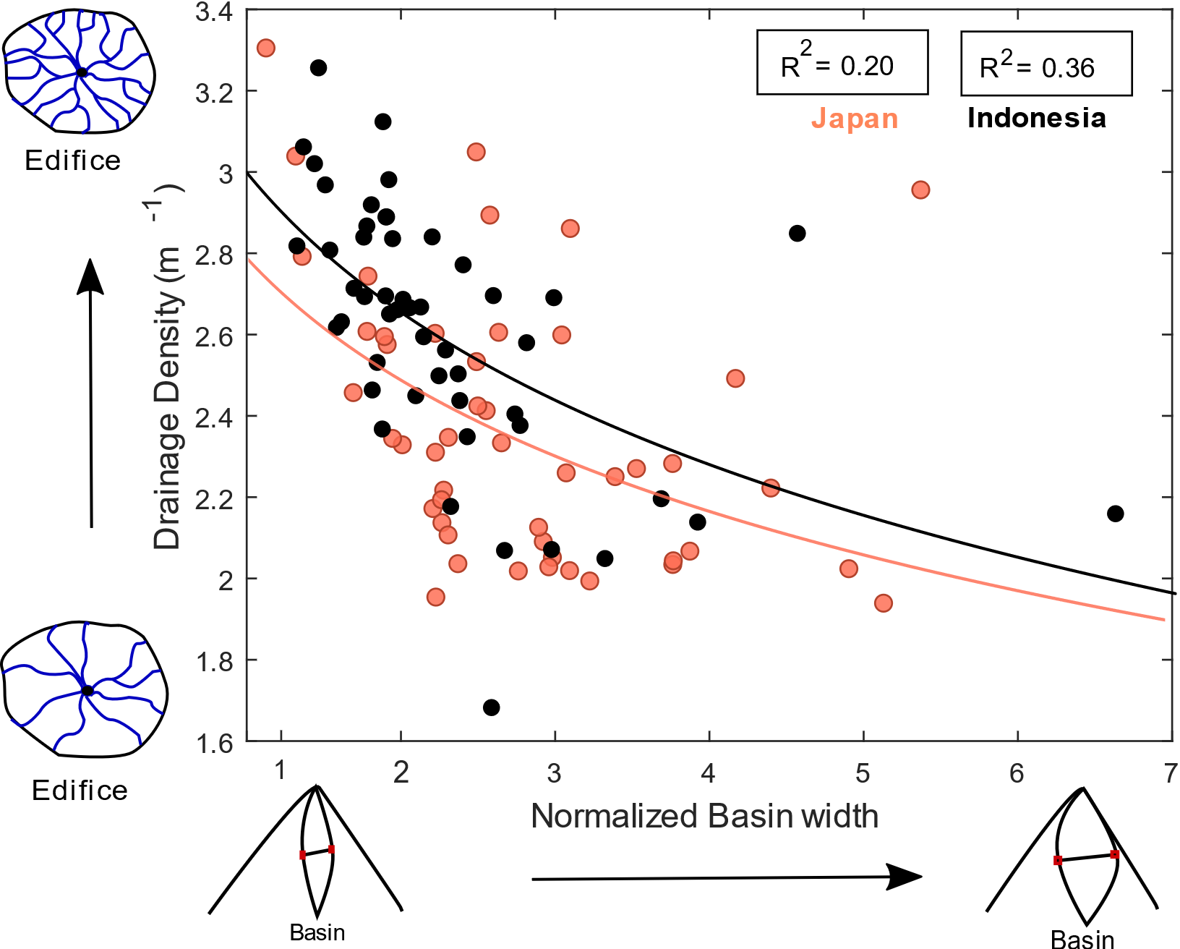
Morphometric relationships

Slide 8
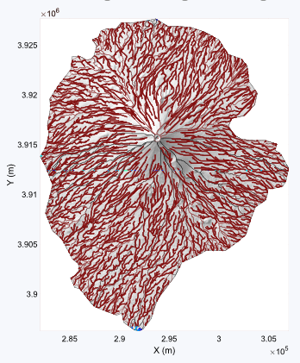
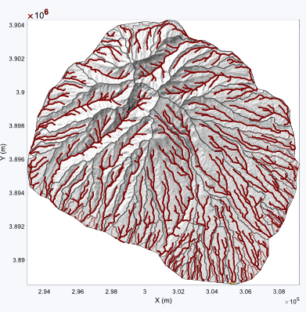
Fuji
Ashitaka
Drainage density 3.31 m⁻¹
Last eruption: 1717 CE
Drainage density: 2.46 m⁻¹
Last eruption: 0.4-0.1 million years ago

Slide 9
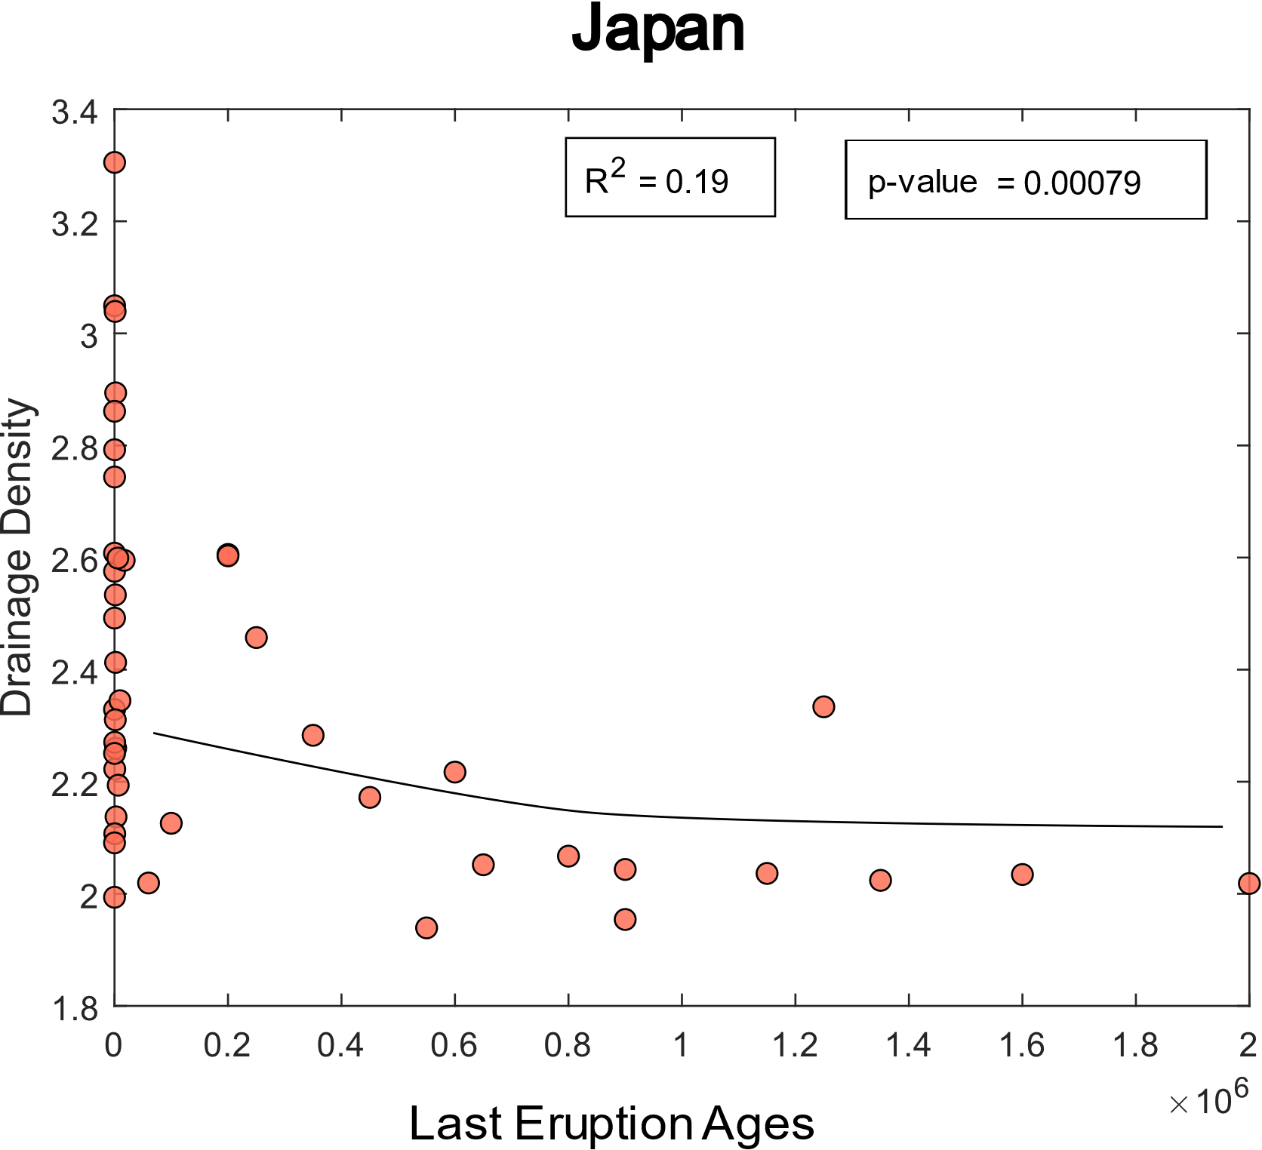
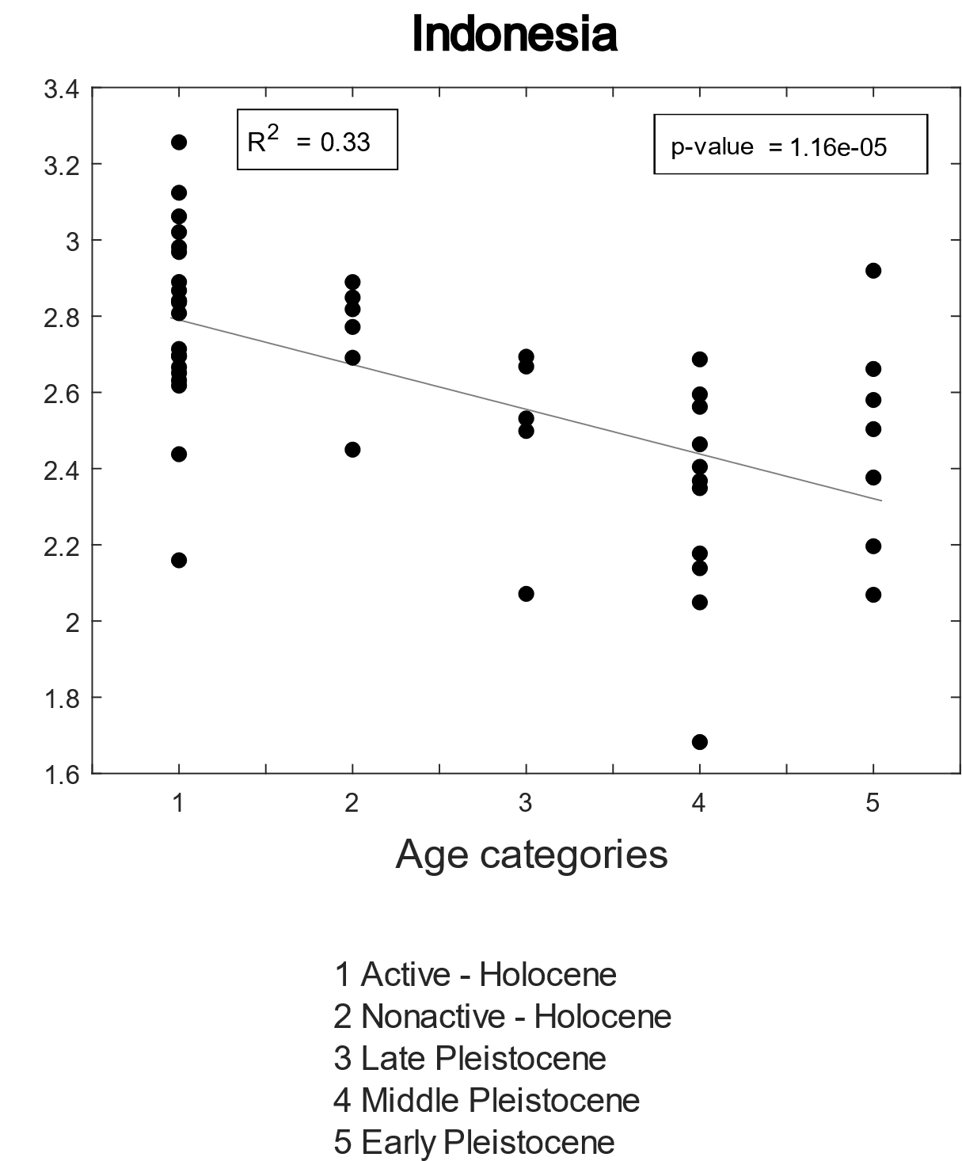
Drainage density evolution

Slide 10
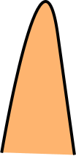
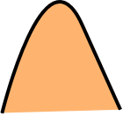

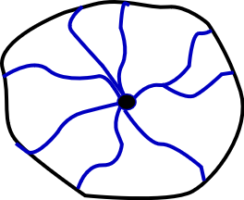


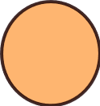

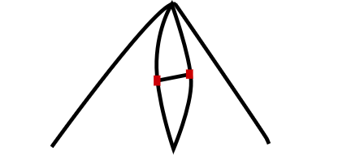
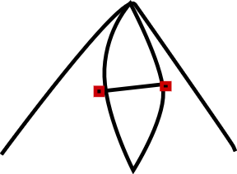
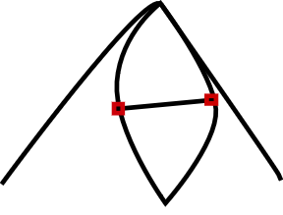
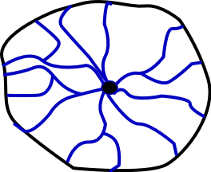
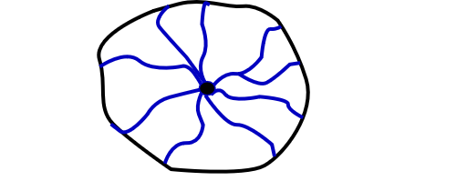
Conclusion
Similar morphological volcano trends
for Indonesia & Japan
Different morphological relationships
for Indonesia & Japan
For the same II Japan has a lower drainage density
For the same II Japan has a lower height/basal width ratio
For the same drainage denisty Japan has lower basin widths
Contour shapes
Basin Width
Drainage density
Volcano age

Slide 11
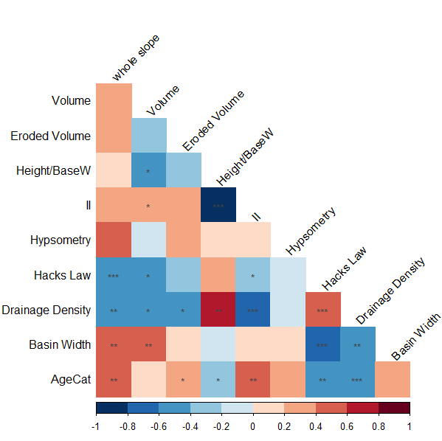
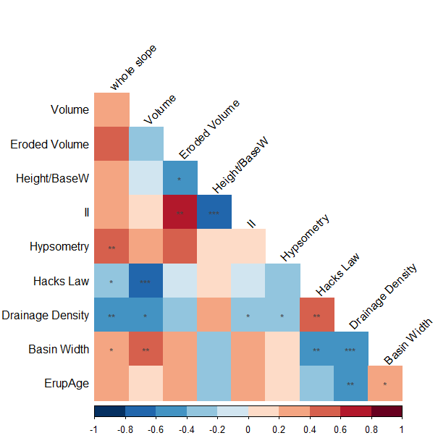
Correlation plots
Indonesia
Japan
* 0.05 significance level
** 0.01 siginificance level
*** 0.0001 significance level

Slide 12
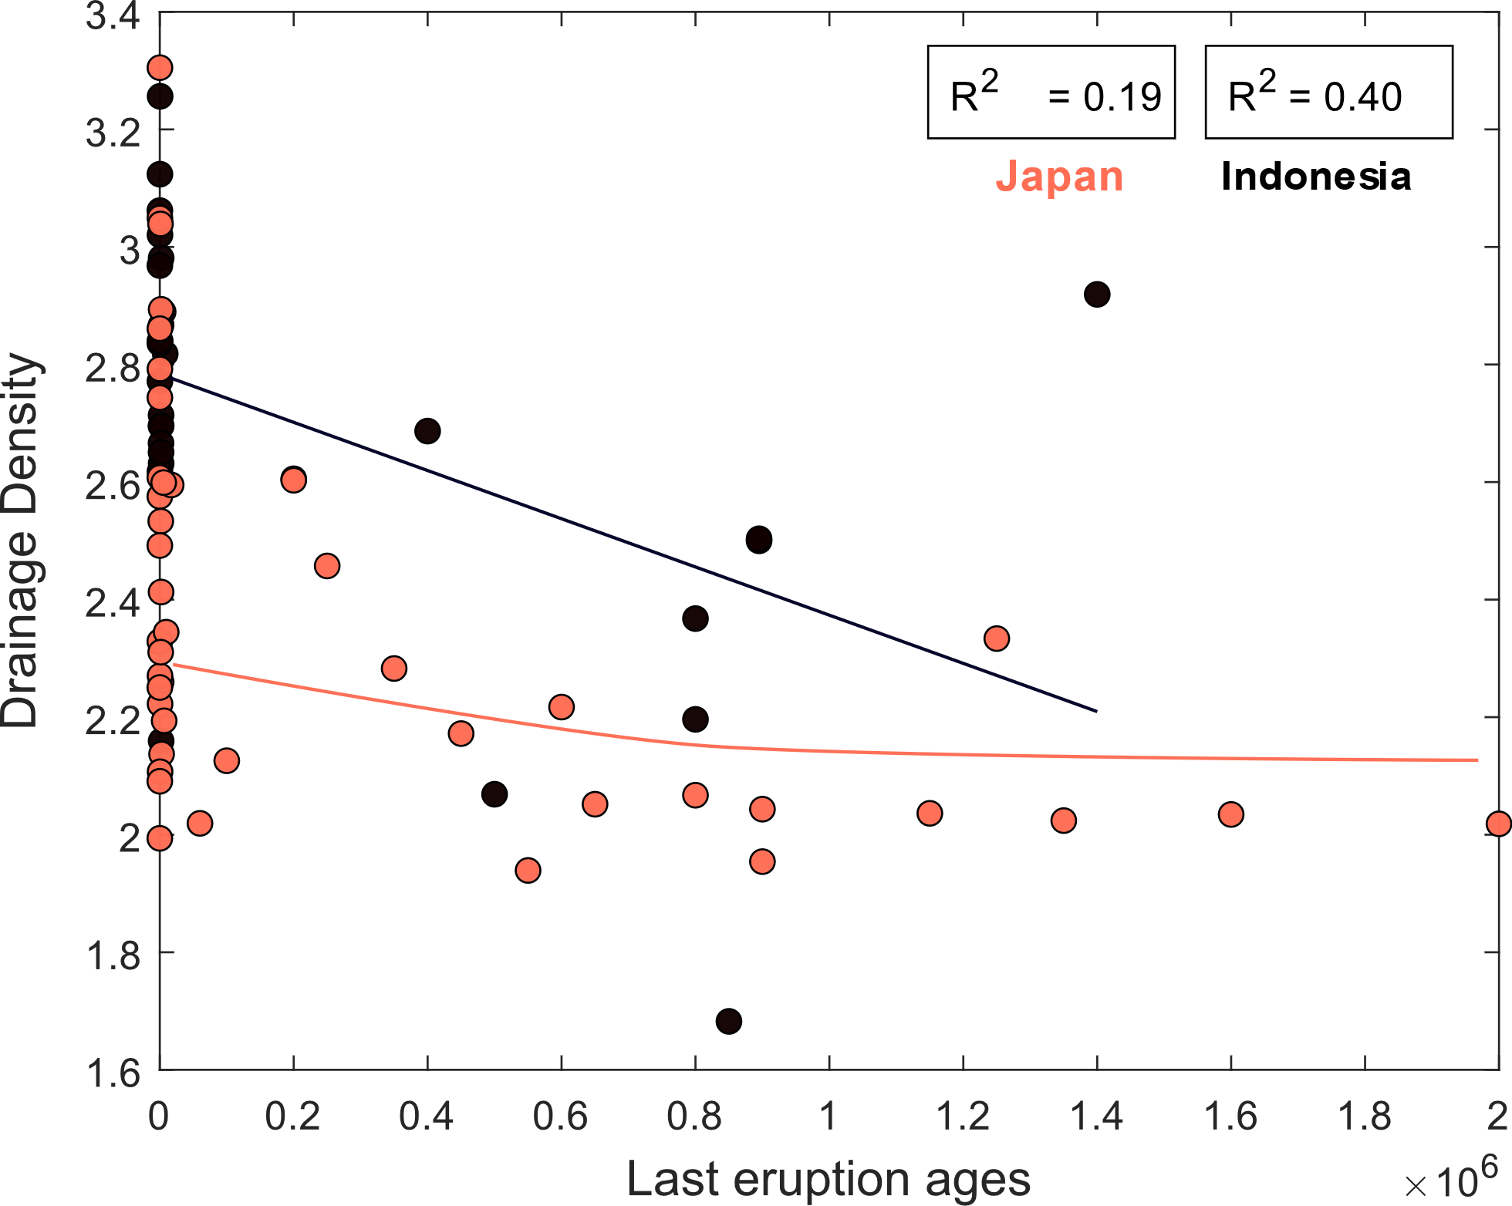
Drainage density evolution

