Slide 1
Early Carboniferous rifting in the Southern Urals: New isotopic dating of plutonic and volcanic complexes
Natalia Pravikova, Alexander Tevelev, Alexey Kazansky, Irina Kosheleva, Ivan Sobolev, Alexandra Borisenko, Egor Koptev, Petr Shestakov, and Jiří Žák

Slide 2
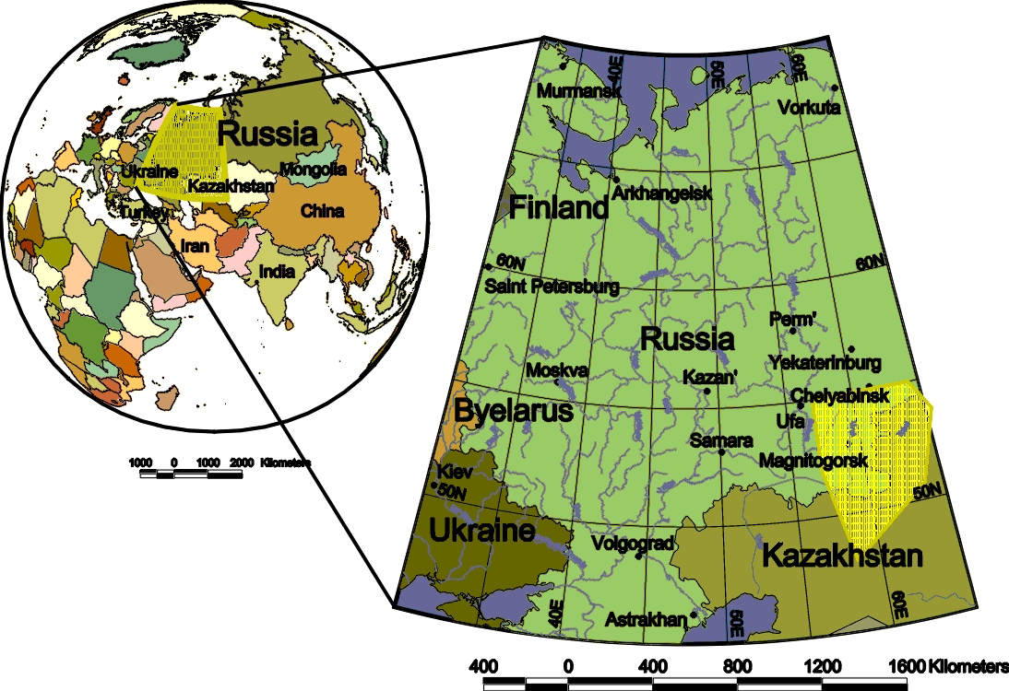
Location of studied area
U R A L S
Area of research

Slide 3
Carboniferous volcanic rocks of the Southern Urals
Early Carboniferous
Volcanic complexes
Early Carboniferous
Plutons:
Magnitogorsk zone (M):
1 - Syrostansky, Turgoyaksky;
2 - Petropavlovsk;
3 - Kasselsky, Zamatokhinsky;
4 – Magnitogorsk group (Kuibasovskiy, Mosovskiy, Magnitogorskiy);
10 - Karagaikulsky and Starobalbukovsky;
East Ural zone (EU):
5 - Chelyabinsk;
6 - Chernorechensky;
7 - Kamensky;
8 - Neplyuevka;
9 – Kaindinskiy, North Kaindinskiy;
11 - Klyuchevsko-Kurtmaksky

Slide 4
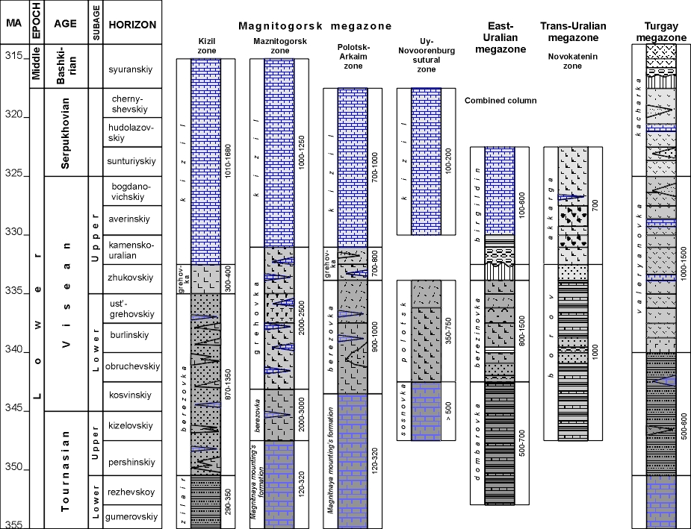
Correlation of stratigrafic columns of the Carboniferous in the Southern Urals

Slide 5
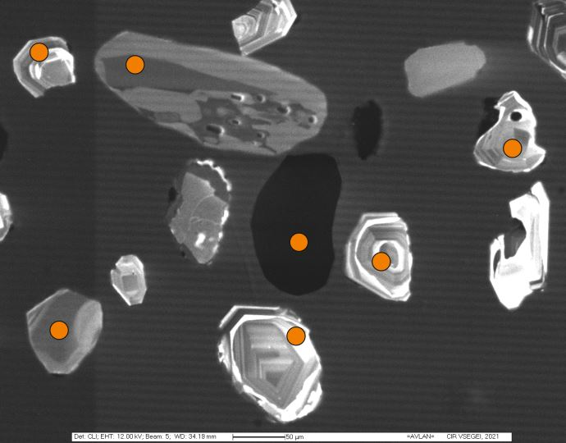
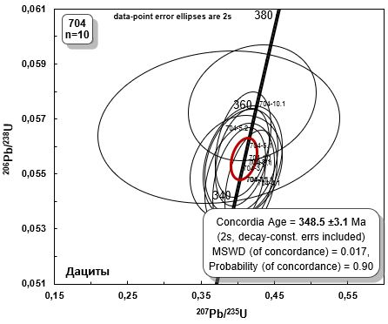
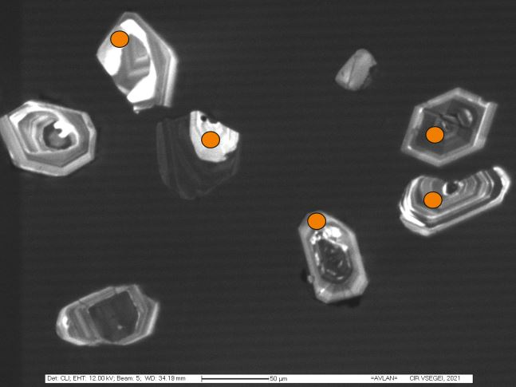
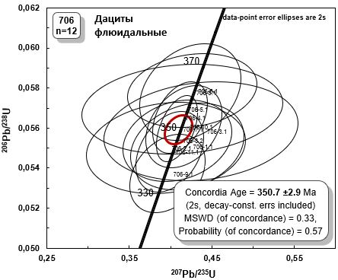
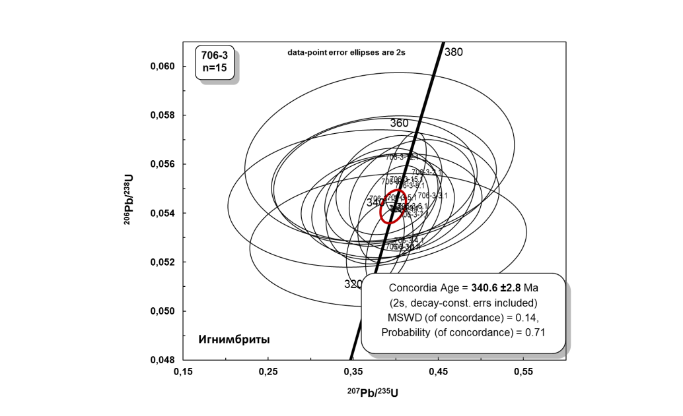
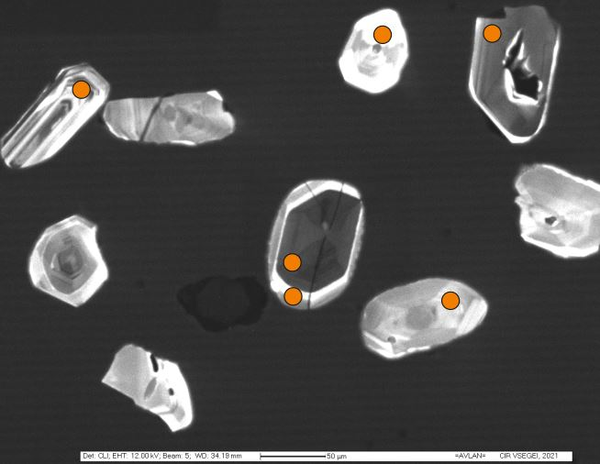
U-Pb dating (SHRIMP) VOLCANICS
704
Dacite
Dacite
С₁v₁=340,6±2,8 Ma
С₁t₂=348,5±3,1 Ma
С₁t₁=350,7±2,9 Ma
706
U-Pb charts
with concordia
(samples 704, 706, 706-3)
Ignimbrite
706.3

Slide 6
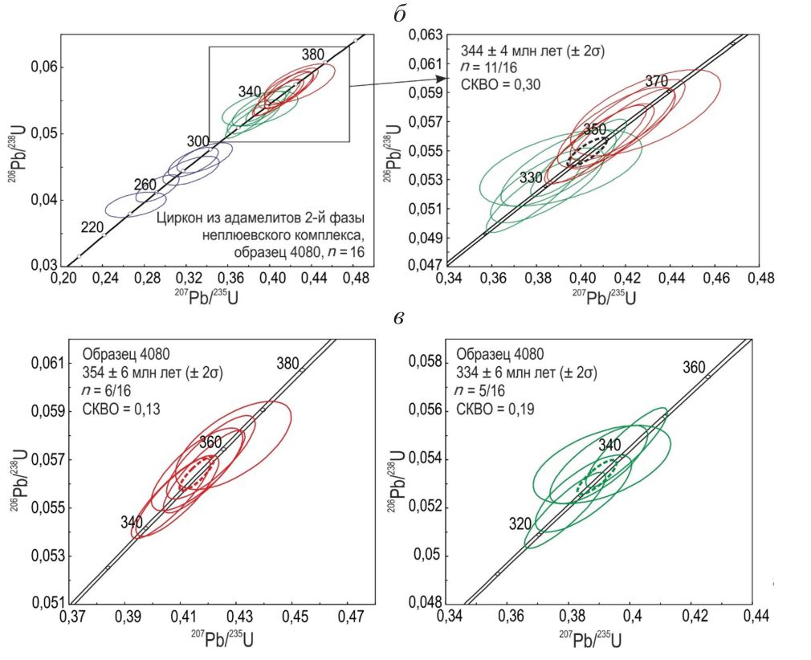
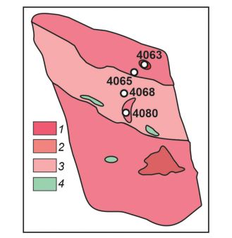
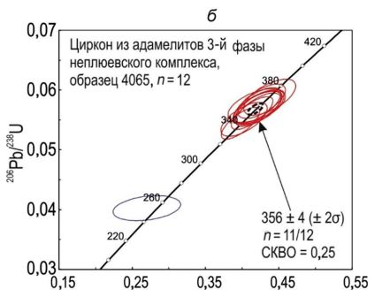
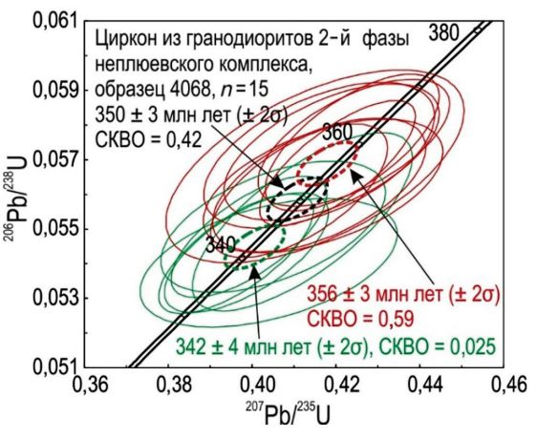
U-Pb dating (SHRIMP) NEPLUEVKA PLUTON [8]
Scheme of sampling in the Neplyuevka pluton. 1 - IV phase, leucogranites;
2 – III phase, adamellites; 3 – II phase, granodiorites;
4 – I phase, gabbro
Sample 4080, Nepluevka complex, III phase, adamellite
N=16
Sample 4065, Nepluevka complex, III phase, adamellite
N=12
С₁t₁=356±4 Ma
Sample 4068, Nepluevka complex, II phase, granodiorite
N=15
U-Pb charts with concordia (samples 4065, 4068, 4080)

Slide 7
Stages of volcanism and plutonism

Slide 8
Geodynamic model
1 - continental crust;
2 - transitional and oceanic crust;
3 - island-arc complexes;
4 - gabbrogranite and tonalitegranodiorite
intrusive complexes;
5 - terrigenous, carbonate and siliceous rocks;
6 - bimodal rift-related active volcanism.

Slide 9
Conclusion
Two main stages of Early Carboniferous plutonism can be distinguished in the Southern Ural. The first began simultaneously in both zones at the Devonian/Carboniferous boundary (ca. 356–357 Ma) and then changed to volcanic activity at around 346 Ma in the Magnitogosk zone and at around 340 Ma in the East Ural zone, respectively. The second stage began after the termination of volcanic activity and corresponds to 334–327 Ma interval in both zones. So, stages of active volcanism and plutonism alternate in time.
Early Carboniferous rifting began with intrusion of plutons, usually associated with transtensional zones under oblique collision. The subsequent volcanic stage corresponds to local extension. The next stage of plutonism began just after volcanism termination and marked a cessation of tectonic activity.
Acknowledgment
The reported study was funded by RFBR and Czech Science Foundation according to the research project № 19-55-26009. Centre of collective usage ‘Geoportal’, Lomonosov Moscow State University (MSU), provided access to remote sensing data.

Slide 10
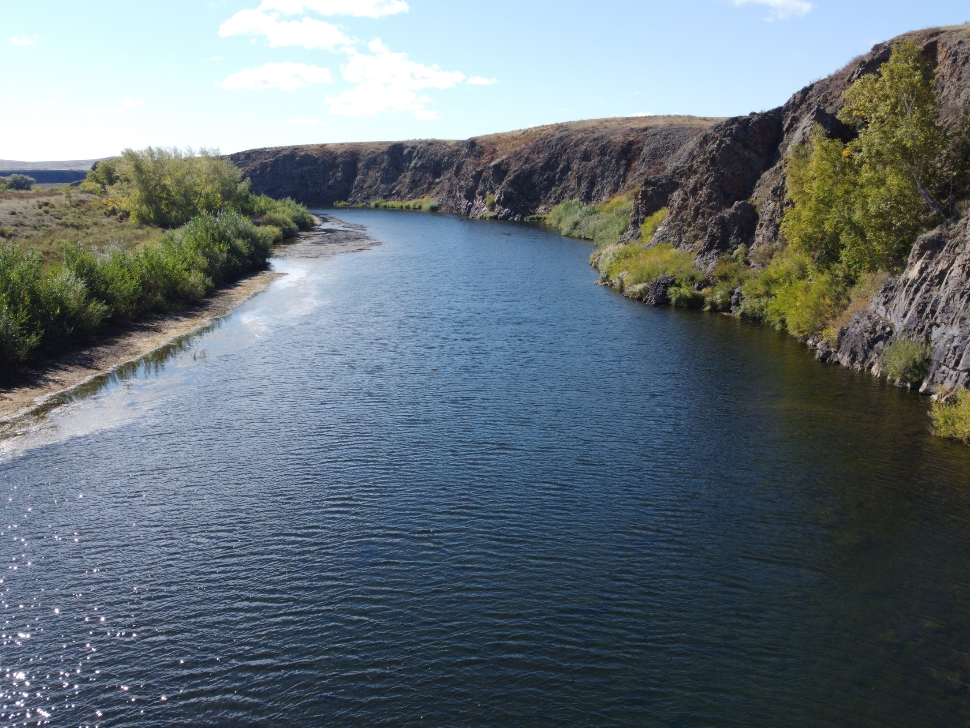
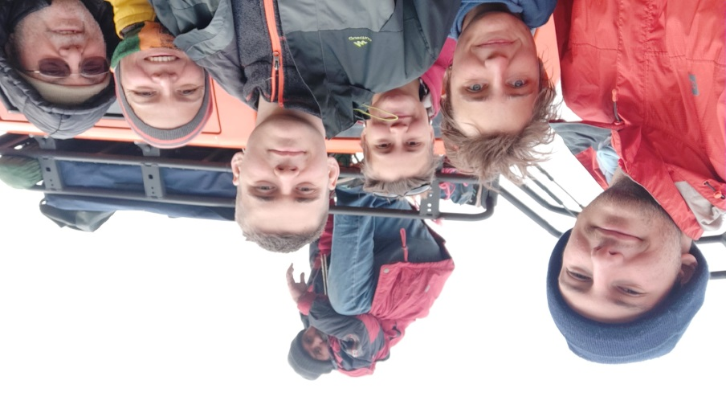
Thank you for your attention!

