Slide 1





Updated GHG emission factors for Irish peatlands: a review
Elena Aitova, Terry Morley, David Wilson, and Florence Renou-Wilson
EGU22, Vienna
26th of May 2022
Notes:
HI My name is Elena Aitova and my presentation is about emissions from irish peatlands. Updated emission factors

Slide 2
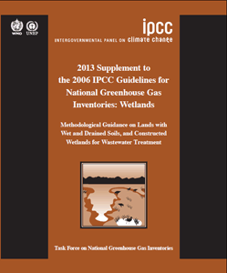
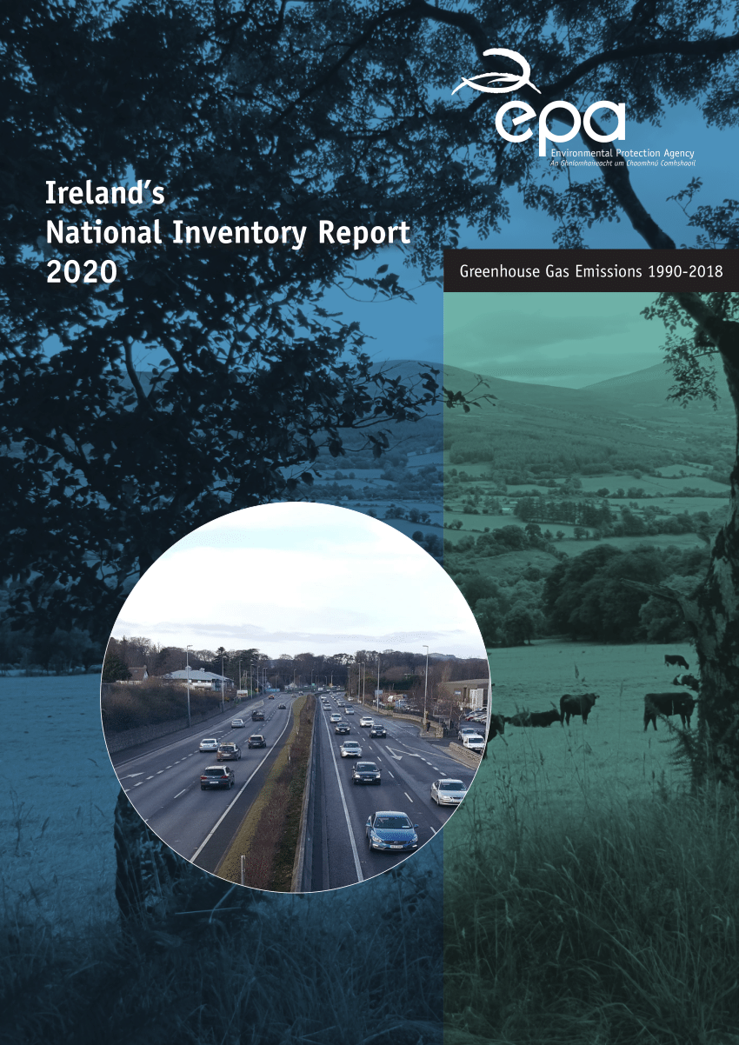


Why update Emission Factors (EFs)?
Emission factor or EF – tonnes of C per hectare per year
Ireland reports emissions from peatlands annually
Ireland uses Tier 1 level
Tier 1 data are climatically and ecologically dissimilar to Ireland
Last report in 2013 (Wilson et al., 2013)
Wilson, D., Müller, C. & Renou-Wilson, F. (2013) Carbon emissions and removals from Irish peatlands: present trends and future mitigation measures. Irish Geography, 46, 1-2, 1–23.
Notes:
So, what are EF? In our case, EF is how many tonnes of carbon per hectare per year is emitted from certain Land use categories on peat soil. At the moment, emissions only from some categories of peatlands are included in NIR but in 2026 it will be mandatory to report emissions from all types of managed peatlands in Ireland. Except for industrial peat extraction, Ireland uses generic or default Tier 1 level to report emissions. This Tier 1 is based on global field data which are often collected from the areas that climatically and ecologically dissimilar to Ireland. And the last time emissions from Irish peatlands were reviewed was in 2013
(horticulture peat and combustion are reported in NIR in other section)

Slide 3
Aims and Objectives
To review all peatland carbon flux (C) studies in Ireland
To propose country-specific emission factors (EFs)
Land Use Categories on Irish peatlands?
Do we have data?
Notes:
So the aim of this work was to…
But before we need to know what land use categories are in Irish peat soil? what type of activities happens on peatlands? And, do we have data for them?

Slide 4
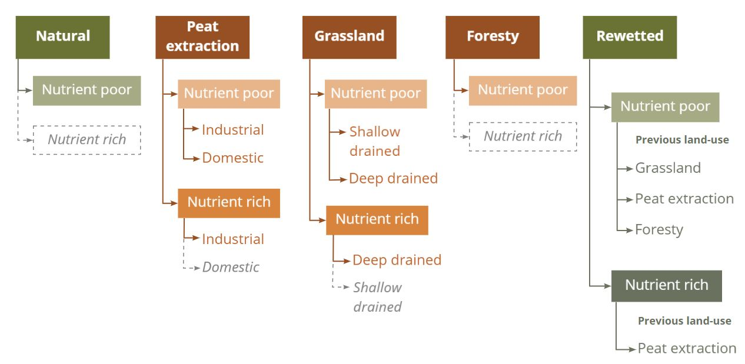
Irish Peatland Land Use Categories
*
*
*
*
Green = wet peat, brown = drained peat.
* - lack of data
Notes:
After we reviewed all C studies in Ireland, we classified LUC on peat soils both rewetted and drained.
Following the IPCC Wetlands Supplement, we classified rewetted, drained peatlands under different nutrient statuses and previous land use for rewetted peatlands.
The large areas of peatlands in Ireland are under agricultural grassland, forestry and are used for domestic peat extraction. By the grassland here we mean agricultural grassland. Due to the difference in area covered, it was important to divide peat extraction sites between industrial and domestic sites.
We also identified where we had C data and where we still have lack of data. The gaps are indicated by Asterisk

Slide 5
Review: 2013 vs 2022
5
14
Peatlands locations:
Table1. Annual numbers of fluxes were reported in 2013 (Wilson et al., 2013) and in 2022 (Aitova et al., 2022)
GHGs | Number of annual fluxes
 | 2013 | 2022
CO₂ fluxes | 33 | 124
CH₄ fluxes | 28 | 95
Fluvial losses | 2 | 13
N₂O fluxes | 0 | 60
Wilson, D., Müller, C. & Renou-Wilson, F. (2013) Carbon emissions and removals from Irish peatlands: present trends and future mitigation measures. Irish Geography, 46, 1-2, 1–23.
Notes:
So, since last EFs reporting in 2013, the monitored number of peatlands increased from 5 to 14. It total, we included 18 studies in our review. As you could see from a table, the numbers of GHG fluxes increased. CO2 almost quadrupled and for the first time we were able to report nitrous oxide emissions.

Slide 6
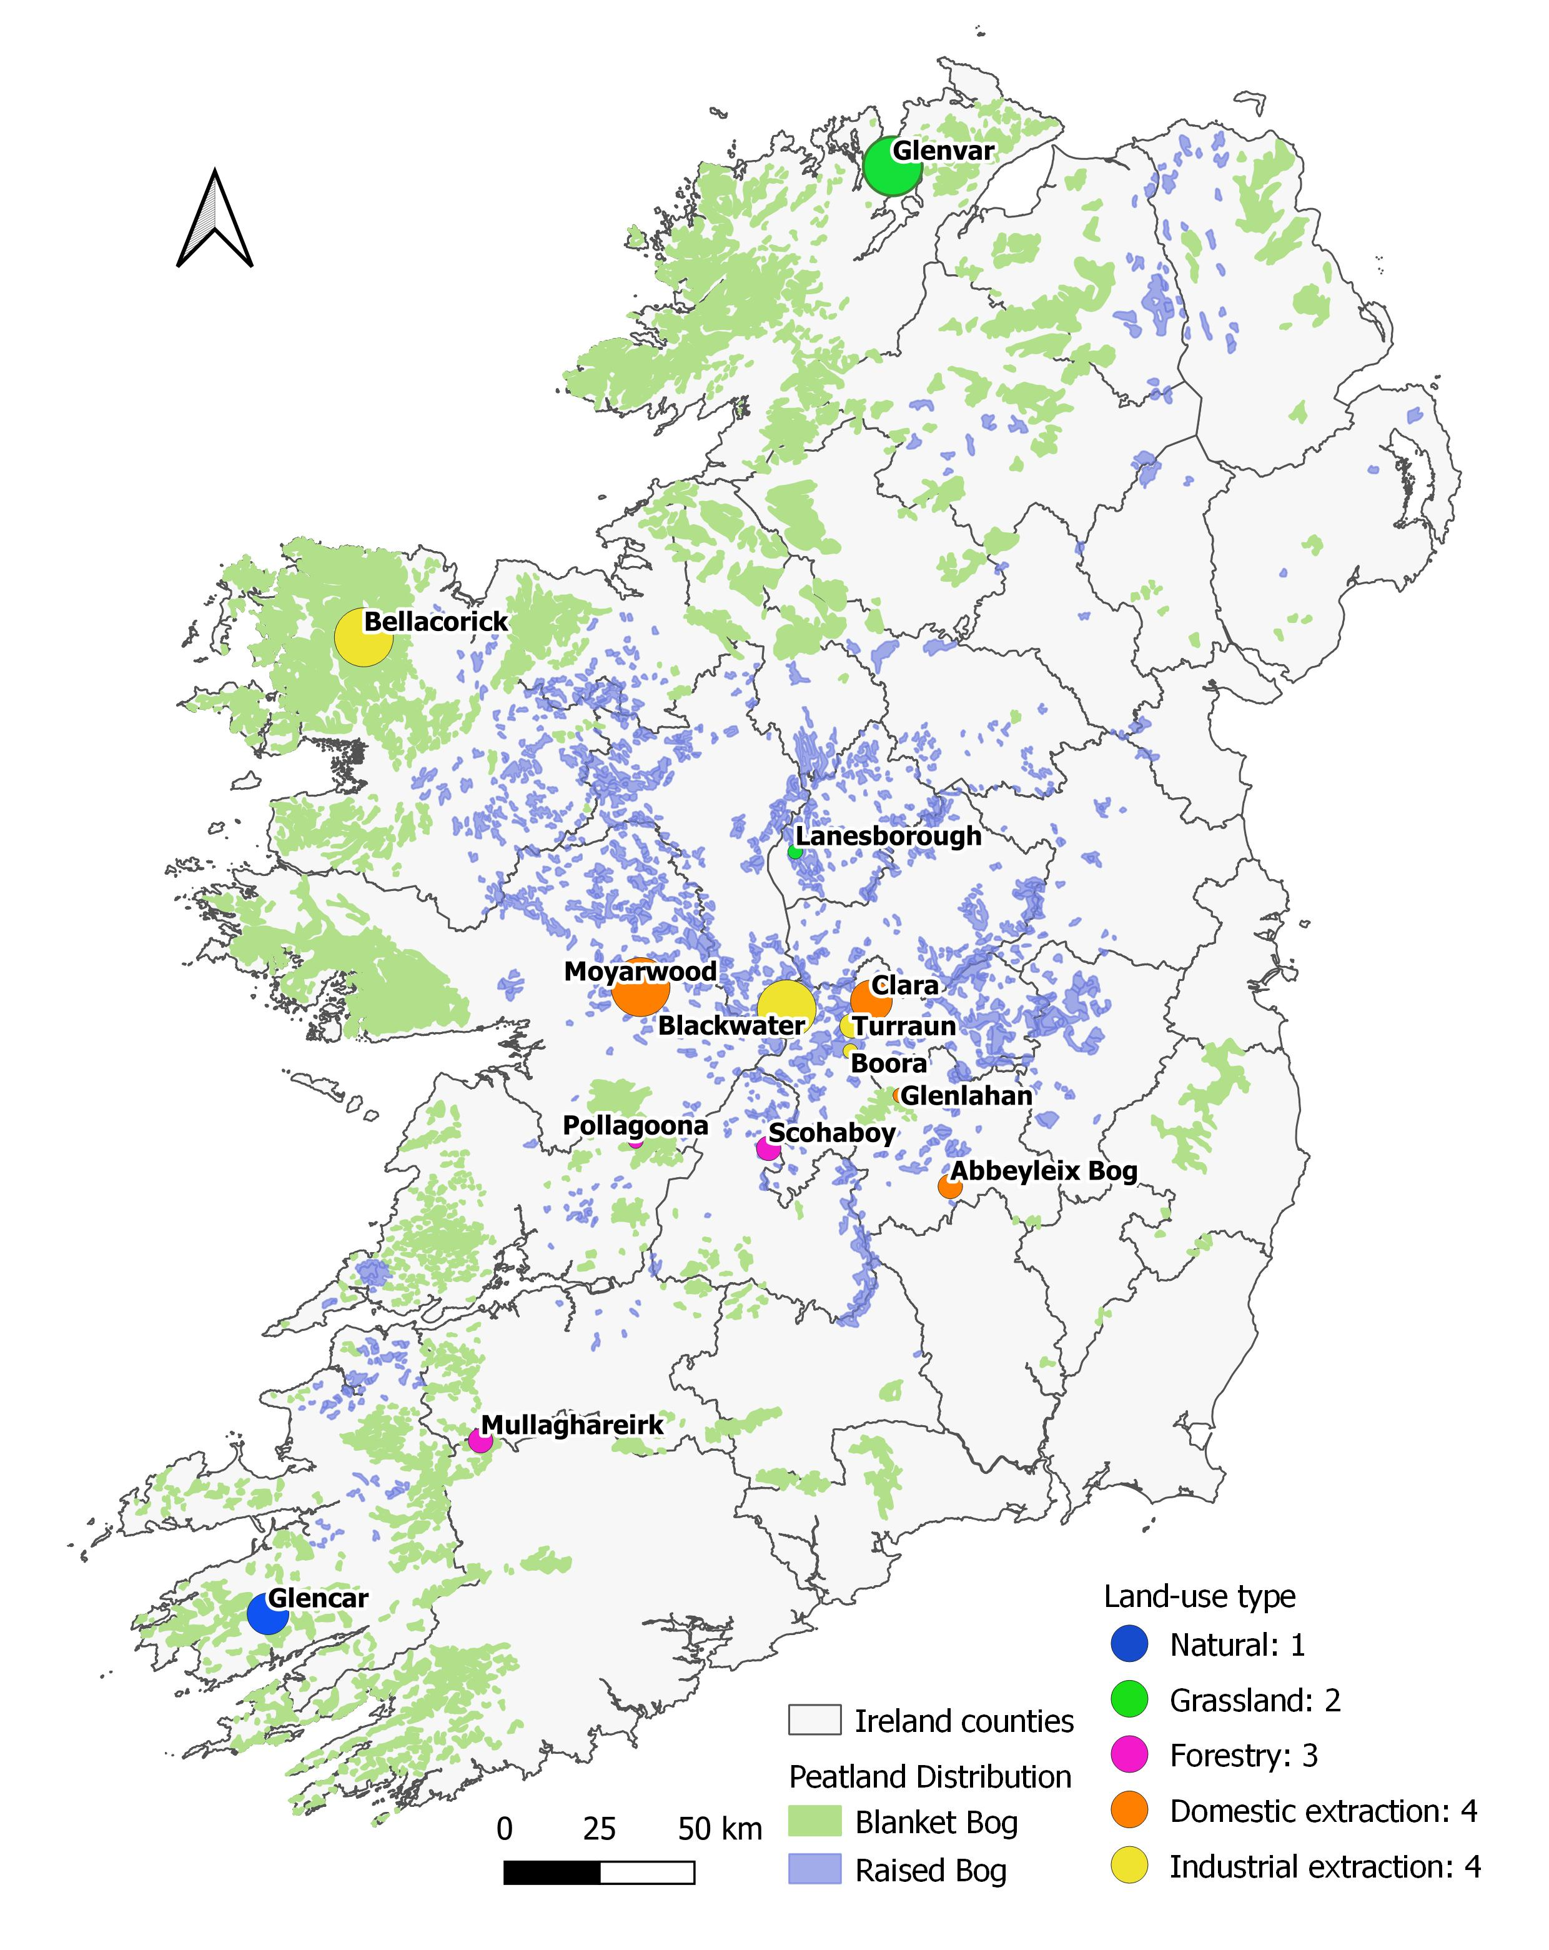
Carbon study sites
Locations of the study sites
and the distribution of Irish peatlands.
Size = number of annual measurements
(CO₂ + CH₄ + N₂O + fluvial losses)
Notes:
The map is shown distribution of C studies in Ireland. The size of circles represent the number of annual measurements and the colour indicates the Lan use. As you could see, the main research focus was on raised bogs in midlands with less focus on blanket bogs. The grassland and forestry are poorly represented despite they cover large areas of Irish peatlands.

Slide 7





Irish Peatland CO₂ Emission Factors
Table 2. CO₂ Emission factors: Tier 1 vs Irish
Drained status | Nutrient status | Land use type | CO₂ (t C ha-1 y-1)
 |  |  | Tier 1 | Irish
Drained | Poor | Industrial cutaway | 2.8 | 1.21
 | Rich | Industrial cutaway |  | 2.18
 | Poor | Domestic cutover |  | 1.59
 | Poor | Grassland | 5.3 | 1.83
 | Rich | Grassland, deep-drained | 6.1 | 5.84
 | Poor | Forestry | 2.6 | 1.68
Rewetted | Poor | Near-natural |  | -0.33
 | Poor | Peat extraction | -0.23 | -0.23
 | Poor | Grassland* |  | 0.85
 | Poor | Forestry |  | 3.33
 | Rich | Peat extraction | 0.5 | 3.22
$$>$$
$$>$$
$$≈$$
$$>$$
$$>$$
Notes:
This table shows Co2 emissions from Irish peatlands compared to generic Tier 1 from wetlands supplement. Generally, Irish emission factors are lower for drained peatlands and higher for rewetted peatlands. This shows the importance to work toward developing country-specific emissions and the importance to develop restoration plans.

Slide 8
Total Emissions from Irish Peatlands
Combined EF = CO₂ + CH₄ + fluvial losses
Table 3. Total emissions from Irish peatlands
Drained status | Land Use Category | Combined EF (t C ha⁻¹ y⁻¹) | Area (ha) | Emissions (t C y⁻¹)
Drained | Near-natural | 0.38 | 269,270 | 102,568
 | Grassland | 4.73 | 332,000 | 1,570,100
 | Domestic peat extraction | 1.99 | 334,259 | 666,529
 | Industrial peat extraction | 2.21 | 80,000 | 176,527
 | Forestry | 0.38 | 450,940 | 170,991
Rewetted | Peat extraction, poor | 0.67 | 17,826 | 11,913
 | Forestry | 3.81 | 3,174 | 12,103
 | Grassland* | 1.77 | 0 | 0
 | Peat extraction, rich | 4.64 | 6,169 | 28,643
 | Total |  |  | 2,739,404
Notes:
Using our EFs for each Gas, we calculated Combined EFs and total emissions from Irish peatlands. We found out that grassland on drained peat soils has the largest emissions. The next is domestic peat extraction – despite the EF is lower than for industrial, the area involved makes domestic peat extraction the second largest contributor to emissions. When we consider combined EF you could see that even rewetted peatlands are not intaking carbon. This is due mainly to a high fluvial loss.

Slide 9
Conclusions
National emissions* 2.7 Mt C y⁻¹
Rewet peatlands ASAP
Grassland and domestic peat extraction - priority
Known Unknowns
No data on fluxes from ditches in Ireland
Unknown area of ditches
Low diversity of monitoring sites (LUC and geographically)
No fluvial losses data from drained peat extraction sites
*excluding emissions from horticulture peat and combustion
Notes:
We calculated that total national emissions from Irish peatlands are 2.7 or 27. But peatlands restoration can reduce these emissions significantly so rewet as soon as possible. Due to the higher emissions, grassland and domestic peat extraction should be in priority to find the best solution to manage these types of peatlands.
However, In Ireland, we still have no data on fluxes from ditches or their area. We also noticed the low diversity of monitoring sites - both by LUC and geographically. We also missing fluvial data from drained peat extraction sites. Lots of opportunities for future peatlands research!

Slide 10
Thank you for your attention!
Feel free to contact me:
Email: e.aitova1@nuigalway.ie
Twitter: @AitovaInNature
Linkedin: /in/elena-aitova/

