Slide 1


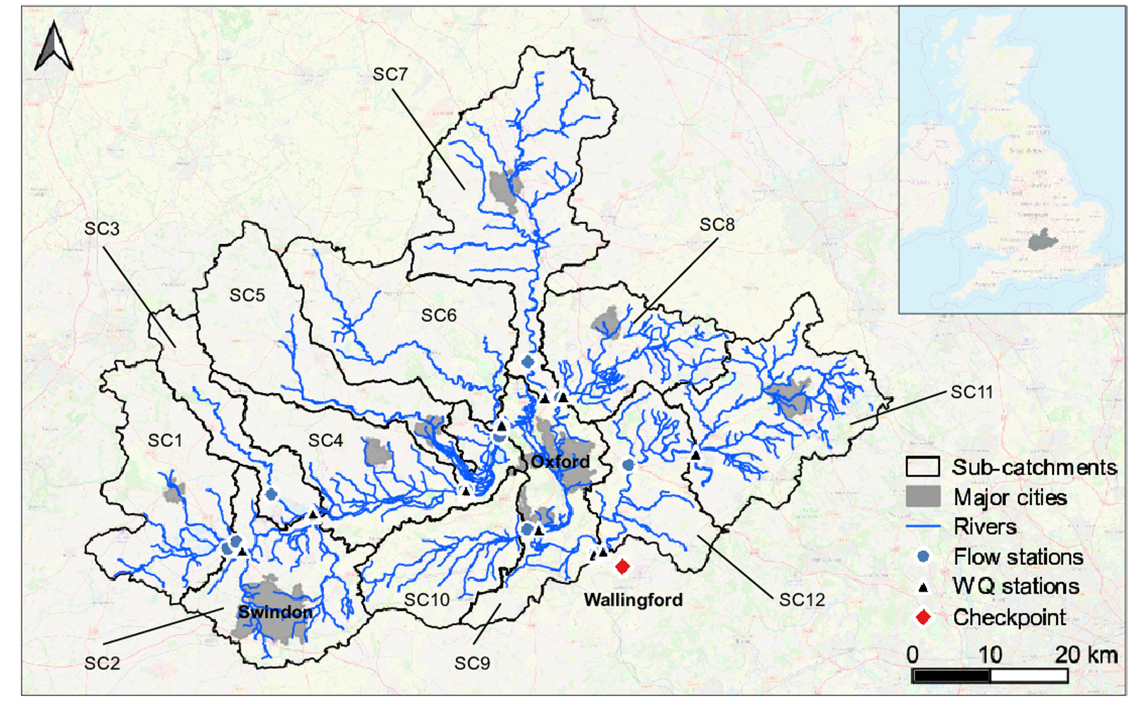
Water quality management at a critical checkpoint by coordinated and validated multi-catchment pollution loads allocation
Upper Thames Catchment, UK
Leyang Liu, Barnaby Dobson and Ana Mijic
Department of Civil and Environmental Engineering, Imperial College London, London, United Kingdom
How should we reduce pollutants loads to more efficiently improve water quality at the checkpoint?

Slide 2
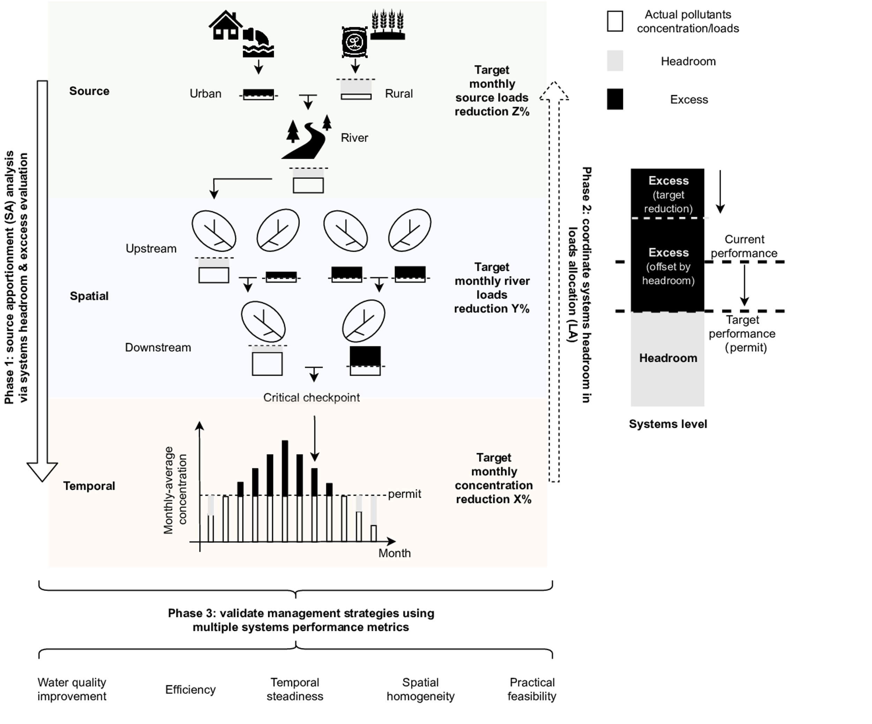
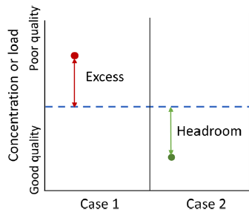
Systems headroom and excess
Scales
Variables
Processes
Source
Urban/rural loads
Permit
Spatial
River loads
CatchWat-SD model
(Elliott et al. 2020)
Temporal
River concentration

Slide 3
1. Evaluation of systems headroom and excess
Temporal:
Headroom: wet period
Excess: dry period
Spatial:
Headroom: 7 catchments
Excess: 5 catchments
Source:
Headroom: rural runoffs
Excess: urban effluent

Slide 4

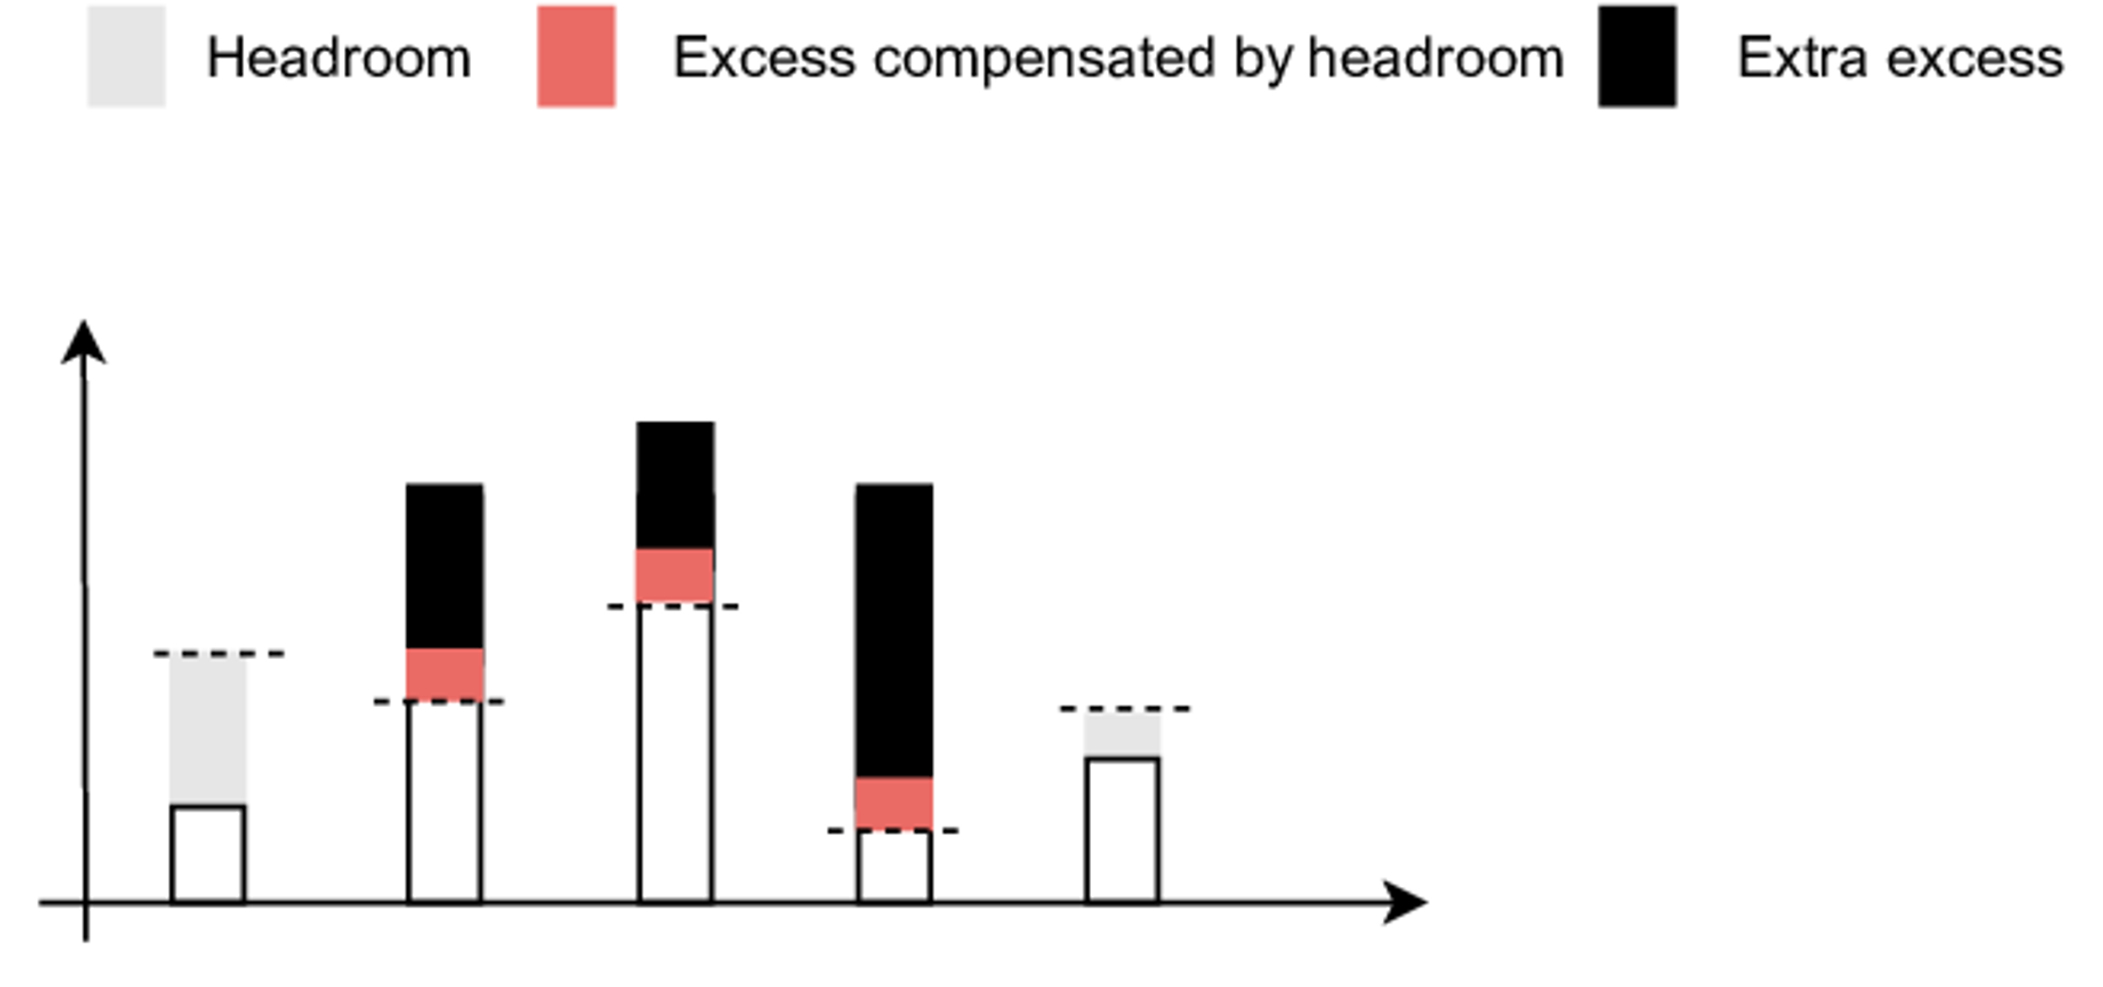
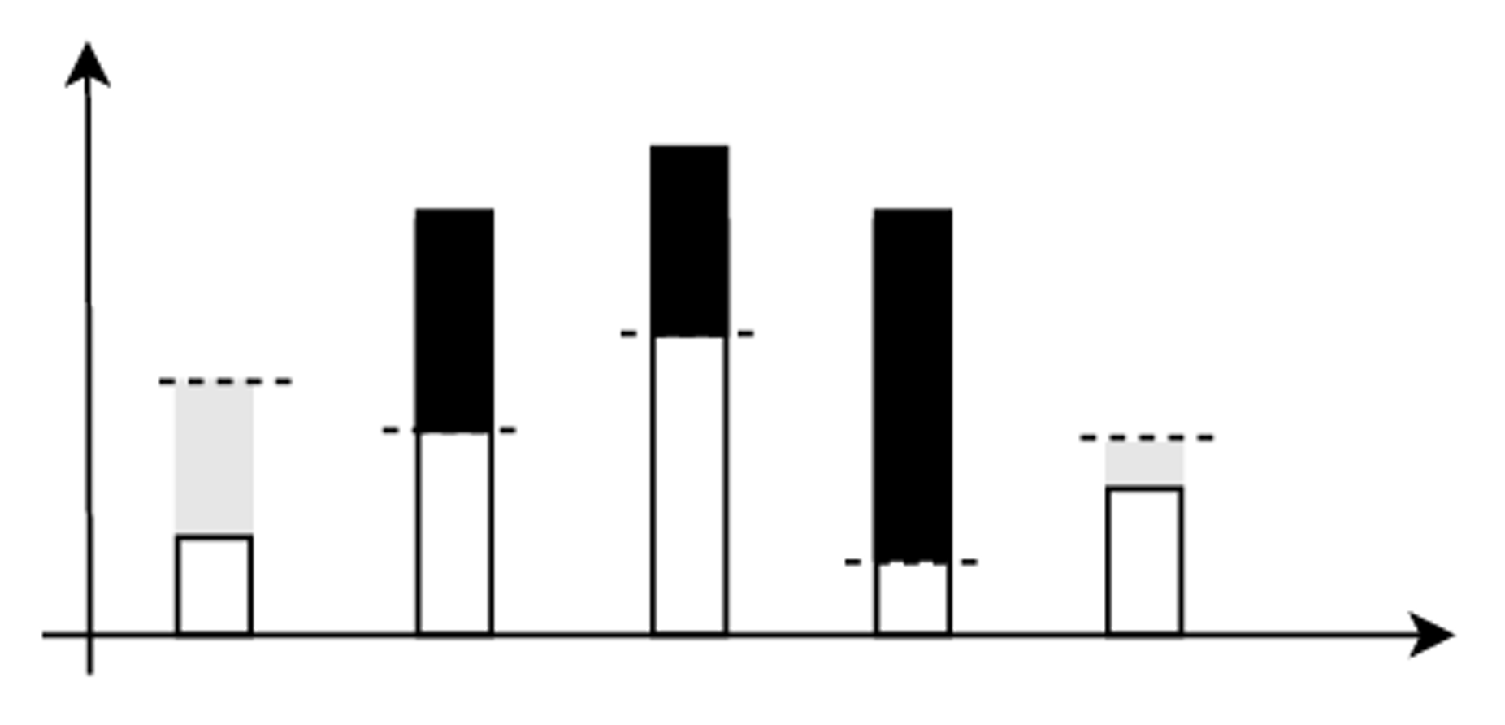
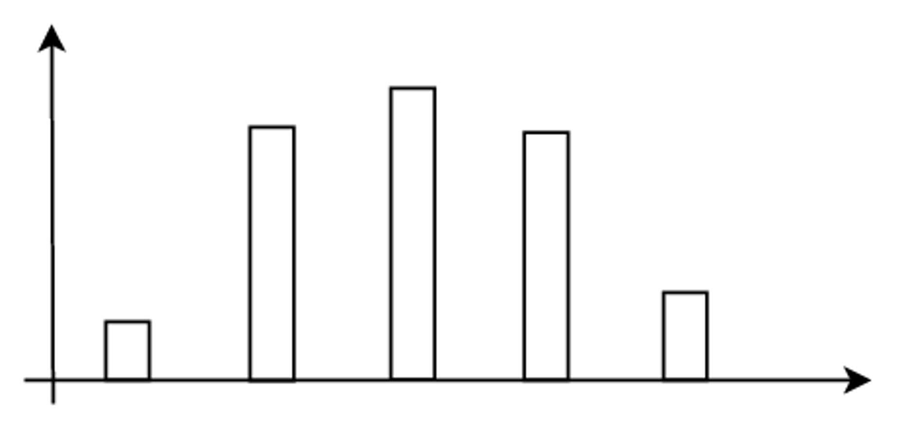
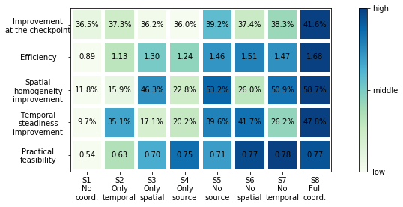
2. Coordinated loads reduction allocation
Coord.
Uncoord.
Coordinated
Temporal
Uncoordinated
Proportionate reduction
Coord.
Uncoord.
Spatial
C%
Loads/concentration
B%
C%
D%
B%
D%
Coord.
Uncoord.
A%
E%
Source/spatial/temporal
Source
A% = E% = 0
B% = C% = D%
Loads reduction percentage (%)
A% = B% = C% = D% = E%

Slide 5
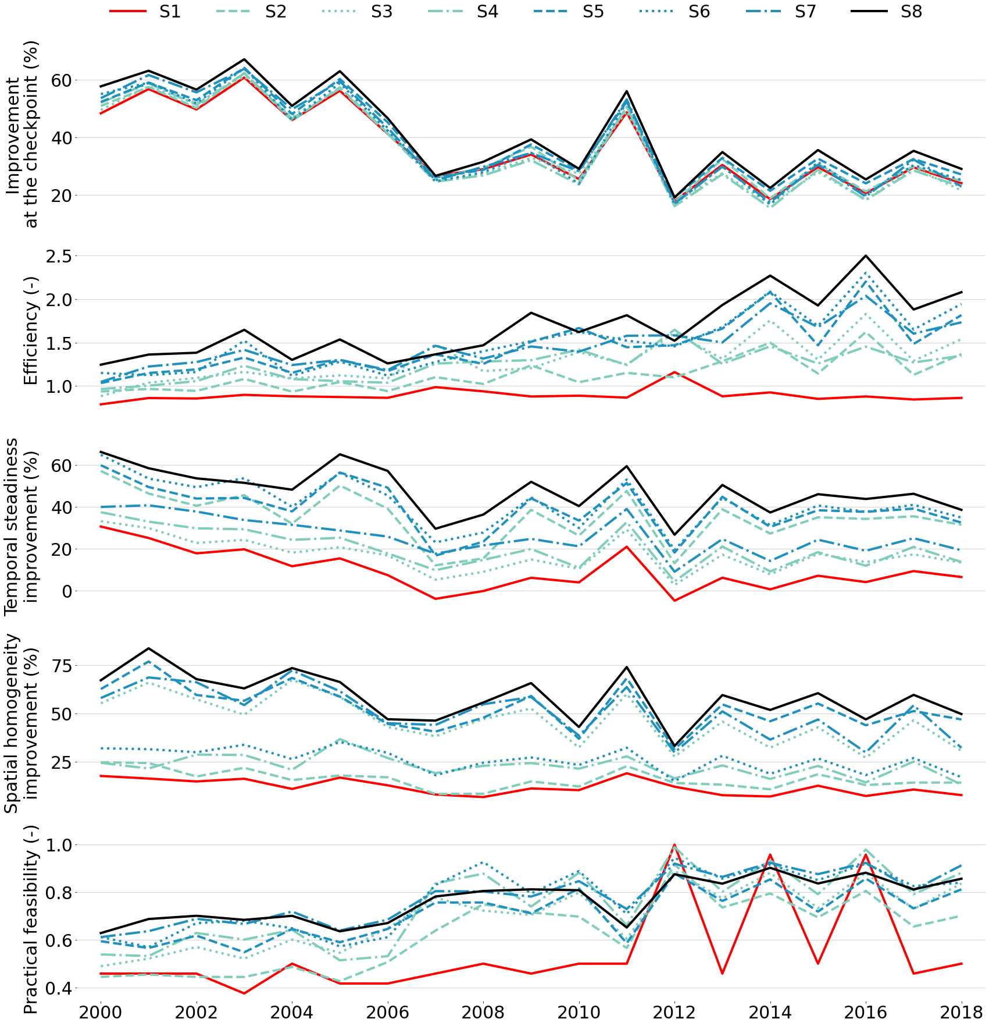
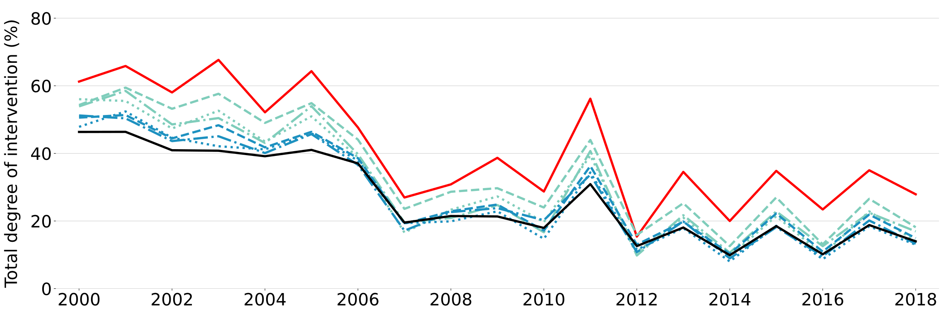
3. Performance of coordinated VS uncoordinated strategy
Fully coordinated strategy
achieves better improvement in river conc.
requires less degree of intervention
is more efficient
Fully coordinated
Fully uncoordinated
Fully uncoordinated
Efficiency =
Improvement
Degree of intervention
Fully coordinated
Fully coordinated
Fully uncoordinated

Slide 6
Loads reduction that coordinates systems headroom and excess can more efficiently improve water quality at checkpoint
How we view the water system?
Evaluate headroom and excess at temporal, spatial and source scales
?
How to use them in loads reduction allocation?
Offset the excess with headroom
How to develop efficient loads reduction strategies?
Coordinate headroom and excess at all three scales
Leyang Liu
leyang.liu16@imperial.ac.uk

