Slide 1






The framework for improving air quality monitoring over Indian cities
Arindam Roy¹, Athanasios Nenes^{1,2}, and Satoshi Takahama¹
¹Laboratory of atmospheric processes and their impacts (LAPI)
École polytechnique fédérale de Lausanne
²Center of Studies on Air quality and Climate Change (C-STACC), Institute of Chemical Engineering of the Foundation for Research and Technology Hellas at Patras, Greece
Mon, 23 May
arindam.roy@epfl.ch

Slide 2
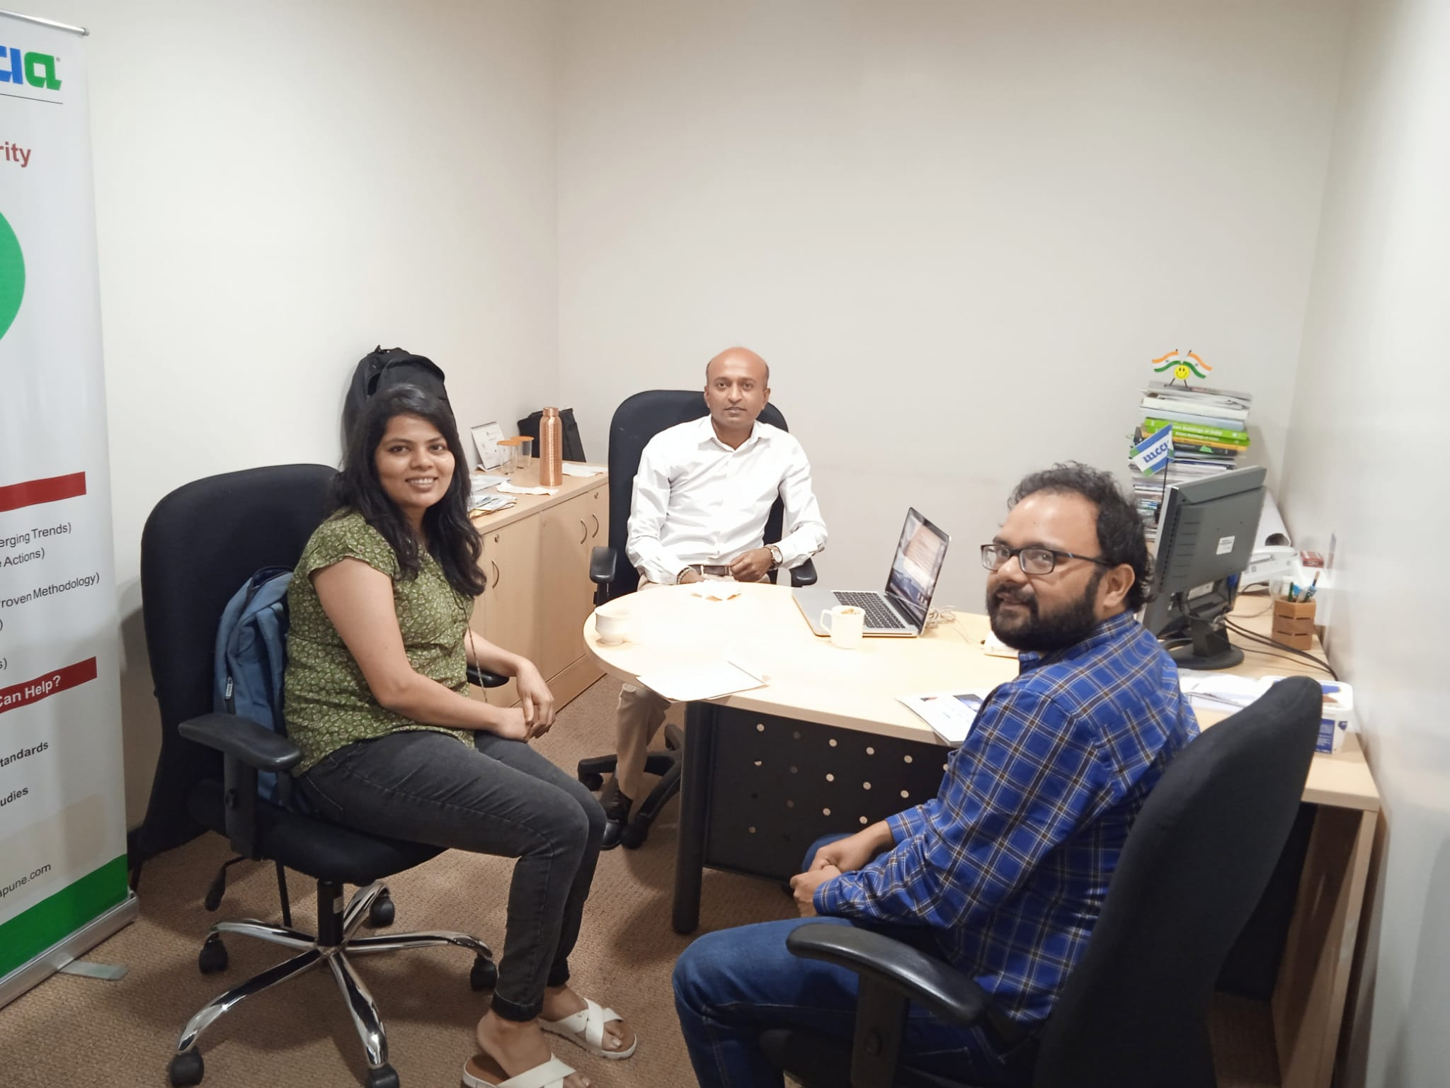
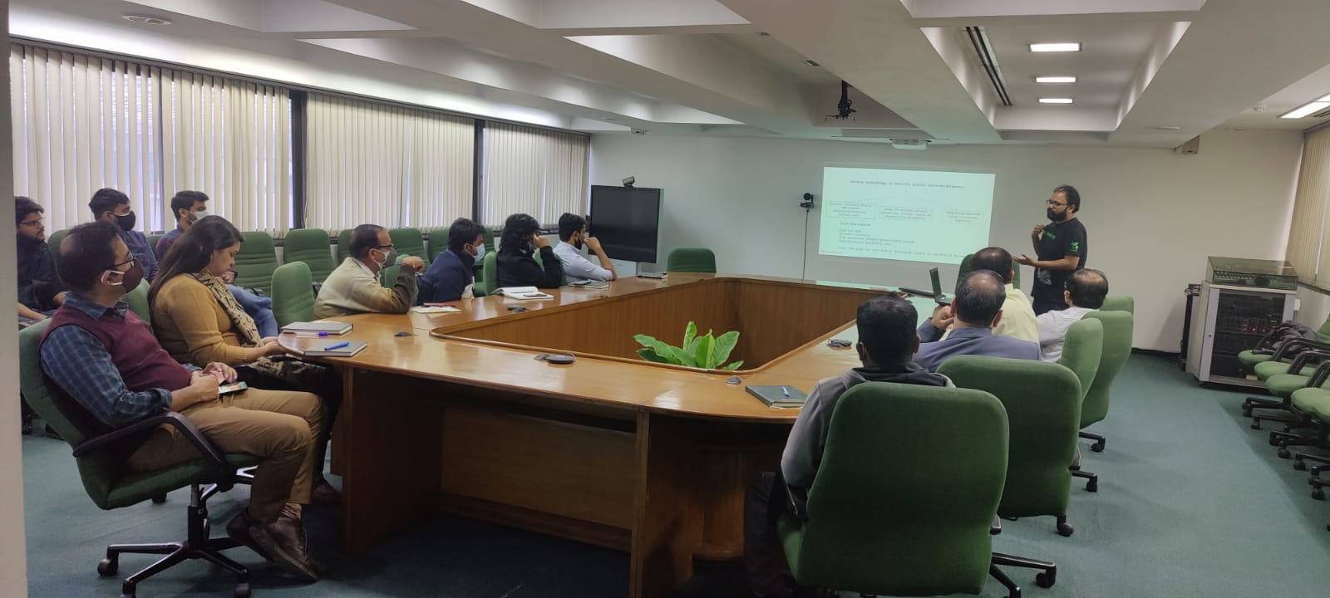
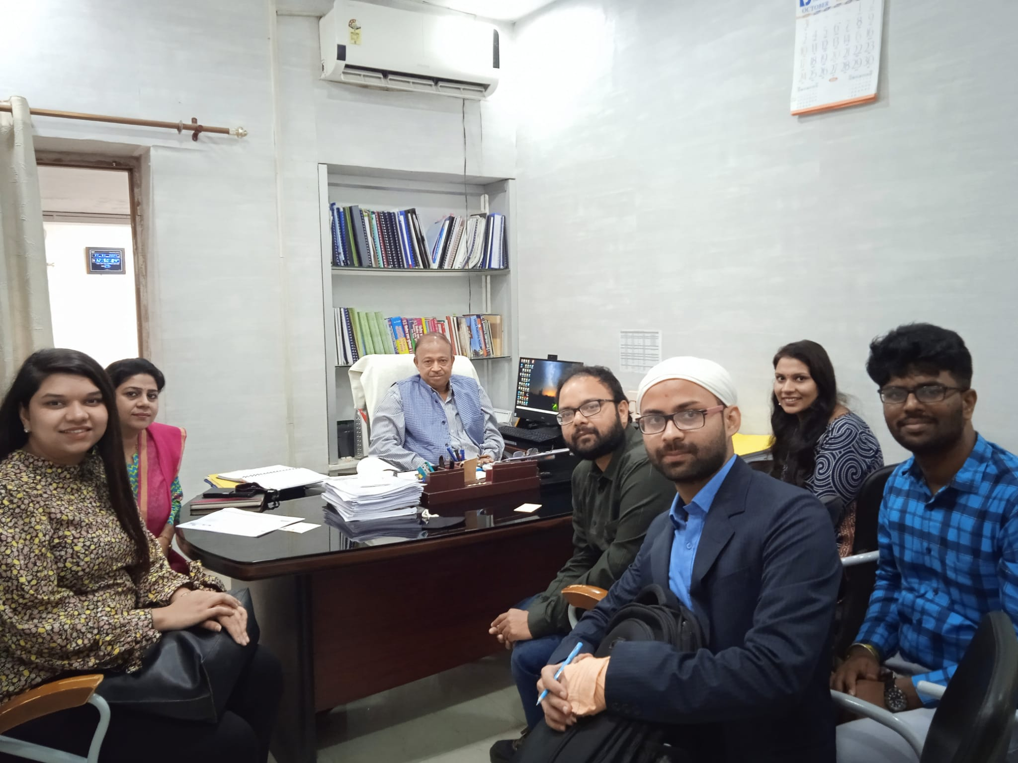
Clean Air Project - India
Funded by Swiss Development Corporation – working as a support system for Clean Air Action Plan, India
Four Indian million-plus cities
Our group at EPFL is working on improving air quality (AQ) practices. Part of our job includes understanding present monitoring scenario, stakeholder engagement, building framework on AQ monitoring and advocating for implementation.

Slide 3
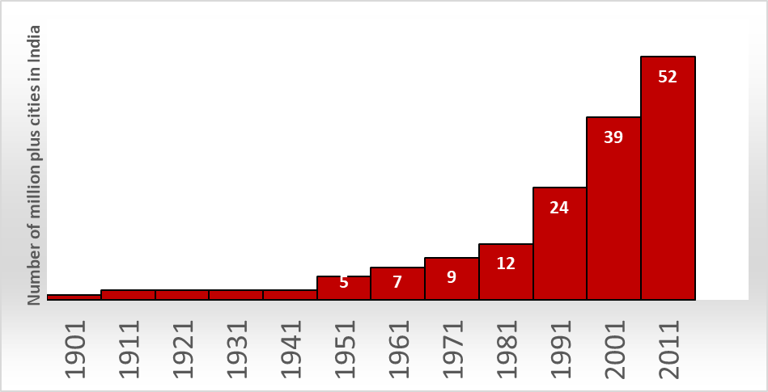
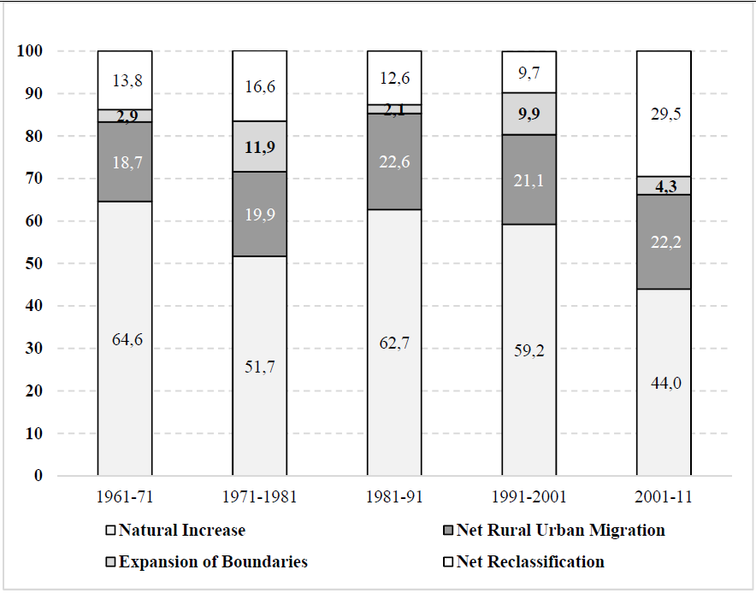
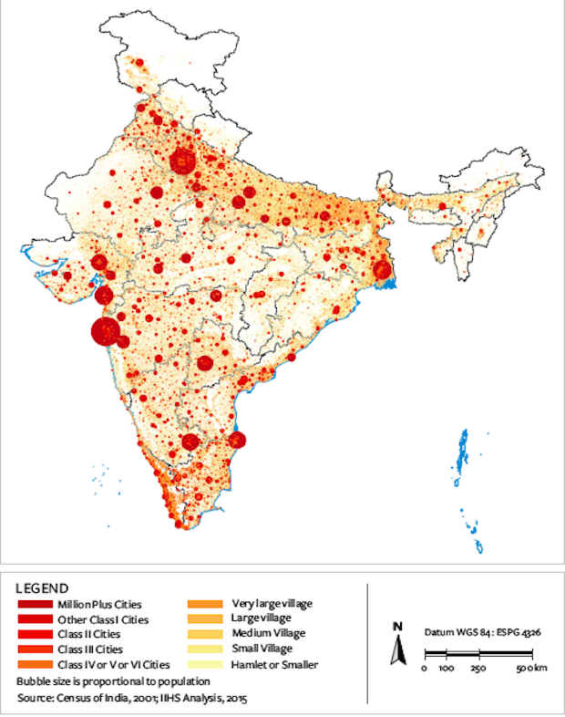
Number of million plus cities in India
Drivers of Indian urban population expansion
Growth rate
Migration
Agglomeration
Rapid transformation of landscape
Problem statement
arindam.roy@epfl.ch

Slide 4



Mixed land-use: everything is everywhere
Land use is India is similarly messy and mixed, and also creates a vibrant street life where activities are located close to one another and it is easy for someone to find what they need within walking distance. Everything is everywhere, it seems. ITDP, 2013
Transport and road dust are the major contributor of PM in Indian cities
Segregated land-use zones
Mixed land-use zones
Unplanned and unprecedented growth over Indian cities results into mixed land use zonation
City area doubles in last 25 years ¦ 38.5% of all Indian town share common boundary with larger cities ¦ 17 of the world’s 20 fastest growing city are from India
Problem statement
arindam.roy@epfl.ch

Slide 5
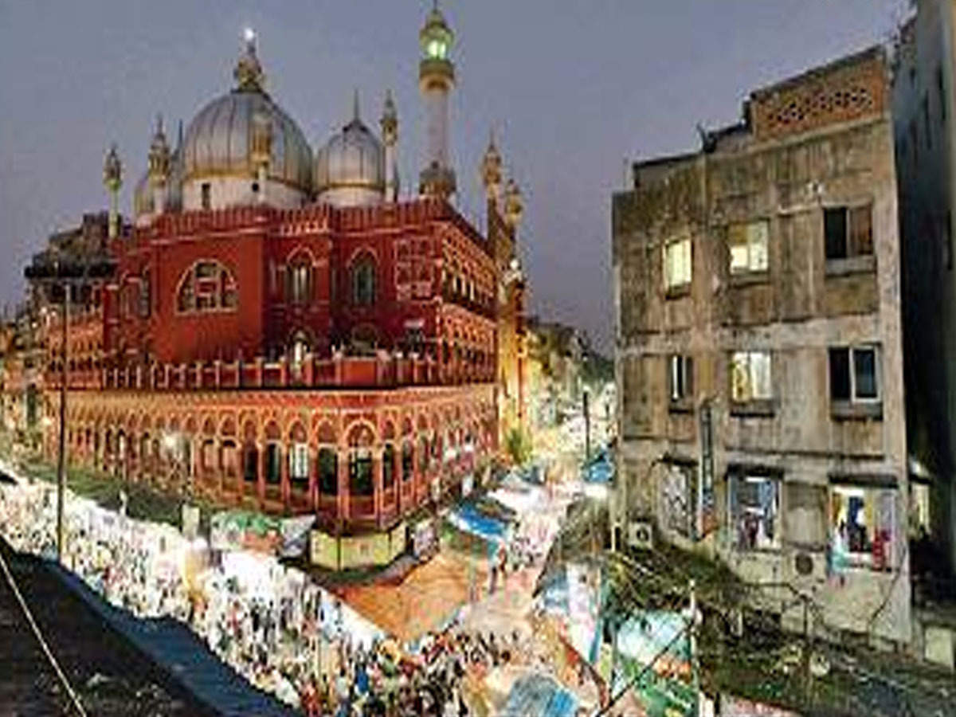
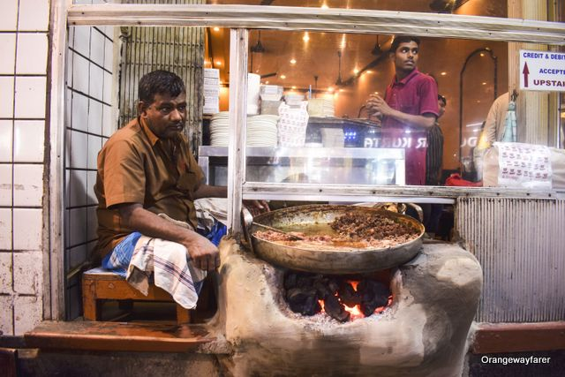
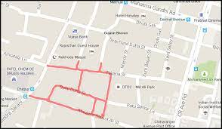

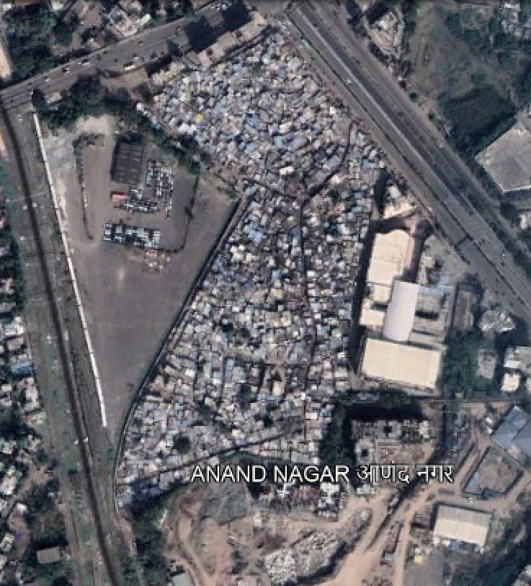
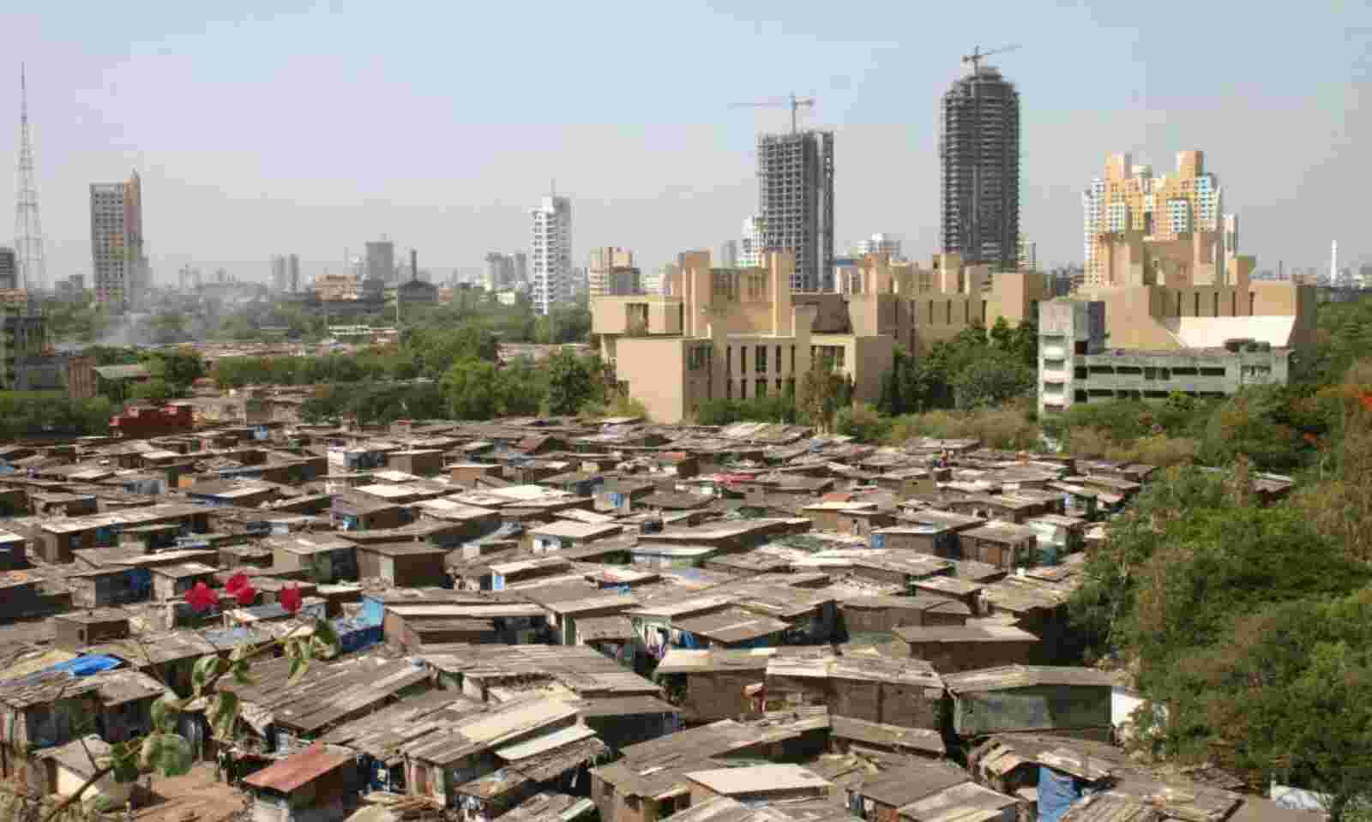
Residential
Tourist
Span – 2.8 km
Shop number ~ 4000
Commercial
Each city have multiple food streets
Low income household
High income household
Shopping
mall
Low income household
Factory
Parking
Span – 0.8 Sq km
Population count ~ 25000
Problem statement
arindam.roy@epfl.ch

Slide 6
Summarizing the problem and challenges
Present deviation from guidelines
Rapid and unplanned development
Unique Indian Landscape
Less monitoring sites
Increase Heterogeneity
Lack of rural and background sites
Lack of meteorological measurement
Migration
Mixed land use
Compromise site
representativeness
Regional transport
Non addressed issues
Focus on all
pollutants
Randomness of sources
Lack of decision-making data
Challenges
arindam.roy@epfl.ch
Summary of challenges

Slide 7
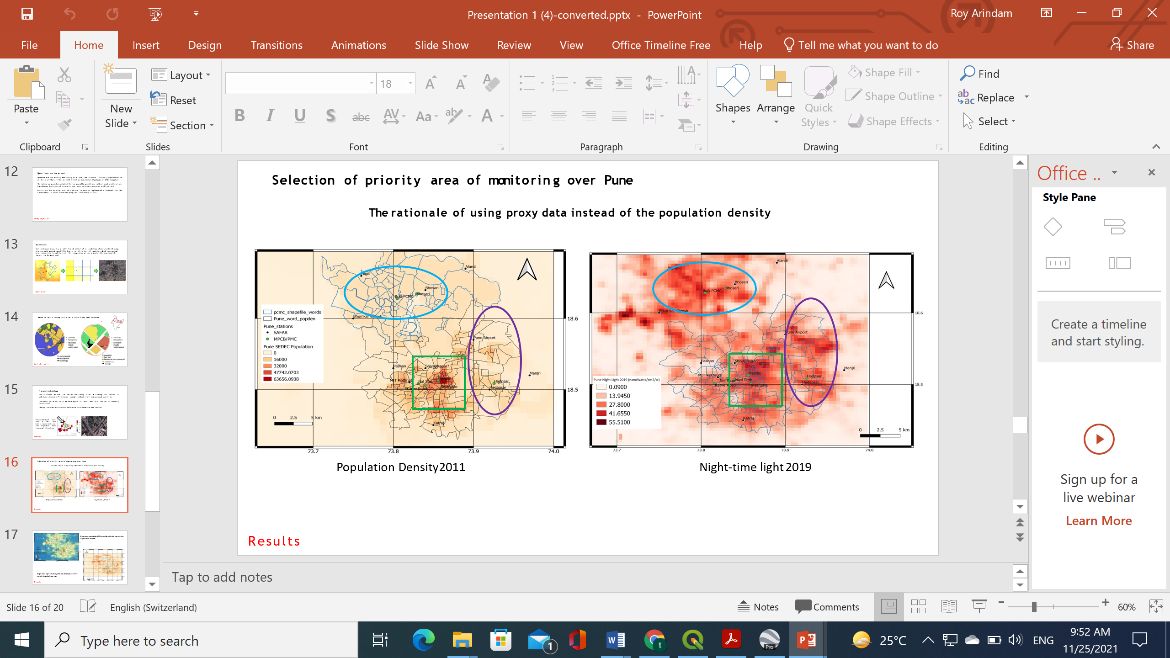
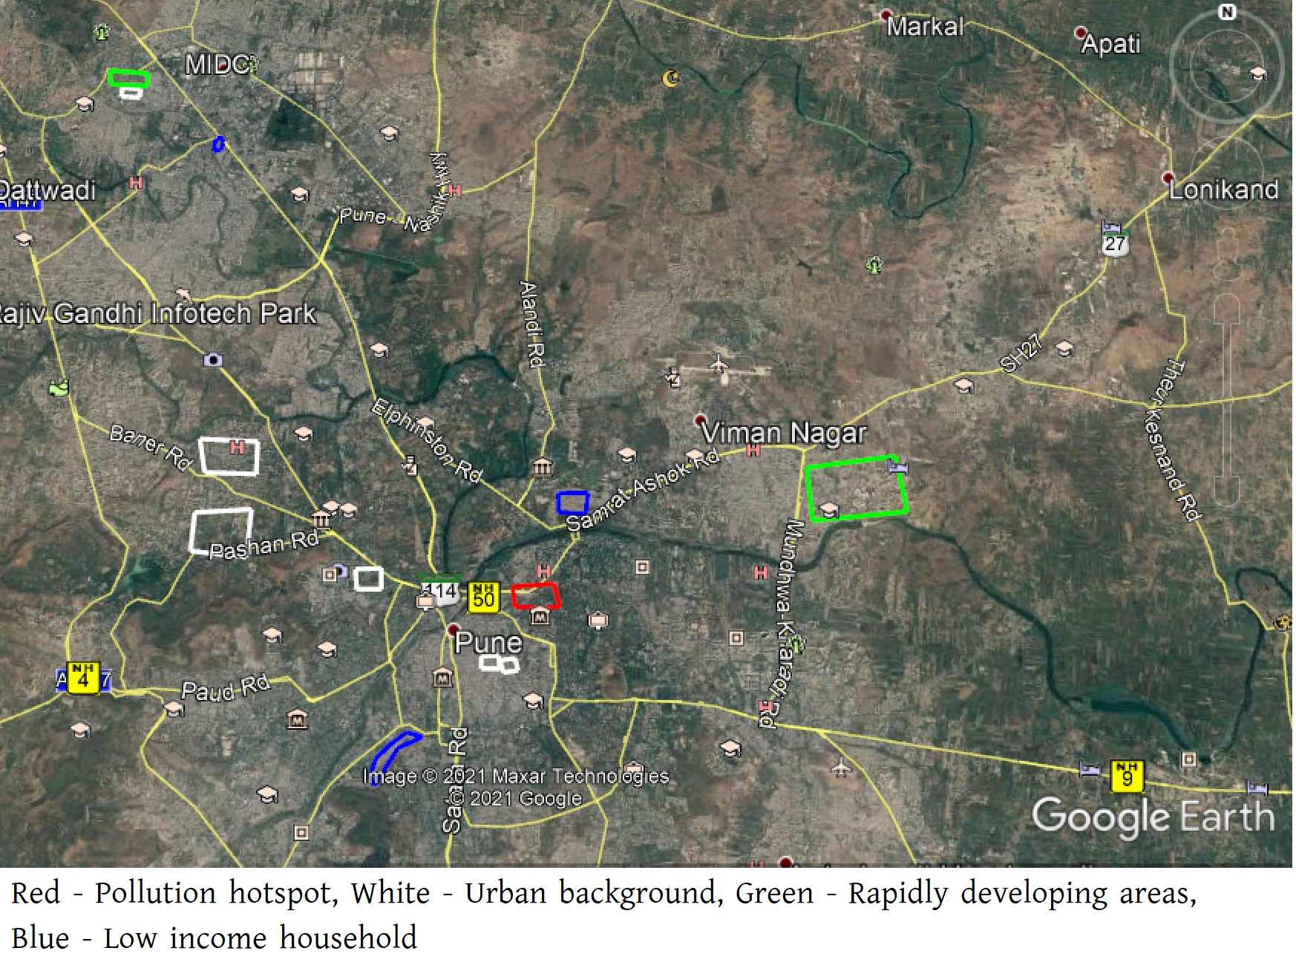
Towards solution – “Where should we place the next monitoring station?”
Metadata for stations
Objective wise station classification
Missing site type
Suggesting locations for AQ monitoring
Probable site using proxy data
Communicate with PCB and feedback
arindam.roy@epfl.ch
Case Study Pune City (Million-plus city in West India)

Slide 8
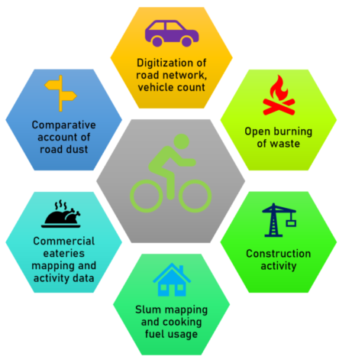
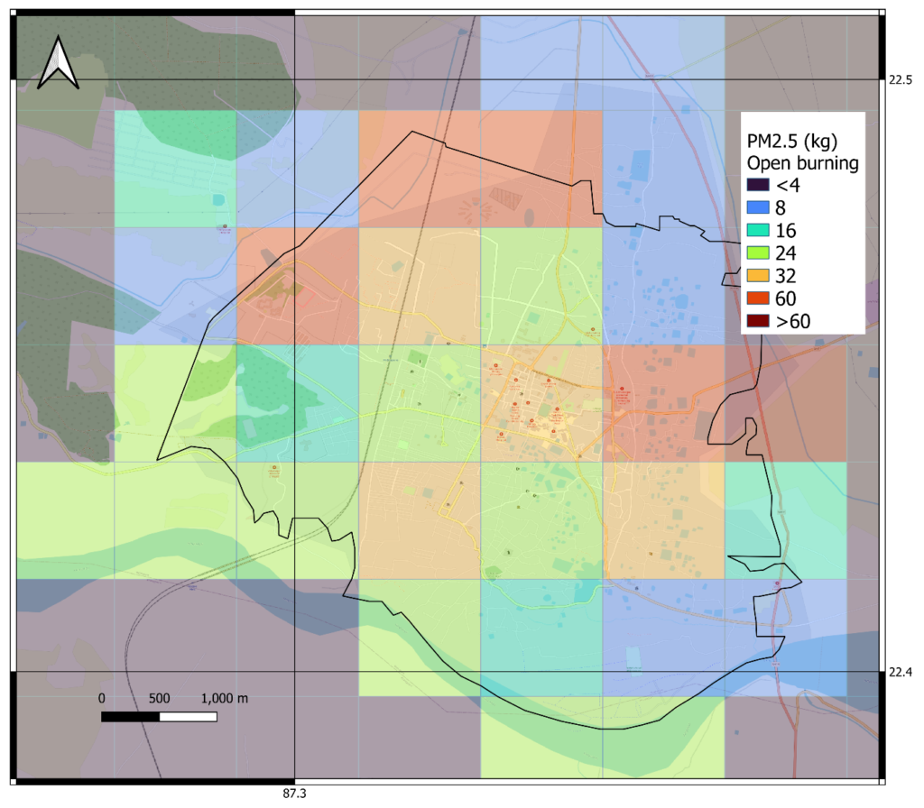
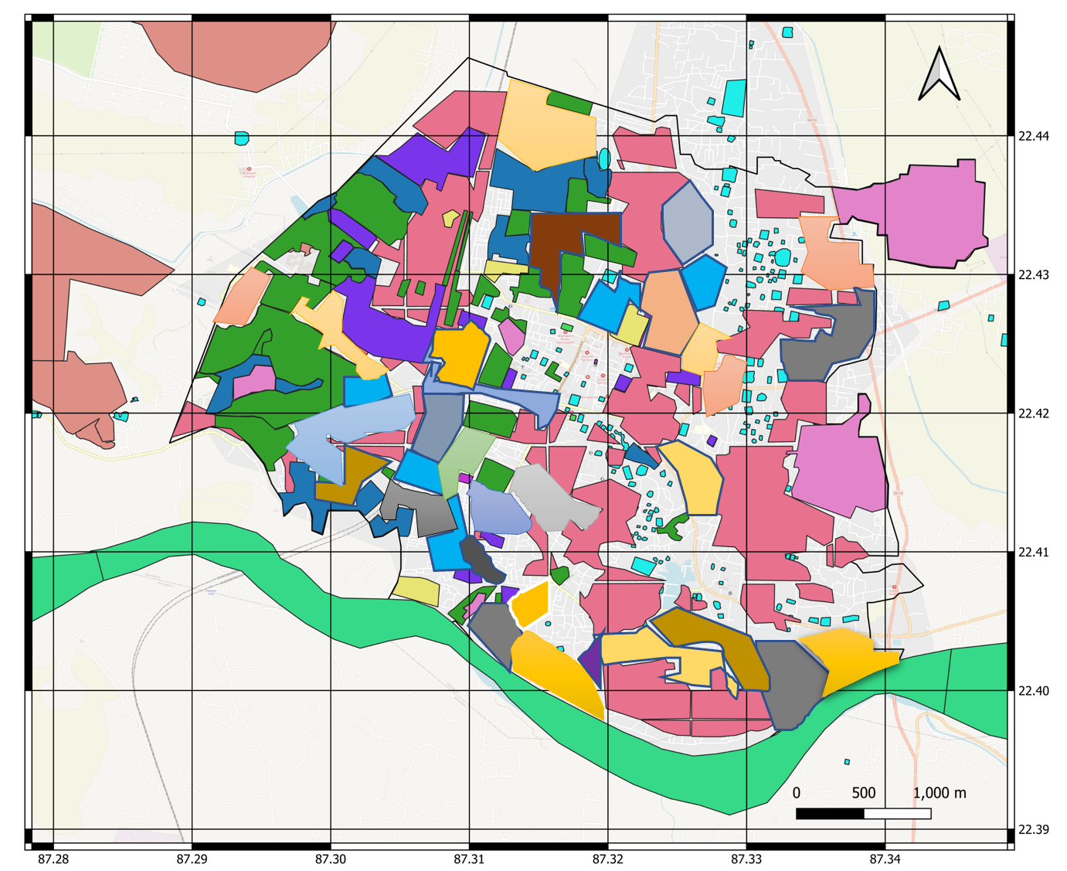
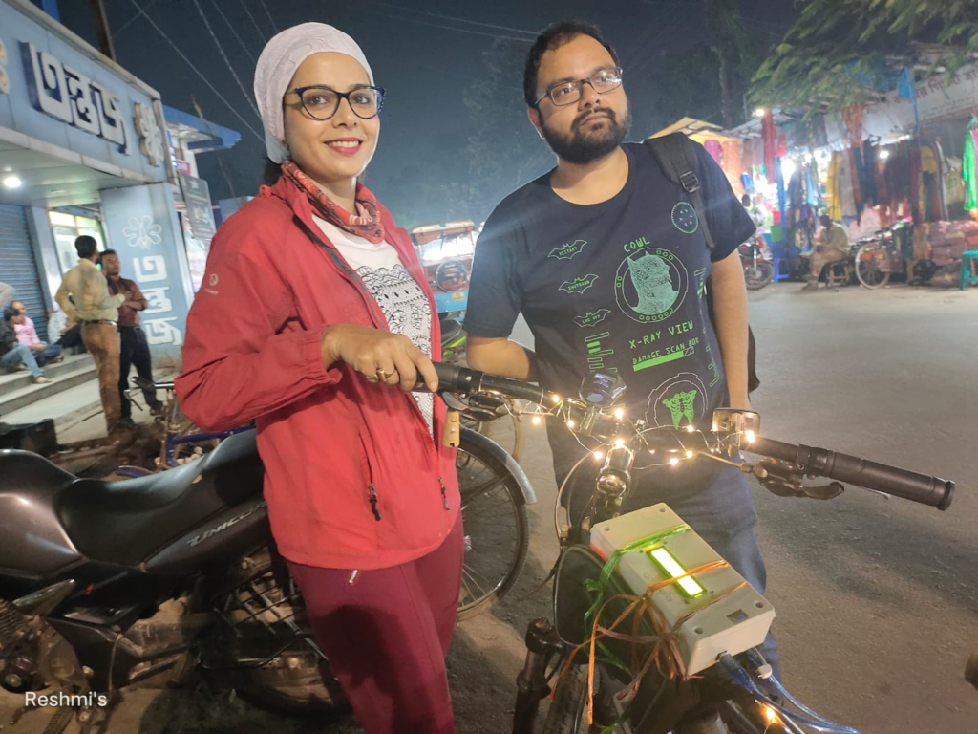
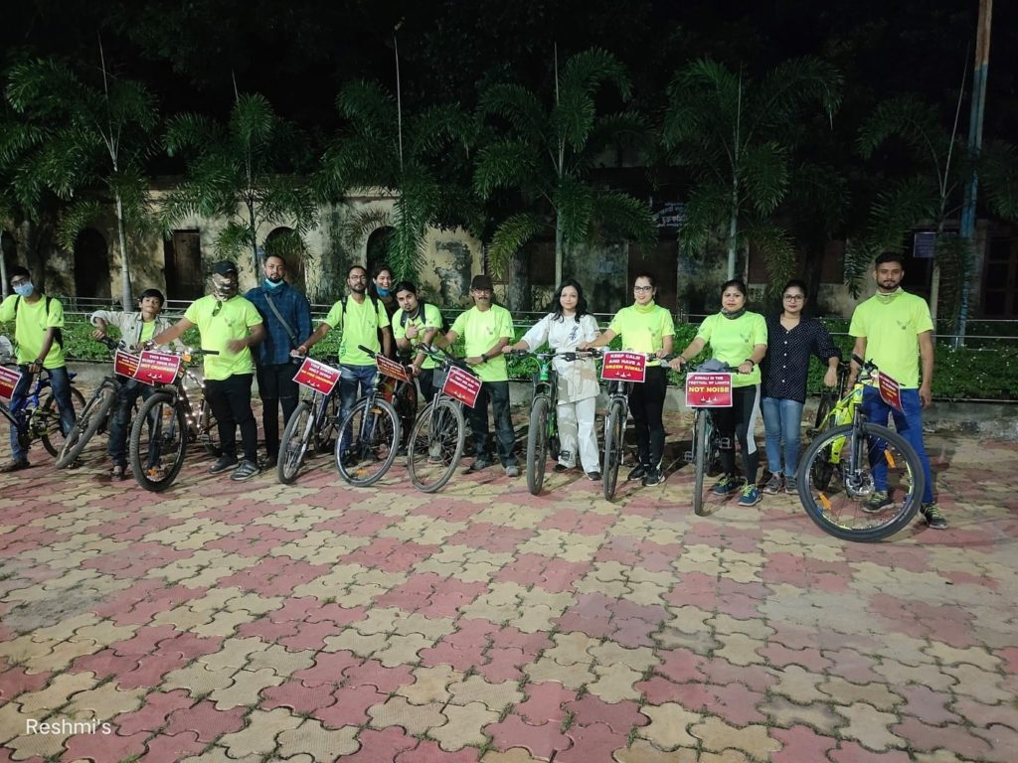
Crowd sourcing data as an potential option for locating new air quality station: A pilot
Emission from open burning
Micro-site type classification
The solution lies in detailing…
arindam.roy@epfl.ch
Towards solution

