Slide 1

Potential of natural language processing for metadata extraction from environmental scientific publications
Guillaume Blanchy*, Lukas Albrecht, John Koestel, Sarah Garré
2022-05-25
*guillaume.blanchy@ilvo.vlaanderen.be
GitHub: https://github.com/climasoma/nlp
CLIMASOMA

Slide 2
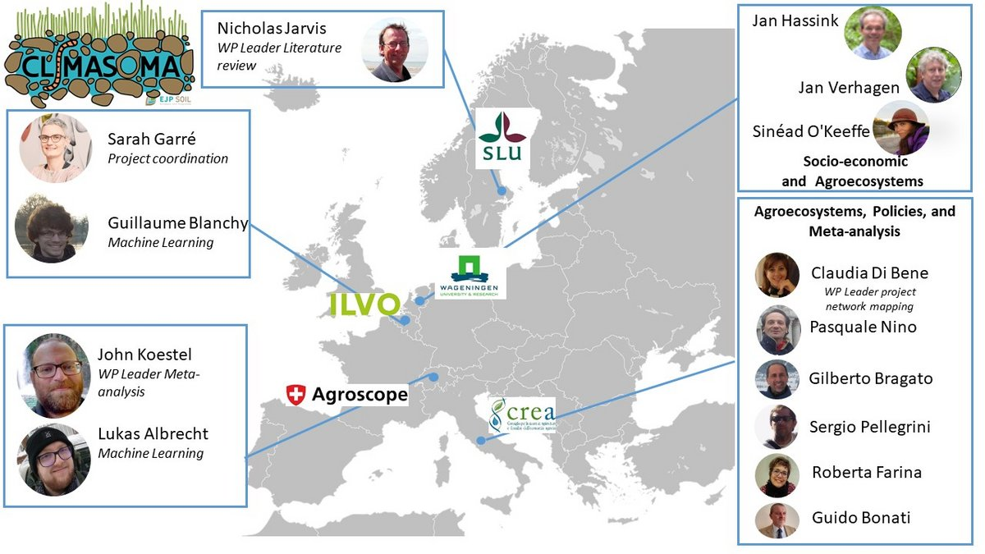

Slide 3
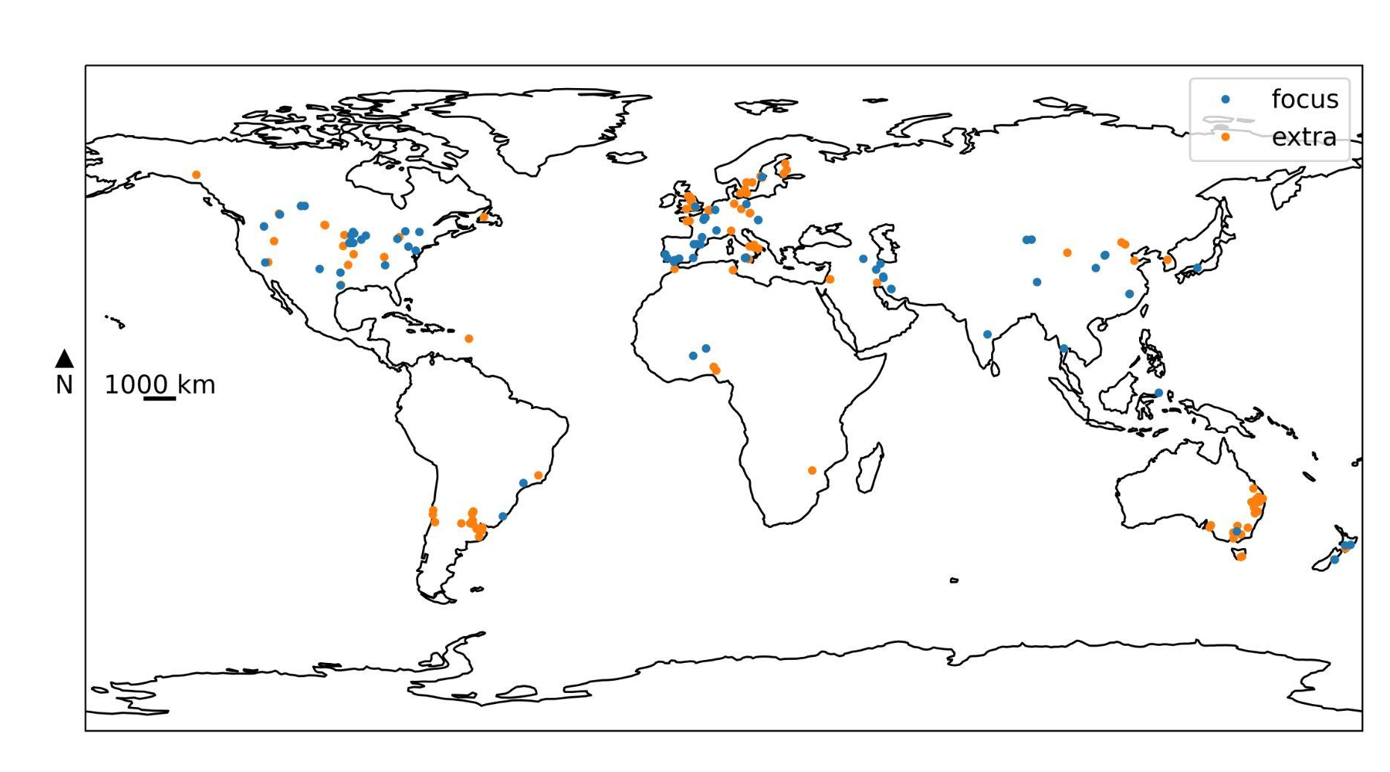
CLIMASOMA: Climate change adaptation through soil and crop management: synthesis and ways forward
Open Tension-Disk Infiltrometer Database: OTIM -> Machine Learning
-
-
-
-
-
-
-
-
-
-
-
-
-
-
-
-
-
-
-
A tension-disk infiltrometer measure the hydraulic conductivity at a given tension
OTIM corpus
More about OTIM: https://github.com/climasoma/otim-db
Link to the report: https://climasoma.curve.space/report

Slide 4
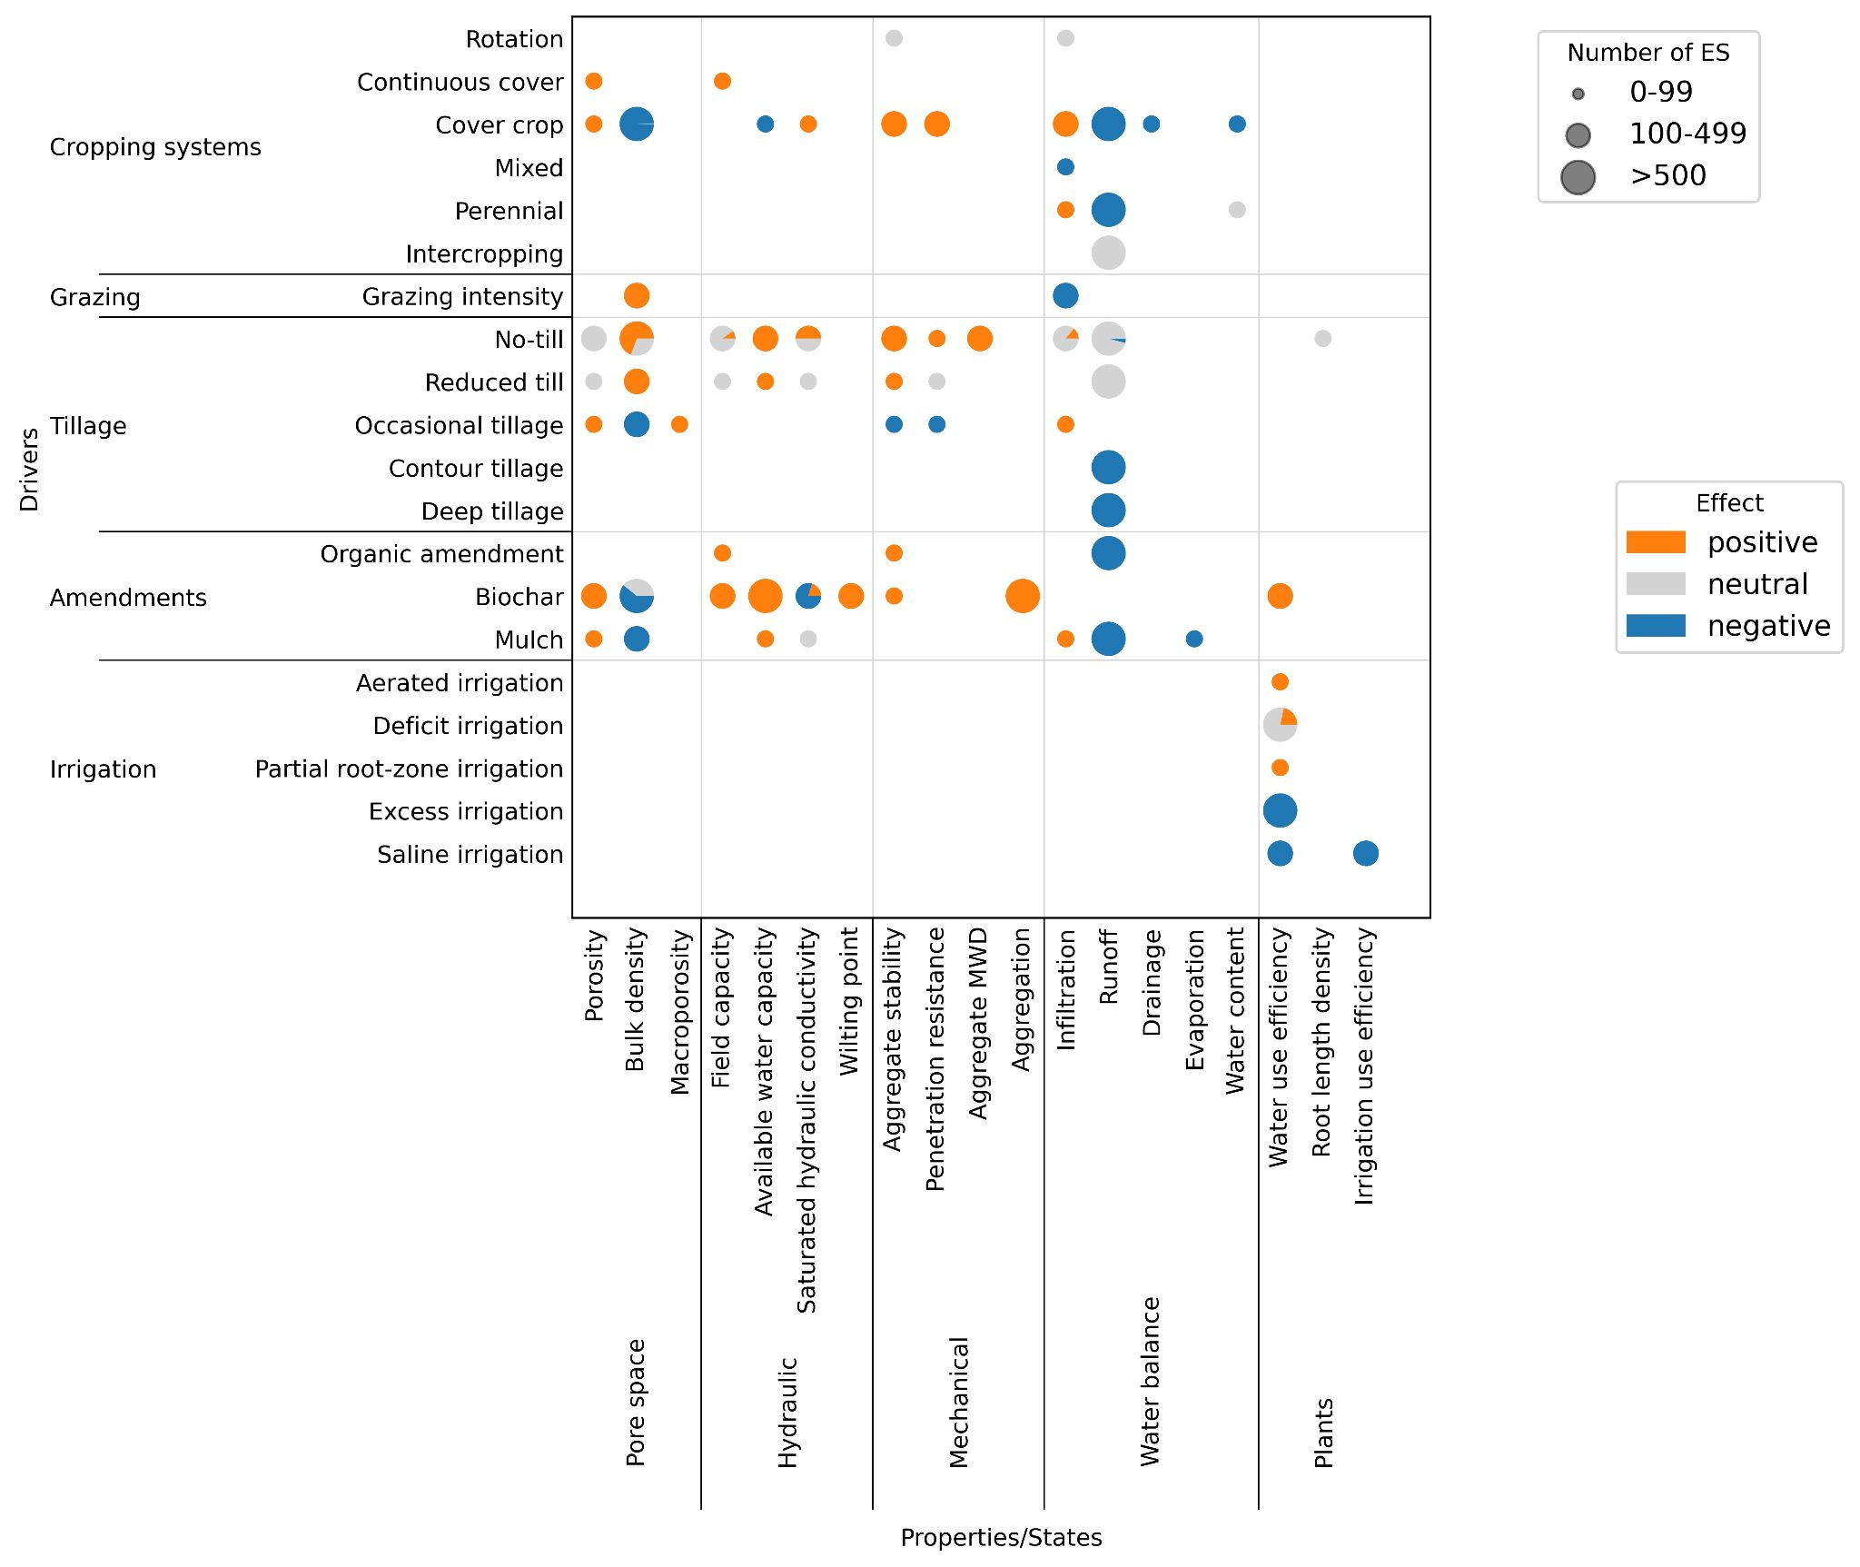
Effect of agricultural practices on soil properties
Based on review paper (meta-analysis) totalizing thousands of primary studies
Meta corpus
No-till has a positive effect (increase) bulk density in most cases
https://github.com/climasoma/review-of-meta-analyses

Slide 5
How to build database or make large review from papers?
Read, Read and Read!
Time consuming
Error prone (especially when transcribing numerical values)
Does not scale easily

Slide 6

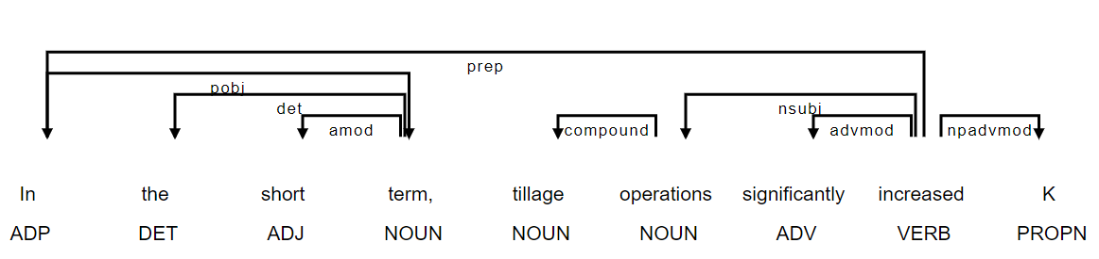
What is natural language processing (NLP)?
https://spacy.io
import spacy
# Load English tokenizer, tagger, parser and NER
nlp = spacy.load("en_core_web_sm")
# Process whole documents
text = ("In the short term, tillage operations significantly increased K.")
doc = nlp(text)

Slide 7
Extract specific information using regular expressions
The site is situated in 51°46'34.9"N 4°49'12.6"E in the Noordwaard Polder in Netherlands at an elevation of 23 m above sea level.
> latitude: (([+-]?[1-8]?\d|[+-]?90)([°◦*oO])\s?(\d{1,2})(.)\s?(\d{1,2}(\.\d+)?)?.?.?\s?(latitude\s)?([NS]))
> longitude: (([+-]?180|[+-]?1[0-7]\d|[+-]?[1-9]?\d)([°◦*oO])\s?(\d{1,2}?)(.)\s?(\d{1,2}(\.\d+)?)?.?.?\s?(longitude\s)?([WEO]))
The soil is a Luvisol (WRB) with a sandy loam texture.
> soil type: (Luvisol|Cambisol|Regosol|Podzol|…)
> soil texture: (sandy loam|loamy clay|sand|clay|loam|clay loam|…)
Annual rainfall precipitation is 850 mm.
> annual rainfall: ((?:cumulated|annual|average)[a-z\s]+(?:rainfall|rain|precipitation))(?:[a-z\s]+)?(\d+[.-\–]?\d+c)?[a-z\s]+(\d+\.?,?\d+(?:-|–|\sand\s|\sto\s)?(?:\d+)?)\s?(m\s?m|cm)
The measurements were collected using a tension-disk infiltrometer with a 4.45 cm radius at tensions of -1, -3, -5 and -7 cm.
> disk size: (radius|diameter)[a-z\s]+(\d+\.?\d+)\s?(cm|mm) or (\d+\.?\d+)\s?(cm|mm)[a-z\s]+(radius|diameter)
> tensions: ((?:(?:-?\d+),?\s){2,})\s?(mm|cm)

Slide 8
How well does it work?
Extracted | Method | n | Precision | Recall | F1-score | Matching
Soil type (WRB/USDA) | Regex + dict. | 174 | 0.92 | 1.00 | 0.96 | 0.95
Soil texture (USDA) | Regex + dict. | 174 | 0.95 | 0.88 | 0.91 | 0.83
Rainfall | Regex | 174 | 1.00 | 0.81 | 0.90 | 0.89
Disk diameter | Regex | 174 | 0.83 | 0.66 | 0.73 | 0.41
Tensions | Regex | 154 | 1.00 | 0.56 | 0.72 | 0.31
Coordinates | Regex | 209 | 0.92 | 0.77 | 0.84 | 0.73

Slide 9
Examples of relationships
Relationship (driver/variable in bold) | Status
In the short term, tillage operations significantly increased K (P < 0.05) for the entire range of pressure head applied [...]. | positive
Both tillage treatments were designed to prevent runoff and both increased rainwater penetration of the soil. | negative
After 3 years of continuous tillage treatments, the soil bulk density did not increase. | neutral
Dry bulk density , saturated hydraulic conductivity (Ks) and infiltration rate [K(h)] were analysed in untrafficked and trafficked areas in each plot. | study

Slide 10
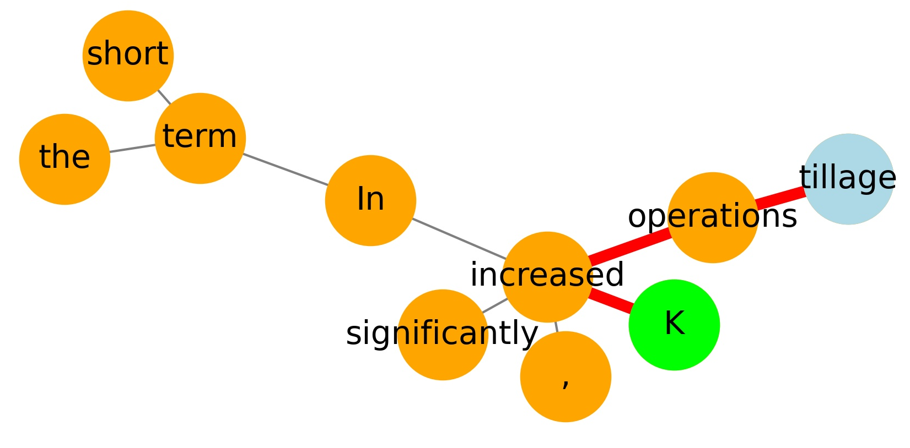
In the short term, tillage operations significantly increased K [...].
(a)
(b)
(c)
> verb in common classification:
positive: 'enhance', 'increase', 'improve',
'mitigate', ...
negative: 'decrease', 'reduce', 'prevent',
'be lower', ...
neutral: have no effect', 'have no significant effect',
'have minimal effect', ...

Slide 11
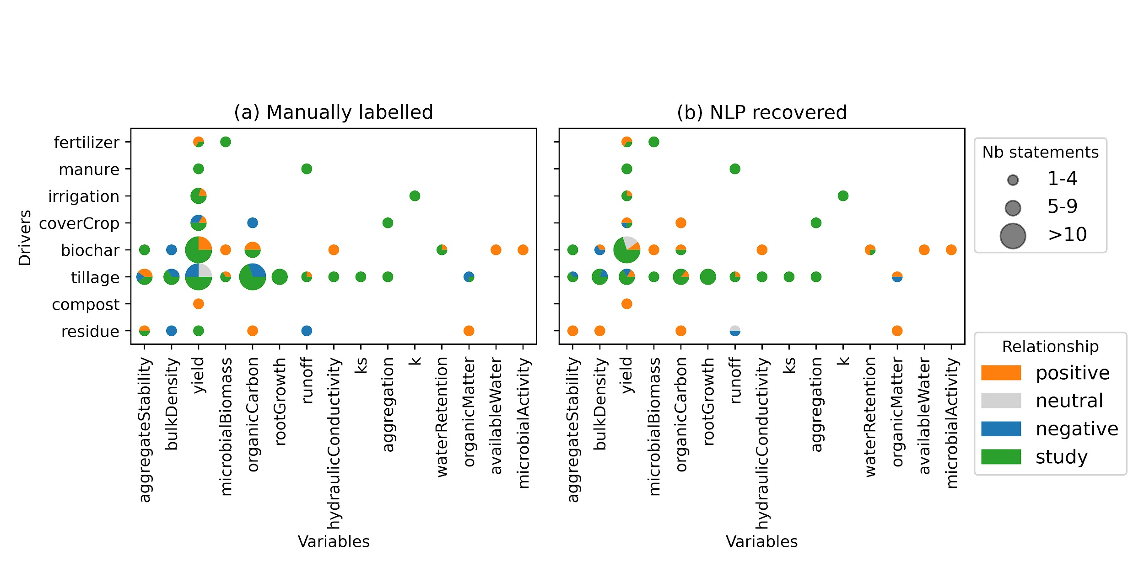
Comparing with manual labelling

Slide 12
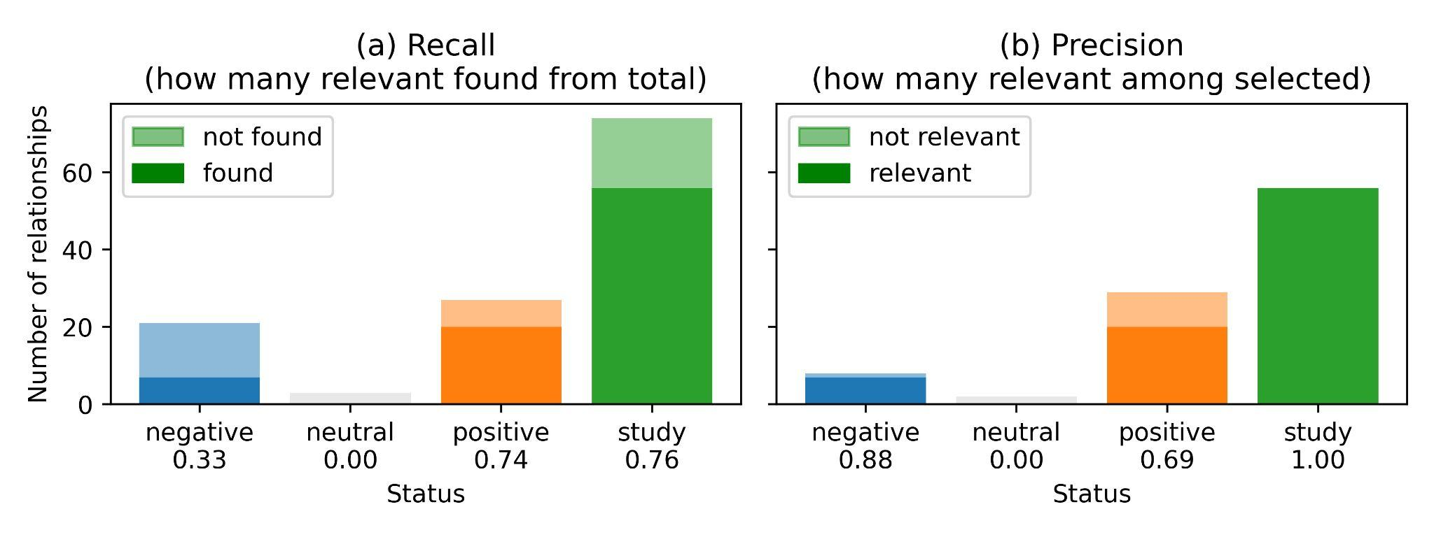
Metrics of relationships extraction

Slide 13




Thank you!
Contact: guillaume.blanchy@ilvo.vlaanderen.be
GitHub: https://github.com/climasoma/nlp
Link to the report: https://climasoma.curve.space/report

